Slide 1

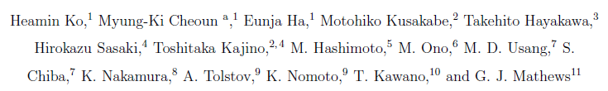
The neutrino Self-Interaction, MSW and Shock Effects on the Neutrino-Process for Supernovae
Myung-Ki Cheoun
(Soongsil University, OMEG Institute, Seoul, Korea)
In collaboration with
13th APCTP-BLTP JINR Joint workshop, Jul1y 14-20, Dubna, Russia
Notes:
(National Institutes for Quantum and Radiological Science and Technology)
(National Astronomical Observatory of Japan)

Slide 2
Contents
Neutrino Process in Supernova Explosion
Neutrino Oscillation in vacuum and matter, and neutrino Self-Interaction in the Neutrino Process
Neutrino-induced Reactions by QRPA
Heavy Elements I (92Nb,98Tc,138La,180Ta …)
Shock Effects and Dependence on Neutrino Luminosity
Heavy Elements II (92Nb,98Tc,138La,180Ta …)
Light Elements (⁷Li,¹¹Be…)
Summary and Sterile Neutrino
O-rich
Core
Core
Si
O-rich
O/C
He/C

Slide 3
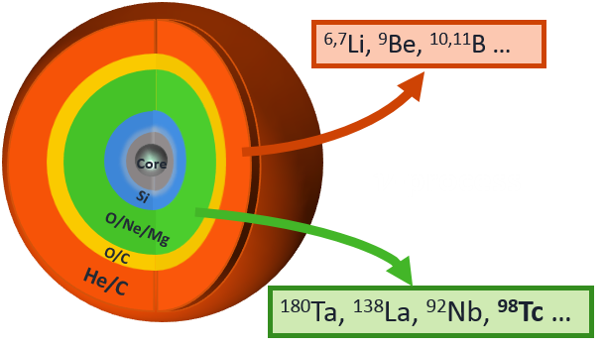
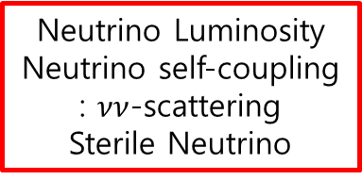




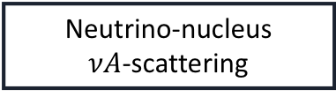


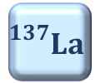



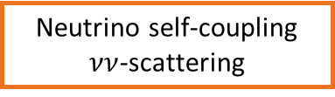








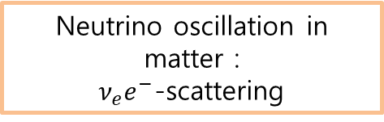



Introduction
Neutrino Process in CCSN Explosion
Why neutrino process in SN?
$${}_{}^{138}{Ce}$$
$${}_{}^{139}{Ce}$$
$${}_{}^{140}{Ce}$$
stable
unstable
$$β^{+}$$
r-process
(rapidly neutron capture)
$${}_{}^{137}{La}$$
$${}_{}^{138}{La}$$
$${}_{}^{139}{La}$$
$${}_{}^{140}{La}$$
$$β^{−}$$
$${}_{}^{136}{Ba}$$
$${}_{}^{137}{Ba}$$
$${}_{}^{138}{Ba}$$
$${}_{}^{139}{Ba}$$
$${}_{}^{140}{Ba}$$
$${}_{}^{138}{Ba\left(ν_{e},e^{−}\right)}{}_{}^{138}La$$
How do neutrino interactions affect the nucleosynthesis in SN environment?
Neutrino sphere
Neutrino propagation with momentum $p$
(Not-to-scale)
$$n_{ν}≈{10}^{32}/cm^{3}$$
P
NS
$$p$$
$$e^{−}$$
$$A$$
$$θ_{q}$$
$$q$$
10km
1000km
250000km
Dominant neutrino interactions depending on the neutrino and electron density.
Neutrino Luminosity
Neutrino self-coupling
: $νν$-scattering
Sterile Neutrino
Neutrino oscillation in matter :
$ν_{e}e^{−}$-scattering
Neutrino-nucleus
$νA$-scattering
Notes:
Neutrino properties
O/Ne/Mg to km…

Slide 4
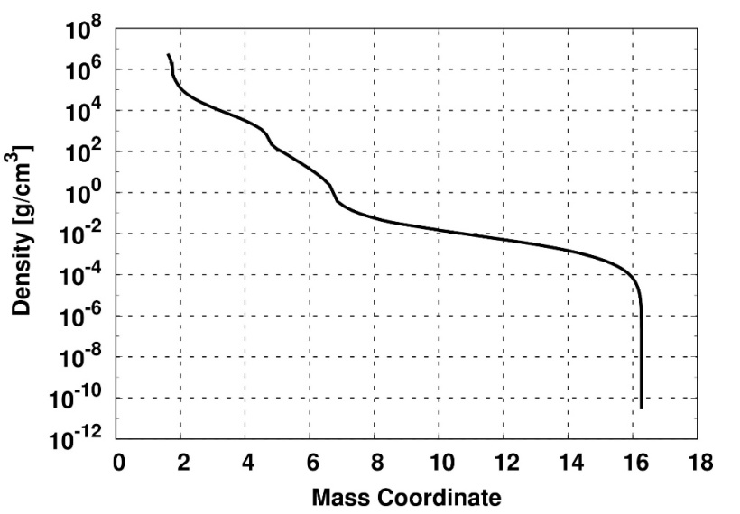
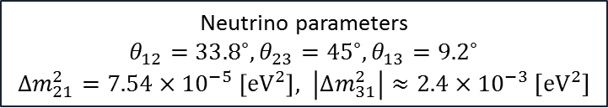
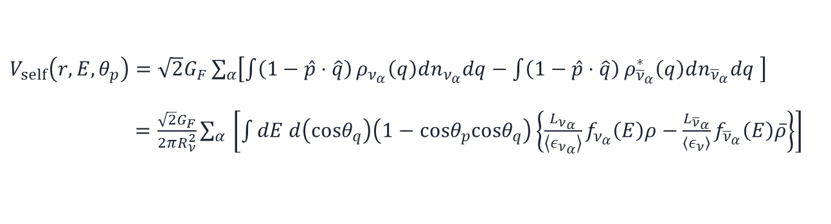
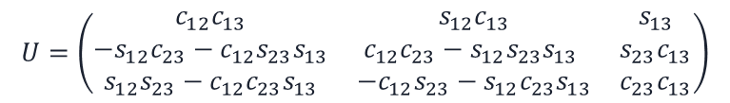
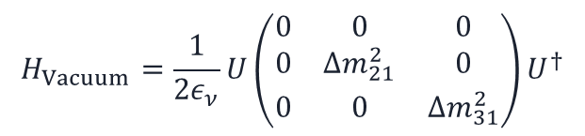
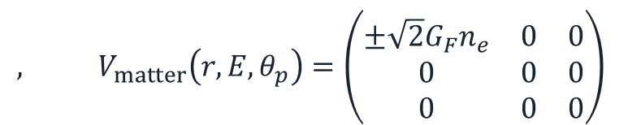


Neutrino process
Neut. Ham. for neutrino density propagation
Total Hamiltonian for neutrino interactions
Diagram
$$H_{total}=H_{Vacuum}+V_{matter}+V_{self}$$
- Vacuum and matter term
$$H_{Vacuum}=\frac{1}{2ε_{ν}}U\left(\begin{matrix}0 & 0 & 0 \\ 0 & Δm_{21}^{2} & 0 \\ 0 & 0 & Δm_{31}^{2}\end{matrix}\right)U^{†}$$
$$, V_{matter}\left(r,E,θ_{p}\right)=\left(\begin{matrix}±\sqrt{2}G_{F}n_{e} & 0 & 0 \\ 0 & 0 & 0 \\ 0 & 0 & 0\end{matrix}\right)$$
Unitary mixing PMNS matrix
$$n_{e}=ρ_{b}Y_{e}N_{A}$$
$$U=\left(\begin{matrix}c_{12}c_{13} & s_{12}c_{13} & s_{13} \\ −s_{12}c_{23}−c_{12}s_{23}s_{13} & c_{12}c_{23}−s_{12}s_{23}s_{13} & s_{23}c_{13} \\ s_{12}s_{23}−c_{12}c_{23}s_{13} & −c_{12}s_{23}−s_{12}c_{23}s_{13} & c_{23}c_{13}\end{matrix}\right)$$
SN1987, 16.2M_sol
with 6M_sol He core !
Neutrino parameters
$θ_{12}={33.8}^{∘},θ_{23}={45}^{∘},θ_{13}={9.2}^{∘}$
$Δm_{21}^{2}=7.54×{10}^{−5} \left[eV^{2}\right], \left|Δm_{31}^{2}\right|≈2.4×{10}^{−3} [eV^{2}]$
K. A. Olive, et al. [Particle Data Group], Chin. Phys. C 38, 090001 (2014).
- Neutrino self-interaction term
A. Tolstov, in private communication (2017)
$V_{self}\left(r,E,θ_{p}\right)=\sqrt{2}G_{F}\sum_{α}{\left[\int{\left(1−\hat{p}⋅\hat{q}\right)}ρ_{ν_{α}}\left(q\right)dn_{ν_{α}}dq−\int{\left(1−\hat{p}⋅\hat{q}\right)}ρ_{{\overline{ν}}_{α}}^{∗}\left(q\right)dn_{{\overline{ν}}_{α}}dq \right]}$ $=\frac{\sqrt{2}G_{F}}{2πR_{ν}^{2}}\sum_{α }{\left[\int{dE d\left(cosθ_{q}\right)\left(1−cosθ_{p}cosθ_{q}\right)\left\{\frac{L_{ν_{α}}}{\left\langle ε_{ν_{α}}\right\rangle }f_{ν_{α}}\left(E\right)ρ−\frac{L_{{\overline{ν}}_{α}}}{\left\langle ε_{ν}\right\rangle }f_{{\overline{ν}}_{α}}\left(E\right)\overline{ρ}\right\}}\right]}$
H. Sasaki, et al., Phys. Rev. D 96, 043013 (2017)

Slide 5
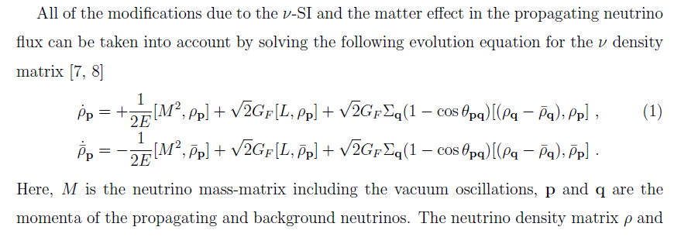
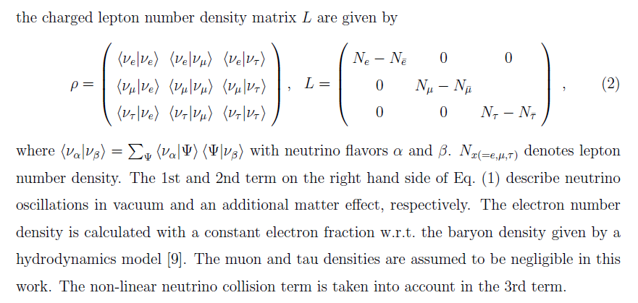
Neutrino process
Neutrino Hamiltonian

Slide 6


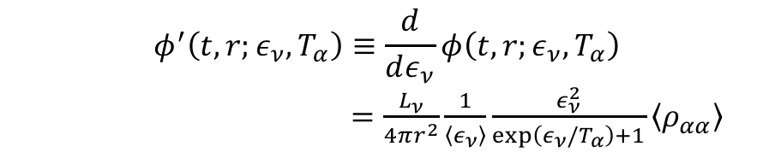

Neutrino process
Self-Interaction effects on the Neutrino Flux
10km
1000km
2000km
250000km
NS
(Not-to-scale)
Inverted mass hierarchy (IH)
$$H_{Vacuum}+V_{matter}+V_{self}$$
The differential neutrino flux with neutrino flavor $α$
$$φ^{′}\left(t,r;ε_{ν},T_{α}\right)≡\frac{d}{dε_{ν}}φ\left(t,r;ε_{ν},T_{α}\right)$$
$=\frac{L_{ν}}{4πr^{2}}\frac{1}{\left\langle ε_{ν}\right\rangle }\frac{ε_{ν}^{2}}{\exp\left(ε_{ν}/T_{α}\right)+1}\left\langle ρ_{αα}\right\rangle$
The neutrino temperatures are
$T_{ν_{e}}=3.2,$ $T_{{\overline{ν}}_{e}}=5$ and $T_{ν_{x}}=6 \left[MeV/k_{B}\right]$
T. Yoshida, et al., Astrophys. J. 686, 448 (2008)
H. Sasaki, et al.(NAOJ) in private communication (2018)
In the case of normal mass hierarchy, the SI effect is suppressed.
For anti-neutrino, similar effects are found.
Initially we assume Fermi-Dirac distribution for neutrino spectra (Case I).
We extend it by using other numerical luminosity (Case II).
Notes:
Why suppressed?..

Slide 8
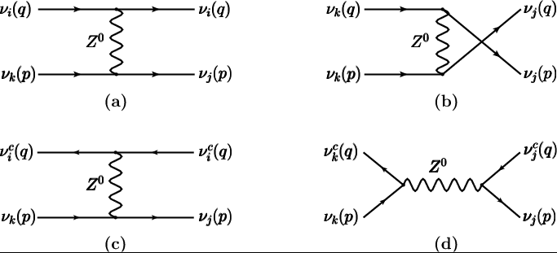

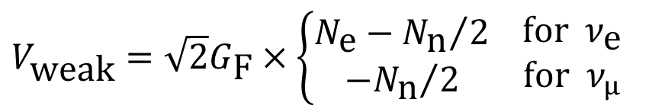
MSW effects
Neutrino process
MSW effects (Neutrino Oscillation in Matter)
Neutrinos in a medium suffer flavor-dependent
refraction
W, Z
f
ν
ν
ν
Z
ν
f
$V_{\text{weak}}=\sqrt{2}G_{\text{F}}×\left\{\begin{matrix}N_{\text{e}}−{N_{\text{n}}}/2 \\ {{−N}_{\text{n}}}/2\end{matrix} \begin{matrix}\text{f}\text{or} { ν}_{\text{e}} \\ \text{f}\text{or} ν_{μ}\end{matrix}\right.$
Typical density of Earth: 5 g/cm³
$$ΔV_{\text{weak}}≈2×{10}^{−13} \text{eV}=0.2 \text{peV}$$

Slide 9
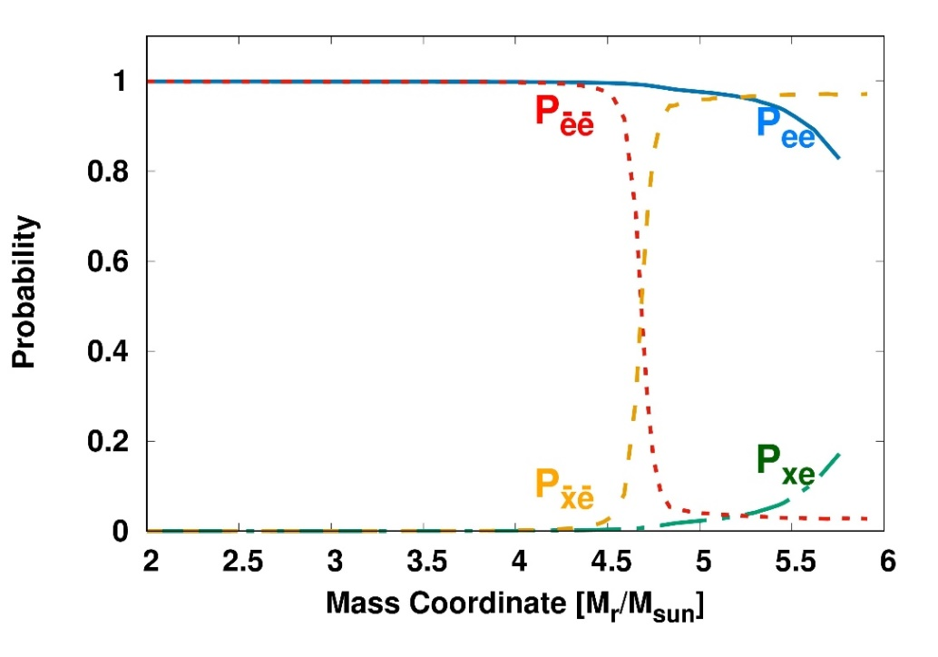

Neutrino process
MSW Effects on the Neutrino Flux (IH)
10km
1000km
2000km
MSW resonance
250000km
NS
(Not-to-scale)
$$H_{Vacuum}+V_{matter}+V_{self}$$
$H_{Vacuum}+V_{matter}$ ( MSW effect)
IH
H. Sasaki, et al.(NAOJ) in private communication (2018)
The differential neutrino flux again including outer region oscillation
$$\frac{d}{dε_{ν}}φ_{α}\left(t,r;ε_{ν},T_{α}\right)=\frac{L_{ν} (t)}{4πr^{2}}\frac{1}{\left\langle ε_{ν}\right\rangle }\frac{ε_{ν}^{2}}{\exp\left(ε_{ν}/T_{α}\right)+1}\left\langle ρ_{αα} (t)\right\rangle ×P_{αβ}\left(ε_{ν}\right)$$

Slide 10
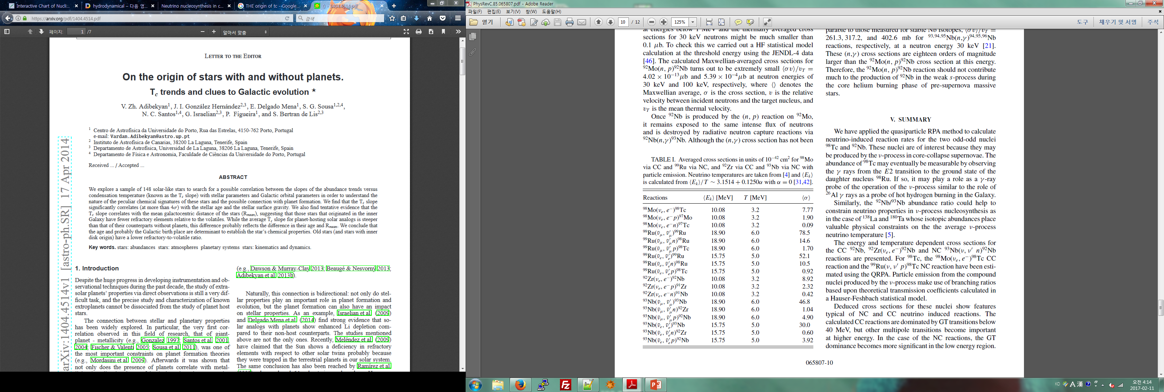
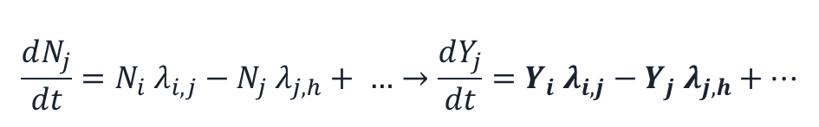
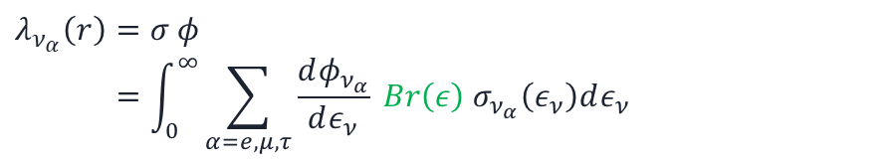

Neutrino process
Neutrino Reactions Rates with Nuclei
Network calculation for nucleosynthesis
$$\frac{dN_{j}}{dt}=N_{i} λ_{i,j}−N_{j} λ_{j,h}+ …→\frac{dY_{j}}{dt}=Y_{i} λ_{i,j}−Y_{j} λ_{j,h}+…$$
$$Y_{j}=\frac{N_{j}}{ρ N_{A}}$$
JINA REACLIB & Los Alamos (n,g) Data !
Kyushu-Tokyo Progenitor Model !
Part for neutrino reaction rates
$λ_{ν_{α}}\left(r\right)=σ φ$
$$=\int_{0}^{∞}{\sum_{α=e,μ,τ}{\frac{dφ_{ν_{α}}}{dε_{ν}} Br\left(ε\right) σ_{ν_{α}}\left(ε_{ν}\right)dε_{ν} } }$$
Cross section data using QRPA
Example:
with Neutrino self-interaction
after
MSW resonance
E-neutrino is increased by SI.
In MSW region, e-neutrino is increased by the e-neutrino resonance w/o SI.
But it is a bit decreased with the decrease of X-neutrino in SI
w/o Neutrino self-interaction
M. K. Cheoun, et al., Phys. Rev. C 85, 065807 (2012)
Notes:
Abundance = rho…blabla

Slide 11
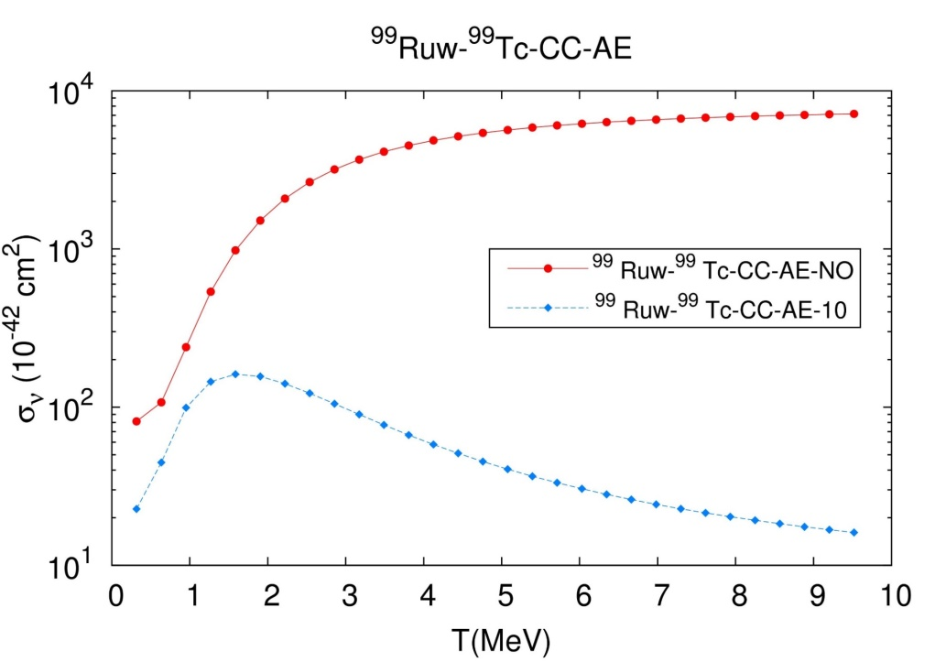
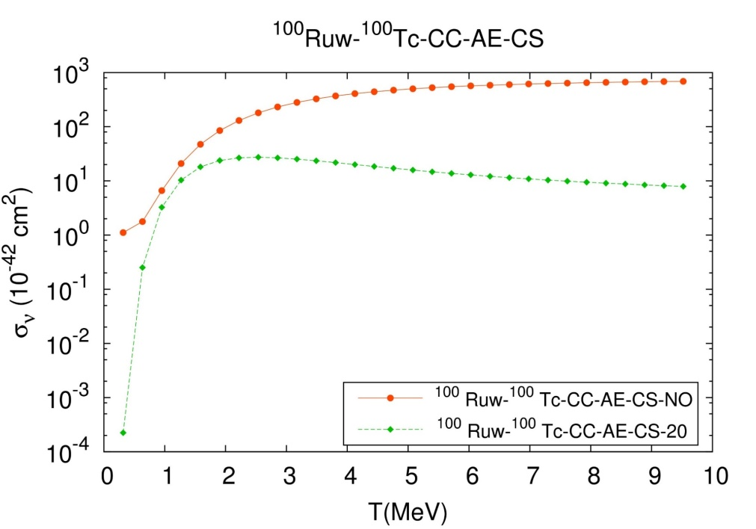
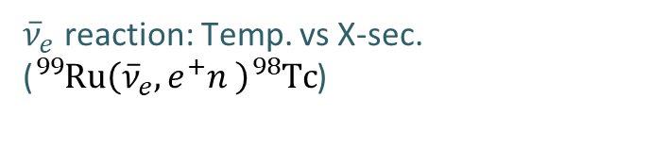
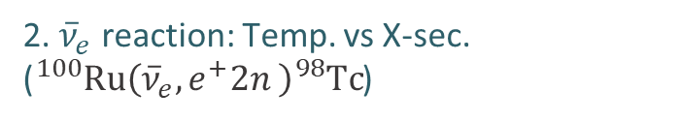
Neutrino process
Neutrino Reactions for 98Tc by QRPA
${\overline{ν}}_{e}$ reaction: Temp. vs X-sec.
(${}_{}^{99}{Ru}\left({\overline{ν}}_{e},e^{+}n \right){}_{}^{98}Tc$)
2. ${\overline{ν}}_{e}$ reaction: Temp. vs X-sec.
(${}_{}^{100}{Ru}\left({\overline{ν}}_{e},e^{+}2n \right){}_{}^{98}Tc$)
Hayakawa, Ko, Cheoun…, ApJL 779, 1 (2013), PRL 121, 102701 (2018), Acta Phys.Polon. B50 (2019) no.3, 385, arXiv:1903.02086 [astro-ph.HE], submitted to PRL (2019).

Slide 12
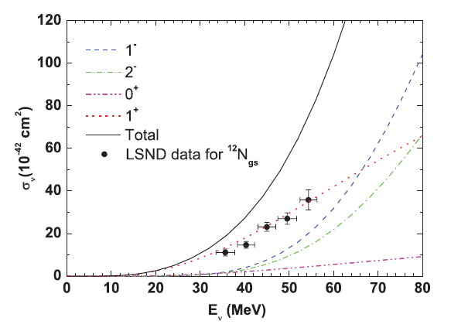
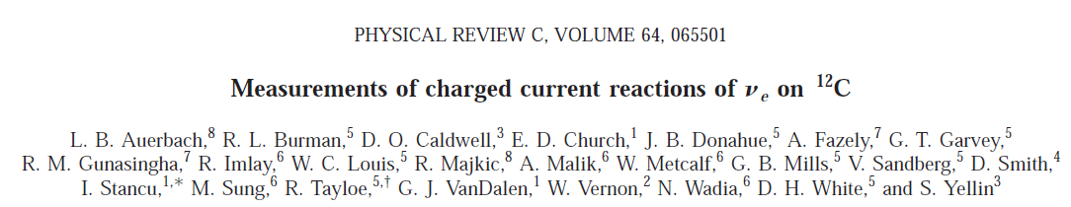
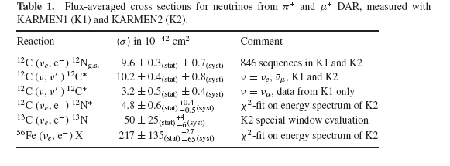
ν-reaction (2 step)
Data in Low E. region: KARMEN/LSND/CC and NC
Cheoun, Phys. Rev. C 81, 028501 (2010)
LSND : ν_{e}¹²C -> e- + ¹²N*
(1⁺⁾
JSNS^2 at JPARC …

Slide 13

Phys. Rev. C99 (2019), 064304;
Phys. Rev. C97, (2018), 064322;
Phys. Rev. C97 (2018), 024320;
EPJA 53, (2017), 26 ….
JPG, in press, 2019
For neutrino-nuclei reactions,
1. We include the transition from 0(+/-) up to 4(+/-) !!!
2. To describe the excitations of compound nuclei, we exploit the (D)QRPA.
3. In the QRPA, the Brueckner G matrix based on the CD Bonn potential and all kinds
of pairing interactions in the BCS are included.
4. These (D)QRPA have been successfully tested to reproduce the GT strength distributions.
5. For the excitation spectrum of the compound nuclei,,we exploit a statistical model
by S. Chiba in TIT.

Slide 14
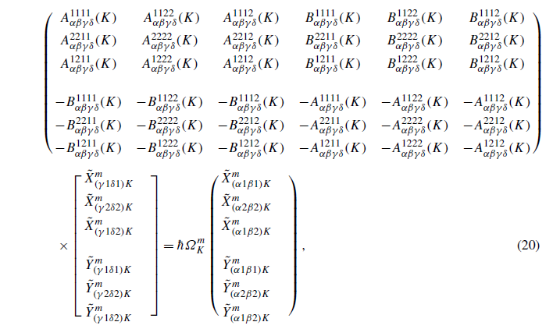
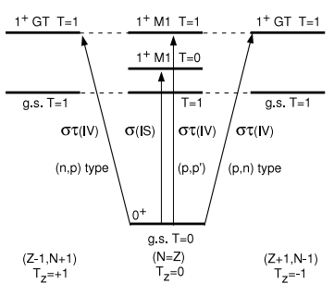
Neut.-induced react. by QRPA + Deform.+ Unlike pairing corre.
Preliminary results by nn + pp + np DQRPA

Slide 15
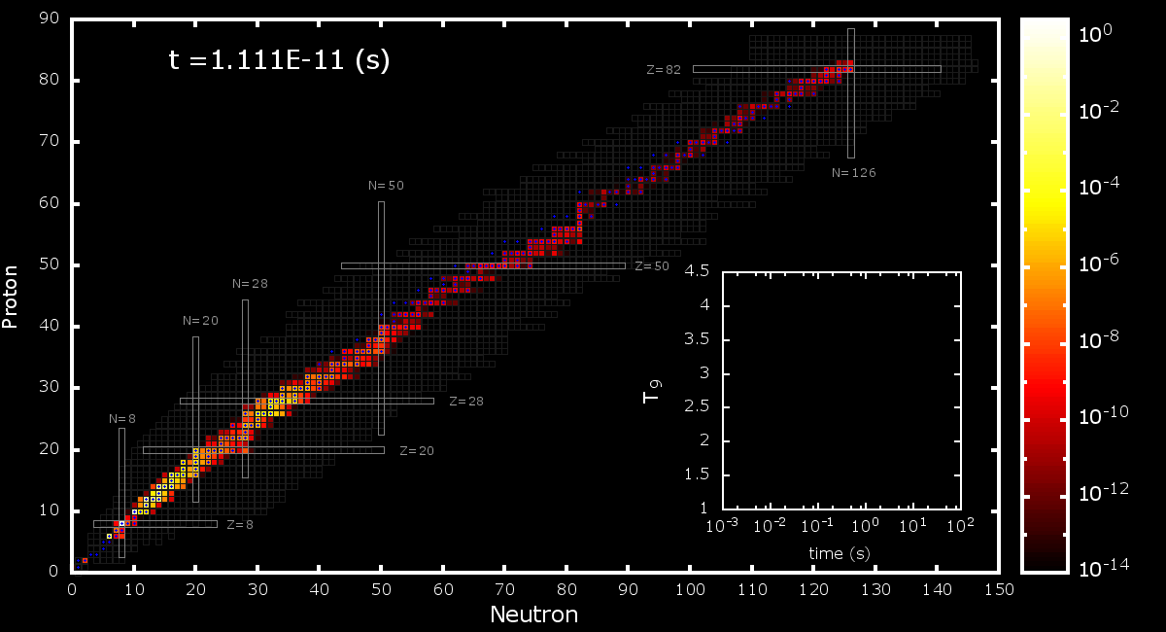
Numerical results for elements abundances
JINA REALIB
Modified (n,g) Reactions
QRPA & Branching Ratios
Hydrodynamics
Model
1987 SN model
Pre-supernova Model
Modified Neutrino Flux by Self-interaction
Neutrino Luminosity
Flavor change probability by matter and shock wave

Slide 16
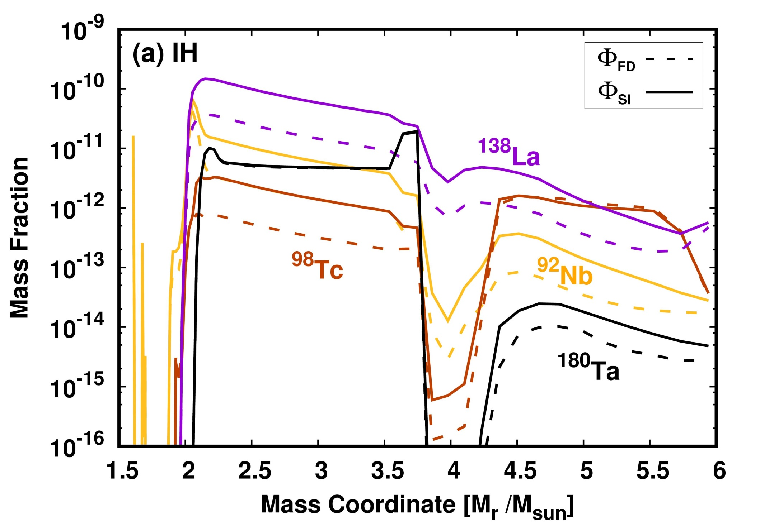
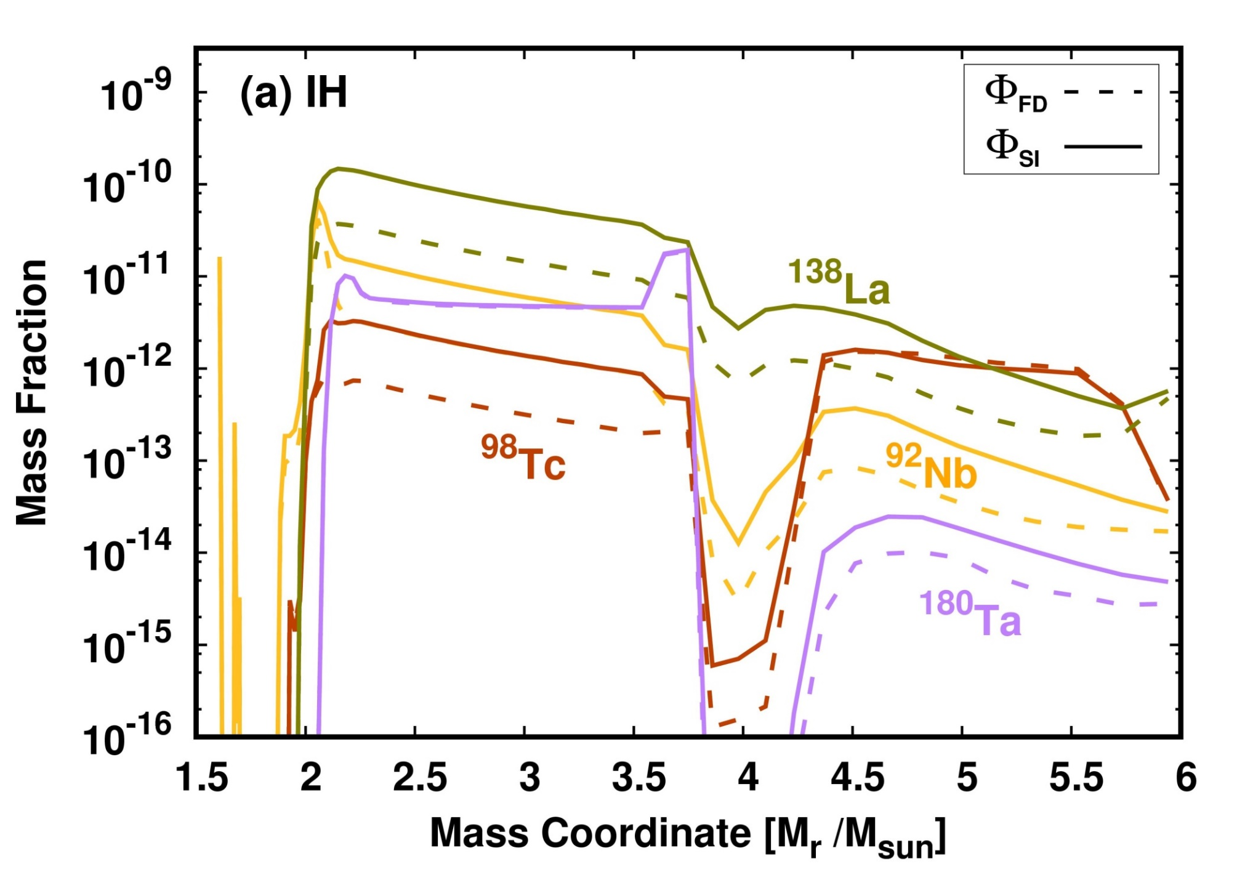
Neutrino process
Results for Heavy Elements
The effect by changed reaction rate
Notes:
Why Nb and La changed in outer region but why MSW is not affected?

Slide 17
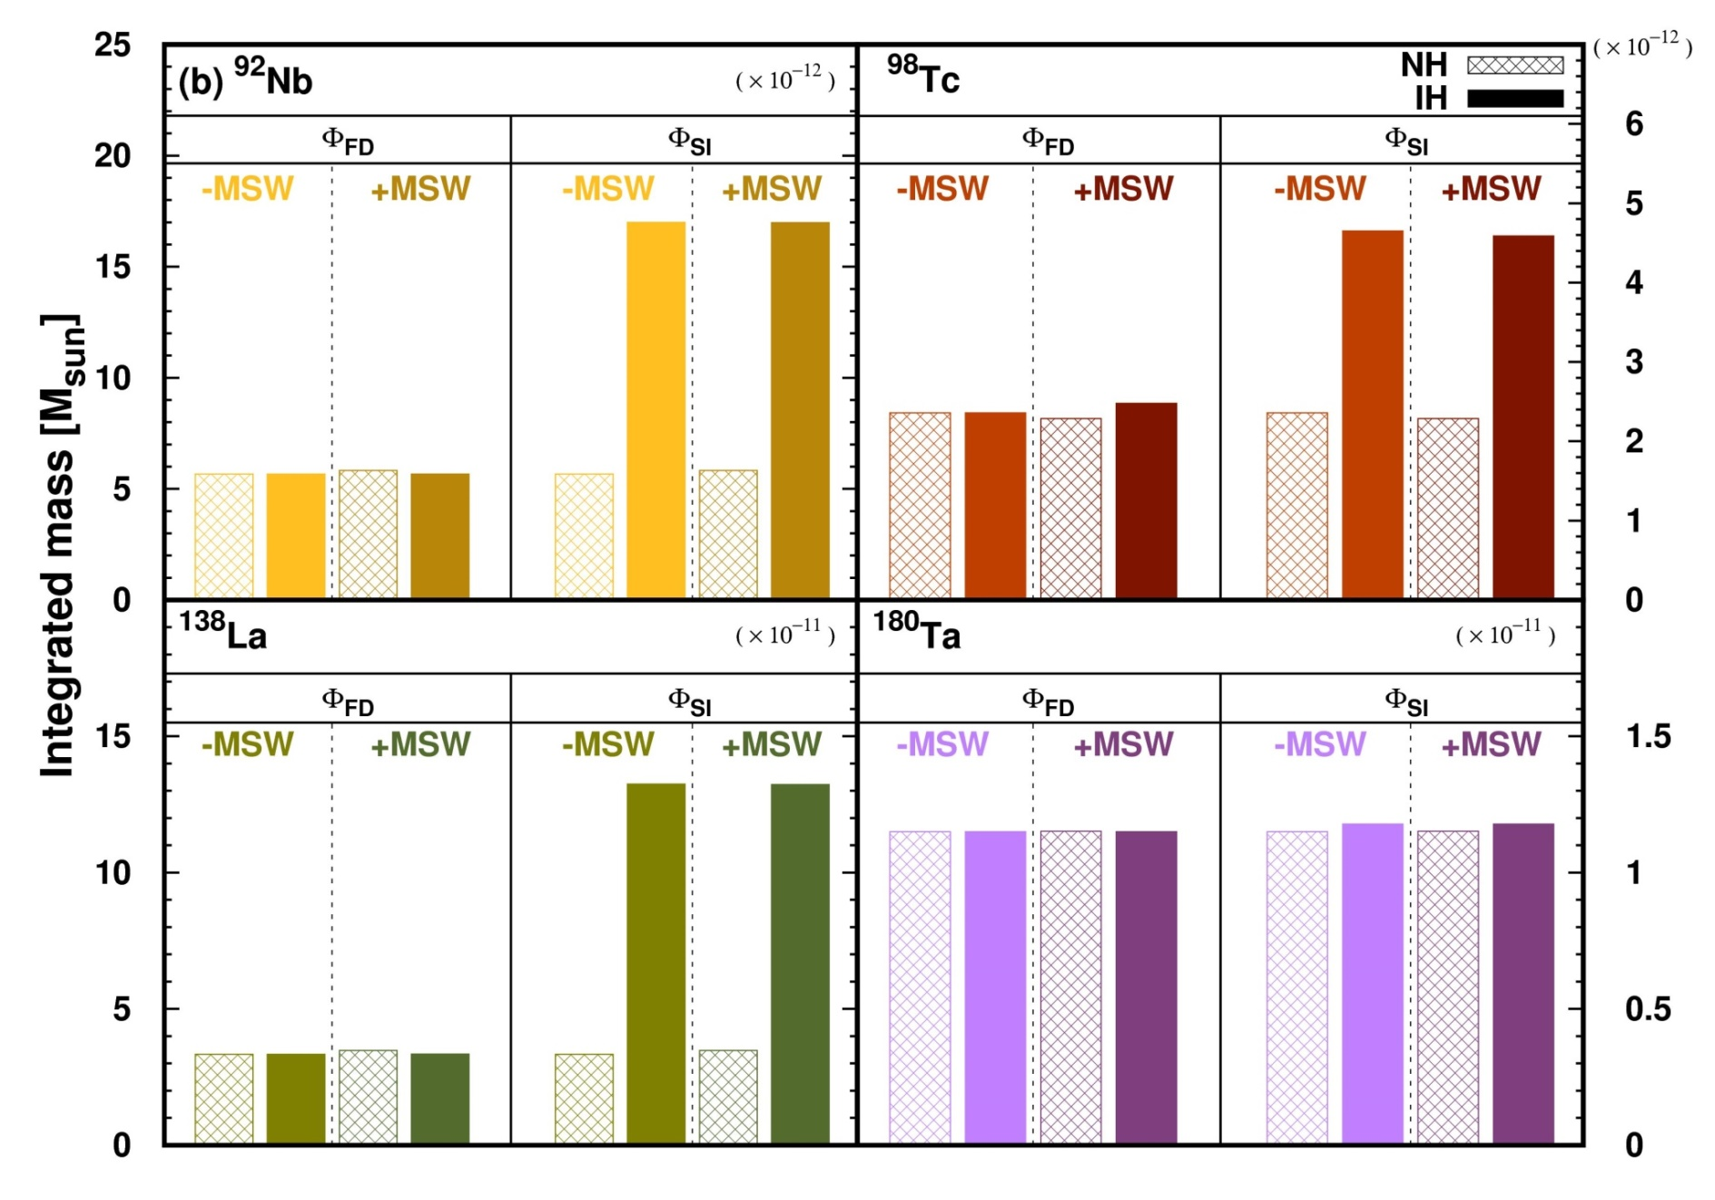
Neutrino process
Results for H. Elem. (Total Integrated Masses)
2 times
3 times
4 times
H. Ko, M. Cheoun…, submitted to PRL, (2018)

Slide 18
Contents
Neutrino Process in Supernova Explosion
Neutrino Oscillation in vacuum and matter, and neutrino Self-Interaction in the Neutrino Process
Neutrino-induced Reactions by QRPA
Heavy Elements I (92Nb,98Tc,138La,180Ta …)
Shock Effects and Dependence on Neutrino Luminosity
Heavy Elements II (92Nb,98Tc,138La,180Ta …)
Light Elements (⁷Li,¹¹Be…)
Summary and Sterile Neutrino
O-rich
Core
Core
Si
O-rich
O/C
He/C

Slide 19
Dependence of the Neutrino Process on the Shock Effects

Slide 20
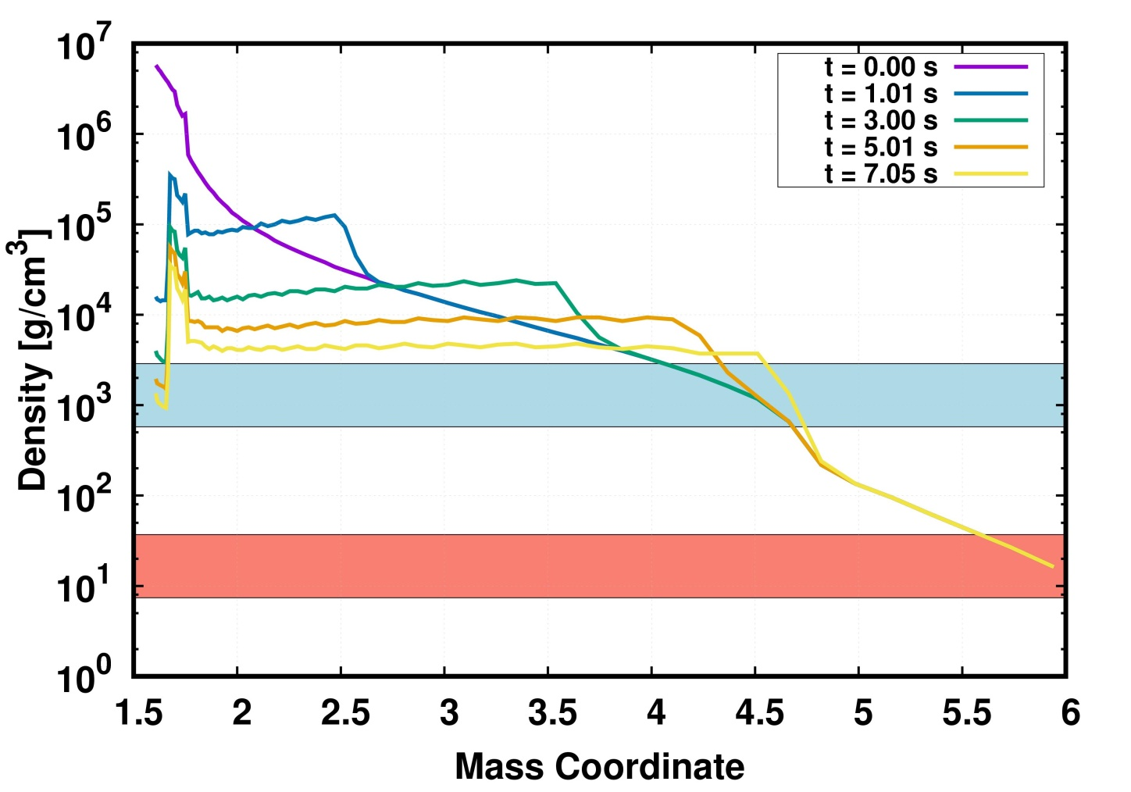
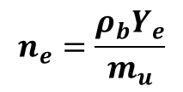
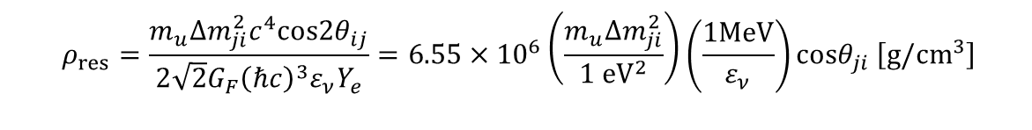


Neutrino process
MSW Effects by Shock W. & Hydrodynamics
Flavor change resonance density [Yoshida et. al. APJ (2006)]
$$n_{e}=\frac{ρ_{b}Y_{e}}{m_{u}}$$
$$ρ_{res}=\frac{m_{u}Δm_{ji}^{2}c^{4}cos2θ_{ij}}{\begin{aligned}2\sqrt{2}G_{F}{\left(ℏc\right)}^{3}ε_{ν}Y_{e} \\ \end{aligned}}=6.55×{10}^{6}\left(\frac{m_{u}Δm_{ji}^{2}}{1 {eV}^{2}}\right)\left(\frac{1MeV}{ε_{ν}}\right)cosθ_{ji} \left[g/cm^{3}\right]$$
Hydrodynamics by A. Tolstov
$$ε_{ν}=10 MeV$$
resonance
$$ε_{ν}=50 MeV$$

Slide 21

Landau-Zener crossing formula
In NH, nu_e has a resonance giving high energy nu_e.
In IH, nu_bar_e has a resonance.

Slide 22

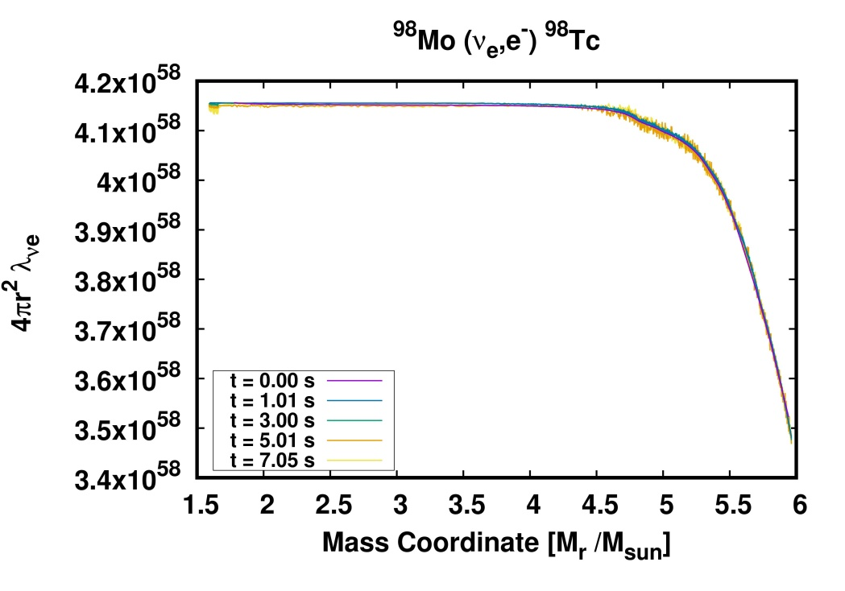
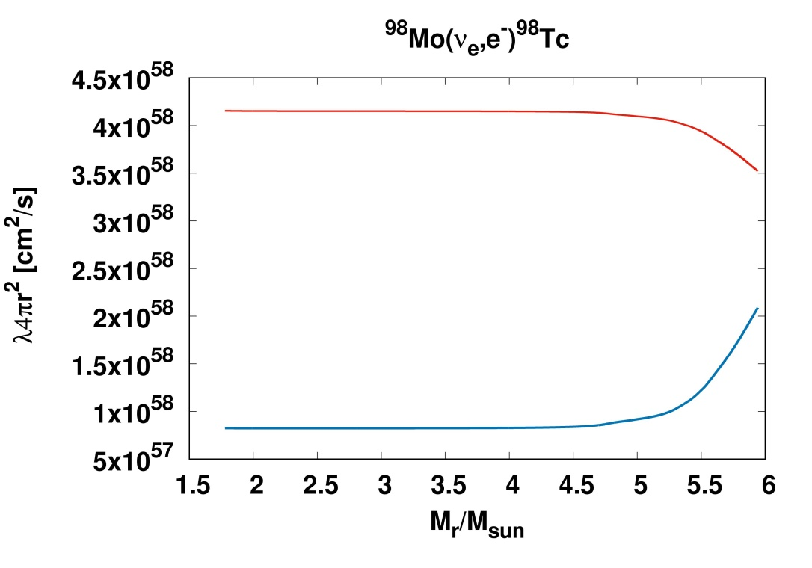
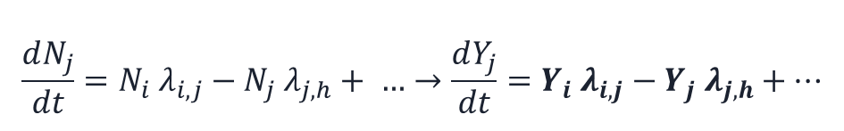


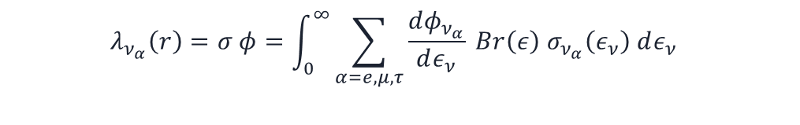
Neutrino process
MSW Effects by Shock W. & Hydrodynamics
Network calculation for nucleosynthesis
$$\frac{dN_{j}}{dt}=N_{i} λ_{i,j}−N_{j} λ_{j,h}+ …→\frac{dY_{j}}{dt}=Y_{i} λ_{i,j}−Y_{j} λ_{j,h}+…$$
$$Y_{j}=\frac{N_{j}}{ρ N_{A}}$$
Part for neutrino reaction
$$P_{ν_{β}ν_{α}}\left(ε_{ν}\right)$$
$$λ_{ν_{α}}\left(r\right)=σ φ=\int_{0}^{∞}{\sum_{α=e,μ,τ}{\frac{dφ_{ν_{α}}}{dε_{ν}} Br\left(ε\right) σ_{ν_{α}}\left(ε_{ν}\right) dε_{ν} } }$$
* Cross section data are taken from M. K. Cheoun, et al., Phys. Rev. C 85, 065807 (2012)
The neutrino reaction rate by Self-interaction and MSW effects
with Neutrino self-interaction
after
MSW resonance
Shock effects are very small on reaction rate
w/o Neutrino self-interaction
Notes:
Abundance = rho…blabla

Slide 23
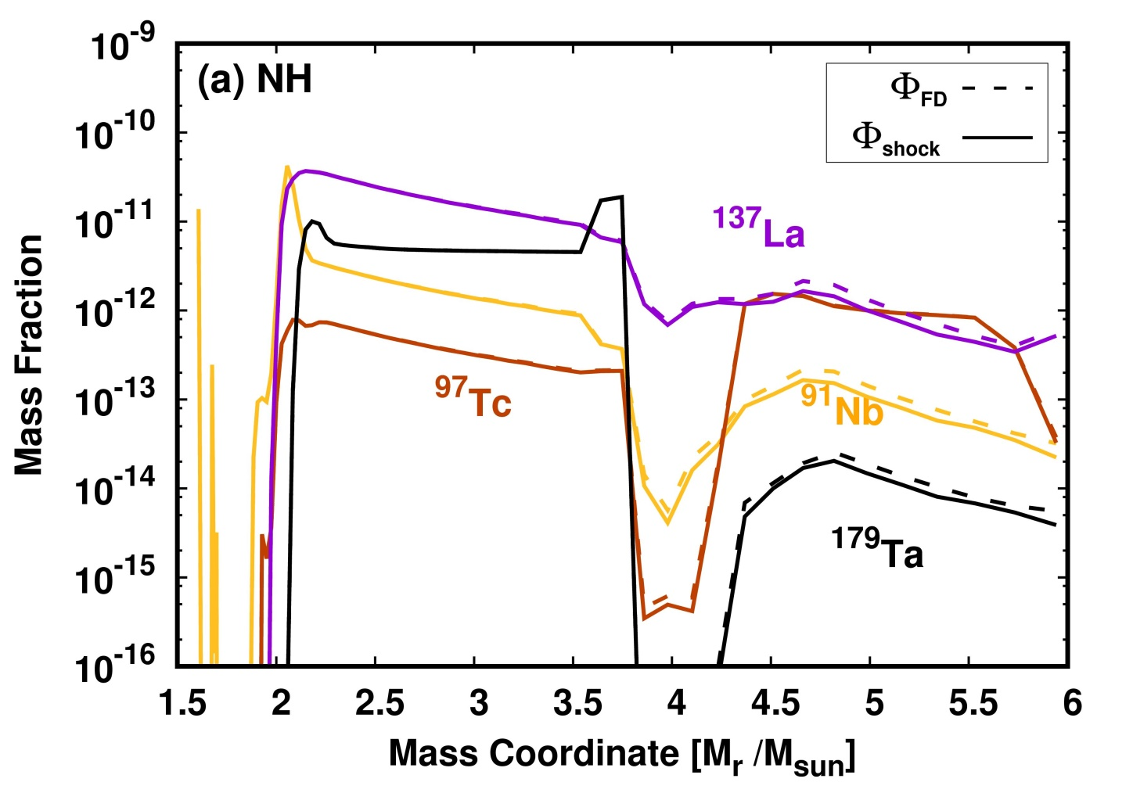
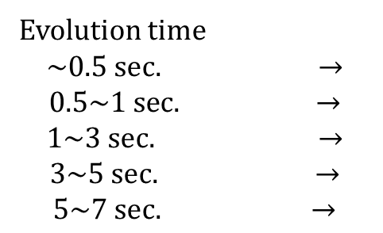
Neutrino process
MSW Effects by Shock W. & Hydrodynamics
The effect by shock – testing results
Evolution time
$$\sim 0.5 sec. →$$
$$0.5\sim 1 sec. →$$
$$1\sim 3 sec. →$$
$$3\sim 5 sec. →$$
$$5\sim 7 sec. →$$
MSW effects density profile
0 sec.
1 sec.
3 sec.
5 sec.
7 sec.
In the case of NH the shock effects are almost negligible.

Slide 24
However, this is not the last story, but the least ….

Slide 25
Dependence of the SI effects in Neutrino Process on the Luminosity
<From the Fogli’s FD Luminosity to numerical Luminosity by neutrino transport calculation>

Slide 28
NEQ L.
+ SI
EQ L
+SI

Slide 29
NEQ L.
+SI

Slide 30
#. Extra – Ta180
Neutrino process
Results for Light Elements II
NEQ L.
+SI
For 7Li, the main CC reaction
is e-neutrino
producing 3He and 7Be
from 4He.
In EQ, NH has a e-neutrino MSW resonance
which increases 7Be and 7Li.
But, IH, the MSW resonance occurs for anti-e-neutrino,
which decreases the ratio.
In NEQ, the e-neutrino MSW resonance comes from
the x-neutrino, which is smaller than the EQ case.
As for SI interaction, for EQ case,
high energy e-neutrino appears due to the swapping,
which increases the ratio.
But, for the NEQ case, no swapping occurs.

Slide 31
In EQ case, ratio of 7Li/11B is decreased in IH scheme
within 2 sigma level. But with the SI, it goes around
3 sigma level.
In case NEQ, ratio of 7Li/11B is decreased in the NH
scheme within 2 sigma level. With the SI, it goes within
1.4 sigma level.
As for the ratio 138La/11B, NH does not show any
SI effects. But IH scheme illustrates the increase
for the EQ case, and the decrease for the NEQ case
by the SI.
Therefore, the ratio turns out to be sensitive to
the MH and the SI effects.

Slide 32
Neutrino Process and
Sterile Neutrino

Slide 33
We found that there is a resonance
for e-neutrino around 1.6 M_sol.
This provides the energetic e-neutrino
which may affect the neutrino reaction
Rate.
But it depends on the scenario
of sterile neutrino.
The 1st scenario is zero luminosity of
Sterile neutrino only with mixing.
The 2nd is equivalent luminosity with
the mixing. But the s-neutrino may
decouple by the s-neutrino interactions
with electrons.

Slide 34
EQ scenario (zero luminosity) but with
the mixing
NEQ scenario (equi-luminosity) with
the mixing
O.K.
????
????

Slide 35
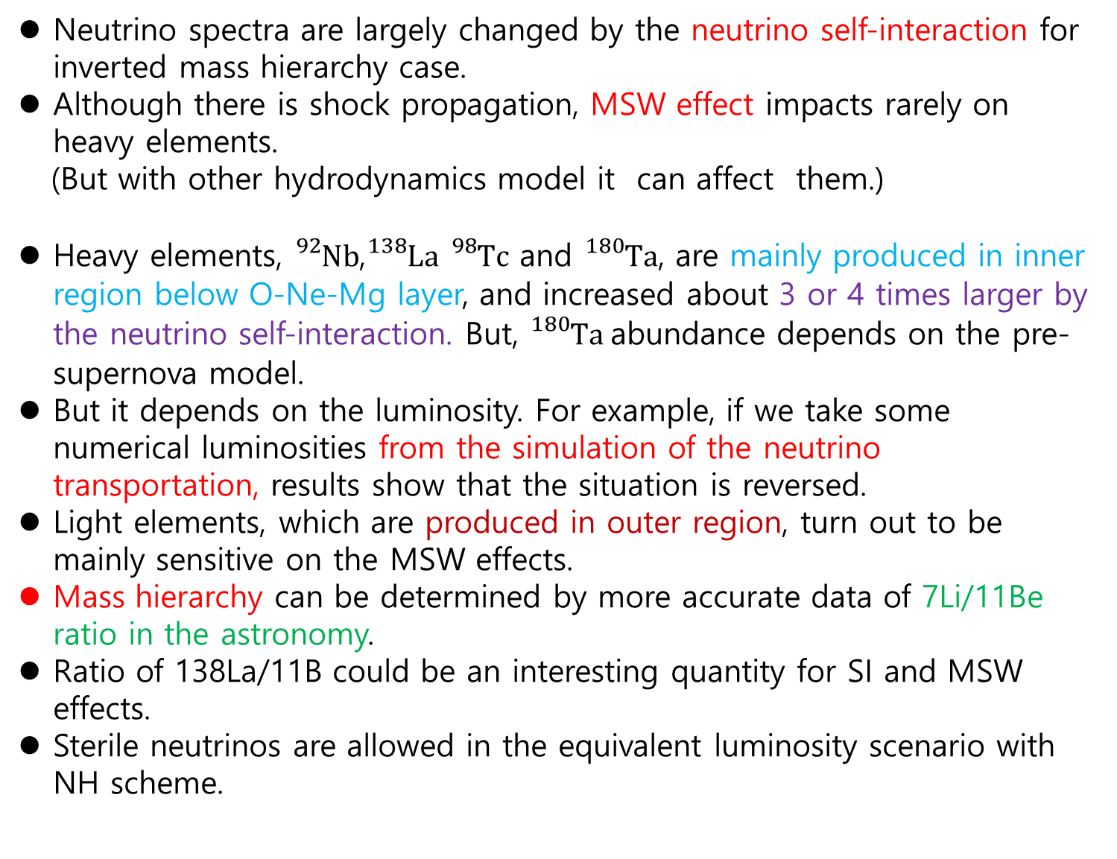
#. Extra – Ta180
Summary
Neutrino process
Summary
Neutrino spectra are largely changed by the neutrino self-interaction for inverted mass hierarchy case.
Although there is shock propagation, MSW effect impacts rarely on heavy elements.
(But with other hydrodynamics model it can affect them.)
Heavy elements, ${}_{}^{92}{Nb}$,${}_{}^{138}La$ ${}_{}^{98}Tc$ and ${}_{}^{180}Ta$, are mainly produced in inner region below O-Ne-Mg layer, and increased about 3 or 4 times larger by the neutrino self-interaction. But, ${}_{}^{180}Ta$abundance depends on the pre-supernova model.
But it depends on the luminosity. For example, if we take some numerical luminosities from the simulation of the neutrino transportation, results show that the situation is reversed.
Light elements, which are produced in outer region, turn out to be mainly sensitive on the MSW effects.
Mass hierarchy can be determined by more accurate data of 7Li/11Be ratio in the astronomy.
Ratio of 138La/11B could be an interesting quantity for SI and MSW effects.
Sterile neutrinos are allowed in the equivalent luminosity scenario with NH scheme.
Notes:
The tail of neutrino spectra is increased in the relative high energy (beyond $20 MeV$) region , which suggests the change of neutrino process results due to the flux (flavor) change.

Slide 36
Thanks
for
your
attention !
Спасибо!!!

