Slide 1
Decay $B_{s}→K^{∗0}μ^{+}μ^{−}$ in covariant confined quark model
Aidos Issadykov, Mikhail A. Ivanov

Slide 2
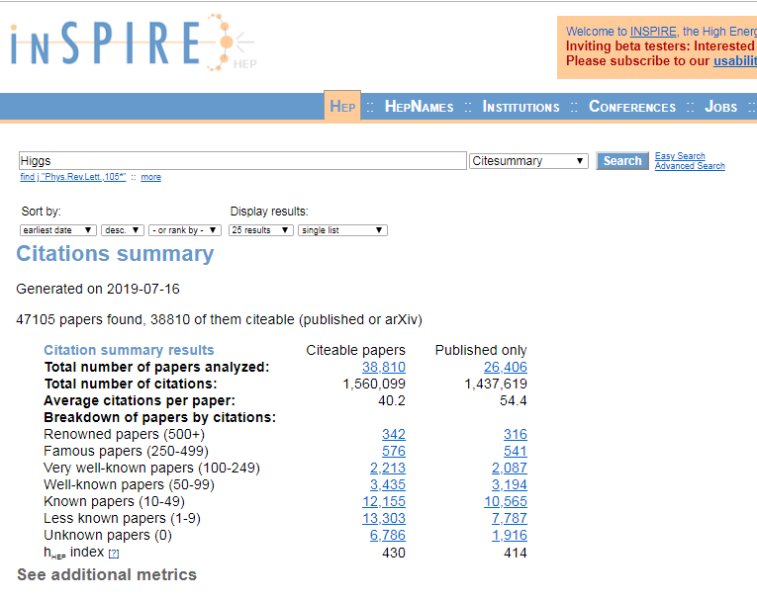

Slide 3
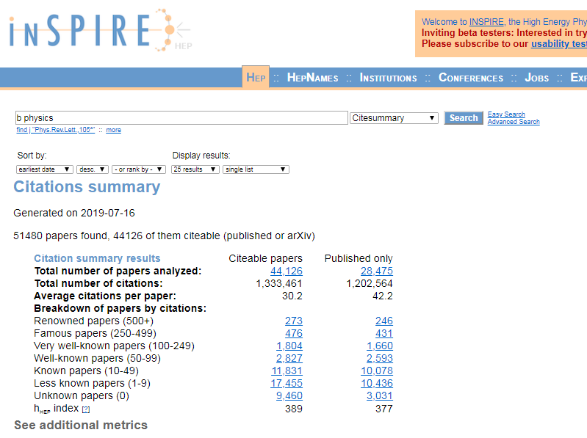

Slide 4
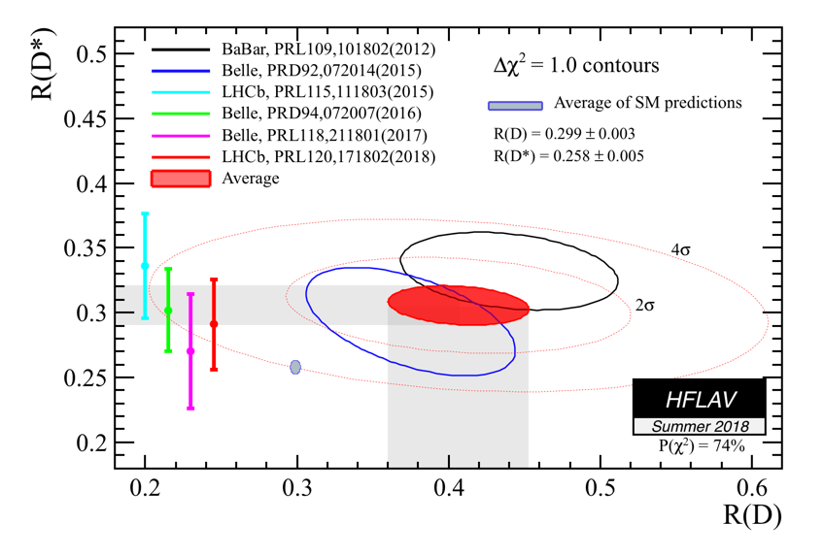
b-c transition
(One of ) the largest discrepancies between SM and measurement
Up to 4.1 σ disagreement

Slide 5
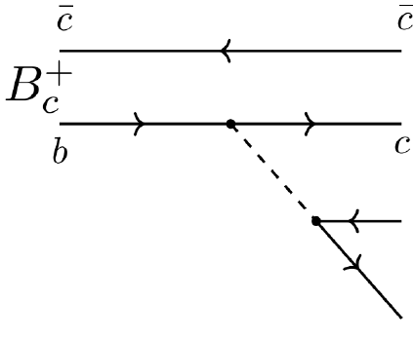
Semileptonic decays of B_{c} meson
*R. Aaij et al. Phys.Rev.Lett. 120 (2018) 121801

Slide 6
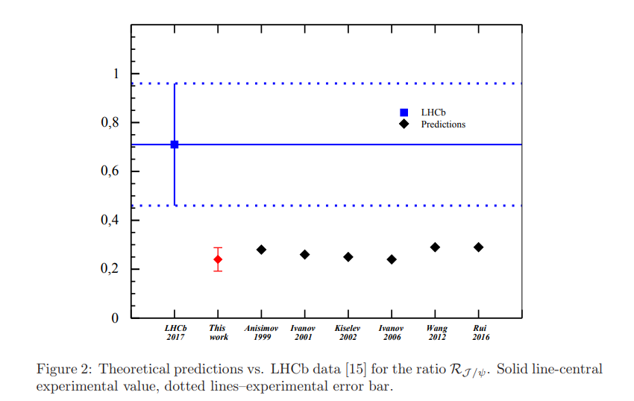
Branching ratios of semileptonic $B_{c}$ decays
*A. Issadykov, Mikhail A. Ivanov, Phys.Lett. B783 (2018) 178-182

Slide 7
Nonleptonic decays of B_{c} meson
LHCb collaboration(nonleptonic):
*R. Aaij et al. [LHCb Collaboration], JHEP 1309 (2013) 075
*R. Aaij et al. [LHCb Collaboration], JHEP 1609 (2016) 153

Slide 8
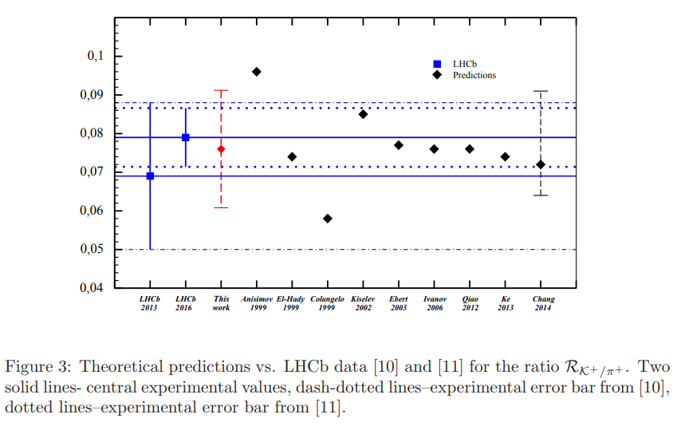
Ratios of branching fractions
*A. Issadykov, Mikhail A. Ivanov, Phys.Lett. B783 (2018) 178-182

Slide 9
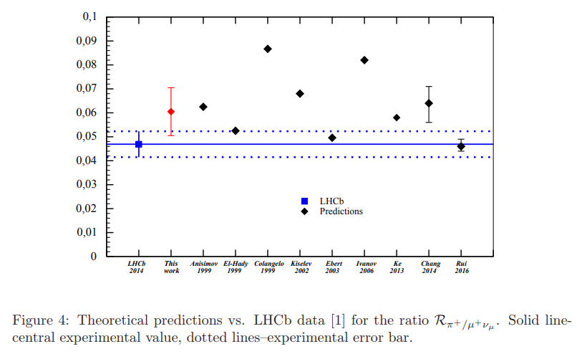
Ratios of branching fractions
*A. Issadykov, Mikhail A. Ivanov, Phys.Lett. B783 (2018) 178-182

Slide 10
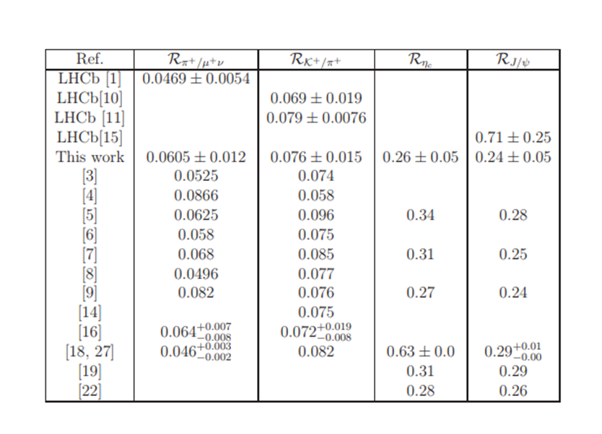
New physics in B_{c} meson decays?

Slide 11
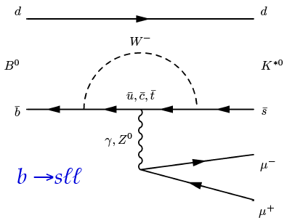
Rare decays of B meson
Loop-level decays b → sℓ⁺ℓ⁻:
forbidden at tree-level in SM
sensitive to NP contributions in loops

Slide 12
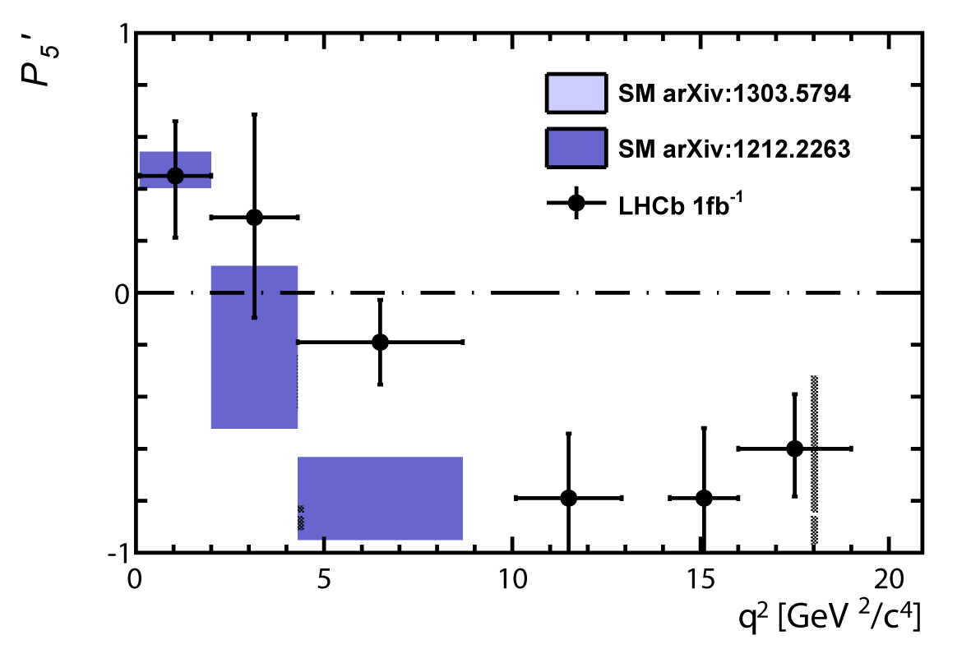
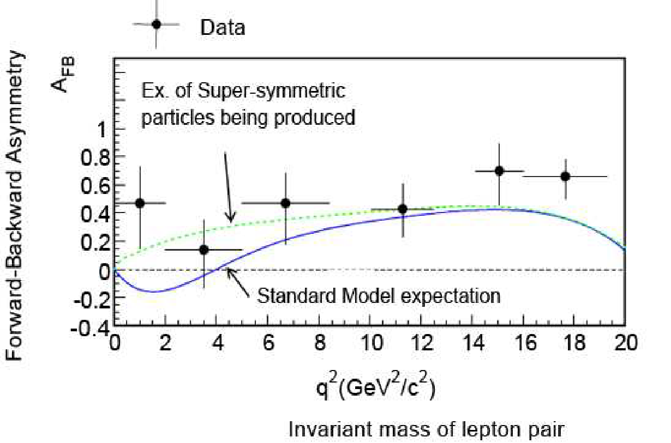
Rare decays of B meson
3.4 σ
~ 3 σ
*Phys.Rev.Lett. 111 (2013) 191801

Slide 13
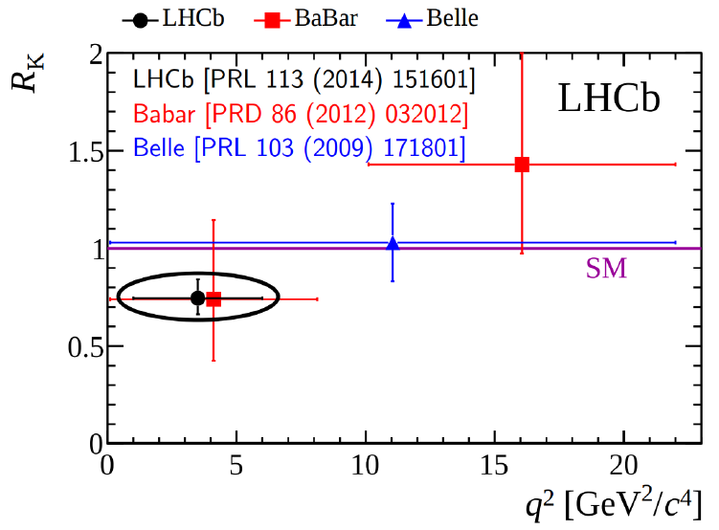
$$R_{K^{}}$$

Slide 14
“b-s anomaly”
В→K* 𝜇⁺𝜇⁻
В_{s}→ $φ$𝜇⁺𝜇⁻
В_{s}→𝜇⁺𝜇⁻
up to 3 σ ??
about 2.2 σ
less than 2 σ
Phys.Rev. D91 (2015) no.7, 074007 (arXiv:1502.05280)
Phys.Rev. D93 (2016) no.9, 094022 (arXiv:1602.07864)
Phys.Part.Nucl.Lett. 15 (2018) no.4, 393-396 (arXiv:1807.04996)
Now*

Slide 15
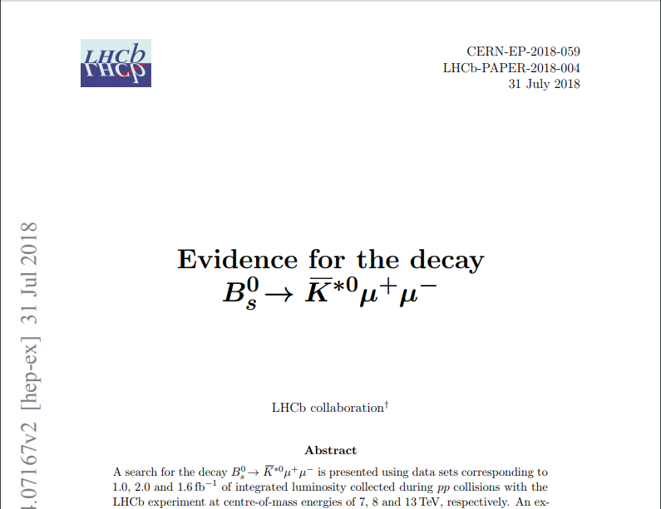
b-d transition

Slide 16
Effective Hamiltonian
$\text{b}\text{ → }\text{s} \text{transition}$ :
$\text{b}\text{ → }\text{d} \text{transition}$ :

Slide 17
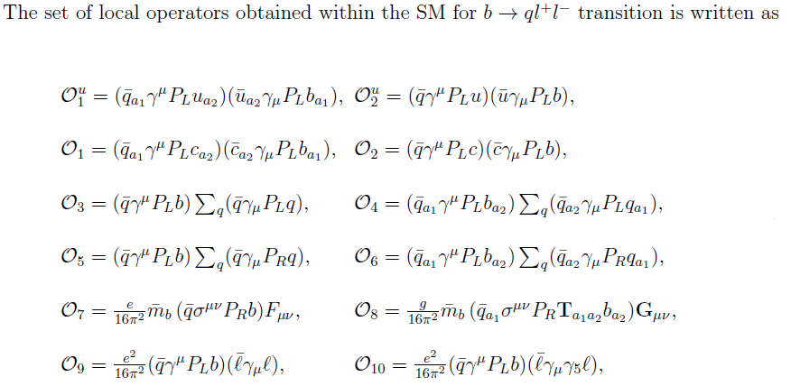
Effective Hamiltonian

Slide 18
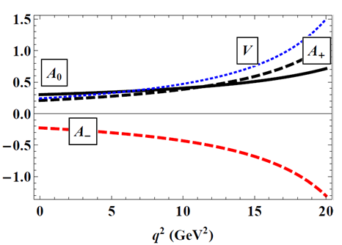
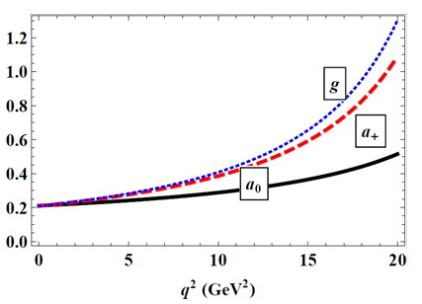
Form factors of B_{s} → K*⁰ decay
*Aidos Issadykov, EPJ Web Conf. 204 (2019) 08003

Slide 19
Form factors of B_{s} → K*⁰ decay
*Lcsr

Slide 20
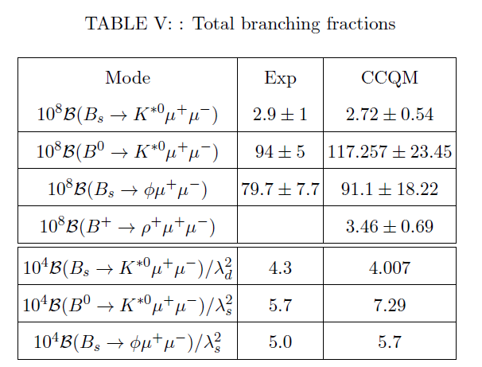
Branching ratios

Slide 21
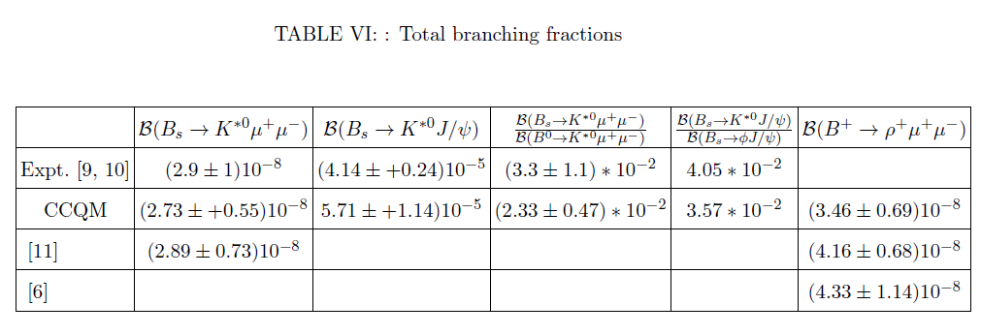
Branching ratios

Slide 22
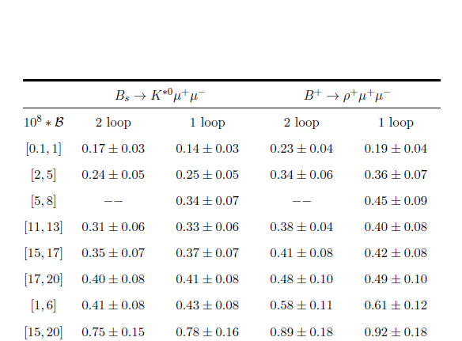
Binned branching ratios

Slide 23
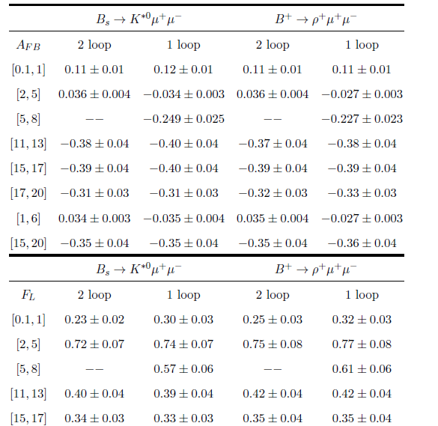
Binned angular observables

Slide 24
Thank you for your attention

Slide 25
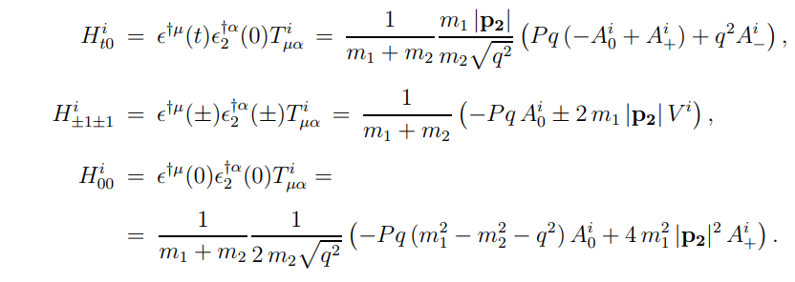

Slide 26
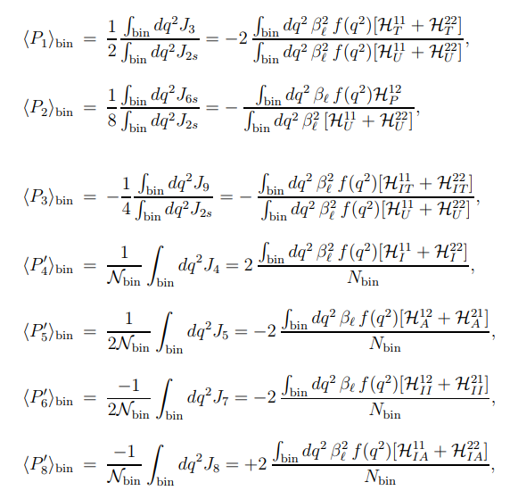

Slide 27
