Slide 1
Collimation of nuclear beams
Roderik Bruce, CERN
Notes:
1
1

Slide 2
Outline
What is collimation and why is it needed?
How is collimation done?
Considerations for designing a collimation system
Collimation of nuclear beams vs proton beams
Simulations of collimation performance
Alternative technique: Crystal collimation

Slide 3
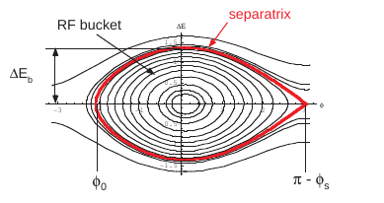
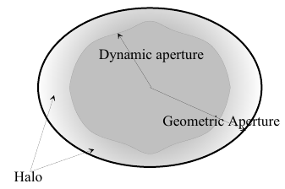
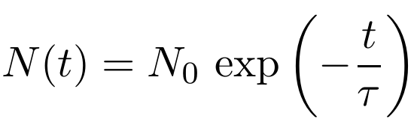
Motivation: Beam losses
Unavoidable beam losses occur in any ion collider
  Regular losses due to collisions, intrabeam scattering, resonances, instabilities, noise, scattering on rest gas, orbit shifts…
  Irregular losses due to hardware or software failures
Beam losses commonly quantified either with absolute loss rate, power of the lost beam, or through a beam lifetime τ (the time at which the beam intensity has dropped to 1/e of its initial value)
Any process bringing particles outside stable phase space area => Losses

Slide 4
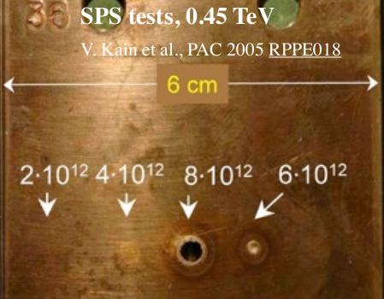
Why do we need collimation?
Effect of beam losses can be detrimental
  Irradiation and activation
  Experimental backgrounds
  In superconducting machines: Magnet quenches
    loss of superconducting due to heating caused by beam losses
  In case of high energy and/or intensity: material damage
0.6 MJ
0.4 MJ
Protons at 450 GeV

Slide 5
Principle of collimation
Intercept any beam losses in a safe way by dedicated devices so that they don’t end up in “bad” locations
Introduce absorbing blocks of suitable material (collimators) that constitute the limiting aperture of the machine
  When offset from ideal orbit increases and particle risks to hit aperture, it should be safely intercepted by the collimator
  Collimators should intercept particles with high betatron amplitude and particles with high energy offset

Slide 6
Implementation of a collimation system
The need for collimation, and the amount and type/material needed, depends on the beam loss scenario and its consequences
  Collimation design can vary widely between machines depending on beam energy, intensity, presence of superconducting magnets etc.
Collimators need to absorb enough of the incoming energy to protect downstream elements
  Use heavier materials or more material to decrease leakage
Collimators can be a significant contributor to machine impedance
Collimators need to be robust and not break themselves due to beam losses
  If increased robustness is needed, use lighter materials
  Design for a worst-case loss scenario (usually failures), with some margin

Slide 7
Example: Losses from fast failure
Standard beam dump: extraction kickers fire when no beam passes (abort gap)

Slide 8
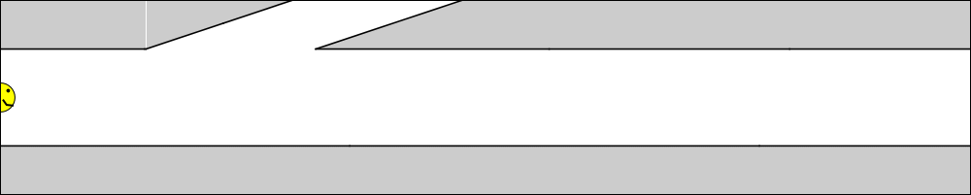
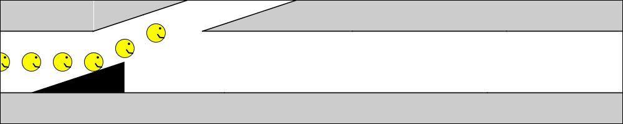
Example: Losses from fast failure
Standard beam dump: extraction kickers fire when no beam passes (abort gap)
Asynchronous dump: kicker(s) fire erroneously when beam passes – kicked beam could directly impact and damage sensitive equipment.

Slide 9
Asynchronous beam dump
Standard beam dump: extraction kickers fire when no beam passes (abort gap)
Asynchronous dump: kicker(s) fire erroneously when beam passes – kicked beam could directly impact and damage sensitive equipment.
Add collimators for protection

Slide 10
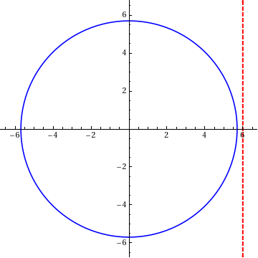
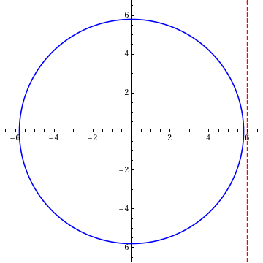
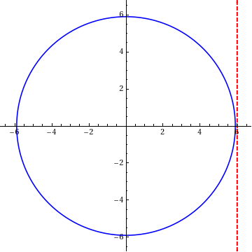
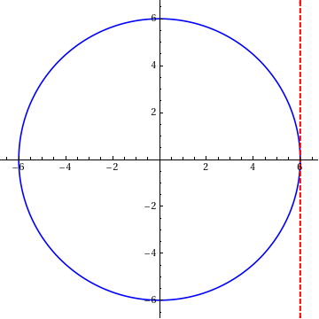
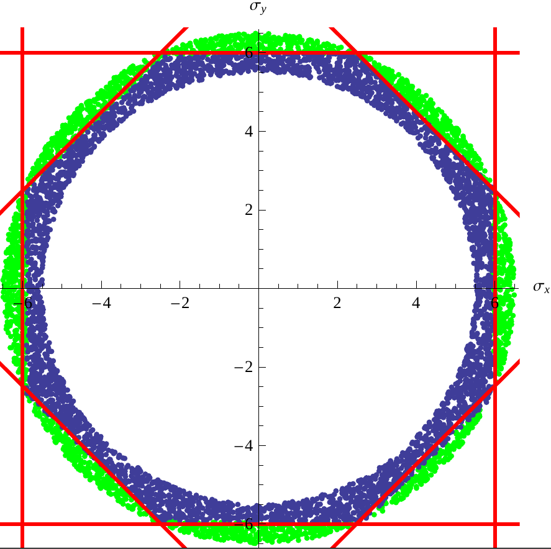
How many collimators are needed?
P_{x} (σ)
To intercept “slow” halo losses (with amplitude
increasing over many turns), only one aperture
bottleneck in the ring is needed
  Need to collimate both horizontal and vertical
  planes, possibly skew plane
Dedicated local protection might be needed
in front of particularly exposed equipment
  Protect against very fast (1-turn) losses
  Protect experiments from background
  Protection against collisional losses
X (σ)
Y (σ)
X (σ)

Slide 11
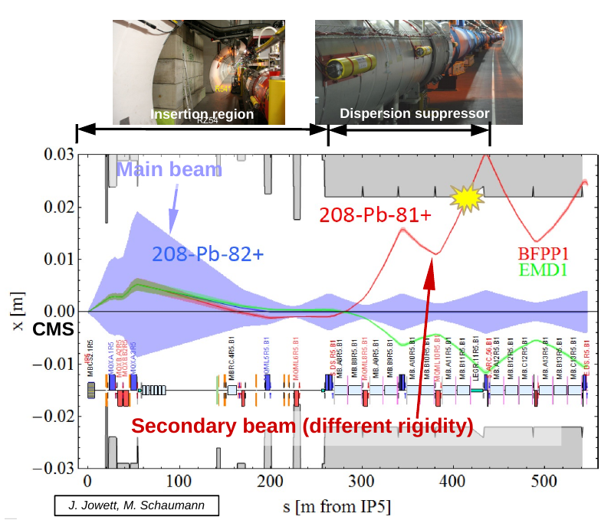
Collisional losses for nuclear beams
Collisions => Nuclei can alter their charge or mass
  Loss of nucleons
  Bound-free pair production (BFPP): creation of electron-positron pair, electron captured by one of the nuclei
Nuclei with altered charge or mass risk being lost in downstream magnets
  Special considerations are needed to assess need for collimation
  See talk tomorrow by
  F. Cerutti

Slide 12
Multi-stage collimation
A single collimator might not be sufficient
  Scattering occurs inside collimator material, with a fraction of the incident particles leaking out
    Nuclear inelastic interactions and electromagnetic dissociation
  Secondary stage at larger aperture to intercept the leakage
  Might need tertiary stage to intercept leakage from secondary stage
Cold magnets
Warm magnets
Cold magnets
Secondary halo
+ hadronic shower
Tertiary halo
Circulating
beam
Primary halo
Insertion
Arc
IP
Primary
Collimators
(TCP)
Secondary
Collimators
(TCSG)
Absorbers
(TCLA)
Tertiary
Collimators
(TCT)
Bottleneck
Conventional multi-stage collimation system

Slide 13
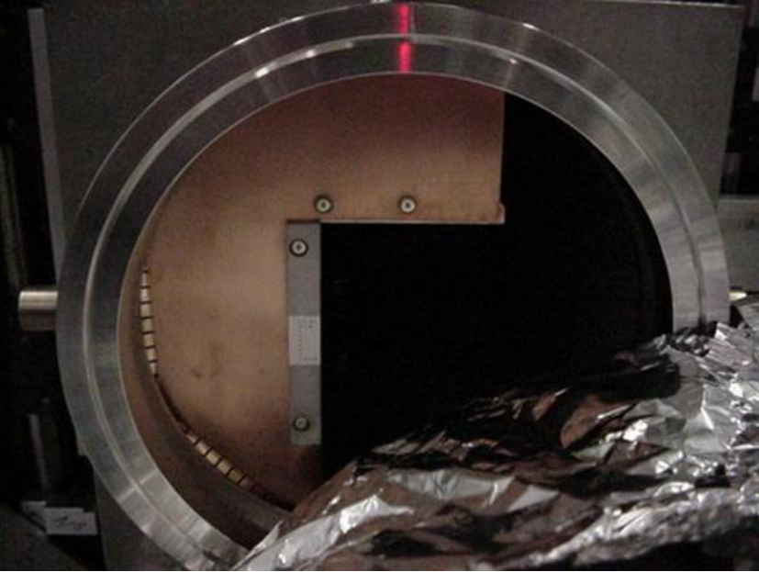
Examples of real collimators: RHIC
Collisions of (among others) 100 GeV/nucleon Au ions
Max stored beam energy for Au: about 700 KJ
Primary purpose of collimators is to reduce experimental backgrounds (but also machine protection)
2-stage system
  L-shaped primary collimators cut
  in both planes
  Three secondary collimators
  (per ring), each in a given plane
Notes:
Made of copper. Simulations of upgrade scenario: http://www.agsrhichome.bnl.gov/AP/ap_notes/ap_note_446.pdf
RHIC run overview: https://www.agshome.bnl.gov//RHIC/Runs/index.html#Run-19

Slide 14
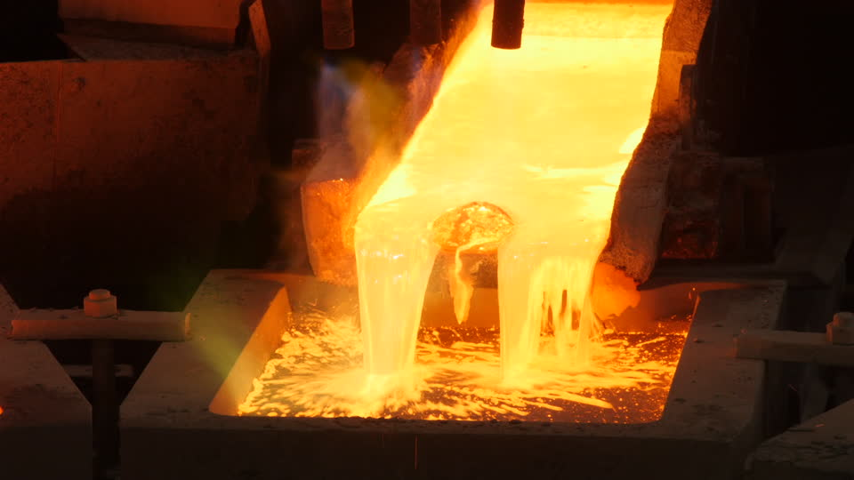

LHC stored energy
Collisions of up to
2.76 TeV/nucleon Pb ions
(achieved 2.51 TeV/nucleon)
Total stored beam energy in design: 3.8 MJ
  achieved about 14 MJ in 2018
14 MJ
  can melt 23 kg of copper
  is the kinetic energy of a
  Лада Нива cruising at about
  550 km/h
Primary purpose of LHC collimation: Machine protection
  Even a small beam loss could cause a quench or even damage

Slide 15
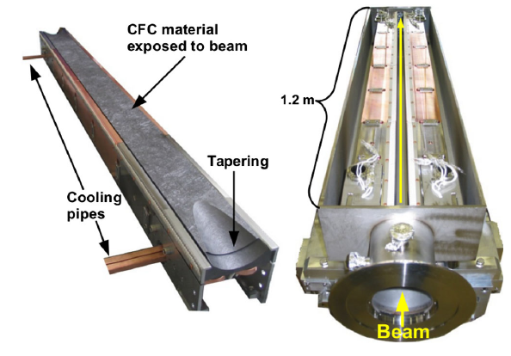
Examples of real collimators: LHC
LHC collimators made of two movable “jaws” with the beam passing in between, most are 1 m long
Robust collimators (close to beam) made of carbon-fibre-composite (TCP, TCSG)
More absorbing collimators (further from beam) made of tungsten alloy (TCLA, TCT)

Slide 16
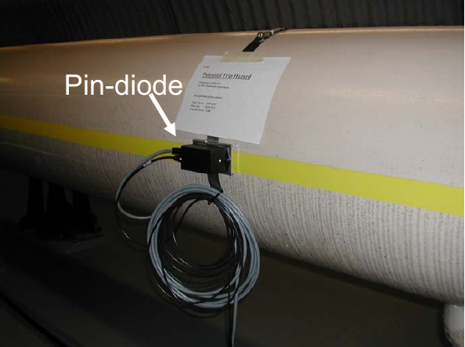
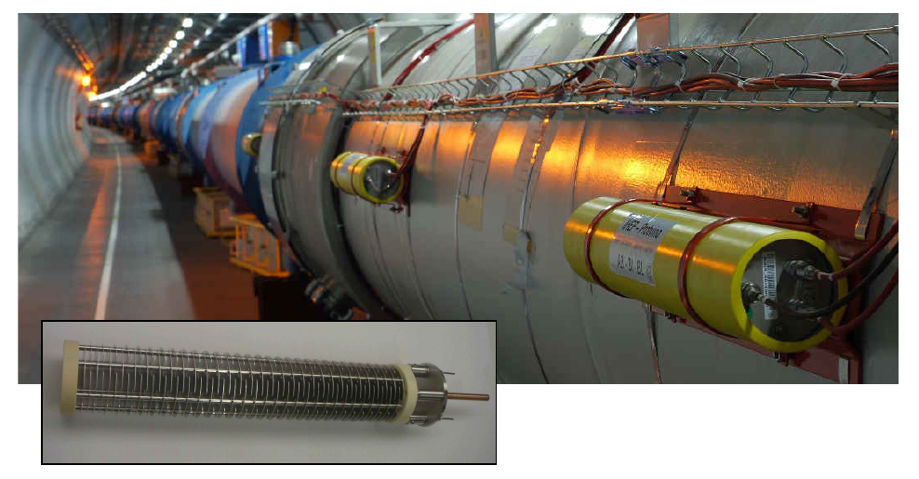
Monitoring losses
Beam loss monitors (BLMs) needed to monitor losses and make sure they occur at safe locations and at safe levels
RHIC: PIN diodes
LHC: Ionization chambers
  Placed just downstream of
  collimators, as well as on magnets
  around the ring
  In total about 4000 monitors
  Triggers automatic dump if losses
  on any element are too high
  With good collimation, we can
  sustain higher losses without dump

Slide 17
Collimator alignment
For best precision, collimators are centered around the circulating beam
  By moving in towards the beam, and stopping when loss is seen on BLM
  By using built-in BPMs
With low-intensity beam!

Slide 18
Collimator alignment
For best precision, collimators are aligned around the circulating beam
  By moving in towards the beam, and stopping when loss is seen on BLM
  By using built-in BPMs
With low-intensity beam!
Reference
collimator
Collimator i
BLM_{ref}
BLM_{i}
Four-stage alignment procedure:
showers
showers
2
1
4
3
Beam
The primary collimator forms a reference cut in the beam halo.
G. Azzopardi
Beam centre calculated from final collimator position.
Beam size calculated using primary collimator before and after.

Slide 19
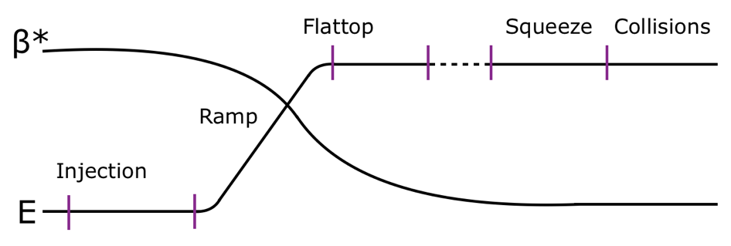
Collimator settings
With high intensity, collimators automatically driven back to the settings found in alignment
Collimators may need to move during machine cycle
  Larger beams at injection before adiabatic damping
  Dynamic change of optics and aperture bottlenecks
Collimator settings must ensure that hierarchy is maintained (primary-secondary-tertiary) and that all machine apertures are protected
  Non-robust collimators must be “in the shadow” in case of single-turn failures
  Settings usually given in units of local beam σ

Slide 20
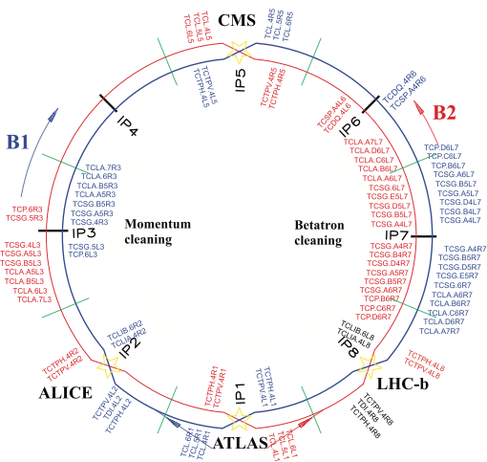
LHC collimation insertions
LHC collimators placed in two main insertions
  IR7 for betatron cleaning
  IR3 for off-momentum cleaning
Additional collimators around experiments, at beam extraction and injection
In total, about 100 collimators
In addition, fixed masks in front of exposed locations

Slide 21
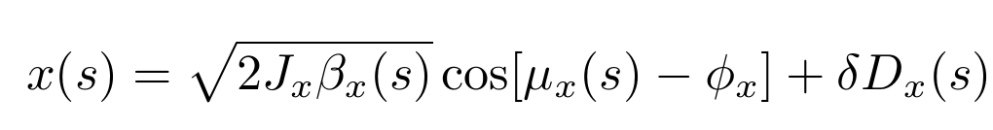
Betatron and off-momentum cleaning
More flexible setup with separate collimators for cleaning of high betatron amplitudes and cleaning of high momentum offsets
Can independently set cuts in momentum offset and betatron amplitude
Betatron collimation:
Increase beta function,
decrease dispersion
Momentum collimation:
Increase dispersion,
decrease beta function

Slide 22
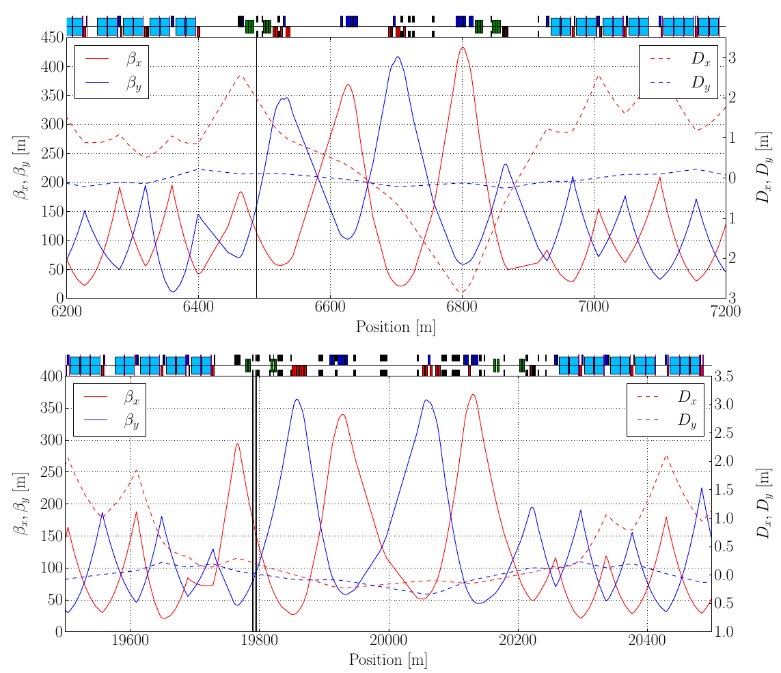
Example of optics in collimation insertion
LHC optics, IR3
LHC optics, IR7
Primary collimators

Slide 23
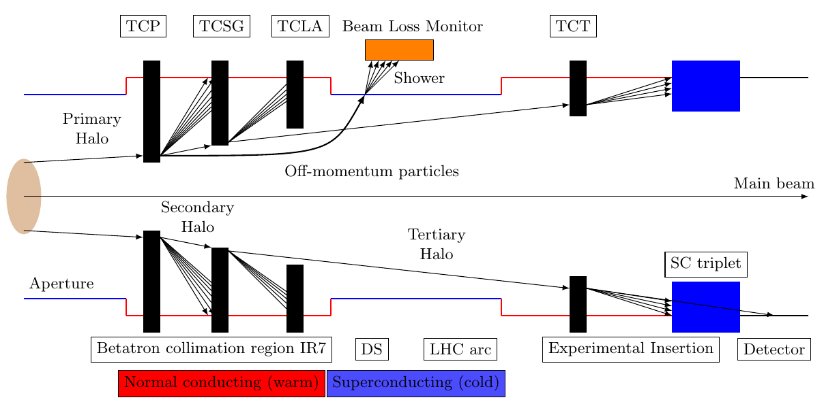
LHC: 3-stage collimation
3-stage system in each insertion (designed primarily for proton operation)
  Pre beam: 3 primary collimators (TCP), 11 secondary collimators (TCSG), 5 active absorbers (TCLA)
  Tertiary collimators (TCT) in front of experiments and superconducting triplet

Slide 24
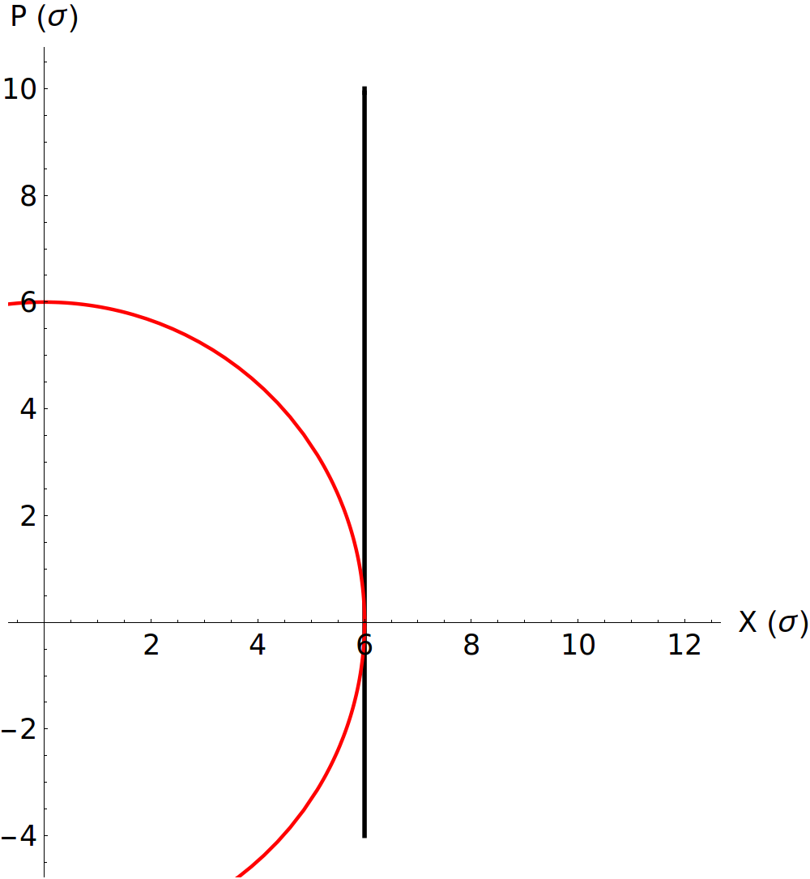
Where to place secondary collimators?
Study particle motion in normalized coordinates (X,P) in red
Assume particle has maximum excursion when it hits TCP cut (in black)
Assume it scatters in TCP – random addition to P
Example: n1=6, n2=7
Random scattering

Slide 25
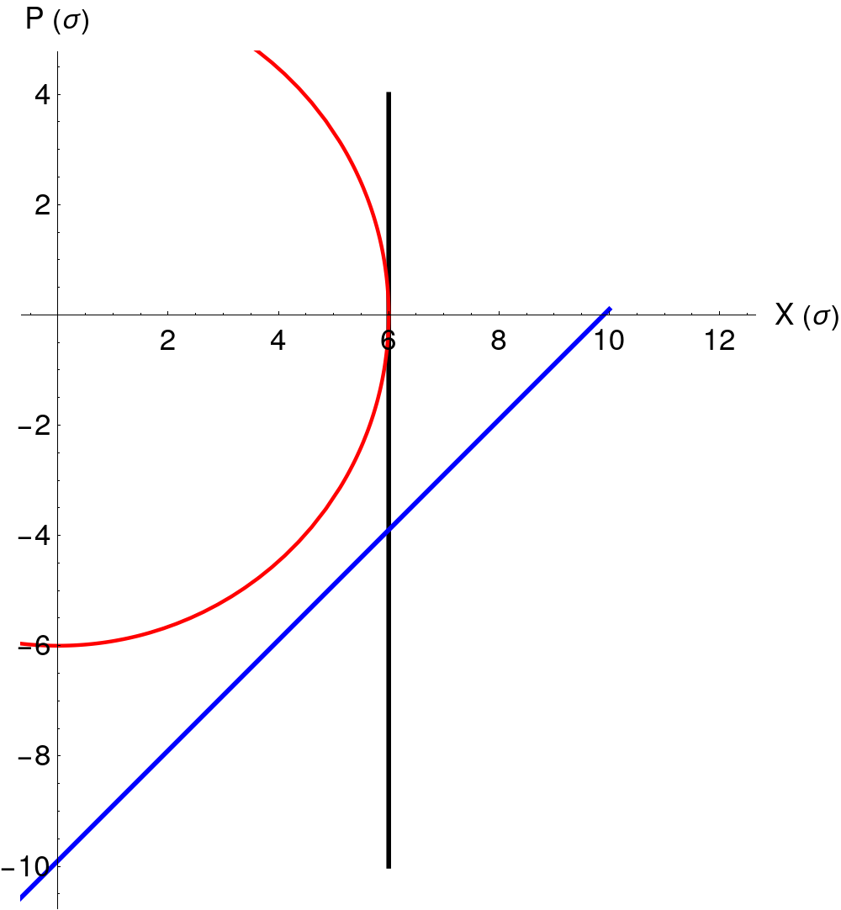
Phase advance to secondary collimator
Now add TCSG with unknown phase advance θ – gives tilted line in TCP phase space
What value should θ have in order for the TCSG to catch as many scattered protons as possible?
TCP
θ
TCSG

Slide 26
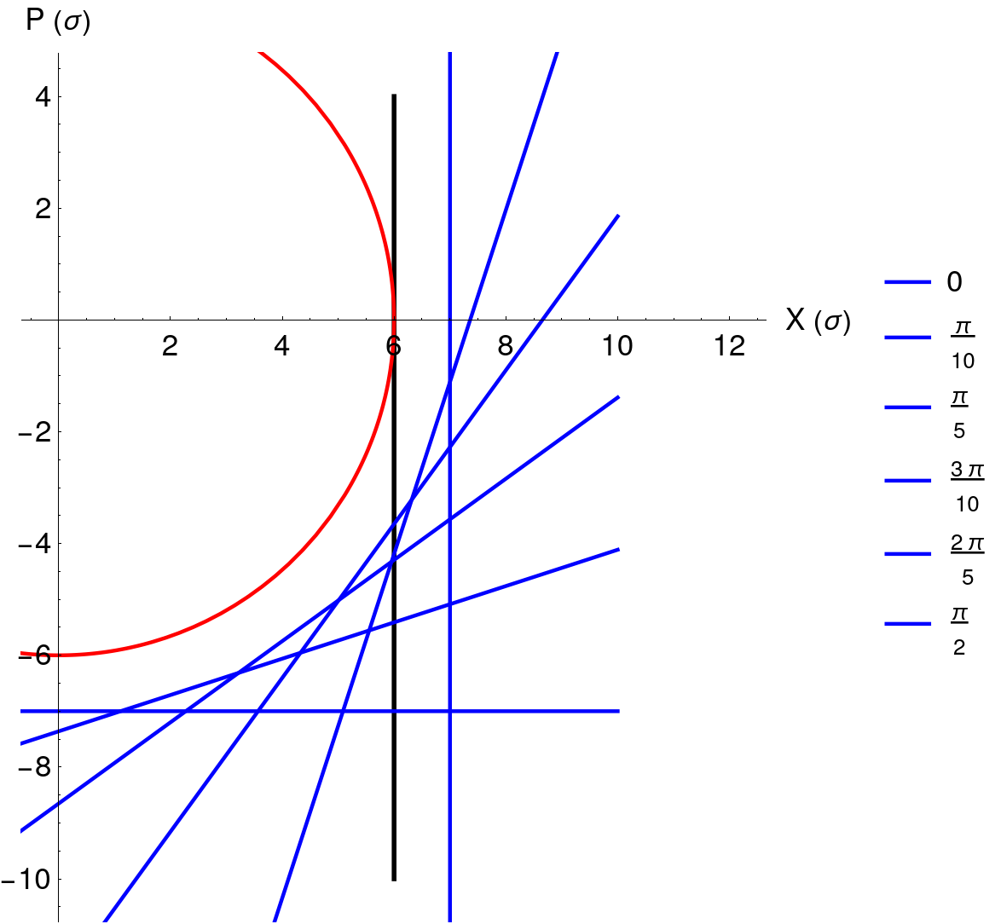
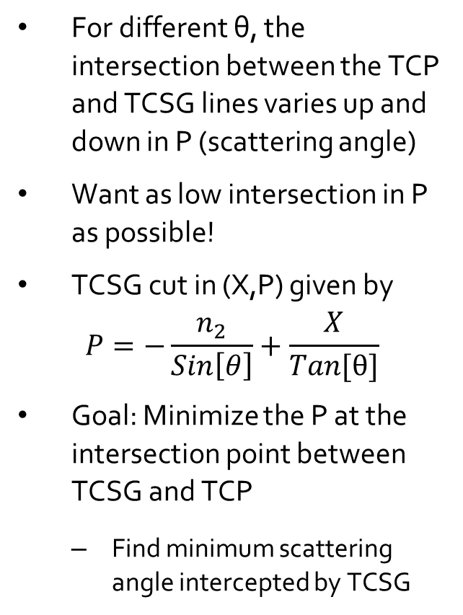
Optimum phase advance
For different θ, the intersection between the TCP and TCSG lines varies up and down in P (scattering angle)
Want as low intersection in P as possible!
TCSG cut in (X,P) given by
$P=−\frac{n_{2}}{Sin\left[θ\right]}+\frac{X}{Tan[θ]}$
Goal: Minimize the P at the intersection point between TCSG and TCP
  Find minimum scattering angle intercepted by TCSG
Studied
values of θ:

Slide 27
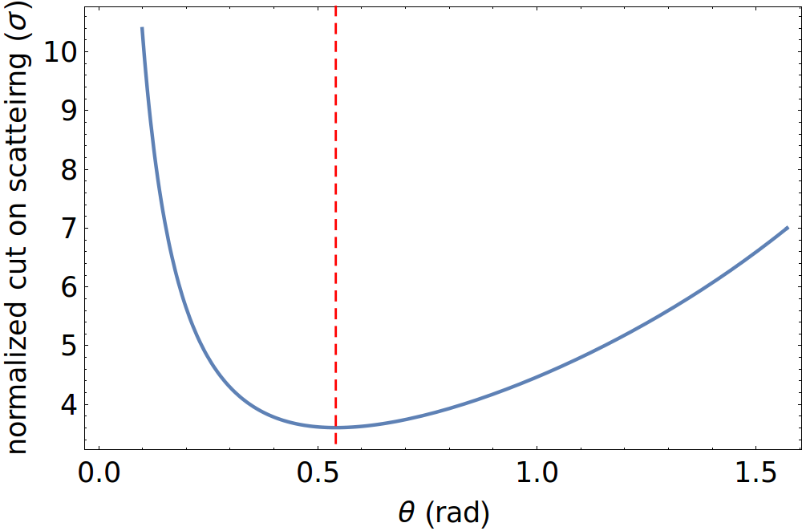
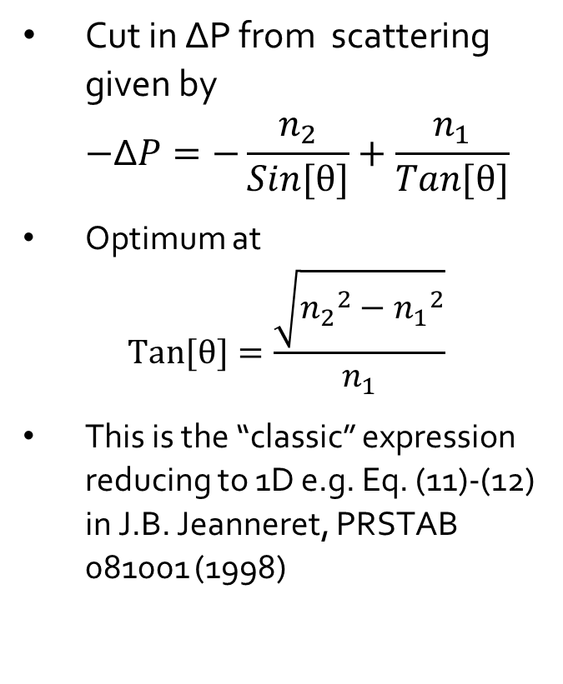

Optimum phase advance
Cut in ΔP from scattering given by
$−\text{Δ}P=−\frac{n_{2}}{Sin[θ]}+\frac{n_{1}}{Tan[θ]}$
Optimum at
$Tan[θ]=\frac{\sqrt{{n_{2}}_{}^{2}−{n_{1}}_{}^{2}}}{n_{1}}$
This is the “classic” expression reducing to 1D e.g. Eq. (11)-(12) in J.B. Jeanneret, PRSTAB 081001 (1998)
Example: n1=6, n2=7
$$\frac{\sqrt{7^{2}−6^{2}}}{6}$$

Slide 28
Testing collimation performance
After positioning collimators: very important to test that the settings are appropriate and protect the machine before injecting high-intensity
Use special test procedure to qualify the cleaning performance
  Inject low-intensity beam, that does not risk to damage the machine
  Typically a few bunches only
Provoke strong beam losses and use instrumentation (BLMs) to monitor distribution and magnitude of losses; compare with expectation
  Loss distribution around the ring is called “loss map”
  Scale up to high-intensity beam and expected loss rate: is it acceptable?
  Loss maps can be used to infer a limit on the instantaneous loss rate (or beam lifetime)

Slide 29
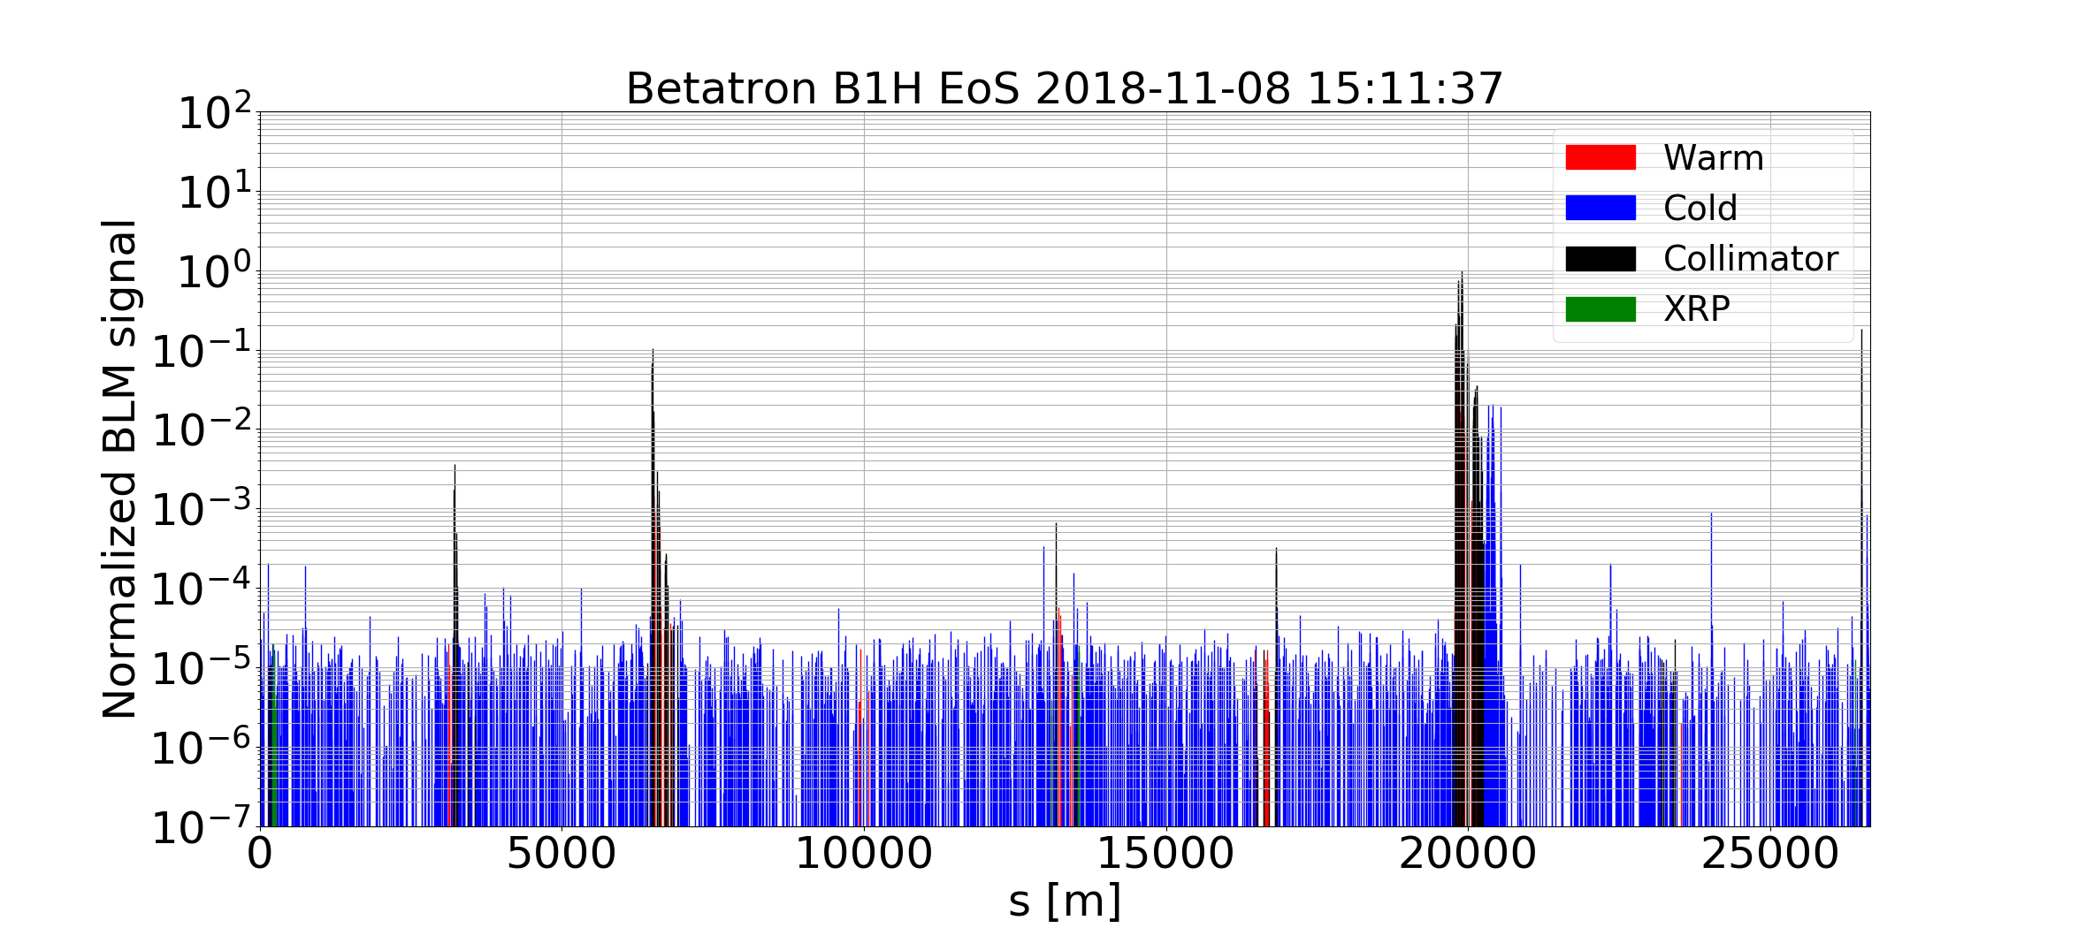
Performance of collimation system
Example from the LHC
  Use white-noise excitation by transverse damper to excite losses on low-intensity beam. Could also move tune to approach resonance, e.g. 3rd order
  Excite beam in horizontal and vertical planes separately
  Off-momentum losses: Apply small shift of RF frequency
Measured “cleaning inefficiency” normalized to highest loss
Loss map from the LHC 2018 Pb-Pb run
N. Fuster Martinez
IR2
IR3
IR4
IR5
IR6
IR7
Beam

Slide 30
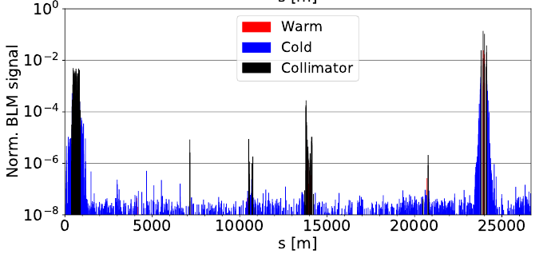
Asynchronous dump test
Test also the loss distribution during certain failure scenario
Example: LHC test procedure for asynchronous beam dump
  Inject safe, low-intensity beam
  Switch off RF system => beam will debunch and slowly enter the abort gap
  Trigger a normal beam dump and register loss distribution. Scale up to full beam
Inject high-intensity beam only if the loss maps and asynchronous beam dump test show acceptable
results
N. Fuster Martinez
Beam 1
Beam 2

Slide 31
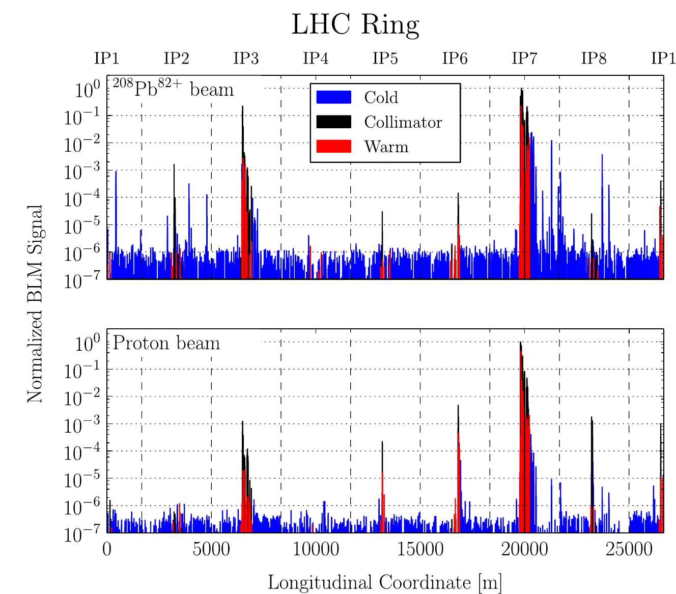
Measured loss patterns: Pb vs p
Highest loss as expected on primary collimator
Some leakage to other places around the ring, in particular for Pb ions
Proton loss map looks cleaner
Measured beam losses around the ring
P. Hermes

Slide 32
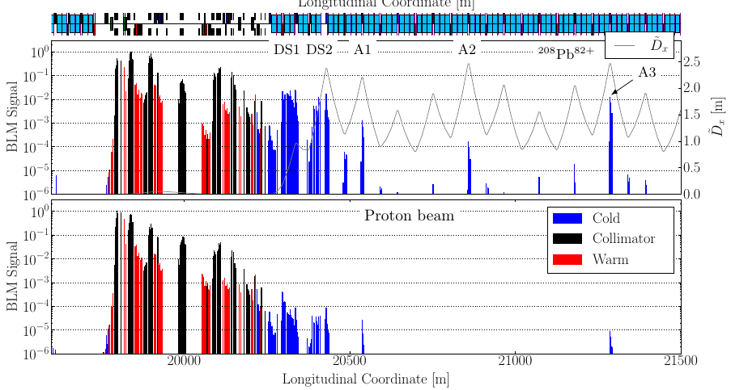
Measured loss patterns: Pb vs p
Measured leakage to cold magnets factor ~100 worse of Pb ions than protons
Pb ion collimation in LHC more critical than p collimation,
in spite of factor ~20 lower stored beam energy
Why??
Measured beam losses: zoom in IR7
P. Hermes

Slide 33

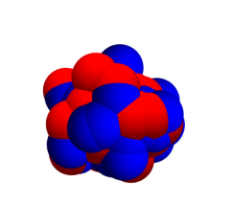
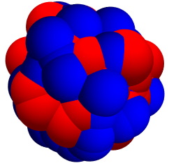
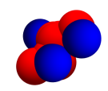

Particle-matter interactions
Protons interacting in collimator
  Disintegrates (energy deposited locally) or survives
  Surviving protons that scatter out have either not undergone interaction, and hits the same collimator again on a later turn, or
  Have significant deviation in energy and/or angle after elastic or single-diffractive scattering
  Particles with angular kicks intercepted by secondary collimators
Ions interacting in collimator
  Electromagnetic dissociation and nuclear interactions cause nuclear breakup with high probability
  Changed charge-to-mass ratio => wrong bending in magnets, behaving effectively as off-momentum
Target
material
Target
material
Target
material

Slide 34
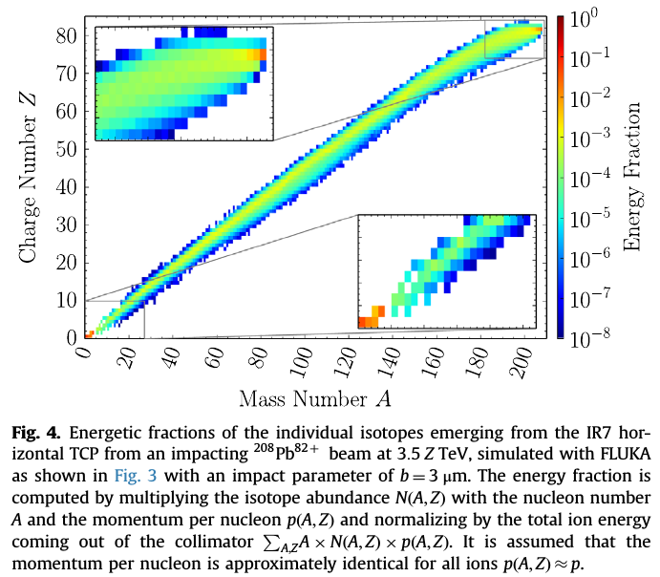
Ion fragment distribution after collimator
P.D. Hermes et al., Nuclear Instruments and Methods in Physics Research A 819 (2016) 73–83

Slide 35
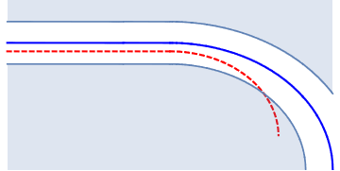

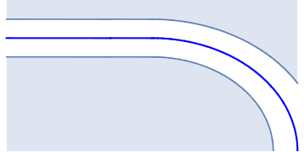
Losses of ion fragments
  Some ion fragments with small angular kick but large effective energy offset
Can bypass downstream collimators in straight section
Possibly lost in the first few dipoles of the arc, acting as spectrometer
In LHC, Pb ion collimation is more critical than p collimation, in spite of factor ~20 lower stored beam energy with Pb
Collimators
Main beam
dp/p<0

Slide 36
Simulation of collimation performance
Very important to accurately predict leakage out of collimation system
  Need to quantify if collimation system protects the machine for all relevant loss scenarios
Typical simulation workflow (3 steps)
  Multi-turn tracking simulation, specific to each beam loss scenario
    Produce simulated loss map (distribution of impacts around the ring)
  Energy deposition studies of showers from impacting particles
    Produce simulated power load inside impacted elements
  In some cases: Thermo-mechanical assessment of material response (quench, damage)

Slide 37
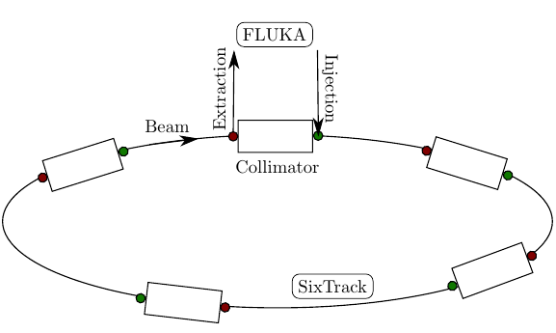
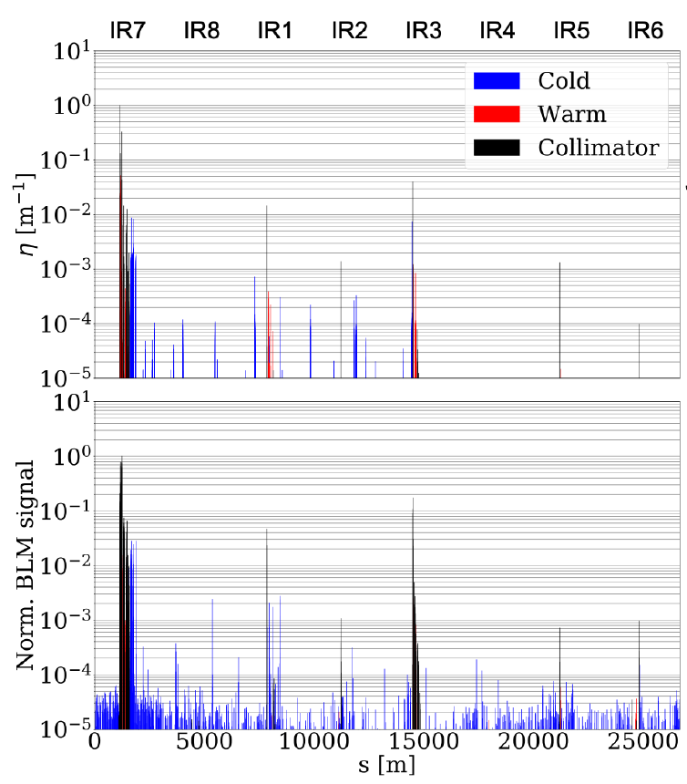
Step 1: Tracking simulations
Need to accurately account for magnetic fields and particle-matter interaction
  Including relevant physics processes, e.g. electromagnetic dissociation
  Example code: coupling between SixTrack and FLUKA
Sometimes too time-consuming to simulate the full loss process (e.g. diffusion)
  Instead, start from impacts at the primary collimator
Output: loss map
Simulated
Measured
N. Fuster Martinez

Slide 38
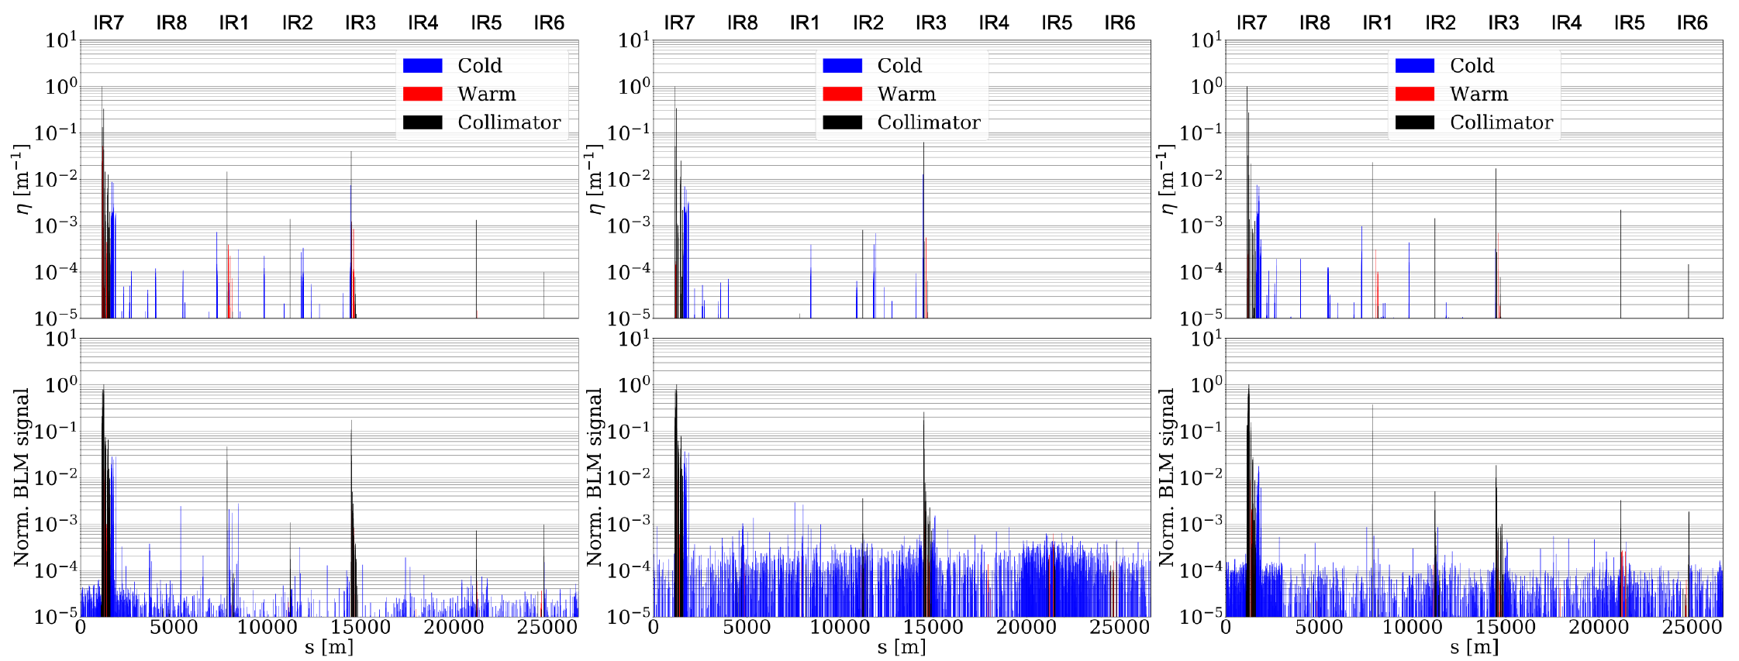
Example application of tracking
Tracking simulation can sometimes be used directly to understand and mitigate losses
Example: Losses in 2018 Pb-Pb run on IR1 tertiary, causing background
  Understood in simulation: origin is one of the two primary jaws
  Mitigation: open this jaw a little, so that all losses impact on the other jaw
L+R
R
L
Sim.
Meas.
N. Fuster Martinez

Slide 39
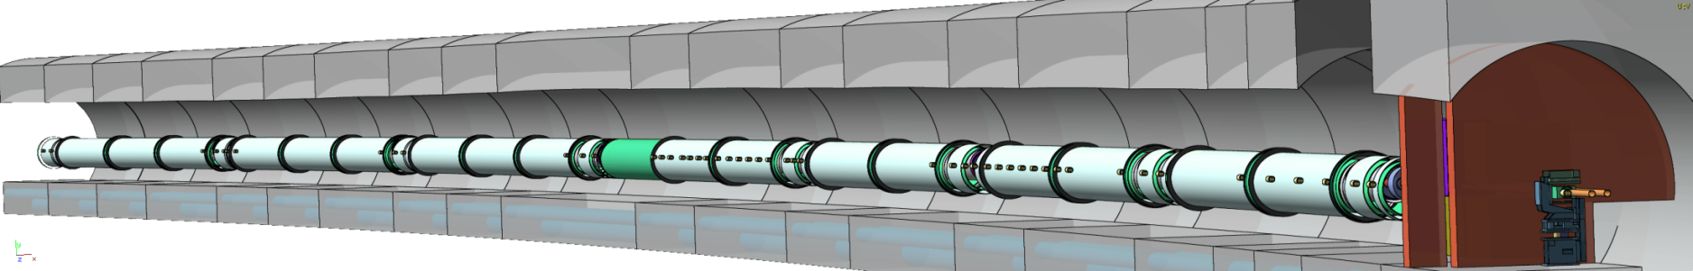
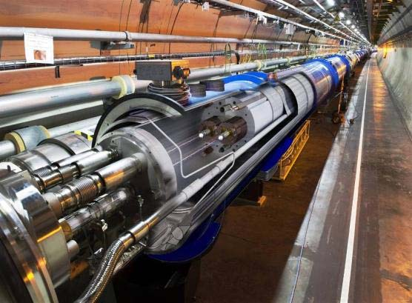
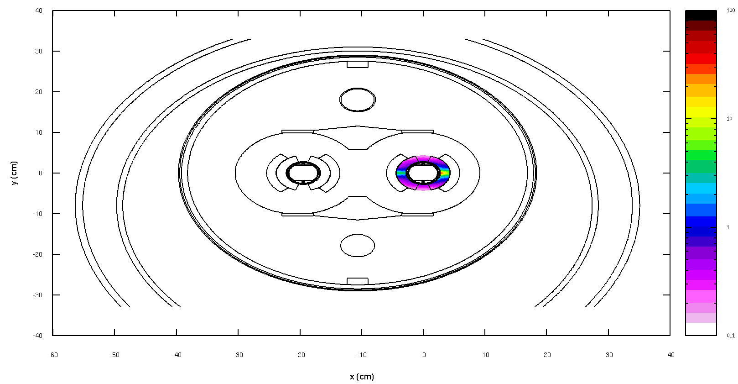
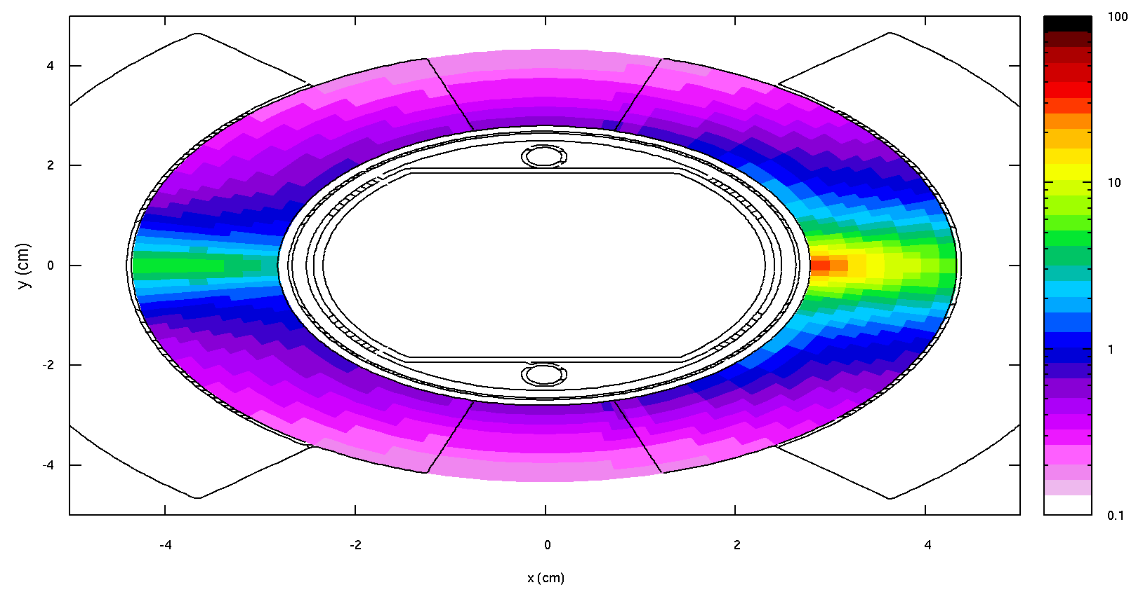
Step 2: Energy deposition studies
Use simulated loss map as input to study detailed energy deposition inside critical elements with particle-physics Monte-Carlo code (see talk F. Cerutti)
  Example codes: FLUKA, Geant4, MARS. Need to model the geometry in 3D
Simulate only the most critical elements, typically the most exposed magnets for quench assessment collimators, to judge if they will be damaged
E. Skordis et al.

Slide 40
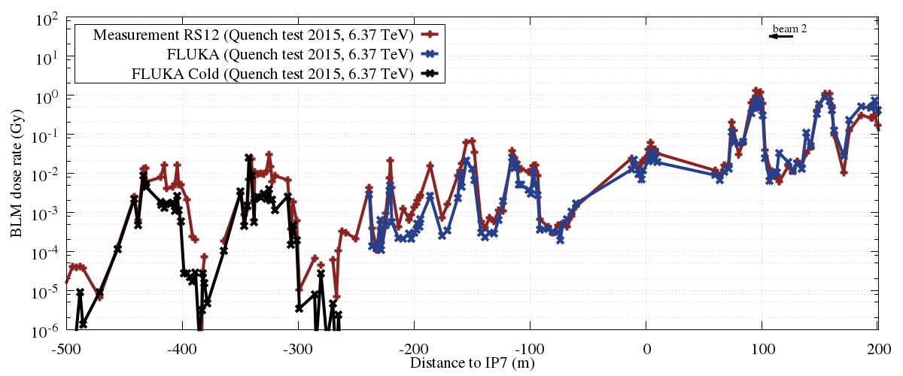
Example result from LHC
FLUKA simulation of BLM signals on cold magnets in IR7
Shape of curve matches very well; discrepancies of up to factor 3-5 found
  Still quite good, considering the uncertainties and unknowns, and that losses span many orders of magnitude
  Need engineering margin when designing collimation systems
E. Skordis et al.

Slide 41
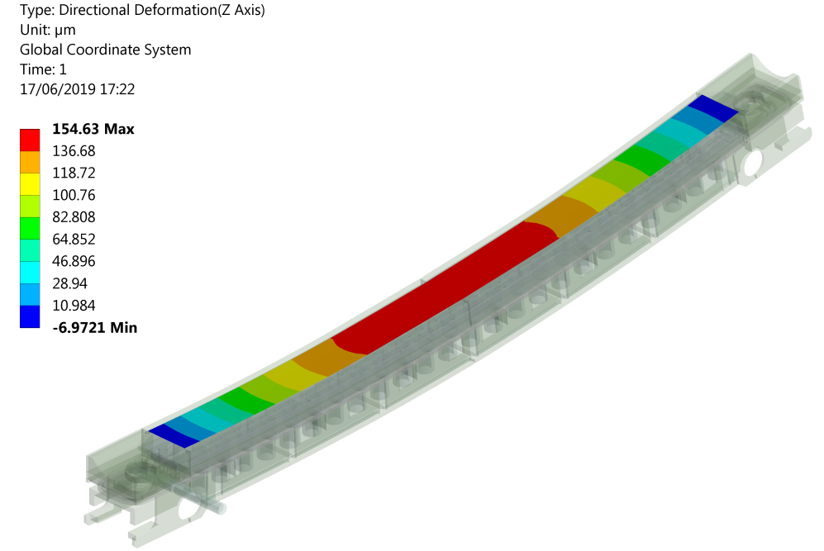
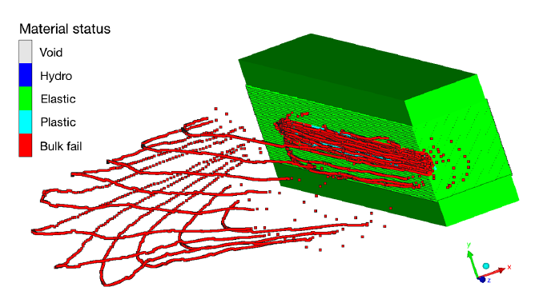
Step 3: Thermo-mechanical analyis
G. Gobbi
Sometimes needed to assess the thermo-mechanical response of the impacted element
  Peak temperature reached, accounting for beam load and cooling?
  Will the magnet quench?
  Deformation or permanent damage induced?
Example code: Ansys
F. Carra et al.

Slide 42
Future alleviation: extra collimators
Simulations used to predict future performance
Example: To cope with increased beam intensity in future LHC upgrade, need to improve cleaning of collimation system
  Upgrade driven by mainly by Pb ion operation
Solution: introduce extra collimators, TCLDs, in the cold region
  Make space by replacing a standard
  dipoles by two shorter 11T dipole, with
  TCLD in between
Present baseline: install 1 IR7
TCLD per beam
TCLD
Collimators
Main beam
dp/p<0

Slide 43
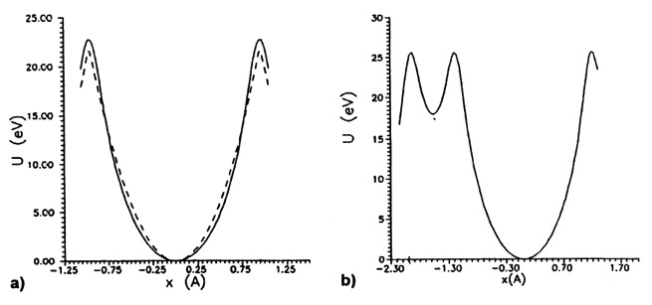


Option: crystal collimation
Potential between a particle and an atom described
by the Thomas-Fermi model:
Potential seen by protons
from crystalline planes
Continuous approximation (small $θimp$):
If the protons have p_{T} < U_{max}
Typical values at energies
of our interest:
Critical channeling angle
Forced to oscillate in a relatively empty space
D. Mirarchi et al.

Slide 44
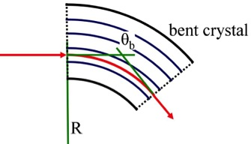
Bent crystals to channel halo particles
If the crystal is bent, incoming particles can be deviated
  Effectively a kick in angle
Main promises:
LHC design parameters
Reduction of inelastic
interactions in the channel
4mm
1mm
Reduced off-momentum losses in DS
50mm
Similar performance with p and Pb
Beam
Significant improvement w.r.t. present
Bending 50μrad B ≈ 310 T @ 7 TeV!

Slide 45
Collimation scheme with crystals
Conventional multi-stage collimation system
Cold magnets
Warm magnets
Cold magnets
Tertiary halo
Secondary halo
+ hadronic shower
Circulating
beam
Primary halo
Insertion
Arc
IP
Protection
Devices
(TCD)
Primary
Collimators
(TCP)
Secondary
Collimators
(TCSG)
Absorbers
(TCLA)
Tertiary
Collimators
(TCT)
Bottleneck
Crystal-based collimation system
Deflected halo
Massive Absorber
Secondary halo
+ hadronic shower & Dechanneling
Circulating
beam
Primary halo
Insertion
Arc
IP

Slide 46







LHC test installation
Four crystals installed in the LHC: two per beam, one per plane
Same specifications for all crystals, two different producers and technologies
TCPCH.A5R7.B2
TCPCV.A6L7.B1
Beam 2
Beam 1
PNPI
Beam 2
PNPI
Beam 1
Pics. Courtesy of Y. Gavrikov
TCPCV.A6R7.B2
TCPCH.A4L7.B1
Beam 1
S. Redaelli
PNPI
Beam 1
INFN-Fe
Beam 1
Complete layout to allow thorough investigations and operational tests

Slide 47

LHC test results
For LHC tests, use existing secondary collimator as absorber
  Works for Pb beams, but not for high-intensity protons
  Robustness of absorber limiting – takes the full power of the losses
Loss map measured with conventional and with crystal collimation: Improvement by factor 2-7
In 2018, crystals successfully inserted with full Pb ion beam

Slide 48
Summary
Collimation needed in ion colliders to safely dispose of beam losses
  Avoid quenches and damage, localize irradiation
Conventional collimation systems consist of blocks of material placed close to the beam
  Possibly several stages to intercept any outscattered particles
  Option: crystal based system
Collimation with nuclear beams more challenging than with protons
  Fragmentation causes large flux of effectively off-energy particles
Simulations important for designing a collimation system and qualifying performance
  Tracking, energy deposition, thermo-mechanical studies

Slide 49
Other lectures touching similar topics
F. Cerutti, “Simulation tools: interaction with matter”, this morning
F. Cerutti, “Secondary beams and machine protection”, Wednesday morning
M. Schaumann, “Performance highlights from the LHC”, Wednesday afternoon

Slide 50

Thanks for your attention!

Slide 51
Backup

Slide 52

Magnetic rigidity change
EM interactions create ions with altered magnetic rigidity:
These ions follow locally generated dispersion function d_{x} from IP
Lost in localized spot where aperture A_{x} , d_{x} and δ satisfy
Apart from significant luminosity decay, induced heating risks to quench superconducting magnets - BFPP gives 25W beam
BFPP at IP2
δ=0.012
Secondary Pb⁸¹⁺ beam emerging from IP and impinging on beam screen
Beam screen
Main Pb⁸²⁺ beam
S. Klein, NIM A 459 (2001) 51

Slide 53


Future alleviation: extra collimator
BFPP beam, without and with bump
TCLD collimator
(post LS2)
IR2 has different quadrupole polarity and dispersion from IR1/IR5
Primary BFPP loss location is further upstream from connection cryostat
Solution is to modify connection cryostat to include a collimator to absorb the BFPP beam – to be ready for LS2 installation
With levelled luminosity in ALICE, quenches were not seen in 2015
TCLDs should allow luminosity increase for upgraded ALICE to run at at 50 kHz
Also during LS2, further TCLD collimators will be installed between 11 T magnets in IR7 to improve Pb collimation (first application of Nb₃Sn superconductors in an operating accelerator).

Slide 54

Timeline of heavy-ion runs

Slide 55
Geometric reduction factor
Fewer collisions when bunches are not fully overlapping
Decrease bunch length and crossing angle to minimize effect
Crossing angle limited by beam-beam separation and aperture

Slide 56

What can happen if a TCT is hit?
Impacts studied in HiRadMat
Significant damage observed
Test 1 (24 SPS bunches = 1 LHC bunch @ 7TeV)
Test 2
(Onset of Damage: 6 SPS bunches)
Test 3
(72 SPS bunches)
A. Bertarelli et al.

Slide 57


Proton acceleration to LHC
Energy:
Linac 50 MeV
PSB 1.4 GeV
PS 28 GeV
SPS 450 GeV
LHC 7 TeV
R. Bruce, 2018.10.29

Slide 58

Superconducting magnets
“Quench” = loss of superconductivity
Happens if working point is outside of surface in magnetic field (B), current (I) and temperature (T)

Slide 59


LHC lattice
In the bends: periodic layout of dipoles interleaved with
focusing and defocusing quadrupoles
At collision points: beam focused down to very small
transverse size (2018: ~10 μm in pp, 20 μm in PbPb)

Slide 60

Large Hadron Collider
LHC designed to collide both protons and nuclei
8 straight sections (4 with experiments) and 8 arcs

Slide 61

Heavy-ion operation at the LHC
About 1 month per year foreseen for heavy-ion operation
So far: Pb-Pb runs at 3.5 Z TeV and 6.37 Z TeV,
p-Pb runs at 4 Z TeV and 6.37 TeV
3.5 Z TeV
4 Z TeV
Heavy-ion runs so far
6.37 Z TeV
6.5 Z TeV
6.37 Z TeV
Xe-Xe

Slide 62
Achieved parameters
LHC design performance significantly surpassed for Pb-Pb
In addition: p-Pb : new mode of operation not foreseen in LHC design
Parameter for Pb beam | LHC design value | Achieved 2018
Beam energy | 2.76 TeV / nucleon 7 Z TeV | 2.51 TeV / nucleon 6.37 Z TeV
Bunch intensity | 7E7 | 2.3E8
Number of bunches | 592 | 733
Stored beam energy | 3.8 MJ | 13.9 MJ
Bunch spacing | 50 ns | 75 ns
Normalized emittance | 1.5 μm | 2.0 μm
β* | 0.5 m | 0.5 m
Number of collision points | 1 | 4
Peak luminosity (Pb-Pb) | 1E27 cm⁻² s⁻¹ | 6.4E27 cm⁻² s⁻¹
ALICE Leveled luminosity (Pb-Pb) | --- | 1E27 cm⁻² s⁻¹

Slide 63
Collisional losses
Only a small fraction of colliding Pb ions undergo nuclear inelastic interactions
The main fraction of the collisions is “wasted” on ultra-peripheral electromagnetic interactions (UEI)
  Pb ions that have undergone UEI are lost from the beam outside of the experiments
Cross sections for Pb-Pb collisions at 2.76 TeV / nucleon
Process | Cross section (b)
Bound-free pair production | 281
Electromagnetic dissociation | 226
Hadronic nuclear inelastic | 8
Total | 515

Slide 64
Ultra-peripheral electromagnetic interactions
Dominating UEI processes
  Bound Free Pair production (BFPP, 281 barn):
  1-neutron Electromagnetic dissociation (EMD1, 96 barn)
  2-neutron Electromagnetic dissociation (EMD2, 29 barn)
All these processes create unwanted beam losses
Meier et al. Phys. Rev. A, 63, 032713 (2001)
Pshenichnov et al. Phys. Rev. C 64, 024903 (2001)

Slide 65
Bound-free pair production
Most critical: BFPP
Secondary beams with wrong charge-to-mass ratio => bent wrongly by dipoles and lost on aperture => risk for magnet quenches
  25 W beam for nominal LHC conditions
  ~150 W beam for achieved conditions in IR1/5
Puts upper limit on luminosity
  Limit found experimentally at 2.3E27 cm⁻²s⁻¹ in IR5.
  Could be different at different magnets / IRs
Interaction
point
Secondary Pb⁸¹⁺ beam
emerging from IP and
impinging on beam
screen
Beam
screen
Main Pb⁸²⁺ beam

Slide 66

Observations of BFPP during operation
Beam loss monitors around LHC ring show positions of losses
Large BFPP spikes seen around the experiments
Bound-free pair production secondary beams from IPs
IBS & Electromagnetic dissociation at IPs, taken up by momentum collimators
Losses from collimation inefficiency, nuclear processes in primary collimators

Slide 67


Alleviation in IR1/5 with orbit bumps
Established technique in 2015: Orbit bumps are used to move the secondary beam losses to empty cryostat in order to reduce risk of quench.
With bumps, achieved ~6E27 cm⁻²s⁻¹ in ATLAS / CMS
w/o bump
with bump
“missing dipole” cryostat
quadrupole
dipole
Careful setup of bumps in beginning of the run to achieve desired loss displacement.
Particle losses

Slide 68

Partial alleviation in IR2
In IR2: not possible due to layout/optics to move losses to empty cryostat
Use orbit bump to distribute losses between different magnets
  Upper luminosity limit not investigated experimentally
ALICE anyway leveled at
1E27 cm⁻²s⁻¹
  Too high event rate for detector otherwise
  ALICE upgrade foreseen in LS2
Nominal
With bump

Slide 69

Future alleviation: extra collimators
BFPP beam, without and with bump
TCLD collimator
(post LS2)
Planned to install one new collimator (TCLD) per side of ALICE in connection cryostat in LS2
Orbit bump used to deviate losses from dipole magnet so that they instead hit collimator
TCLDs should allow luminosity increase for upgraded ALICE to run at 50 kHz

Slide 70

Effect of impacting beam
Even a small beam loss in a magnet could cause a quench or even damage
  Tests with protons: very localized ionization loss from nuclear beams potentially more critical
  Ionization energy loss in
  material given approximately
  by Bethe-Bloch formula
0.6 MJ
0.4 MJ

Slide 71
Limit from collimation
Efficiency of collimation system introduces upper limit on acceptable beam losses (Pb/s)
  In case of large beam losses, a proportionally large leakage to cold magnets occurs
  Beams should be dumped by beam loss monitors before quench or damage occur
  If losses are frequently too high, frequent dumps make operation less efficient or even impossible
Gives effectively an upper limit on the total beam intensity

Slide 72



Milestones achieved for crystals
2015
First p channeling at the LHC: 450 GeV and 6.5 TeV
First Pb channeling at the LHC: 450 Z GeV
2016
First channeling during energy ramp
First assessment of cleaning performance with p beams
First Pb channeling at the LHC: 6.37 Z TeV
2017
First channeling of Xe at 450 Z GeV 6.5 Z TeV, together with assessment of cleaning performance
2018
First channeling during squeeze and collision
First operational use in a physics run
Operational tests with 6.37 Z TeV Pb beams
Total MD time: 58h with p, 34h with ions

Slide 73

Losses of ion fragments
  Some ion fragments with small angular kick but large effective energy offset
Can bypass downstream collimators in straight section
Possibly lost in the first few dipoles of the arc, acting as spectrometer
Pb ion collimation in LHC more critical than p collimation, in spite of factor ~20 lower stored beam energy
Simulation by P. Hermes

Slide 74

Collimation
From Wikipedia:
  “A collimator is a device which narrows a beam of particles or waves. To narrow can mean either to cause the directions of motion to become more aligned in a specific direction (i.e., make collimated light or parallel rays), or to cause the spatial cross section of the beam to become smaller (beam limiting device). “

Slide 75

Multi-stage collimation
Primary physics interaction with collimator removing (hadronic) beam particles are
  Nuclear inelastic interactions
  Electromagnetic dissociation (for nuclear beams)
Design of collimation system typically done using simulations
  See later
Beam loss scenarios? 2 stages?
What material?

Slide 76

Effective kicks in angle and energy
P. Hermes
Because of fragmentation, surviving ions more likely to be outside energy acceptance
A large fraction of those are inside the angular acceptance of the secondary collimators
Notes:
Figure 6.1: Top and middle plot: FLUKA simulated map of transverse angular kick received
at the passage through a 10.3 cm thick carbon target vs particle momentum per nucleon for
an initial beam of 208 Pb82+ ions (top) and protons (middle). The horizontal lines represent the
TCSG acceptance and the vertical lines the rigidity acceptance of the MQ.11R7.B1. All data
points are weighted with the total energy per bin. The bottom plot shows a projected histogram
of all particles inside the TCSG acceptance as a function of the momentum per nucleon. Both
histograms are weighted with the particle energy and are normalized to cover a surface of 1.

