Slide 1
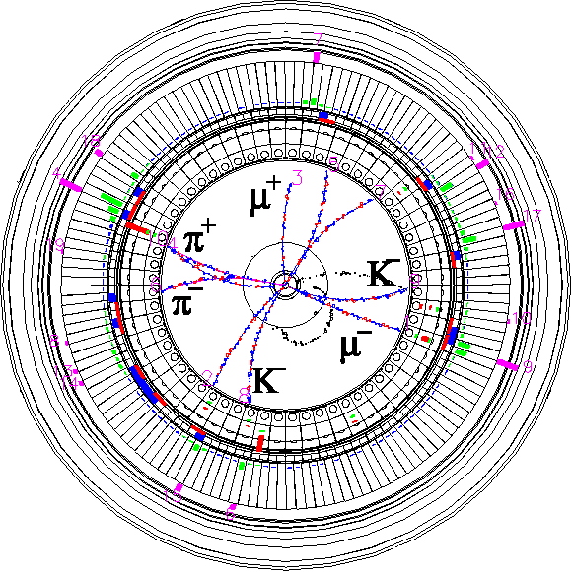
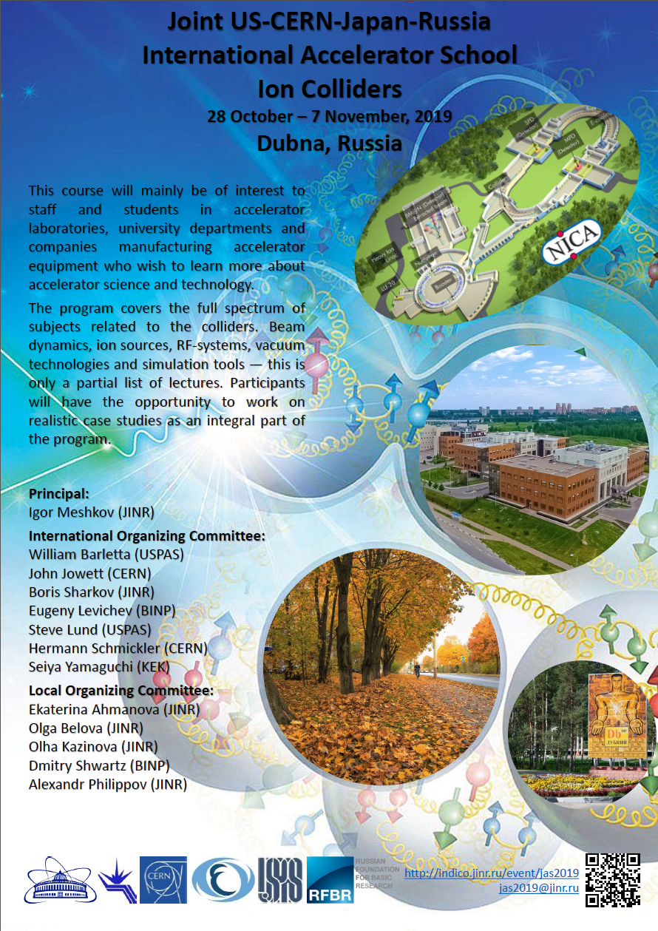
Vacuum Technologies
Introduction to vacuum science and technology for accelerators
Kyo Shibata (kyo.shibata@kek.jp)
KEK, SuperKEKB Vacuum Group
2019.10.31
Joint US-CERN-Japan-Russia International Accelerator School, 2019
Ion Colliders
Inter-University Research Institute Corporation High Energy Accelerator Research Organization (KEK)
大学共同利用機関法人 高エネルギー加速器研究機構 (KEK)

Slide 2
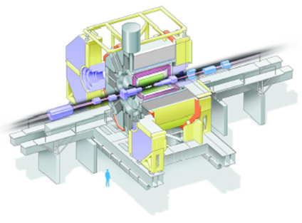
Introduction 1
Why do accelerators require “vacuum”?
Interactions between accelerated particles and residual-gas atoms may degrade the beam quality and/or shorten beam lifetime.
Radiation generated by the interaction between accelerated particles and residual-gas atoms may cause background noise of physics detector.
Activation of surrounding materials due to lost particles may be a problem, especially at hadron machines.
How is “vacuum” generated?
Knowledge of vacuum science and technology can help to generate “High/Ultra-High Vacuum”.
What should we be aware of when designing an accelerator vacuum system?
There are many differences between accelerator vacuum systems and general vacuum systems.
Accelerators must have specific vacuum system since there are accelerated beams in it.
Interaction between accelerated particle and residual gas.
Detector background
Beam quality degradation
Detector
Bunched beam
Radiation
Lifetime shortening
Surrounding materials

Slide 3
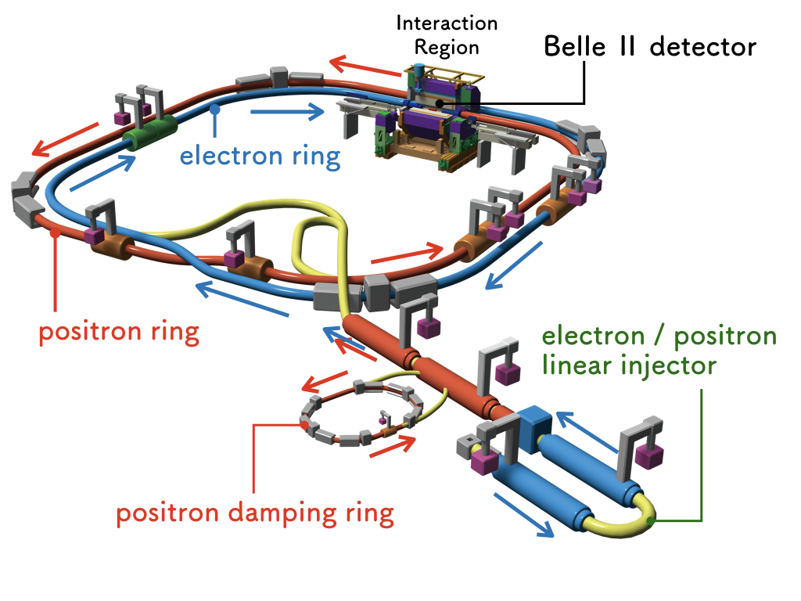
Introduction 2
SuperKEKB;
An upgrade of the KEKB
High-luminosity electron-positron collider
Main ring (MR) is composed of
Low Energy Ring (LER) :
4.0 GeV positron, 3.6 A
High Energy Ring (HER) :
7.0 GeV electron, 2.6 A
Luminosity : 8.0 × 10³⁵ cm⁻²⋅s⁻¹
Twice beam current of KEKB
Smaller emittance for “nano-beam collision scheme”
SuperKEKB is “a lepton collider”.
Please be aware that this lecture may be biased toward lepton colliders.
Sorry, I am not an expert of ion colliders…☹
HER
Main Ring
LER
SuperKEKB

Slide 4
Overview of Vacuum 1
Definition of vacuum
“The state of a gas at which its pressure in a vessel and therefore its particles density is lower than that of the ambient surrounding atmosphere”
At sea level (Elevation: 0 m);
Atmospheric pressure : 1 atm = 101,325 Pa = 1,013.25 hP = 1,013.25 mbar
The state of a gas with a pressure of 100,000 Pa (a little bit lower than 1 atm) : Vacuum
At the top of Mt. Everest (Elevation: 8850 m);
Atmospheric pressure : ∼33,000 Pa = ∼330 hPa (∼0.3 atm, 0.33 bar)
The state of a gas with a pressure of 50,000 Pa (0.5 atm): not vacuum
The state of a gas with a pressure of 30,000 Pa (0.3 atm): Vacuum
Above the top of Mt. Everest
The state of a gas in which the pressure of the gas is lower than ∼300 hPa (lower than the pressure of the atmosphere on the Earth’s surface) : Vacuum

Slide 5
Overview of Vacuum 2
Definition of pressure
Pressure is defined as the ration of force acting perpendicular and uniformly distributed per unit area.
p = F⊥/A
p : pressure [Pa]
F⊥ : Force [N]
A : Area [m²]
Classification of vacuum ranges
F⊥ [N]
p [Pa]
A [m²]
Vacuum ranges | Pressure [Pa]
 | Min | Max
Low (rough) vacuum (LV) | 1×10² | 1×10⁵
Medium vacuum (MV) | 1×10⁻¹ | 1×10²
High vacuum (HV) | 1×10⁻⁵ | 1×10⁻¹
Ultra-high vacuum (UHV) | 1×10⁻⁹ | 1×10⁻⁵
Extremely high vacuum (XHV) |  | 1×10⁻⁹
Vacuum ranges required for typical accelerators.

Slide 6
Overview of Vacuum 3
Exercise 1
The vacuum chamber with a blank flange with a diameter of 100 mm is evacuated.
When the difference in internal and external pressure of the vacuum chamber is 1 atm,
what is the force on the flange in unit [N]
what is the mass equivalent to that force on Earth in unit [kg]
p_{out}
Hint 1：
1 Pa = 1 N⋅m⁻²
Hint 2：
1 atm = 1.013×10⁵ Pa
Hint 3：
9.8 N = 1 kgf
F
p_{in}
p_{out} − p_{in} = 1 atm

Slide 7
Overview of Vacuum 4
Answer
Pressure : Ratio of force per unit area
p [Pa= N⋅m⁻²] = F⊥ [N] /A [m²]
Force :
F [N] = p [Pa] × A [m²]
Mass : M [kg]
Acceleration of gravity : g [m⋅s⁻²]
Weight : F [N] = M [kg] × g [m⋅s⁻²]
= M [kg] × 9.8 [m⋅s⁻²]
Weight (gravitational force) acting on a body with a mass of 1 kg is 9.8 N.
(1 [kgf] = 9.8 [N])
r
A = πr²
Diameter : 100 mm
F = 1.013×10⁵ Pa×π× (0.1/2)² m² = 795.6 N
795.6/9.8=81.2 kgf
Equivalent mass : 81.2 kg

Slide 8
Gas laws for an ideal gas
Boyle-Mariotte law for an ideal gas:
The transition from one state of a gas, specified by its pressure p₁, volume V₁, and temperature T₁ to another state with quantities p₂, V₂, T₂ can be described by
Avogadro’s law:
Under the same conditions of pressure and temperature, equal volumes of all gases have the same number of particles.
The number of particles in 1 mol of a substance is given by Avogadro’s number N_{A} = 6.02×10²³ molec./mol.
1 mol of any gas under standard conditions (1 atm, 0°C) occupies 22.4 L.
Dalton’s law:
For a gas mixture, the total pressure is the sum of all partial pressures
p₁, V₁, T₁
p₂, V₂, T₂
p₁V₁/T₁
p₁V₁/T₁ = p₂V₂ /T₂ = const
= p₂V₂/T₂
0 °C, 1 atm
0 °C, 1 atm
22.4 L
11.2 L
3.01×10²³ molec.
6.02×10²³ molec.
(0.5 mol)
(1.0 mol)
p = p₁ + p₂ + ⋅⋅⋅ + p_{i} = Σp_{i}
p = p₁ + p₂ + ⋅⋅⋅ + p_{i} = Σp_{i}

Slide 9
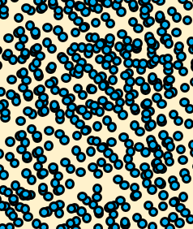
Equation of state of ideal gas
Equation of state of ideal gas (ideal gas law):
Equation of state of ideal gas is derived from Boyle-Mariotte law and Avogadro’s law.
How the measurable quantities (p, V, T) of an ideal gas depend on each other is described by
For given p, V and T, total number of molecules can be calculated by equation of state of ideal gas.
“pV-value [Pa⋅m³]” can be used instead of N if T is constant.
Pressure : p [Pa]
Volume : V [m³]
Temperature : T [K]
Number of particles : N
Equation of state of an ideal gas
pV = NkT
pV = n_{M}RT = (m/M)RT
n_{M} [mol] : amount of substance
m [kg] : mass of molecules
M [kg⋅mol⁻¹] : molar mass
R = 8.314 J⋅K⁻¹⋅mol⁻¹ : molar gas constant
pV = NkT or p = (N/V)kT = nkT
N [molec.] : number of molecules
n [m⁻³] : number density of molecules
It is impossible to count the total number of molecules N. ☹
k = 1.38×10⁻²³ [J⋅K⁻¹] : Boltzmann’s constant
N = pV/kT
We can use pV instead of N if T is constant. ☺
N = pV/kT

Slide 10
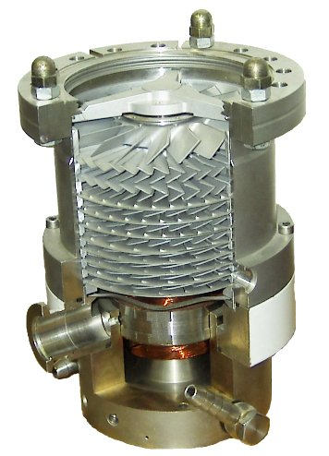
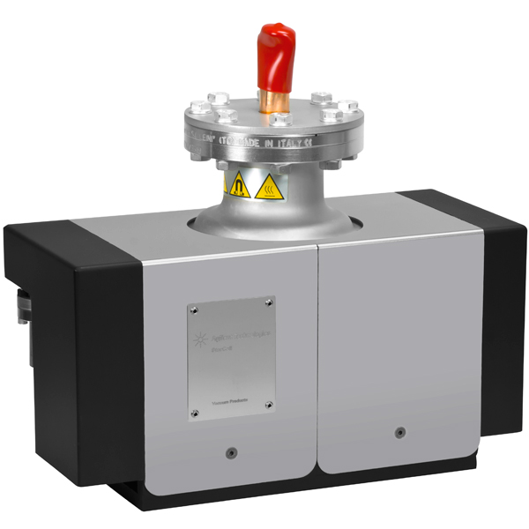
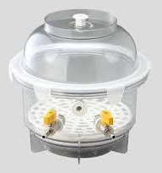
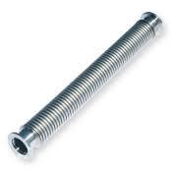
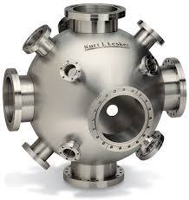
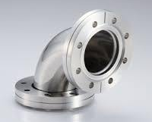
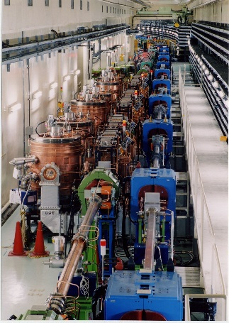
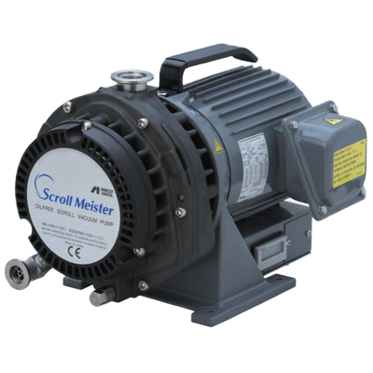
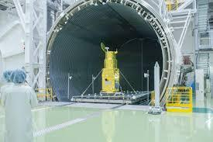
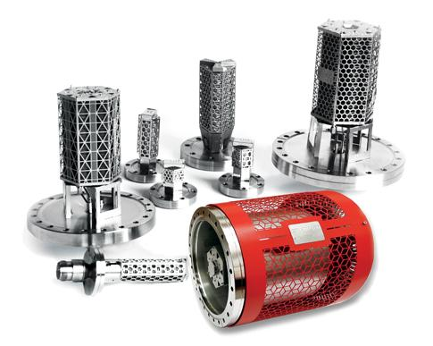
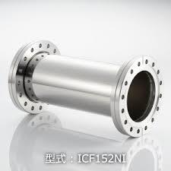
Vacuum generation 1
Apparatus necessary to generate vacuum:
+
+
Beam pipes
Vacuum vessel
Volume: V [m³]
Outgassing rate: Q [Pa⋅m³⋅s⁻¹]
Vacuum pump
Pumping speed: S [m³/s]
Intermediate (pipe)
Conductance : C [m³/s]

Slide 11
Vacuum generation 2
How does the pressure in the vacuum vessel change?
In order to understand evacuation process, we have to know following terms and concepts;
Outgassing rate : Q_{s} [Pa⋅m³⋅s⁻¹]
Effective pumping speed : S_{eff} [m³⋅s⁻¹]
Pumping speed : S [m³⋅s⁻¹]
Conductance : C [m³⋅s⁻¹]
Gas flow rate: Q [Pa⋅m³⋅s⁻¹]
Example of simple vacuum system
Pump-down equation:
pressure : p(t) [Pa]
volume: V [m³]
pipe
$$p\left(t\right)= \left(p_{0}−\frac{Q_{S}}{S_{eff}}\right)exp\left(−\frac{S_{eff}}{V}t\right)+\frac{Q_{S}}{S_{eff}}$$
effective pumping speed: S_{eff} [m³/s]
After enough time has passed.
$$p\left(t=∞\right)=\frac{Q_{S}}{S_{eff}}$$
conductance : C [m³/s]
outgassing rate: Q_{s} [Pa⋅m³⋅s⁻¹]
gas flow rate :
Q [Pa⋅m³⋅s⁻¹]
vacuum vessel
pumping speed: S [m³/s]
vacuum pump

Slide 12
Gas flow rate (Throughput)
If there is the differential between the pressures at the inlet and outlet ends of the piping element, gas flow will occur inside the piping element.
The quantity of gas flowing through a piping element can be indicated by :
Molecule flow rate Q_{N} [molec.⋅s⁻¹]
Number of molecules which pass through cross-section of the piping element during a unit of time.
pV flow rate Q [Pa⋅m³⋅s⁻¹] :
pV-value of Q_{N.}
Q = Q_{N}/kT, for given T (constant)
Gas flow
piping element
Equation of state of ideal gas
1 sec. later
pV = NkT
p [Pa]
V [m³]
T [K]
Since p and V are measurable quantities, Q is easier to use than Q_{N}.
We will use Q instead Q_{N} in this lecture.
Q [Pa⋅m³⋅s⁻¹]
Q_{N} [molec.⋅s⁻¹]

Slide 13
Type of flow
Three types of flow are mainly encountered in vacuum technology.
Viscous flow (continuum flow) found exclusively in Low Vacuum (1×10² ∼ 1×10⁵ )
The character of this type of flow is determined by the interaction of the molecules.
Internal friction, the viscosity of the flowing substance, is a major factor.
Molecular flow found exclusively in High and Ultra High Vacuum (∼ 1×10⁻¹ )
In this flow the molecules can move freely, without any mutual interference.
In this lecture, the gas flow is assumed to be molecular flow unless otherwise noted.
Knudsen flow found exclusively in Medium Vacuum (1×10⁻¹ ∼ 1×10² )
This flow is the transitional range between viscous flow and molecular flow.
Viscous flow
Gas flow
Molecular flow
Gas flow
In Low Vacuum
In High and Ultra-High Vacuum

Slide 14
Conductance
Net gas flow rate Q [Pa⋅m³⋅s⁻¹] from vessel 1 to vessel 2 is proportional to pressure difference Δp [Pa].
Proportional coefficient C [m³⋅s⁻¹] is defined as conductance.
Conductance is a measure of how effectively gases are transported through a piping element.
Vessel 1
Pressure: p₁
Vessel 2
Pressure: p₂
Conductance: C
Q = C⋅Δp
Flow rate : Q₁
Q₂
Net flow rate :
Q = Q₁ – Q₂ = C(p₁-p₂)
Conductance is (for circular pipe, molecular flow)
Independent of average pressure
Proportional to cube of ID of the pipe (2a)
Inversely proportional to the length of the pipe (L)
Proportional to most probable velocity of gas molecular
2a
C ∝ (2a)³/L
Larger a Shorter L
L
Larger C

Slide 15
Pumping speed 1
Pumping speed of vacuum pump S [m³⋅s⁻¹]
S is defined as the volume of gas per unit of time, dV/dt [m³⋅s⁻¹], that is removed from the system.
Flow rate of gas removed from the vessel at the inlet pressure of the pump p [Pa], is given by
Unit [m³⋅s⁻¹] is same as the conductance.
Vacuum vessel
Pressure at inlet of pump : p
Q [Pa⋅m³⋅s⁻¹] = Sp
Pumping speed: S [m³/s]
Gas flow rate:
Q [Pa⋅m³⋅s⁻¹] = Sp
Effective pumping speed S_{eff} [m³⋅s⁻¹]
In most cases, a pump is connected to a vacuum vessel via piping elements.
Piping elements introduce a flow resistance resulting in an effective pumping speed at outlet of the vacuum vessel smaller than the original pumping speed of the pump.
Effective pumping speed at outlet of the vacuum vessel S_{eff} is given by
S_{eff} < S
S_{eff}
C
S
1/S_{eff} = 1/S + 1/C

Slide 16
Pumping speed 2
Exercise 2
A vacuum vessel is connected to a vacuum pump via a piping element. The pumping speed of the pump is 0.3 m³⋅s⁻¹ and the conductance of the piping element is 0.1 m³⋅s⁻¹.
What is the effective pumping speed?
S_{eff}
C = 0.1 [m³⋅s⁻¹]
Hint ：$\frac{1}{S_{eff}}=\frac{1}{C}+\frac{1}{S}$
S = 0.3 [m³⋅s⁻¹]

Slide 17
Pumping speed 3
Answer
1/S_{eff} = 1/S + 1/C
S_{eff} = CS/(S+C) ---------- Eq.1
= 0.1×0.3/(0.1 + 0.3) = 0.075 m³⋅s⁻¹ (S = 0.3 m³⋅s⁻¹)
Dividing a numerator and a denominator of Eq.1 by C :
S_{eff} is smaller than S.
In order to get large S_{eff} for given S, it is necessary to use piping elements with a large conductance.
Piping between the pump and the evacuated volume must be thick and short.
S_{eff} is less than S/3. ☹
$$S_{eff}=\frac{CS}{C+S}=\frac{S}{1+\frac{S}{C}}<S$$
Conductance is (for circular pipe, molecular flow)
Independent of average pressure
Proportional to the third power of ID of the pipe (2a)
Inversely proportional to the length of the pipe (L)
Proportional to most probable velocity of gas molecular
$$\lim_{C→∞}{\frac{S}{1+S/C}}=S$$
$$\left(\lim_{C→∞}{S/C}=0\right)$$
C ∝ (2a)³/L
Larger a Shorter L
Larger C

Slide 18
Pump-down equation 1
Exercise 3
The vacuum vessel with a volume of 1 m³ is evacuated by a vacuum pump with an effective pumping speed of 0.3 m³⋅s⁻¹. When the initial pressure at t = 0 is 1×10⁵ Pa, what is the pressure of the vessel at the following times.
However, it is assumed that there is no outgassing from the inner surface of the vessel.
t = 1 sec.
t = 10 sec.
t = 100 sec.
1 m
1 m
S_{eff} = 0.3 m³⋅s⁻¹
p(t=0) = 1×10⁵ Pa
1 m

Slide 19
Pump-down equation 2
Exercise 3
The vacuum with a volume of 1 m³ is evacuated by a vacuum pump with an effective pumping speed of 0.3 m³⋅s⁻¹. When the initial pressure at t = 0 is 1×10⁵ Pa, what is the pressure of the vessel at the following times.
However, it is assumed that there is no outgassing from the inner surface of the vessel.
t = 1 sec.
t = 10 sec.
t = 100 sec.
1 m
1 m
S_{eff} = 0.3 m³⋅s⁻¹
1 m
p(t=0)
= 1×10⁵ Pa
Hint 1：
What is number of particles which is evacuated from the vessel by the pump in a time period Δt?
When the pressure in the vessel is lowered from p(t) to p(t+Δt), what is a change amount of particle number in the vessel?

Slide 20
Pump-down equation 3
Exercise 3
The vacuum with a volume of 1 m³ is evacuated by a vacuum pump with an effective pumping speed of 0.3 m³⋅s⁻¹. When the initial pressure at t = 0 is 1×10⁵ Pa, what is the pressure of the vessel at the following times.
However, it is assumed that there is no outgassing from the inner surface of the vessel.
t = 1 sec.
t = 10 sec.
t = 100 sec.
1 m
1 m
S_{eff} = 0.3 m³⋅s⁻¹
1 m
p(t=0)
= 1×10⁵ Pa
Q = p(t)S_{eff} [Pa⋅m³⋅s⁻¹]
Hint 2：
What is number of particles which is evacuated from the vessel by the pump in a time period Δt?
Q×Δt/kT = p(t)×S_{eff}×Δt/kT
When the pressure in the vessel is reduced from p(t) to p(t+Δt), what is a change amount of particle number in the vessel?
{p(t+Δt) − p(t)}×V/kT

Slide 21
Pump-down equation 4
Exercise 3
The vacuum with a volume of 1 m³ is evacuated by a vacuum pump with an effective pumping speed of 0.3 m³⋅s⁻¹. When the initial pressure at t = 0 is 1×10⁵ Pa, what is the pressure of the vessel at the following times.
However, it is assumed that there is no outgassing from the inner surface of the vessel.
t = 1 sec.
t = 10 sec.
t = 100 sec.
1 m
1 m
p(t=0)
= 1×10⁵ Pa
S_{eff} = 0.3 m³⋅s⁻¹
Q = p(t)×S_{eff} [Pa⋅m³⋅s⁻¹]
1 m
p(t) → p(t+Δt)
ΔN×kT = {p(t+Δt) − p(t)}×V [Pa⋅m³]
Hint 2：
What is number of particles which is evacuated from the vessel by the pump in a time period Δt?
Q×Δt/kT = p(t)×S_{eff}×Δt/kT
When the pressure in the vessel is reduced from p(t) to p(t+Δt), what is a change amount of particle number in the vessel?
{p(t+Δt) − p(t)}×V/kT

Slide 22
Pump-down equation 5
Answer
Number of particles evacuated from the vessel in a time period Δt :
Change amount of particle number in the vessel when the pressure is reduced from p(t) to p(t+ Δt):
Since A) = B),
Q×Δt/kT = p(t)×S_{eff}×Δt/kT
{p(t+Δt) − p(t)}×V/kT
{p(t+Δt)- p(t)}/Δt = -(S_{eff}/V) × p(t)
1 m
dp(t)/dt = -(S_{eff}/V) × p(t)
1 m
Δt → 0
p(t=0)
= 1×10⁵ Pa
S_{eff} = 0.3 m³⋅s⁻¹
$\int{\frac{1}{p\left(t\right)}dp}$=$\int{−\frac{S_{eff}}{V}}dt$
1 m
p(t) → p(t+Δt)
Q = p(t)×S_{eff} [Pa⋅m³⋅s⁻¹]
p(t) = p₀exp{ -(S_{eff}/V)t} = 1×10⁵ e^{−0.3t}
p₀ = p(t=0) = 1×10⁵ Pa
S_{eff} = 0.3 m³⋅s⁻¹
V = 1 m³
{p(t+Δt) − p(t)}×V [Pa⋅m³]

Slide 23
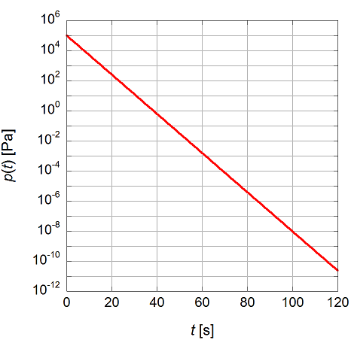
Pump-down equation 6
Answer
p(t)= 1×10⁵ e^{-0.3t}
t = 1 s
p(1) = 7.4×10⁴ Pa
t = 10 s
p(10) = 5.0×10³ Pa
t = 50 s
p(50) = 3.1×10⁻ ² Pa
t = 100 s
p(100) = 9.4×10⁻⁹ Pa
p(t)= 1×10⁵ e^{-0.3t}
Is it really possible to get 1×10⁻⁸ Pa so fast (in 100 sec.)?
Practically, it takes much longer time to get 1×10⁻⁸ Pa.
Why? We must have overlooked something… ☹

Slide 24
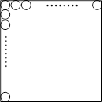
Where are residual gas particles? 1
Exercise 4
Gas molecules with a diameter of 0.3 nm are adsorbed on inside walls of a cubic vessel with a volume of 1 m³, and one monolayer of gas molecules is formed on the walls. What is the number of the adsorbed particles? However, it is assumed that the molecules are arranged in a square lattice-like form on the surface.
When the pressure and temperature of the vessel are 1×10⁻¹ Pa and 300 K respectively, what is the number of the gas molecules in the inner space of the vessel.
1 m
1 m
square lattice
1 m

Slide 25
Where are residual gas particles? 2
Answer
The inner surface area of the cubic vessel with a volume of 1 m³ : 6 m²
The area occupied by one particle with a diameter of 0.3 nm : (0.3×10⁻⁹)² m²
The number of the particles adsorbed on the inner wall N_{surface} is given by
According to a state equation of ideal gas, particle number density of gas molecules n [molec.⋅m³] with a temperature of T [K] and a pressure of p [Pa] is given by n = p/kT.
The number of the gas molecules in the inner space of the vessel with a volume of 1 m³ N_{gas} is given by
square lattice
0.3 nm
$$N_{surface}=\frac{6 m^{2}}{{\left(0.3×{10}^{−9} m\right)}^{2}}=6.7×{10}^{19}$$
0.3 nm
$$N_{gas}=nV=\frac{pV}{kT}=\frac{1×{10}^{−1} Pa×1 m^{3}}{1.38×{10}^{−23} J∙K^{−1}×300 K}=2.41×{10}^{19}<N_{surface}$$
In Low and Medium Vacuum ranges (10⁻¹ ∼ 10⁵ Pa) : N_{gas} > N_{surface}
In High and Ultra-high Vacuum ranges (∼ 10⁻¹ Pa) : N_{gas} < N_{surface}
In the evacuation process in low pressure regions (High & Ultra-high Vacuum), the evacuation of gas particles desorbed from the surface is dominant over the evacuation of the gas particles in the space.

Slide 26
Where are residual gas particles? 3
There are many gas particles adsorbed on the inner surfaces of the vacuum vessel.
Gas particles adsorbed on the surface never be evacuated from the vessel.
Gas particles which have been adsorbed previously, usually during venting of the vacuum vessel, desorb again, when the vessel is pumped to vacuum.
Gas particles that desorb quickly from the surface is easily evacuated.
Gas particles that rarely desorb need not to be evacuated. (They do not contribute to pressure.)
Gas particles that stay on the surface for ∼1000 sec. are difficult to be evacuated, and the pressure is determined by them. (mainly H₂O)
Evacuable particles (determining pressure)
Adsorption
Desorption
Desorption
Adsorption
Non-evacuable particles

Slide 27
Where are residual gas particles? 4
Exercise 3 (Review)
The vacuum with a volume of 1 m³ is evacuated by a vacuum pump with an effective pumping speed of 0.3 m³⋅s⁻¹. When the initial pressure at t = 0 is 1×10⁵ Pa, what is the pressure of the vessel at the following times.
However, it is assumed that there is no outgassing from the inner surface of the vessel.
Actually, the pressure in the vacuum vessel is determined by the outgassing from the inner surface of the vessel. (It is impossible to get 1×10⁻⁸ Pa in 100 sec.)
↓ The problem lies here!!
Outgassing rate Q_{s} [Pa⋅m³⋅s⁻¹]
Gas flow (pV throughput ) released from the interior surfaces per unit time in [Pa⋅m³⋅s⁻¹] (or in [Pa⋅m³⋅s⁻¹ ⋅m⁻²] )
Q_{s} depends on the material, surface area, surface treatment, contamination condition, etc.
The smaller the surface area, the lower the outgassing rate.
The cleaner the surface, the lower the outgassing rate.
Outgassing from surface is not negligible.
Q_{s}

Slide 28
Realistic pump-down equation 1
Realistic pump-down equation in the case of the vacuum vessel with outgassing rate:
$$−V\frac{dp\left(t\right)}{dt}=p\left(t\right)S_{eff}+Q_{s}$$
{p(t+Δt)- p(t)}×V = −S_{eff}×p(t)×Δt + Q_{s}×Δt
Δt → 0
If Q_{s} is constant.
Effective pumping speed : S_{eff}
Pressure : p(t)
Volume : V
$$p\left(t\right)= \left(p_{0}−\frac{Q_{S}}{S_{eff}}\right)exp\left(−\frac{S_{eff}}{V}t\right)+\frac{Q_{s}}{S_{eff}}$$
Q=p(t)×S_{eff}
$$= \left(p_{0}−\frac{Q_{S}}{S_{eff}}\right)exp\left(−\frac{t}{τ}\right)+\frac{Q_{s}}{S_{eff}}$$
Outgassing rate : Q_{s}
$τ$=$\frac{V}{S_{eff}}$ : Evacuation time constant
Vacuum vessel

Slide 29
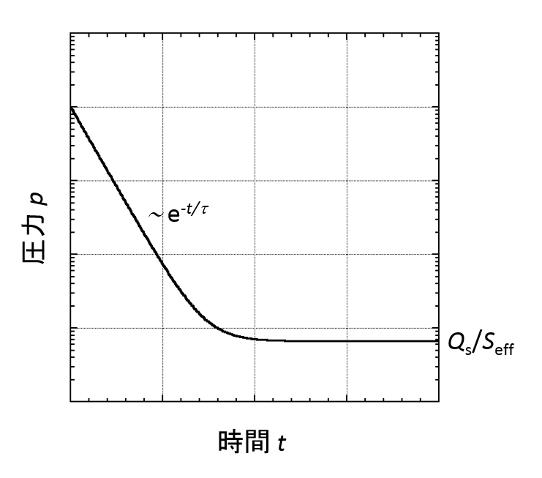
Realistic pump-down equation 2
Time variation in pressure during pumping down:
At first, pressure drops exponentially.
After a sufficient period of time, pressure becomes almost constant.
Ultimate pressure : p(t=∞) = Q_{s}/S_{eff}
To reduce the ultimate pressure, followings are required:
Small outgassing rate
Large pumping speed
No air leakage
Pump-down curve
$$p\left(t\right)=\left(p_{0}−\frac{Q_{S}}{S_{eff}}\right)exp\left(−\frac{t}{τ}\right)+\frac{Q_{s}}{S_{eff}}$$
(log scale)
Pressure p
Air leakage
Q_{s} = 0
Small Q_{s}
Large S_{eff}
Time t
(linear scale)

Slide 30
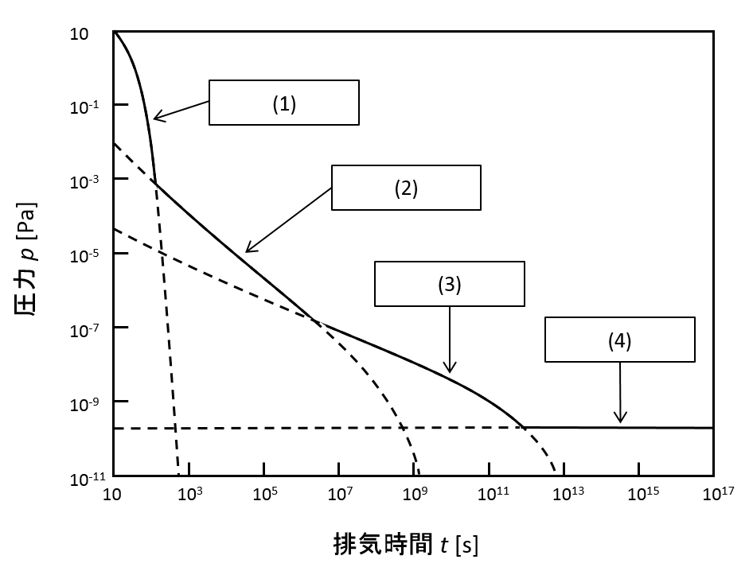
Pump-down curve
In fact, Q_{s} is not constant.
Q_{s} slowly decreases with time.
Change of Q_{s} is so slow that it is hard to see it on a linear time axis.
Realistic pump-down curve of metal vacuum vessels on logarithmic time scale.
$$p\left(t\right)=\left(p_{0}−\frac{Q_{S}}{S_{eff}}\right)exp\left(−\frac{t}{τ}\right)+\frac{Q_{s}}{S_{eff}}$$
Pressure p (log scale)
At the beginning of pumping, the pressure drops rapidly with time by evacuating the volume of air in the vessel.
The pressure decreases exponentially with time.
Thereafter, the molecules (mainly H₂O) gradually desorbed from the inner wall into the volume are evacuated.
The pressure decreases as t⁻¹.
After time further passes, diffusion and permeation become the main phenomenon that determines the pressure.
But, it takes long time to get these regions.
Time t
(linear scale)
1. Volume
(log scale)
2. Desorption
Taking a long view on logarithmic time scale
3. Diffusion
Pressure [Pa]
4. Permeation
Time t [s]
(logarithmic scale)

Slide 31
How to generate ultra-high vacuum 1
In most cases, pressure is determined by gas desorbed from the surfaces.
Gas molecules in the space inside the vacuum vessel can be evacuated immediately.
Diffusion and permeation become dominant after a sufficient amount of time.
In an actual vacuum system, the pressure is determined by gas desorption rate.
How to reduce gas desorption rate.
Keeping the surface clean
Degrease with solvent rinse, swabbing, etc.
No touch the surface with bare hands
Making the surface area as small as possible
Buffing
Electropolishing, chemical polishing
Just waiting
Pressure decreases as t⁻¹.
Can you wait?
1. Volume
2. Desorption
Pressure [Pa]
3. Diffusion
4. Permeation
Time t [s]
If you need 10⁻⁸ Pa, you may have to wait more than 1 year… ☹
Pressure | 10⁻⁴ Pa | 10⁻⁵ Pa | 10⁻⁶ Pa | 10⁻⁷ Pa | 10⁻⁸ Pa
Required time | 1 h | 10 h | 100 h (4.2 d) | 1000 h (42 d) | 10000 h (420 d, 1.1 y)

Slide 32
How to generate ultra-high vacuum 2
How to reduce gas desorption rate
Inducing the gas molecules to be desorbed from the surface to make surface clean.
How?
What determines the gas desorption rate?
Gas desorption rate and Average surface residence time
Gas desorption rate Q_{des} [molec.⋅m⁻²⋅s⁻¹] is given by;
Average surface residence time τ [s] is given by;
In order to increase Q_{des};
Reducing τ , that is, increasing T is effective.
For H₂O, τ can be shortened from 200 sec. to 0.1 sec (∼1/2000) by increasing T from 25°C to 100°C.
To evacuate the water, it is effective to uniformly heat the vacuum vessel at ∼150°C. (Baking)
Adsorption
Desorption
Q_{des}=σ/τ
σ：number of molecule adsorbed on the surface per unit area [molec.⋅m⁻²]
τ：average surface residence time [s]
$$τ=\frac{1}{A_{frequency}}exp\left(\frac{E_{d}}{RT}\right)$$
A_{frequency}：frequency factor[s⁻¹]
E_{d}：activation energy for desorption [J⋅mol⁻¹]
R：molar gas constant（R = 8.31 J⋅K⁻¹⋅mol⁻¹ ）
T：surface temperature [K]
After “average surface residence time” of adsorption, adsorbed particle desorbs again.

Slide 33
Baking 1
Example of “Baking” of stainless steel vacuum vessel.
Main gas component before baking is H₂O.
Vacuum vessel was heated up to 150°C, and held at that temperature for ∼12 hours.
Main gas component after baking is H₂.
After baking, the pressure reached ∼10⁻⁸ Pa.
It took about only 30 hours to get ∼10⁻⁸ Pa.
Baking is necessary to make Ultra-high vacuum in a short time.
23 ℃
150 ℃
23 ℃
10⁻⁴
H₂O
10⁻⁶
H₂
10⁻⁸
Pressure [Pa]
10⁻¹⁰
N₂ +CO
10⁻¹²
O₂
0
800
1600
2400
Evacuation time t [min.]

Slide 34
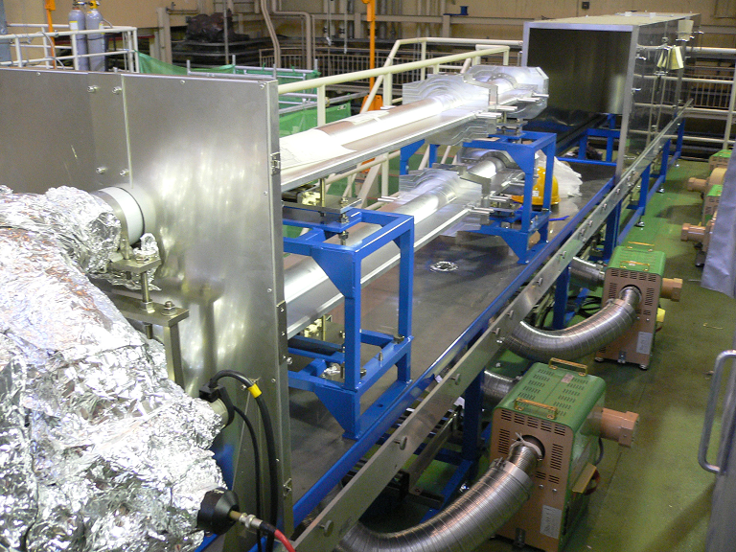
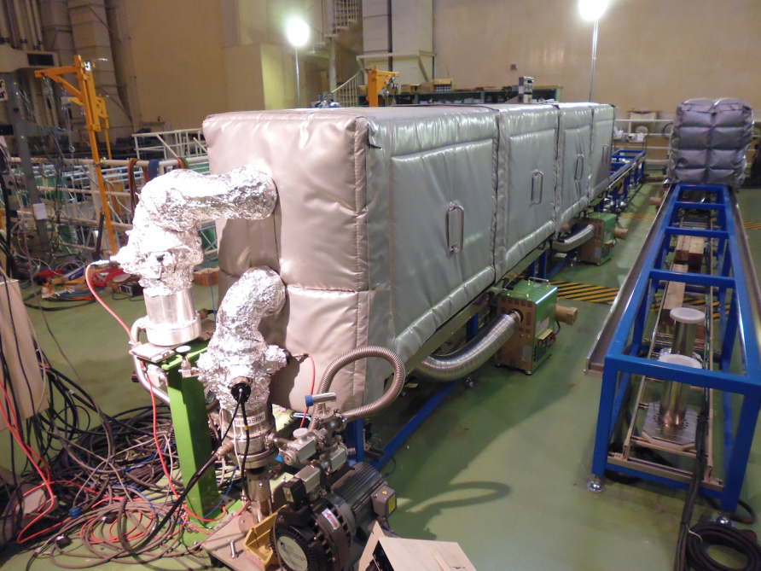
Baking 2
Baking of SuperKEKB beam pipes before installation.
All beam pipes of SuperKEKB were baked at laboratory before installation.
Beam pipes were placed in a thermal insulated box (hot-air oven), and heated up to 150°C with hot air.
Typical baking period was 24 hours.
Pressure inside of beam pipes dropped to ∼10⁻⁸ Pa after baking.
hot-air oven
oven open
oven close
beam pipe
pumping unit
Now baking
hot-air circulator

Slide 35
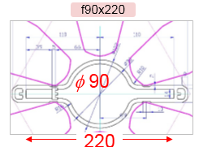
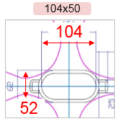
Vacuum system for accelerators 1
Vacuum vessels are “long and narrow beam pipes”.
Material:
Requirement for accelerators:
low outgassing, high radiation shielding, high radiation resistance, high machinability, good weldability, non-magnetic (low permeability, in magnets), high electric conductivity, etc.
Stainless steel, aluminum alloy, copper (oxygen free copper), titanium, ceramics (in AC magnets), etc.
Cross-section:
Requirement for accelerators:
Large enough to keep the beam in it.
Larger aperture results in larger outgassing. ☹
Small enough to fit in magnet apertures.
Smaller aperture results in smaller conductance.☹
Beam pipes for SuperKEKB
Material : oxygen free copper, aluminum alloy
Cross-section : racetrack (electron ring),
circular with antechambers (positron ring)
Aluminum alloy
(positron)
oxygen free copper (electron)
Beam pipes of SuperKEKB

Slide 36
Vacuum system for accelerators 2
Gas load in accelerators
Thermal outgassing
Thermal outgassing rate can be reduced by baking.
Gas desorption induced by bombardment (irradiation) only occurred with beam
Photon stimulated desorption (PSD)
Electron stimulated desorption (ESD)
Ion stimulated desorption (ISD)
Photons, electrons and ions are produced by accelerated beam.
Outgassing rates due to these gas desorption are difficult to be reduced by baking because photons, electrons and ions have large energy. (They can desorb molecules which can not be desorbed by baking.)
Pressure in the beam pipes may increase with stored beam.
Beam pipe
electron
ionization
ion
Synchrotron radiation
accelerated by beam
Beam orbit
residual gas
PSD
photo-electrons
ESD
ISD
Direction of acceleration

Slide 37
Vacuum system for accelerators 3
Evacuation of “long and narrow beam pipes”.
Disadvantages compared to general vacuum system:
Small conductance of long and narrow beam pipe
Large gas loads (PSD, ESD, ISD) due to beams
Required vacuum range:
Low ∼ High vacuum (1×10⁻⁵ ∼ 1×10⁵ Pa) :
These vacuum ranges are easily achievable.
Ultra-high vacuum (∼ 1×10⁻⁵ ) :
Many accelerators require ultra-high vacuum range.
Careful designing of the vacuum system is necessary.
Selection of suitable materials for each accelerator
Surface treatment to reduce outgassing rate
Baking before and after installation
Arrangement of pumps to get large effective pumping speed
Estimation of location of high gas load and outgassing rate
Etc.
Conductance is (for circular pipe, molecular flow)
Independent of average pressure
Proportional to the third power of ID of the pipe (2a)
Inversely proportional to the length of the pipe (L)
Proportional to most probable velocity of gas molecular
C ∝ (2a)³/L
smaller a Longer L
Smaller C

Slide 38
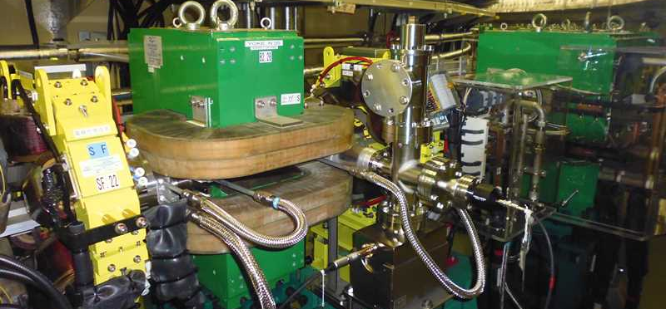
Pressure distribution in beam pipe
Pressure distribution in “long and narrow beam pipes”.
For periodically pumped, linear vacuum system with
Conductance of pipe with unit length : C [m³⋅s⁻¹⋅m]
Linear outgassing rate : q [Pa⋅m³⋅s⁻¹⋅m⁻¹]
Effective pumping speed : S_{eff} [m³⋅s⁻¹]
Distance between pumps : 2L [m]
q
p(x)
Q(x)
x = L
x
x
x = 0
x + Δx
2L
$$p_{max}=\frac{qS_{eff}L^{2}}{2C}+\frac{qL}{S_{eff}}$$
2S_{eff}
p(x)
2S_{eff}
Q(x+Δx) − Q(x) = qΔx
(C/Δx)×{p(x+Δx) − p(x)} = −Q(x)
$$p_{avg}$$
$$\frac{dQ}{dx}=q$$
p(−L) = p(L)
$$p\left(x\right)=−\frac{q}{2C}x^{2}+\frac{qS_{eff}L^{2}}{2C}+\frac{qL}{S_{eff}}$$
$$C\frac{d^{2}p\left(x\right)}{dx^{2}}=−q$$
x
Δx → 0
$$C\frac{dp\left(x\right)}{dx}=−Q\left(x\right)$$
Vacuum system with small C, large L and q results in larger p_{max}.
Narrow beam pipe
No space for pump
Large gas load due to PSD, ESD and ISD
It must be checked if p_{max} is acceptable.
Some accelerators may not have enough space for vacuum system…☹

Slide 39
Vacuum pumps for accelerators
Classification of vacuum pumps
Gas transfer pumps
They transport gas molecules in the volume inside the vacuum vessel to the outside of the vessel.
Atmosphere may flow back into the vacuum vessel. (There is a path between the inside and outside of the vacuum vessel.)
Turbo-molecular pump, scroll pump, etc.
Gas entrapment pumps (Gas binding pumps)
They avoid returning gas molecules to the volume by adsorption.
Atmosphere can not flow into the vacuum vessel. (There is no path between the inside and outside of the vacuum vessel.)
Ion pump, Getter pump, etc.
Gas entrapment pumps are more suitable for accelerators.
Non-evaporable getter (NEG) pump and ion pump are mainly used in SuperKEKB.
Gas transfer pumps
Vacuum
Atmosphere
Turbo-molecular pump
scroll pump
Gas entrapment pumps
Vacuum
Atmosphere
Ion pump
getter pump

Slide 40
Beam impedance and wall current
Countermeasures against electromagnetic field and wall current accompanying beam may also be necessary.
If there is a cavity structure or a change in the cross-section, electromagnetic field is trapped or disturbed resulting heat generation and beam instabilities.
Small gap or poor electrical contact can cause discharge or heat generation.
Countermeasures:
Usage of nonmagnetic materials with good electrical conductivity. (copper plating on ceramic pipe)
Avoidance of unnecessary change of cross-section. (if necessary, change as smooth as possible.)
Avoidance of unnecessary gaps, steps and cavity structures. (especially at beam pipe connection.)
Installation of RF shield over pumping port.
Etc.
Cavity structure
Beam pipe
bunch

Slide 41
Electron cloud
Countermeasures against electron cloud may also be necessary.
Photo-electrons are emitted from the surface which irradiated by SR.
Photo-electrons accelerated by the beam with positive charge hits the inner wall, and secondary electrons are emitted.
Number of electrons in the beam pipe increases in an avalanche. (generation of electron cloud)
Electron cloud can cause beam instability and/or abnormal pressure rise (ESD)
It is essential for SuperKEKB positron ring.
Countermeasures:
Usage of low secondary electron yield surface (low secondary electron yield coating)
Usage of special devices to remove electron cloud (electron clearing electrode)
Usage of antechamber to reduce photo-electron
electron cloud
Secondary electron
bunch (positive charge)
instability
Photo-electron

Slide 42
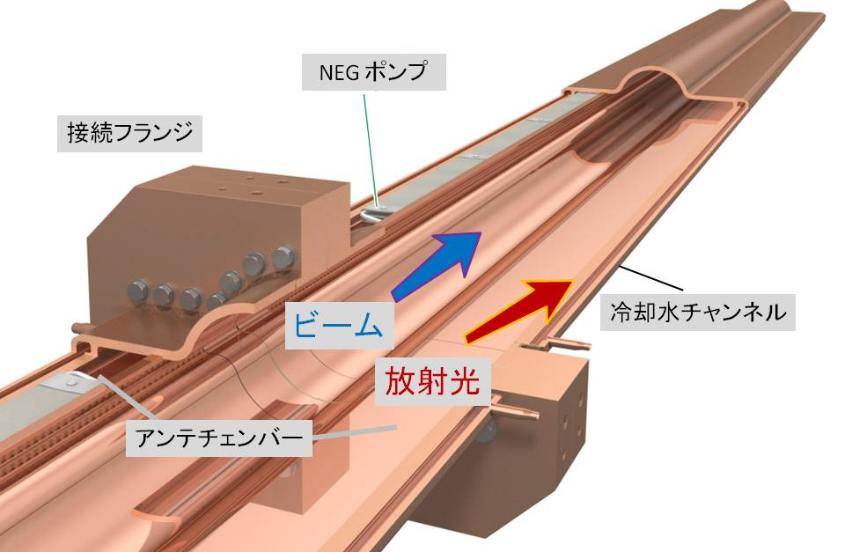
Beam pipe for SuperKEKB
Beam pipe of SuperKEKB has antechambers at both sides of beam channel.
Intense SR passes through antechambers, and irradiates the side wall.
Large gas load due to PSD distributes along beam pipe.
NEG pumps are installed in one of antechambers.
Gas molecules desorbed by PSD can be evacuated effectively by distributed pumping scheme.
Antechamber can reduce beam impedance.
Since the necessary things are located deep in the antechamber, the electromagnetic field are not easily disturbed.
Antechamber can prevent photo-electrons from entering the beam channel.
As results, electron cloud density also can be reduced.
NEG pump
Connection flange
Beam
Cooling channel
SR
Antechamber

Slide 43
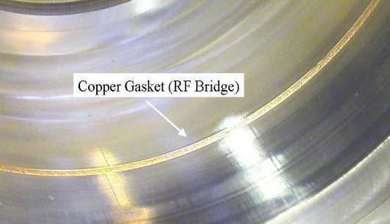
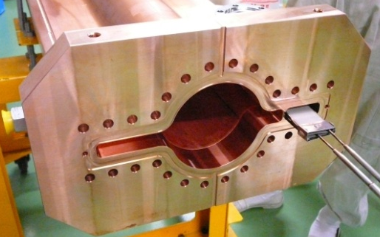
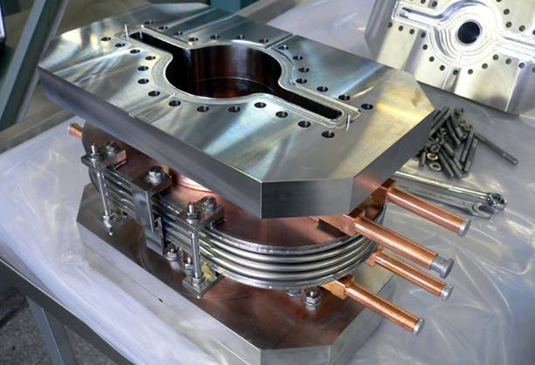
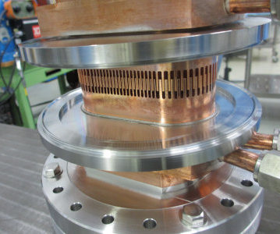
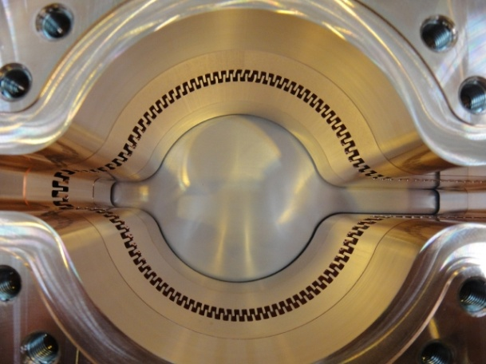
Other features of SuperKEKB vacuum system 1
Stepless connection flange
Low beam impedance
New RF shield in bellows chamber
Low beam impedance
High thermal strength for large stored current
Also used in gate valves
Stepless flange (MO-type flange)
Bellows chamber
New RF shield (Comb-type RF shield) in bellows chamber

Slide 44
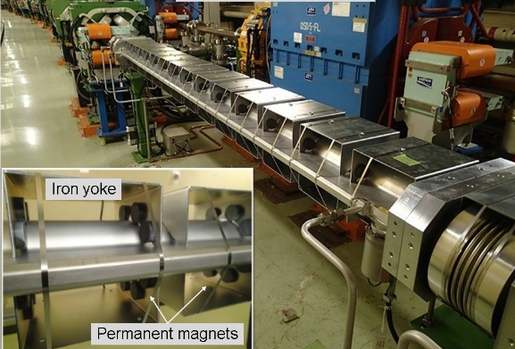
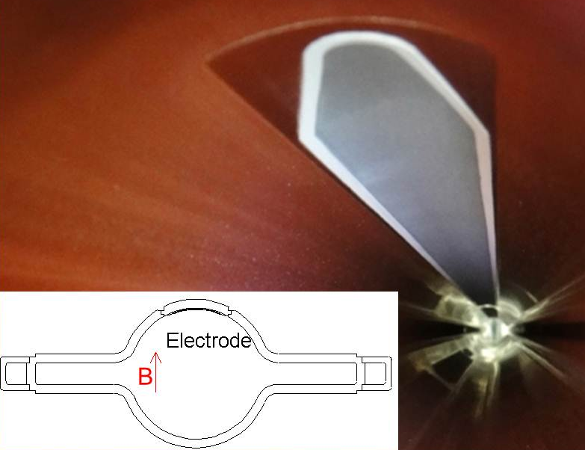
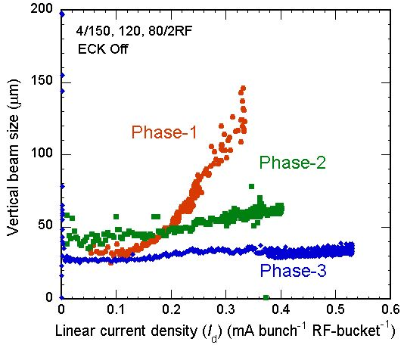
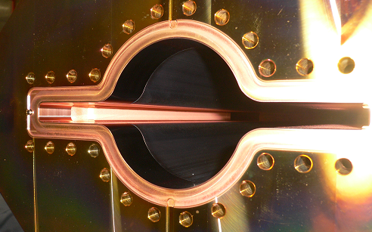
Other features of SuperKEKB vacuum system 2
Various countermeasures against electron cloud.
Titanium nitride coating with low secondary yield
Groove structure surface with low secondary yield
Clearing electrode to attract electron cloud
Permanent magnets to suppress electron emission from inner surface
Permanent magnets
Clearing electrode
Insufficient countermeasures
blowup ☹
no blowup ☺
sufficient countermeasures
Titanium nitride coating
Grooved surface
Vertical beam size vs linear current density

Slide 45
Vacuum scrubbing
Pressure may increase with accumulating beam due to PSD, ESD or ISD.
As beam dose increases, pressure increase may be suppressed. (so called “Aging effect”)
For lepton machines, PSD can be main gas load because SR power is proportional γ⁴.
In ion colliders, PSD is negligible if γ is not so large.
For lepton machines, dedicated beam operation in order to get low pressure is required at the beginning of beam operation.
The surface of newly installed components has large PSD rate. (Large gas load)
SR irradiation can reduce PSD rate gradually.
Beam operation to get low pressure is called as “Vacuum scrubbing” or “Aging”.
Beam pipe
ionization
ion
electron
Synchrotron radiation
accelerated by beam
Beam orbit
PSD
photo-electrons
residual gas
ESD
ISD
Direction of acceleration
SR power :
$$P_{SR}∝γ^{4}$$
$$γ=\frac{E}{m_{0}c^{2}}$$
E : beam energy
m₀ : rest mass
c : speed of light
For electron m_{e} : 9.109×10⁻³¹ kg
For proton m_{p} : 1.673×10⁻²⁷ kg
m_{p}/m_{e} > 1800

Slide 46
Pressure history of SuperKEKB
Vacuum scrubbing at SuperKEKB
At the beginning of beam operation, it is impossible to store large beam current due to pressure rise by SR irradiation.
Stored beam current is gradually increased while keeping the pressure that provides sufficient beam lifetime.
It took several months to accumulate 1 A.
Positron ring
Electron ring

Slide 47
Summary
Many accelerators require High or Ultra-high Vacuum,
In order to suppress degradation of beam quality and short lifetime due to interactions between residual gas molecules and accelerated particles.
In order to suppress detector background noise.
In order to suppress activation of surrounding materials due to lost particles.
Accelerators must have special vacuum systems which is very different from the normal vacuum systems.
Vacuum vessels are narrow and long beam pipes with small conductance, and high energy particles are in it.
Main gas load during beam operation may be “Photon Stimulated Desorption”, “Electron Stimulated Desorption” or/and “Ion Stimulated Desorption”.
Vacuum scrubbing with beam may be necessary at the early stage of beam commissioning.
Vacuum science & technology is necessary to design accelerator vacuum systems.
This lecture was just an introduction to vacuum science and technology.
Further study is required. (There are many excellent textbooks on Vacuum, so please refer to it. )

Slide 48
Fin.
Thank you for your attention.
Inter-University Research Institute Corporation High Energy Accelerator Research Organization (KEK)
大学共同利用機関法人 高エネルギー加速器研究機構 (KEK)

