Slide 1
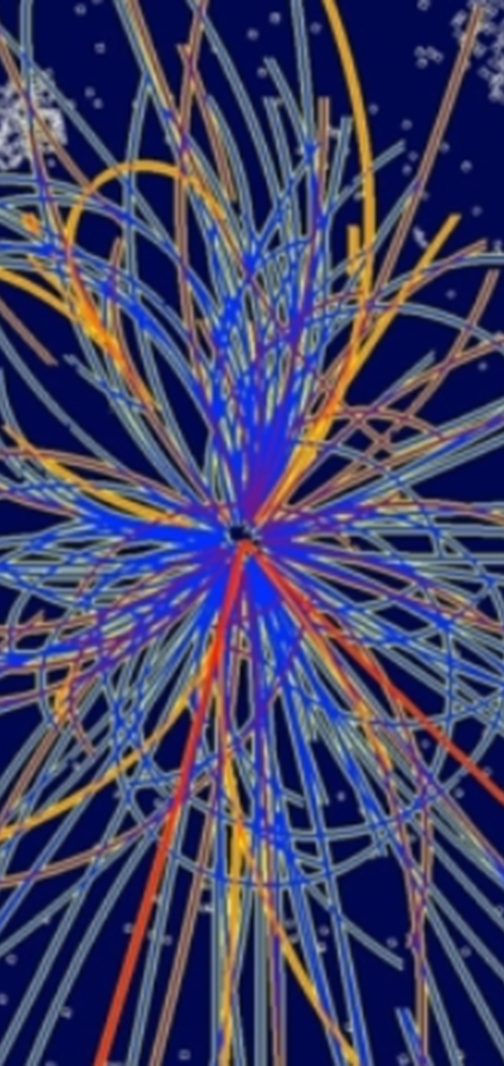


Outlook: collider tasks for physics beyond Standard Model
E. Levichev
Budker Institute of Nuclear Physics
Novosibirsk, Russia
JAS 2019, Ion Colliders Dubna, 28 Oct — 7 Nov 2019

Slide 2
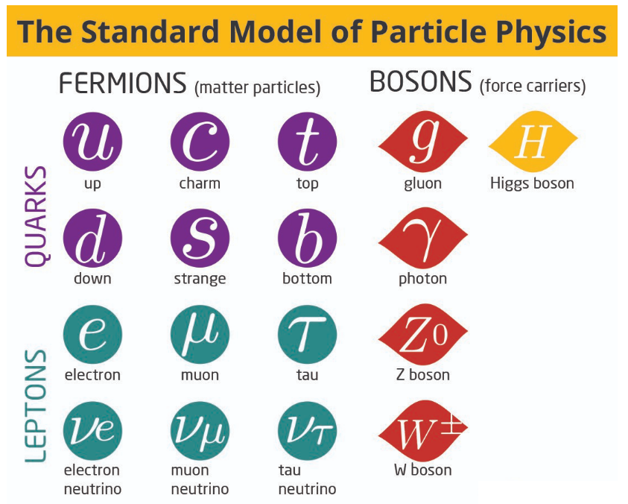
Standard Model
The standard model is the name given in the 1970s to a theory of fundamental particles and how they interact. It incorporated all that was known about subatomic particles at the time and predicted the existence of additional particles as well.
There are seventeen named particles in the standard model, organized into the chart to the right. The last particles discovered were the W and Z bosons in 1983, the top quark in 1995, the tau neutrino in 2000, and the Higgs boson in 2012.
Among thousands of HEP experiments there is no one contradicting the SM. However…

Slide 3
Standard Model is an incomplete theory
It does not explain gravity. The approach of simply adding a graviton to the SM does not recreate what is observed experimentally.
The SM explains about 5% of the energy present in the universe. About 26% should be dark matter, which would behave just like other matter, but which only interacts weakly (if at all) with the SM fields. The SM does not supply any fundamental particles that are good dark matter candidates.
The remaining 69% of universe's energy should consist of the so-called dark energy. Attempts to explain dark energy in the terms of SM lead to a mismatch of 120 orders of magnitude.
According to the SM, neutrinos are massless particles. However, neutrino oscillation experiments have shown that neutrinos do have mass. Mass terms for the neutrinos can be added to the SM by hand, but these lead to new theoretical problems.
The universe is made out of mostly matter. However, the SM predicts that matter and antimatter should have been created in (almost) equal amounts if the initial conditions of the universe did not involve disproportionate matter relative to antimatter. Yet, no mechanism sufficient to explain this asymmetry exists in the Standard Model

Slide 4
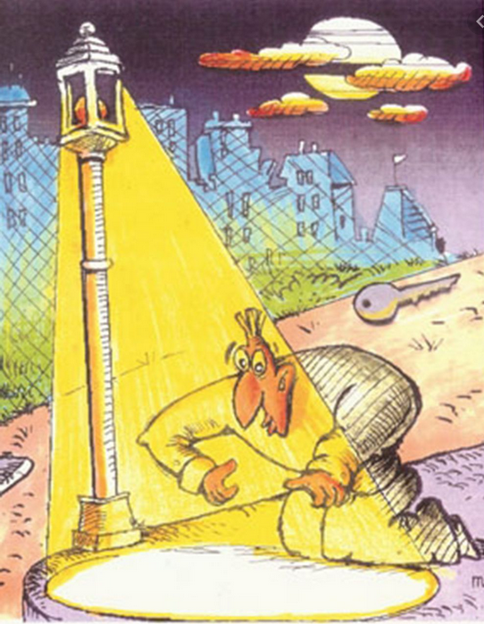
There is something beyond SM
There should be more general theory including the SM as a particular case.
LHC has not revealed no any hints of New Physics.
Discovering New Physics is a sweet dream of any HEP lab.
New Physics may hide everywhere, any directions of search are equal but probability is different.
Any new combination of experimental parameters (collider characteristics) have not yet applied can bring us to New Physics
Key to New Physics

Slide 5
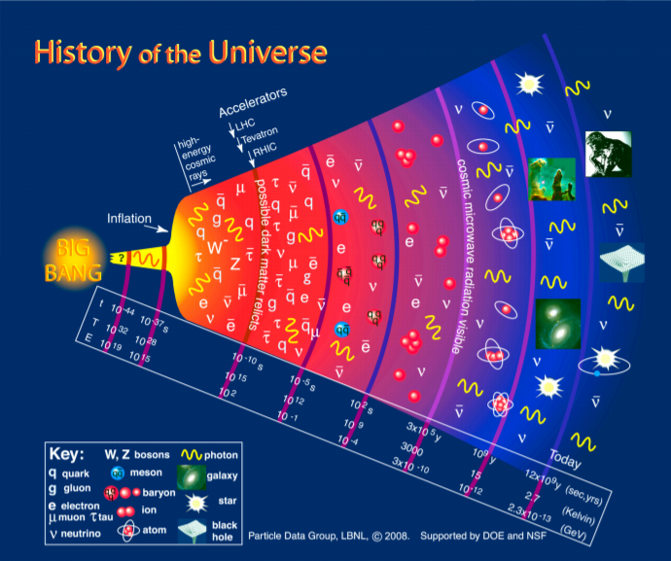
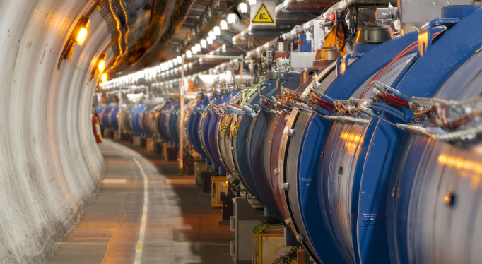
Why colliders?
Non-collider particle astrophysics observations made a number of very important discoveries, including: the first detection of neutrinos, neutrino oscillation, Dark Matter, Dark Energy, etc. But in astrophysics we cannot change the experimental conditions, just to measure the results.
At collider we can control conditions of experiment and change parameters (energy, intensity, polarization, etc.) in wide range.
New Physics search requires multiple approaches: colliders, neutrino experiments (solar, reactor, etc.), cosmic surveys, etc.

Slide 6
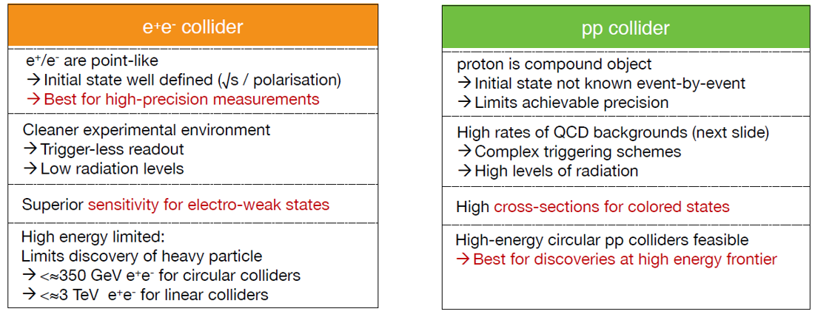
Lepton vs proton
Best for high-precision measurements
Best for discoveries at high energy

Slide 7
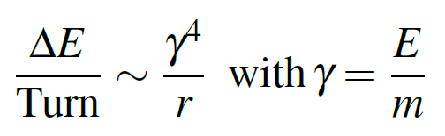
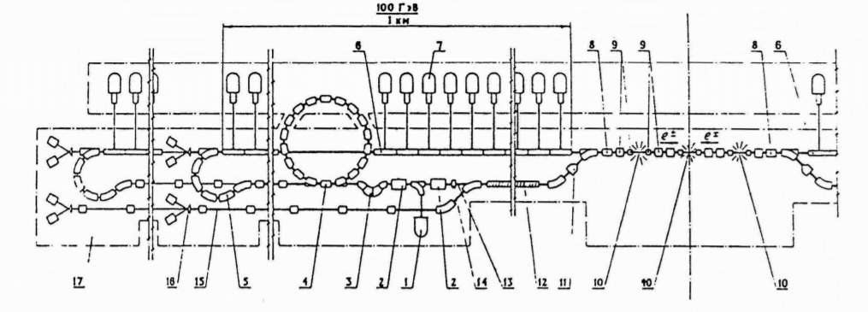
Circular vs linear
The energy loss per turn due to synchrotron radiation of a particle with energy E and mass m in circular accelerator or storage ring with curvature radius r :
For light particles (e+e-) a circular machines energy is limited by the SR loss → Linear electron-positron colliders (1) are preferable for very high beam energy; (2) can be extended for higher energy.
First proposal in
VLEPP, Novosibirsk
No problems with heavy particles such as protons, ions, muons.

Slide 8
Toward New Physics search
Energy frontier (collision energy never ever reached)
Luminosity frontier (“tradition” energies but more precise experiments)
Exotic particle collision (polarized, γγ, μμ)
Exotic objects production: quarkyonic matter at NICA, dimuonium atom (μ+μ-) at small Novosibirsk collider, dark photon search, etc.
In reality, many of above features can be mixed. A new collider is planned to operate in new energy range with unprecedented luminosity and hope to discover new particles, etc.

Slide 9
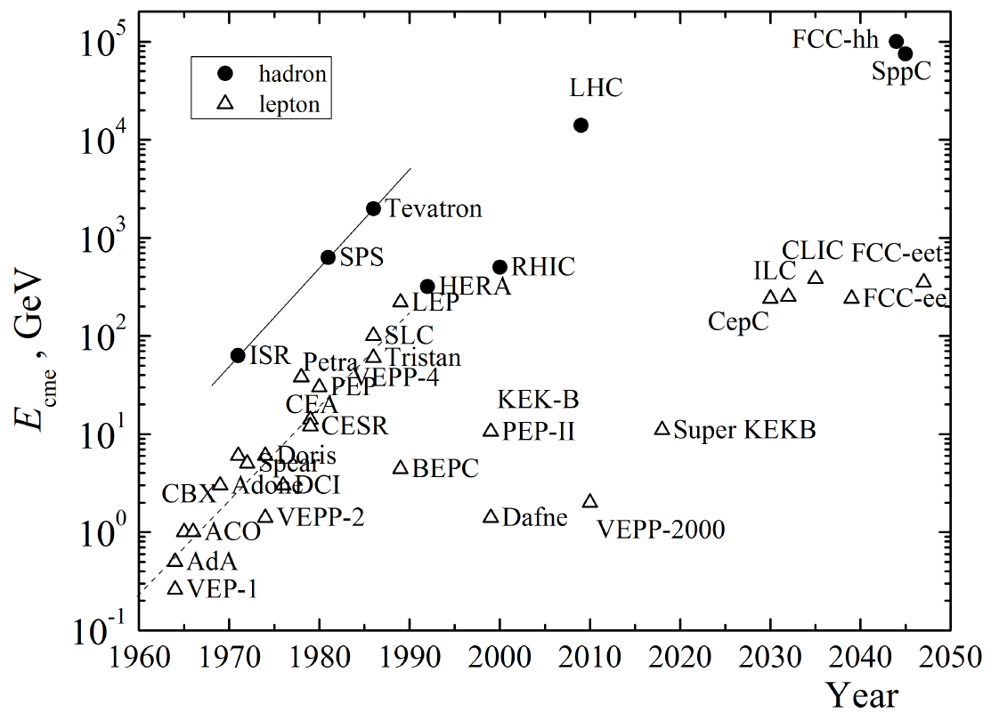
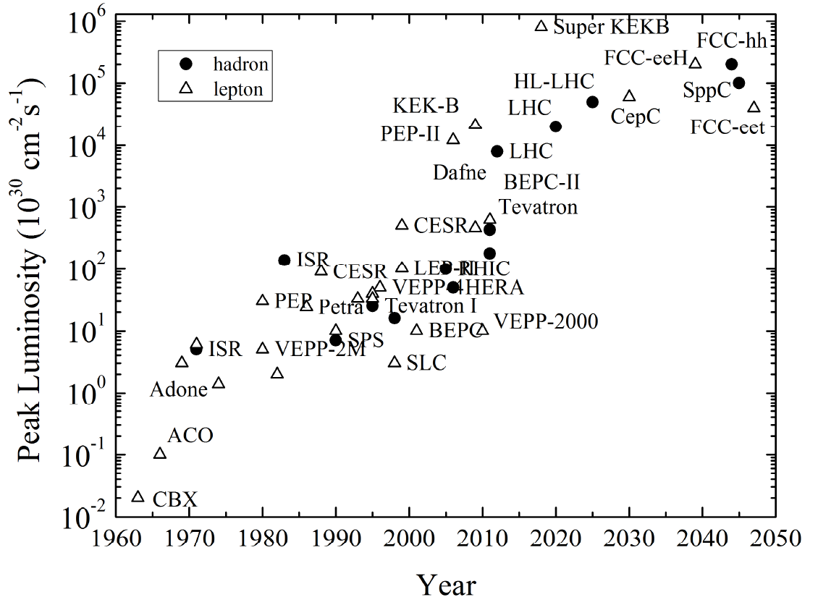
Energy and luminosity
H-factories
B-factories
ct-factories
φ-factories
Courtesy V.Shiltsev

Slide 10
Simple classification
►Extremely large facilities (~30…100 km). World-wide efforts are needed.
LHC upgrade HL-LHC, HE-LHC, LHeC; lepton linear colliders ILC (Japan), CLIC, FCC-ee, FCC-hh and FCC-he (CERN); CEPC/SppC (China).
►Large facilities (~1-3 km). Mainly national with international contribution.
Super KEKB Factory (Japan); Super Charm-Tau Factory (Novosibirsk), HIEPA (China), NICA (Dubna), eRHIC (USA), JLEIC (USA), ELISe (Darmstadt)
►Small facilities (~100 m). One lab/university installation.
μμ-tron (Novosibirsk), DERICA (Dubna)

Slide 11
Disclaimer
Too many proposals. I apologize that I cannot consider all of them.
Since (almost) all future projects are still evolutionize, collider parameters (and even configuration) I will present below may differ from those you know.

Slide 12



Extremely large facilities (~30…100 km)
The Large Hadron Collider
International Linear Collider
Compact Linear Collider
CEPC/SppC

Slide 13
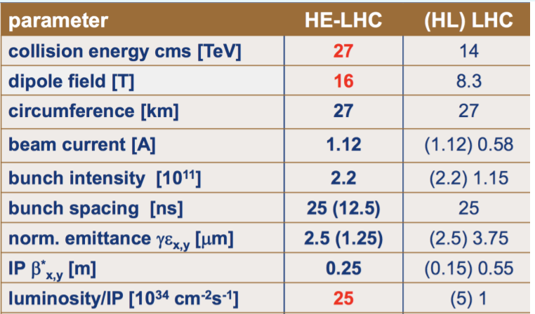
HL- and HE-LHC
HL-LHC
The High-Luminosity LHC (HL-LHC) is a luminosity upgrade of the LHC. The HL-LHC will be the first accelerator ever to feature multiple quadrupole and dipole magnets based on Nb₃Sn SC, thereby constituting an important technological stepping stone towards longer-term future projects.
The HL-LHC will also be the first hadron collider to use crab cavities. The peak luminosity will be levelled at a constant value of around 5 × 10³⁴ cm⁻² s⁻¹, in order to limit radiation and event pile-up in the experiments. Expected to operate from 2026 through to the late 2030s, the HL-LHC will increase the integrated luminosity of the LHC by an order of magnitude.
HE-LHC
Reaching a target beam energy around 13.5 TeV in the existing LHC tunnel would rely on the FCC-hh magnet technology. The present LHC dipole magnets, which have a nominal field of 8.33 Tesla, would be replaced by FCC-type 16 Tesla dipole magnets. Achieving a centre-of-mass energy close to 27 TeV with 16 T magnets requires a dipole-filling factor similar to that of the LHC.

Slide 14
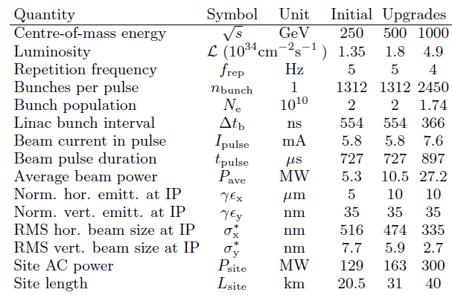
e+e- ILC
► The International Linear Collider (ILC) provides unprecedented precision in the measurements and searches needed to detect deviations from the SM. The well-defined collision energy, highly polarized beams, low background, will allow these precision measurement. Energy upgrade is possible. The technology is mature and ready for implementation.
► More than 20 years of world-wide efforts.
► TDR published in 2013.
► First stage ILC250 (250 GeV c.m.) for the Higgs physics study.
► 130-300 MW overall power consumption.
► Site location candidate is Kitakami region in Nothern Japan (closed cities are Sendai, Morioka).
Main ILC parameters
ILC TDR 2013

Slide 15
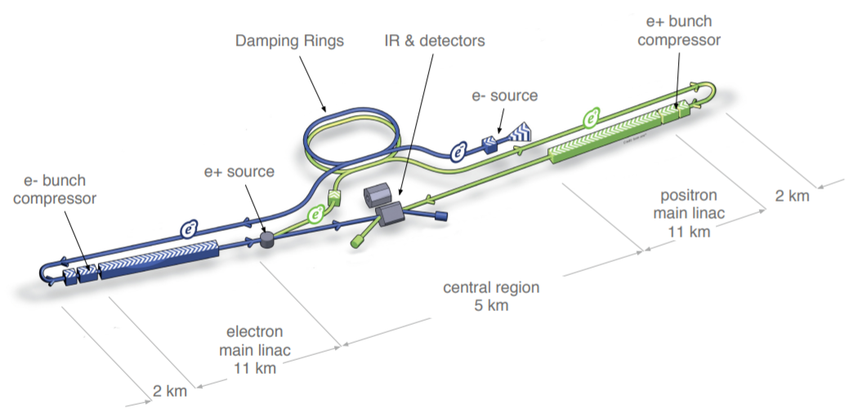
ILC layout
~31 km for 1 TeV c.m.
~20 km for 250 MeV c.m.

Slide 16
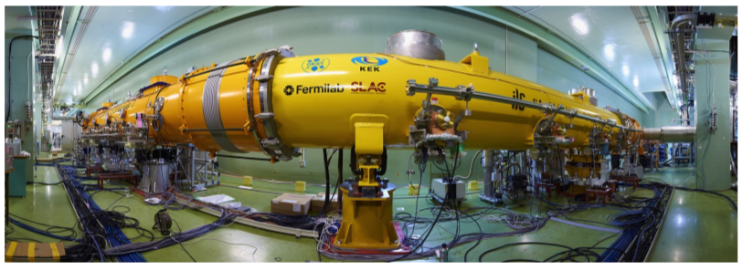
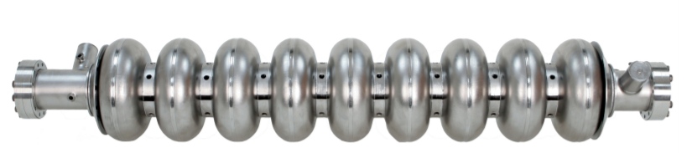
ILC main accelerator features
Polarized electron source based on a photocathode DC gun
Polarized positron source in which positrons are obtained from e+e- pairs by converting high energy photons produced by passing the high-energy main electron beam through undulator
5 GeV 3.2 km e+e- damping rings, housed in a common tunnel
Beam transport from DR to the main linacs, followed by a two-stage bunch compressors prior to the injection into the main linac
Two 11 km main linacs, utilizing 1.3 GHz SCRF TESLA-type cavities operating at an average gradient of 31.5 MV/m, with a pulse length of 1.6 ms
Two beam delivery systems, each 2.2 km long, which bring the beams into collision with 14 mrad crossing angle at a single interaction point
Two critical tasks: SC RF and nano-beam technology (IP beam size is about 6 nm).
Nine-cell 1.3 GHz niobium cavity
Fish-eye view of the RF test cryo-module at KEK

Slide 17
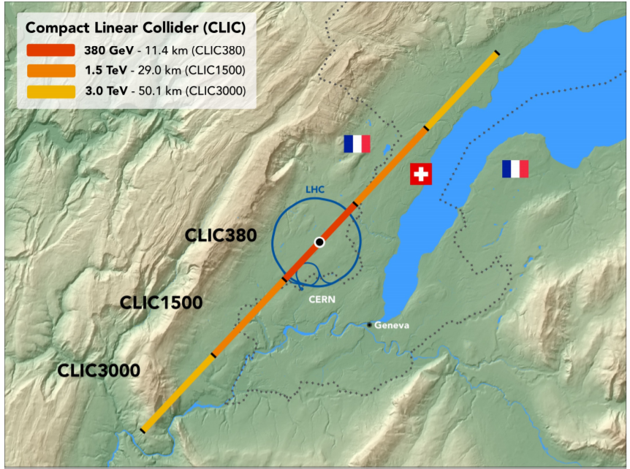
CLIC
CLIC 2018 Summary Report, CERN
► The Compact Linear Collider (CLIC) is a multi-TeV high-luminosity e+e- collider under development at CERN.
► CLIC uses a novel two-beam acceleration technique with normal-conducting accelerating structures operating at 70-100 MV/m. (However, a traditional variant with klystron RF feeding is also considered).
► The maximum c.m. energy is 3 TeV, the first stage is 380 MeV (Higgs and top-quark physics).
CLIC footprint

Slide 18
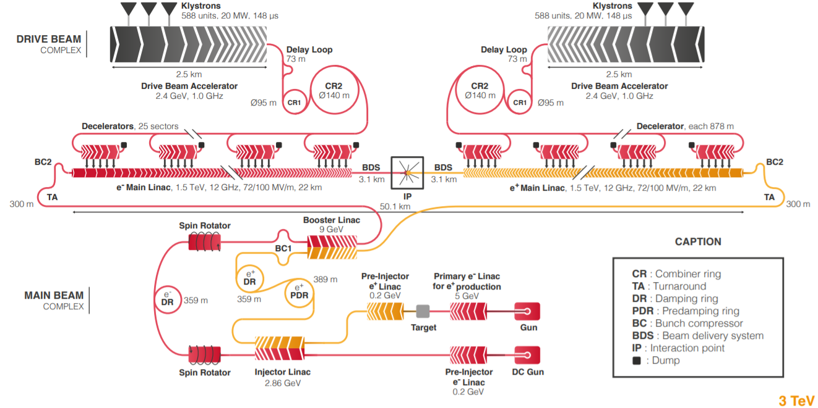
CLIC layout for 3 TeV

Slide 19
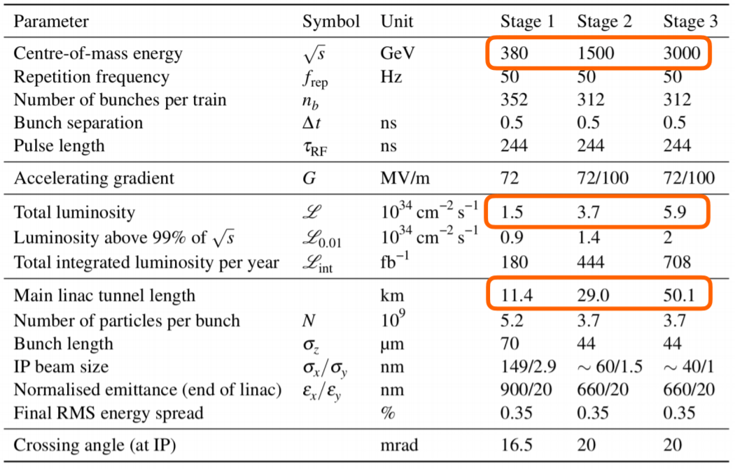
CLIC parameters

Slide 20
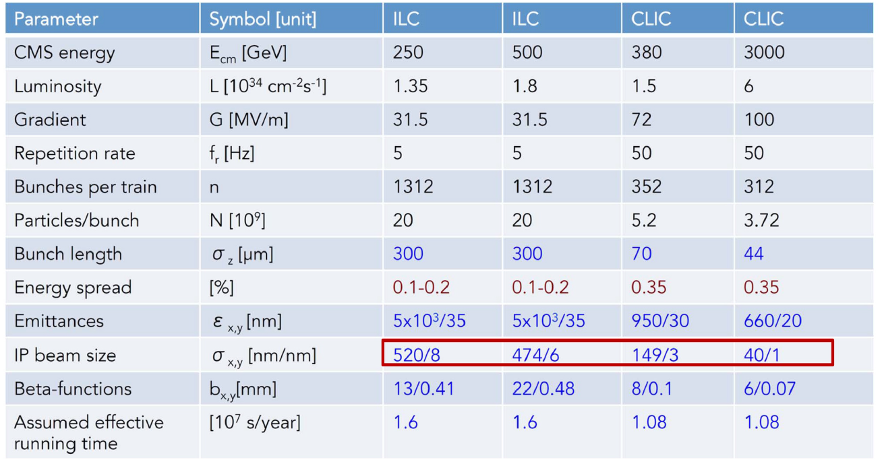
ILC and CLIC

Slide 21
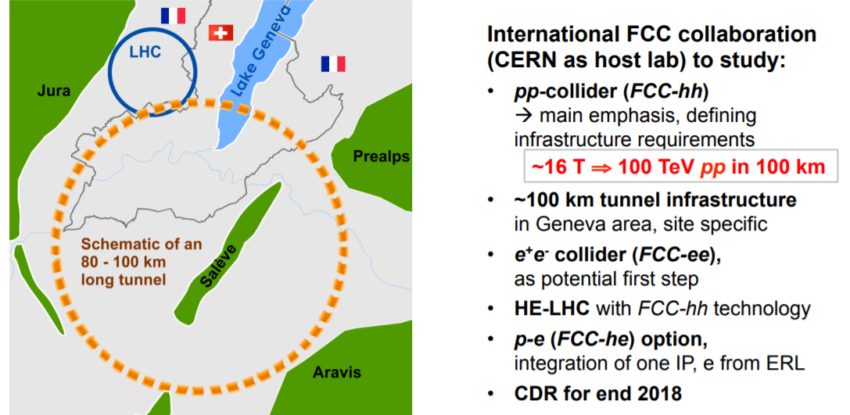
Future Circular Colliders (FCC) Study

Slide 22
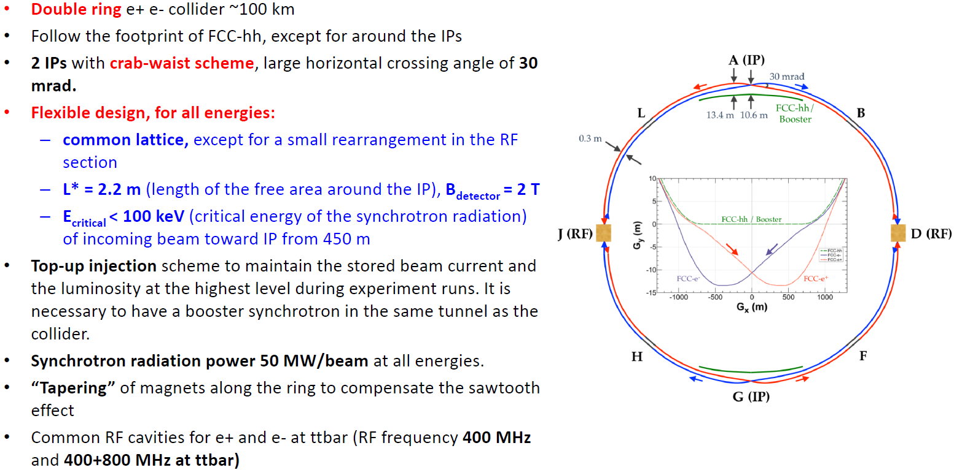
FCC-ee key features and layout

Slide 23
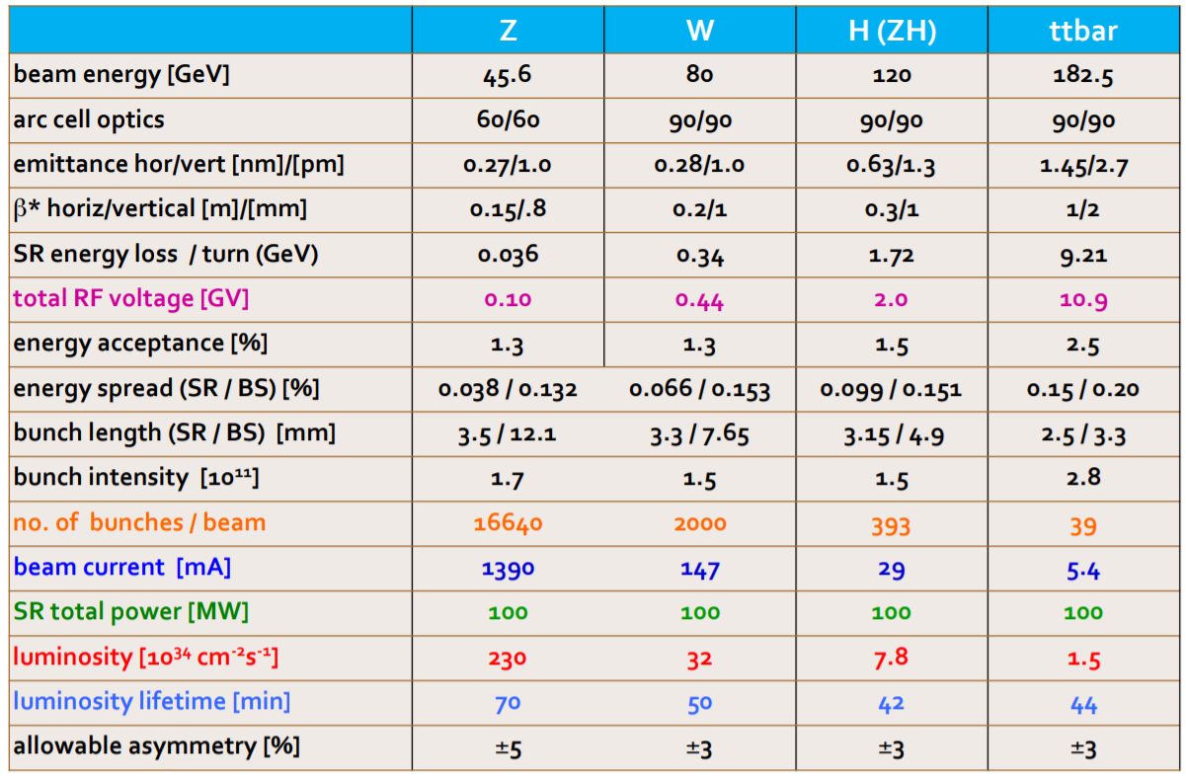
FCC-ee parameters

Slide 24
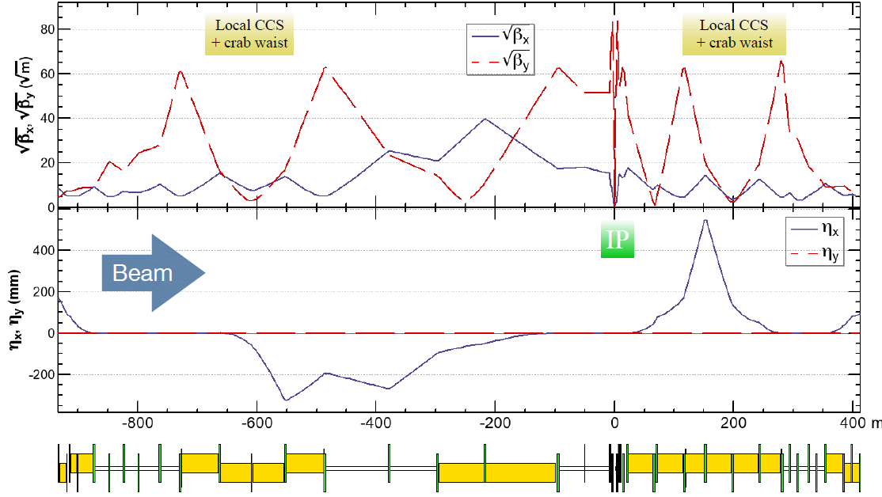
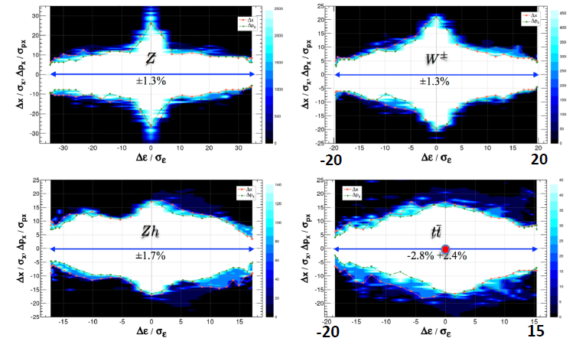
FCC-ee optics and dynamics
Dynamic aperture and dynamic momentum acceptance is a serious problem for future colliders
FCC-ee optical functions close to IP.
Maximum β_{y}≈7.5 km !

Slide 25
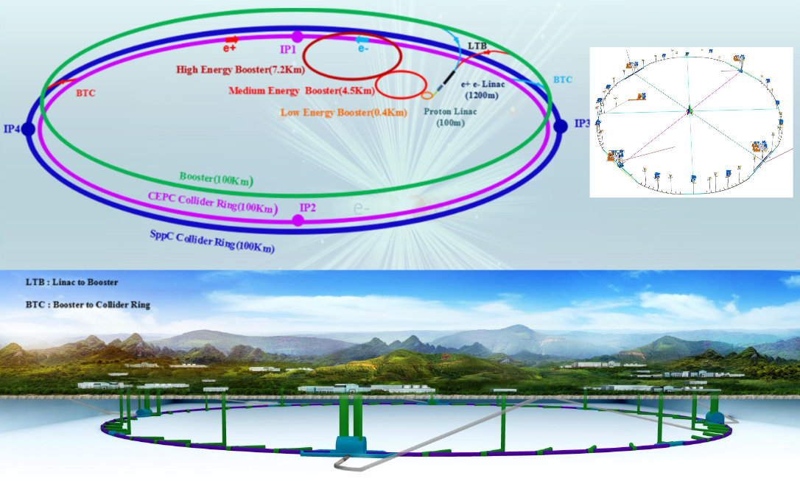
CEPC (H, Z, W) + SppC

Slide 26
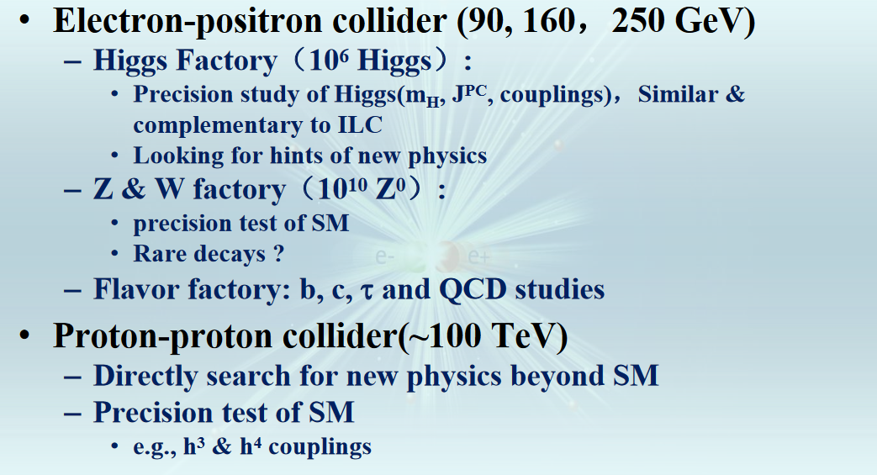
CEPC/SppC main principles

Slide 27
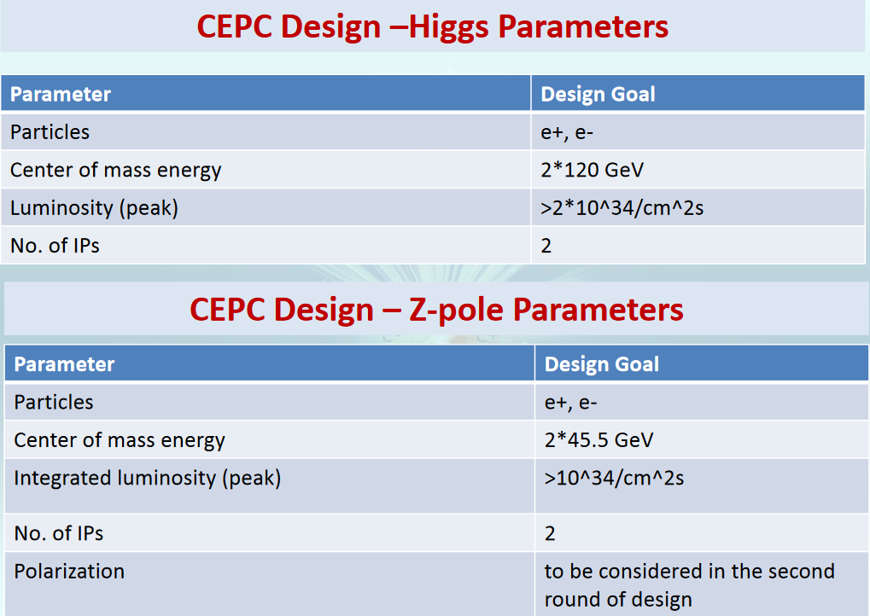
CEPC main parameters

Slide 28
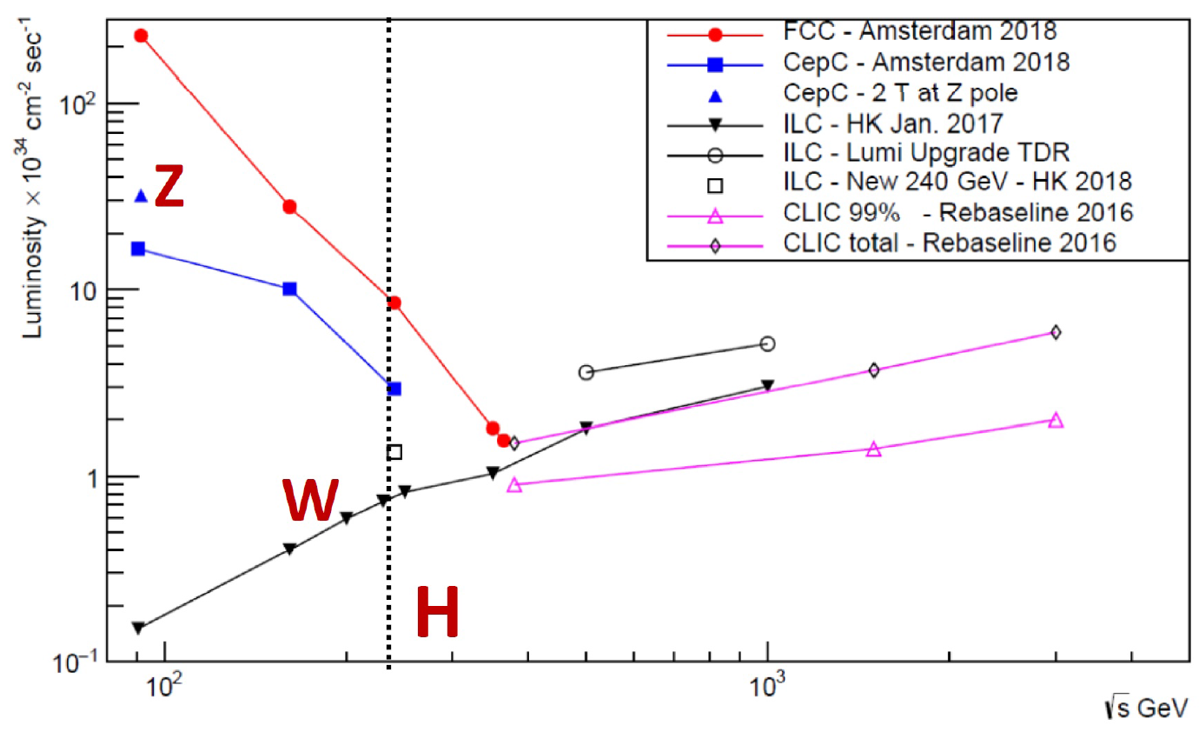
Lepton colliders

Slide 29
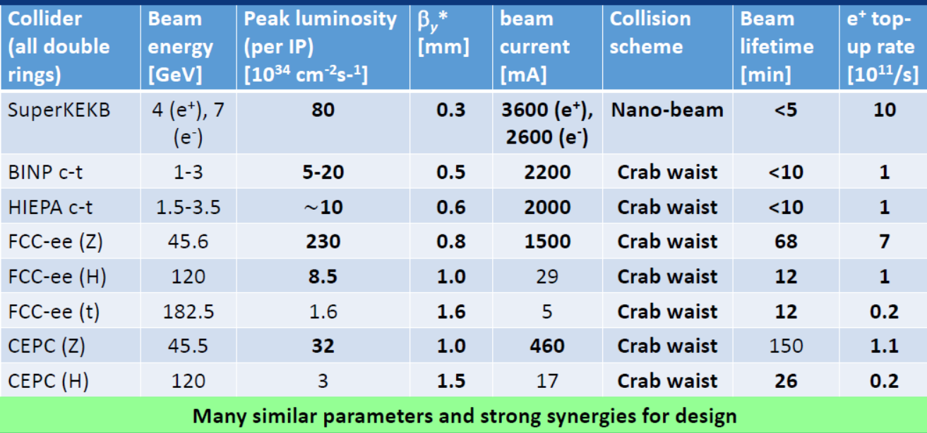
Lepton colliders

Slide 30
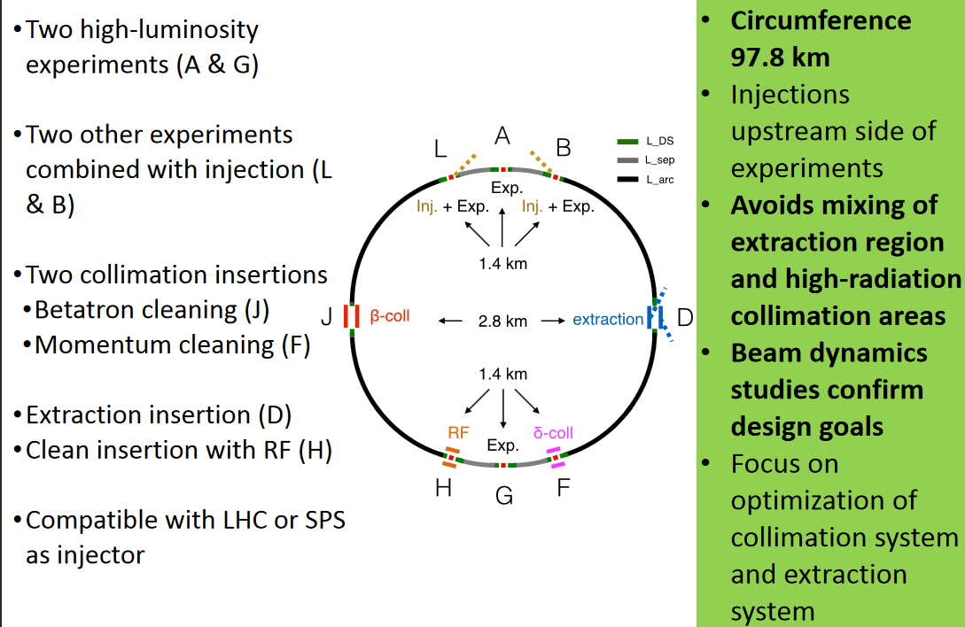
FCC-hh main features

Slide 31
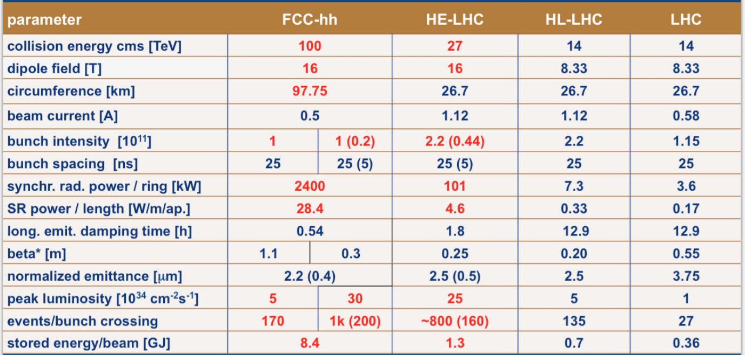
FCC-hh parameters

Slide 32
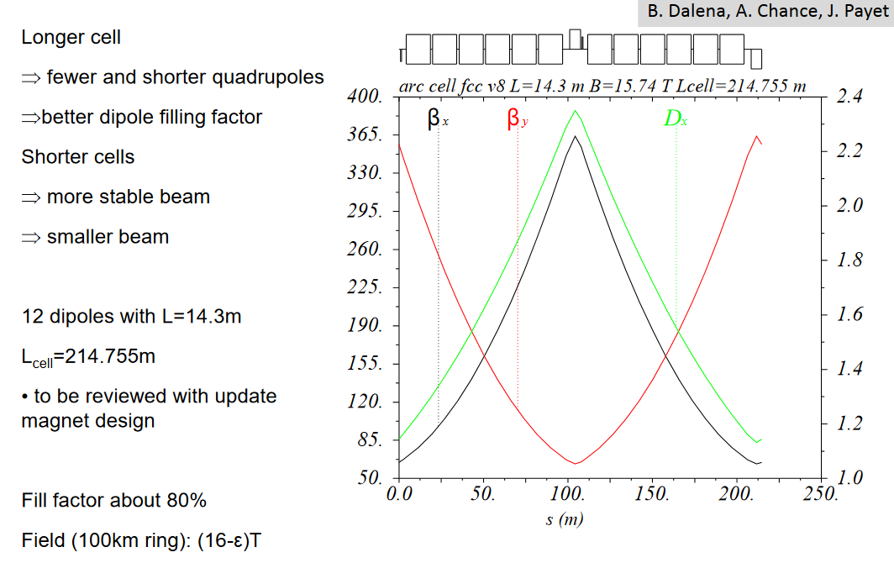
FCC-hh optics

Slide 33
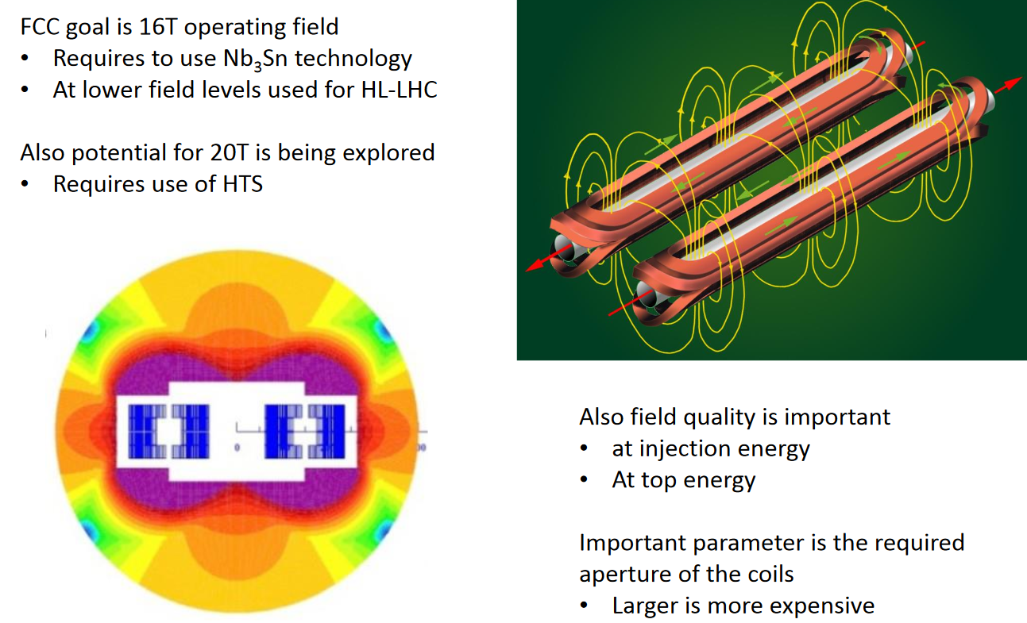
FCC-hh SC magnets
Crucial issue for all extremely high energy hadron colliders is high field superconducting magnet.

Slide 34
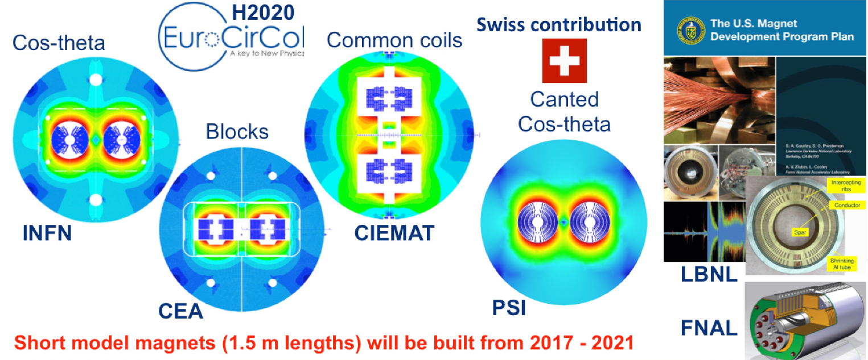
FCC-hh SC magnets

Slide 35
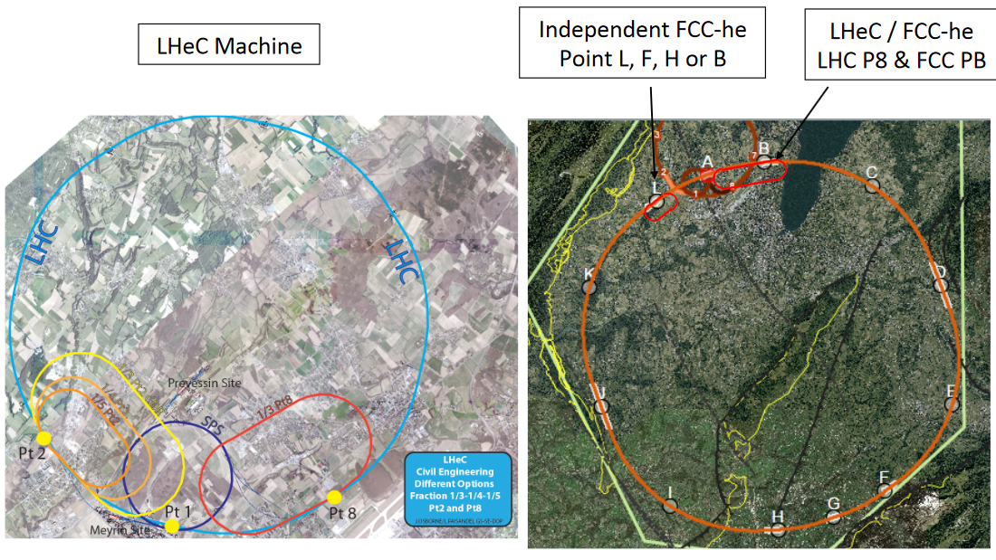
CERN based EIC: LHeC/FCC-he

Slide 36
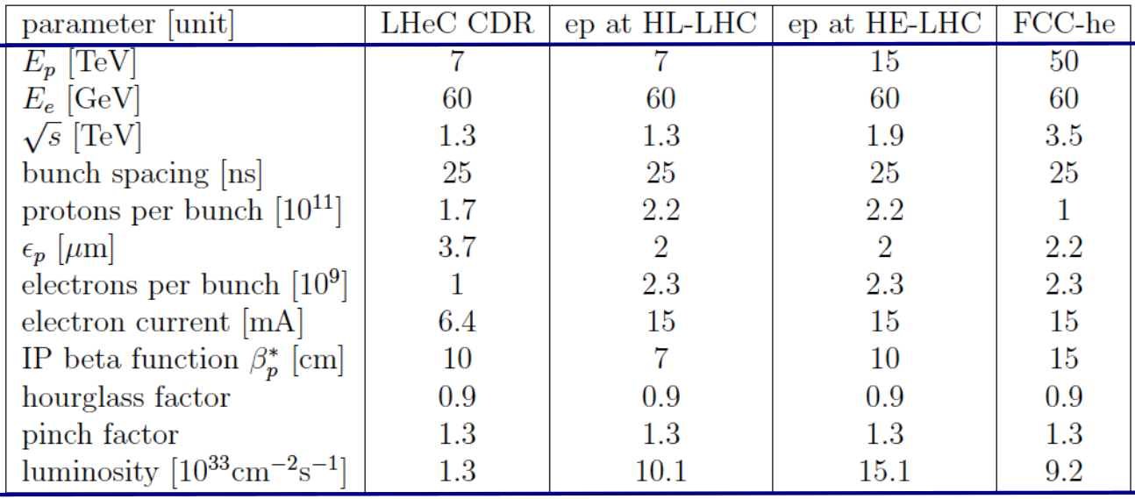
LHeC/FCC-he parameters
Electron-ion collider (EIC) is a QCD lab to explore the structure and dynamics of the visible world (mass, spin, etc.).

Slide 37
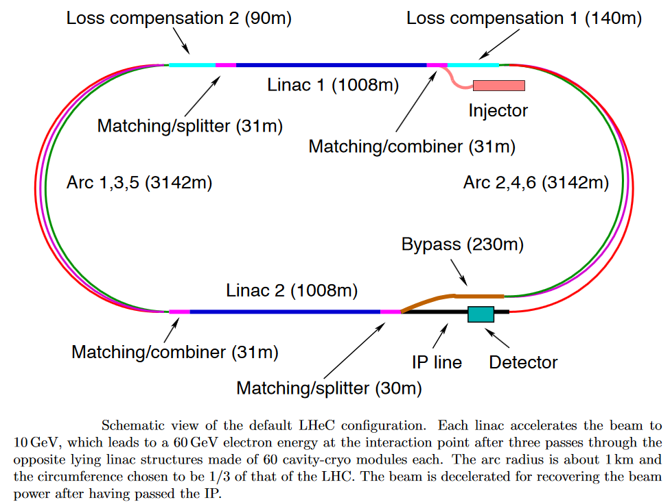
LHeC/FCC-he ERL

Slide 38


Large facilities (~0.5…3 km)
eRHIC
JLEIC
Novosibirsk Super Charm Tau Factory
HIEPA

Slide 39
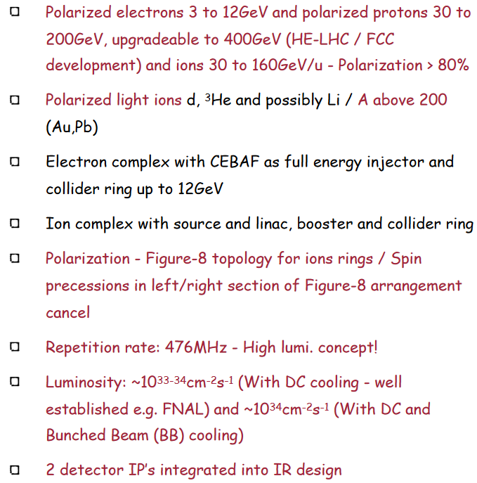
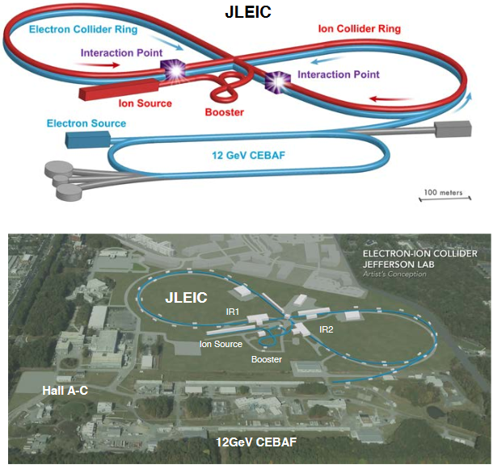
US-based EIC: JLEIC, eRHIC

Slide 40
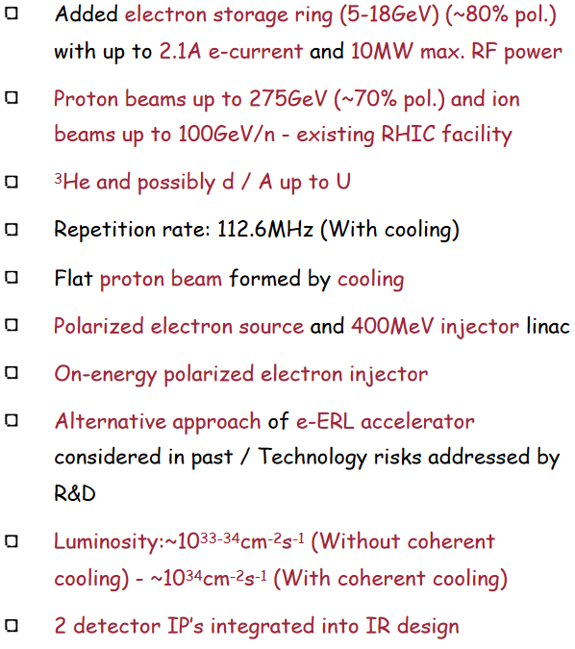
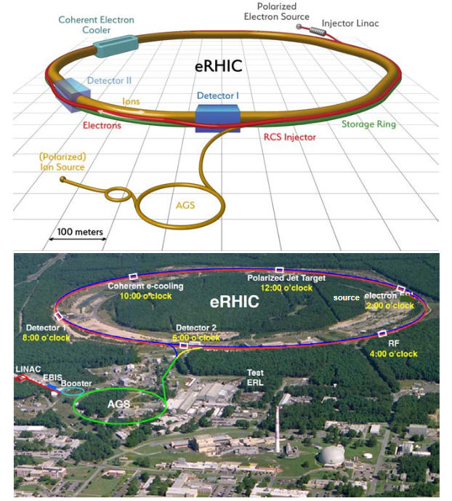
US-based EIC: JLEIC, eRHIC

Slide 41
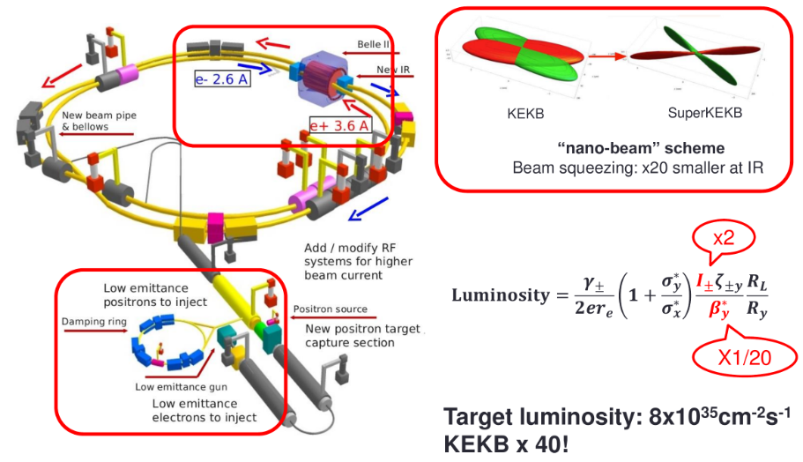

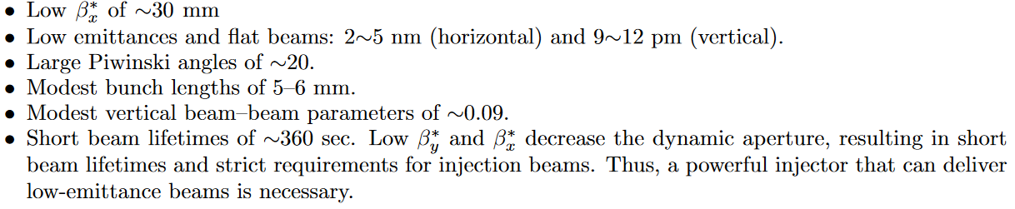
Super KEKB
Super KEK B is a e+e- collider with design peak luminosity of 8x10³⁵ cm⁻²c⁻¹. It is an asymmetric-energy double ring collider (7 GeV e- x 4 GeV e+). Its mission is to seek new physics beyond the SM at Y(4S).
It applies partial CW technology called “nano-beam scheme”

Slide 42
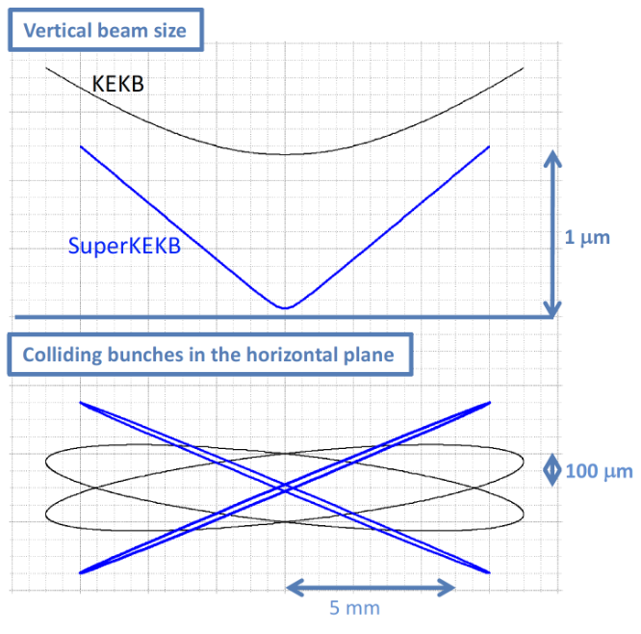
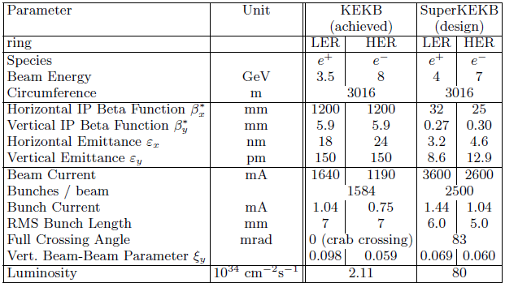
Super KEKB nano-beam scheme
Main parameters of the Super KEKB factory
Nano-beam scheme illustration

Slide 43
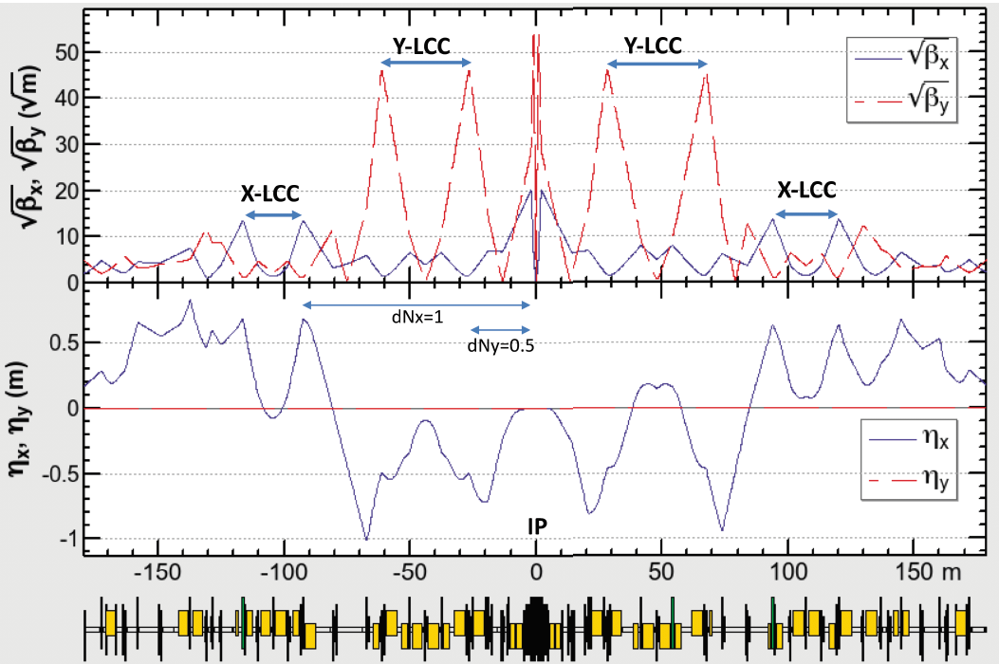
Super KEKB IR optics

Slide 44
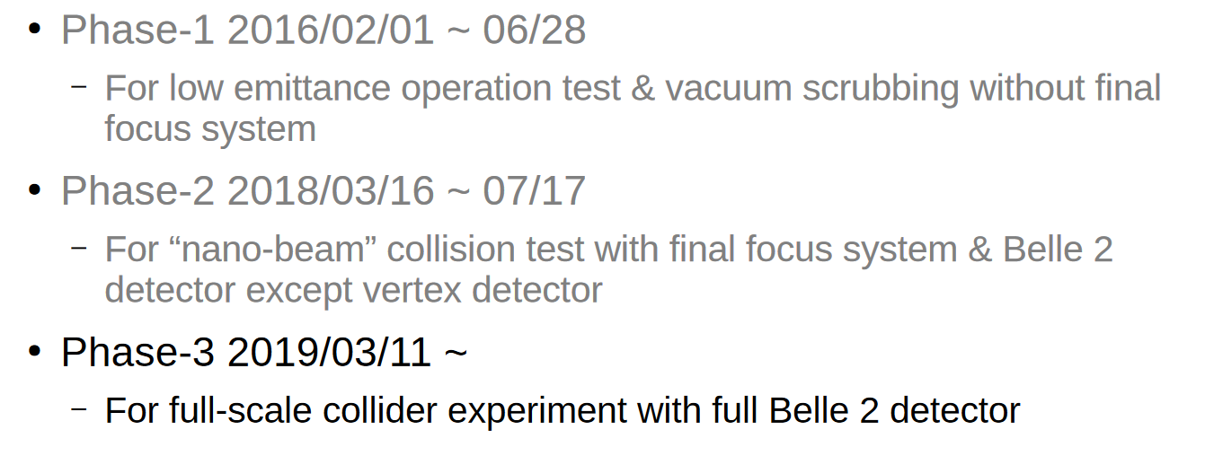
Super KEKB nano-beam scheme
A.Morita, IPAC2019

Slide 45
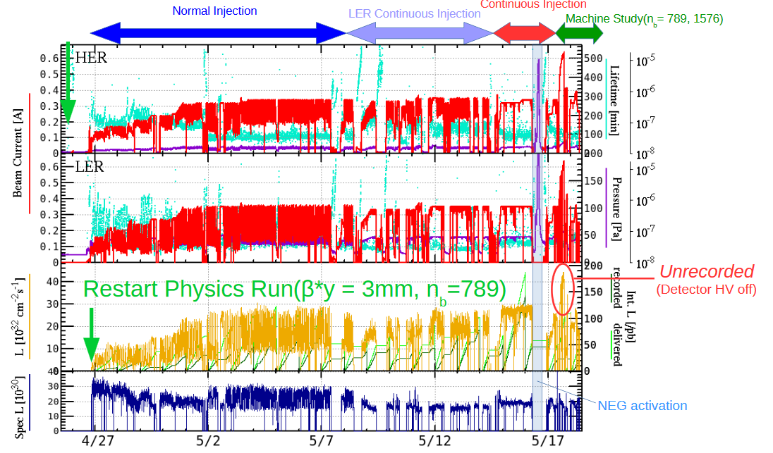
Super KEKB nano-beam scheme
A.Morita, IPAC2019

Slide 46
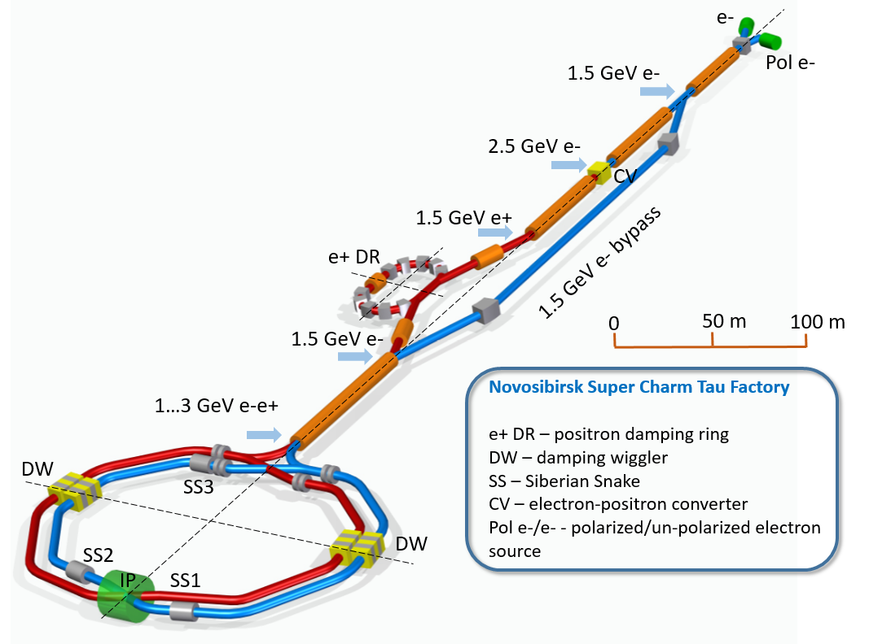
Novosibirsk Super Charm Tau
► D-Dbar mixing
► CP violation searches in charm decays
► Rare and forbidden charm decays
► Standard Model tests in τ leptons decays
► Searches for lepton flavor violation τ→μγ
► CP/T violation searches in τ leptons decays
Longitudinal polarization of electrons
L ≈ 10³⁵ cm⁻² s⁻¹ at high energy (~2-3 GeV)
L ≈ 10³⁴ cm⁻² s⁻¹ at high energy (~1-1.5 GeV)
(Production of the polarized anti-nucleons)

Slide 47
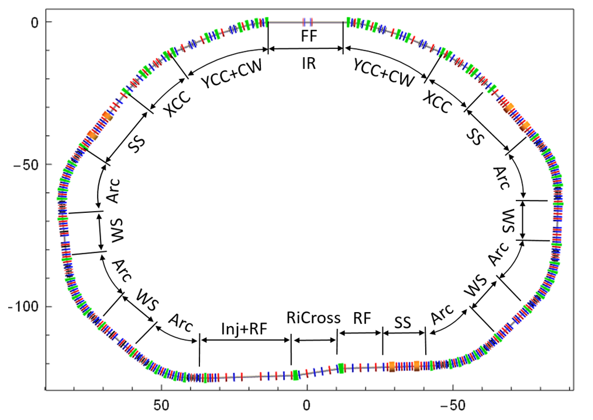
Novosibirsk SCTF main principles
► Variable energy E_{cm}= 2 – 6 GeV
► Luminosity L = 0.5÷1×10³⁵ cm⁻²s⁻¹
► Crab-waist collision scheme
► Electrons are polarized longitudinally at IP
► No energy asymmetry
► No beam monochromatization
► Energy calibration with medium accuracy is sufficient (Compton backscattering)

Slide 48

Novosibirsk SCTF optics
Legend
FF+IR – Final Focus and Interaction Region
Arc – low emittance arc cell
W1-W4 – damping wiggler sections
SS1-3 – Siberian Snake spin manipulation sections
Injection – straight section for injection and RF cavities

Slide 49


HIEPA
High Intensity Electron Positron Accelerator in Hefei (China) is the next generation charm-tau factory with c.m. energy of 2-7 GeV.

Slide 50






NICA
Nuclotron-based Ion Collider fAcility will study hot and dense barionic matter, spin physics, basic properties of strong interacting vacuum, QCD symmetries, etc.
NICA provides variety of beam species from protons and polarized deuterons to massive gold ions.
For ions:
For protons:
NICA consists of two SC rings with maximum BR = 45 Tm and circumference of 503 m. Two IPs are for multi-purpose detector MPD and spin physics detector SPD.
Superferric magnets with maximum field 1.8-2 T and ramping rate of 1 T/s.
Stochastic and electron cooling systems are needed to assure high average luminosity operation in presence of strong intrabeam scattering.

Slide 51


Small size colliders (~100 m)
μμ-tron

Slide 52


DERICA
DERICA is prospective accelerator and storage ring facility planned at (JINR) Dubna to study physics of Radioactive Isotope Beams (RIB) including low energy compact electron-RIB collider (EIC). Electron-ion collisions allow to study RIB form-factors.
L.Grigorenko

Slide 53


Novosibirsk μμ-tron
μμ-tron is a low energy very compact electron-positron collider proposed at BINP to discover and study a dimuonium atom.
Dimuonium, bimuonium or true muonium is a lepton atom (μ⁺μ⁻).
From 6 leptonic atoms (e⁺e⁻), (μ⁺e⁻), (μ⁺μ⁻), (τ⁺e⁻), (τ⁺μ⁻), (τ⁺τ⁻) only two (e⁺e⁻), (μ⁺e⁻) were observed.
Dimuonium is pure QED system (no strong interaction, calculable).
Very compact (large $m_{μ}$), more sensitive to new physics than other exotic atoms.

Slide 54




μμ-tron
True muonium: smallest QED system
Henry Lamm, arXiv 1509.09306v1, 30 Sep 2015
$M_{μμ}≈2×105$ MeV,
$$σ\left(e^{+}e^{−}\right)=0.33 barn,$$
$$Γ_{μμ}=0.37×{10}^{−3}eV.$$
~1 ps lifetime
S Philips, U.of New Hampshire, 2012.
S Brodsky, R Lebed, Phys.Rev.Lett. vol. 102, no. 21, 2009

Slide 55

μμ-tron layout
6 m

Slide 56



μμ-tron parameters

Slide 57
SUMMARY
Superconducting strong field (16-20 T) magnets and relevant technologies (new types of conductor).
High gradient acceleration (SC structures, HF structures, wake field acceleration).
Effective cooling for massive particles (electron, stochastic, …)
Nano-beam technology (strong focusing gradient, relevant diagnostics, mechanical precision of all accelerator components).
High current technology (low impedance, powerful fast feedback).
Circular colliders tends to be more and more nonlinear – tools to get large dynamic aperture.
New ideas

Slide 58
ACKNOWLEDGMENTS
I would like to thank Igor Meshkov and Vladimir Shiltsev for helpful discussions.

