Slide 1
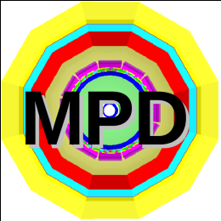
A “vector finder” approach to track reconstruction in the Inner Tracking System of MPD/NICA
D.Zinchenko¹, A.Zinchenko¹, E.Nikonov²
¹VBLHEP, JINR, Dubna, Russia
²LIT, JINR, Dubna, Russia
AYSS-2019 15 April 2019

Slide 2
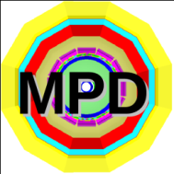
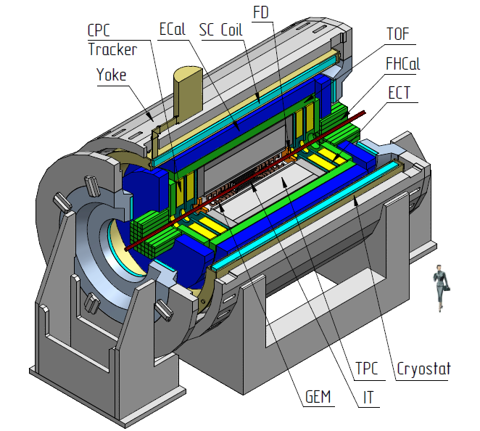
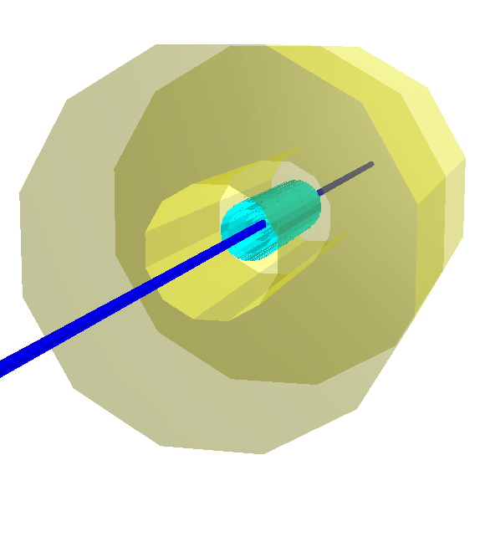
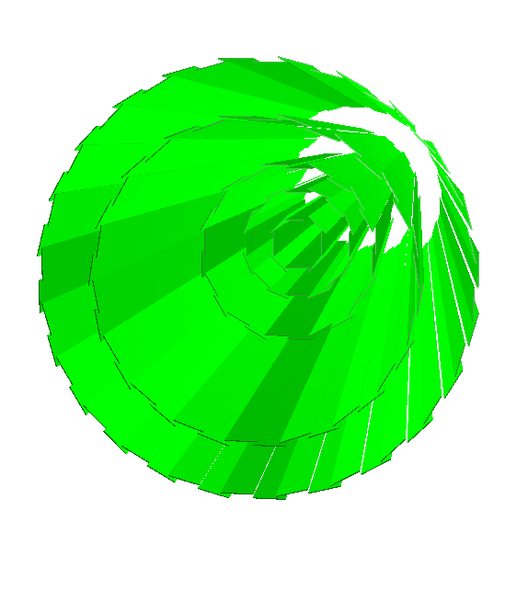
MPD, TPC&ITS geometry
TPC and ITS geometry
MPD/NICA general design scheme
5-layer ITS geometry
D. Zinchenko

Slide 3
Method
Vector Finder – a prior - constrained combinatorial search method (combines hits with angular positions which can exist in actual particle tracks)
D. Zinchenko

Slide 4
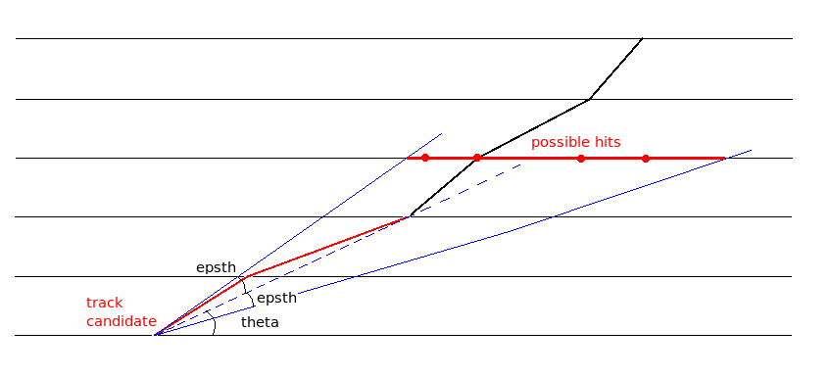
Track scheme with angles (longitudinal)
Example: Adding 3^{d} layer hit to current track candidate (red). Angle delta epsth is preset. Area where possible hits are searched for, is highlighted with red and bordered with blue lines.
D. Zinchenko

Slide 5
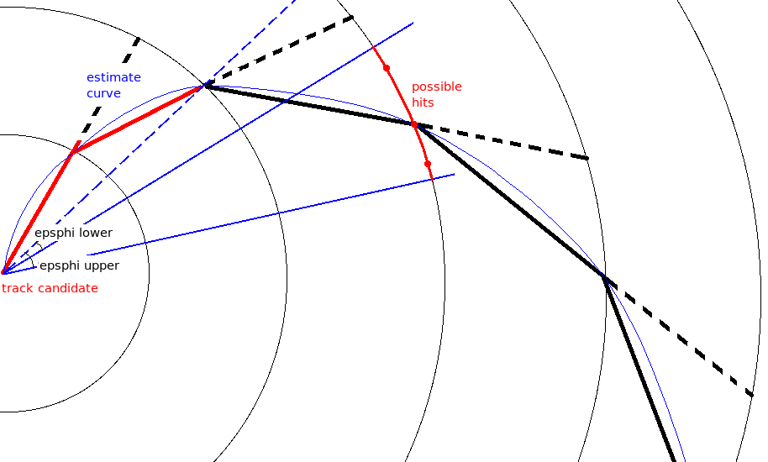
Track scheme with angles (transverse)
Example: Adding 3^{d} layer hit to current track candidate (red). Angles epsphi, lower and upper, depend on momentum, which is estimated based on track curvature for track candidate. Area where possible hits are searched for, is highlighted with red and bordered with blue lines.
D. Zinchenko

Slide 6
Event generators
Box – FairBoxGenerator of muons – μ⁻ and μ⁺
500 μ⁻, 500 μ⁺ per event, Pt range from 0.02 to 2.0 GeV/c, polar angle from 40 to 140°
UrQMD – central Au+Au collisions at sqrt(s) = 9 GeV
D. Zinchenko

Slide 7
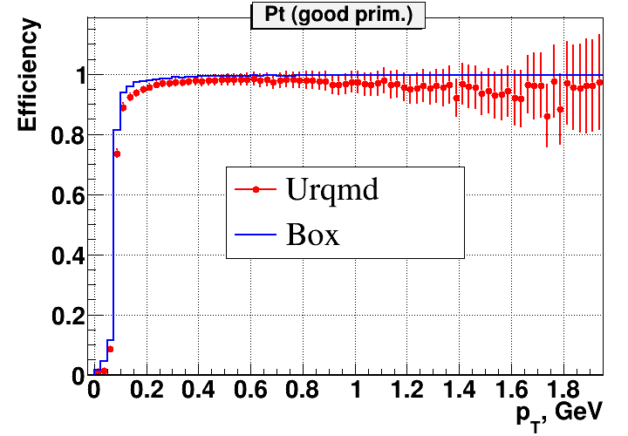
Efficiency dependence on Pt
/c
D. Zinchenko

Slide 8
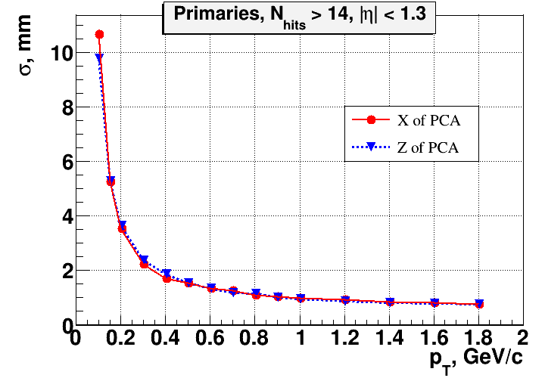
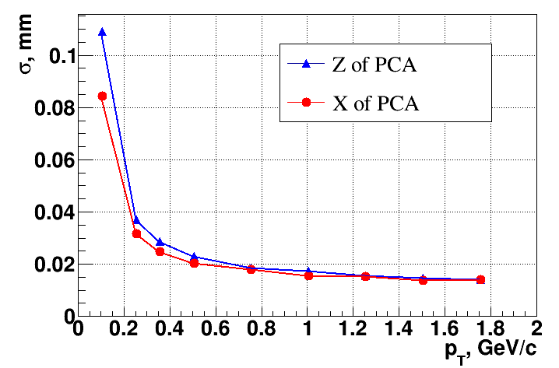
Coordinates of PCA versus Pt
Left – TPC (Kalman filter based approach) Right – ITS (Vector Finder approach)
PCA – point of the closest approach to the interaction point
D. Zinchenko

Slide 9
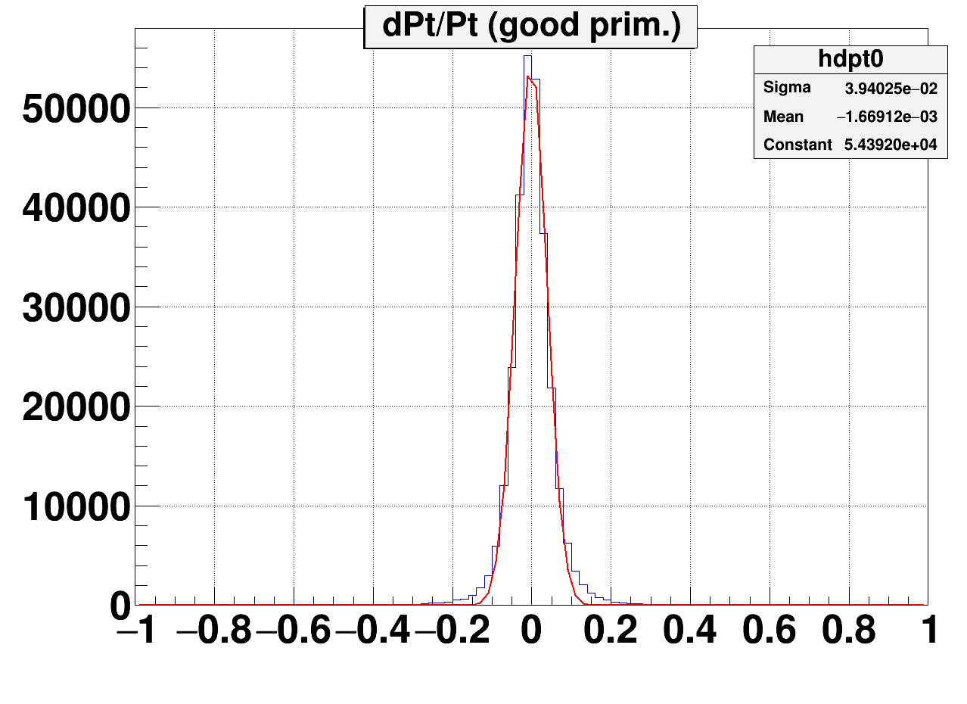
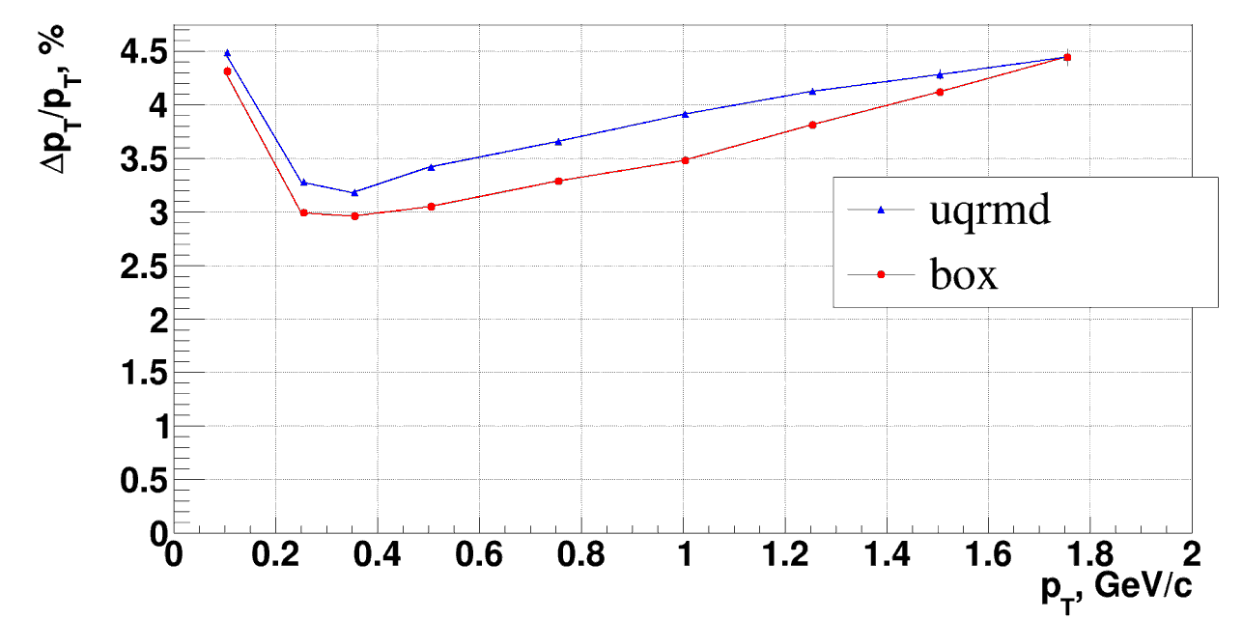
dPt/Pt (gauss fit) and dependence on Pt
dPt/Pt — relative transverse momentum resolution (momentum reconstruction accuracy)
D. Zinchenko

Slide 10
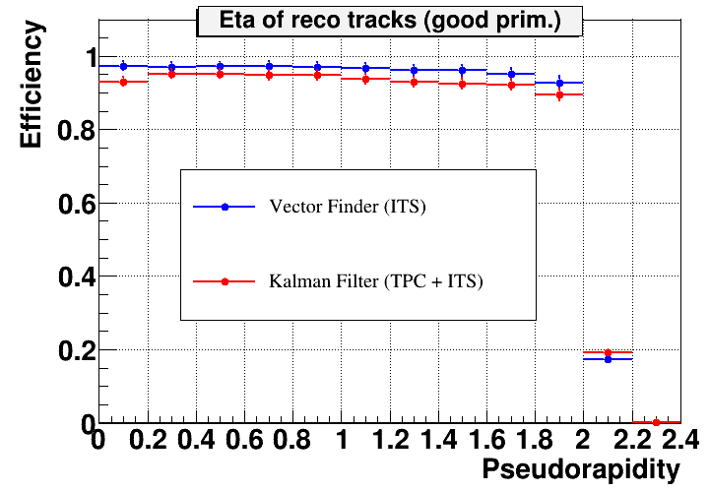
Efficiency dependency on Pseudorapidity
D. Zinchenko

Slide 11
Summary and next steps
Stand-alone ITS track reconstruction using Vector Finder approach has been developed and implemented
It improves track reconstruction efficiency as compared with the TPC-based tracking
ITS significantly improves track position uncertainty near the interaction point
Combined ITS + TPC track reconstruction using Vector Finder approach is the next step.
D. Zinchenko

