Slide 1


Vertex detector: status report
N. Zamyatin on behalf SPD JINR- group
International Workshop “SPD at NICA-2019”
7 June 2019

Slide 2
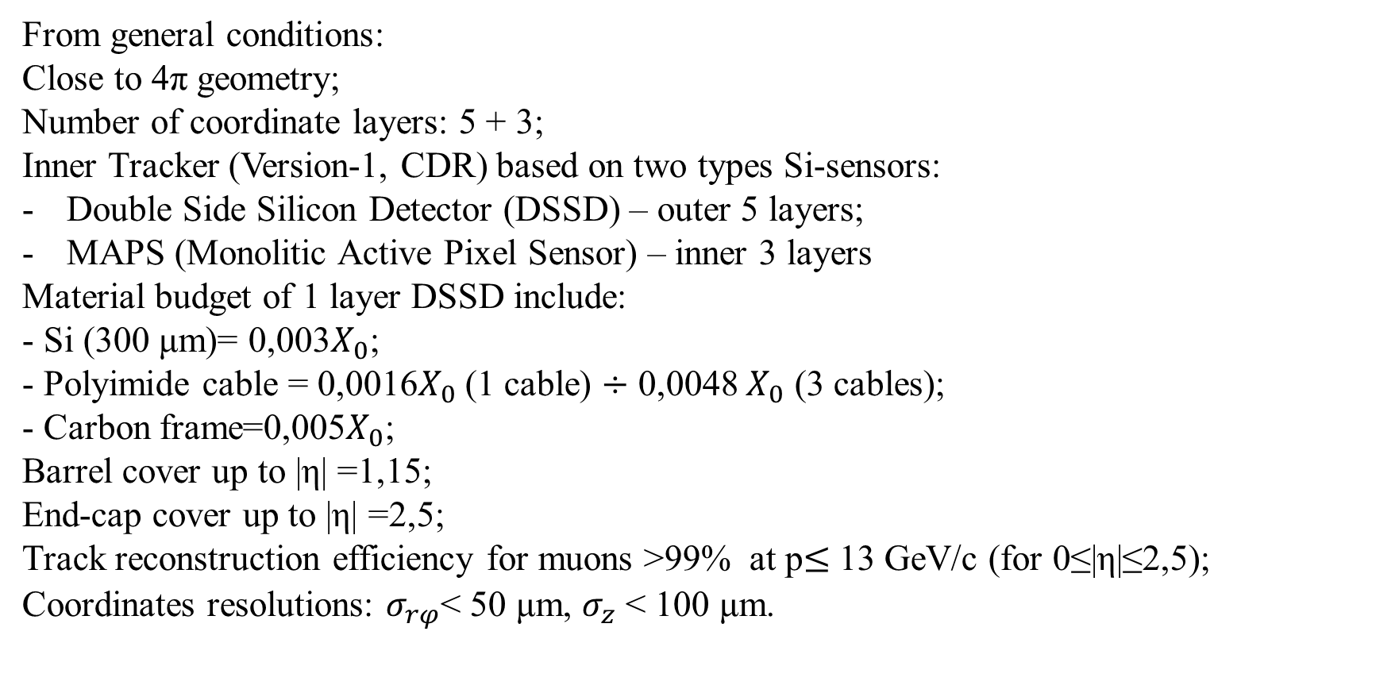
Performance requirements of the Inner Tracker
From general conditions:
Close to 4π geometry;
Number of coordinate layers: 5 + 3;
Inner Tracker (Version-1, CDR) based on two types Si-sensors:
Double Side Silicon Detector (DSSD) – outer 5 layers;
MAPS (Monolitic Active Pixel Sensor) – inner 3 layers
Material budget of 1 layer DSSD include:
- Si (300 μm)= 0,003$X_{0}$;
- Polyimide cable = 0,0016$X_{0}$(1 cable) $÷$ 0,0048 $X_{0}$ (3 cables);
- Carbon frame=0,005$X_{0}$;
Barrel cover up to |η| =1,15;
End-cap cover up to |η| =2,5;
Track reconstruction efficiency for muons >99% at p$≤$ 13 GeV/c (for 0≤|η|≤2,5);
Coordinates resolutions: $σ_{rφ}$< 50 μm, $σ_{z}$ < 100 μm.

Slide 3
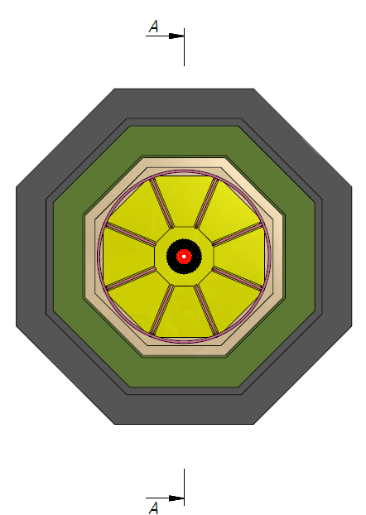
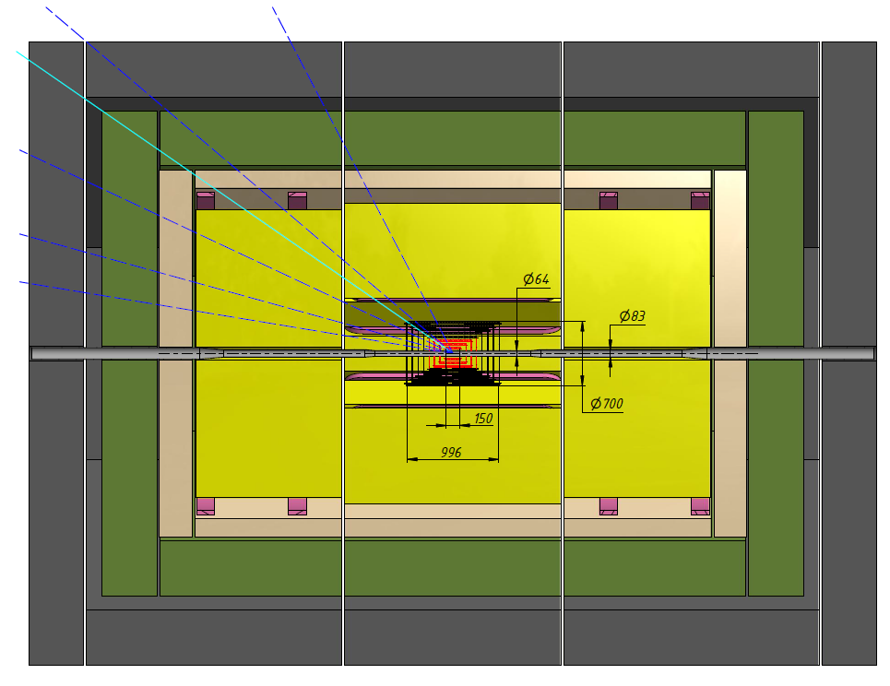
SPD facility
|η| =1
|η| =0.5
|η| =1.15
Range system
|η| =1.5
Electromagnetic calorimeter
PID
|η| =2
Tracking system
|η| =2.5
Barrel Si-MAPS
Barrel Si-DSSD
Region of VD

Slide 4
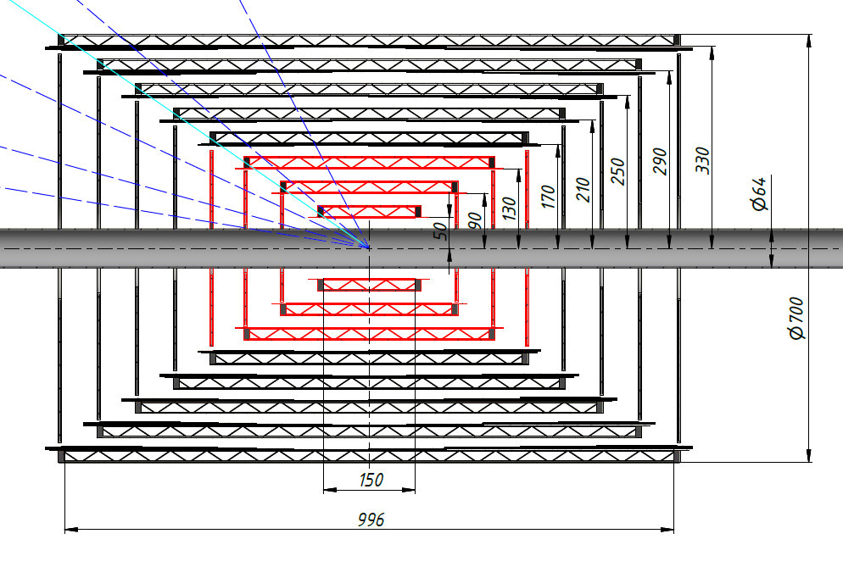

Barrel Si-MAPS
Barrel Si-DSSD
|η| =1.15
|η| =1
|η| =0.5
|η| =1.5
|η| =2
|η| =2.5
End Cap Si-MAPS
End Cap Si-DSSD
Fig.2 Cross-section of Inner Tracker
Primary goal of IT: determine coordinates of primary and secondary vertexes for rejection of physical background ($π^{±}$ for DY processes)

Slide 5
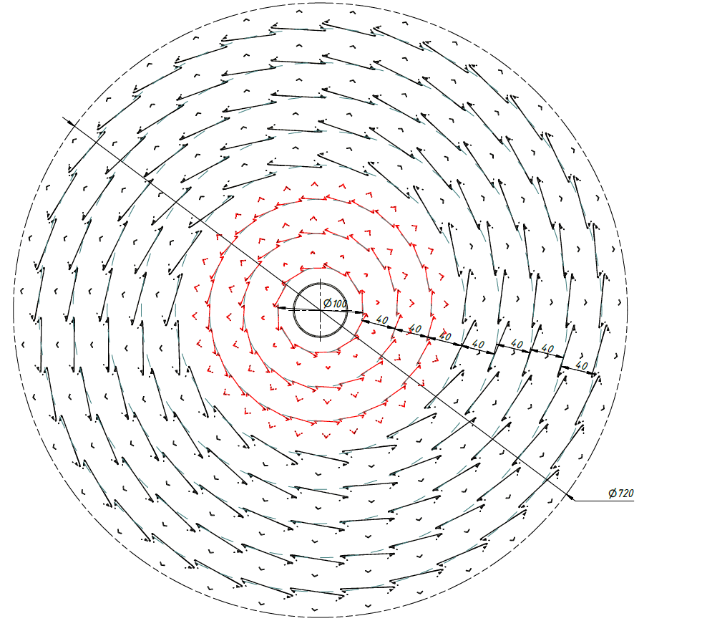
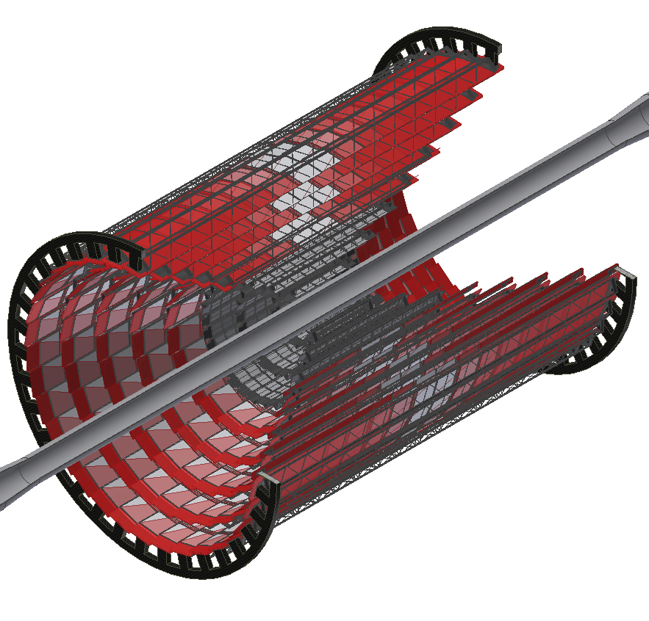
Vertex Detector Layout
Barrel Si-MAPS
Barrel Si-DSSD
General view of Vertex Detector (left) and $rφ$-plane (right)

Slide 6
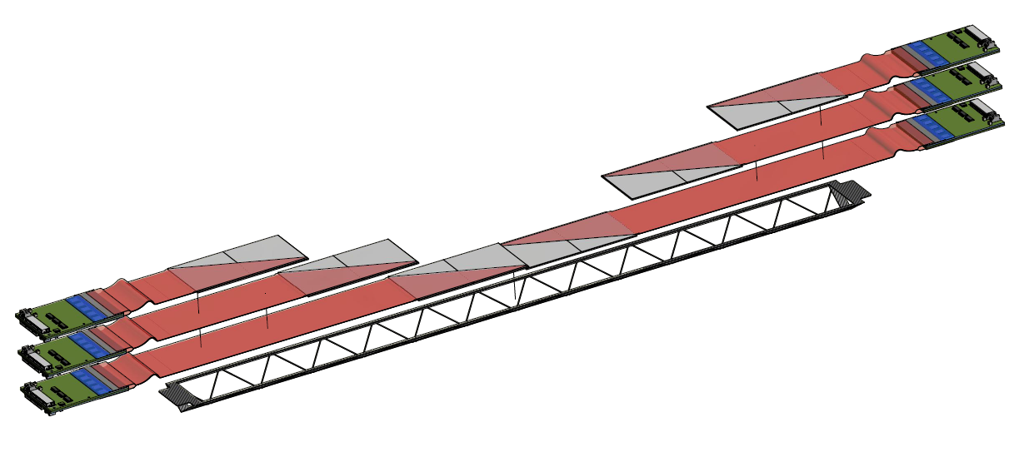
View of carbon fiber ladder with Si-modules
Laying modules on carbon fiber support.
Puts from center to edge.
Electronics located at the edges of the ladder.
Si -modules
Front-End Electronics
Polyimide cables
Carbon fiber ladder
Front-End Electronics
[see B. Topko talk]

Slide 7
 | Number of Sensors per ladder | Number of ladders | Number of Sensors | Area, m² Area of 1 MAPS 4,5 cm² Area of 1 DSSD 40 cm²
1 layer – MAPS | 10 | 12 (L=150 мм) | 10×12 = 120 | 0,054
2 layer – MAPS | 18 | 20 (L=270 мм) | 18×20 = 360 | 0,162
3 layer – MAPS | 26 | 28 (L=390 мм) | 26×28 = 728 | 0,327
4 layer – DSSD | 8 | 19 (L= 496 мм) | 8×19 = 152 | 0,603
5 layer – DSSD | 10 | 23 (L=620 мм) | 10×23 = 230 | 0,912
6 layer – DSSD | 12 | 27 (L=746 мм) | 12×27 = 324 | 1,285
7 layer – DSSD | 14 | 31 (L=870 мм) | 14×31 = 434 | 1,722
8 layer – DSSD | 16 | 35 (L=996 мм) | 16×35 = 560 | 2,222
Total for barrel |  |  | Number of MAPS = 1208 | Total area MAPS =0,54 m²
 |  |  | Number of DSSD = 1700 | Total area DSSD = 6,74 m²
Total barrel + 2 end-cap: |  | Cost estimation (1,5 Meuro/m²⁾
Number of MAPS = 1798 | Total area MAPS = 0,804 m² | 1,5 Meuro
Number of DSSD = 2096 | Total area DSSD =8,32 m² | 12,5 Meuro

Slide 8
Attention
Tracker system based on silicon detectors is the most expensive part of SPD facility. It’s important to remember that:
Cost of barrel layers is proportionally R² и L_{z}
Main goal – optimization Vertex Detector construction (decrease the active area and keep satisfaction for physics requirements)

Slide 9
Possible versions of Vertex Detector design
Version - 1 (CDR):
Double Side Silicon Detector (DSSD - outer 5 layers) and Monolitic Active Pixel Sensor (MAPS - inner 3 layers)
Version – 2 (full MAPS):
Monolitic Active Pixel Sensor (MAPS) - 3 or 5 layers
Version – 3 (full DSSD):
- Double Side Silicon Detector (DSSD) - 8 or 5 layers

Slide 10
Parameter | MAPS - sensors | DSSD - sensors
Resolution-pitch, mkm | 5/30 | 30/95
Material budget/layer, % Х₀ | 0.3 | 0.3 (Si-300mkm) + 0.16÷0.48 (polyimid cables)
FE-chip | FE-electronics integrated on MAPS | Need to choice of the type FE-ASIC chip-128 ch (need collaboration with ASICs development centers)
Power, mW/cm2 | 100 mW/cm2 | 250 mW/chip (10 chips per 80 cm2 of Si-DSSD is equal 2.5 W)
Cooling | Cooling of the full area ladders | Cooling only FE-chips area
cable | Cables from ladders to DAQ | Cables-1 from sensors to FE and cables-2 from FE to DAQ
Staging | yes | yes
Commercial available | ? | yes
Assembling process | in collaboration with CERN, experience of ALICE-upgrade and VD-MPD | Based on BM@N assembly process + experience of JINR team (Yu. Murin) in CBM
Radiation hardness | Not full depleted pixel (10¹³ n_{eq}/cm²) | Up to 5×10¹⁴ n_{eq}/cm² (with cooling of Si)
∆E from VD layers | impossible | +

Slide 11
FE-ACICs
 | APV25 | VATAGP7.3 | n-XYTER | TIGER | ???
Channels number | 128 | 128 | 128 | 64 (128?)
Dynamic Range | -40fC ÷ 40fC | -30fC ÷ 30fC | Input current 10nA Polarity - and+ | 1÷50fC
Gain | 25mV/fC | 20µA/fC |  | 10.35mV/fc
Noise | 246e⁻+36 e⁻/pF | 70e⁻+12 e⁻/pF | 900e⁻ at 30pF | 2000e⁻ at 100pF
Peaking time | 50ns | 50ns/500ns | 30ns/ 280ns | 60ns/ 170ns
Power consumption | 1.15mW/ch. | 2.18mW/ch. | 10mW/ch. | 12mW/ch.
ADC | No | No | 16fC, 5 bit | 10-bit Wilkinson ADC
TDC | No | No |  | 10-bit Wilkinson ADC
Output | Multiplexing single end diff. signal. | Multiplexing single end diff. signal.20MHz | 4x500Mbit/s LVDS | 4x640Mbit/s LVDS

Slide 12
Summary
Conceptual design of Vertex Detector SPD in progress (few version: based on full DSSD layers, full MAPS layers and combined (DSSD + MAPS) detector construction);
These versions will be use for SPD simulation;
At this moment R&D focused on reduce active area, material budget and power dissipation of the tracker;
Finally version should be accept after full Monte-Carlo simulation.

Slide 13
Backup slides

Slide 14

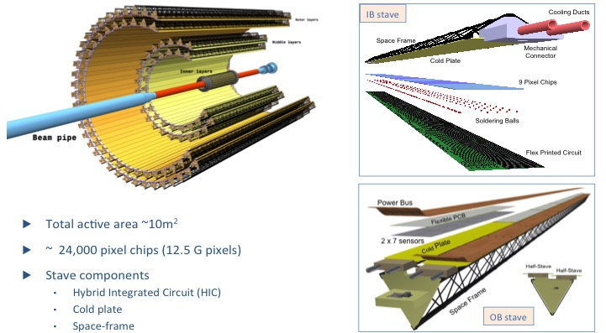
New ITS design

Slide 15
ALPIDE Chip

Slide 16
CMOS Pixel Sensor
J. Phys. G: Nucl. Part. Phys. 41 (2014) 087002
TowerJazz 0.18μm CMOS Imaging Process
Pixel pitch ~ 30 μm
High-resistivity (> 1kΩ cm) p-type
epitaxial layer (25μm) on p-type substrate
Small n-well diode (2 μm diameter),
=> low capacitance
Reverse bias voltage to substrate
(contact from the top) can be used
to increase depletion zone around NWELL collection diode
Deep PWELL shields NWELL of PMOS
Transistors
Very low power dissipation
Schematic of MAPS pixel
in imaging CMOS TowerJazz 0.18 μm technology

Slide 17
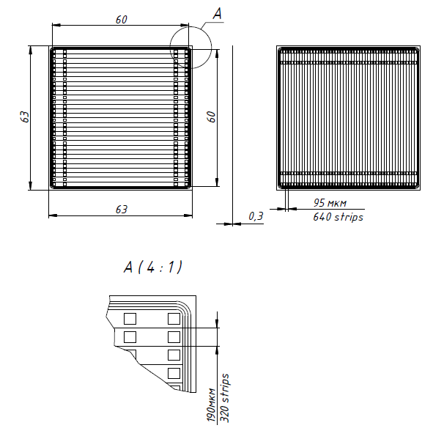
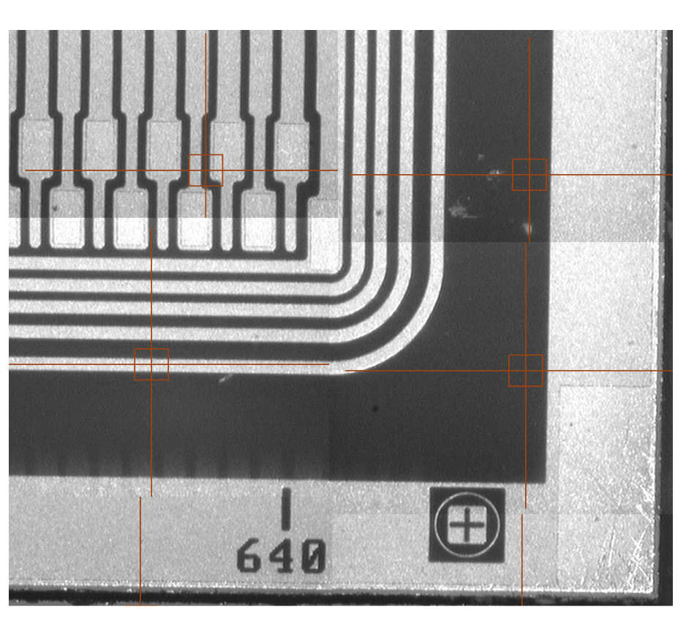
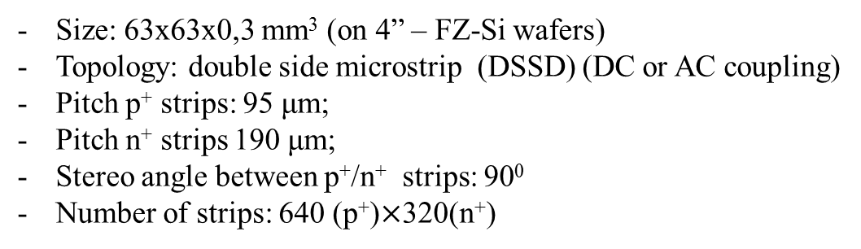
Detector’s topology
Size: 63x63x0,3 mm³ (on 4” – FZ-Si wafers)
Topology: double side microstrip (DSSD) (DC or AC coupling)
Pitch p⁺ strips: 95 μm;
Pitch n⁺ strips 190 μm;
Stereo angle between p⁺/n⁺ strips: 90⁰
Number of strips: 640 (p⁺)$×$320(n⁺)

Slide 18
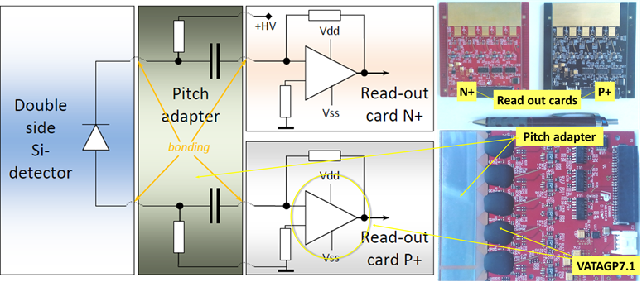
The functional scheme of detector module and appearance of two electronic boards
(FE-design of BM@N experiment)
DSSD with DC topology don’t contain integral resistors and capacitors (RC), therefore external R, C are required to supply bias voltage to each strip and to electrically decouple the DC current from the electronic inputs. This role is performed by Pitch Adapter (PA) with a topology of two types for p+ and n+ sides of the detector. In addition, PA has topology of contact pads similar to chips located on the side of electronic chips. PA modules are made on sapphire plates with an epitaxial layer of silicon (SOI). Integrated poly silicon bias resistors have a value of 0.7 – 1.0 MΩ, decoupled capacitors have a value of 140 pF. PA is assembled together with read-out ASICs on the read-out card. Positive polarity signals come from detectors to P+ read-out card (black PCB) while negative signals come to N+ read-out card (red PCB).

Slide 19
Parameters of new read-out chip
Readout ASIC VATAGP7.3.
Number of sensitive pre-amplifier (CSA) inputs – 128
Input charges (dynamic range) - -30fC ÷ +30fC
Peaking time (slow shaper) - 500ns (typ.)
Peaking time (fast shaper) - 50ns
Noise (ENC)- 70e +12e/pF (typ.)
Lowest threshold (no capacitance) 0.12fC
Good linearity for charges up to +/- 15fC
Gain from input to output buffer (diff. output currents) 16.5µA/fC
Output Serial analog multiplexer with 20 MHz clock speed nominal.
Voltage supply - +1.5V, -2.0V
Power dissipation per channel – tbd
We are waiting delivery of first 10 ASICs at the end of Q2 2019

Slide 20
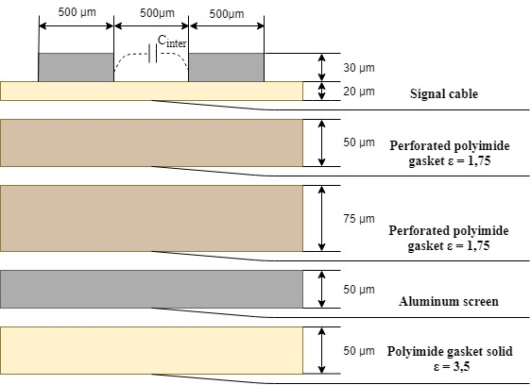
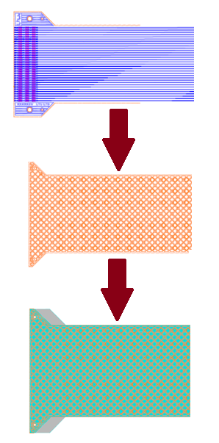
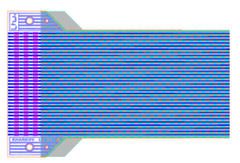
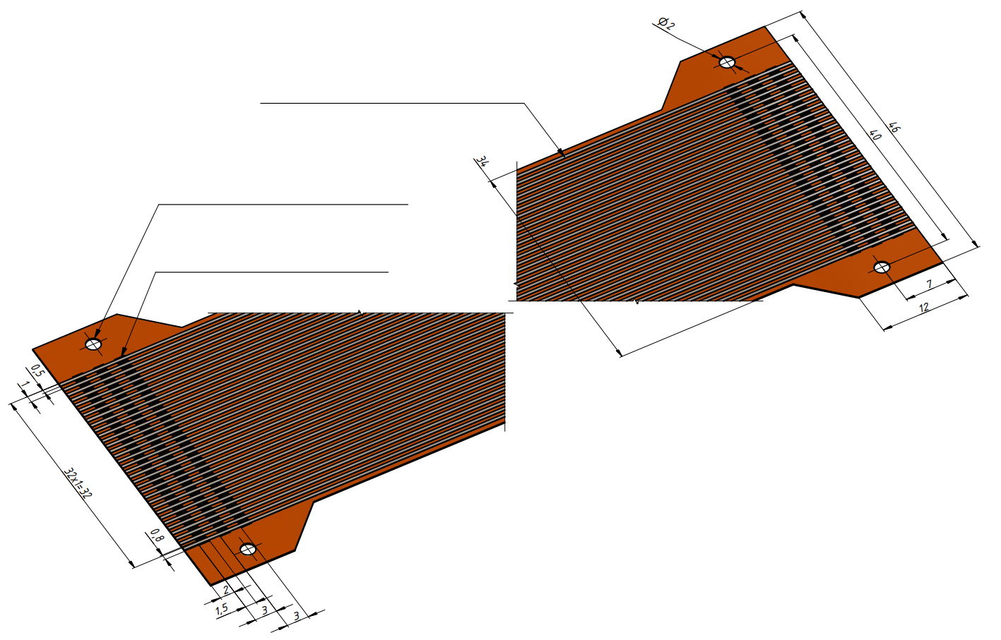
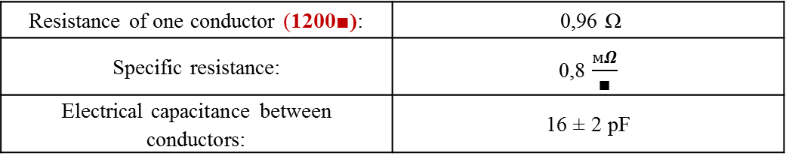
Polyimide cable
Manufacturing: Light Technologies Ukraine. Ukraine, Kharkov
viatcheslav.borshchov@cern.ch, maksym.protsenko@cern.ch
Maximum cable length 600 mm
The combination of signal and shielding layers
Signal cable
Perforated dielectric strip (perforation area 70%)
Additional holes for combining layers
Shielding layer with gasket
33 aluminum conductors (width 0.5 mm)
Cable positioning holes
3 rows of windows for unwelding conductors
Resistance of one conductor (1200■): | 0,96 Ω
Specific resistance: | 0,8 $\frac{мΩ}{∎}$
Electrical capacitance between conductors: | 16 ± 2 pF

Slide 21

Варианты симметричных линий
экран h=50 мкм
экран h=50 мкм
экран h=50 мкм
прокладка h=75 мкм, ε = 1,75
прокладка h=75 мкм, ε = 1,75
прокладка h=75 мкм, ε = 1,75
прокладка h=50 мкм, ε = 1,75
2 прокладки h=75+50 мкм,
ε = 1,75
прокладка h=50 мкм, ε = 1,75
(h эфф =70 мкм; εэфф = 2,25)
экран h=50 мкм
прокладка h=50 мкм, ε = 1,75
2 прокладки h=75+50 мкм,
ε = 1,75
прокладка h=50 мкм, ε = 1,75
(h эфф =120 мкм; εэфф = 2,15)
прокладка h=50 мкм, ε = 1,75
(h эфф =195 мкм; εэфф = 1,95)
экран h=50 мкм
экран h=50 мкм
maksym.protsenko@cern.ch

Slide 22
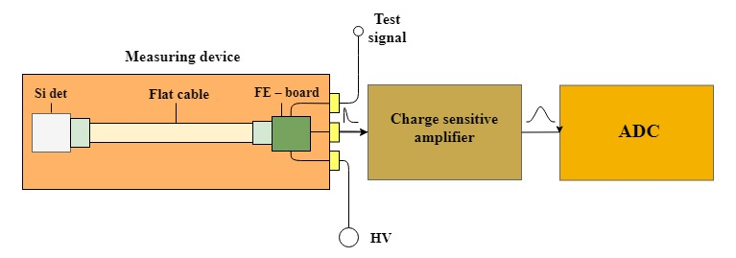
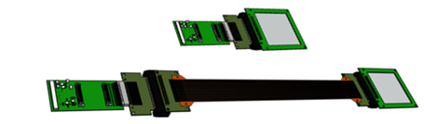
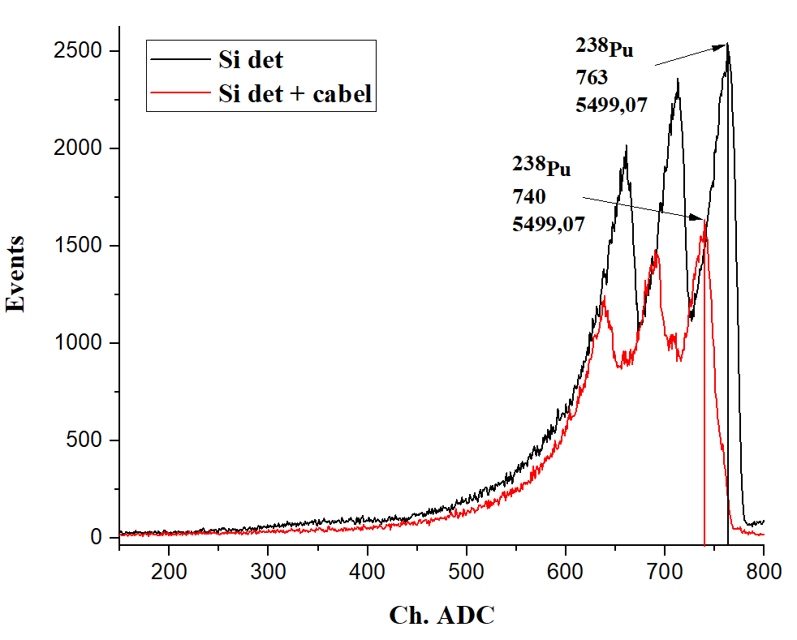
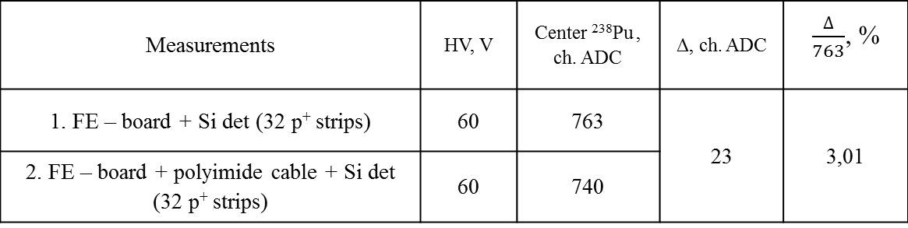
Measurement of the attenuation of α-signal in a polyimide cable without vacuum
1.
2.
Measurements | HV, V | Center ²³⁸Pu , ch. ADC | Δ, ch. ADC | $\frac{∆}{763}$, %
1. FE – board + Si det (32 p⁺ strips) | 60 | 763 | 23 | 3,01
2. FE – board + polyimide cable + Si det (32 p⁺ strips) | 60 | 740
The signal attenuation with polyimide cable (600 mm lenght or 1200■) is 3%

Slide 23
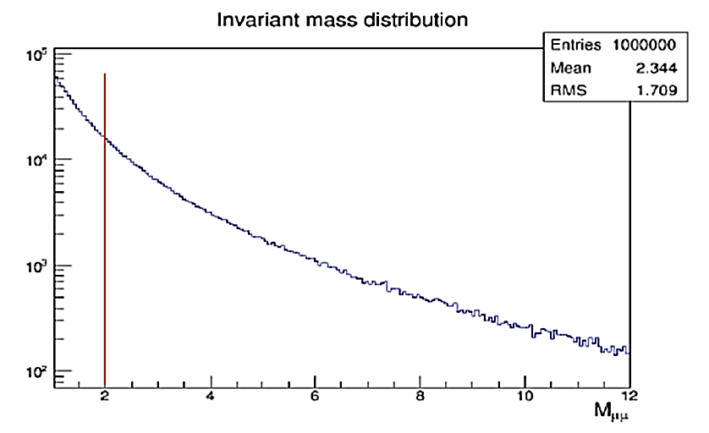
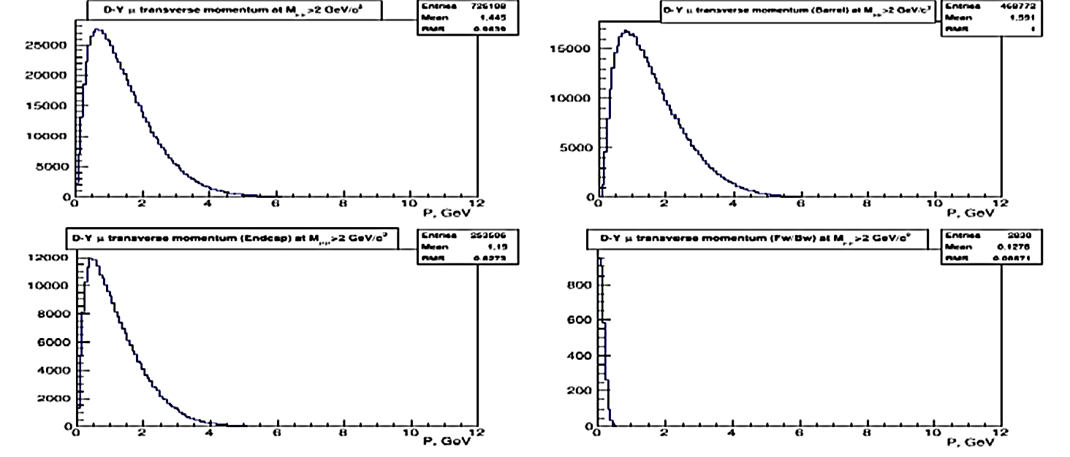
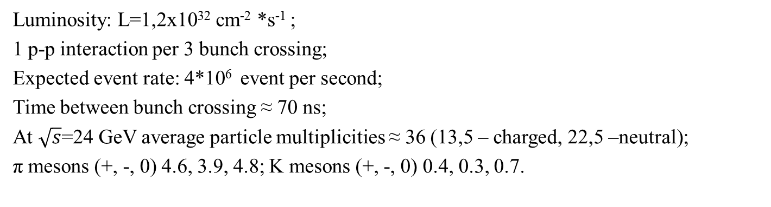
General conditions
Fig.1The di-muon invariant mass distribution
Fig.2 Distributions of the muon transverse momentum from
the DY events for different angular intervals.
Upper: left- all angles; right - 35º ÷145º
Bottom: left – 3º ÷35º ; right - 0º ÷3º .
Luminosity: L=1,2x10³² cm⁻² *s⁻¹ ;
1 p-p interaction per 3 bunch crossing;
Expected event rate: 4*10⁶ event per second;
Time between bunch crossing ≈ 70 ns;
At $\sqrt{s}$=24 GeV average particle multiplicities ≈ 36 (13,5 – charged, 22,5 –neutral);
π mesons (+, -, 0) 4.6, 3.9, 4.8; K mesons (+, -, 0) 0.4, 0.3, 0.7.
[From Letter of Intent]

Slide 24
End Cap
 | Number of Si-DSSD (63x63)mm on the end cap | Number of Si –MAPS (15x30)mm on the end cap |  |  | Area, m²
1 end cap - MAPS | 38 | 38 |  |  | 0,017
2 end cap – MAPS | 97 | 97 |  |  | 0,043
3 end cap – MAPS | 160 | 160 |  |  | 0,072
4 end cap – DSSD | 28 |  |  |  | 0,113
5 end cap – DSSD | 41 |  |  |  | 0,164
6 end cap – DSSD | 56 |  |  |  | 0,225
7 end cap – DSSD | 73 |  |  |  | 0,29
 | Total DSSD = 198 det x 2 = 396 det |  |  |  | Total MAPS = 0,132 m² x 2 =0,264 m²
 | Total MAPS = 295 det x 2 = 590 det | Total MAPS = 295 det x 2 = 590 det |  |  | Total DSSD = 0,79 m² x 2 =1,58 m²

