Slide 1
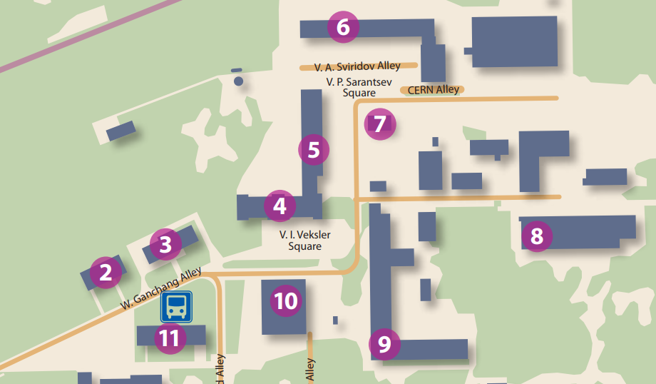
WiFi: LHEP or LHEP-HALL (no password)
Friday, 7th June, 17:30
  Excursion to the NICA construction site
  and Magnet production workshop
  Please, sign-up with the Organizing committee!
  Lunch:
  cafe “Pizzeroni”, this building
  LHEP canteen, see the map

Slide 2
Spin Physics Detector (SPD) project at the NICA collider
Roumen Tsenov, deputy director of the Laboratory of High Energy Physics,
SPD project coordinator in JINR

Slide 3
NICA (Nuclotron based Ion Colider fAcility)
is the flagship project in high energy physics
of the Joint Institute for Nuclear Research
Main targets of the NICA project:
- study of hot and dense baryonic matter
- investigation of nucleon spin structure,
polarization phenomena
Ring circumference, m | 503.04
heavy ions
energy range for Au⁷⁹⁺: √S_{NN}, GeV | 4 - 11
r.m.s. Δp/p, 10⁻³ | 1.6
Luminosity for Au⁷⁹⁺, cm⁻² s⁻¹ | 1x10²⁷
polarized particles
max. √S for polarized p, Gev | 27
Luminosity for p, cm⁻² s⁻¹ | 1x10³²

Slide 4
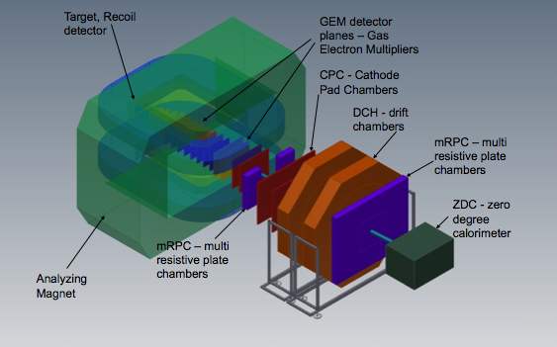
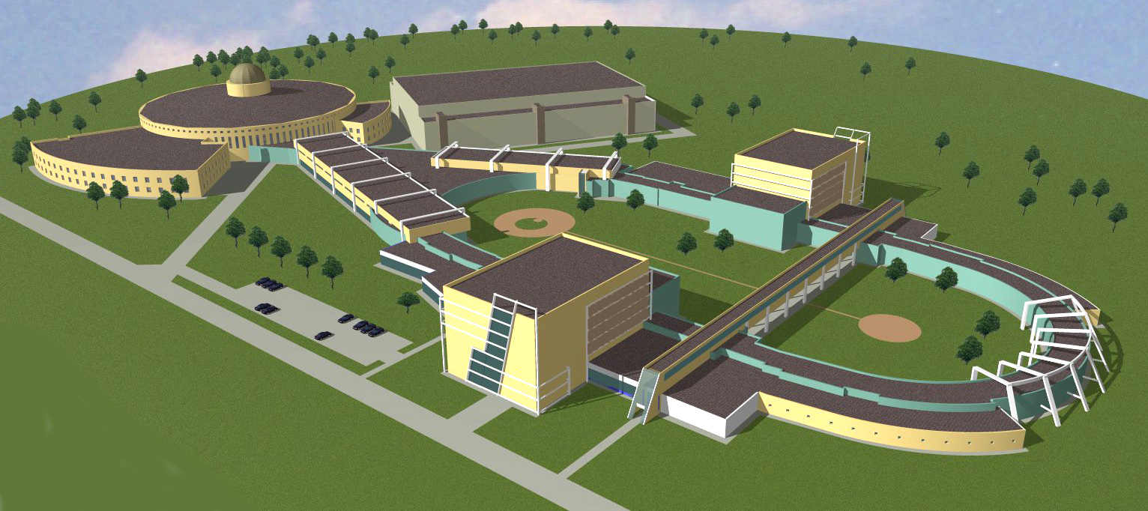
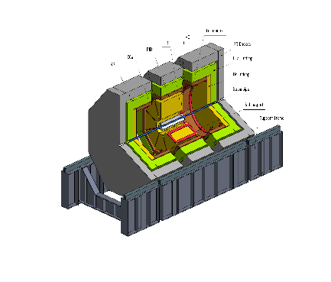
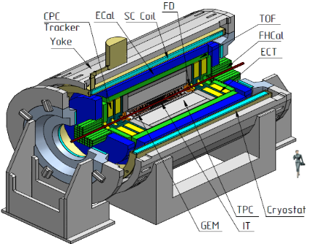
The NICA complex
existing facilities
to be constructed
KRION-6T+ HILac (3MeV/u)
BM@N
SPD
PS & LU-20 (5MeV/u)
hall for fixed target
experiments
Booster
(600 MeV/u)
SPD hall
MPD hall
NUCLOTRON 0.6-4.5 GeV/u
MPD
Collider

Slide 5

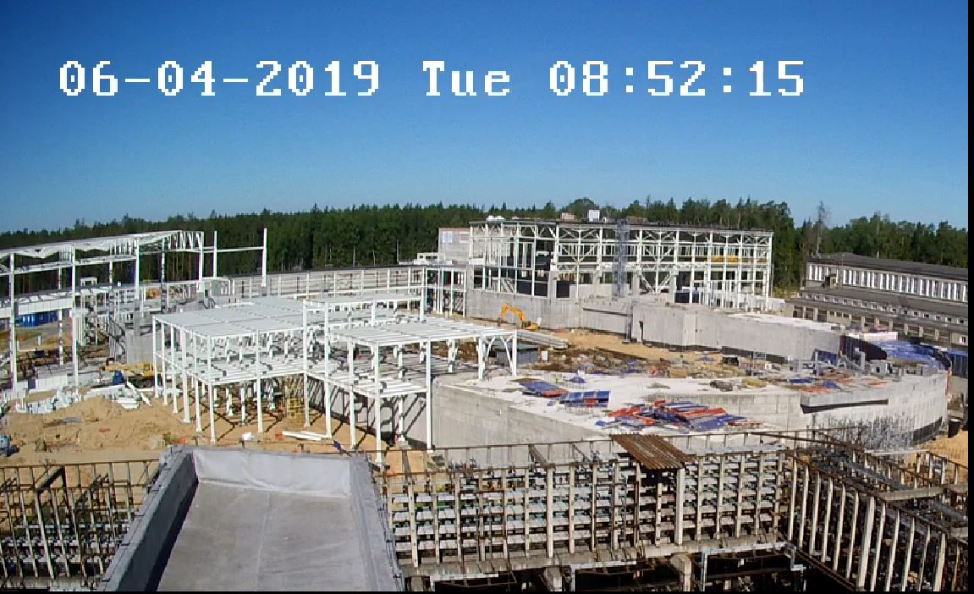
Civil Construction, bld.17
June 2018
Collider
Western semiring
MPD Hall
SPD Hall
http://nucloweb.jinr.ru/nucloserv/205corp.htm

Slide 6
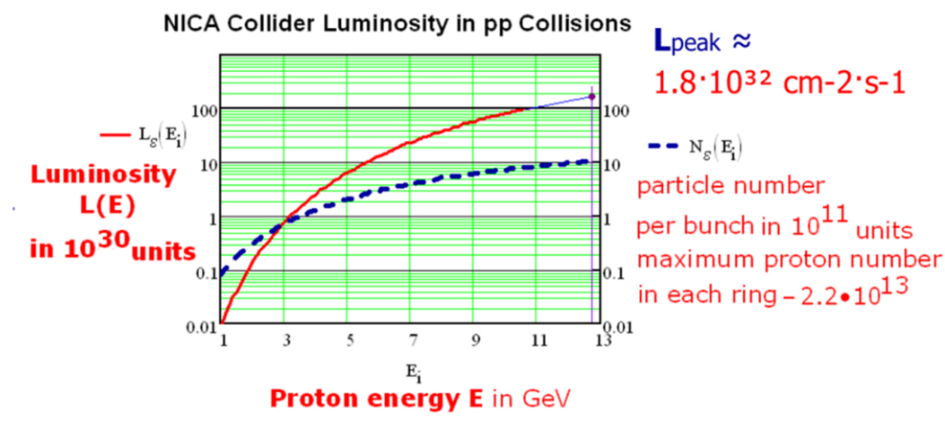
Polarized beams
Bunch crossing each 80 ns;
crossing rate 12.5 MHz .
Polarized beams
p↑p↑ at √s_{pp} = 12 - 27 GeV, L_{av} ≈ 10³² cm⁻²s⁻¹
d↑d↑ at √s_{NN} = 4 - 13 GeV
longitudinal and transverse polarization at SPD and MPD

Slide 7
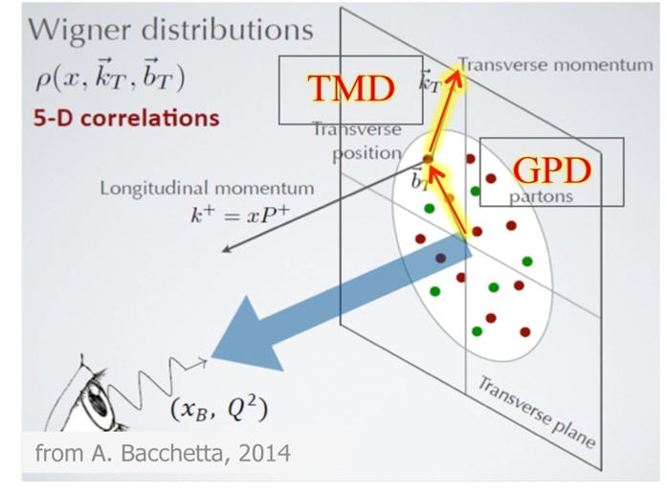
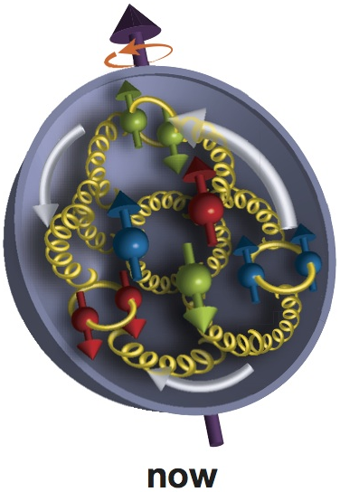
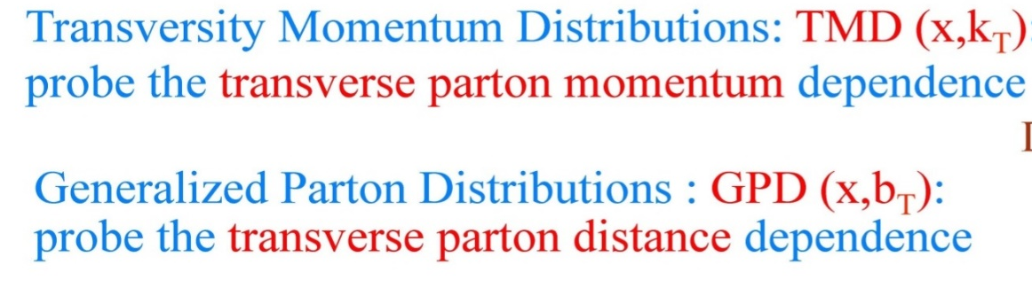
Spin dependent PDFs

Slide 8

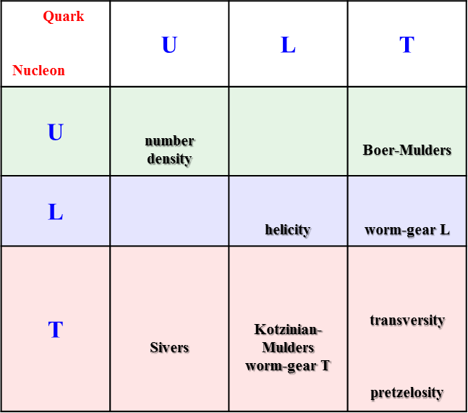
Nucleon structure and PDFs
Quark Nucleon | U | L | T
U | number density
L |  |  | worm-gear L
T | Sivers | Kotzinian-Mulders worm-gear T | transversity pretzelosity
PDFs describe different properties:
3 PDFs are needed to describe nucleon structure in collinear approximation
8 PDFs are needed if we want to take into account intrinsic transverse momentum k_{T} of quarks
spin of the nucleon spin of the quark k_{T}
f₁ -- density of partons in non-polarized nucleon;
g₁ -- helicity, longitudinal polarization of quarks in longitudinally polarized nucleon;
f┴_{1T} - Sivers, correlation between the transverse polarization of the nucleon (transverse spin) and the transverse momentum of non-polarized quarks;
etc…

Slide 9
Start of the SPD project
Letter of Intent presented at the JINR PAC in summer 2014, where:
  the physics program of the experiment was developed;
  requirements to NICA polarized beams were formulated;
  desired detector characteristics and sketch of the facility were given;
A few presentation at international conferences about the physics potential and program of the SPD were given;
Several workshops on spin physics at NICA were organized:
  NICA-SPIN-2013, Дубна, 17-19.03.2013
  SPIN-Praha-2013, 7-13.07.2013
  NICA-SPIN-2014, Praha, 11-16.02.2014
  SPIN-Praha-2015, 26-31.07.2015
  DSPIN2013, DSPIN2015, DSPIN2017
arXiv: 1408.3959
In 2017 a new stage of the project started:
From LoI to CDR (Conceptual Design Report)

Slide 10
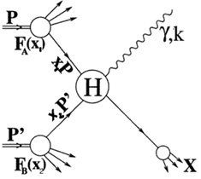
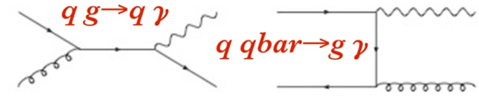
Physics tasks
Nucleon spin structure studies
  Drell-Yan pair production;
  Direct photons;
  Nucleon PDFs by J/ψ production;
Spin-dependent effects in elastic pp, pd and dd scattering;
Spin effects in exclusive hadron production;
Spin effects in production of hadrons with high p_{T} ;
etc….
Notes:
10
10
10
10

Slide 11
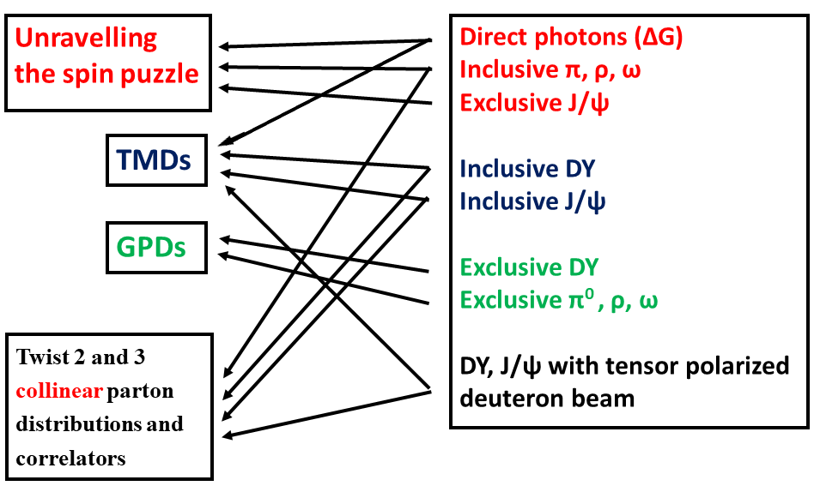

Slide 12
Minimum biased events
PYTHIA 6, √s_{pp} = 26 GeV; 4 MHz event rate
Average charged particle multiplicity ≈ 7.8
Average neutral particle multiplicity ≈ 6.5
√s
from A. Guskov

Slide 13
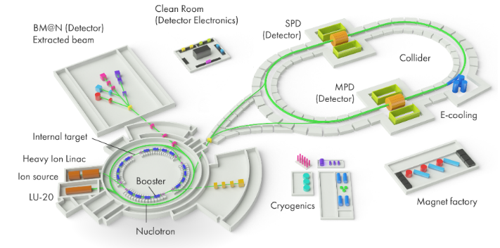
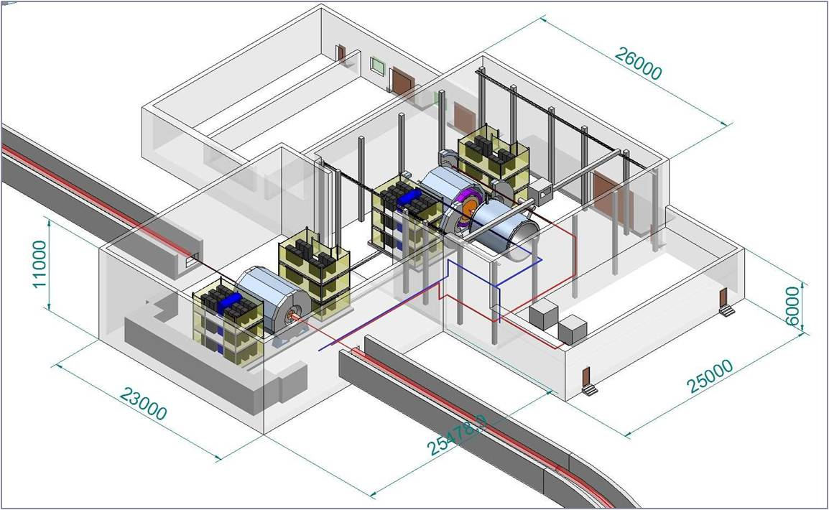
Requirements for the SPD
close to 4π geometrical acceptance;
high-precision (~50 µm) and fast vertex detector;
high-precision (~100 µm) and fast tracker,
good particle ID capabilities;
efficient muon range system,
good electromagnetic calorimeter,
low material budget over the track paths,
trigger and DAQ system able to cope with event rates at luminosity of 10³² (cm.s)⁻¹,
modularity and easy access to the detector elements, that makes possible further reconfiguration and upgrade of the facility.

Slide 14
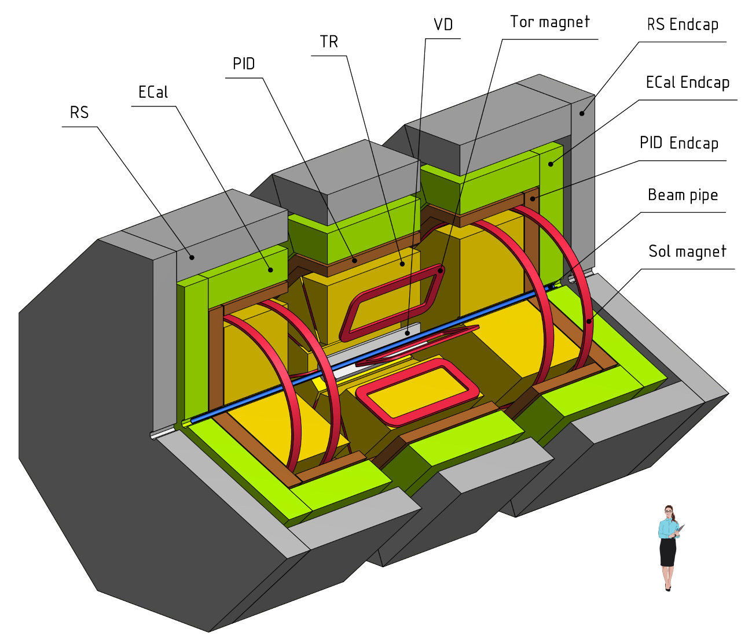
General view
Length: 9.2 m;
Diameter: 6.8 m;
Mass: 1800 t;
Consists of three modules;
Easy way to rearrange.

Slide 15
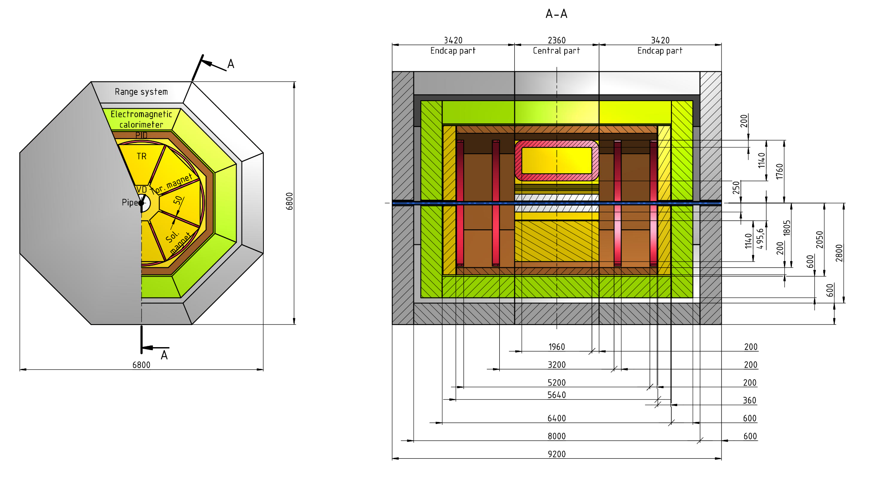
Dimensions

Slide 16
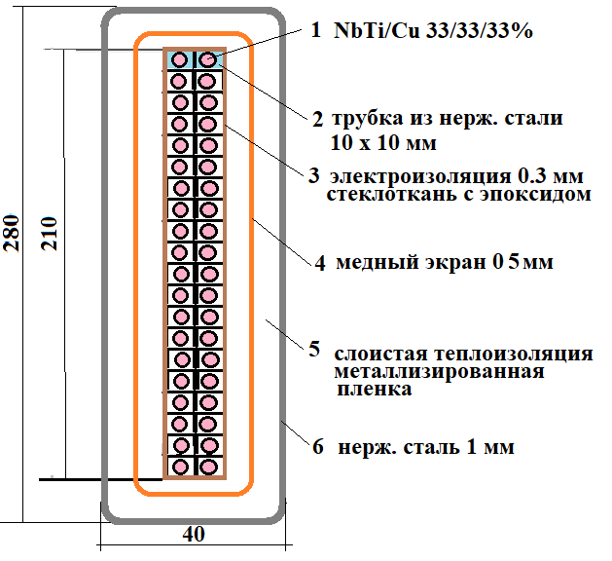
Hybrid magnetic system
stainless steel tube
insulation epoxy
layer, 0.3 mm
copper shield
multilayer thermal shield
outer cover,
1mm stailess steel

Slide 17
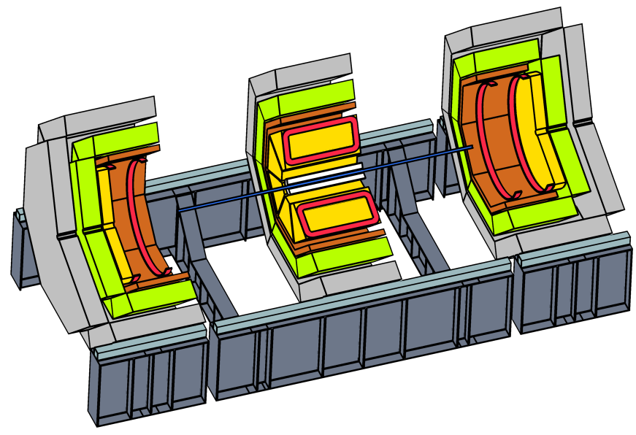
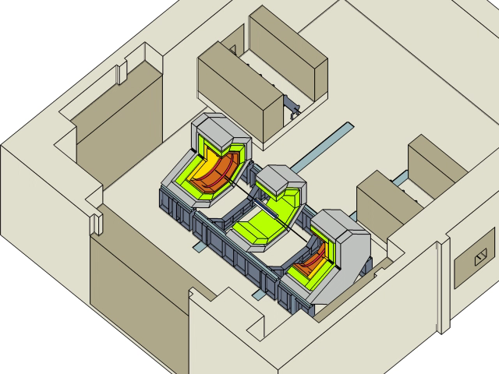
Reconfigurable design

Slide 18
SPD advantages:
measurements with pp, pd and dd beams,
possibility to perform energy scan with small steps,
measurements via muon
and electron-positron pairs,
operations with
non-polarized,
transverse and
longitudinally
polarized beams
and their combinations,
possibility to extract all
first order PDFs in one
experiment.
HOME INSTITUTE, EXPERIMENT | RHIC, STAR | RHIC, fsPHENIX | NICA, SPD
Beams | pp, pA, pHe³ | pp pA, pHe³ | pp,pd, dd, pHe³, dHe³
Polarization | 0.6 | 0.6 | 0.6-0.8
Luminosity, cm⁻¹ s⁻¹ | 5∙10³² | (0.8-6)∙10³² | 10³²
√s , GeV | 160,200, 500 | 160,200, 500 | 10-26
X₁, range | 0.3-1.0 | 0.3-1.0 | 0.1-0.8
Q _{T}, GeV | 1-10 | 1-10 | 0.5-6
Lepton pairs | µ+µ- | µ+µ- | µ+µ-, e+e-
Start of data taking | >2020 | >2021 | 2025
Measurements
Transversity | yes | yes | yes
Boer-Mulders | yes | yes | yes
Sivers | yes | yes | yes
Predzelosity | no | yes | yes
Worm-Gear | yes | no | yes
Flavour separation | yes | yes | yes
Exclusive DY | yes | no | yes
Deuteron quadrupole structure | no | no | yes

Slide 19
Collaborating institutions – 20 so far
  INFN section of Turin and University of Turin;
  Charles University, Prague;
  Technical University, Prague
  Tomsk State University;
  Tomsk Polytechnic University;
  Institute of Applied Physics of the Belarus Academy of Sciences;
  Gomel State Technical University, Belarus;
  Institute for High Energy Physics, Protvino;
  Institute of Nuclear Physics of the Moscow State University;
  Institute for Nuclear Research of the RAS, Troitsk;
  Lebedev Physics Institute of the RAS, Moscow;
  Institute for Theoretical and Experimental Physics, Moscow;
  St. Petersburg Nuclear Physics Institute, Gatchina;
  St. Petersburg State University;
  St. Petersburg Polytechnic University;
  Instituto Superior de Tecnologías y Ciencias Aplicadas (INsTEC), Havana University;
  Warsaw University of Technology;
  Samara National Research University;
  Belgorod State University;
  A.I. Alikhanyan National Science Laboratory, Armenia
Protocols for joint research within the SPD project signed.
EoI letters received
Bilateral agreements on NICA exist.

Slide 20
Roadmap
JINR project for the SPD design (Jan. 2019);
Conceptual and technical design of the Spin Physics Detector (SPD) at the NICA collider
Setting up of the collaboration, MoU (2020);
Preparation of the Conceptual Design Report (2019);
Preparation of the Technical Design Report, including prototyping (2020-2022).
Construction of the detector would take at least three years (2022-2025) and first measurements could be expected as early as close to the end of 2025…

Slide 21


SPD/NICA will provide a unique opportunity
not available at other facilities
to study all of the PDFs in one experiment
and obtain comprehensive information
on the nucleon spin structure
at high statistical level
with minimal systematic uncertainties
You are welcome
to join the SPD/NICA project!
Web site: spd.jinr.ru.
Contact person: Roumen Tsenov (tsenov@jinr.ru)
http://indico.jinr.ru/event/SPD-NICA-2019

Slide 22
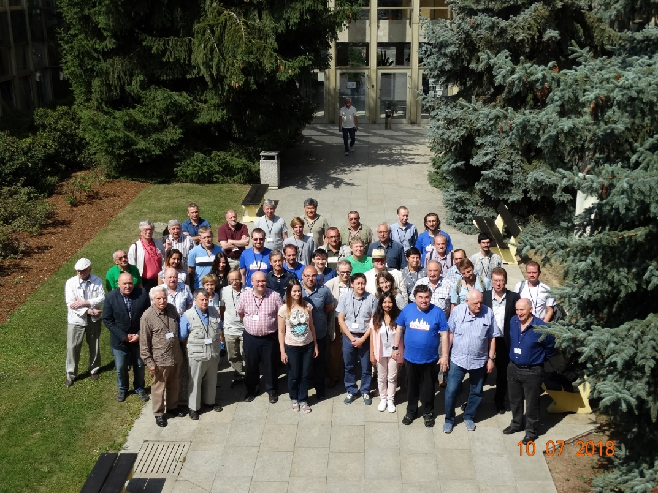
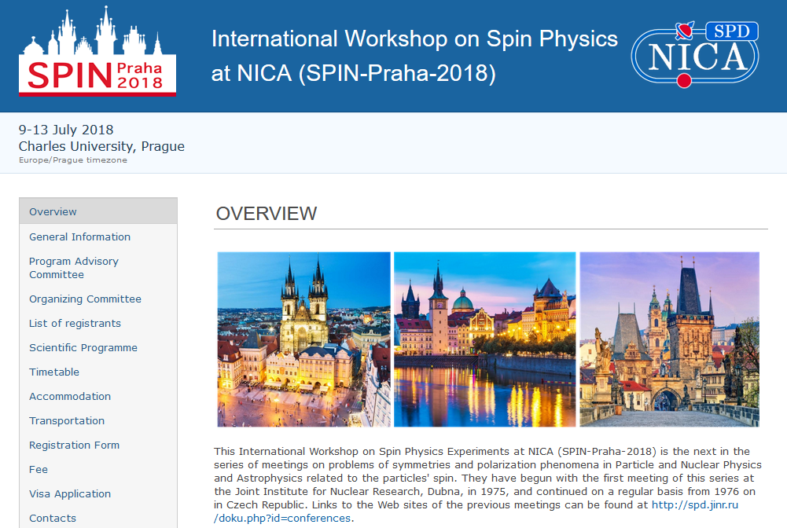
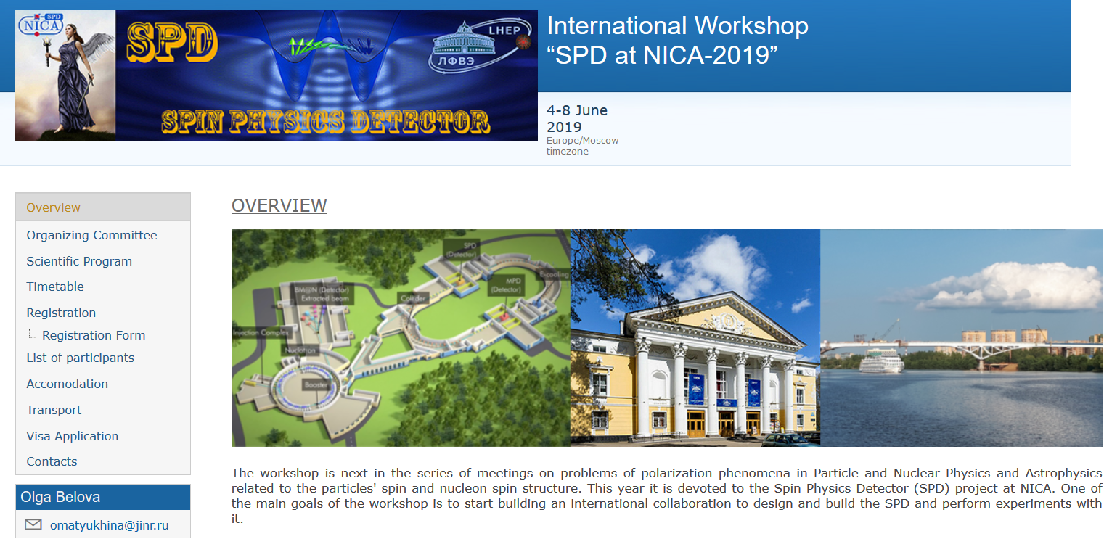
http://SPIN-Praha-2018
Notes:
22
22

Slide 23

SPD/NICA will provide a unique opportunity
not available at other facilities
to study all of the nucleon PDFs in one experiment
and obtain comprehensive information
on the nucleon spin structure
at high statistical level
with minimal systematic uncertainties.

Slide 24
Back-ups

Slide 25
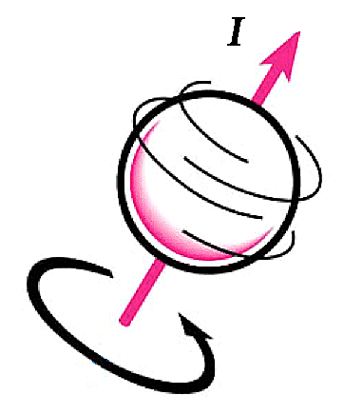
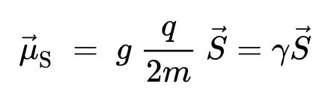
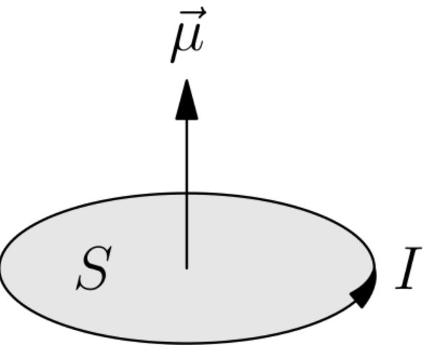
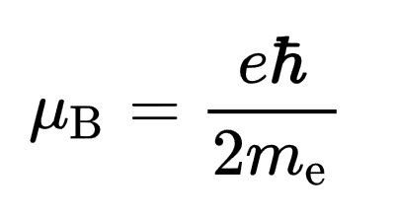
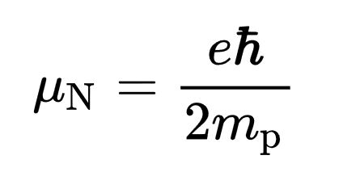
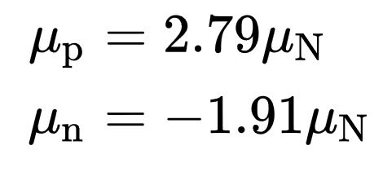
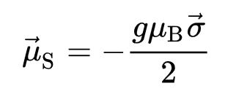
Spin and magnetic moment
nuclear magneton:
for the electron:
μ_{d} = 0.86μ_{N}

Slide 26
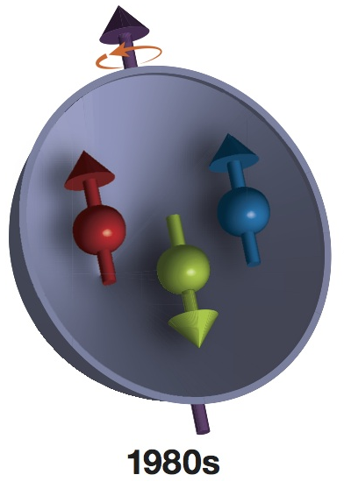
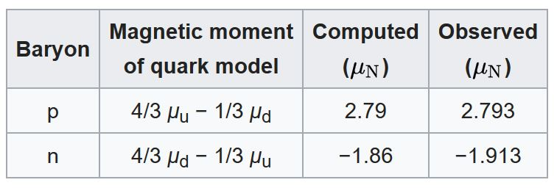
Nucleon spin structure
Before 1988
quarks
The quark model says:
the nucleon spin is carried only by quarks.

Slide 27
quarks
PROBLEM: According to the experimental data, only 30% of the nucleon spin is carried by quarks. Where does the rest of the spin come from?

Slide 28
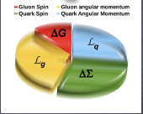

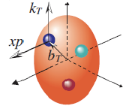
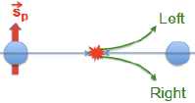
Spin and 3D structure of hadrons
Spin puzzle: small contribution of quarks (may be fractional because of density matrix rather than wave function description) to the proton spin
The deficit may be due to:
1.Gluon average spin ΔG, and
2.Orbital motion L related to transverse (completing to 3D) structure of proton
All ingredients can be explored at SPD!
Main instrument: transverse spin asymmetries
The simplest transverse asymmetry : left-right; more involved: azimuthal modulations

Slide 29
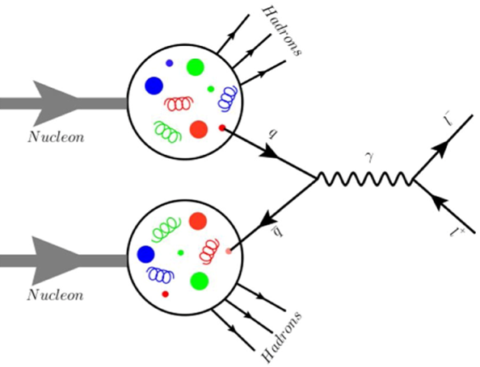

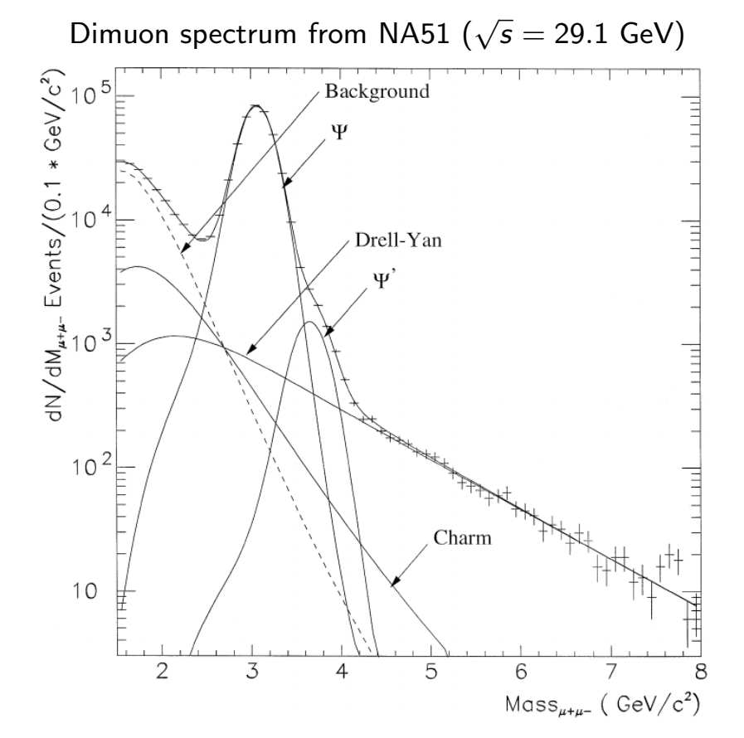
Drell-Yan process
A quark-antiquark pair creates a lepton (e/μ) pair trough a virtual photon
We can use this “virtual photon microscope” to look into nucleons and obtain access to PDFs.

Slide 30
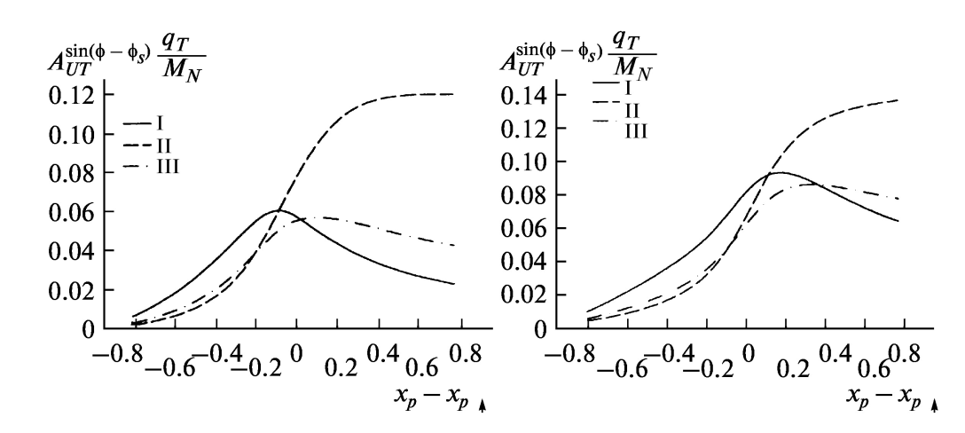
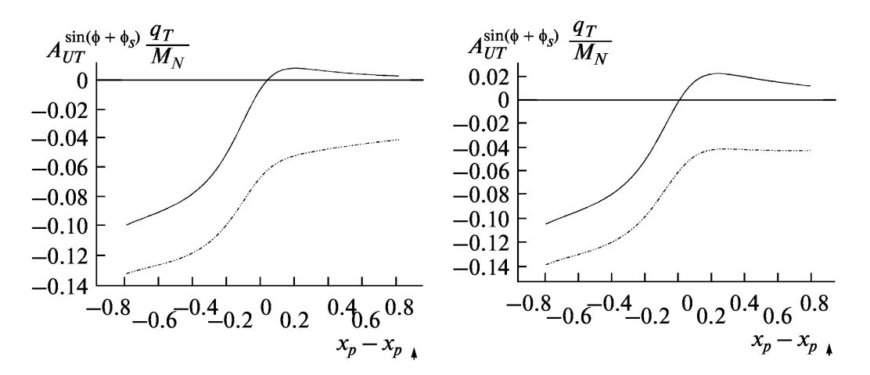
Asymmetries in DY pair production
Q² = 4 GeV²
Q² = 15 GeV²
Sivers
J.C.Collins et al., PRD73
(2006)014021
Boer-Mulders
s= 400 GeV²

Slide 31
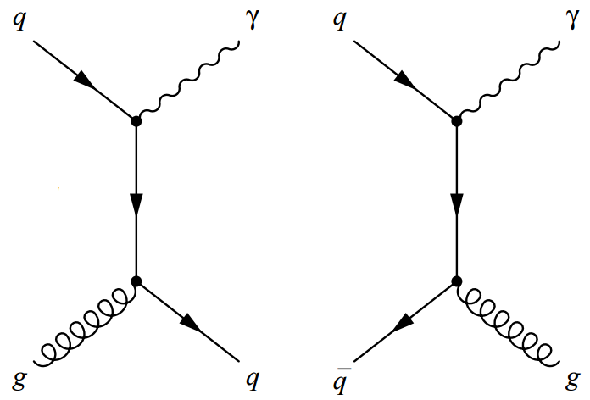
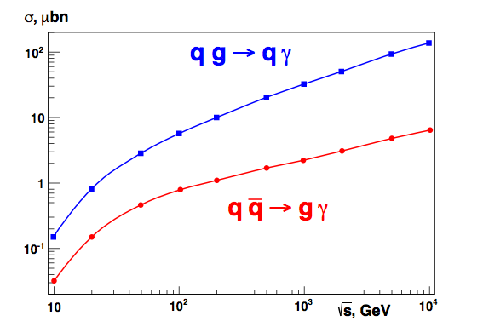
Prompt (direct) photon production
Gluon Compton
scattering
Quark-antiquark
annihilation
The gluon Compton scattering mechanism dominates…
q g→q γ 85%
q qbar→g γ 15%
NICA
…so we can obtain access to the contribution of gluon to spin of the nucleon.
RHIC

Slide 32
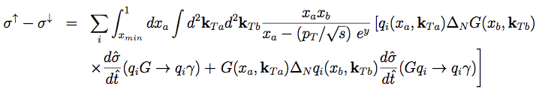
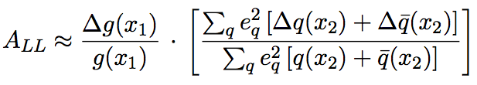

Prompt photons
The gluon Compton scattering gives access to the gluon content of proton:
Transverse beam polarization: access to the Sivers function for gluons
Longitudinal beam polarization: access to gluon polarization ∆g/g

Slide 33
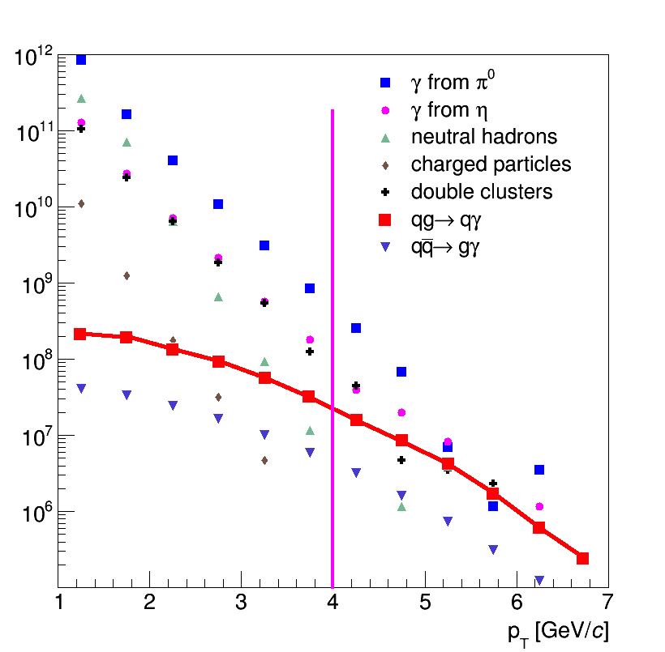
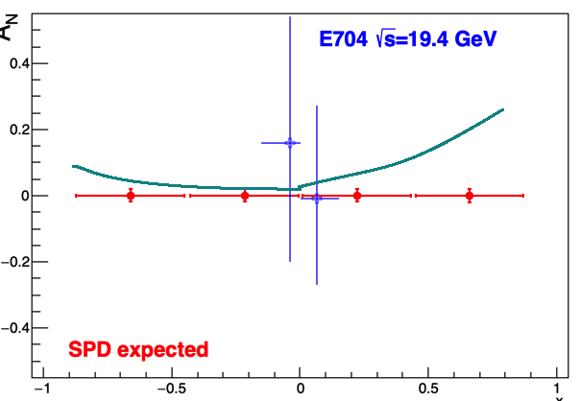
Prompt photon asymmetries: accuracy
Statistics: 3×10⁷ prompt photons with p_{T}>4 GeV/c for one year of data taking (10⁷ s). It could keep statistical uncertainty of AN and ALL asymmetries measurement below 0.001 level.
Main contribution to systematics comes from MC-dependent subtraction of background from decay photons, charged particles etc. The expected total error does not exceed (1-2)×10⁻².
Signal and different sources of background for prompt photon production
Similar accuracy is expected for ALL while the expected asymmetry is between ±0.05
SPD data for AN and ALL at √s∼20 GeV will be complementary to the expected results from RHIC (√s∼200 GeV) and corresponds to the region of typically larger values of ΔG/G
SPD expectations, previous measurement at similar kinematic range and theory predictions for AN

Slide 34
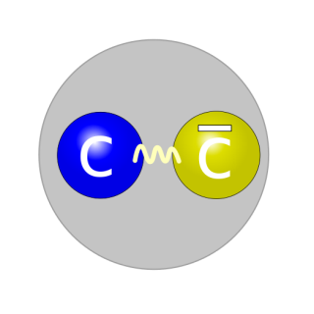
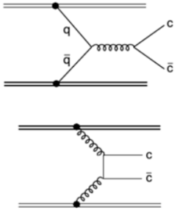
Charmonium (J/ψ) production
Applicability of the method is limited due the lack of understanding J/ψ production mechanism.
J/Ψ
Proton-proton collisions at SPD provide ideal opportunity for verification of theoretical approaches to J/ψ production.
Quark annihilation
NRQCD
Gluon fusion
Studying of J/Ψ production gives us access to the gluon PDFs.

Slide 35
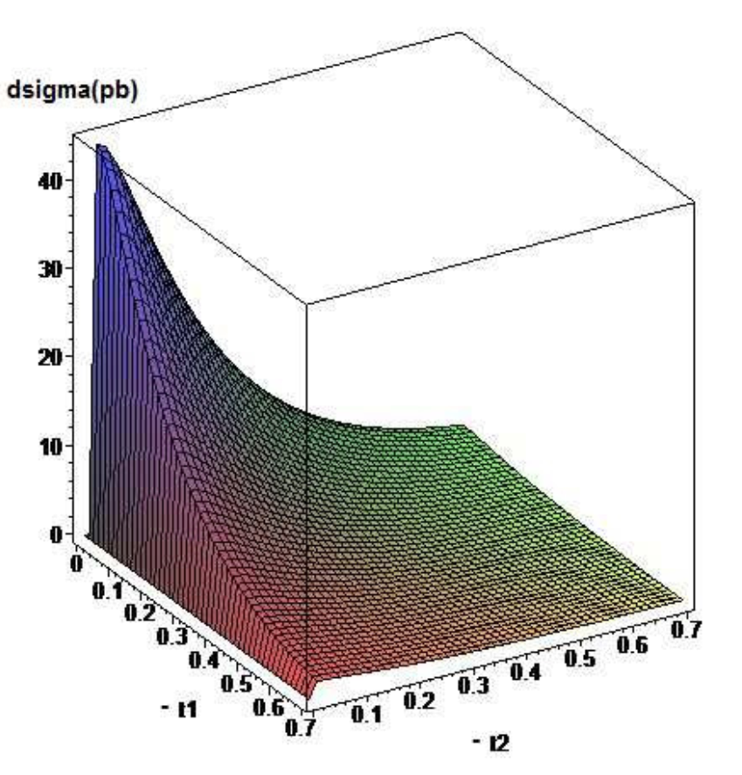
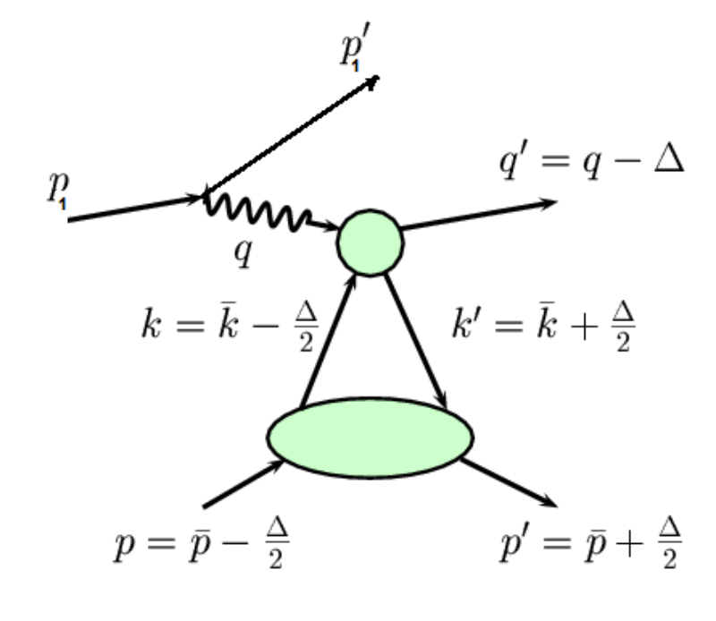

GPD through vector meson exclusive production
Exclusive DY
p+p → p+p+VM

Slide 36

Year 2014

Slide 37


Vertex detector (Inner tracker)
Charged particle creates electron/hole pairs, which migrates to electrodes creating signal in the nearest strips
Silicon vertex detector around the beam pipe;
Several layers of double ­sided silicon strips and MAPS;
Optimized number of layers w.r.t. material budget;
Goal: few tens of µm resolution for the vertex reconstruction.
Notes:
On the two sides of the substrate tiny aluminum strips are running in orthogonal directions (the typical inter-strip distance is 50 µm).
When a charged particle crosses the Silicon substrate electron/hole pairs are created. These electrons and holes then migrate to the different sides of crystal, creating signal in nearest strips

Slide 38


Central tracker
Minimum material on the particle tracks (X₀ ~ 0.1);
Time (~ 100 ns) and spatial resolution (~100 μm);
Expected particle rates (DAQ rates) ~ MHz;
Technology developed also in JINR, production workshops available

Slide 39



Electromagnetic calorimeter
Photon energy range 0.1 - 10 GeV;
Due to space limitations the total length of the ECAL module should be less than 50 cm;
Required energy resolution <10.0%/√E (GeV) and energy threshold below 100 MeV;
Design ("shashlik") similar of that for KOPIO ECal
About 6500 modules
Shashlik
Notes:
EM shower
Shashlik

Slide 40
DAQ
The SPD DAQ may be developed a la upgraded DAQ of the COMPASS experiment;
Event rate 3.0 MHz (at L=10³² cm⁻²s⁻¹, √s=27 GeV);
Rough preliminary estimation of the total data flux from the detectors (Si tracker + straw tracker + PID + ECal + range system): 10-20 GBytes/s (no detailed simulation results available yet);
Triggered or trigger-less DAQ: to be decided.

Slide 41

Software and computing

Slide 42



Kinematics
COMPASS
SPD

Slide 43


Unpolarised Drell-Yan
Boer-Mulder
Boer-Mulder
“Naïve” Drell-Yan model
Collinear ($k_{T}$= 0) LO pQCD no rad. processes
Intrinsic transverse motion + QCD effects
Experimentally observed large ν
and violation of the LT-relation

Slide 44





DY UA: NA10 vs SPD
In 6 bins
SPD dA $≈$ 0.02
with $\left\langle P_{beam 1,2}\right\rangle =1.0$ SPD dA $≈$ 0.008

Slide 45
Resources
Форма 29
NN пп | Наименование статей затрат | Полная стоимость | 2019 | 2020 | 2021
1. | Ускоритель, часы | 2100 | - | 700 | 1400
2. | Конструкт. бюро, нормо-часы, | 12250 | 4000 | 4000 | 4250
3. | Опытное пр-во, нормо-часы | 12700 | 4700 | 4000 | 4000
4. | Материалы, тыс. долл. | 850 | 445 | 205 | 200
5. | Оборудование, тыс. долл. | 920 | 465 | 235 | 220
6. | Оплата НИР, тыс. долл. | 280 | 105 | 105 | 70
7. 8. | Команд. расходы, тыс. долл., в т. ч. а) в страны не рублёвой зоны б) в страны рублевой зоны По протоколам о сотрудничестве | 285 225 60 120 | 95 75 20 30 | 95 75 20 40 | 95 75 20 50
 | Итого по прямым расходам, тыс. долл. | 2455 | 1140 | 680 | 635

Slide 46
Ресурсы по подсистемам
 | Ускоритель,часы | КБ, часы | ОП, часы | Материалы, k$ | Оборуд., k$ | НИР, k$ | Итого, k$
Калориметр |  | 800 | 800 | 25 | 25 | 20 | 70
Мюонная система |  | 1000 | 1000 | 135 | 135 | 10 | 280
Идентификация частиц |  | 1000 | 1000 | 15 | 15 | 40 | 70
Магнит |  | 2000 | 2000 | 15 | 15 | 100 | 130
Трекер |  | 1000 | 500 | 135 | 135 | 20 | 290
Вершинный детектор |  | 1500 | 1500 | 250 | 250 |  | 500
Система сбора данных |  |  |  |  | 70 |  | 70
Компьютинг |  |  |  |  | 30 |  | 30
Тестовая зона | 1800 | 3500 | 4000 | 250 | 250 |  | 500
Локальная поляриметрия | 300 | 1100 | 1100 | 105 | 105 | 50 | 260
Станция мечения |  | 350 | 800 | 20 | 20 | 40 | 80
2100 ч. 12250ч. 12700ч. 850 k$ 920 k$ 280 k$ 2050 k$
ИТОГО из бюджета лаборатории: 2050 k$ + 285 k$ (МНТС) = 2335 k$

Slide 47
JINR participation:
112 authors, 37.7 FTE
Laboratory of High-Energy Physics
  authors: 74
  FTE: 24.4
Laboratory of Nuclear Problems
  authors: 30
  FTE: 11.3
Laboratory of Theoretical Physics
  authors: 6
  FTE: 2
Directorate (1), Laboratory of Information Technologies (1)

Slide 48

COMPASS data, pion beam

Slide 49









Kinematical ranges and statistics
PRL 119 (2017) 112002
COMPASS-2015 data
$4.3 GeV{/c}^{2}<M_{μμ}<8.5 GeV/c^{2}$
$q_{T}>0.4 GeV/c$
$\left\langle f\right\rangle ≈0.18$
$\left\langle P_{Target}\right\rangle ≈0.73$
${t≈1.08864×10}^{7}s$ (18 weeks, 126 days)
$\left\langle x_{F}\right\rangle =0.33$
$\left\langle q_{T}\right\rangle =1.2 GeV/c$
$\left\langle M_{μμ}\right\rangle =5.3$ $GeV/c^{2}$
$N_{DY}$= 35 $×$ ${10}^{3}$
SPD
$4.0 GeV{/c}^{2}<M_{μμ}<9.0 GeV/c^{2}$
$\left\langle P_{beam 1,2}\right\rangle ≈0.6$
$\left\langle x_{F}\right\rangle =0.0$
$\left\langle q_{T}\right\rangle =2.4 GeV/c$
$\left\langle M_{μμ}\right\rangle =4.8$ $GeV/c^{2}$
L = ${10}^{32} {cm}^{−2}s^{−1}$
${t=10}^{7}s$ (16.5 weeks)
$σ_{DY[4−9]}=0.074 nb$
$N_{DY}$ = $σ_{DY}×L×t$
$N_{DY}$= 88.8 $×$ ${10}^{3}$
$$dA=\frac{1}{P_{b1}P_{b2}}×\frac{1}{\sqrt{N}}$$

Slide 50



Asymmetries in high p_{T} hadron production
Diquark properties;
Confinement laws;
Nature of the huge spin effects;
Deuteron spin structure;
Properties of the bare NΛ- and NK-interactions;
Nature and properties of the cold super dense baryonic matter (CsDBM) (pA and AA);
Dilepton production puzzle in np-interaction.
Notes:
50
50

Slide 51
Systems that have not been thought out yet…
System for particle ID (multigap glass RPCs, Micromegas, Aerogel Cherenkov?);
"Zero degree" system (fine grained hadron calorimeter?)
Front-end electronics of the different subsystems;
Notes:
51

Slide 52


Beam test facility

