Slide 1
“HIGHER INSTITUTE FOR TEHNOLOGY AND APPLIED SCIENCES” (InSTEC)
SPD WORKSHOP, DUBNA, JUNE 2019
Notes:
Ofrezca una breve descripción general de la presentación. Describa el enfoque principal de la presentación y por qué es importante.
Introduzca cada uno de los principales temas.
Si desea proporcionar al público una guía, puede repetir esta diapositiva de información general a lo largo de toda la presentación, resaltando el tema particular que va a discutir a continuación.
1

Slide 2
SOME WORDS ABOUT InSTEC
1981 AS FACULTY FOR TECHNOLOGY AND NUCLEAR SCIENCES
FOUNDATION
1987 HIGHER INSTITUTE FOR TECHNOLOGY AND NUCLEAR SCIENCE, INDEPENDENT UH
FIRST STAGE
2003 HIGHER INSTITUTE FOR TECHNOLOGY AND APPLIED SCIENCES, STILL INDEPENDENT UH
SECOND STAGE
2018 HIGHER INSTITUTE FOR TECHNOLOGY AND APPLIED SCIENCES, AGAIN FACULTY OF UH
CURRENTLY
SPD WORKSHOP, DUBNA, JUNE 2019

Slide 3
MISION
PREPARATION OF PROFESIONALS FOR THE CUBAN NUCLEAR PROGRAM.
RESEARCH IN BASICS SCIENCES AND ENGINEERING.
FIRST TEACHERS: MAINLY PREPARED IN URSS, GDR, HUNGARY, AMONG OTHERS.
FOUR DISCIPLINES :
NUCLEAR PHYSICS.
RADIOCHEMISTRY.
ENGINEERING IN ENERGY AND NUCLEAR TECHNOLOGIES.
METEOROLOGY
SPD WORKSHOP, DUBNA, JUNE 2019

Slide 4
“CURRENT STATUS OF THE HEP-PHENOMENOLOGY AT InSTEC”
NUCLEAR PHYSICS DEPARTMENT
THEORETICAL NUCLEAR PHYSICS
HIGH ENERGY PHYSICS (PHENOMENOLOGY)
NUCLEAR ELECTRONIC AND INSTRUMENTATION
EXPERIMENTAL AND APPLIED NUCLEAR PHYSICS
OUR GROUP:
AVERAGE AGE AROUND 24 YEARS. IN DIFFERENT STAGE OF PREPARATION (UNDERGRADUATED, ALREADY GRADUATED, IN MASTER PROGRAMS, SOME IN PhD POSITION, ETC.)
Notes:
Ofrezca una breve descripción general de la presentación. Describa el enfoque principal de la presentación y por qué es importante.
Introduzca cada uno de los principales temas.
Si desea proporcionar al público una guía, puede repetir esta diapositiva de información general a lo largo de toda la presentación, resaltando el tema particular que va a discutir a continuación.
4

Slide 5
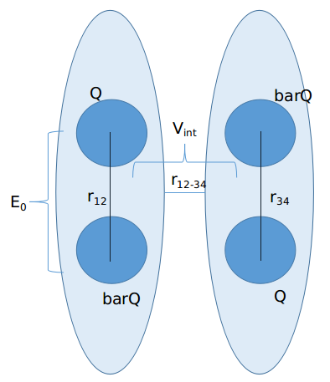
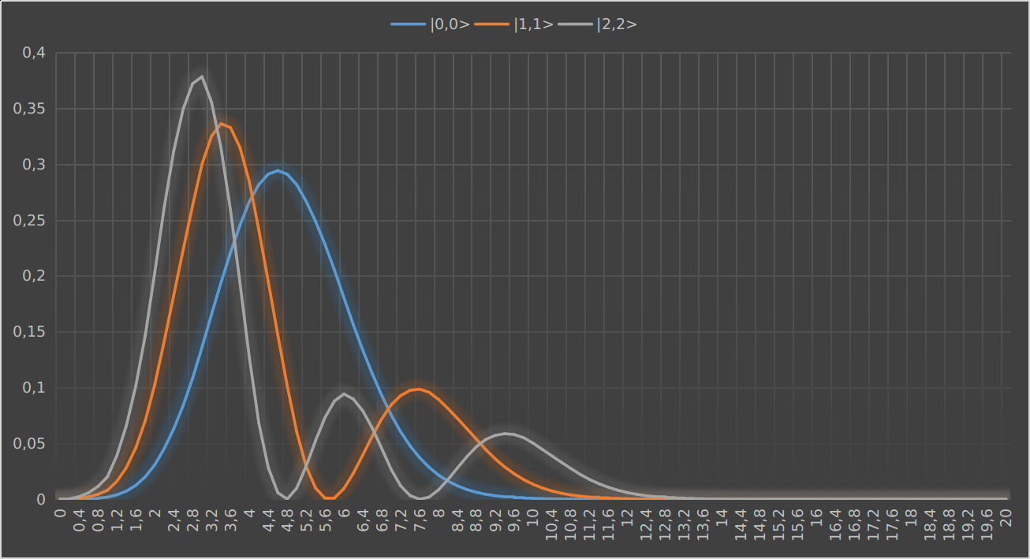
“CURRENT STATUS OF THE HEP-PHENOMENOLOGY AT InSTEC”
HIGH ENERGY PHYSICS (PHENOMENOLOGY)
DEVELOPMENT OF A PHENOMENOLOGICAL POTENTIAL MODEL FOR BOUND STATES OF QUARKONIUM (CHARMONIUM, BOTTONIUM), AND EXOTIC MESONS-LIKE STRUCTURES (TETRAQUARK): NON RELATIVISTIC AND RELATIVISTIC QUANTUM MECHANICS APPROACHES.
1. PERTURBATIVE APPROACH TO THE INTERACTION POTENTIAL BETWEEN TWO DIQUARKS (L=0)
ccbar-ccbar

Slide 6
2. SOLUTION OF THE DIRAC EQUATION WITH SPIN SYMMETRY AND POTENTIAL TENSOR FOR QUARKONIUM BOUND STATES
a) CASE OF CHARMONIUM
b) CASE OF BOTTONIUM

Slide 7
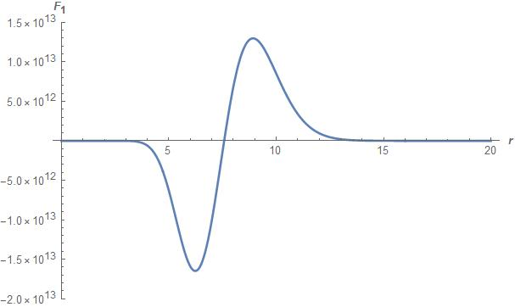
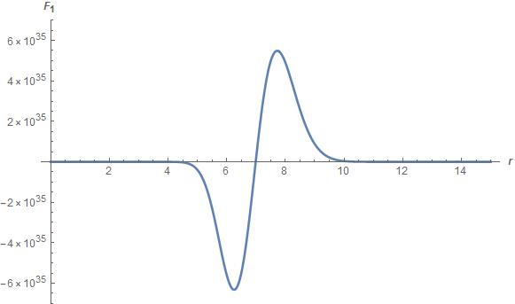
WAVE FUNCTIONS
a) CHARMONIUM
b) BOTTONIUM

Slide 8
3. Effects of nuclear transparency in the transition zone for the production of vector mesons.
USING THE FEYNMAN DIAGRAM TECHNIQUE, THE GBW MODEL FOR THE NUCLEON-DIPOLE INTERACTION AND THE REGGE THEORY, A NEW APPROACH HAS BEEN PRESENTED TO CALCULATE UNIFORMLY (PERTURBATIVE AND NON-PERTURBATIVE REGIME EQUALLY), THE PRODUCTION OF MESONS VECTOR. THE INTERACTION BETWEEN THE COLOR DIPOLE CREATED BY THE VIRTUAL PHOTON AND THE NUCLEON (PROTON) IS CARRIED OUT BY THE EXCHANGE OF TWO VIRTUAL GLUONS, WHICH THEY CONNECT THE COLOR DIPOLE WITH THE GLUON SEA INSIDE THE NUCLEON BY MEANS OF A TWO- GLUONS EXCHANGE. THE MODEL WAS TESTED IN THE PHOTOPRODUCTION OF MESONS Ρ0, Φ, AND J / Ψ.

Slide 9
THIS TYPE OF PROCESS INVOLVING SMALL CONFIGURATIONS ALLOWS:
THE STUDY OF THE DYNAMICS OF COLOR INTERACTIONS (IN THE CASE OF PARTICIPATING COLORLESS SYSTEMS).
TO PROVIDE INFORMATION ABOUT THE NATURE OF THE STRONG FORCE AND THE PERFORMANCE OF QCD IN TIGHTLY BINDING SYSTEMS.

Slide 10
COLOR TRANSPARENCY (CT):
CANCELATION OF (QCD) COLOR FIELDS FOR PHYSICALLY SMALL SINGLE CONFIGURATIONS OF QUARKS AND GLUONS (COLOR DIPOLES) VANISHING OF THE FINAL (INITIAL) STATE INTERACTIONS
VANISHING OF THE FINAL (INITIAL) STATE INTERACTIONS
If the proton contains (for the case of collision) more than the minimum constituents, the incident particle that interacts with the proton discerns more structures in addition to its three valence quarks. In our case, the incident particle is a virtual photon, which comes out of an ultra-peripheral e-p collision.

Slide 11
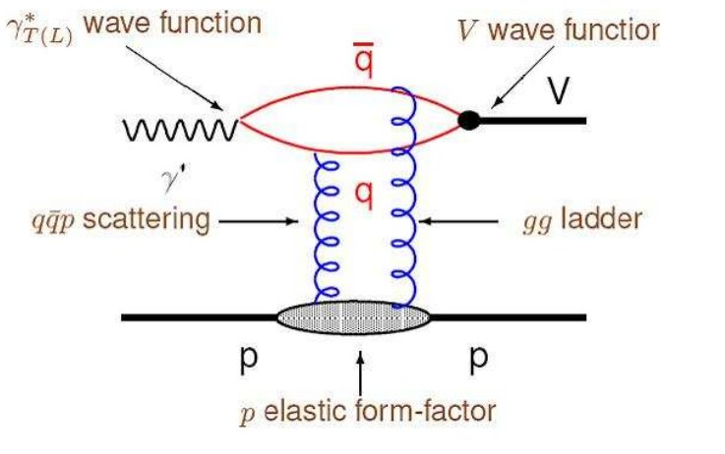
VECTOR MESON PRODUCTION
TYPICAL FEYNMAN DIAGRAM FOR THE PRODUCTION OF VECTOR MESONS.
CASE OF TWO - GLUONS EXCHANGE (LEADING TWIST APPROXIMATION)

Slide 12
VECTOR MESON PRODUCTION
MODELS
SEVERAL APPROACHES
IN PARTICULAR , WE FOLLOWED THE GOLEC-BIERNAT-WUSTOFF (GBW) MODEL.
$$σ_{nucl}^{dip}=σ_{0}\left\{1−exp\left(\frac{Q_{sat}^{2}}{4}r_{⊥}^{2}\right)\right\}$$
USUALLY: $σ_{0}$ IS CALCULATED SOLVING THE SCHROEDINGER EQUATION (IN SOME VECTOR SPACE) TO DETERMINE THE INITIAL AND FINAL WAVE FUNCTIONS
WE PROPOSED
$$σ_{0}=σ_{Regge}{|M|}^{2}$$

Slide 13
WHERE $σ_{Regge}$ ACCOUNTS FOR THE CASE BOTH GLUONS ARE SOFT (LOW MOMENTUM)
$$σ_{Regge}=\frac{W^{α}}{\left.b(W\right)}$$
$${|M|}^{2} WAS CALCULATED USING THE FEYNMAN RULES$$
$${|M|}^{2}=\frac{4α_{s}^{2}}{π^{3}}\left(p_{v}+m_{q}\right)\ln\left\{\frac{Q_{max}+4p_{v}}{Q_{min}+4p_{v}}\right\}+M_{0}^{2}$$

Slide 14
$${|M|}^{2} WAS CALCULATED USING THE FEYNMAN RULES$$
$${|M|}^{2}=\frac{4α_{s}^{2}}{π^{3}}\left(p_{v}+m_{q}\right)\ln\left\{\frac{Q_{max}+4p_{v}}{Q_{min}+4p_{v}}\right\}+M_{0}^{2}$$
FINALLY:
$$σ_{T}=\iint{dxdzf\left(z\right)f\left(1−z\right){\{xG(x,Q^{2}\}}^{2}}σ_{nucl}^{dip}$$

Slide 15
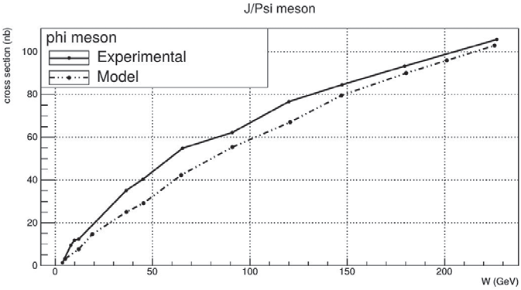
Meson | $$ρ^{0}$$ | $$J/ψ$$
δ | 0,266 | 0,681
relative error | 0,0988 | 0,0403
deviation | 0,174 | 0,027
THE RESULTS OF THE HERA COLLABORATION FOR δ WERE 0.22 FOR THE ρ0 y 0.70 FOR J/Ψ
FIGURE 1 Comparison between the experimental results (continuous line) and our model predictions (dotted line) for J/Ψ cross-section photoproduction

Slide 16
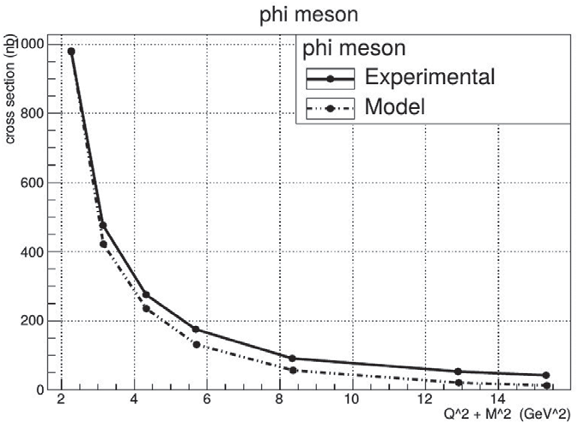
FIGURE 2 Comparison between the experimental results (continuous line) and our model predictions (dotted line) for 𝜙 cross-section photoproduction versus the square sum of the mass and the transfer momentum.

Slide 17
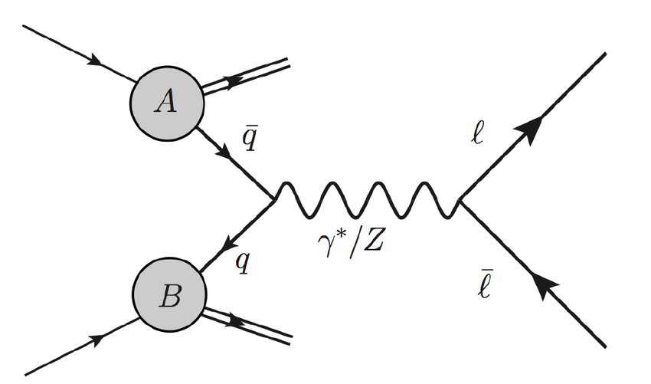
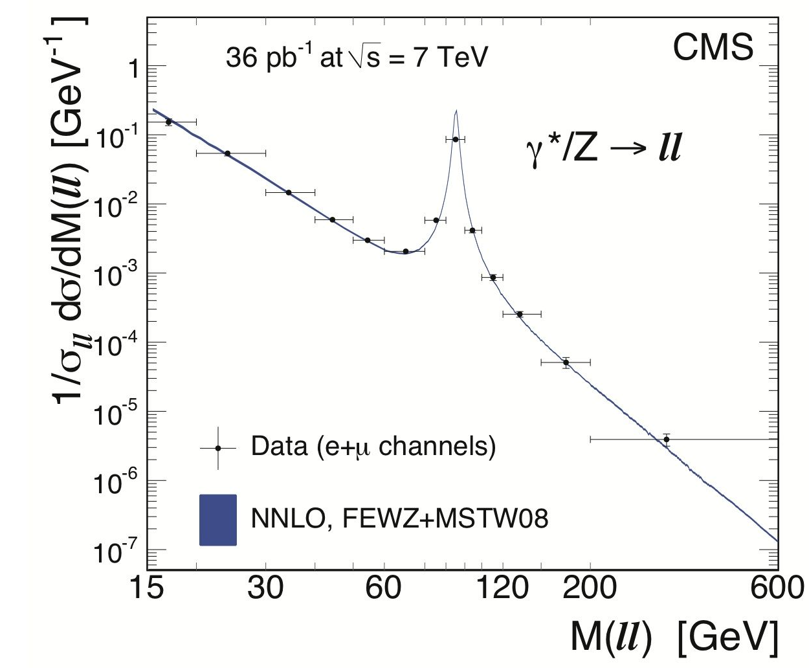
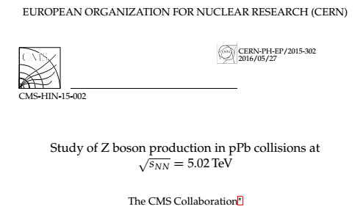
4. DRELL-YAN Z-BOSON PRODUCTION IN pPb, PbPb COLISSIONS
91,1876(21)GeV
$$q$$
$$\overline{q}$$
Figure A: Dilepton mass cross section of a collision pp at $\sqrt{S}=7 TeV$
STAR-SMFNS 2019

Slide 18
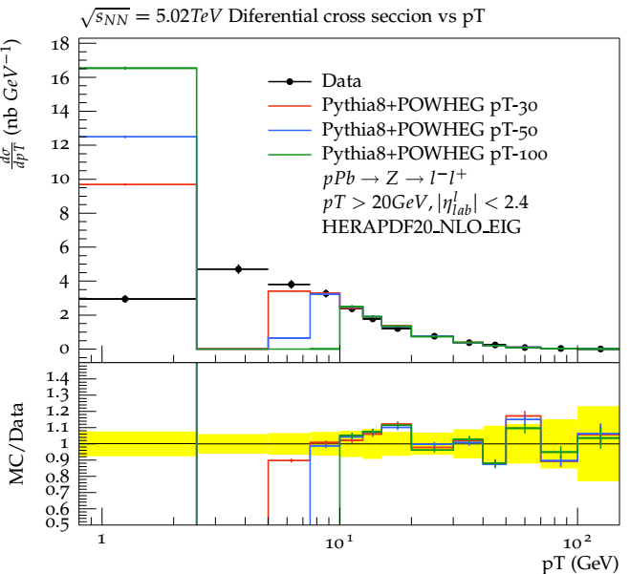
What “pT cut” does?
“pT cut”
pTsqmin
Minimum value of pT² to produce shower
Figure 4: Cross section dependency with transversal momentum using different “pt cut” values. Parton shower – OFF.
STAR-SMFNS 2019
Notes:
What really pT cut parameter does?....

Slide 19
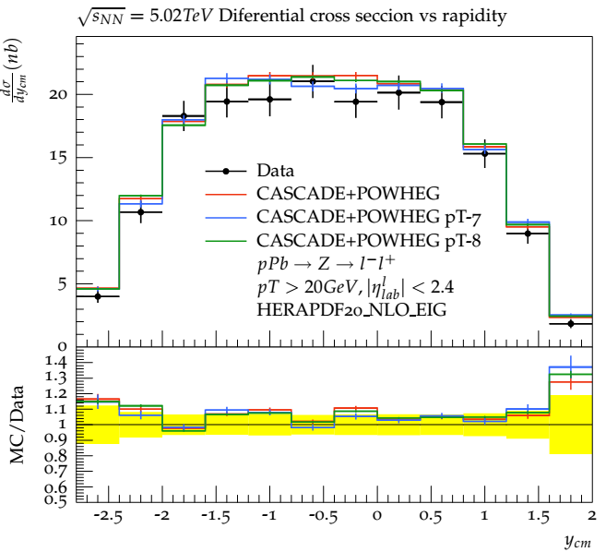
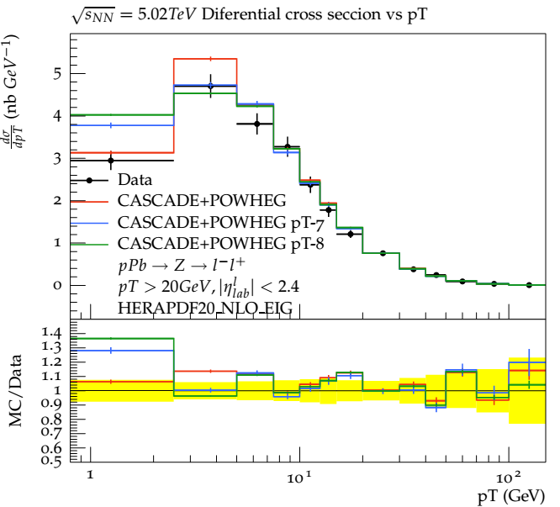
Cross section dependence with “pT cut” parameter
a)
b)
Figure 5: Cross section decency with a) rapidity and b) transversal momentum. CASCADE+POWHEG NLO calculation. Dependency with “pt cut”
STAR-SMFNS 2019

Slide 20
Simulation
Experiment
?
pp collision
pPb collision
pPb COLISSION AT $\sqrt{S_{NN}}=5.02 TeV$
Beam symmetry
Scale factor
$$\frac{dσ_{pA}}{dx_{i}}\sim A\frac{dσ_{pp}}{dx_{i}}$$
Laboratory Frame
Center of Mass Frame
Using Asymmetric beams
Using a shift on rapidity distribution
$$∆y=0.465$$
STAR-SMFNS 2019

Slide 21
Cross section dependence with “pT cut” parameter
a)
b)
Figure 5: Cross section dependence with a) rapidity and b) transversal momentum. CASCADE+POWHEG NLO calculation. Dependency with “pt cut”
STAR-SMFNS 2019

Slide 22
Cross section dependence with “pT cut” parameter
Figure 5.b: Cross section dependence with transversal momentum. CASCADE+POWHEG NLO calculation. Dependency with “pt cut”
STAR-SMFNS 2019

Slide 23
THANKS

Slide 24
BACKGROUND

Slide 25
searching for a comprehensive approach that contains, intrinsically, a connection between non-perturbative and perturbative QCD has been a challenge for physics in the last decades. The Physics related to color transparency and the production of vector mesons is, maybe, a unique scenario to explore the interplay between both.

