Slide 1
Status Update of the DCH Software Nikolay Voytishin
BM@N Software Meeting
February 22, 2019

Slide 2
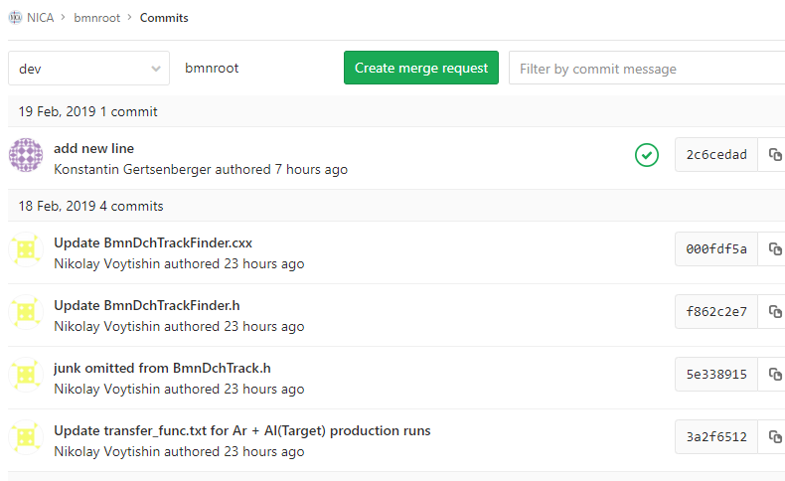
Current status
DCH reconstruction updated and available as a task in /bmnroot/macro/run/run_reco_bmn.C

Slide 3
Usage
How to launch:
root -b -q 'run_reco_bmn.C("run7-4649:/path_to_your_digi_file_directory/bmn_run4649_digi.root",“output_file_name.root",start_event,number_of_events)‘
Input files needed (for DCH part):
digi file;
/bmnroot/input/transfer_func.txt (already there for Ar production runs);
Output files:
output_file_name.root – file with branches with hits/tracks from different detectors;
test.BmnDCHTracking.root – file with hists for DCH performance check (to be removed from the task, once everything settled).

Slide 4
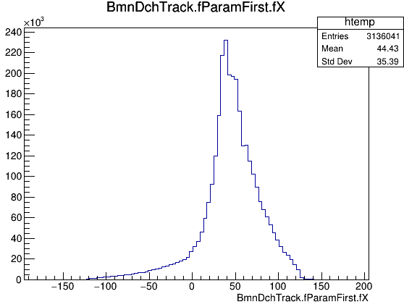
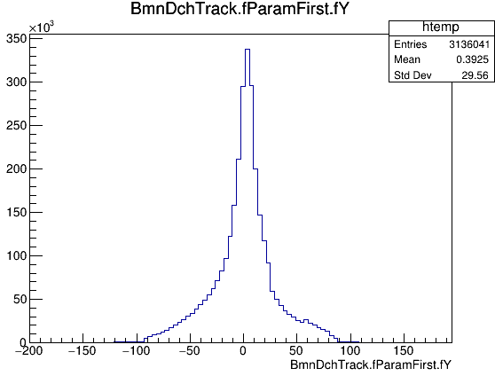
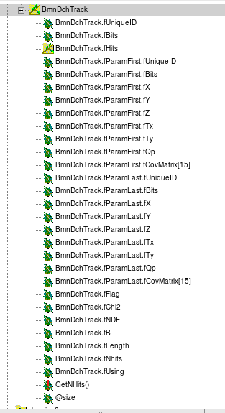
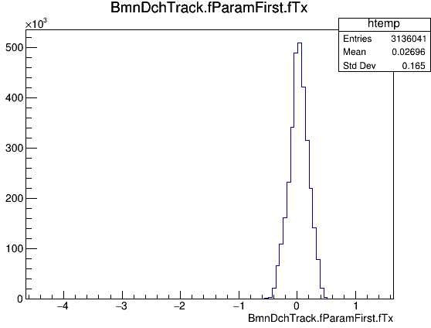
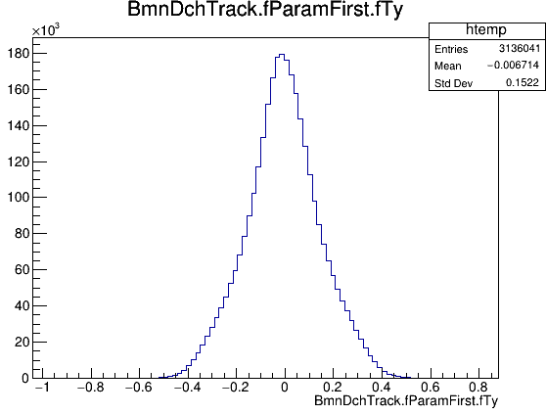
Output tree
The DC1, DC2 and global DC tracks can be distinguished by Z coordinate
fFlag contains the numbers of the pair segments that were matched in a global DCH track
fFlag = 1000*(dc1_seg_number +1) + (dc2_seg_number + 1)

Slide 5
DataBase usage plans
SRC (Alignment, Cuts for segment builder, Array increment):
B off, Empty target; (transfer function)
B on, Empty target; (transfer function)
B on, Non-empty target. (transfer function)
BMN (Alignment, Cuts for segment builder, Array increment):
B off, Al target (4648); (transfer function)
B on, Non-empty target (4649). (transfer function)
Remark. All above is ready in form of txt files. The procedure for automatic insertion to DB under development.

Slide 6
Backup slides

Slide 7
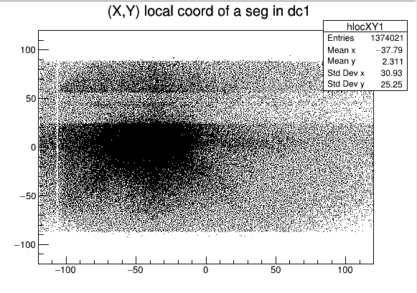
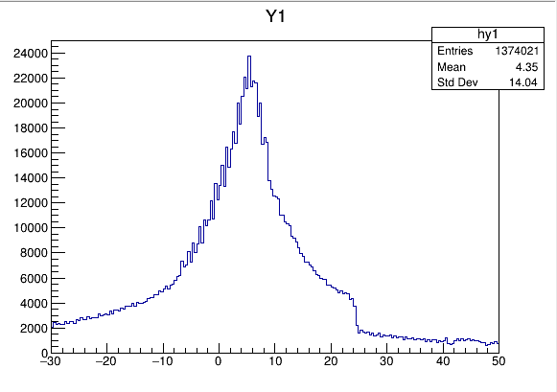
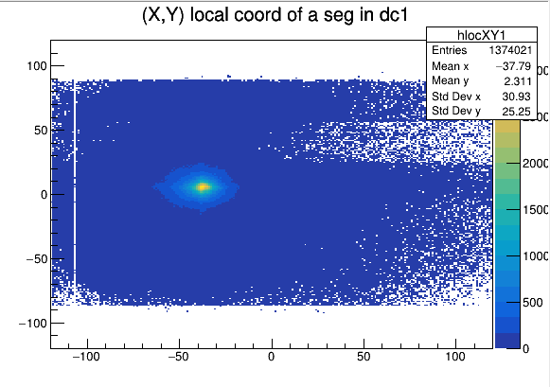
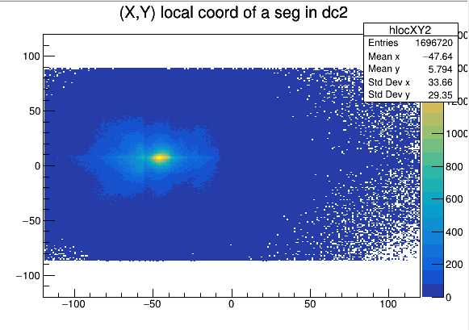
Local coordinates of a segment

Slide 8
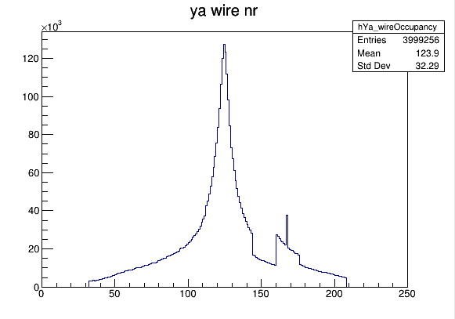
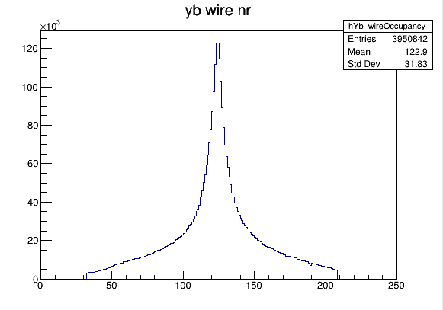
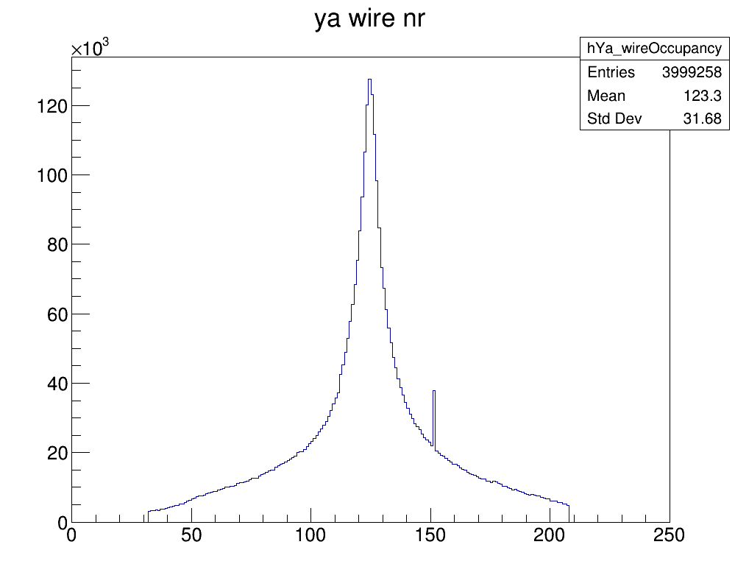
Y wire occupancy
Wrong mapping

Slide 9
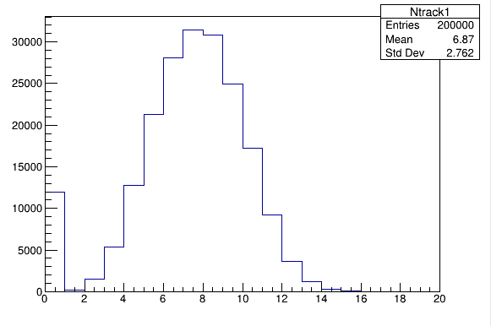
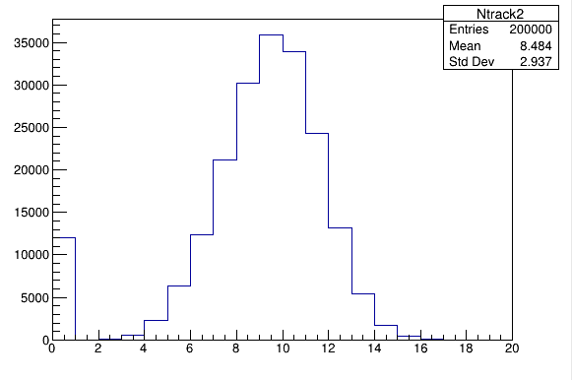
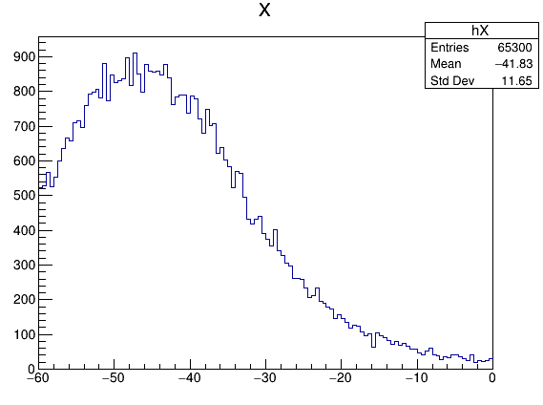
Segment multiplicity & matching criteria
DC1
DC2
Matching Criteria
Size_seg_dc1 + Size_seg_dc2 >=13;
fabs(dx) < 8 cm;
fabs(dy) < 10 cm;
fabs(daX) < 0.1 rad;
fabs(daY) < 0.14 rad.

