Slide 1
The upgrade of the TOF system NA61/Shine
Dmitriev Aleksandr on behalf of the mRPC group
11.02.2019

Slide 2
План доклада
Обзор установки/старый TOF
Требования к новому TOFу
МРПК
Считывающая электроника
Тест
Результаты теста

Slide 3
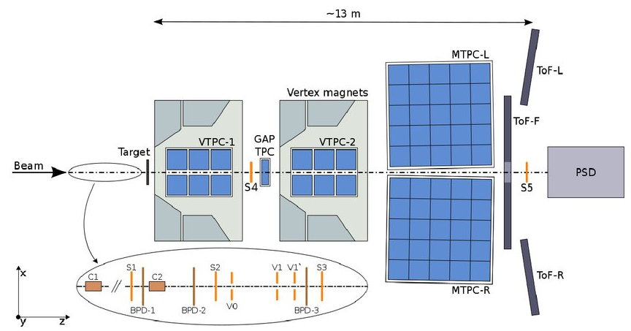
New RPC TOF
MRPC
MRPC

Slide 4
TOF requirements
time resolution better than 75 ps;
high granularity to minimize efficiency degradation due to double hits;
good position resolution;
high combined geometrical and detection efficiency;
identification of pions and kaons up to the momentum of 4 GeV/c ;
identification of (anti)protons up to the momentum of 7 GeV/c;
low heat dissipation from the electronics.

Slide 5
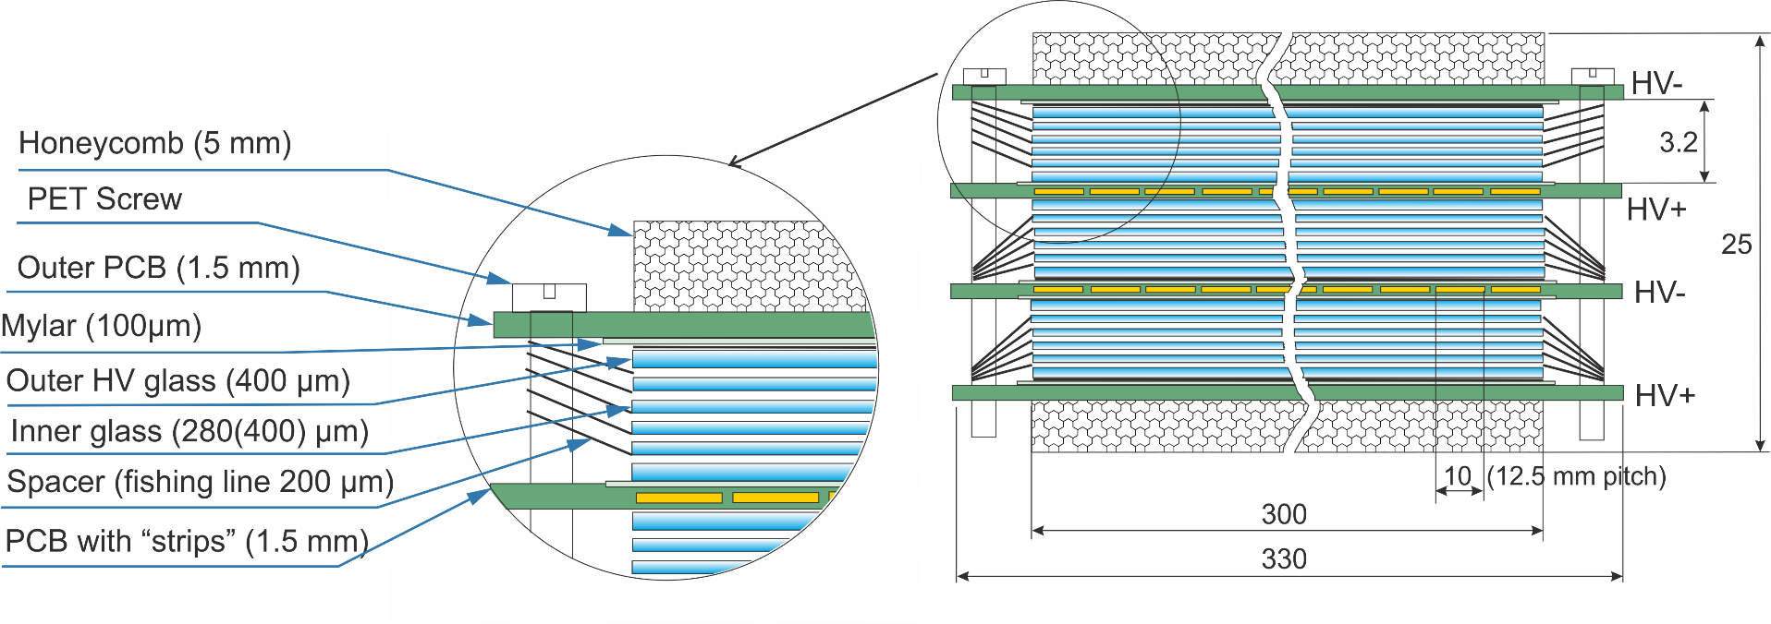
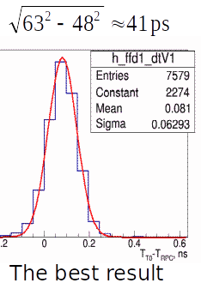
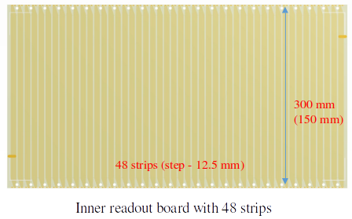
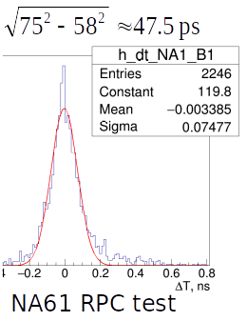
Triple-stack MRPC with strip readout (600x300/150 mm)

Slide 6
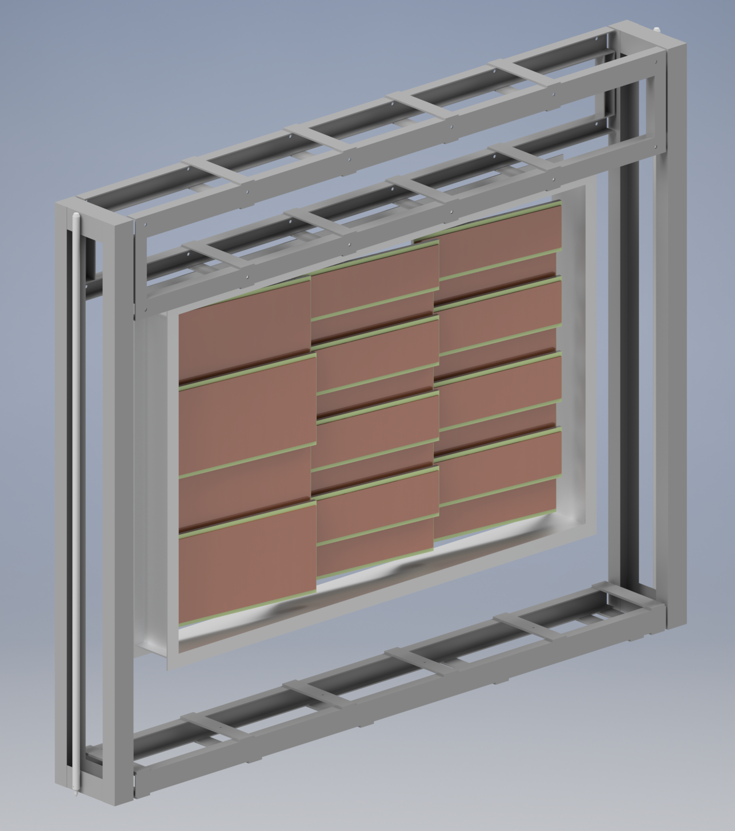

Slide 7
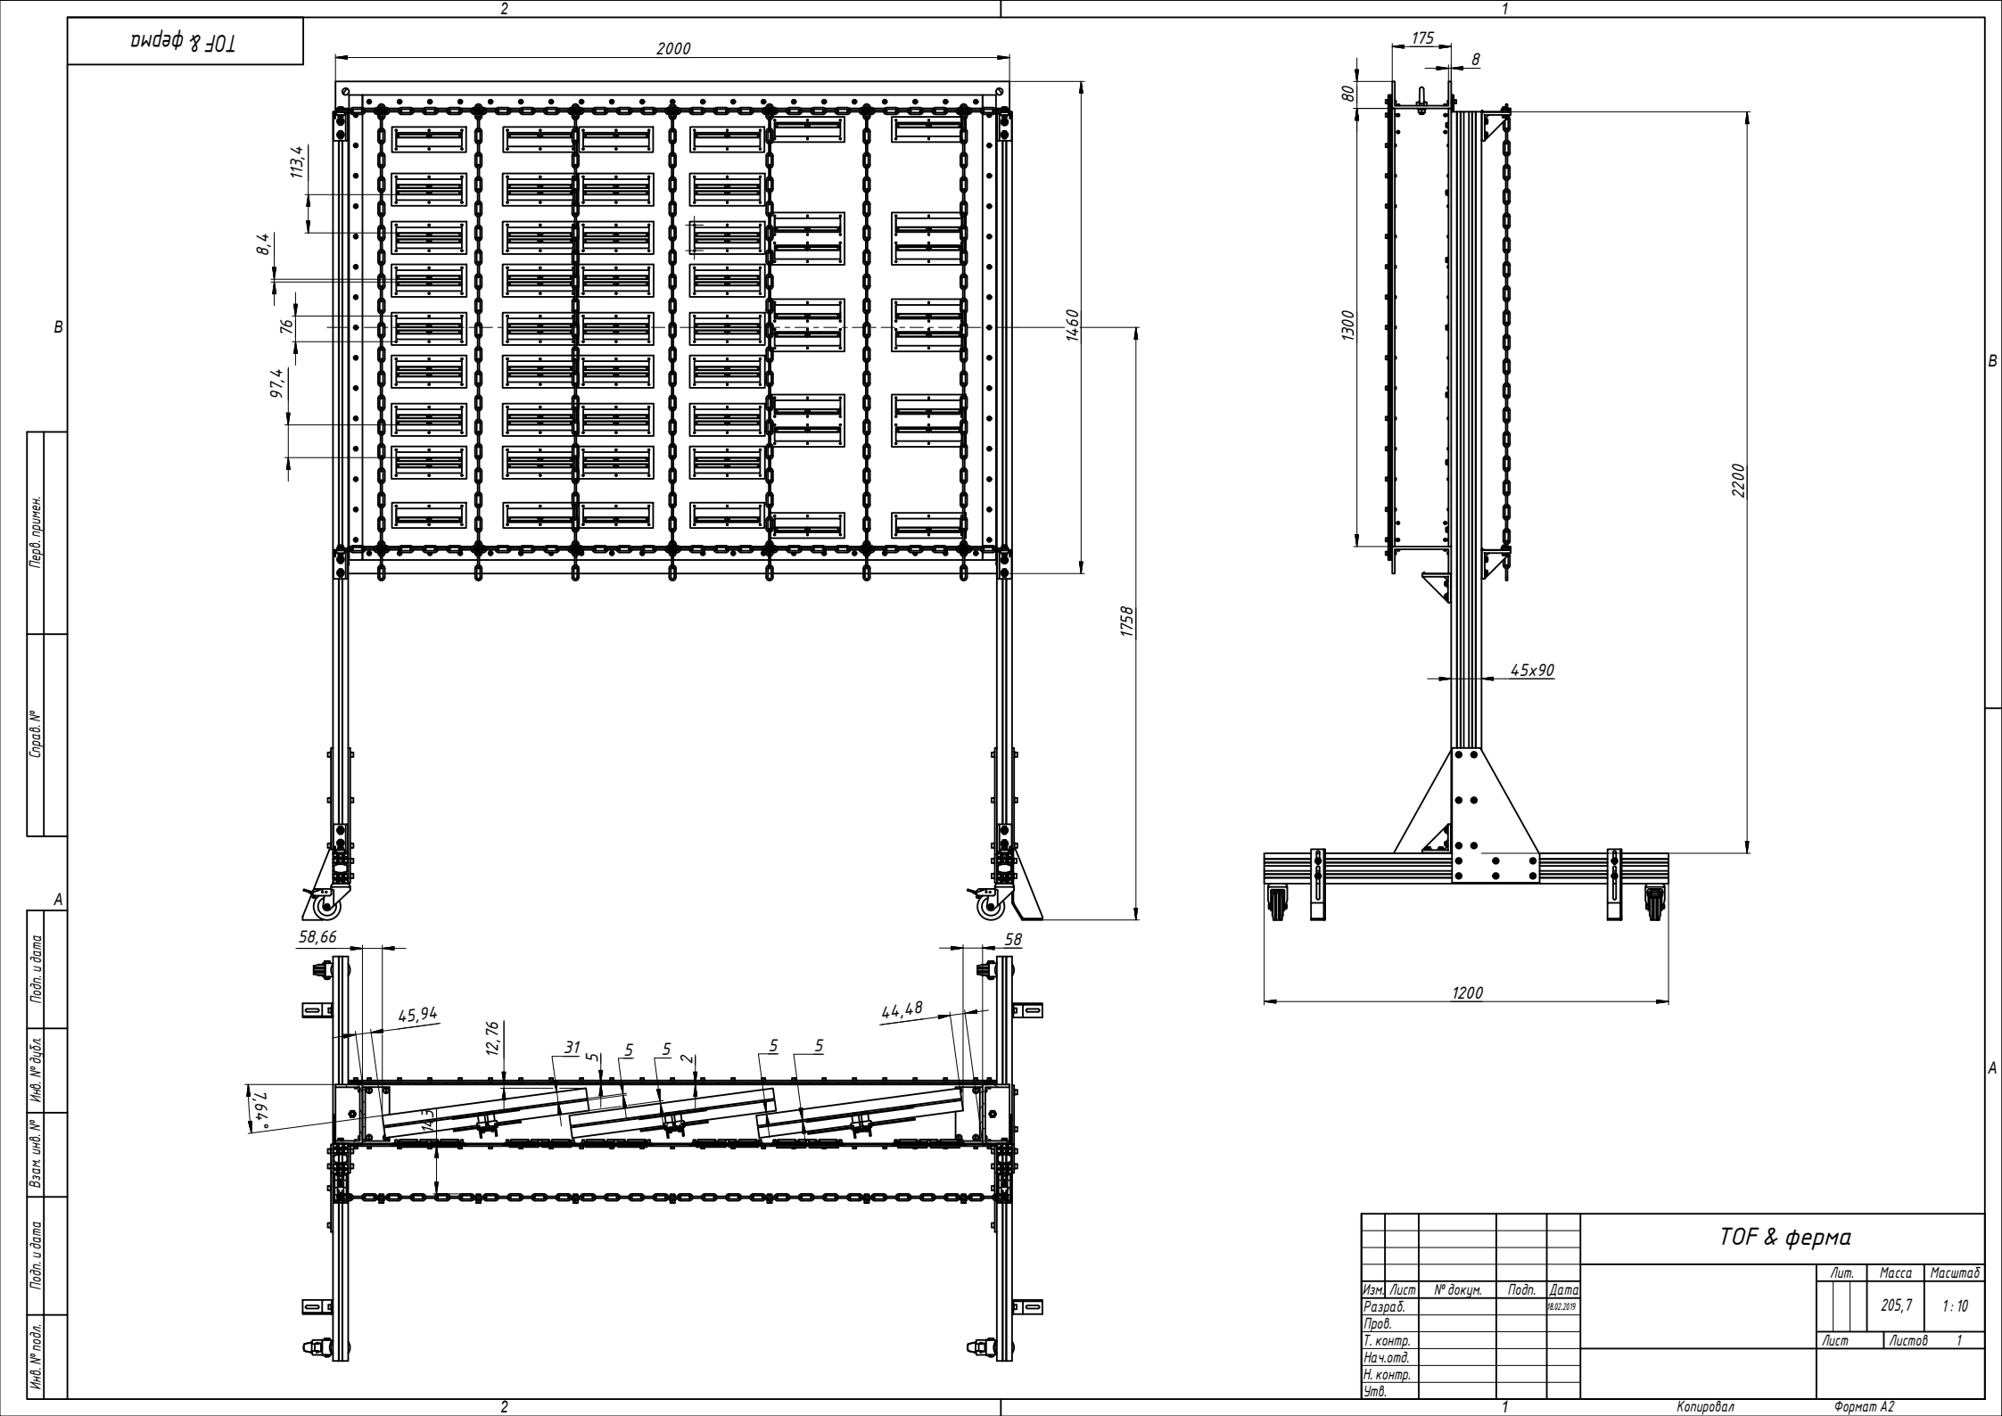

Slide 8
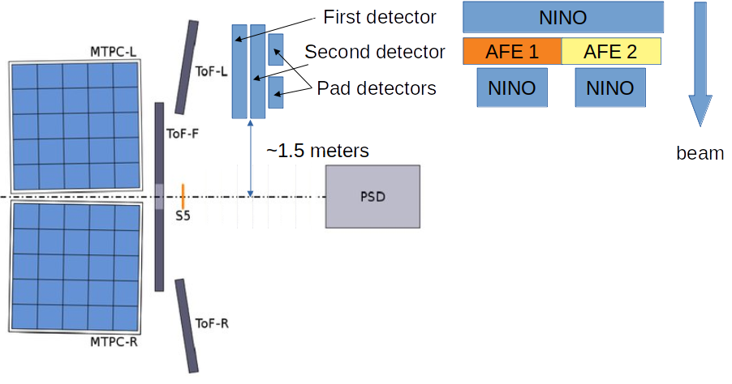
Setup of the November(2018) test
Two data set:
Hadron+Al 80 GeV/c, Pb+Pb 150GeV/c
Pour hadron statistic
Hadron T0 – S2, Lead T0 – S3.

Slide 9
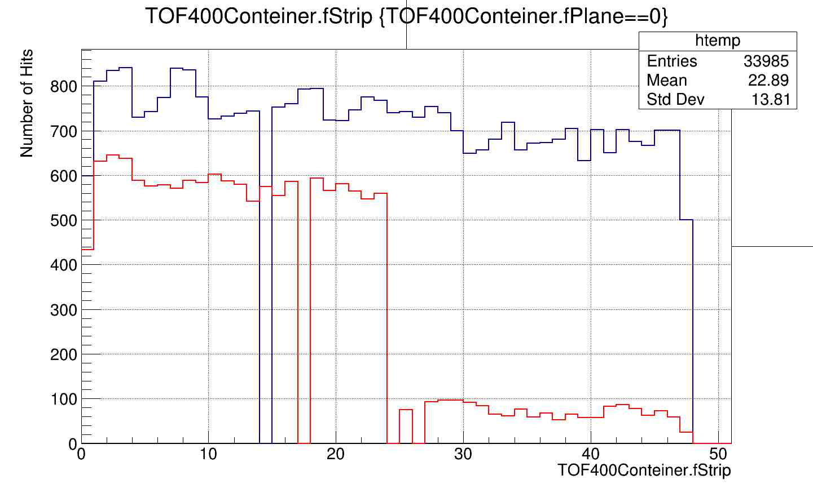
Hadron runs

Slide 11
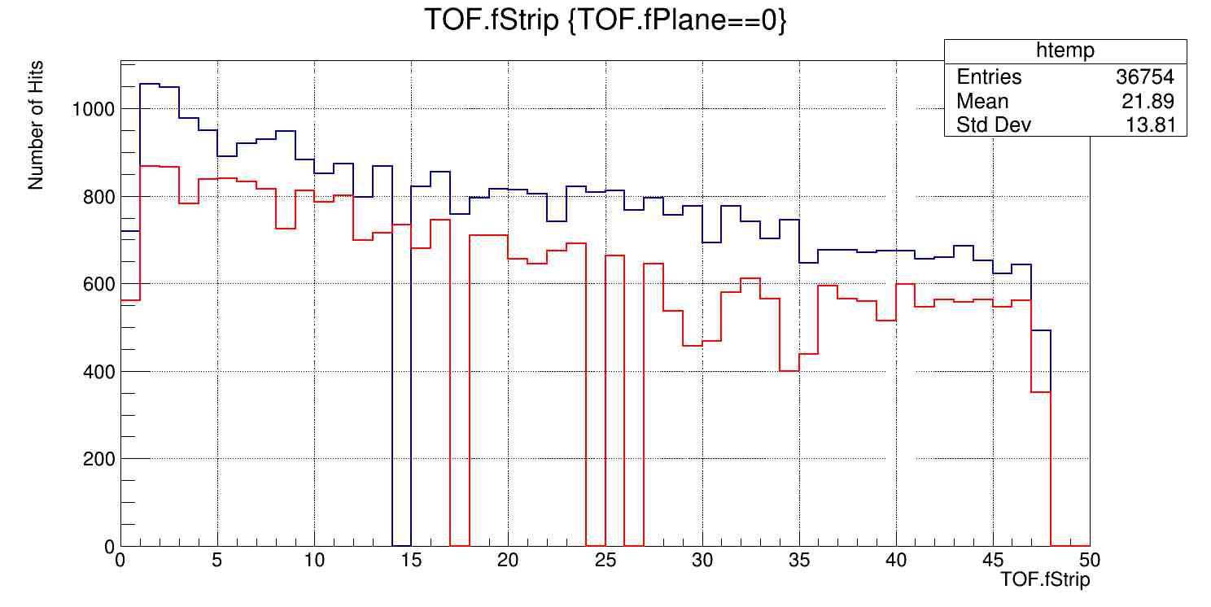
Lead runs

Slide 12
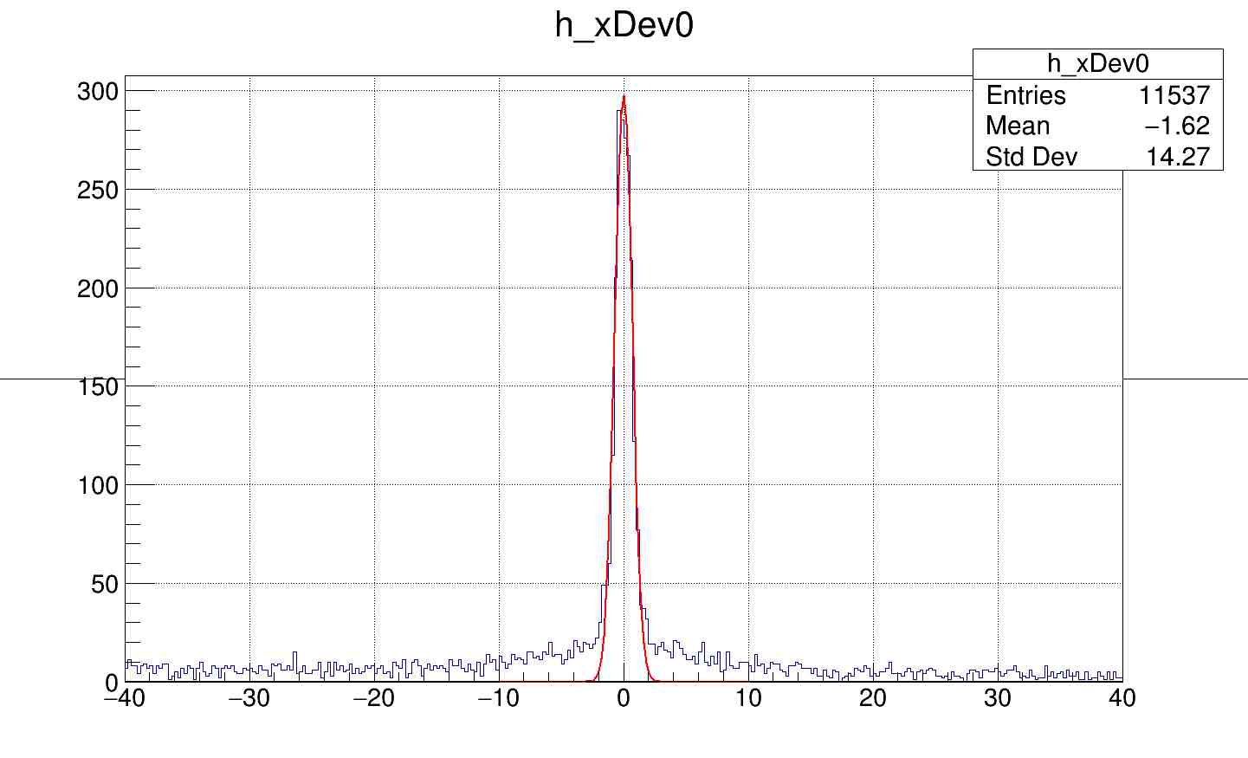
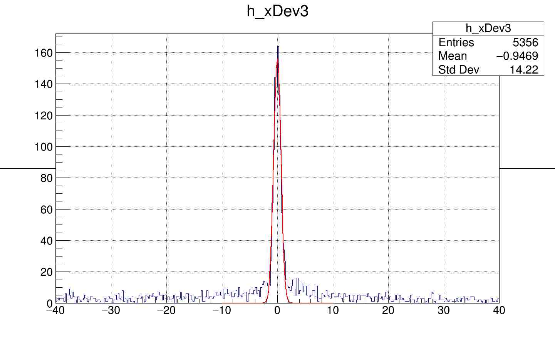
Track matching.
X Position resolution of mRPC
12.5/sqrt(12) mm = 3.6 mm
NINO
σ = 0.70 cm
DRS
σ = 0.68 cm
ResX, cm
ResX, cm
X Resudials for tracks extrapolated to detectors​

Slide 13
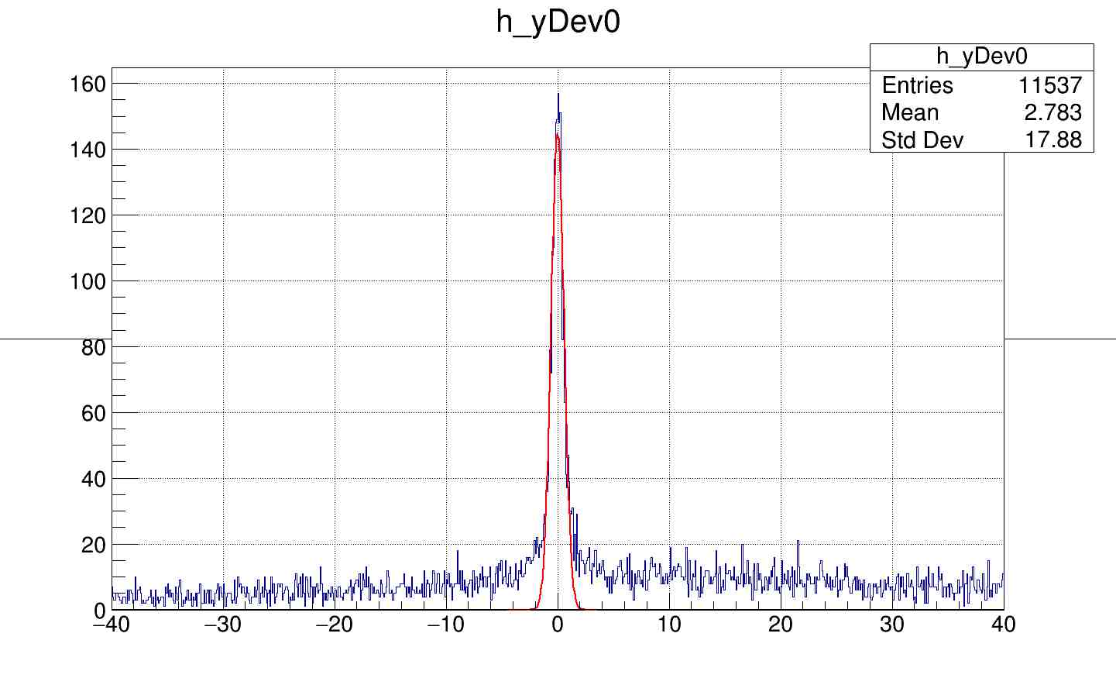
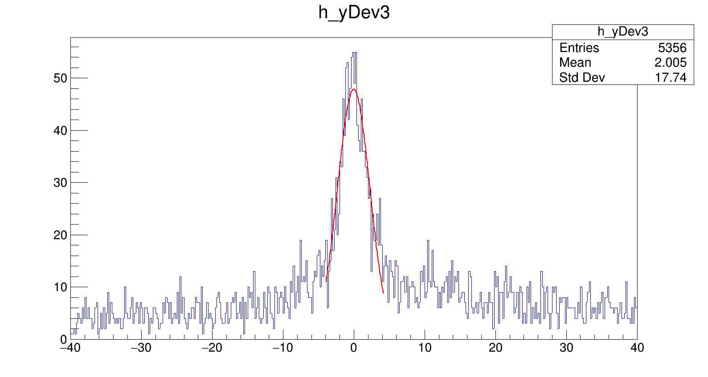
Track matching
NINO
σ = 0.60 cm
DRS
σ = 2.28 cm
ResY, cm
ResY, cm
Y Resudials for tracks extrapolated to detectors​

Slide 14
Backup

Slide 15
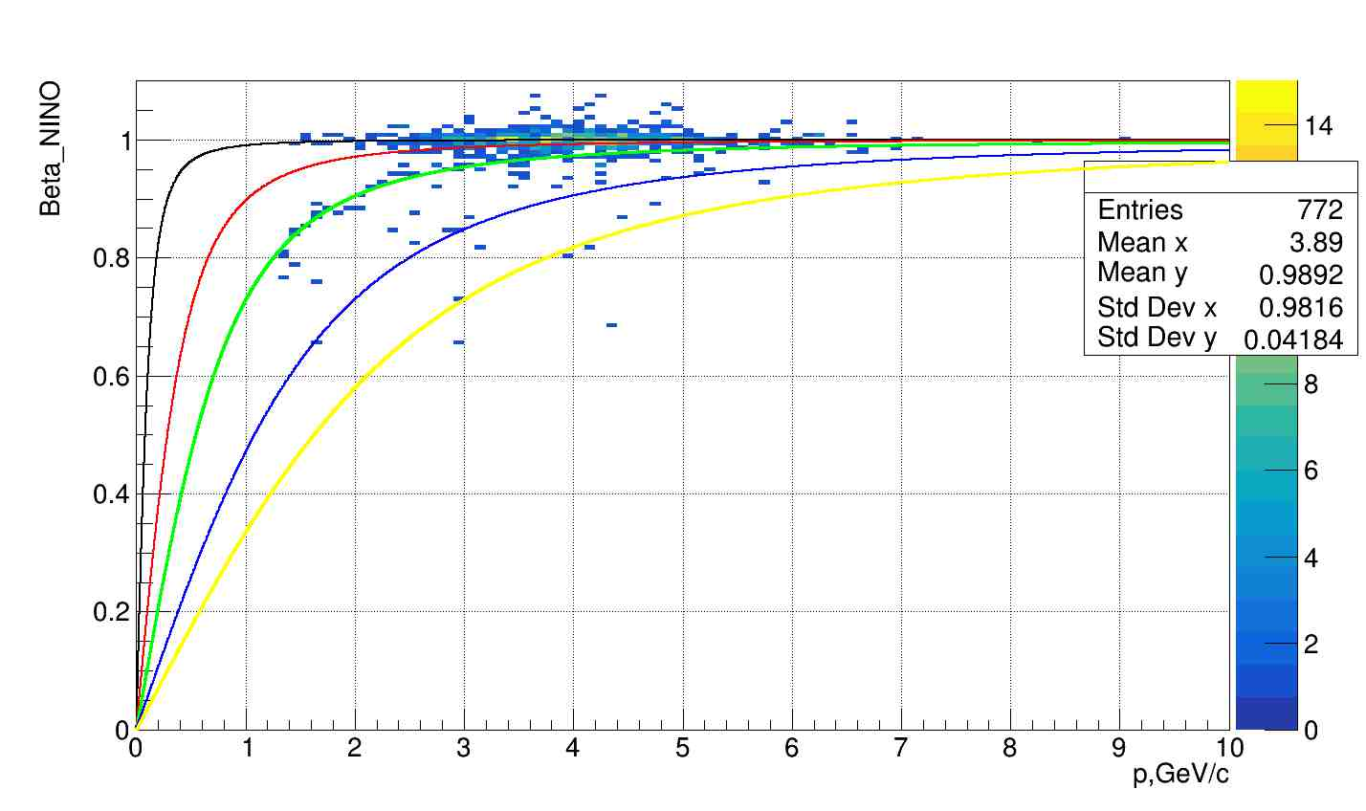
Beta NINO. Hadron run
π
K
p
d
Need to improve with Lead data by:
T-A correction
mass correction
t
p/q, GeV/c

Slide 16
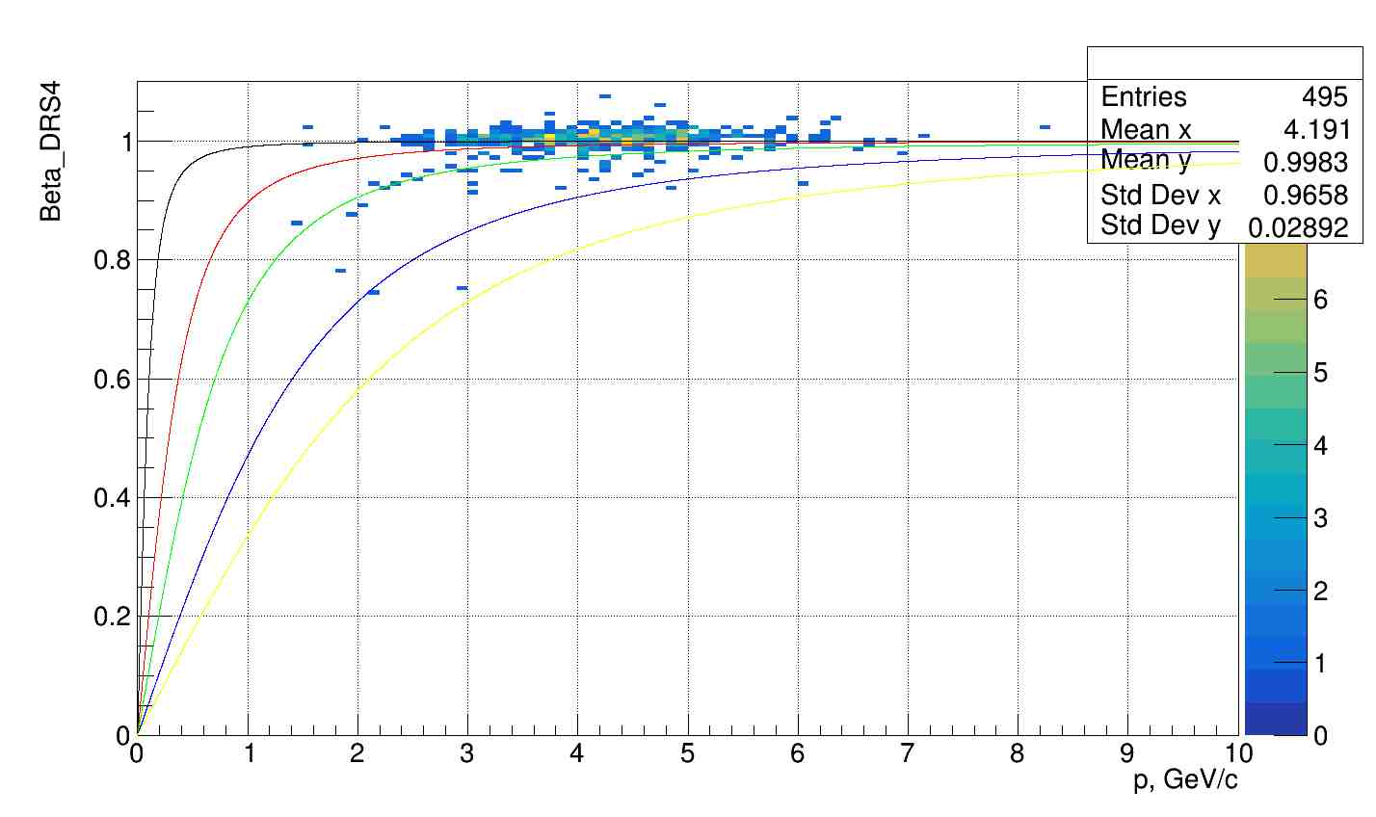
Beta DRS. Hadron run
π
K
p
d
t
Need to improve with Lead data by
Waveform filtration
mass correction
p/q, GeV/c

