Slide 1



The Neutron Star Equation of State
In The Multi-Messenger Era
David E. Álvarez Castillo
Joint Institute for Nuclear Research
Dubna, Russia
The II International Workshop on Theory of Hadronic Matter
Under Extreme Conditions Nuclear
Dubna, Russia
September 17, 2019

Slide 2
Outline
A brief introduction to the neutron star equation of state and its location within the QCD phase diagram.
The compact star mass twins hypothesis.
Astrophysics measurements of compact stars: multi-messenger astronomy & the GW170817 event.
Astrophysical implications and perspectives.

Slide 3
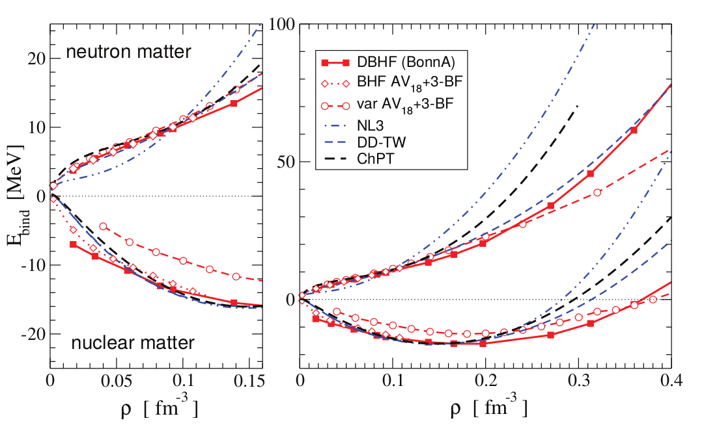
Nuclear Matter
C. Fuchs, H.H. Wolter, EPJA 30(2006)5

Slide 4
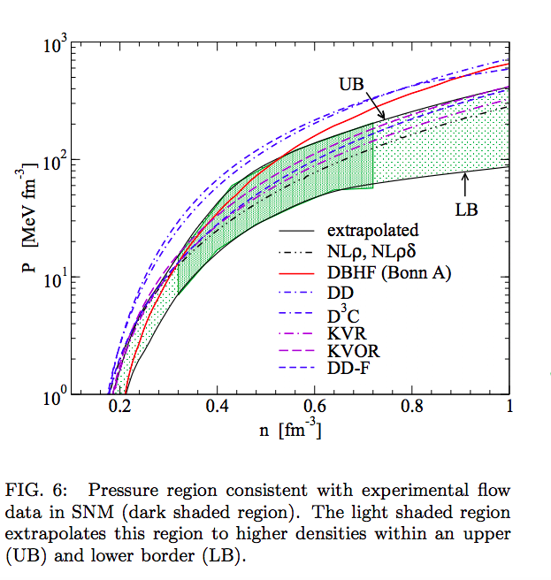
Flow Constraint
Klaehn et al. PhysRev C74 (2006)
P. Danielewicz, R. Lacey and W.G. Lynch, Science 298, 1592 (2002)

Slide 5
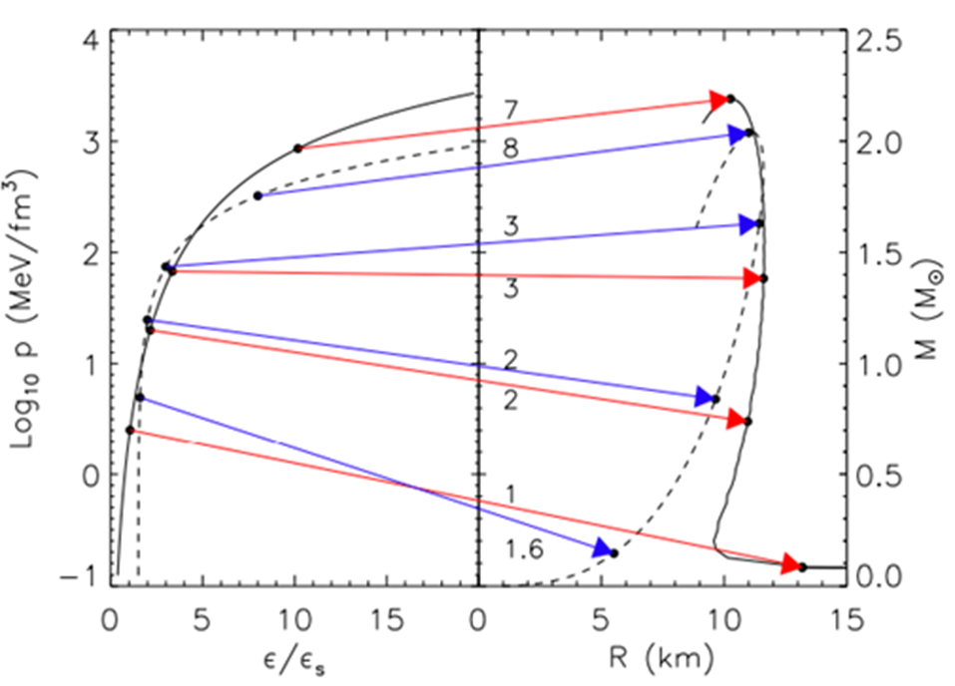
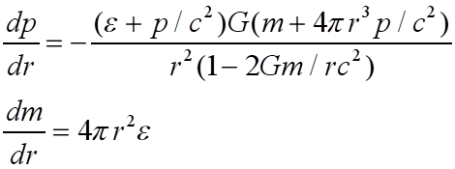

Compact Star Sequences
(M-R ⇔ EoS)
Lattimer,
Annu. Rev. Nucl. Part. Sci. 62, 485 (2012)
arXiv: 1305.3510
TOV Equations
Equation of State (EoS)

Slide 6
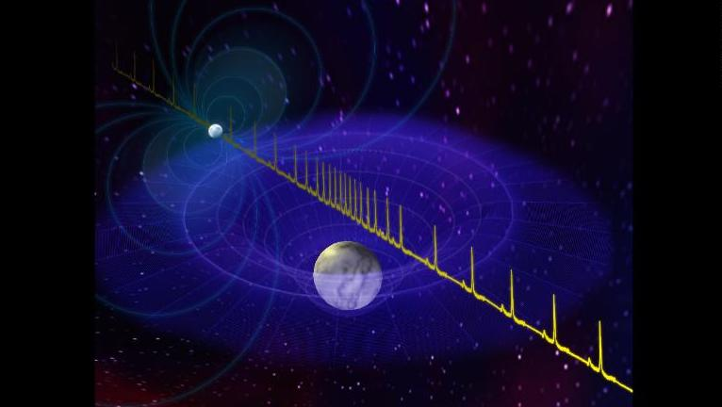
Massive Neutron Stars

Slide 7
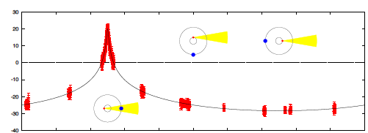
PSR J1614-2230
A precise AND large mass measurement
Shapiro delay:

Slide 8
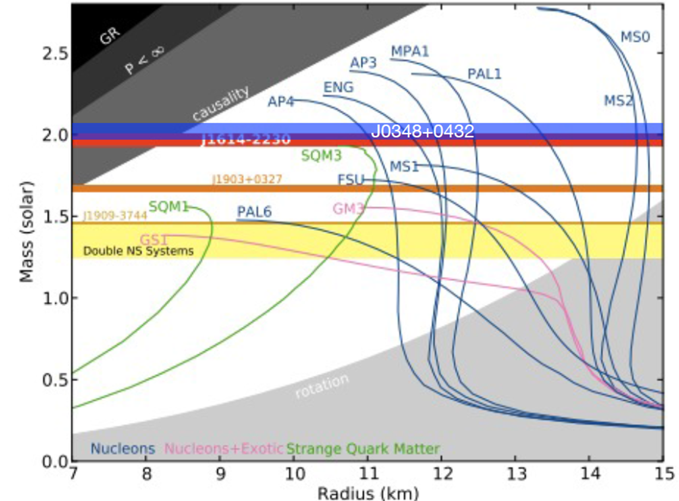
Massive Neutron Stars

Slide 9
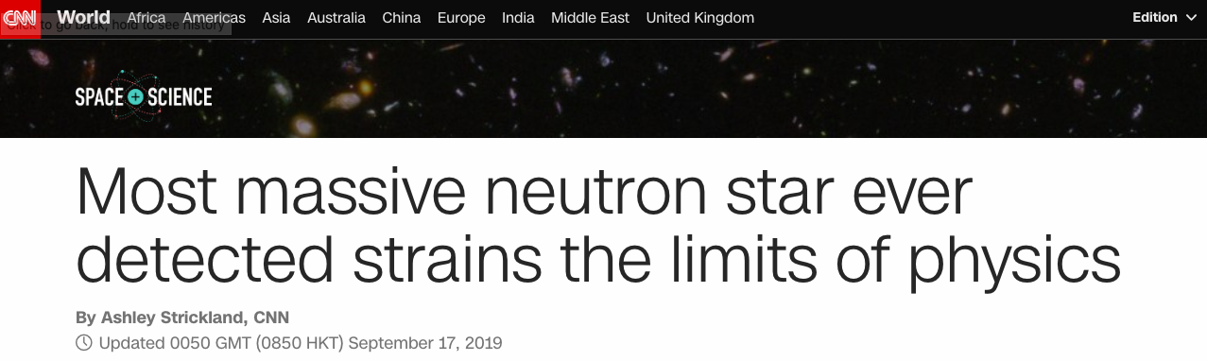
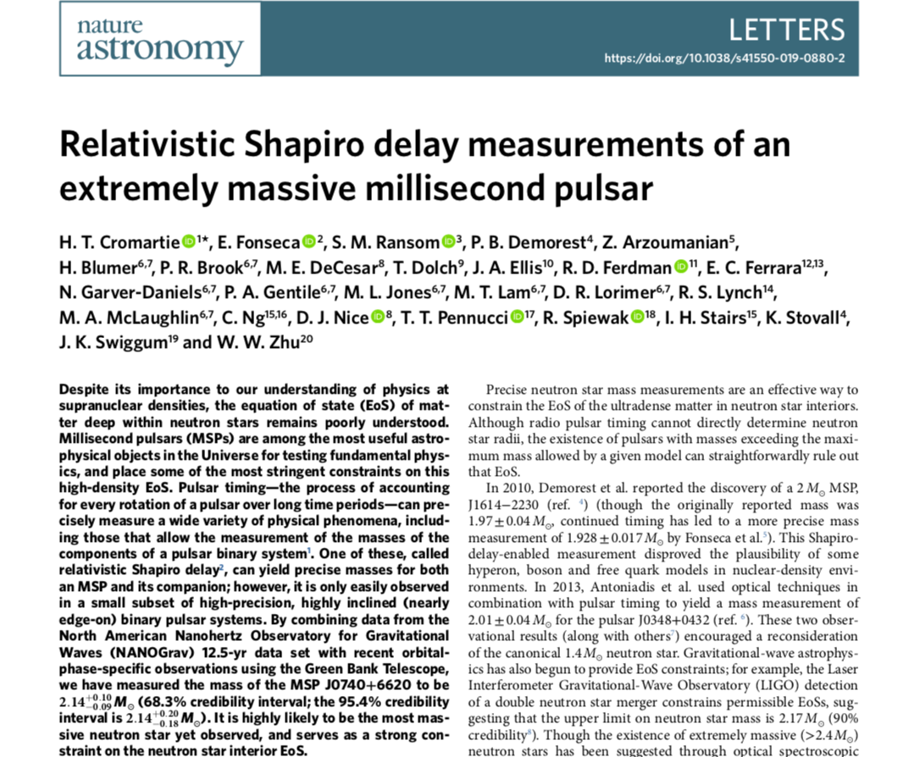

Slide 10
Massive Neutron Stars
PSR J0740+6620: M=2.17(+0.11, -0.10) Msun, at 68.3% credibility

Slide 11
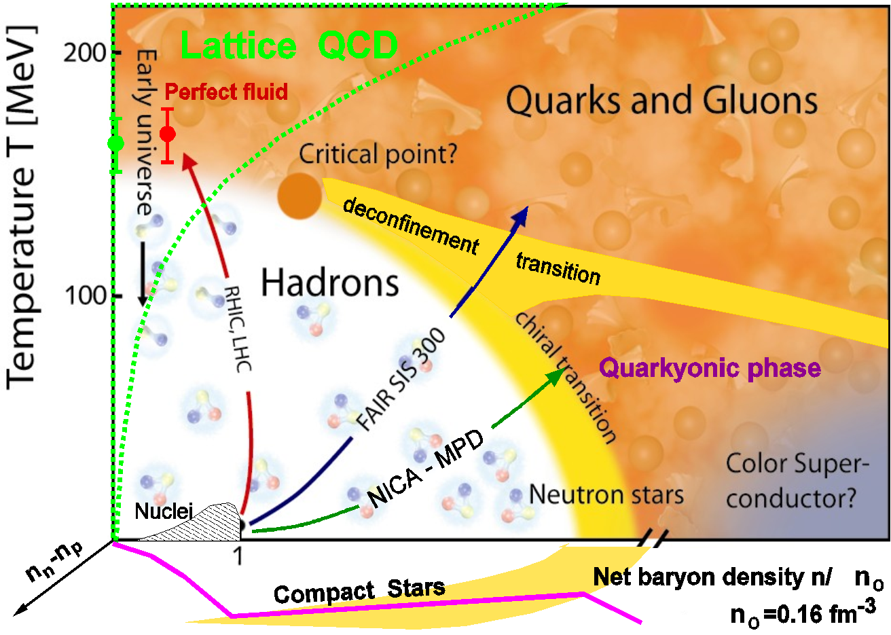
Critical Endpoint in QCD

Slide 12
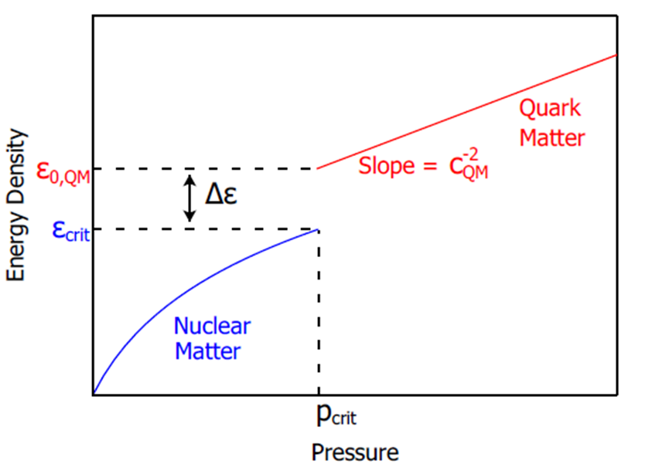
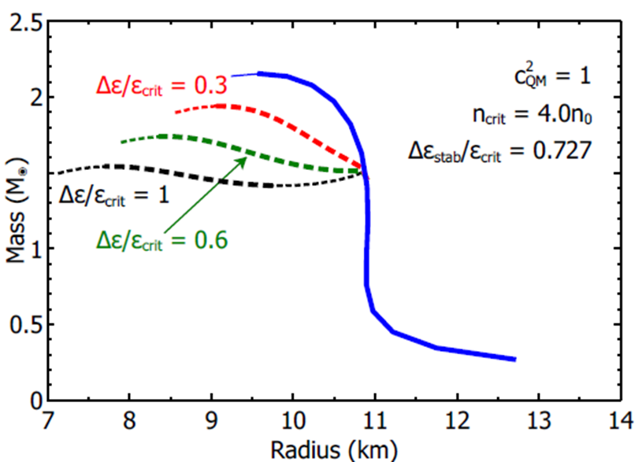
Compact Star Mass Twins and the AHP scheme
First order PT can lead to a stable branch of hybrid stars with quark matter cores which, depending on the size of the “latent heat” (jump in energy density), can even be disconnected from the hadronic one by an unstable branch → “third family of CS”.
Measuring two disconnected populations of compact stars in the M-R diagram would represent the detection of a first order phase transition in compact star matter and thus the indirect proof for the existence of a critical endpoint (CEP) in the QCD phase diagram!
Alford, Han, Prakash,
Phys. Rev. D 88, 083013 (2013)
arxiv:1302.4732

Slide 13
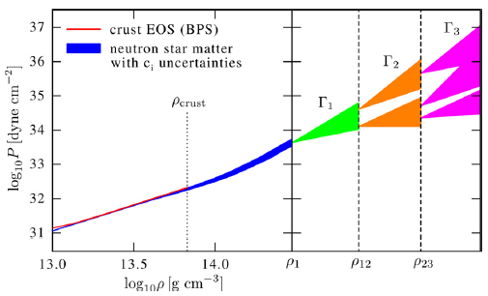

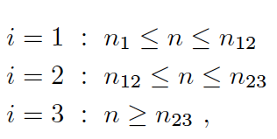

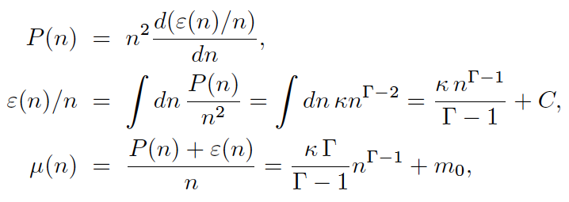
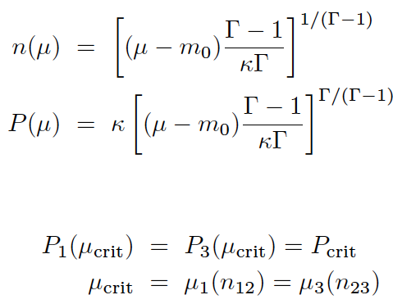

Piecewise polytrope EoS
Hebeler et al., ApJ 773, 11 (2013)
Here, 1st order PT in region 2:
Maxwell construction:
Seidov criterion for instability:

Slide 14
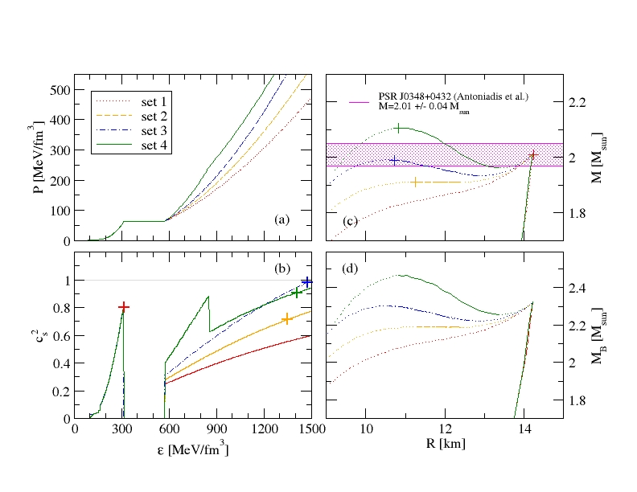
Compact Star Twins
Alvarez-Castillo, Blaschke (2017)
High mass twins from multi-polytrope equations of state
arXiv: 1703.02681v2, Phys. Rev. C 96, 045809 (2017)

Slide 15
Multi-messenger Astronomy

Slide 16
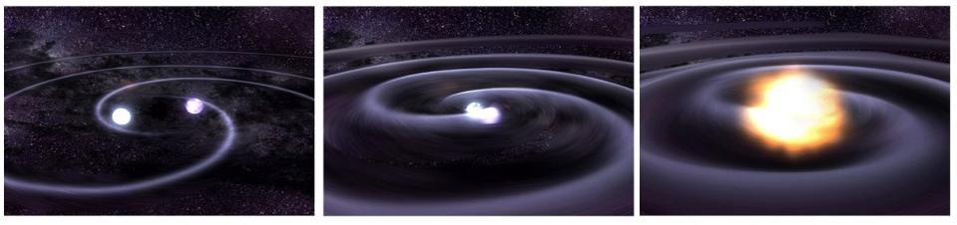
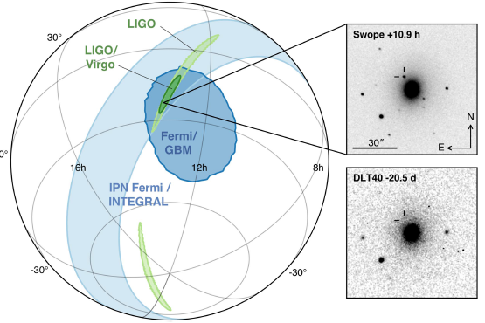
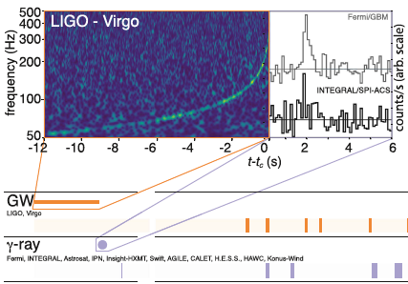
GW170817: Neutron Star Merger
GW170817A , announced 16.10.2017 *)
*) B.P. Abbott et al. [LIGO/Virgo Collab.], PRL 119, 161101 (2017); ApJLett 848, L12 (2017)

Slide 17
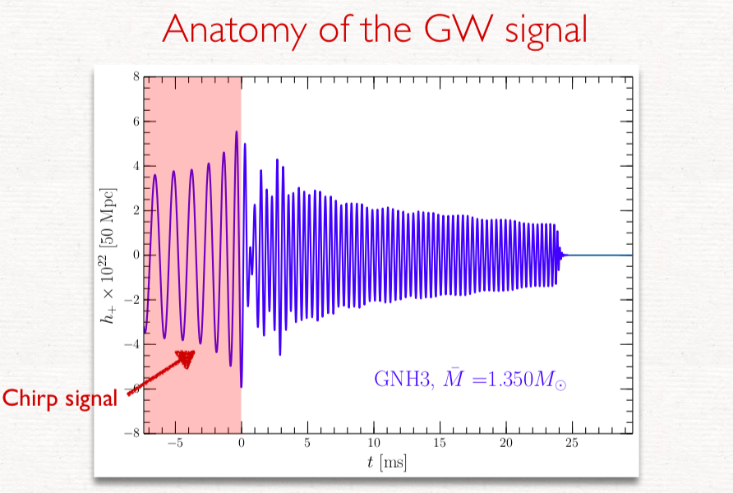

Slide 18
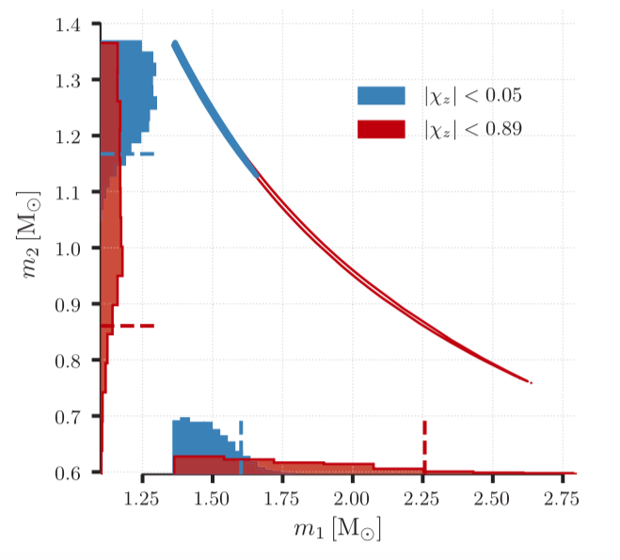
Implications from GW170817
GW170817: Observation of Gravitational Waves from a Binary Neutron Star Inspiral
B. P. Abbott et al. arXiv:1712.00451

Slide 19
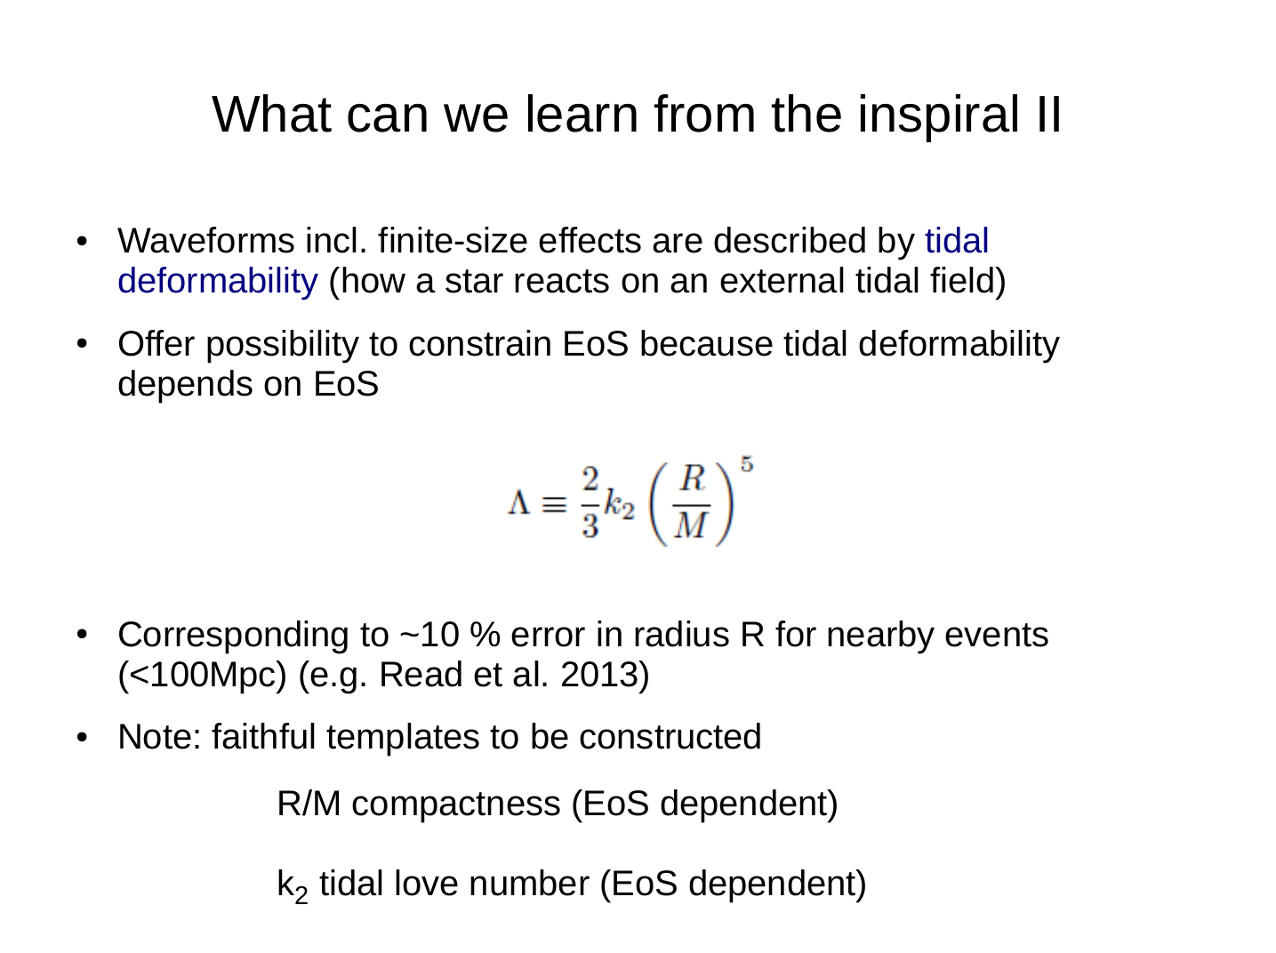

Slide 20
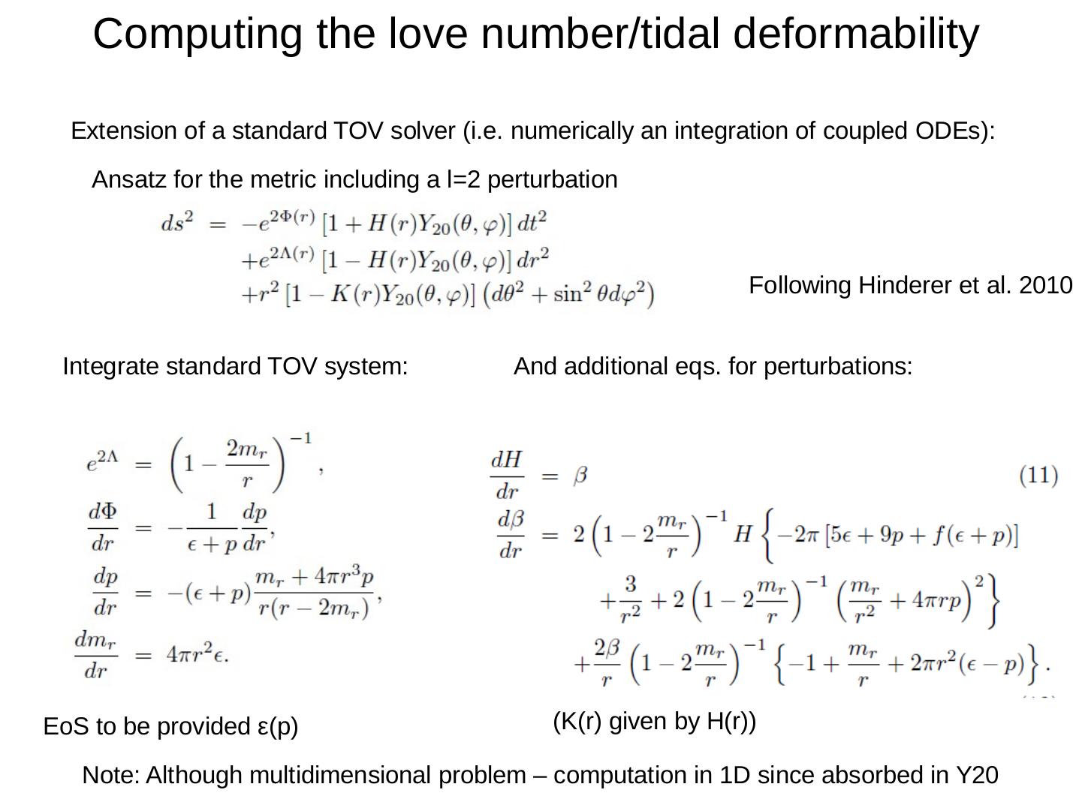

Slide 21

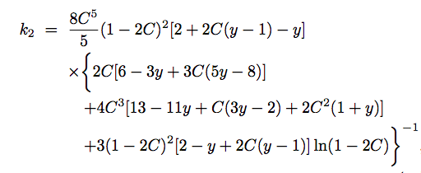
Love number

Slide 22
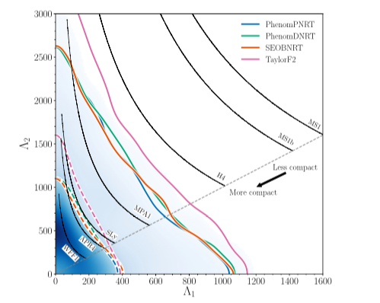
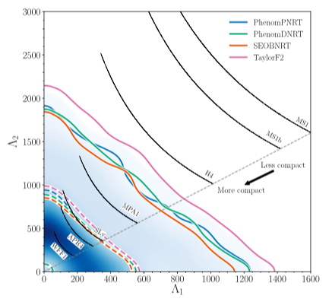
Implications from GW170817
Properties of the Binary Star Merger GW170817
B. P. Abbott et al., Phys. Rev. X 9, 011001 (2019)

Slide 23
Implications from GW170817
Vasileios Paschalidis, Kent Yagi, David Alvarez-Castillo,
David B. Blaschke, Armen Sedrakian
Phys. Rev. D 97, 084038 (2018), arXiv:1712.00451

Slide 24
Implications from GW170817
Vasileios Paschalidis, Kent Yagi, David Alvarez-Castillo,
David B. Blaschke, Armen Sedrakian
Phys. Rev. D 97, 084038 (2018), arXiv:1712.00451

Slide 25
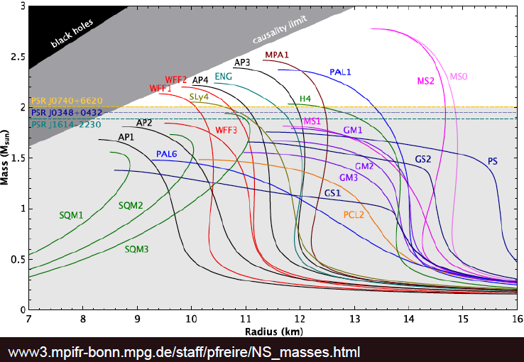
Massive Neutron Stars:
Is there a concrete limit for the maximum mass?

Slide 26
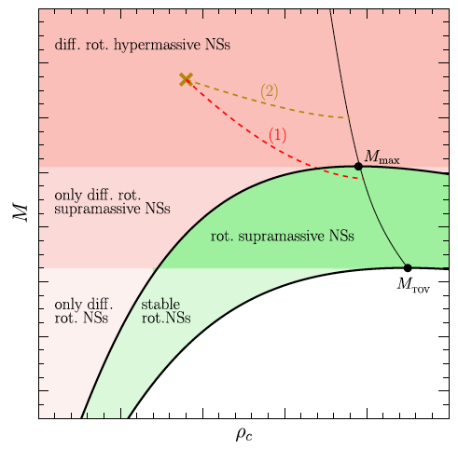
Upper limit on the Maximum mass of static compact stars?
26
Rezzolla et al., ApJ Lett 852 (2018) L25

Slide 27
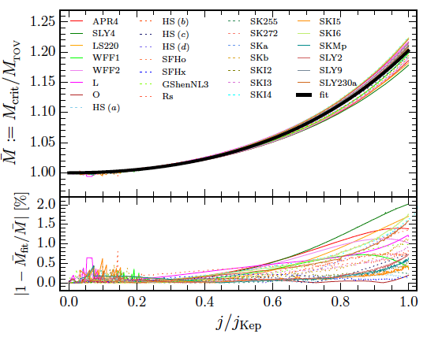


Universal relation for maximum mass increase upon rigid rotation
“Universal” increase of maximum mass by 20% due to rigid rotation at maximum (critical) angular momentum
27
Breu & Rezzolla et al., MNRAS (2016)

Slide 28
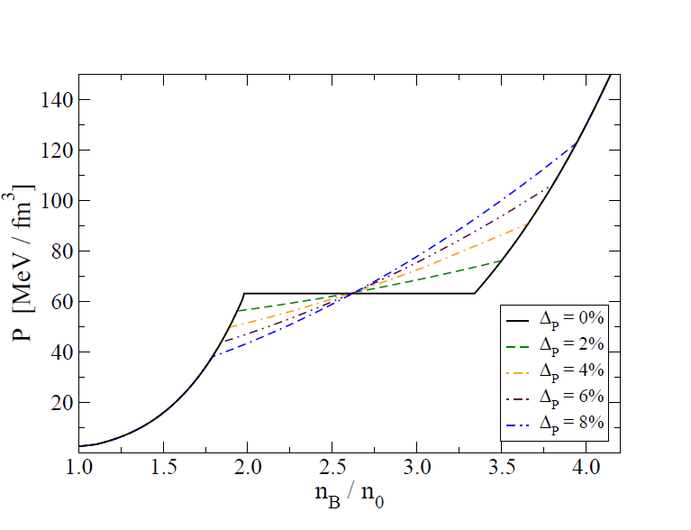
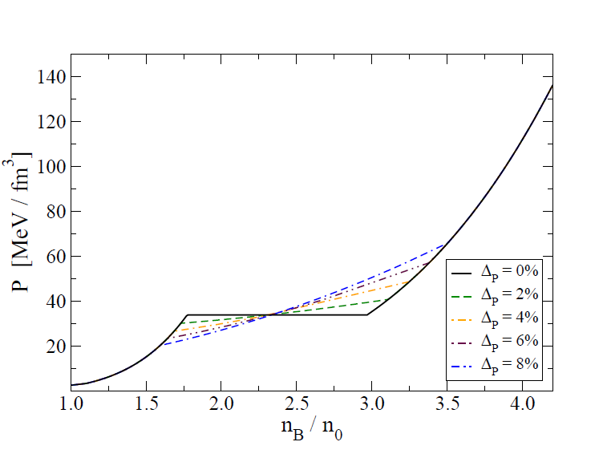
Mixed phase effects
(pasta phases)
High mass twin stars
(ACB4)
Low mass twin stars
(ACB5)

Slide 29
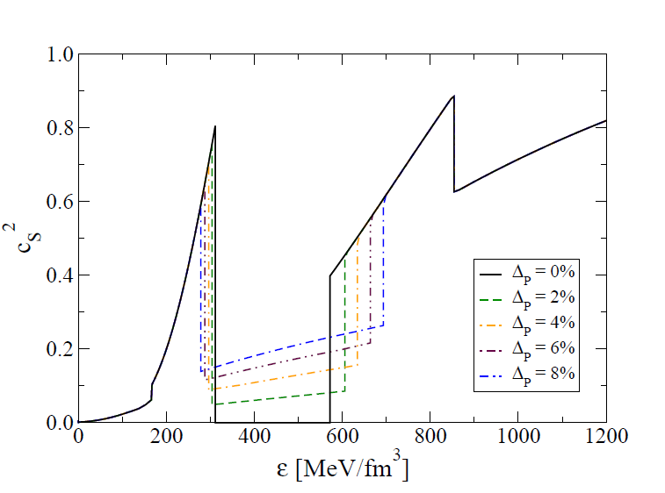
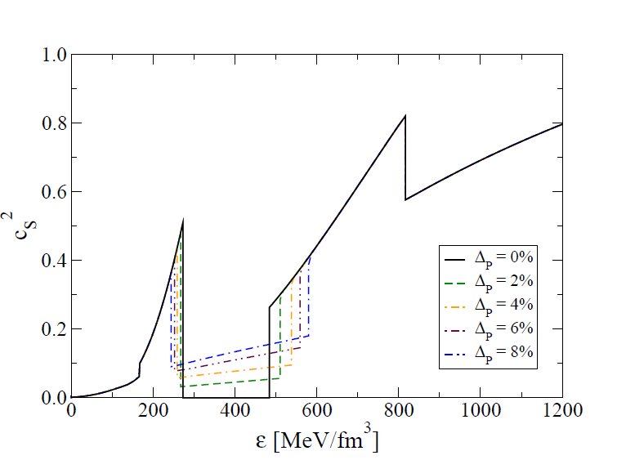
Speed of sound and causality
High mass twin stars
(ACB4)
Low mass twin stars
(ACB5)

Slide 30
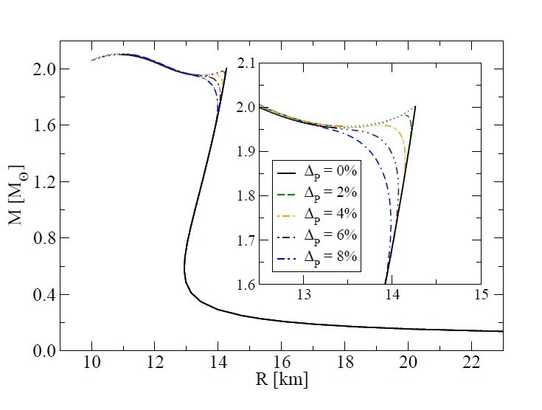
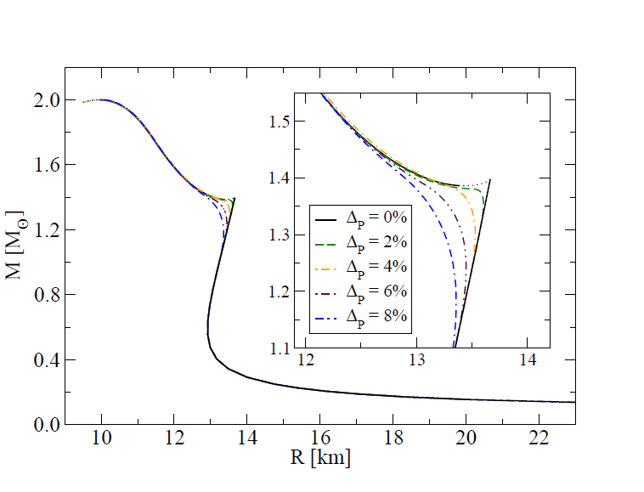
Mass Radius Relations
ACB4
ACB5

Slide 31
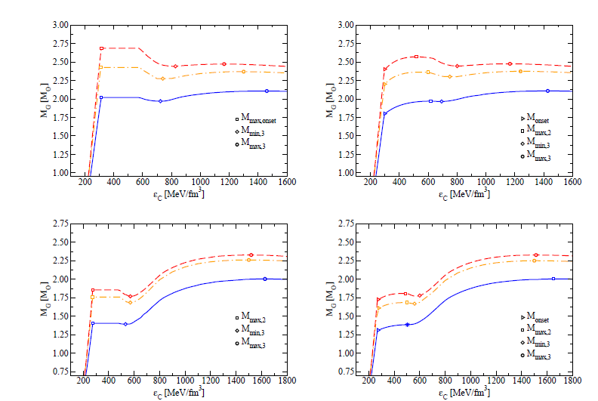
Effect of Rotation and Mixed Phase
Full GR
Perturbative
Approach ~Ω²
ACB4
Static (TOV)
ACB5
31
Maxwell construction
Critical value of Mixed-phase parameter

Slide 32
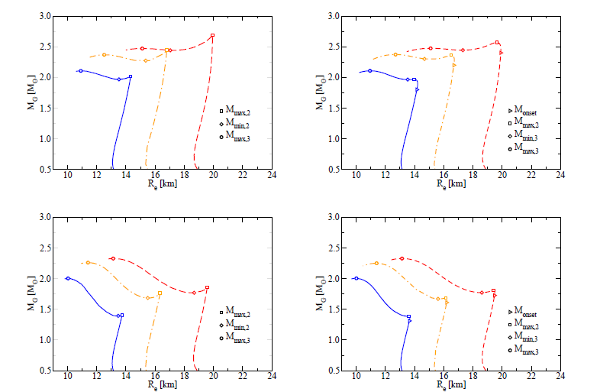
Effect of Rotation and Mixed Phase
ACB4
ACB5
Maxwell construction
Critical value of Mixed-phase parameter

Slide 33
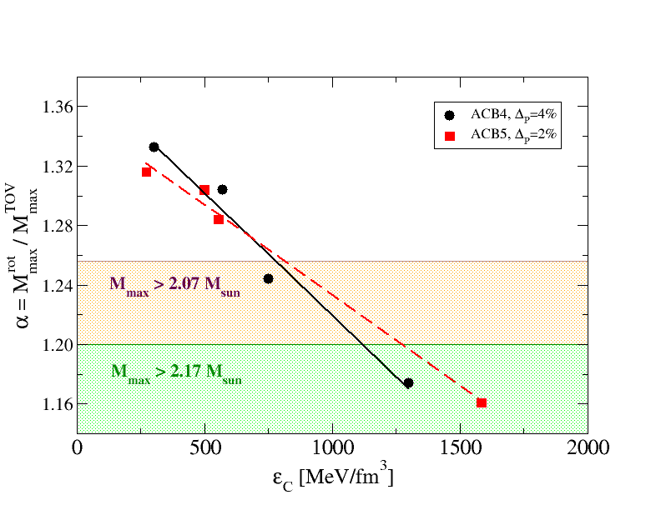
Universal relationship for rotating Compact Stars

Slide 34

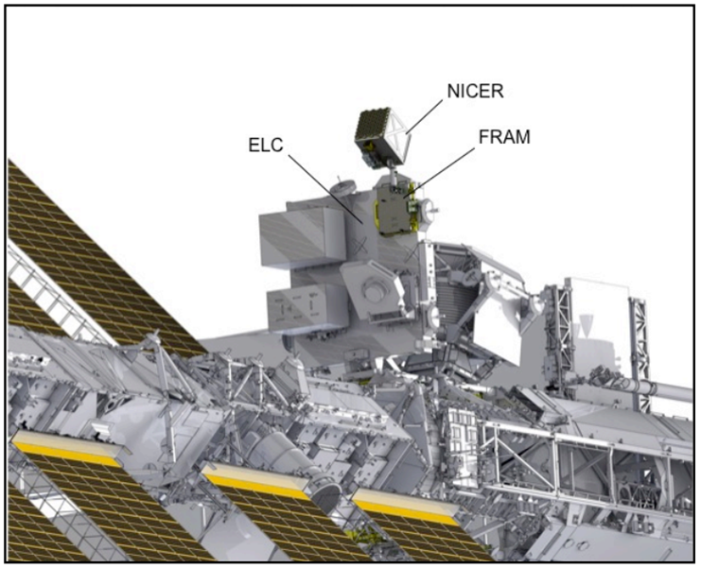
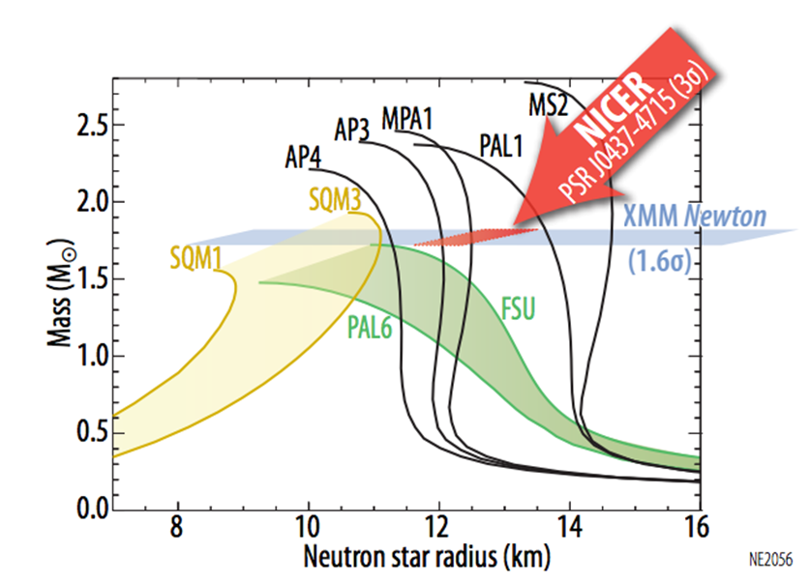
NICER 2017
Gendreau, K. C., Arzoumanian, Z., & Okajima, T. 2012, Proc. SPIE, 8443, 844313

Slide 35
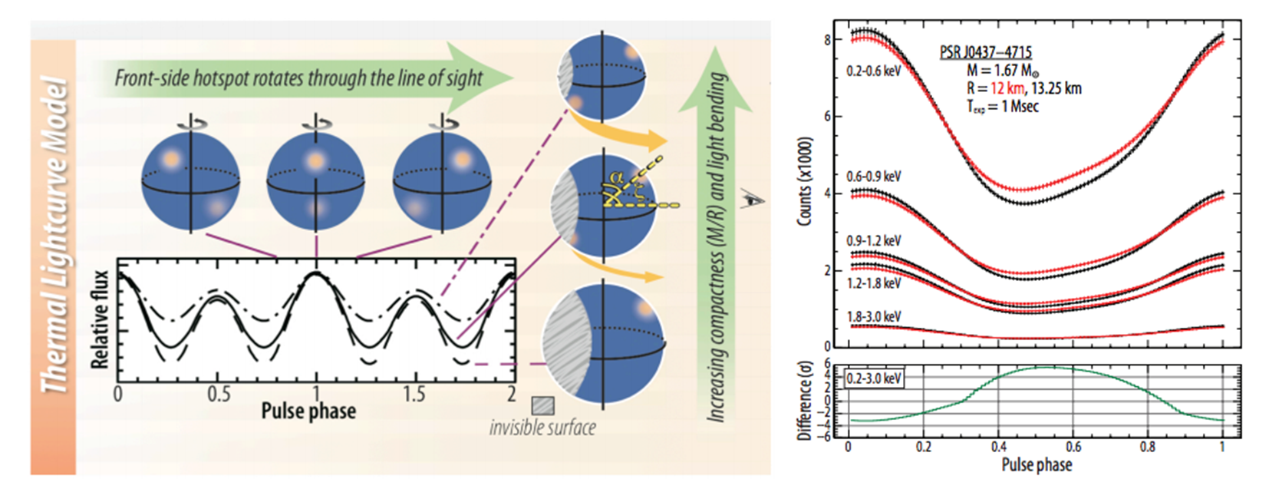
Hot Spots

Slide 36
Implications from GW170817
Nonlocal NJL
D. Alvarez-Castillo, D. Blaschke, G. Grunfeld, V. Pagura
Phys. Rev. D 99, 063010 (2019) - arXiv: 1805.04105

Slide 37
GW170817 - Nonlocal NJL
D. Alvarez-Castillo, D. Blaschke, G. Grunfeld, V. Pagura
Phys. Rev. D 99, 063010 (2019) - arXiv: 1805.04105

Slide 38
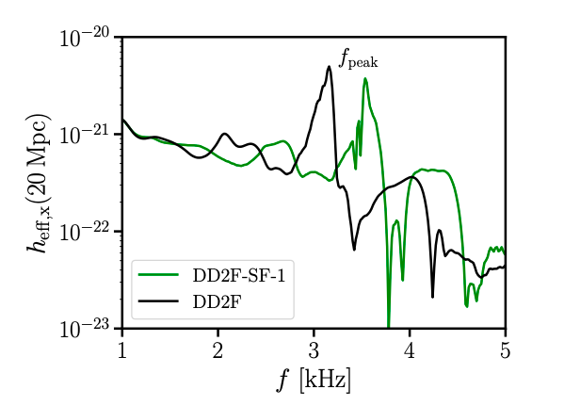
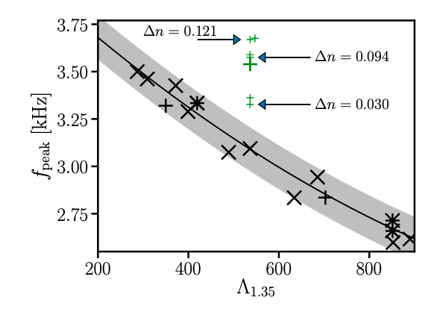
Gravitational Wave Signals
First Order Phase Transitions
A. Bauswein et al. - arXiv: 1904.01306, PRL 122 (2019) 061102

Slide 39
Conclusions
GW170817 favours softer EoS but also hybrid stars with strong phase order transitions.
Future GW observations, NICER and SKA will soon result into stronger NS EoS constraints probing the mass twins hypothesis.
Many possible astrophysical scenarios for mass twins
could be confirmed implying a CEP in QCD.
The mixed phase construction mimics the pasta phase in accordance with a full pasta calculation. This construction makes the approach more realistic and has advantages for numerical treatment of hybrid stars in general relativity.

Slide 40
Conclusions
The conjecture of an upper limit on the maximum mass of nonrotating compact stars derived from GW170817 has been revisited. We find a criterion for the minimal central energy density in the maximum mass configuration that would correspond to the core of GW170817. The equation of state at high densities must be effectively soft, either as a relatively soft hadronic one or a hybrid one with a strong phase transition. The NICER radius measurement could be decisive.
Gracias

