Slide 1
In-medium effects in HIC
D.N. Voskresensky NRNU (MEPhI), Moscow, -- JINR, Dubna
EoS of baryon-rich hadron matter (dense, not too hot)
Effects of first-order phase transition and CEP
Pions and kaons in baryon-rich hadron matter
EoS of baryon-poor hadron matter (hot, not too dense)

Slide 2

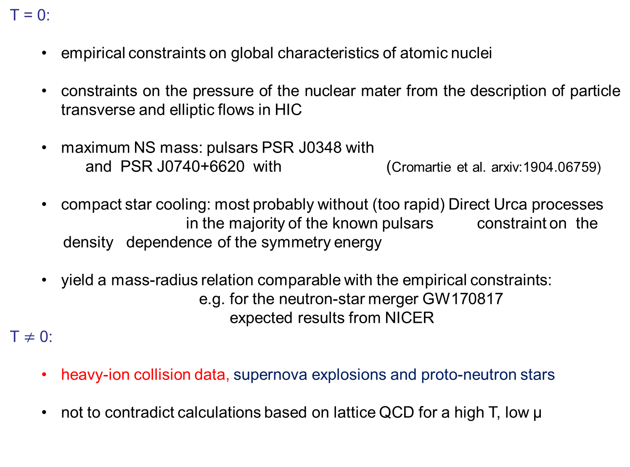
Existing constraints on hadronic EoS
T = 0:
  empirical constraints on global characteristics of atomic nuclei
  constraints on the pressure of the nuclear mater from the description of particle transverse and elliptic flows in HIC
  maximum NS mass: pulsars PSR J0348 with
  and PSR J0740+6620 with (Cromartie et al. arxiv:1904.06759)
  compact star cooling: most probably without (too rapid) Direct Urca processes
  in the majority of the known pulsars constraint on the
  density dependence of the symmetry energy
  yield a mass-radius relation comparable with the empirical constraints:
  e.g. for the neutron-star merger GW170817
  expected results from NICER
T $≠$ 0:
  heavy-ion collision data, supernova explosions and proto-neutron stars
  not to contradict calculations based on lattice QCD for a high T, low μ

Slide 3
EoS of baryon-reach hadron matter (dense, not too hot)
massive baryons are good quasiparticles

Slide 4
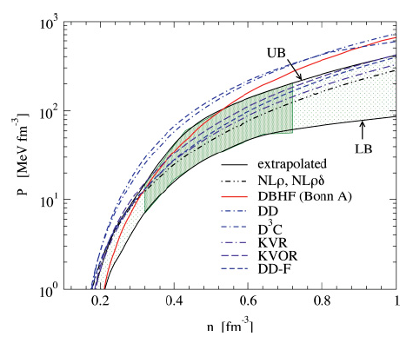
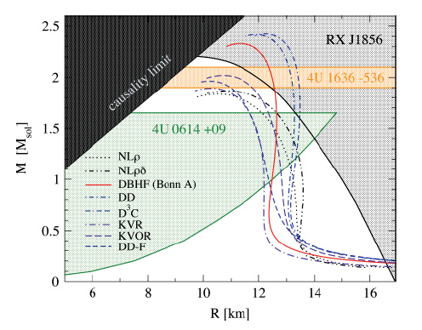
Nucleon EoS, T=0
Most difficult is to satisfy simultaneously the flow and the maximum NS mass constraints constraints
Ordinary non-linear Walecka RMF models can only marginally satisfy simultaneously both constraints
idea of a quenching (“cut”)-mechanism (excluded volume-like effect for $n≫n_{0}$): use EoS satisfying all necessary constraints for $n<n^{∗}∼(2−4) n_{0}$ and stiffen it for higher n

Slide 5

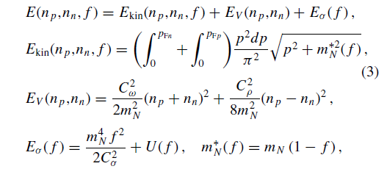
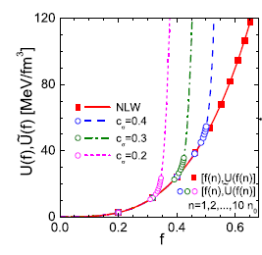
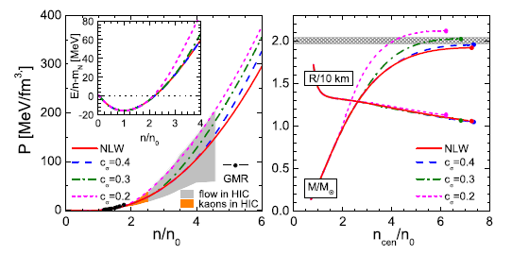
Quenching (for f>f*) in scalar sector of RMF model
For $n∗taken >3n_{0} o$nly marginally satisfy modern constraint max M > 2.07 M _{sol}

Slide 6
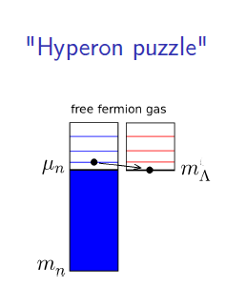
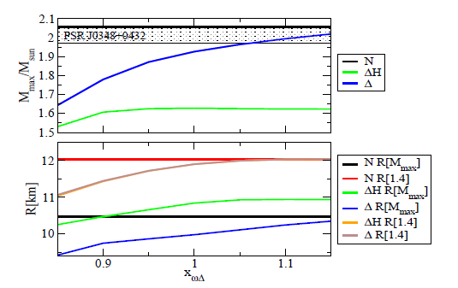
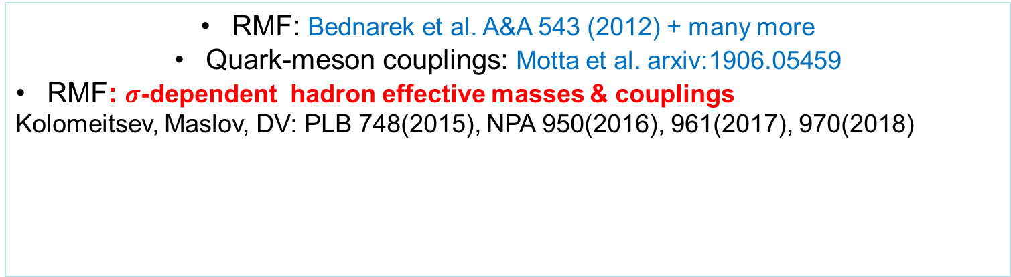
Hyperon and Delta puzzles
non-linear Walecka RMF model
Possible solutions: H,Δ extra high-density repulsion between hyperons
RMF: Bednarek et al. A&A 543 (2012) + many more
Quark-meson couplings: Motta et al. arxiv:1906.05459
RMF: $σ$-dependent hadron effective masses & couplings
Kolomeitsev, Maslov, DV: PLB 748(2015), NPA 950(2016), 961(2017), 970(2018)

Slide 7
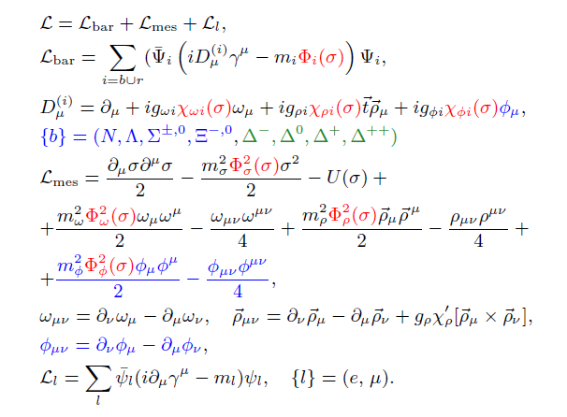


RMF model with Ϭ-field-scaled all hadron masses & couplings
vac. couplings follow SU(6)

Slide 8
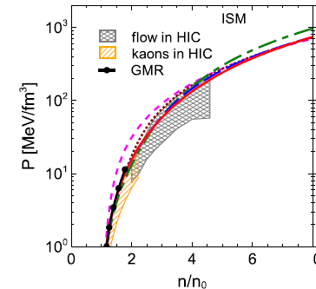

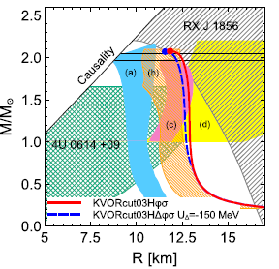
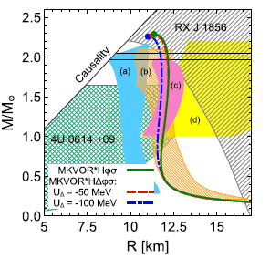

Scalings with the ``quenching” in ω (KVORcut) and ω,ρ (MKVOR) sectors
Maslov, Kolomeitsev, D.V. NPA 950(2016),961(2017)
KVORcut-quenching for $n∗taken$
$\sim 4 n_{0}$,$\sim 3 n_{0}$,$\sim 2 n_{0}$,respectively
KVORcut02 is too stiff in ISM, KVORcut04 too soft in NS
KVORcut03,MKVOR-based EoS are appropriate

Slide 9
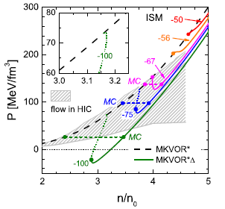
Possible effects of Delta-isobars in HIC
Kolomeitsev, Maslov, D.V. NPA961(2017)
Most realistic estimate: U_{Δ} ~ -50 MeV
A possible 1-order phase tr. in models with a ``quenching in isovector sector”, if Delta potential were deep enough (for U_{Δ} <-56 MeV)
Such models easier satisfy the flow constraint at n~4n ₀ , not breaking NS max. mass constraint
Signatures in HIC?

Slide 10
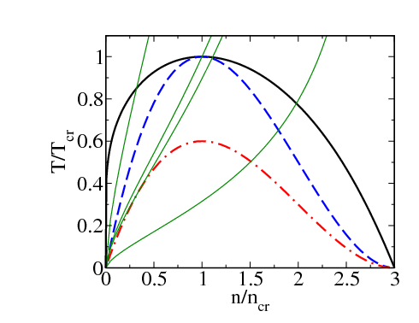
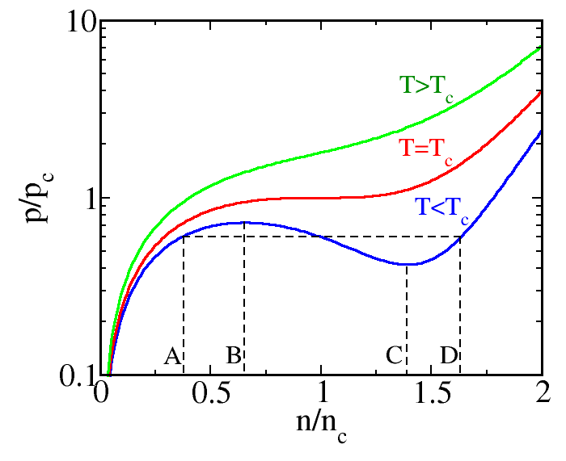

Pressure isotherms and constant entropy trajectories
Effects of the first-order phase transition
(gas-liquid, T<(15-20) MeV, quark-hadron for T~100 MeV)
$S≃const$trajectories
Gi~1
ITS
SV
MC
AS
region of instability
in ideal hydro
OL
- - - isothermal spinodal (ITS), - . - . - adiabatic spinodal (AS),
Maxwell construction
In non-ideal hydro spinodal instability appears earlier (after crossing of ITS line),
in ideal hydro – later (after crossing AS line)

Slide 11
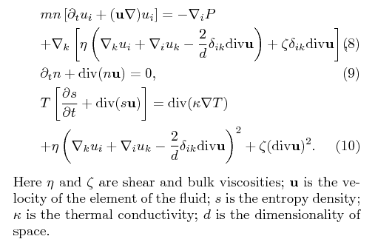
I order phase transition in non-ideal non-relativistic hydrodynamics
in collective processes u is usually small

Slide 12

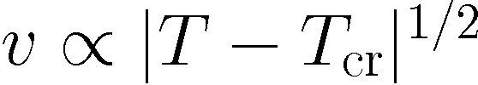
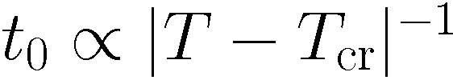
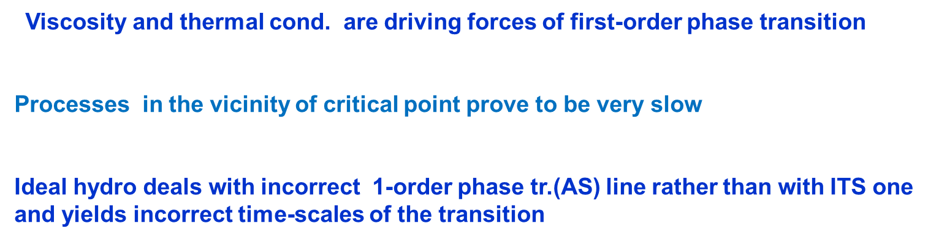
in vicinity of the critical point - analytical solutions
V.Skokov, D.V. JETP Lett.90(2009); NPA828(2009) 401;846(2010)
neglecting u² terms:
heat transport time
: T ∂s/ ∂ t = κ Δ T,
t _{T} ~ R² c_{v} / κ , c_{v} is specific heat density
viscosities
R (t) -- the size of evolving seed
typical time for density fluctuation: t _{ρ} ~ (4 η /3 +ζ)/v²
Viscosity and thermal cond. are driving forces of first-order phase transition
Processes in the vicinity of critical point prove to be very slow
Ideal hydro deals with incorrect 1-order phase tr.(AS) line rather than with ITS one
and yields incorrect time-scales of the transition

Slide 13
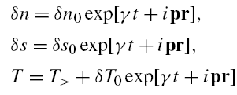


Instabilities in spinodal region
Skokov, D.V. Nucl. Phys. A828(2009); A846 (2010); Randrup, PRC79(2009)
aerosol-like mixture of bubbles and droplets (mixed phase)
From equations of non-ideal hydro:
surface tension
In the limit
unstable solution
sound velocities
Fastest growing bubbles (droplets): $r∼1/p_{m}$

Slide 14
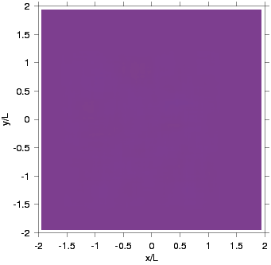
Spinodal instability
Dynamics in spinodal region.
Blue – hadrons,
Red – quarks.
Skokov, D.V. JETP Lett. 90 (2009); Nucl. Phys. A828 (2009)

Slide 15
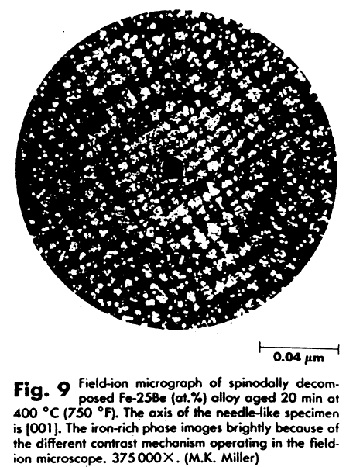
What one may observe if system is in spinodal region
is a structured phase !
a spine

Slide 16

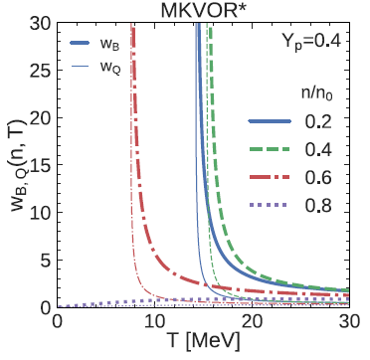
Normalized variance of the baryon number
Maslov, D.V. EPJA55(2019)
diverges on ITS line
Effects of crossing of the ITS line m.b. easier to observe than the vicinity
of the critical point (due to a critical slowing down effect in letter case)

Slide 17
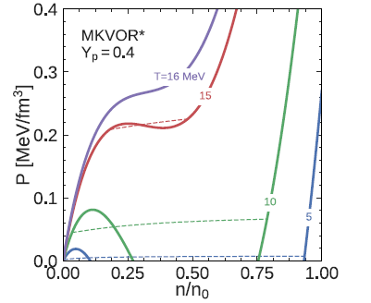
Specificity of P(n) isotherms in asymmetric matter
Maxwell construction from horizontal line is transformed into a curve
In NS and hybrid stars there is a region of structured pasta phase (at 1-order phase tr. occurs in presence of global charge neutrality). Surface tension + screening effects within WZ cells are important [D.V.,Yasuhira,Tatsumi Phys.Lett.B541(2002), T.Maruyama et al. PRC 72(2005), Maslov et al. PRC100(2019)]
Now, a novel possibility is the structured Coulomb pasta in HIC (in absence of global charge neutrality). Surface tension + redistribution of charge within WZ cells
Maslov, D.V. EPJA 55(2019)
Any features of pasta in dynamical problem HIC?

Slide 18
Pions and kaons in dense baryon matter
Their description is beyond RMF approximation
s and p-wave polarization for pions at arbitrary isospin composition N/Z

Slide 19
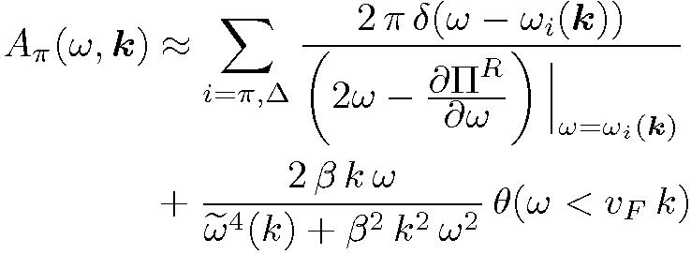
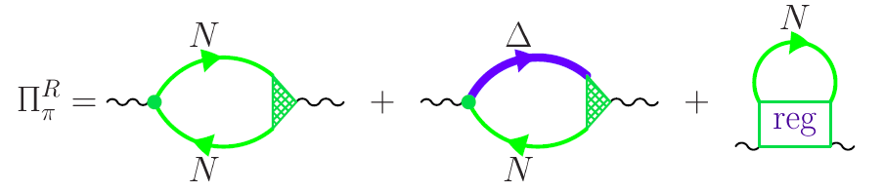
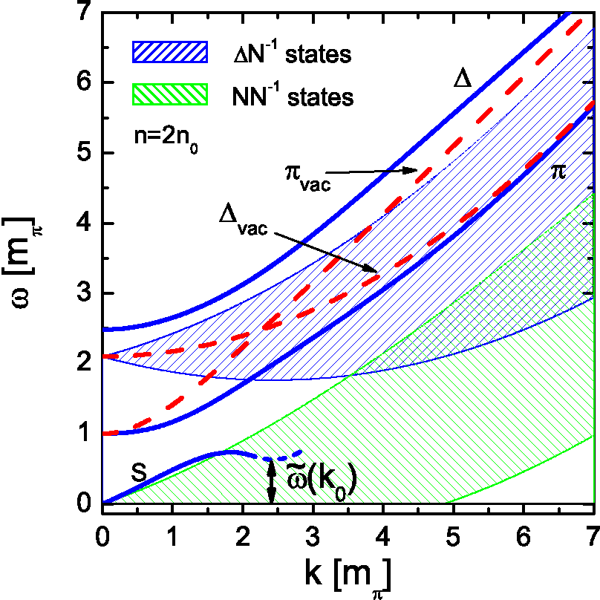

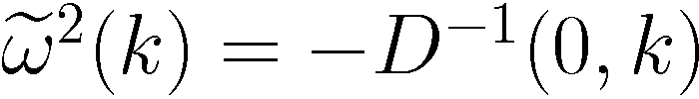
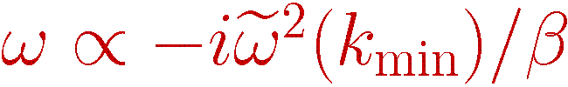
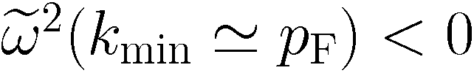
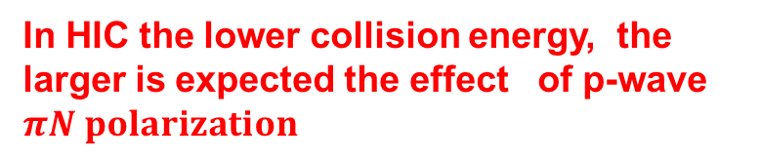


Pion softening in dense baryonic matter
Migdal,Saperstein,Troitsky,D.V.,Phys.Rept.192(1990)
ISM (N=Z)
pion propagator has a complex pole for k$∼p F$
effective pion gap
for n>n _{c}~1.5-3 n₀
instability
pion condensation
In HIC the lower collision energy, the larger is expected the effect of p-wave $πN polarization$
“pion gap”
For N≠Z for π+ , $π$- spectra are different due to effects of s-wave $πN$interaction

Slide 20
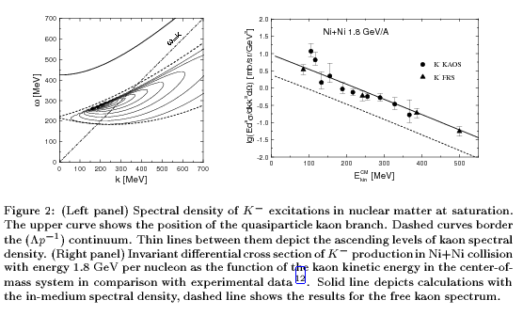
Antikaon spectra in nuclear matter
s-wave and p-wave polarization effects for arbitrary N/Z
K- have short mean free path and radiate from freeze out
Possibility of S and/or P wave antikaon condensation in dense NS interiors
Kolomeitsev, Kampfer,D.V. Int.J.Mod.Phys.E5(1996), Kolomeitsev, D.V. PRC68(2003)

Slide 21
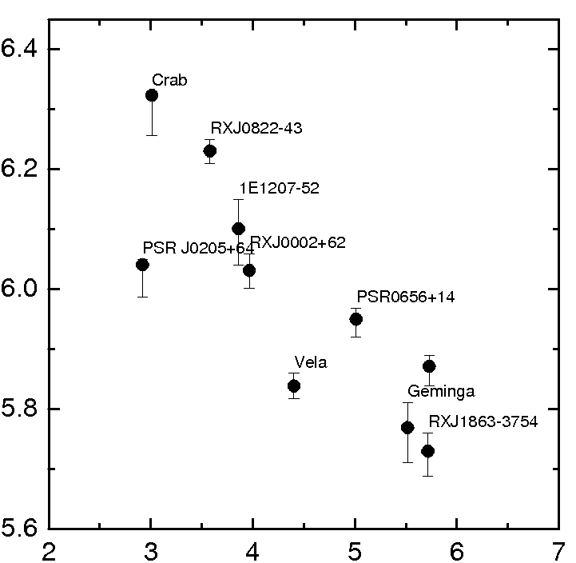



Pion softening in neutron star cooling
Description in ``minimal cooling” scheme (D.Page, D.Yakovlev et al.) seems problematic
3 groups+Cas A:
∞
>10³ in emissivity
slow cooling
XMMU-J17328
CaS A
intermediate cooling
rapid cooling
With pion softening effect included data are described within one cooling scenario.

Slide 22
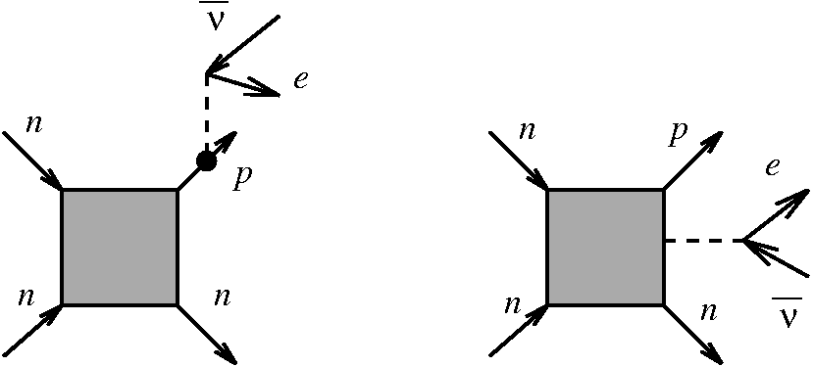

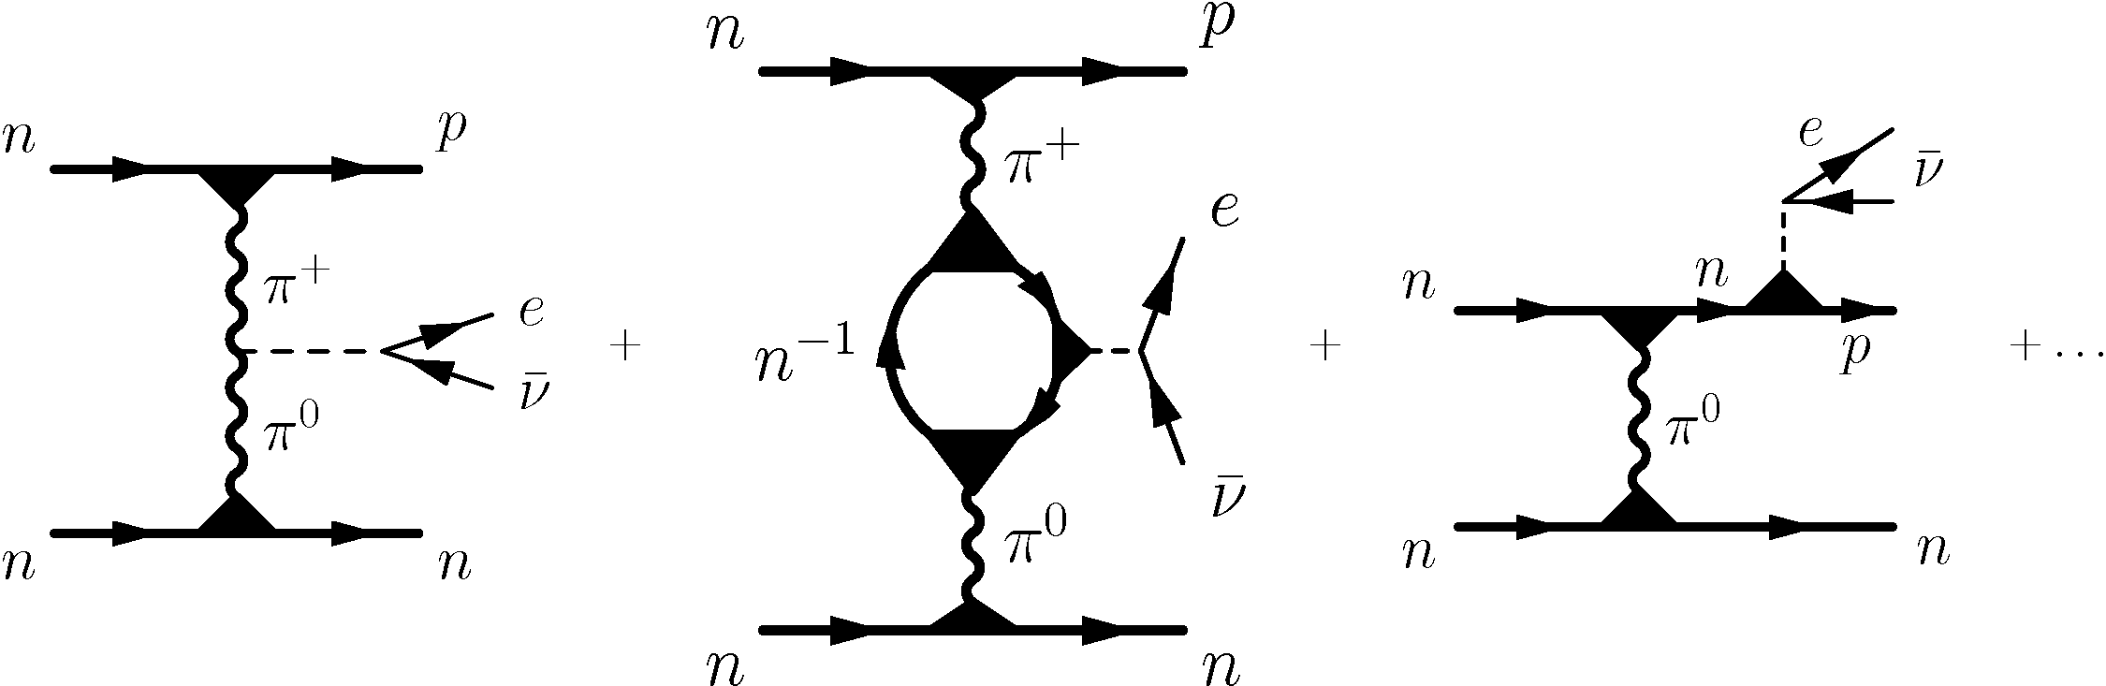
In-medium effects in direct reactions
(λ _{ν} >>R, a similarity with dilepton production in HIC)
Straight generalization of MU
emissivity:
larger
smaller
Very strong density = NS mass
dependence
More massive NS cool more rapidly
Very important!
ef. pion gap
D.V.,Senatorov JETP 63(1986), PLB184(1987) included in code in series of works by
Blaschke,Grigorian,D.V.; cf. AA424(2004),EPJ A52(2016)

Slide 23
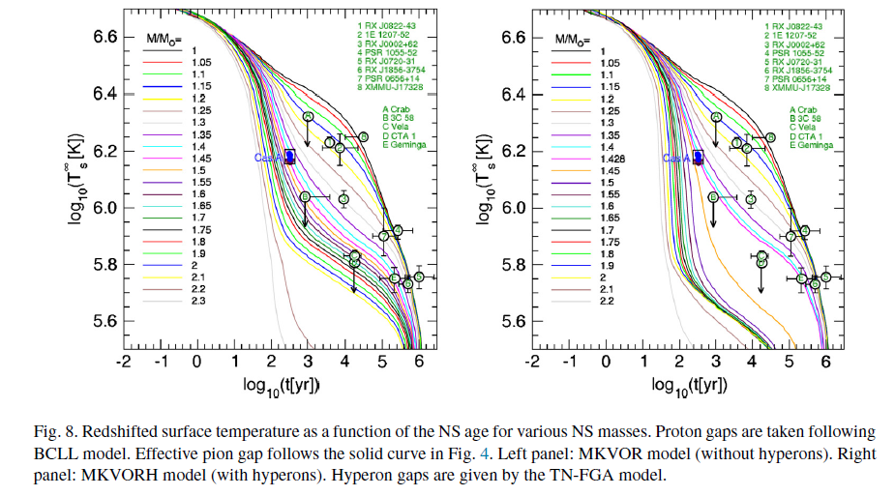
Cooling of NS can be explained taking into account pion softening
Hyperon effect
Fig. from Grigorian,D.V.,Maslov, NPA 2018
Absence of too rapidly rotating young pulsars also can be explained taking into account pion softening effect on neutrino emissivity and bulk viscosity
Kolomeitsev, D.V. PRC91(2015)

Slide 24
EoS of baryon-poor hadron matter (hot, not too dense)
blurred baryons

Slide 25




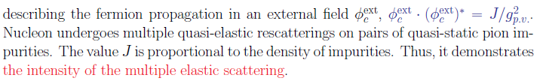
Hot hadron liquid with a small baryon chemical potential
Use m* _{N} >>m*_{π}
Consider self-consistent model
No other approximations!

Slide 26
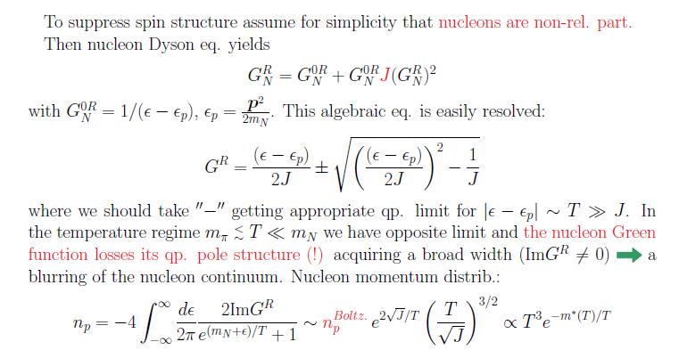

Blurring of baryon vacuum
Interesting:
-not quasiparticles,
not resonances !
Would be interesting to study such a model on lattice

Slide 27
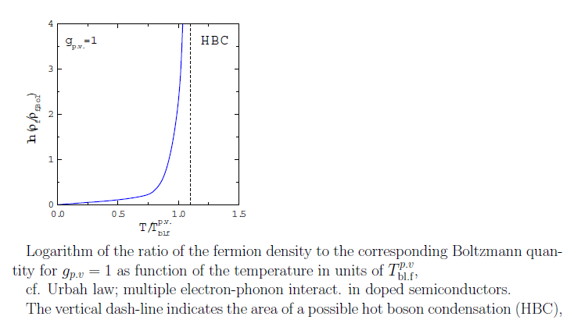


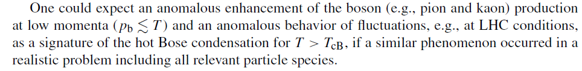

Other baryons ($Δ,$Λ, $Σ) can be$ included in a similar way.
Boson effective masses decrease as well
squared effective pion mass may reach zero

Slide 28
Conclusion/Plan
Hadron description
EoS of baryon-reach hadron matter (dense, not too hot)
quasiparticle description, a cut-mechanism for EoS
Effects of first-order phase transition and CEP
viscosity and thermal conductivity are necessary to describe
dynamics of first order phase transition
Pions and kaons in baryon-reach hadron matter
p-wave polarization effects
EoS of baryon-poor hadron matter (hot, not too dense)
baryon blurs (not quasiparticles, not resonances)
=================================================
There are many other possible effects: possible pion and zero-sound condensation in peripheral HIC, instabilities in interpenetrating beams, BEC of pions at energies LHC, etc.
Key message -- simultaneous analysis is required of relevant phenomena in different domains of nuclear physics: hadron scattering, atomic nuclei, compact stars, supernovas, heavy-ion collis. in all collision-energy regimes

