Slide 1

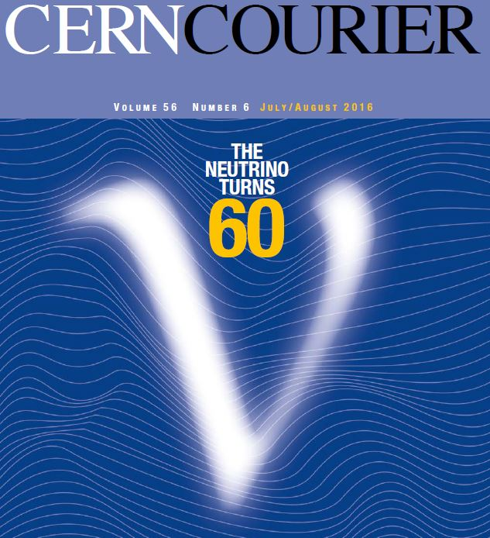
A very intense neutrino super beam experiment for leptonic CP violation discovery based on the European Spallation Source linac
Roumen Tsenov
LHEP-JINR and Department of Atomic Physics, University of Sofia
(on behalf of the ESSνSB Collaboration)
Notes:
Tittle page and out line

Slide 2
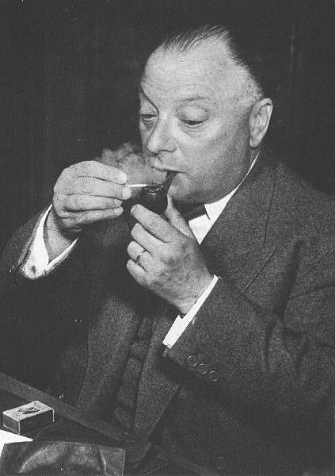
Neutrinos: the birth of the idea
e⁻ spectrum in beta decay
Pauli's letter of the 4th of December 1930
Dear Radioactive Ladies and Gentlemen,
As the bearer of these lines, to whom I graciously ask you to listen, will explain to you in more detail, how because of the "wrong" statistics of the N and Li6 nuclei and the continuous beta spectrum, I have hit upon a desperate remedy to save the "exchange theorem" of statistics and the law of conservation of energy. Namely, the possibility that there could exist in the nuclei electrically neutral particles, that I wish to call neutrons, which have spin 1/2 and obey the exclusion principle and which further differ from light quanta in that they do not travel with the velocity of light. The mass of the neutrons should be of the same order of magnitude as the electron mass and in any event not larger than 0.01 proton masses. The continuous beta spectrum would then become understandable by the assumption that in beta decay a neutron is emitted in addition to the electron such that the sum of the energies of the neutron and the electron is constant...
I agree that my remedy could seem incredible because one should have seen those neutrons very earlier if they really exist. But only the one who dare can win and the difficult situation, due to the continuous structure of the beta spectrum, is lighted by a remark of my honoured predecessor, Mr Debye, who told me recently in Bruxelles: "Oh, It's well better not to think to this at all, like new taxes". From now on, every solution to the issue must be discussed. Thus, dear radioactive people, look and judge.
Unfortunately, I cannot appear in Tubingen personally since I am indispensable here in Zurich because of a ball on the night of 6/7 December. With my best regards to you, and also to Mr Back.
Your humble servant
. W. Pauli translation: L.M. Brown, Phys. Today, Sept.1978, 23
1930
dN
dE
MeV
E
Wolfgang Pauli

Slide 3
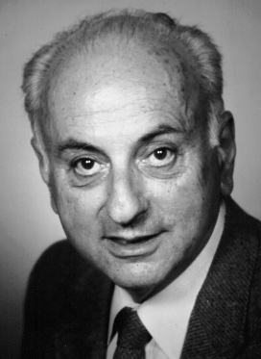
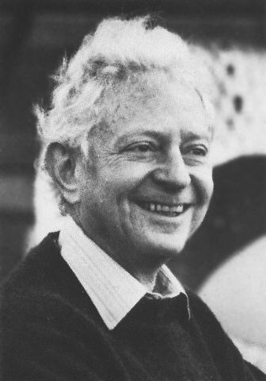
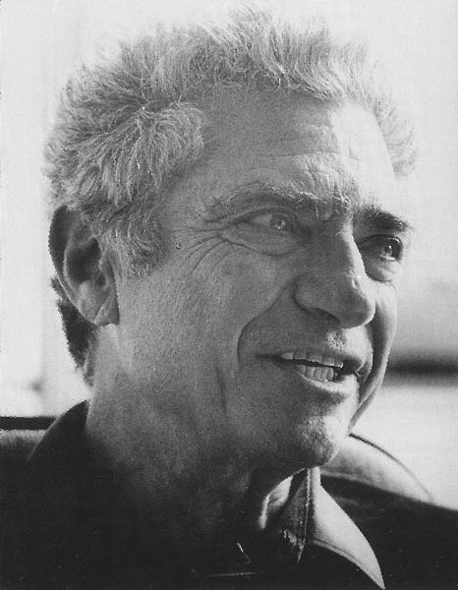
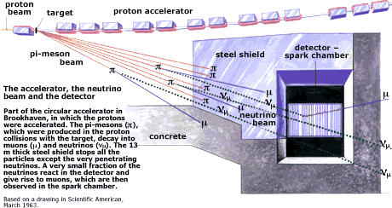
Nobel Prize in Physics 1988
Two Neutrinos
1962
AGS Proton Beam
M.Schwartz L.Lederman J.Steinberger
_{μ}⁻
Neutrinos from
π-decay
produce only muons
(not electrons)
when they interact
in matter.
ν_{μ}
W⁻
N
_{hadrons}

Slide 4
Total neutrino – nucleon CC cross section
neutrino
anti-neutrino
We distinguish:
quasi-elastic
single pion production („RES region”,
e.g. W<=2 GeV)
more inelastic („DIS region”)
σ_{ν} is very small: λ_{int} in water for 30 GeV neutrino is 8x10¹⁰m (~ 0.55 AU) !

Slide 5
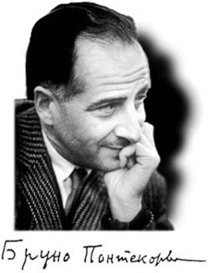
Neutrino Oscillations
source
propagation in vacuum (or matter)
detection
L
Energy (i.e. mass) eigenstates
propagate
weak interaction
produces
‘flavour’ neutrinos
e.g. pion decay π → μν
¦ν_{μ}> = α ¦ν₁ > +
β ¦ν₂ > +
γ ¦ν₃ >
weak interaction: (CC)
ν_{μ} Ν → μ⁻ Χ
ν_{e} Ν → e⁻ Χ
ν_{τ} Ν → τ⁻ Χ
P ( μ → e) = ¦ < ν_{e} ¦ ν (t)>¦²
¦ν (t)> = α ¦ν₁ > exp( i E₁ t)
+ β ¦ν₂ > exp( i E₂ t)
+ γ ¦ν₃ > exp( i E₃ t)
t = proper time ∝ L/E
First idea by Bruno Pontecorvo, 1957

Slide 6
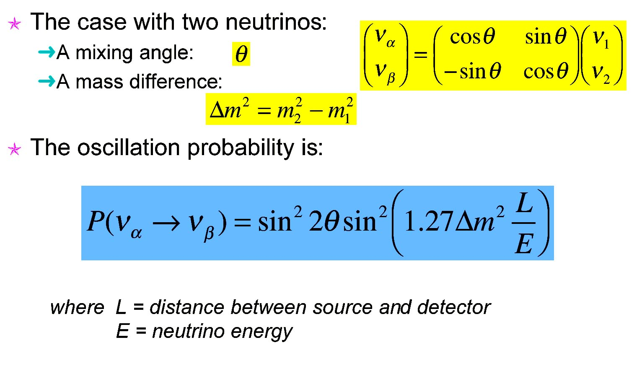
Oscillation Probability
Δm² in ev²
L in km
E in GeV

Slide 7
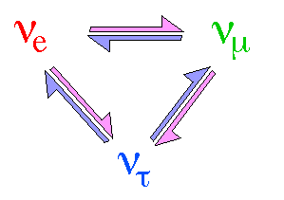
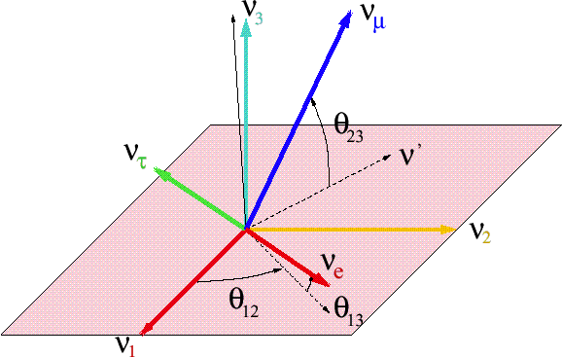
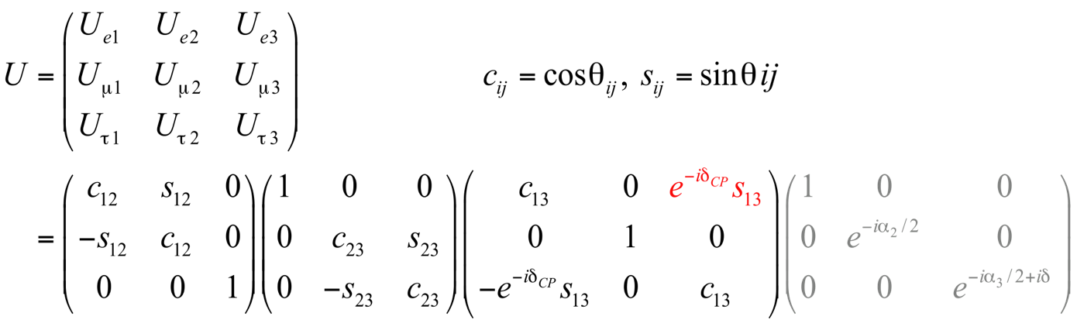
Three neutrino mixing
3 mixing angles, θ₁₂, θ₂₃, θ₁₃, and one phase, δ_{CP}
Usual parameterization
solar,
reactors
atmospheric,
accelerators
reactors,
accelerators
CP violation
Majorana phases
δCP for neutrinos
-δCP for anti-neutrinos

Slide 8

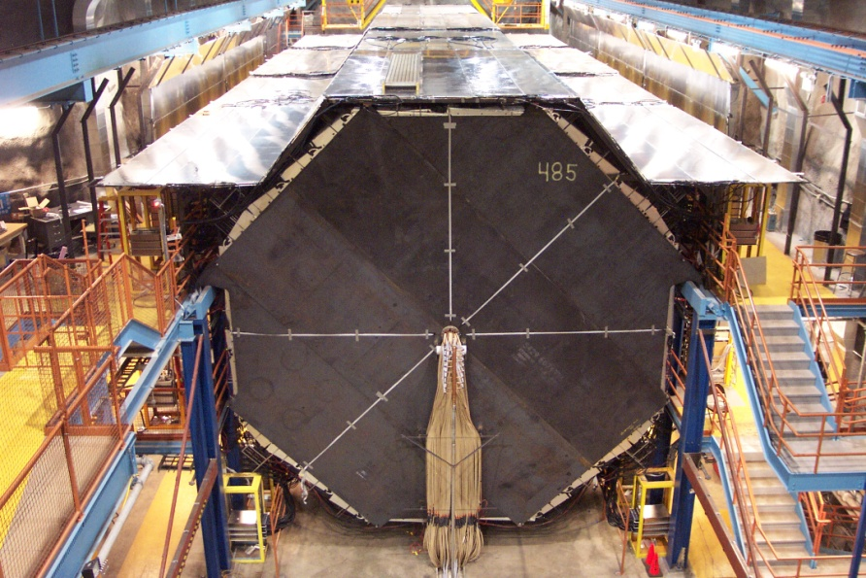
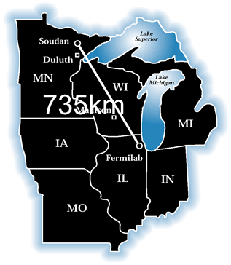
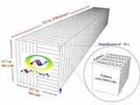
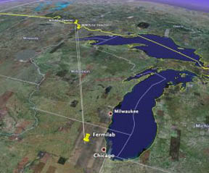
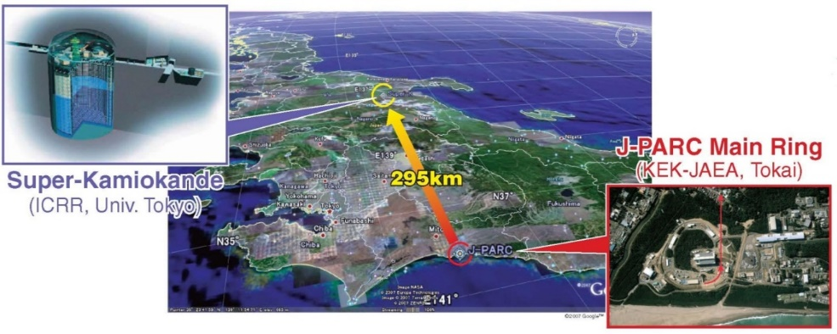

LBL experiments at accelerators
K2K (Japan)
MINOS (USA)
NOν A (USA)
T2K (Japan)
OPERA (Europe)
8

Slide 9
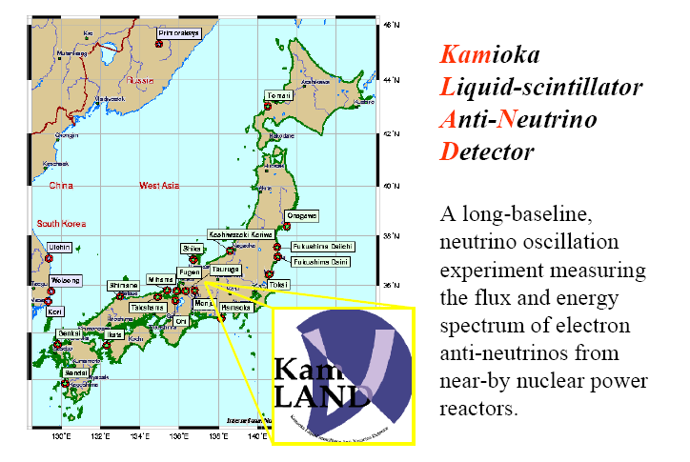
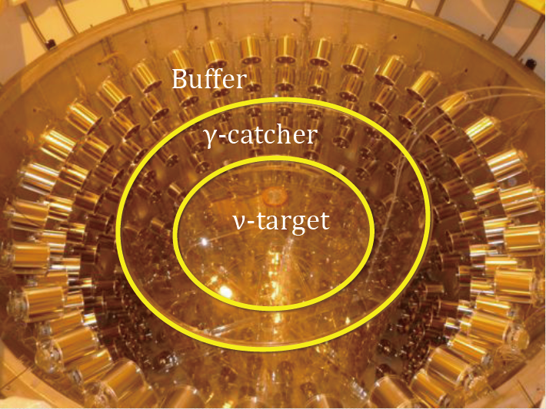
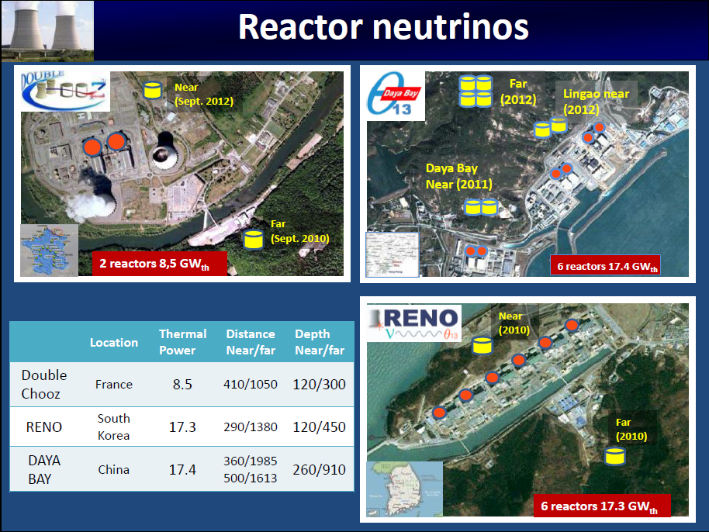
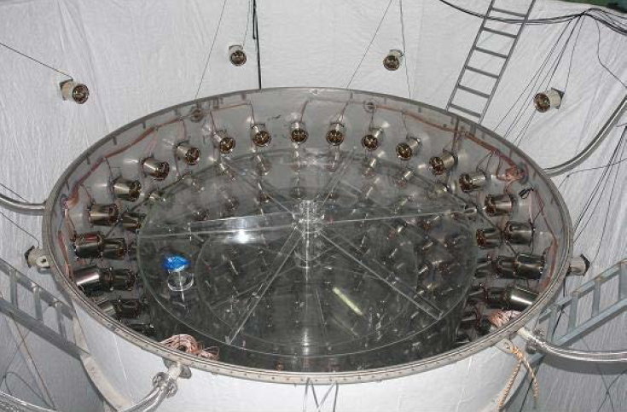
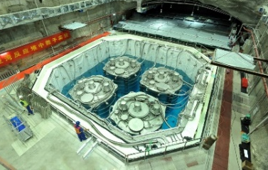
SBL experiments at reactors
Double CHOOZ (France)
KamLAND
(Japan)
Daya Bay (China)
RENO (S. Korea)
9

Slide 10
What have we measured up to now?
Global fit Aug 2016 (www.nu-fit.org)
What is not know yet:
  - the mass hierarchy: sign Δm₁₃²
  - the CP violating phase δ

Slide 11
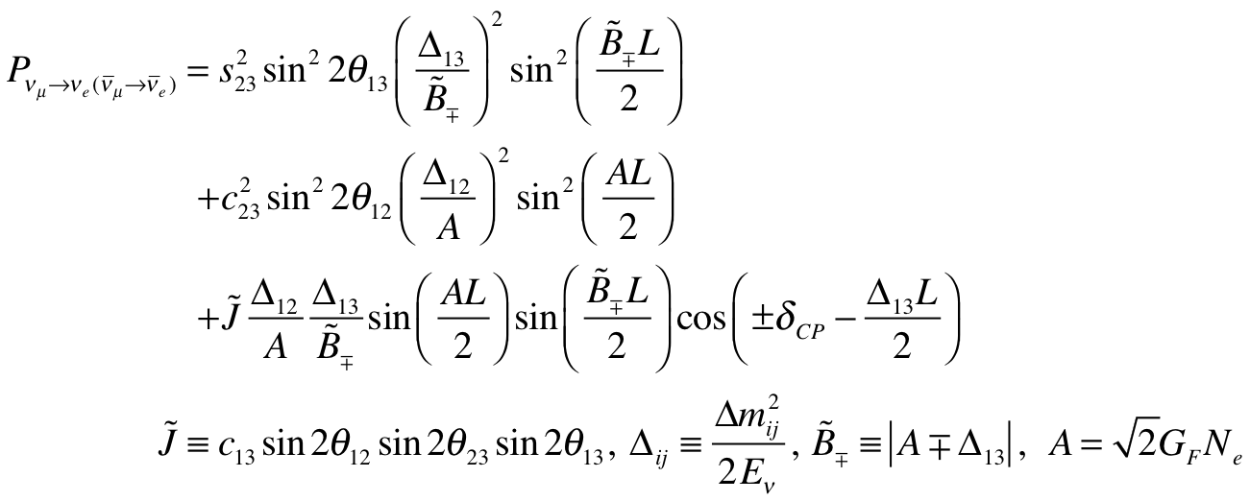
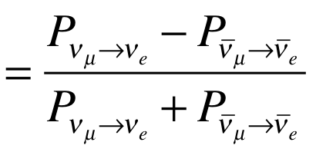
CP Violating observables
(and mass hierarchy)
atmospheric
Non-CPV terms
solar
interference
CP violating
matter effect
⇒ accessibility to mass hierarchy
⇒ long baseline
A
≠0 ⇒ CP Violation
be careful, matter effects also create asymmetry

Slide 12
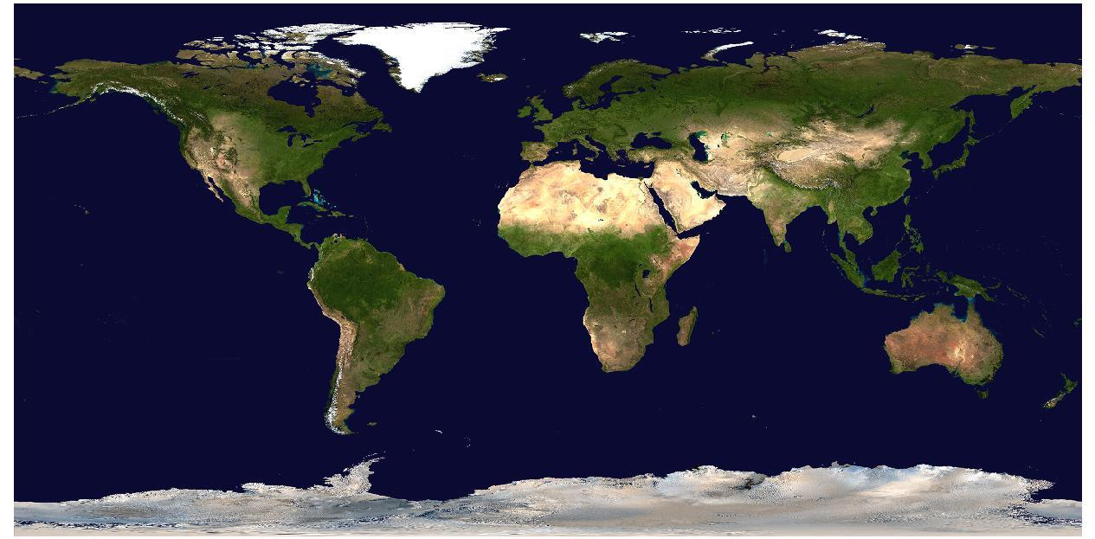
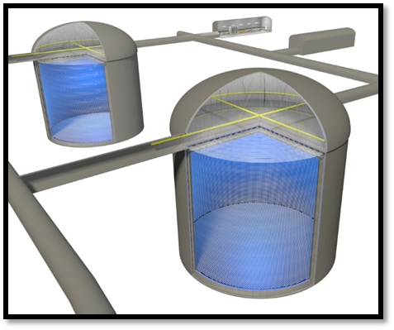
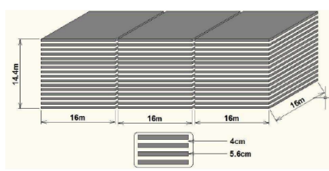
Future neutrino experiments
(in construction / approved / in preparation)
RENO-50
Hyper-K
KM3NeT
/ORCA
LBNF/DUNE
JUNO
PINGU
INO
RENO-50
12

Slide 13
How can we produce a "conventional" neutrino beam?
proton beam
decay tunnel
hadrons
physics
p
π
ν
⨂B
target
hadronic collector
(focusing)
Detector
Maximum proton power up to now: ~700 kW
For CP violation neutrino experiments power of few MW is needed.
Super Beams
Challenges:
high repetition rate (pulsing the whole system faster)
targets able to afford the proton beam intensity
power dissipation
radiations
…

Slide 14
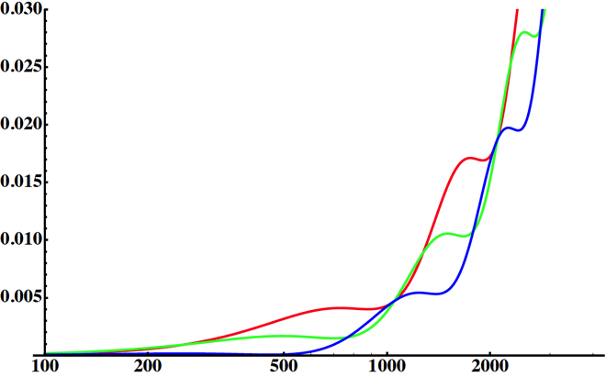
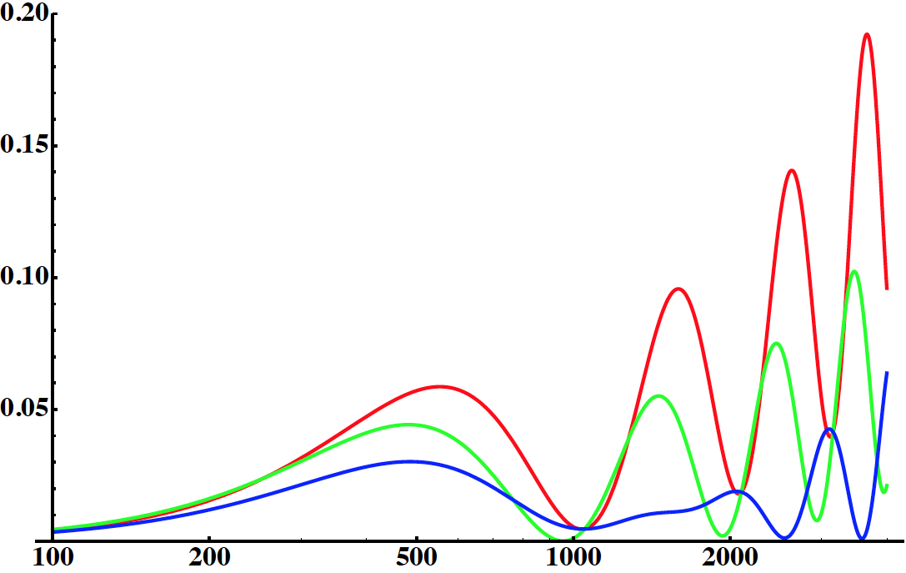
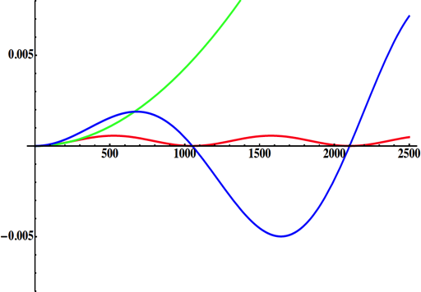
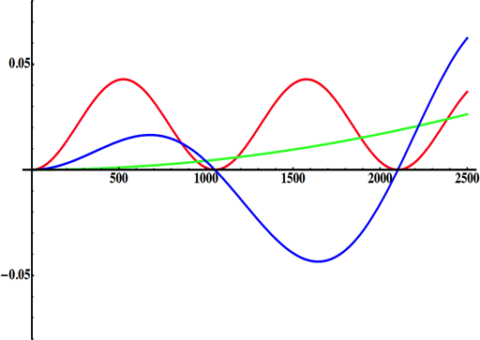
Neutrino Oscillations with "large" θ₁₃
2nd oscillation maximum
1st oscillation maximum
P(ν_{μ}→ν_{e} )
θ₁₃=1º
("small" θ₁₃)
δ_{CP}=-90
δ_{CP}=0
δ_{CP}=+90
θ₁₃=8.8º
("large" θ₁₃)
L/E
L/E
solar
atmospheric
for "large" θ₁₃ 1st oscillation maximum is dominated by atmospheric term,
for small θ₁₃ 1st oscillation maximum is better
atmospheric
solar
L/E
L/E
CP interference
θ₁₃=1º
CP interference
θ₁₃=8.8º
2nd oscillation maximum is better

Slide 15
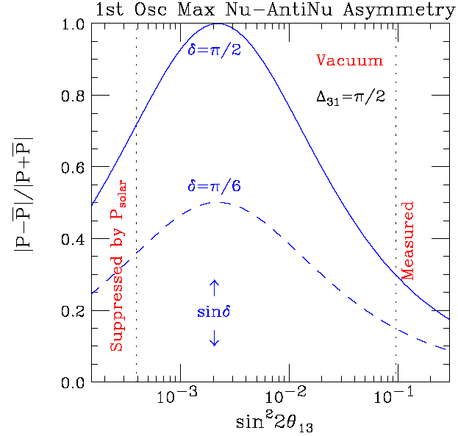
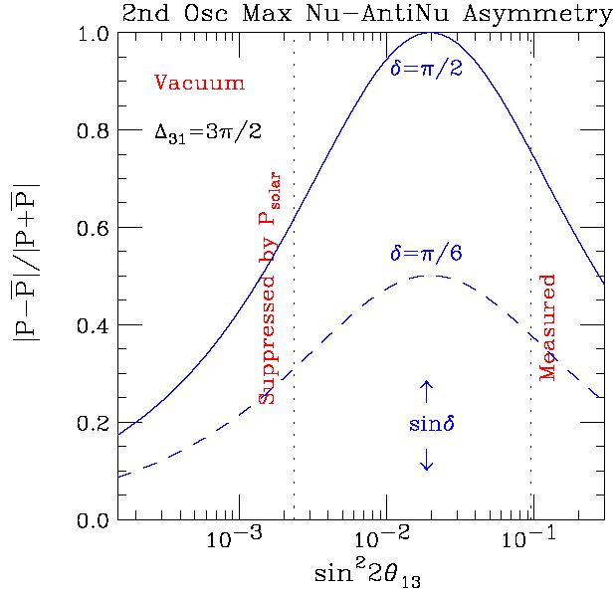
Neutrino oscillations with "large" θ₁₃
at the 1st oscillation max.: A=0.3sinδ_{CP}
at the 2nd oscillation max.: A=0.75sinδ_{CP}
2nd oscillation maximum is better

Slide 16

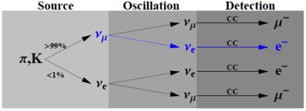
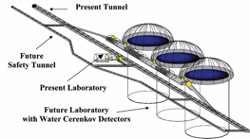
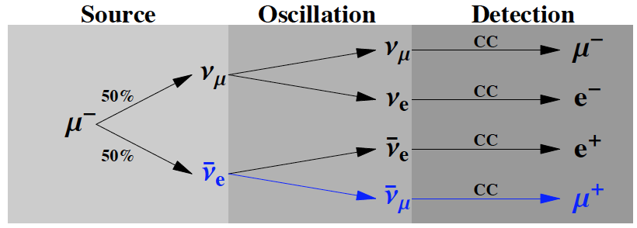
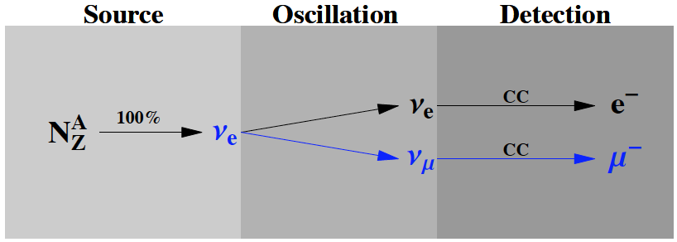
The EUROν project
(FP7 design study, 2008 - 2011)
SPL 3.5-5 GeV, 4 MW
p
SPL Super-Beam
Accumulator
ring
proton driver
50 Hz
Magnetic
horn capture
(collector)
p
Target
ν, μ
hadrons
decay tunnel
~300 MeV ν_{μ} beam to far detector
Neutrino Factory
5 GeV?, 4 MW
proton driver
Accumulator
ring + bunch
compressor
Magnetic
capture
Recirculating
Linacs 2 → 50 GeV
Ionization
cooling
Drift
Target
Phase rotation
Linac → 2 GeV
Decay ring – 50 GeV
≈2000 m circumference
ν beam to far detector
magnetized detector needed
Beta-Beam
ν beam to near detector
EURISOL
Existing at CERN
⁶He for ν_{e} and ¹⁸Ne for ν_{e}
γ~100
Proton
driver
DECAY
RING
Isol target
& ion source
SPS
B = 5T
L=6880 m
New RFQ
Linac
PSB
PS

Slide 17

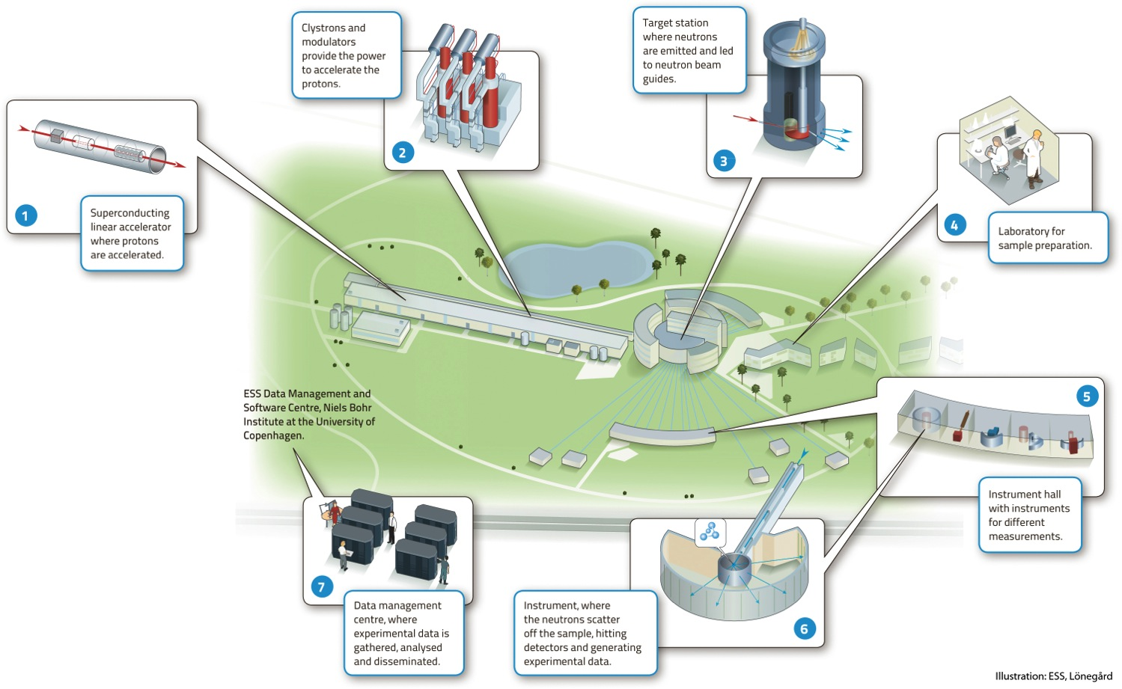


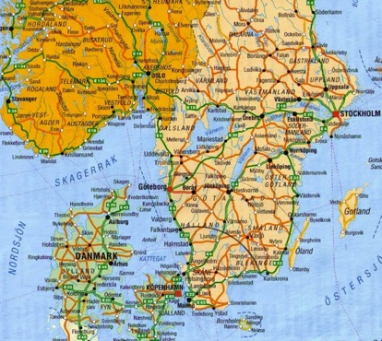
European Spallation Source
Construction has started.
(~1.8 B€ facility)

Slide 18
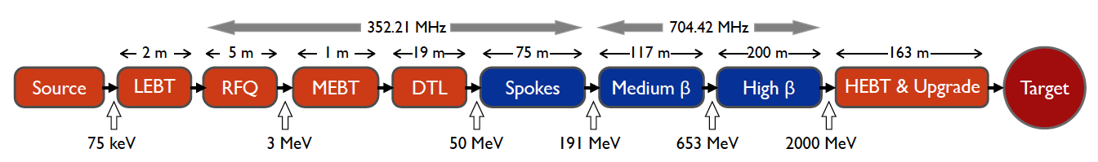
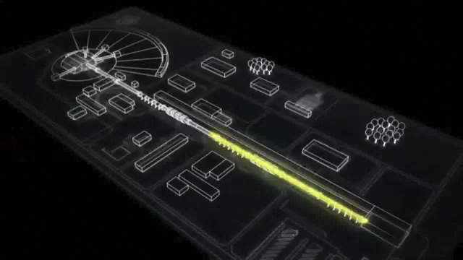
ESS proton linac
The ESS will be a copious source of spallation neutrons
5 MW average beam power
125 MW peak power
14 Hz repetition rate (2.86 ms pulse duration, 10¹⁵ protons)
2.0 GeV protons (up to 3.5 GeV with linac upgrades)
>2.7x10²³ p.o.t/year

Slide 19
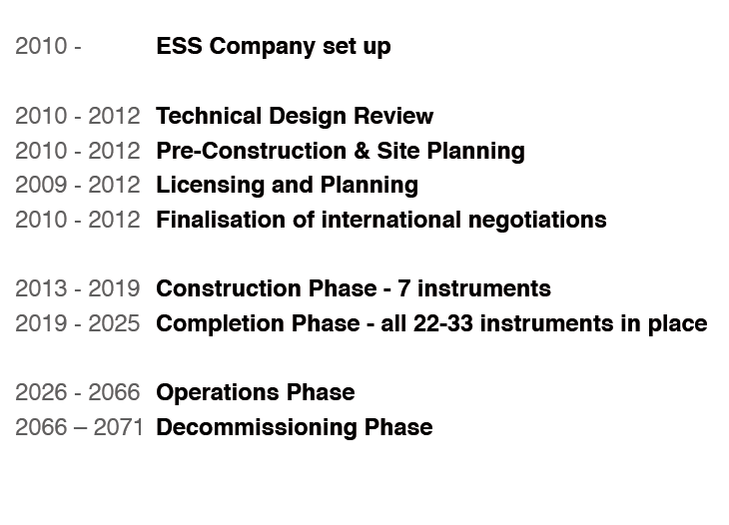
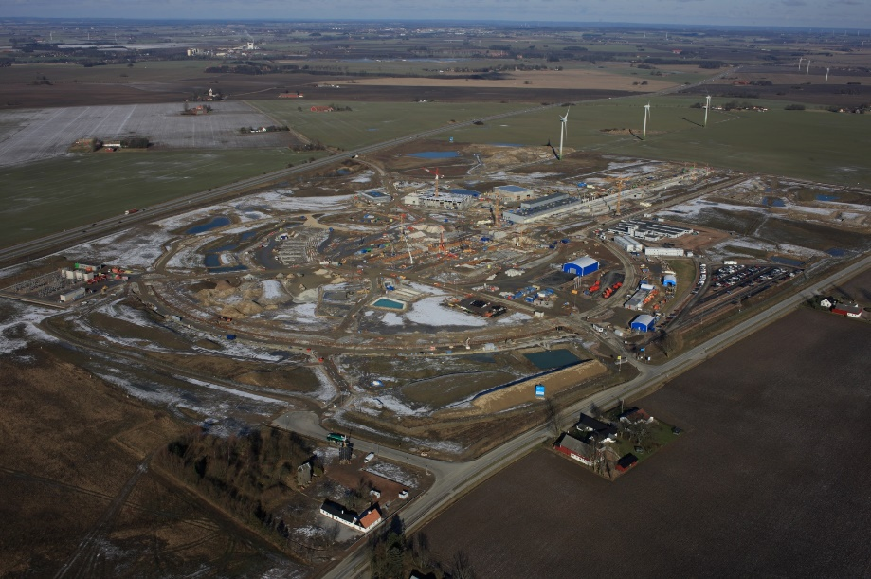
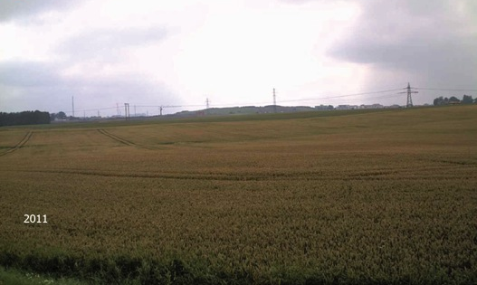
ESS Schedule
1st beam before the end of the decade
5 MW by 2023
ESS site 2011
ESS site Feb. 2016

Slide 20
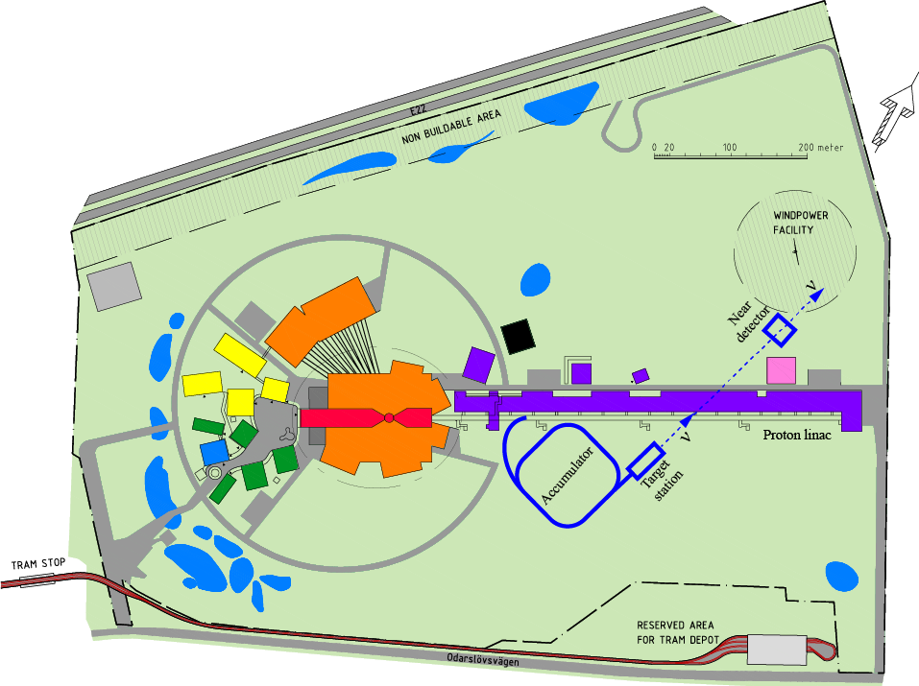
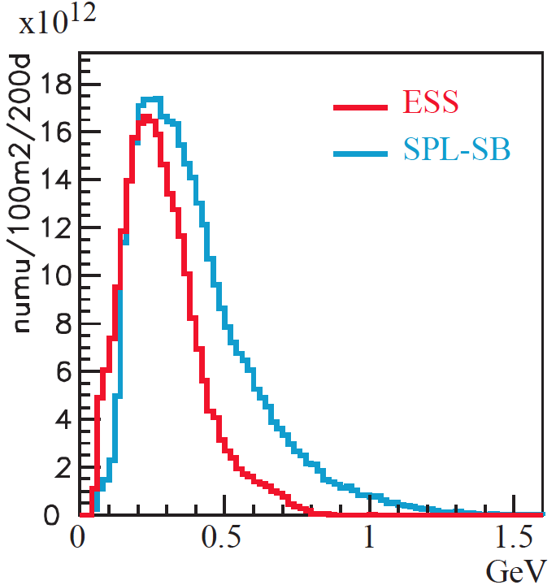
How to add a neutrino facility to ESS?
The neutron program must not be affected and if possible synergetic modifications
Linac modifications: double the rate (14 Hz → 28 Hz), from 4% duty cycle to 8%.
Accumulator (ø 143 m) needed to compress to few μs the 2.86 ms proton pulses, affordable by the magnetic horn (350 kA, power consumption, Joule effect)
  H⁻ source (instead of protons)
  space charge problems to be solved
~300 MeV neutrinos
Target station (studied in EUROnu)
Underground detector (studied in LAGUNA)
Short pulses (~μs) will also allow DAR experiments
The linac and accumulator could be the first step towards Neutrino Factory, Muon Collider, etc.
neutrino flux at 100 km (similar spectrum than for EUROnu SPL SB)

Slide 21
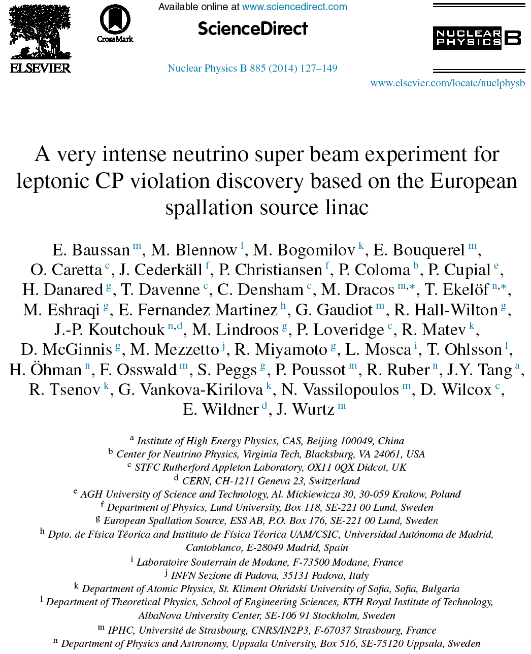
ESS Neutrino Super Beam Collaboration
(ESSνSB)
arXiv:1212.5048
arXiv:1309.7022
14 participating institutes form 10 different countries,
among them ESS and CERN

Slide 22
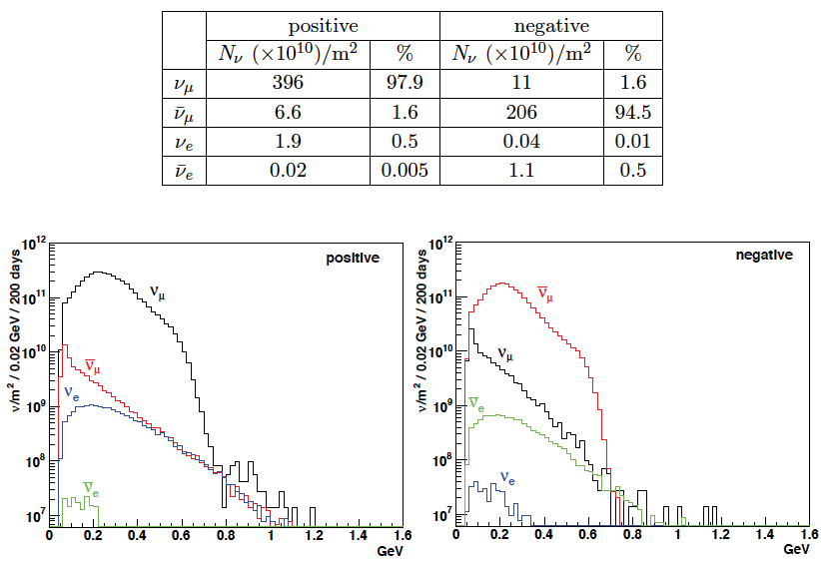
ESS neutrino energy distribution
at 100 km from the target and per year

Slide 23
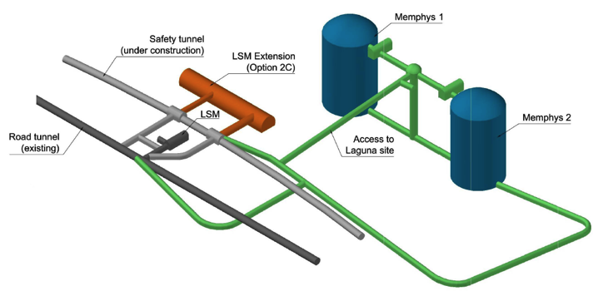
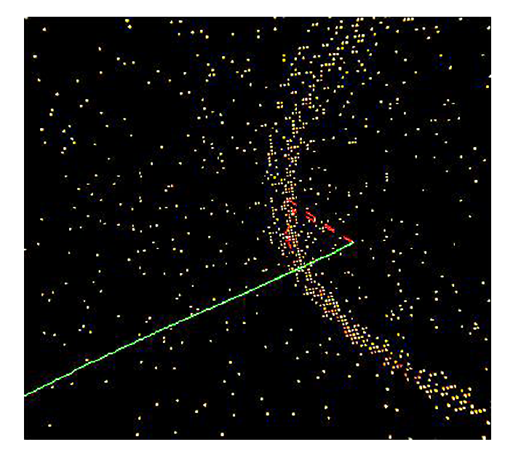
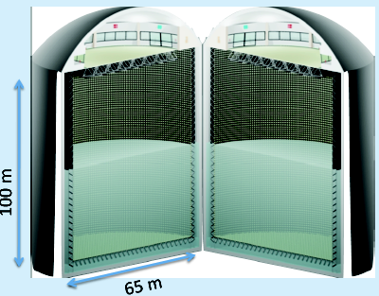

The MEMPHYS (MEgaton Mass PHYSics)
Water Cherenkov Detector
Proton decay
Astroparticle physics: galactic SN ν, Supernovae "relics"
Solar and atmospheric neutrinos
Neutrino oscillations (Super Beam)
500 kt fiducial volume (~20xSuperK)
Readout: ~240k 8” PMTs
30% optical coverage
(arXiv: hep-ex/0607026)

Slide 24



WC detector possible locations
(Nucl. Phys. B 885 (2014) 127)
Garpenberg
Zinkgruvan
~60% δ_{CP} coverage at 5 σ C.L.
>75% δ_{CP} coverage at 3 σ C.L.
systematic errors: 5%/10% (signal/background)
Garpenberg mine (1230 m)

Slide 25

Physics Performance of ESSνSB
neutrinos
anti-neutrinos
540 km (2 GeV protons)
2 years
8 years

Slide 26
New design,
2/3 of the reference one
J-PARC 1.3 MW
reference design

Slide 27



See Dr. Zelimir DJURCIC’s talk

Slide 28







Sensitivity to δ_{CP} - neutrino energy spectra
Hyper-K first maximum LBNE/DUNE first maximum ESSnuSB second maximum
Hyper-K
Hyper-K
Events/100MeV
Relative difference in counts at maximum between δ_{CP} = 3π/2 and π/2 :
430/275 = 1.6 150/100 = 1.5 105/22 = 4.8

Slide 29
ESSνSB in comparison with others

Slide 30

Conclusion
The European Spallation Source linac will be ready in less than 10 years (5 MW, 2 GeV proton beam by 2023).
Neutrino Super Beam based on ESS linac is very promising.
ESS will have enough protons to go to the 2nd oscillation maximum where the sensitivity to CP violation is larger.
CP violation discovery: 5 σ could be reached over 60% of δ_{CP} range in ESSνSB.
The megaton far detector has a potential for a rich astroparticle physics programme.
Rich muon programme.
A Design Study is needed.
EuroNuNet : Combining forces for a novel European facility for neutrino-antineutrino symmetry violation discovery (http://www.cost.eu/COST_Actions/ca/CA15139)

Slide 31

δ_{CP}, not just one more parameter to measure…
Why is the Universe as we know it made of matter, with no antimatter present?
What is the origin of this matter-antimatter asymmetry?
Are neutrinos connected to the matter-antimatter asymmetry, and if so, how?
If neutrinos exhibit CP violation, is it related to the CP violation observed in the quark interactions?
  Already observed CP violation in the quark sector is not enough to explain the matter-antimatter asymmetry.
  CP violation in the lepton sector could be enough to explain matter-antimatter asymmetry if |sinθ₁₃sinδ_{CP}|≿0.11 (hep-ph/0611338) ⇒ |sinδ_{CP}|≿0.7 (45º≾δ_{CP}≾135º or 225º≾δ_{CP}≾315º).
Are neutrinos their own antiparticles (do we need Majorana phases)?
What role did neutrinos play in the evolution of the universe?

Slide 32
Back-up

Slide 33
NH ↔ IH
Neutrino 2016

Slide 34
Neutrino 2016

Slide 35



Garpenberg Mine (Boliden)
Distance from ESS: 540 km
Depth: 1232 m
Truck access tunnels
Two ore hoist shafts
A new ore hoist shaft is planned to be ready in 3 years, leaving the two existing shafts free for other uses
Granite drill cores around a candidate position

Slide 36





Mitigation of high power effects
(4-Target/Horn system for EUROnu Super Beam)
Packed bed canister in symmetrical transverse flow configuration (titanium alloy spheres)
4-target/horn system to mitigate the high proton beam power (4 MW) and rate (50 Hz)
target inside the horn
Helium Flow
proton beam switchyard

Slide 37
Number of events

Slide 39



The MEMPHYS Detector
(Proton decay)
(arXiv: hep-ex/0607026)

Slide 40


The MEMPHYS Detector
(Supernova explosion)
MEMPHYS
SUPERK
Diffuse Supernova Neutrinos
(10 years, 440 kt)
For 10 kpc: ~10⁵ events

Slide 41

Systematic errors
Phys. Rev. D 87 (2013) 3, 033004 [arXiv:1209.5973 [hep-ph]]

