Slide 1
Optimization Algorithm for Computing Options for the Hybrid System
St.Petersburg State University
Dmitry Khmel
Alexander Bogdanov
Eduard Stepanov
Dubna 2016

Slide 2
Topicality
The rapid growth in derivatives trading
Financial crises
The big risk in derivatives trading
High performance requirements calculation

Slide 3
Efficiency calculations
Main conclusions:
The main factor is the speed of the calculations;
Enough to accurately predict the relative accuracy of the market should be 1% or higher.

Slide 4
The calculation of option prices
To evaluate options was applied Monte Carlo.
Benefits :
Ease of implementation
The high degree of parallelism
Disadvantages
Accuracy is based on statistical estimates

Slide 5

The mathematical formulation of the problem
Path integral:
$$E\left[F\left(S_{T}\right)\right]=\int_{−∞}^{+∞}{…}\int_{−∞}^{+∞}{dx_{1}… dx_{n}} dx_{n+1}max\left\{e^{x_{n+1}}−K, 0\right\}∙$$
$$∙\frac{1}{\sqrt{{\left(2πσ^{2}∆t\right)}^{n+1}}}exp\left\{−\frac{1}{2σ^{2}∆t}\sum_{k=1}^{n+1}{{\left[x_{k}−\left(x_{k−1}+μ∆t\right)\right]}^{2}}\right\}$$
$$μ=r−\frac{σ_{vol}^{2}}{2}$$
r – risk-free interest rate, ${ σ}_{vol}$ – volatility

Slide 6
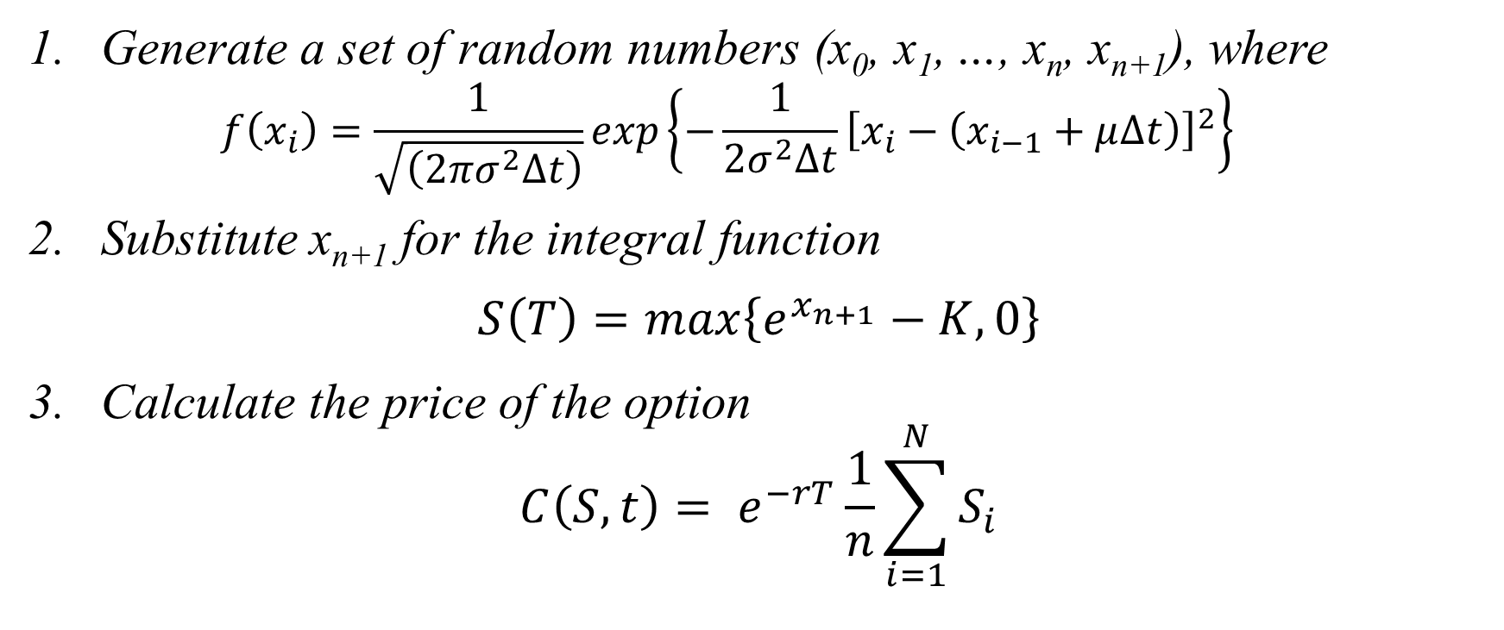
The main stages of the algorithm
Generate a set of random numbers (x₀, x₁, …, x_{n}, x_{n+1}), where
$$f\left(x_{i}\right)=\frac{1}{\sqrt{\left(2πσ^{2}∆t\right)}}exp\left\{−\frac{1}{2σ^{2}∆t}{\left[x_{i}−\left(x_{i−1}+μ∆t\right)\right]}^{2}\right\}$$
Substitute$\text{x}\text{n}\text{+1}$ for the integral function
$$S\left(T\right)=max\left\{e^{x_{n+1}}−K, 0\right\}$$
Calculate the price of the option
$$C\left(S, t\right)= e^{−rT}\frac{1}{n}\sum_{i=1}^{N}{S_{i}}$$

Slide 7
Converting mathematical statement
From the density distribution of random numbers that can be determined:
$x_{i}\sim N(μ∆t+x_{i−1},σ_{vol}\sqrt{∆t})$
M[x_{i}] = $μ∆t+x_{i−1}$
D[x_{i}] = $σ_{vol}\sqrt{∆t}$
Get $x_{i}$ possible from a standard normal distribution
$$x_{i}=μ∆t+x_{i−1}+σ_{vol}\sqrt{∆t} ∗X_{rand}$$
$X_{rand}\sim N(0, 1)$

Slide 8

Converting mathematical statement
$$X_{i}=\left(X_{rand(i)}∗σ_{vol}\sqrt{∆t}+\left(r−\frac{σ_{vol}^{2}}{2}\right)∆t\right)+X_{i−1}$$
$${Const= σ}_{vol}\sqrt{∆t}+\left(r−\frac{σ_{vol}^{2}}{2}\right)∆t$$
$$X_{n}=\left(X_{rand(1)}+…+X_{rand(n)}\right)∗Const+X_{0}$$

Slide 9
Comparison of option pricing model Black-Scholes

Slide 10
Acceleration calculations when evaluating european option

Slide 11
Acceleration on multi-GPU

Slide 12
Conclusion
For a certain class of use GPGPU tasks provides a significant advantage
Algorithms written for of GPGPU, require a deep understanding of the principles and objectives of parallelization features of the architecture of GPUs

Slide 13
Thank you for attention

