Slide 1
HPC Design of Ion Based Molecular Clusters
A. Bende, C. Varodi, T. M. Di Palma
INCDTIM – Istituto Motori-CNR, Napoli, Italy
Romania-JINR cooperation framework
Hulubei-Meshcheryakov Programe

Slide 2
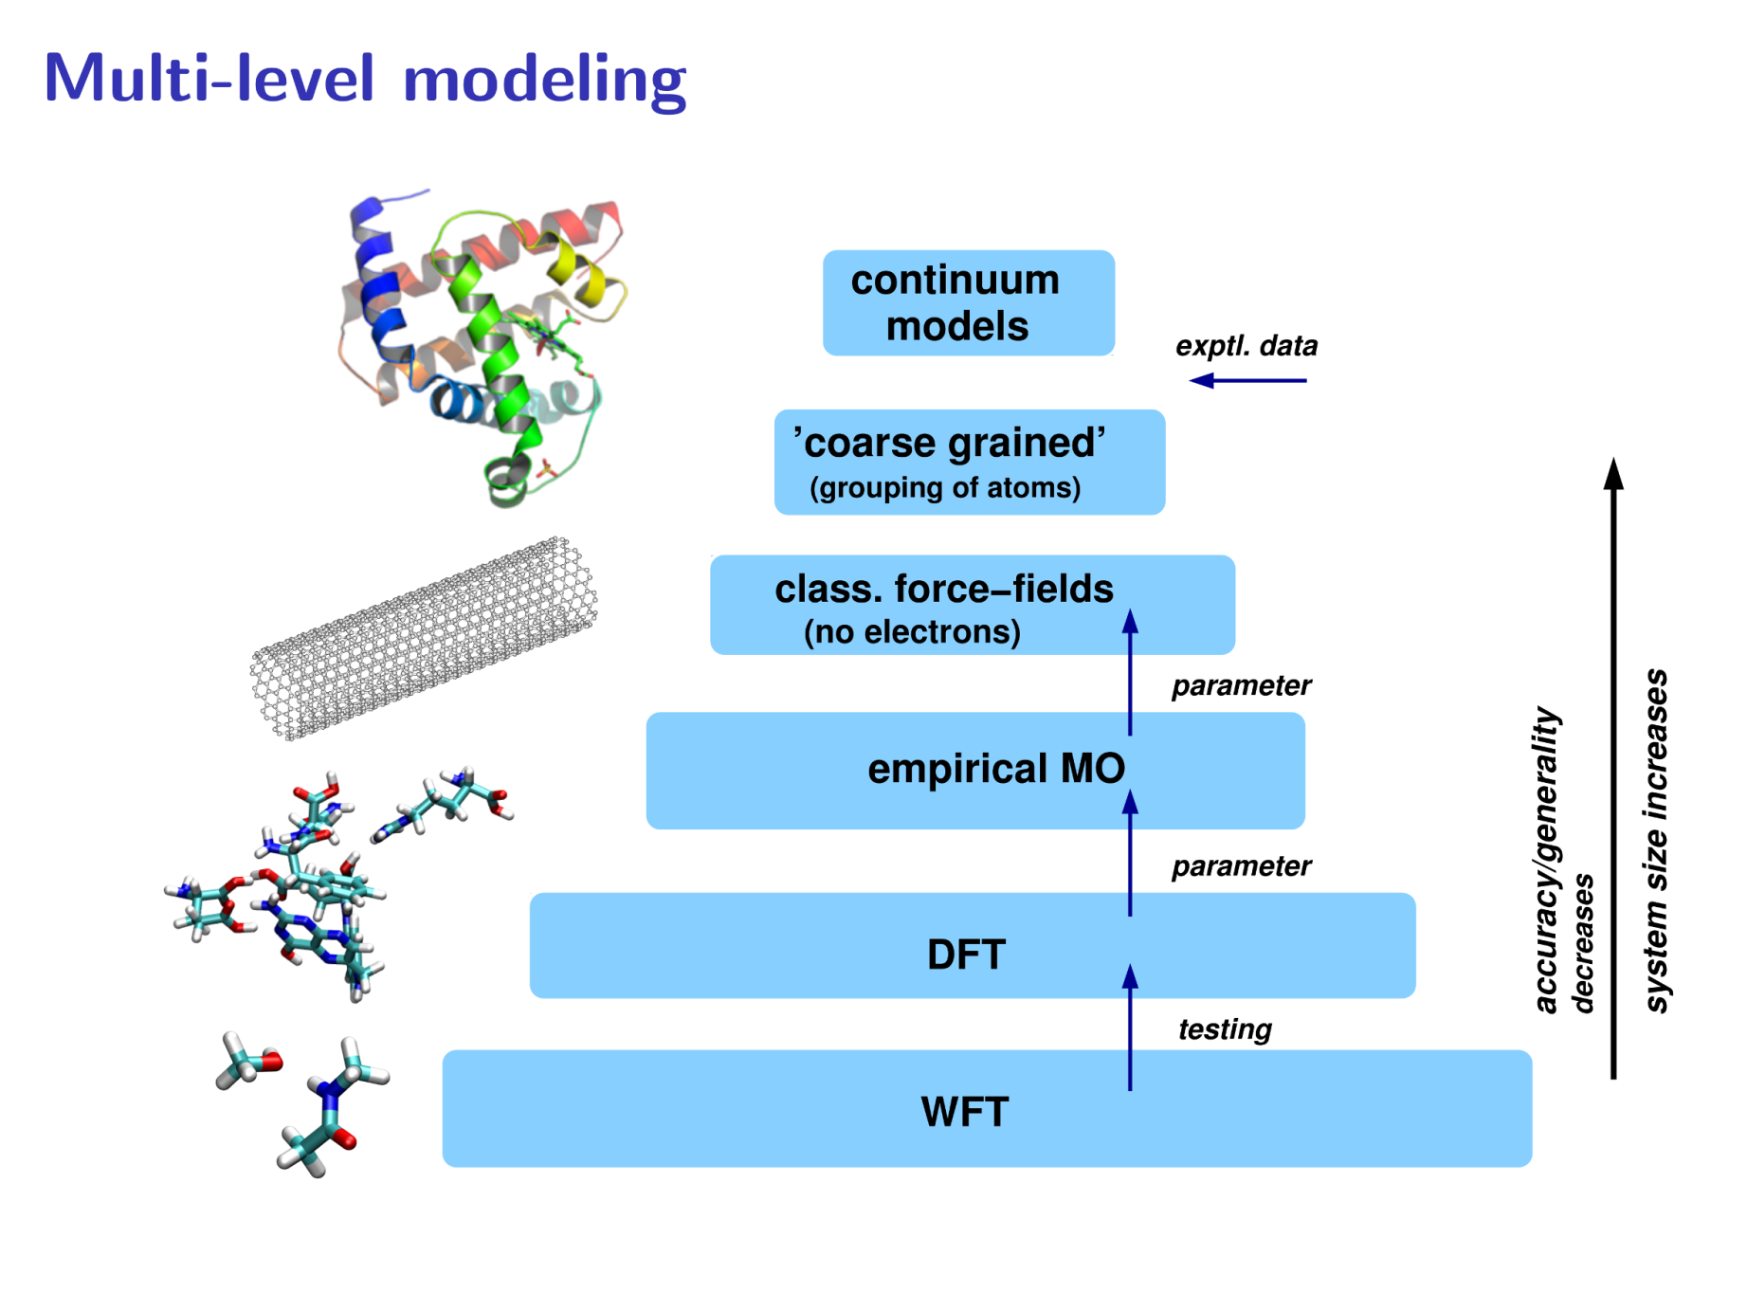
(Source: Prof. Stefan Grimme, Univ. Bonn, Germany)

Slide 3



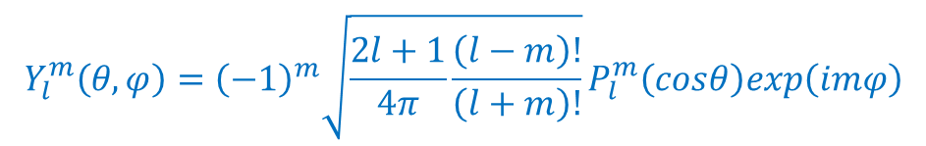
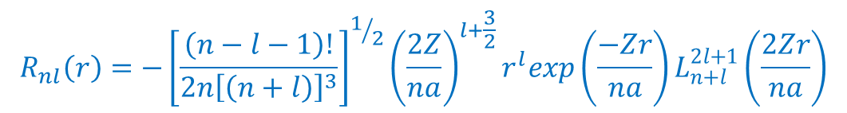
Modeling molecular structures at WFT level. How?
What we exactly know: The quantum mechanical description of the Hydrogen atom.
Schördinger equation:
$\frac{−ℏ^{2}∇^{2}}{2m}ψ\left(x\right)−\frac{a}{r}ψ\left(x\right)=Eψ\left(x\right)$, where $a=\frac{e^{2}}{4πε_{0}}$ and $m=\frac{m_{p}m_{e}}{m_{p}+m_{e}}$
Solution:
In polar coordinates: x → (r,θ,ϕ)
$$ψ\left(r,θ,φ\right)=R(r)Y_{l}^{m}\left(θ,φ\right)$$
$$R_{nl}\left(r\right)=−{\left[\frac{\left(n−l−1\right)!}{2n{\left[\left(n+l\right)\right]}^{3}}\right]}^{1/2}{\left(\frac{2Z}{na}\right)}^{l+\frac{3}{2}}r^{l}exp\left(\frac{−Zr}{na}\right)L_{n+l}^{2l+1}\left(\frac{2Zr}{na}\right)$$
$$Y_{l}^{m}\left(θ,φ\right)={\left(−1\right)}^{m}\sqrt{\frac{2l+1}{4π}\frac{\left(l−m\right)!}{\left(l+m\right)!}}P_{l}^{m}\left(cosθ\right)exp\left(imφ\right)$$
$$L_{n+l}^{2l+1}$$
are the associated Laguerre functions
$$P_{l}^{m}\left(x\right)$$
are the Legendre polinoms

Slide 4
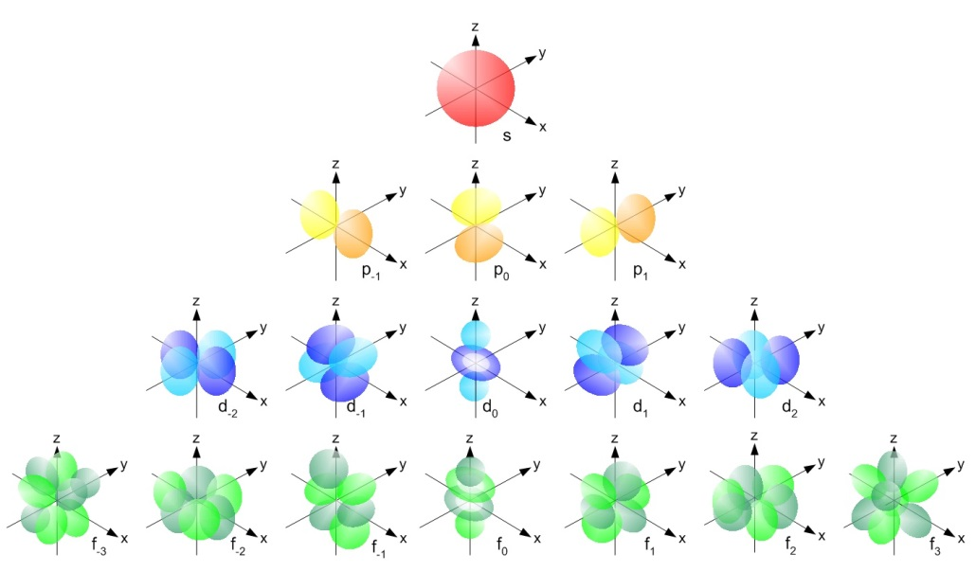
http://chemwiki.ucdavis.edu/
We assume that all type of molecular orbitals can be described with a linear combination of these atomic orbitals (LCAO).
Basis set for molecular orbitals

Slide 5
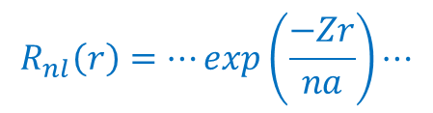
Problems:
$$R_{nl}\left(r\right)=⋯exp\left(\frac{−Zr}{na}\right)⋯$$
Difficulties with mathematical
integration
Approximations:
Replace exp(-r) with linear combination of Gaussian type functions exp(-r²)
Basis set truncation:
H: s and p orbitals
C, O, N, etc s, p, d (f, and g) n=3 or 5
“Molecular Size” = N The Total Number of Basis Functions
N = N_{A} + N_{B} + N_{C} + …

Slide 6
Scaling of Quantum Chemistry methods:
N⁴: Hartree-Fock, DFT <ij|kl>
N⁵: Second order Moller-Plesset perturbation theory (MP2)
N⁶: MP3 and CCSD (coupled cluster with single and double perturbation
N⁷: MP4 and CCSD(T)
+
Large internal memory (RAM)
Huge local storage
Efficient routines for manipulation of large matrixes
Massive parallelization

Slide 7
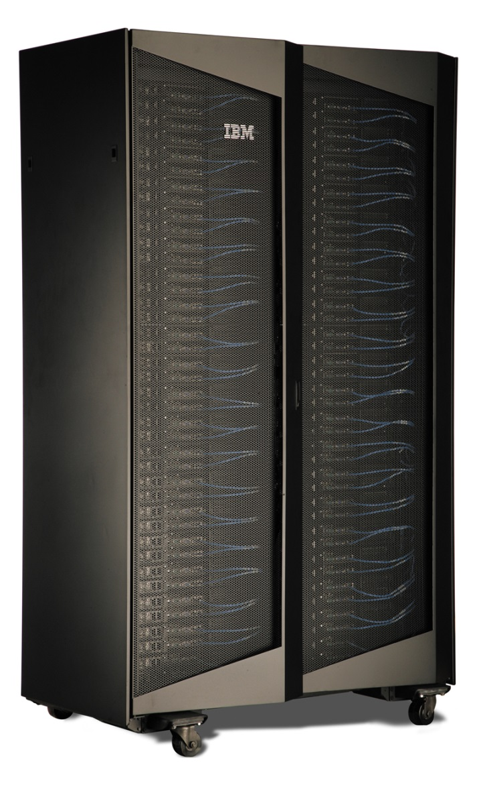
Computer facility for numerical simulation and molecular modeling - INCDTIM
IBM System iDataPlex dx360 M4:
File Server for Storage: General Parallel File System (GPFS);
Storage: 20TB with SAS 2.0 disks and 10000 rpm, with real storage of 15 TB;
Two Head Node Servers: CISCx86 6-core, with 2.93 GHz, 12 MB L3 cache;
26 Nodes: Two Intel Xeon Sandy Bridge E5-2665 8-Core 2.4 GHz, 20 MB L3 cache, DDR3 64 GB, 1600 MHz ECC (416 cores);
2 Nodes: Two Intel Xeon Sandy Bridge E5-2665 8-Core 2,4 GHz, 20 MB L3 cache, DDR3 64 GB, 1600 MHz ECC + NVIDIA Tesla M2090 GPU (32 cores);
Network Connection: FDR Infinteband with 56 GB/s bandwidth

Slide 8


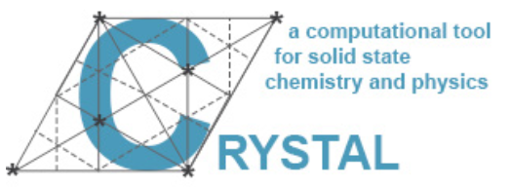


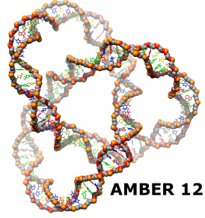


Quantum Chemistry Softwares:
Paid licenses:
Gaussian 09
vers. D.01
Molpro 2012.1
Free licenses:
NWChem 6.5
Orca 3.0.3
CRYSTAL 13
Molecular Dynamics Codes:
Car-Parinello MD
Amber 12
DFTB+

Slide 9

Ion-based molecular clusters:
-
-
Lone pair orbitals
+
Strong electron correlation effects (charge transfer energy)
-
H⁺
Na⁺

Slide 10
Experimental: Mass spectra for homogeneous clusters (MTBE)_{m}
73
88
176
177
73 – t-butyl
88 – MTBE
176 – (MTBE)₂
177 – (MTBE)₂ – H⁺

Slide 11
Mass spectra for mixed cluster (MTBE)_{m}–(H₂O)_{n}–H⁺
unde, n = m – 2
Many peaks!!!
Structures based on special H-bond interactions
O···H⁺···O
Strong intermolecular interactions

Slide 12
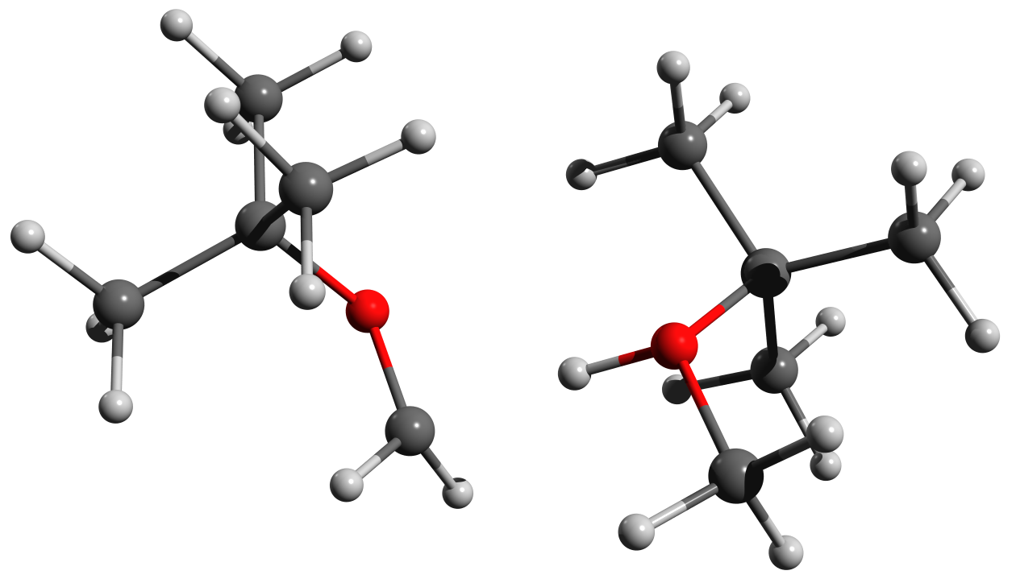
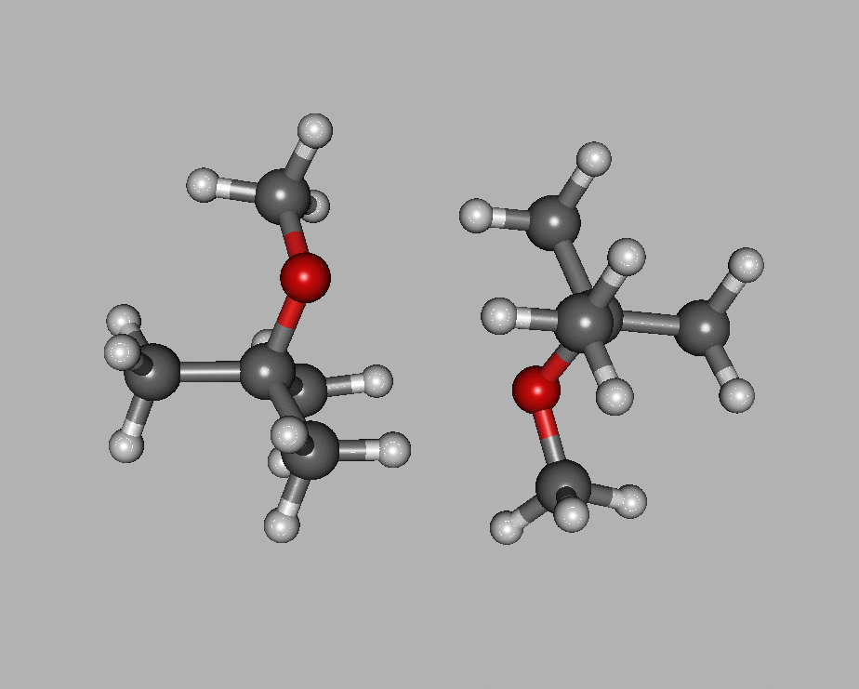
(MTBE)₂⁺ Dimer
Vertical_IP = 9.25 eV
Adiabatic_IP = 8.24 eV
~
0.19e
0.81e
B
A
C₁ - O
1.405 Å
C₂ - O
1.405 Å 1.328 Å
1.430 Å
1.529 Å 1.471 Å
ΔE = -23.84 kcal/mol

Slide 13
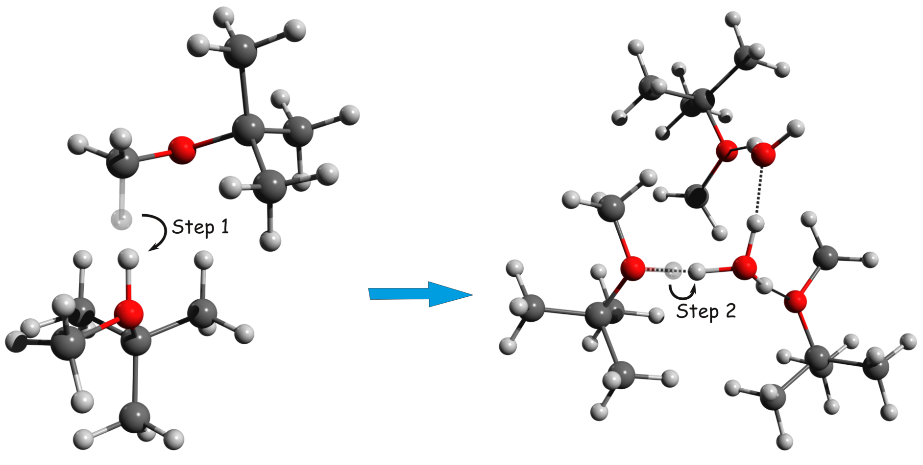
Two-step proton transfer mechanism

Slide 14
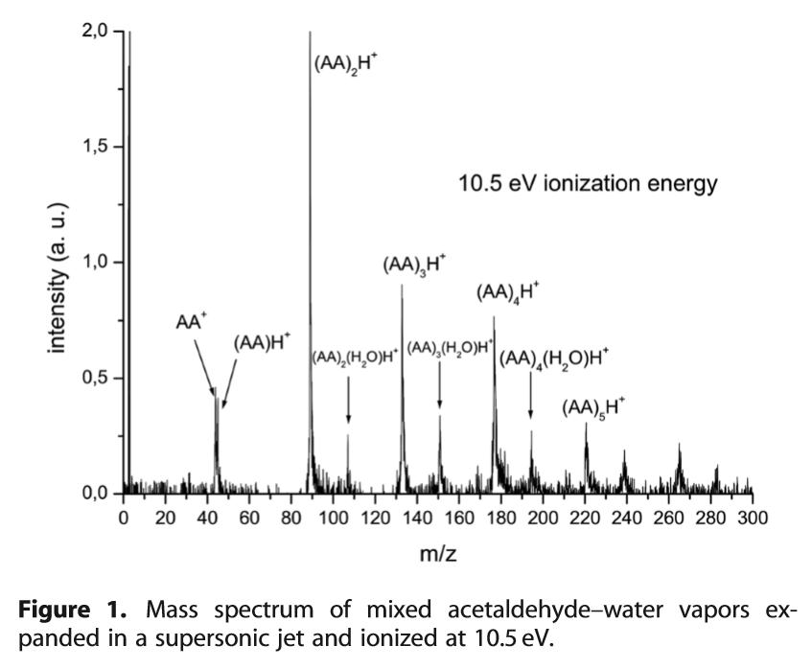
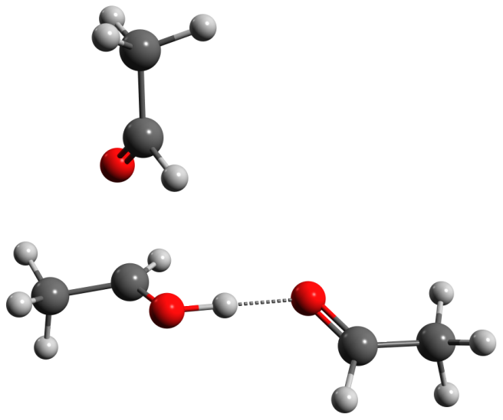
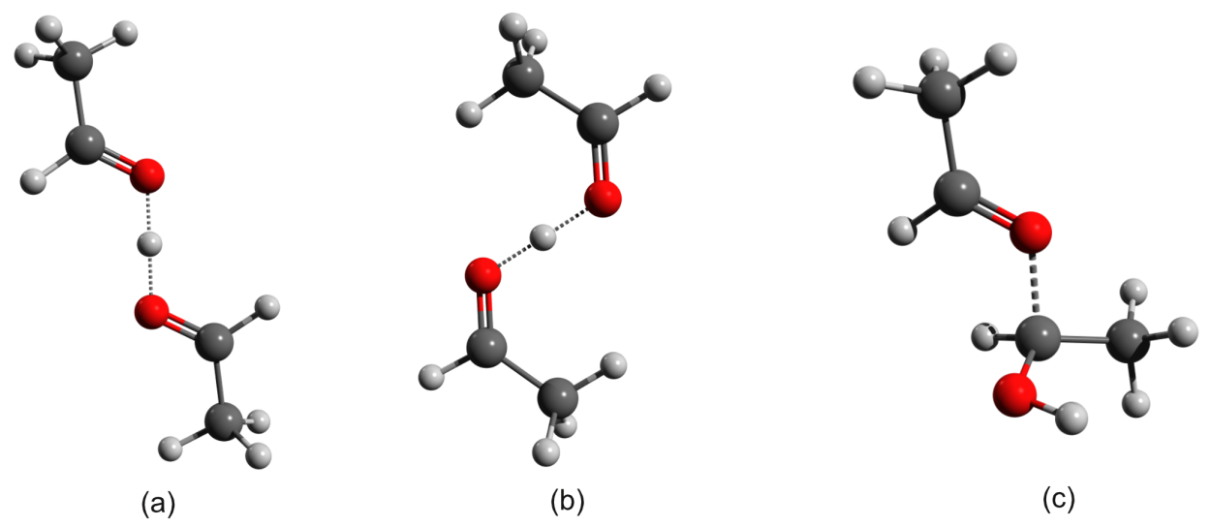
Acetaldehyde – H⁺ and Acetaldehyde – H₃O⁺ clusters

Slide 15
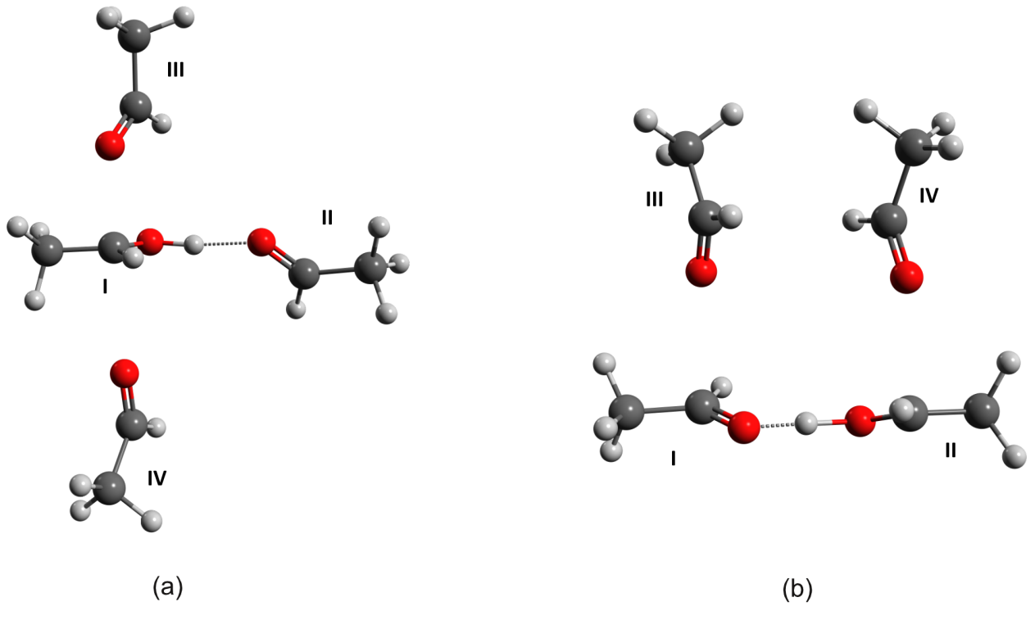
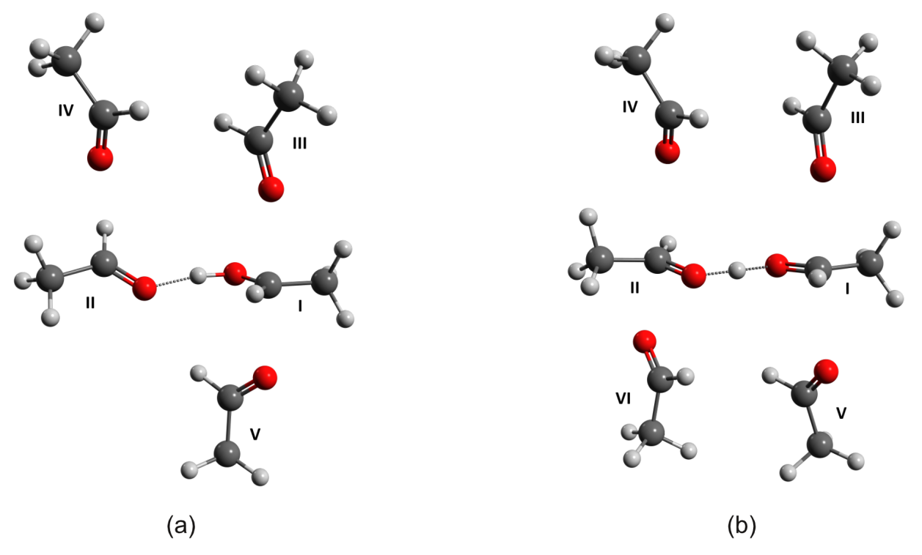
Tetramer
Hexamer

Slide 16
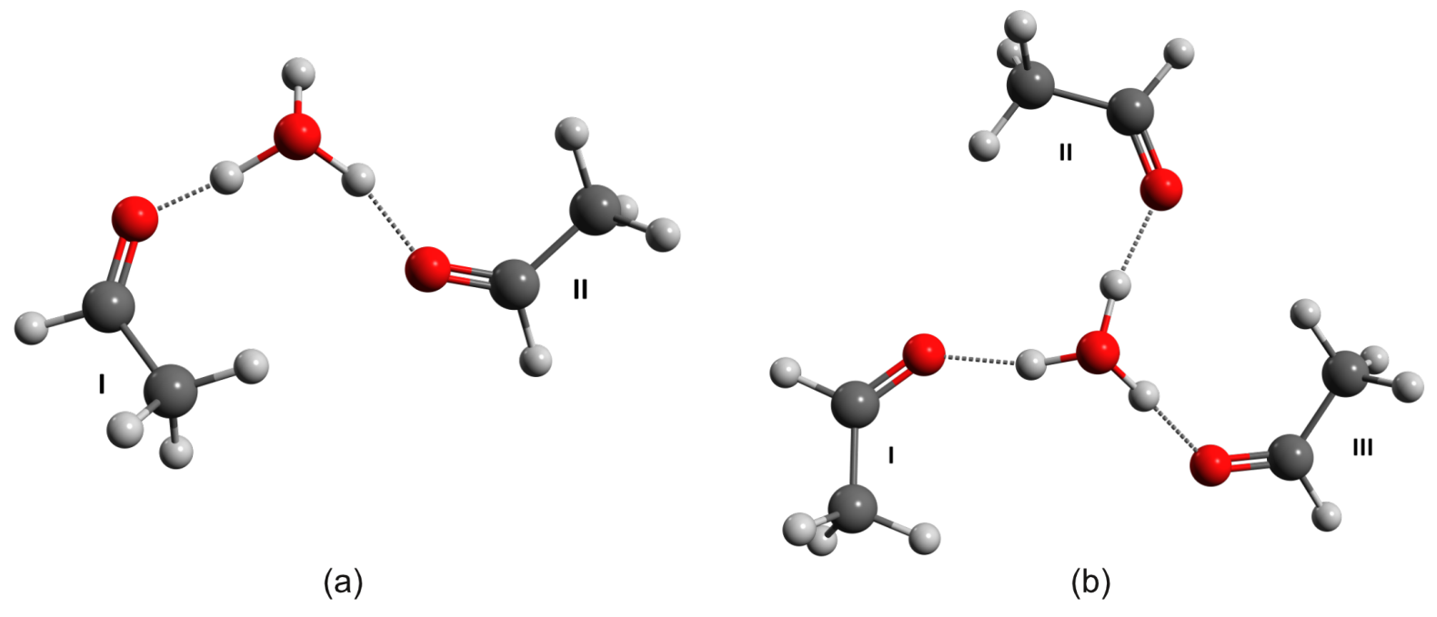
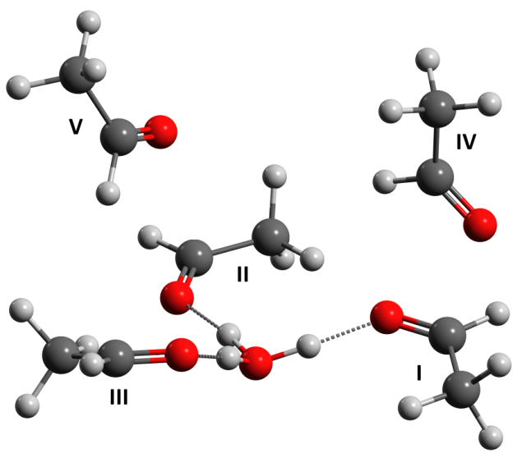
AA₂ – H₃O⁺ and AA₃ – H₃O⁺
AA₅ – H₃O⁺

Slide 17
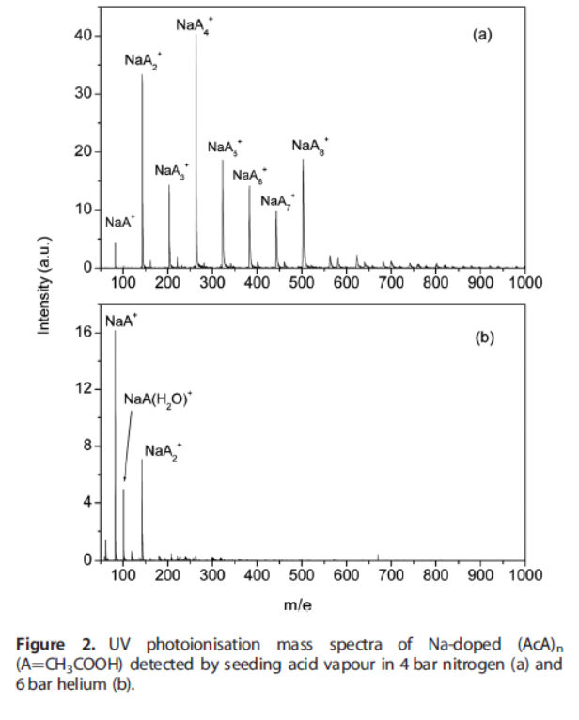
Na⁺ - dopped acetaldehyde clusters

Slide 18
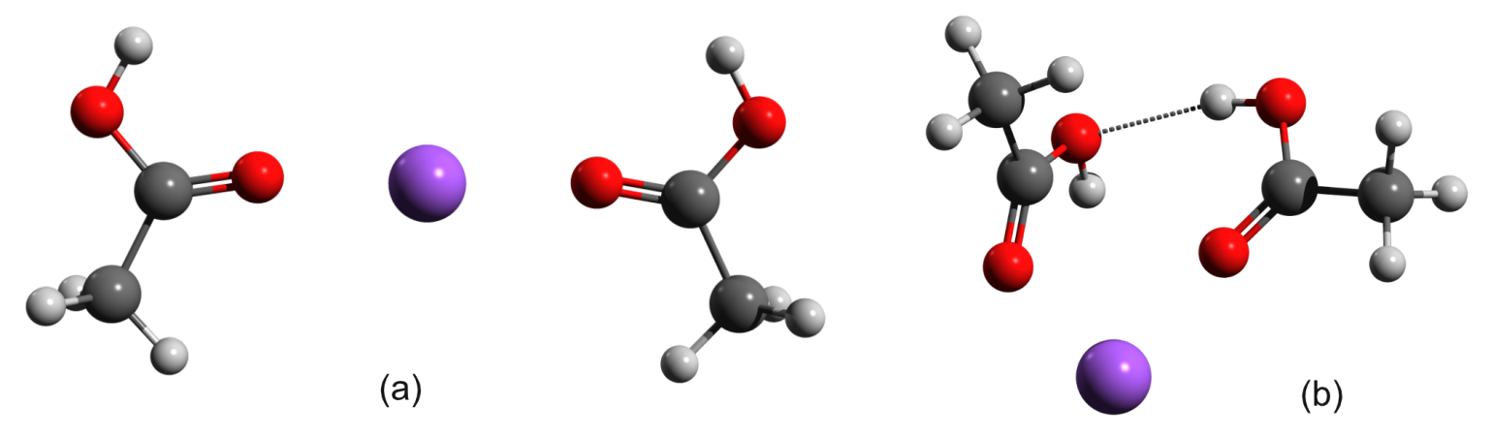
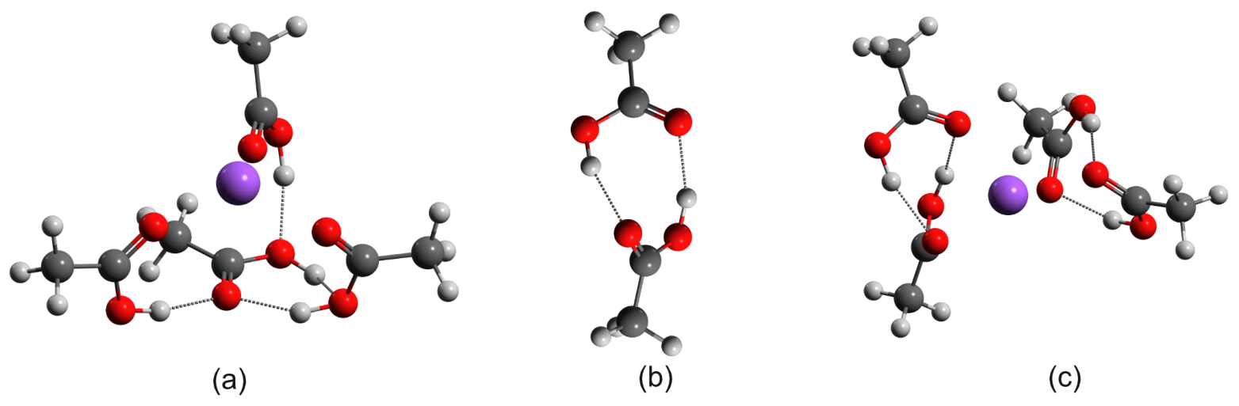
AcA Dimer + Na⁺
Tetramer
Trimer

Slide 19
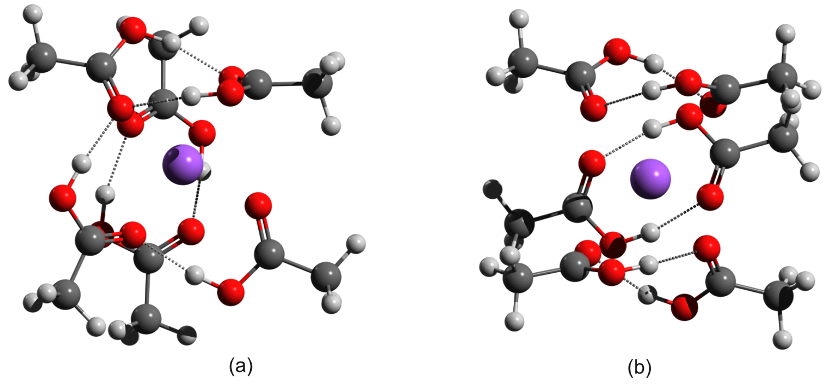
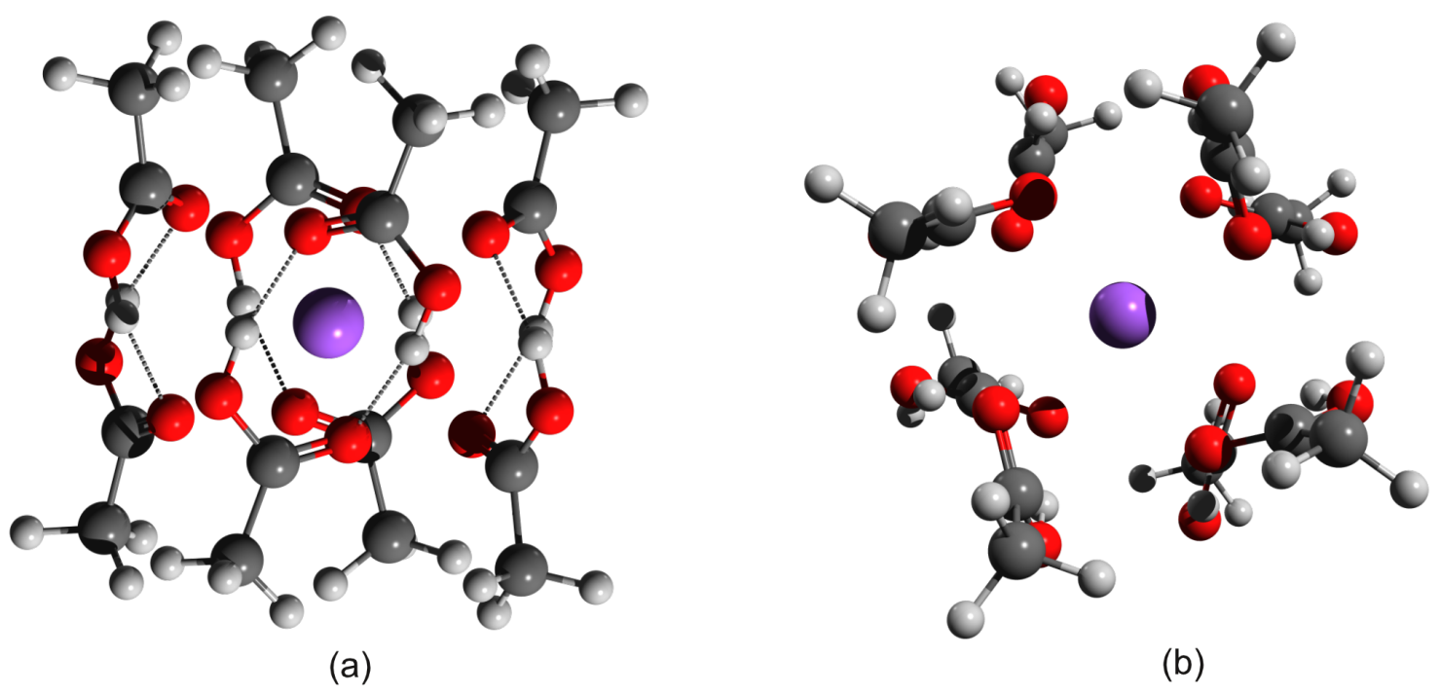
Hexamer
Octamer

Slide 20
Thank you for your attention

