Slide 1
Data Knowledge Base Prototype for Collaborative Scientific Research
M. Grigorieva (National Research Center "Kurchatov Institute"),
M. Gubin (Tomsk Polytechnic University),
A. Alexeev (Tomsk Polytechnic University),
M. Golosova (National Research Center "Kurchatov Institute"),
A. Klimentov (Brookhaven National Lab, National Research Center "Kurchatov Institute" ),
V. Osipova (Tomsk Polytechnic University)

Slide 2
Thanks
This talk drew on presentations, discussions, comments, input from many. Thanks to all, including those I’ve missed
D. Golubkov, D. Krasnopevtsev and D. Laykom
Special thanks go to Torre Wenaus who initiated this work and for his ideas about Data Knowledge Base content and design
This work was funded in part by
the Russian Ministry of Science and Education under contract #14.Z50.31.0024 and
the Russian Foundation for Basic Research under contract #16-37-00246.

Slide 3
Outline
Data Knowledge Base highlights
Sources of metadata
DKB architecture and prototype
Data analysis ontology
Summary and next steps

Slide 4
Data Knowledge Base Role in Science
Data Knowledge Base (DKB) is an intelligence behind GUIs and APIs to aggregate and synthesize a range of primary metadata sources, and enhance them with flexible schema-less addition of aggregated data.
One of the main goals - to equip scientific community with a knowledge-based infrastructure providing fast access to relevant scientific information, it will facilitate the access to information which is currently scattered around different services for each experiment.
The DKB should be capable of automatic acquisition of knowledge from miscellaneous, not coherent and distributed sources, including archives of scientific papers, research groups wiki pages, tutorials, conference and workshop information, and link these information with well-structured technical data about the experiment (datasets, analysis code, various metadata information on all used signal and background samples).
DKB should provide a coherent and integrated view of the experiment life-cycle.
Possible DKB applications and practiced utilization:
Assist scientists when customizing their experimentation environments
Preservation of the data analysis process and reproduce the results of analysis (i.e. for collaborators outside the original team)
“Often the only people that can realistically reproduce the results are those that were part of the original analysis team. This poses a potential problem for long-term preservation, in the case that people take on different responsibilities in the collaboration or even leave the field entirely” (K. Cranmer, L. Heinrich, R. Jones, D.South. Analysis Preservation in ATLAS // Journal of Physics: Conf.series 664 (2015) 032013)
The prevention of deletion of datasets, used in publications during analysis and journal review periods
Discovering Similar / Related datasets that have a large probability of containing data that is required for a specific purpose, ranked by that probability

Slide 5
Metadata Sources [ATLAS as an example]
Data Processing:
Rucio (Distributed Data Management System)
Production System:
DEFT [Database Engine For Tasks]
JEDI [Job Execution and Definition Interface]
JIRA ITS (Issue Tracking Service)
Analysis Code Repositories (ATLAS policy required all analysis code to be checked into version control systems to preserve it for the latter reference)
Google docs (datasets lists)
ATLAS virtual machine images (preserving exact SW and hardware configurations)
Scientific analysis:
Indico (manage complex conferences, workshops and meetings)
CERN Document Server
CERN Twiki
ATLAS Supporting documents (Internal Notes)
In order to be interpreted and mined, experimental data must be accompanied by auxiliary metadata, which are recorded at each data processing step. Metadata describes scientific data and represent scientific objects or results of scientific experiments, allowing them to be shared by various applications, to be recorded in databases or published via Web.
AMI (Atlas Metadata Interface)
GLANCE (search engine for the Atlas Collaboration)
Despite the available documentation, it is in practice often quite involved to trace exactly how a given result was produced. The necessary information is scattered over many different repositories, such as the metadata interface, the various source code repositories, internal documents and web-pages. We need to present the whole process of data analysis life cycle from physicist idea to data processing chain and resulting publications.

Slide 6
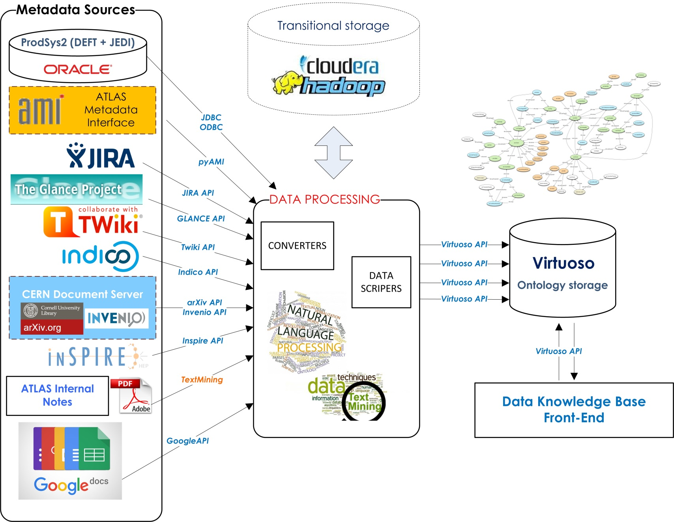
Prototype Data Knowledge Base Architecture

Slide 7
ATLAS Data Analysis Ontology
Despite a lot of papers published in ATLAS collaboration, there is still “no formal way of representing or classifying experimental results – no metadata accompanies an article to formally describe the physics result therein” [D. Carral, M. Cheatham. “An ontology Design Pattern for Particle Physics Analysis”].
Ontology is a domain-specific dictionary of terms and definitions, it can also captures the semantic relationships between the terms, thus allowing logical inferencing about the entities represented by the ontology and by the data annotated using the ontology’s terms.
The ontology-based approach to knowledge representations offers many significant opportunities for new approaches to data mining that go beyond the simple search for patterns in the primary data by integrating information incorporated in the structure of the ontology representation.
Ontological storage will provide linked representation of all elements of the ATLAS data analysis.

Slide 8
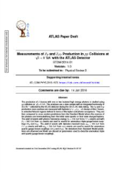
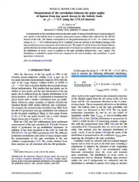
ATLAS Experiment Ontology Prototype
Each ATLAS publication is based on some physical hypothesis, which should be confirmed or refuted. To test the hypotheses scientists usually use two data sets: simulated data (Monte-Carlo) and real data from ATLAS detector. These data sets are processed in ATLAS Data Processing Chain. And the results of the data analysis are described in Papers and Conference Notes.
Each ATLAS Paper have link to the Supporting document (Internal ATLAS Note), describing the initial data samples that were used for the analysis.

Slide 9
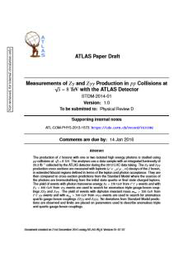
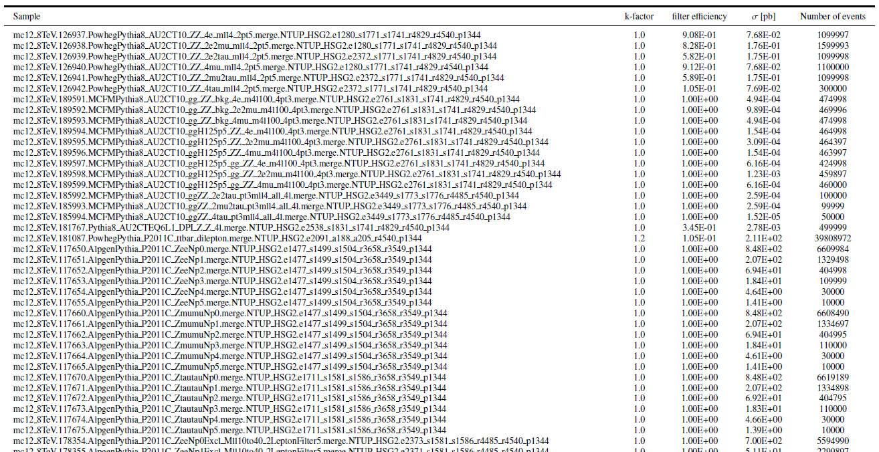
Example: Data samples representation in ATLAS supporting documents
a list of datasets
a table of dataset attributes
a simple description - how the signal and the background data samples were obtained

Slide 10
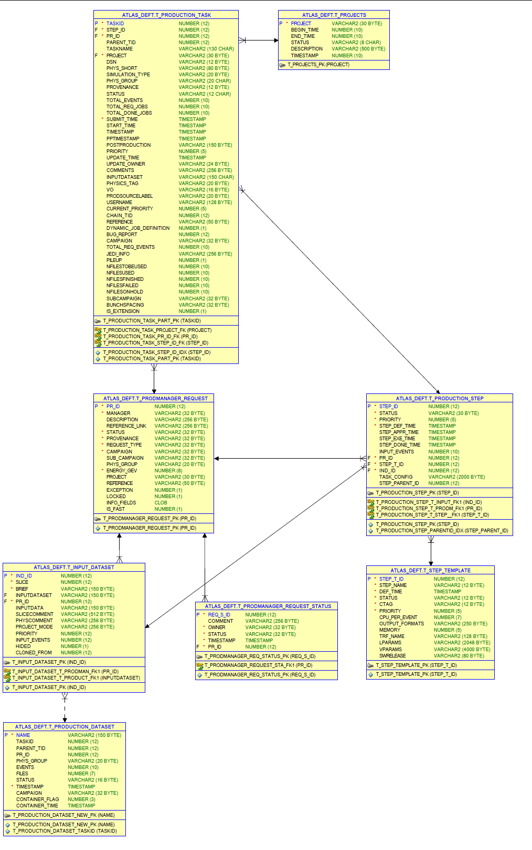
Example: Datasets ID’s in ATLAS NOTEs
ProductionSystem: DEFT Database
Monte-Carlo dataset IDs

Slide 11
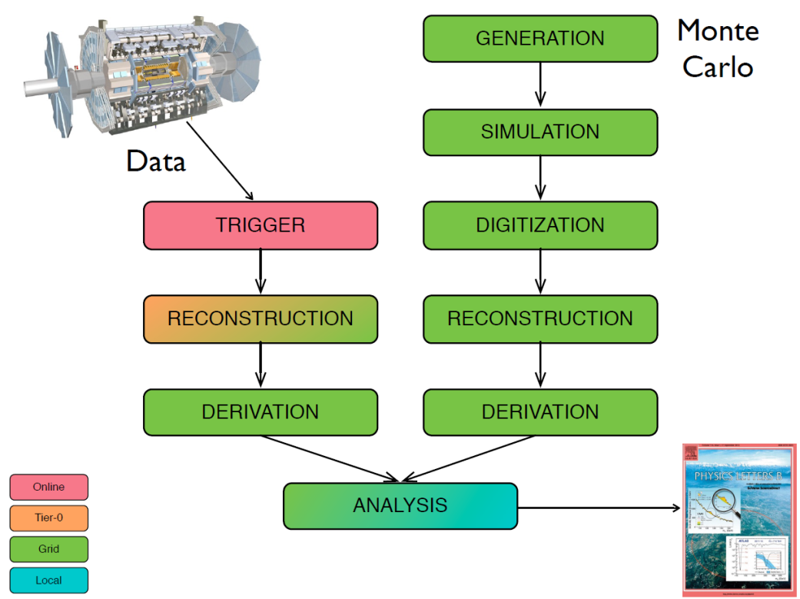
What metadata can be extracted from ATLAS Internal Notes:
LHC Energy Run
LHC Luminosity
Year, Run Number, Periods
Colliding beams (p-p, Pb-Pb)
Monte-Carlo generators
Triggers menus
Statistics
Data Samples
Real Data Samples
Monte-Carlo Data Samples
Signal
Background
Software Release
Conditions Data
Formalization of the data analysis description
Available in paper’s metadata
In general, the data analysis described in the Internal Note is well structured. The authors use a very definite sentences, words, phrases to describe how and on which datasets an experiment was conducted. This will allow us to annotate the text with the knowledge base significant elements.
Available only in the full text of a Document
Experiment specific metadata must be automatically derived from ATLAS paper & internal documents texts.

Slide 12
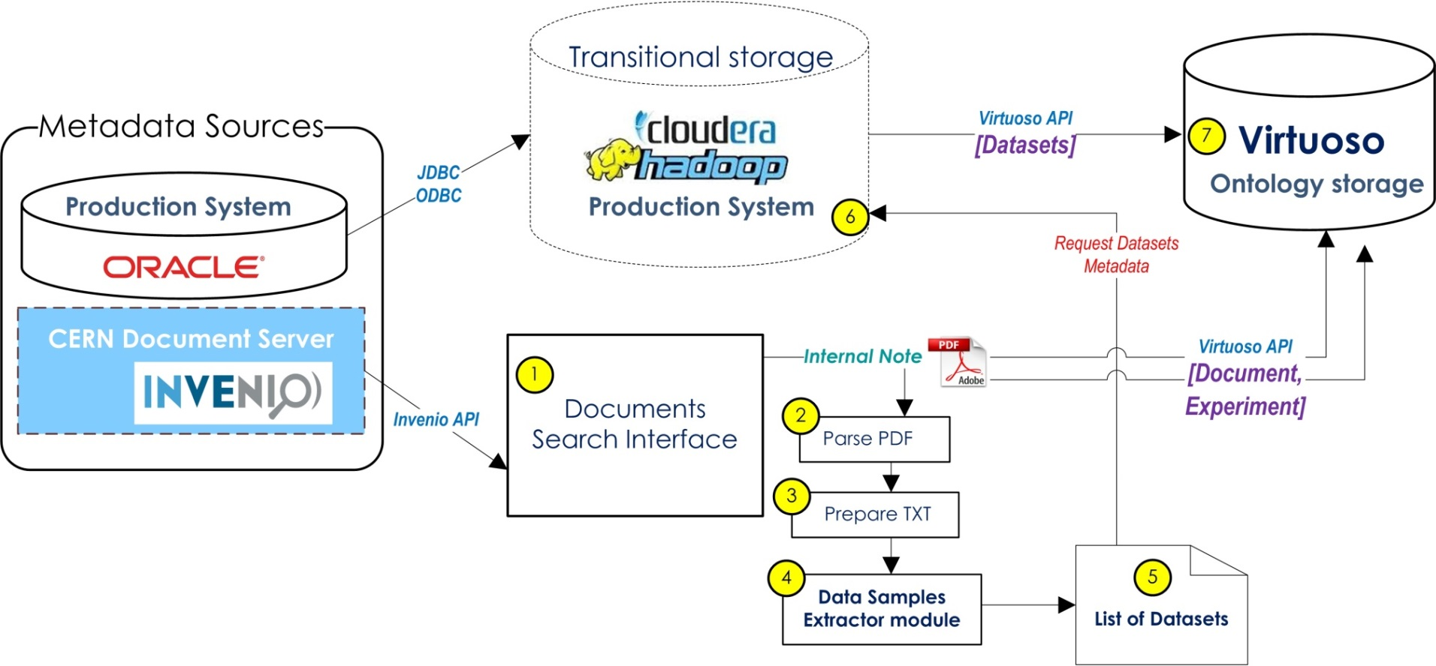
Datasets mining workflow
1. Parametric search of ATLAS papers and Internal Documents in CDS
2-4. Analyze full text of the document, extract information about datasets
( Insert Paper’s metadata in Virtuoso storage )
5. Result list of datasets
6. Request to Hadoop Production System storage for the datasets metadata
7. Insert datasets metadata in Virtuoso Storage

Slide 13
Summary & Conclusion
The development of Data Knowledge Base prototype for HEP (using ATLAS metadata as an example:
Ontology storage:
Developed ATLAS Data Analysis ontology prototype for main classes: Document, Data Sample, ATLAS Member, ATLAS Experiment [OWL]
Virtuoso ontology storage installed in Tomsk Polytechnic University
Transitional Hadoop Storage installed in Kurchatov Institute
Production System metadata exported from Oracle DB and imported to Hadoop Storage
Internal Notes processing:
Developed tools to prepare Notes full texts for data mining
Developed dataset’s extraction module for Notes
In progress:
Web Interface Prototype, based on NodeJS Framework
Tools for Insert/update/select data in Virtuoso using Virtuoso API
Search Interface for ATLAS Documents using RESTFUL Invenio API

Slide 14
Near term plan
To develop first DKB architecture prototype v.1.0.0, including:
ontological database backend (Virtuoso) with ontology model version “Document-Dataset-Experiment”;
simple web-interface, allowing user’s search for the metadata of the experiments, publications and datasets by parameters;
tools for Internal Documentation full texts dataset mining;
tools for data manipulation in Virtuoso.

