Slide 1
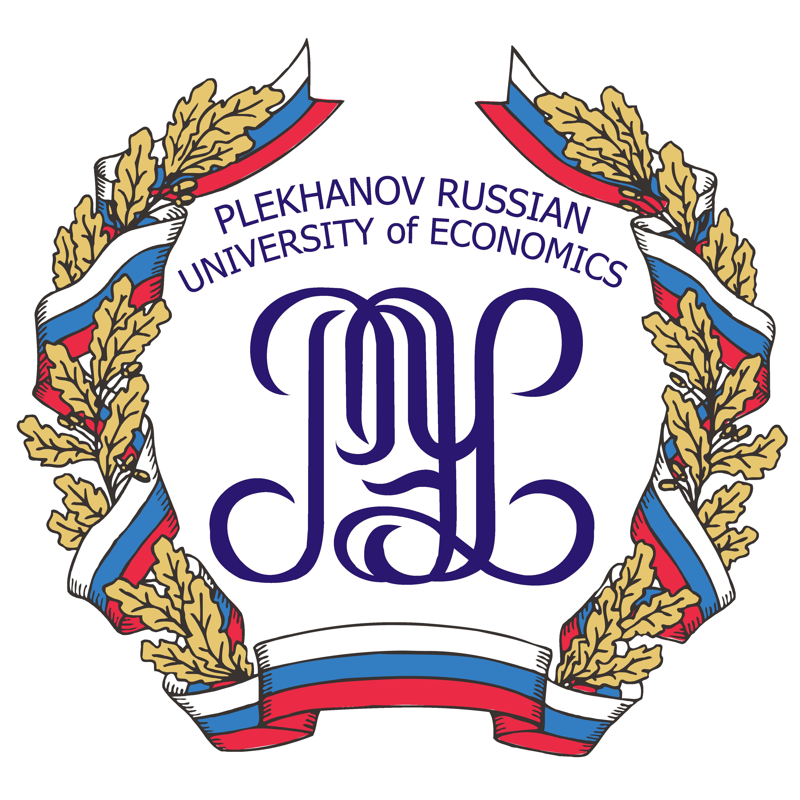
Methods of Semantic Integration in Distributed Information Systems: Challenges of Application
DUBNA, 2016, July, 07
Yury Akatkin, Elena Yasinovskaya
Andrey Shilin, Michael Bich
Plekhanov Russian University of Economics
Notes:
‘’

Slide 2
introduction
Semantic assets are the basis for data collection, search, analysis and data visualization using semantic properties, and enable semantic interoperability of distributed information systems as a whole. At this time interoperability in distributed systems is mostly supported on technical and organizational levels, however semantic interoperability is quite essential for heterogeneous environment of distributed systems.
The ability of information systems to interact on a semantic level can be achieved by joining the efforts of IT-specialists and domain experts. The goal of this joined effort is to transfer the knowledge of the experts about the domain from paper documents into machine-readable representation (ontologies, thesauri, and glossaries). Without this step, the dissemination of knowledge outside of a particular information system is difficult and insufficient for the “understanding” and the (re)use by other interacting distributed systems.

Slide 3
Background
1
Semantic modeling has been a subject of research ever since the late 1970s, however, the object-oriented approach still dominates.
[C. J. Date, “An Introduction to Database Systems (8th Edition)”. Pearson Education Inc., 2004, p. 1024, ISBN 0-321-18956-6]
Technologies already exist to overcome the heterogeneity in hardware, software, and syntax that is used in different systems (e.g., the ODBC standard, XML based standards, web services and Service Oriented Architectures). While these capabilities are essential to information integration, they do not address the issue of heterogeneous data semantics that exist both within and across enterprises.
[Madnick S., Gannon T., Zhu, H., Siegel M., Moulton A., Sabbouh M. “Framework for the Analysis of the Adaptability, Extensibility, and Scalability of Semantic Information Integration and the Context Mediation Approach”, Massachusetts Institute of Technology Cambridge, MA, USA, 2009]
2
The heterogeneity problem occurs when data sources and receivers use different contexts (assumptions); a user submits a query and interprets the results in a certain context, which is completely different from contexts received from sources. Implicit assumptions made in each source need to be explicitly described and used to reconcile conflicts when data from these systems are combined
Madnick, S.E., & Zhu, H. (2006) “Improving data quality through effective use of data semantics”, Data and Knowledge Engineering, 59(2), 460-475
3

Slide 4
Semantic integration
Distributed information systems as a rule combine heterogeneous sources of data, so data integration is necessary and can be provided at the physical, logical and semantic level. Physical and logical levels are the most used levels of data integration, but they do not take into account the semantic properties of data and therefore are not able to resolve semantic conflicts between these heterogeneous data sources.
Data integration on the semantic level supports a unified view of data based on their semantic properties in the context of a single domain ontology[1], connected with the other semantic assets that they rely on
[1] V.А.Serebryakov «Semantic integration of data», 2012
Levels of Semantic Information
Approaches to Data Integration
 | Traditional | Semantic
Data structure | Mostly relational, focused on consistent data sets | Focused on the relationship between the data units, regardless of their similarity
Method of integration | Data is selected from resources, converted in accordance with predetermined requirements and loaded into storage | Establishes a relationship between data units in accordance with the definitions in their common ontologies
Scalability | The cost grows exponentially with each new data source | Increasing the number of sources has an insignificant affect on the cost
Origin of sources | Internal | Internal and external
Attitude to standards | Strict adherence to standards, the violation leads to the loss of context | Flexible adherence to standards, the context is preserved under all conditions
Semantic Assets
Thesauri and Ontologies
Vocabularies and Taxonomies
Glossaries
Rules of Semantic Interaction
L. Chernyak, «Data Integration: Semantics and Syntax», 2009

Slide 5
Semantic interoperability
Methods of Semantic Integration
Semantic interoperability:
the ability of computer systems to exchange data with unambiguous,
shared meaning.
Required to enable machine computable logic, inferencing, knowledge discovery, and data federation between information systems
Data exchange
Transformation of open data
into Linked Open Data:
possible to harvest, compare, and visualize data from heterogeneous resources
Large-scale information systems
Internet Resources and Data Portals
E-Government
System of Systems (SoS)
Cross-border information sharing
Open Data Portals, DataHubs
Linked Open Data resources
Distributed warehouses
To achieve Semantic Interoperability, the distributed systems must refer to an agreed authority, typically a terminology that clearly defines the meanings of the items carrying the information. The use of controlled terminologies, and controlled mapping tables and mapping rules for any transformation promises sufficient reliability. These controlled terminologies and mapping tables, also in their representations as taxonomies, ontologies, thesauri are called
semantic interoperability assets

Slide 6
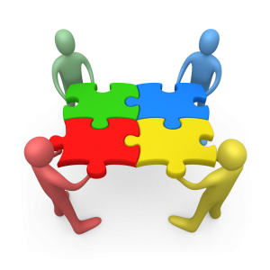
challenges
The gap between domain experts and IT professionals: modeling the information system and information exchange processes in a heterogeneous environment should be based on knowledge of the domain, its objects, and relationships between these objects. This process must be accessible and understandable to all the participants, regardless of their competence;
Semantic assets are developed by teams consisting of experts in various fields. Their collaboration at the stage of formalization and modeling using semantic integration methods arise these challenges
Determination of the depth of domain formalization: the model may be insufficient, or conversely, excessive for the particular information system, however in most cases neither developers nor experts can determine that before the operation stage
The lack of a unified and accessible conceptual framework: It often leads to the creation of new semantic assets instead of reusing existing ones. Resulting in unnecessary duplication or incorrect use of terms
The lack of collaboration tools for domain experts supporting the processes of formalization and modeling, which can then be used to provide information sharing in distributed information systems and to achieve semantic interoperability
Difficulty to visualize, validate and interpret the results of semantic integration: it is difficult to understand from the program code or exchange file what information will be available to other participants, how it can be represented and how it can be used
Common methodology supported by tools of collaboration, which will simplify the application of semantic integration methods during the design of semantic assets
There are no collaboration tools that support domain formalization and the design of models, which when completed can be used to provide information sharing in distributed information systems and to achieve semantic interoperability.

Slide 7
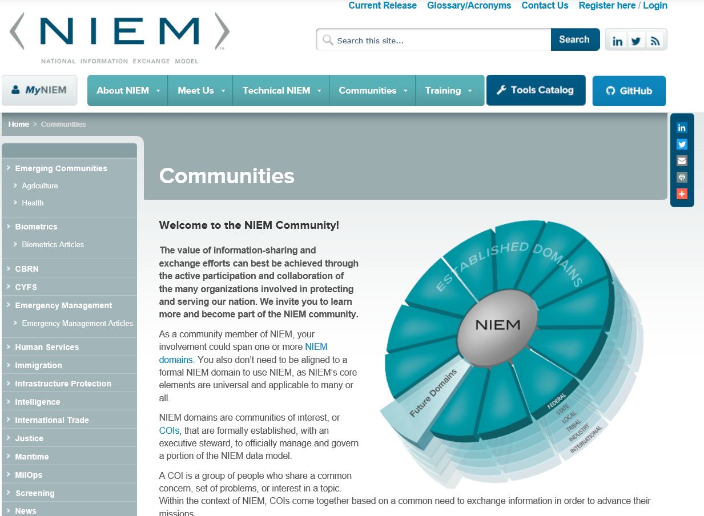
Currently available solutions

Slide 8
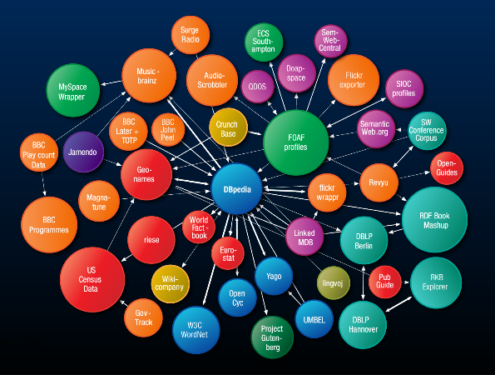
principles
Collaboration of domain experts and IT specialists using a community-driven, standards-based approach and tools for
Consolidation and re-use of semantic assets
modeling of information systems and information exchange services
Provision of core vocabularies and data models for information exchange
transformation of open data to linked open data, followed by data harvesting, analysis and visualization
large step forward from theoretical research to the practical application of semantic interoperability, and data search and analysis based on semantic properties in a heterogeneous information environment
Unambiguous interpretation of data for all the participants of information exchange in distributed information systems
HOWEVER
currently available tools require programming knowledge and are difficult for domain experts to use without the help of IT specialists. This interaction is time-intensive and leaves additional chances for errors and misunderstanding.

Slide 9
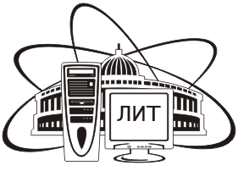
Center of semantic integration
CSI
Research and approbation of modern approaches to (1) management of semantic assets, (2) creation and dissemination of standards, (3) development of methods and tools based on Model Driven Architecture (MDA) principles to consolidate, integrate, create and (re)use semantic assets.
Develop the beta-version of Center of Sematic Integration: the collaboration platform in the sphere of semantic interoperability that provides the expert community with information, methodology, special tools, and necessary organizational and regulatory support.
In 2016, the Plekhanov Russian University of Economics issued an order to start the research and development for project Center of Semantic Integration.
The Center is located on the JINR cloud infrastructure and after completion will unite the working groups, scientific teams, developers, providers of information and information exchange specialists

Slide 10
CSI. Prospects
e-Government
the collaboration of experts in various fields working on the development of semantic models for public services, cross-sector cooperation, and information sharing in order to achieve semantic interoperability of Russian e-Government systems
Scientific Research
involvement of young scientists and students as well as other research teams in (1) semantic modeling of various domains, (2) creating glossaries, taxonomies, thesauri and ontologies for use in research projects, (3) organizing scientific materials, and (4) improving search procedures for scientific and technical information.
Data Analysis
Semantic integration of information systems
(1) the ability to normalize public open data, (2) transform it into linked open data reusing semantic assets and search for related data from other sources, (3) providing meaningful interpretation, (4) visualization and combined analysis of data from different sources.
the opportunity to use the tools for substantive domain modeling of distributed information systems, constructing information exchange schemas using the federated data model

Slide 11
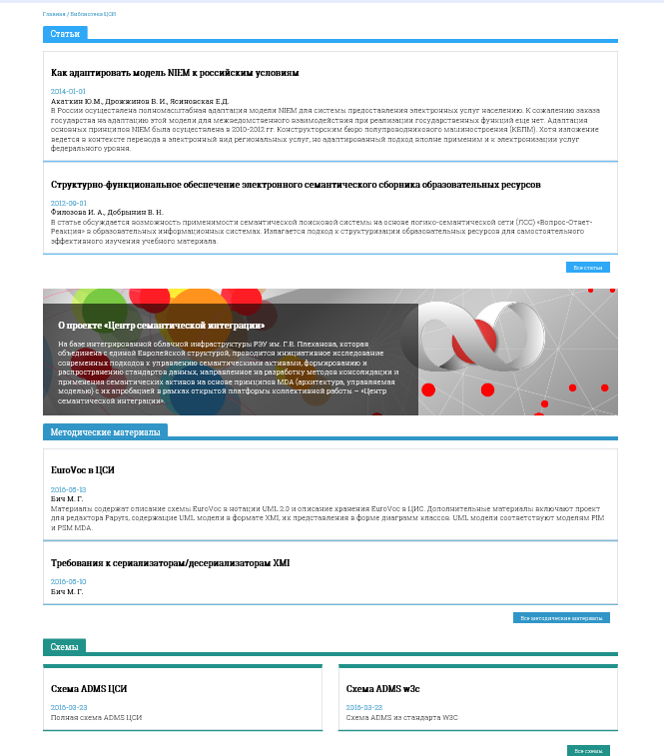
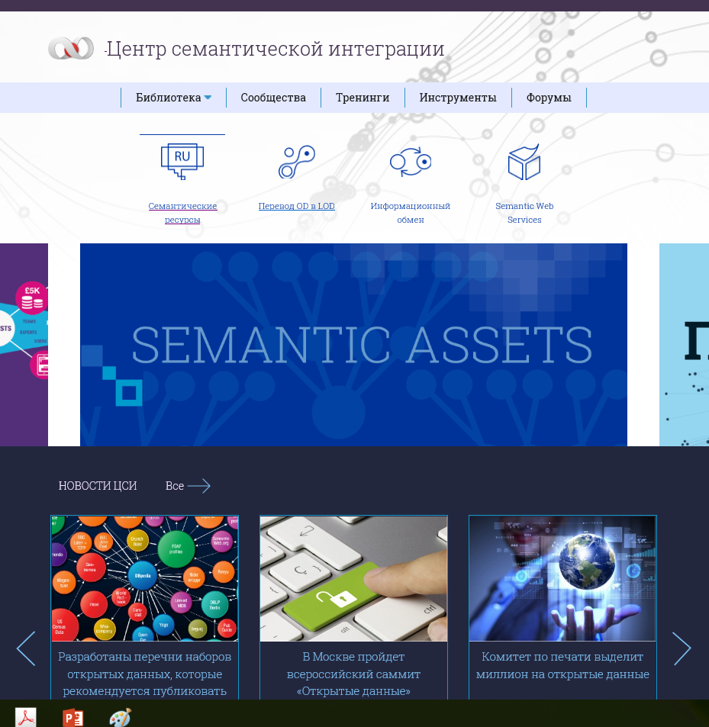
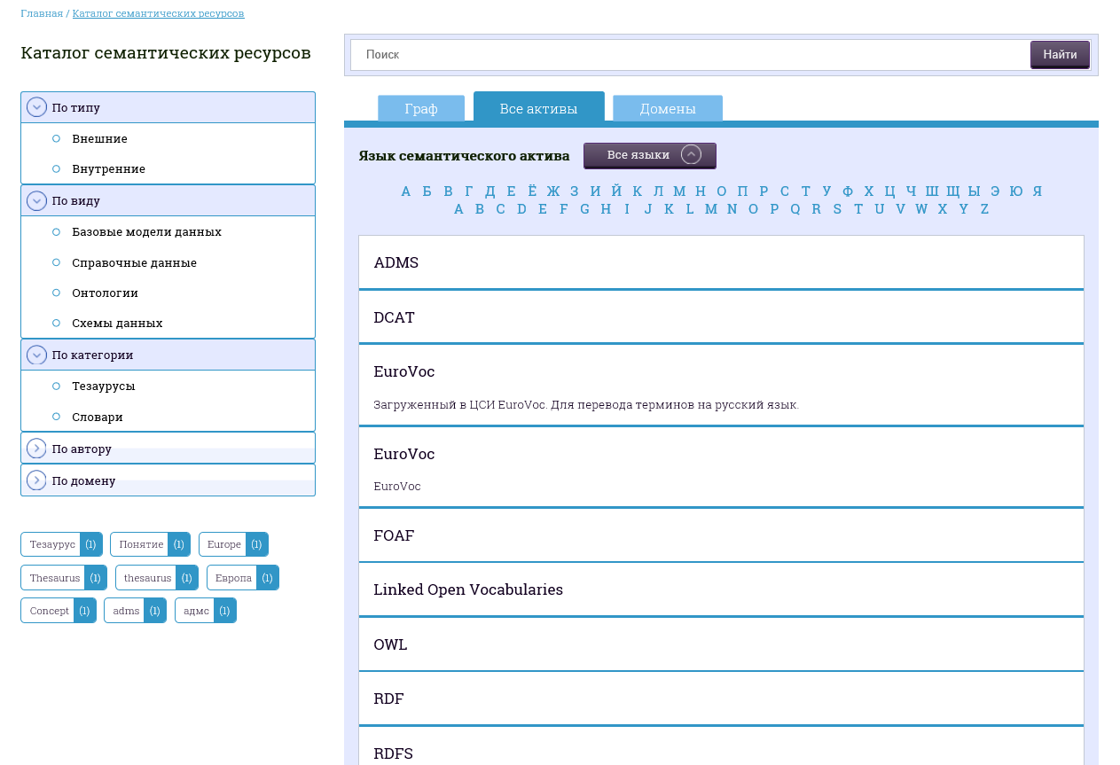
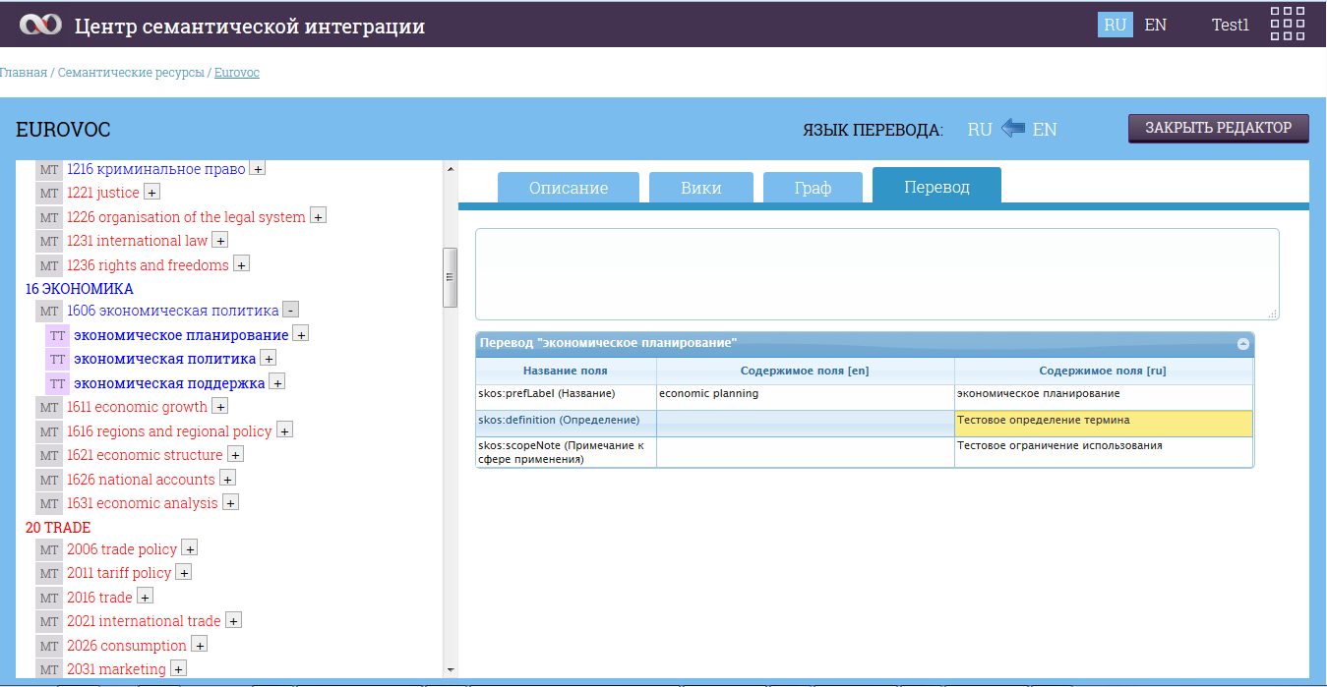
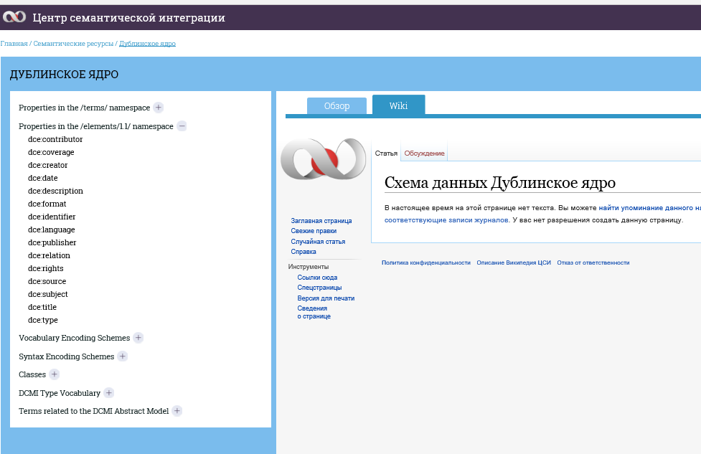
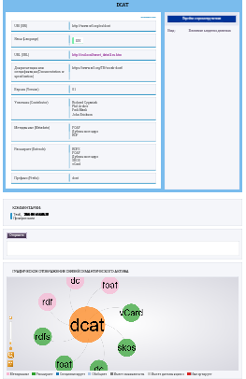
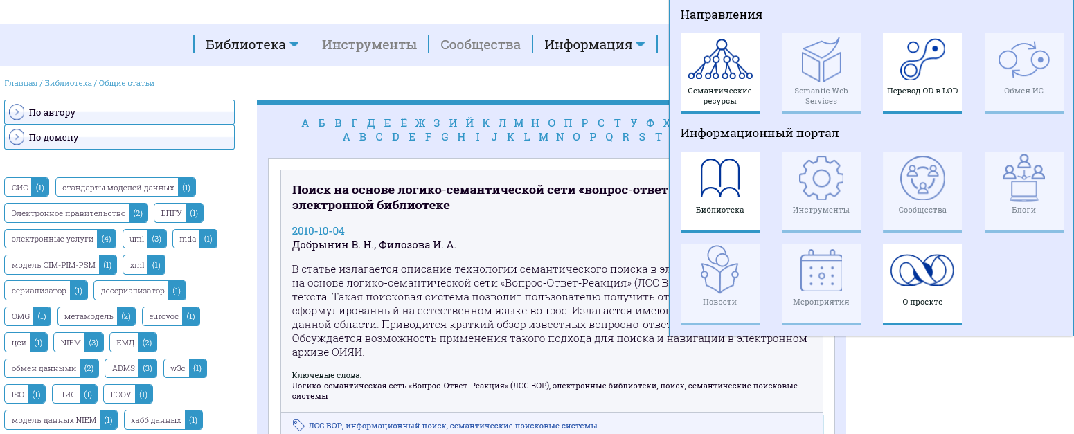
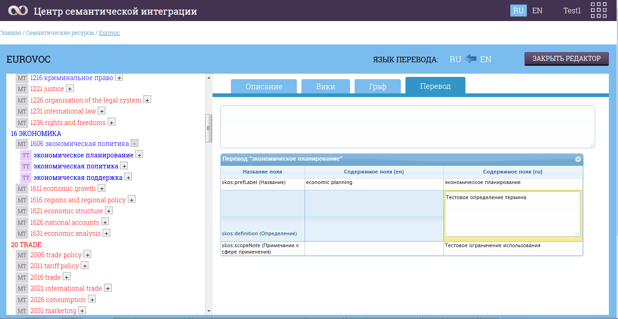
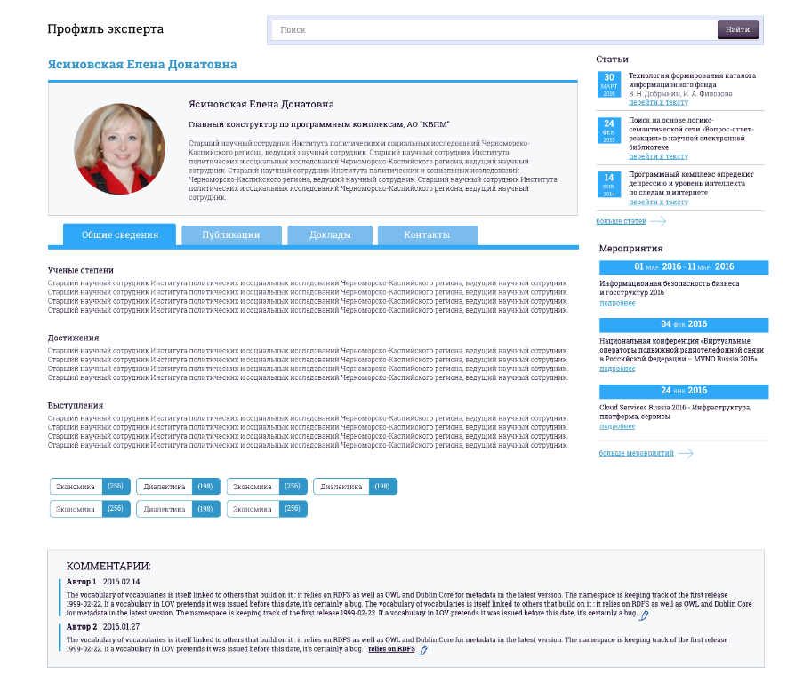
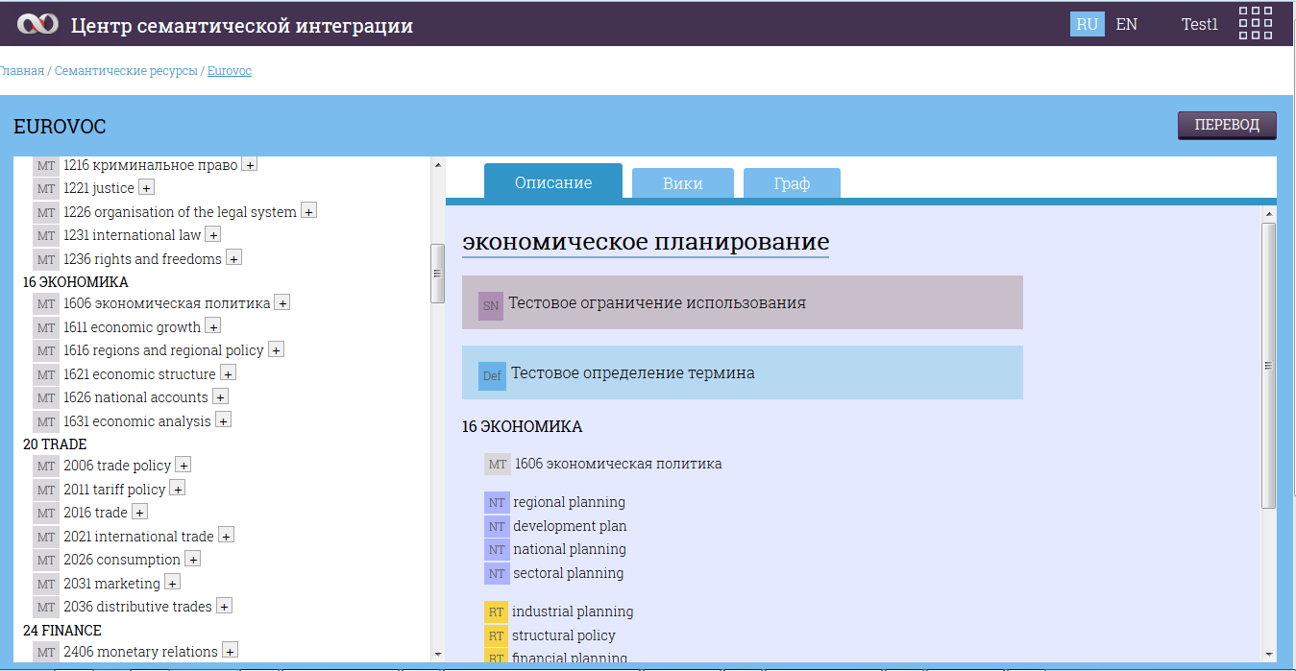
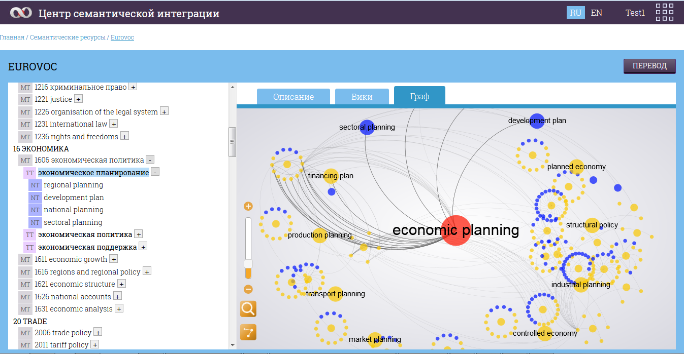
CSI. Current status

Slide 12
questions?

