Slide 1
Creating distributed rendering applications
Supervisor: D.Sc., Prof. Alexander Bogdanov
Reporter: Andrei Ivashchenko
Authors: A. Bogdanov, A. Ivashchenko, A. Belezeko
GRID’16

Slide 2
Contents
Circumstances for use
Current state of core technologies
Tools and libraries for distributed rendering system creation
Tests and examples

Slide 3
Rendering application
Rendering application is a program that is intensively uses graphics hardware acceleration
Types of rendering applications
Batch rendering
Real-time rendering

Slide 4
When distributed rendering is required?
Lack of computational power
  Too much primitives to operate in real-time
  Labor-intensive post-processing
  Massive shader subroutines
Out-of-core processing
  GPU memory is not enough to process data without read-backs

Slide 5
Common problems
Out-of-core-related issues
Bandwidth limitations
Proper usage of compression, sorting an frame compositing techniques
Load balancing
Parallelism

Slide 6
Low level graphics APIs
DirectX
  Microsoft platforms
OpenGL
  Multiplatform
Vulkan
  Multiplatform

Slide 7
DirectX for parallel
DirectX 9
  SLI and CrossFire support introduced
DirectX 11
DirectX 12
  Multiadapter Linked GPU
  Multiadapter Unlinked GPU

Slide 8
OpenGL for parallel
For each glContext a dedicated process should persist
Processes are able to exchange contexts with each other
Pixel Buffer Object (PBO) allows to exchange between contexts
Not parallel by nature

Slide 9
Sort-first

Slide 10
Sort-last

Slide 11
Sort-middle

Slide 12
Compression
Run-Length Encoding
  Fast
  Lossless
  Small compression rates
Chroma (YUV) Subsampling
  Lossy
  Artefacts may appear
  Tight compression

Slide 13
Chromium

Slide 14
Test environment

Slide 15
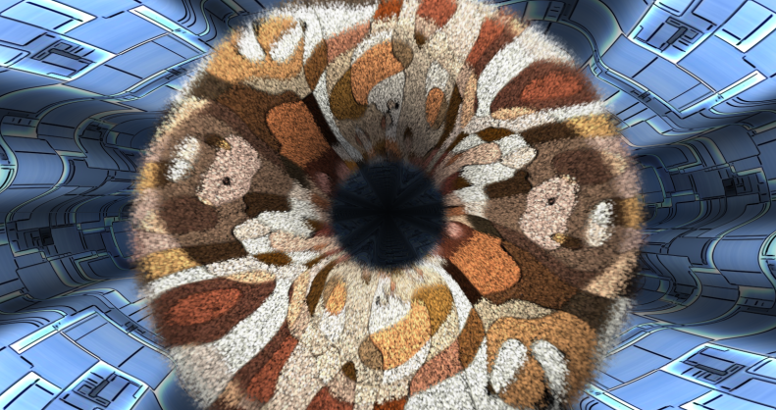
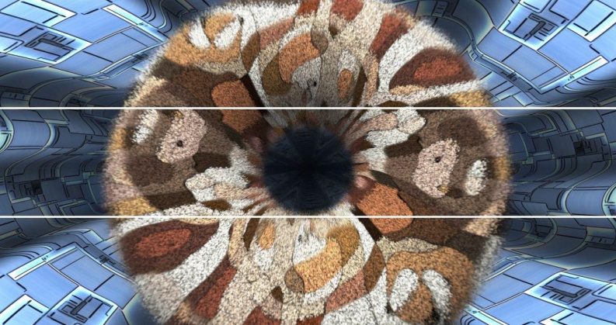
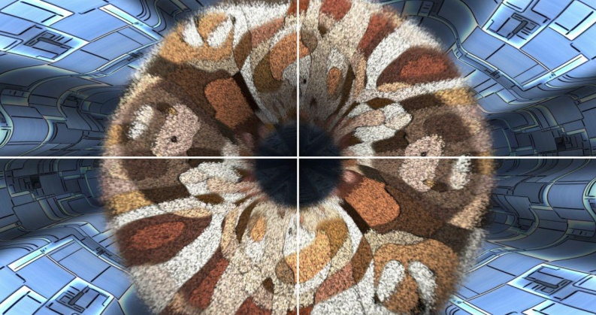
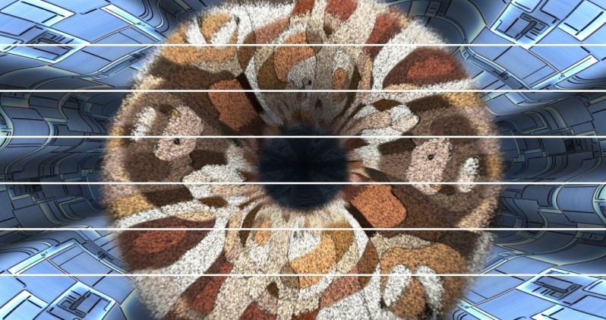
FurMark
Original
3 tiles
4tiles
7 tiles

Slide 16
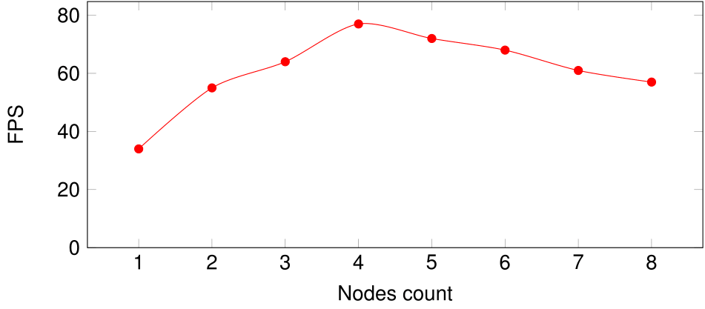
FurMark result

Slide 17
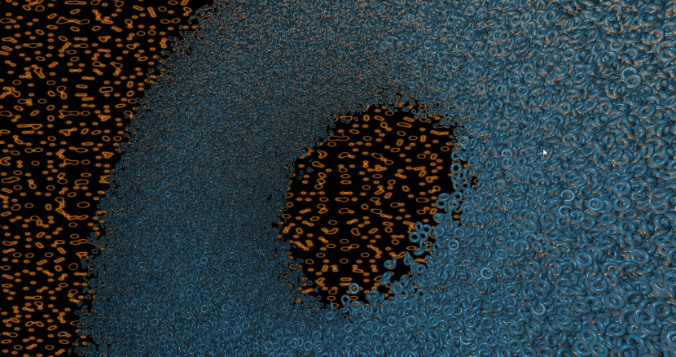
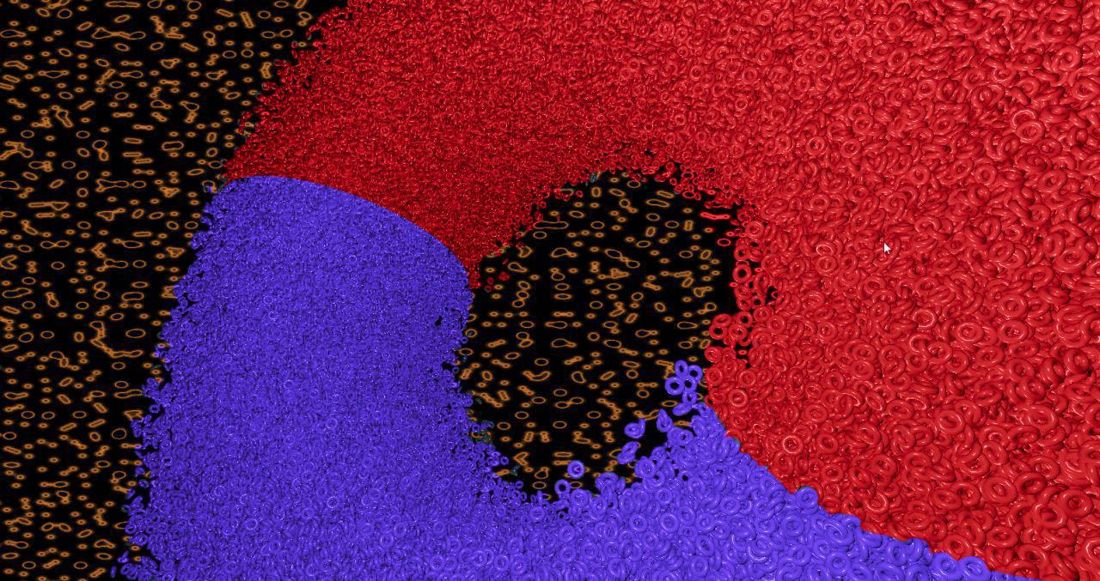
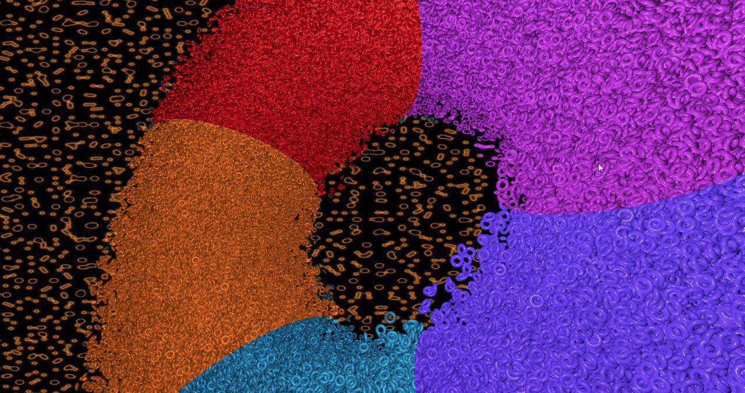
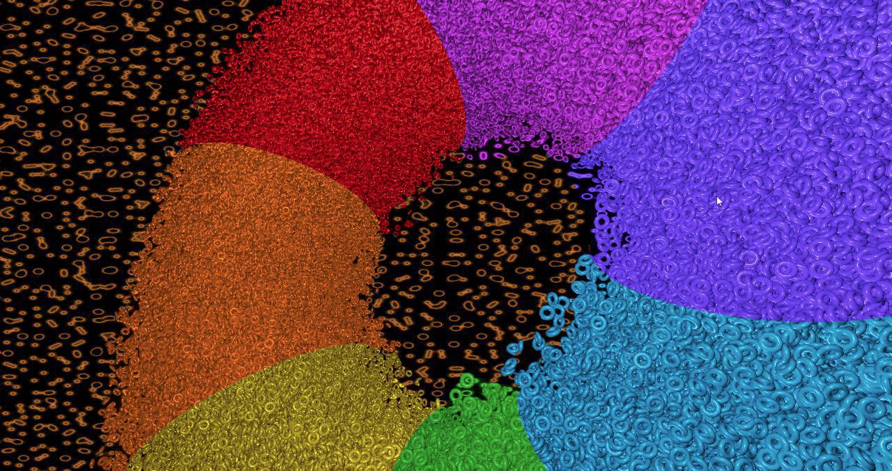
GiMark
2 nodes
highlighted
Original
5 nodes
highlighted
7 nodes
highlighted

Slide 18
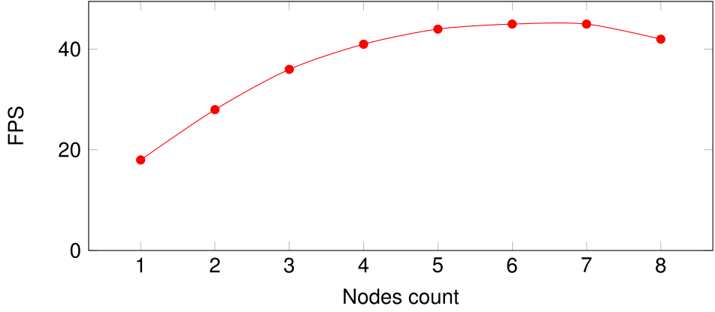
GiMark result

Slide 19
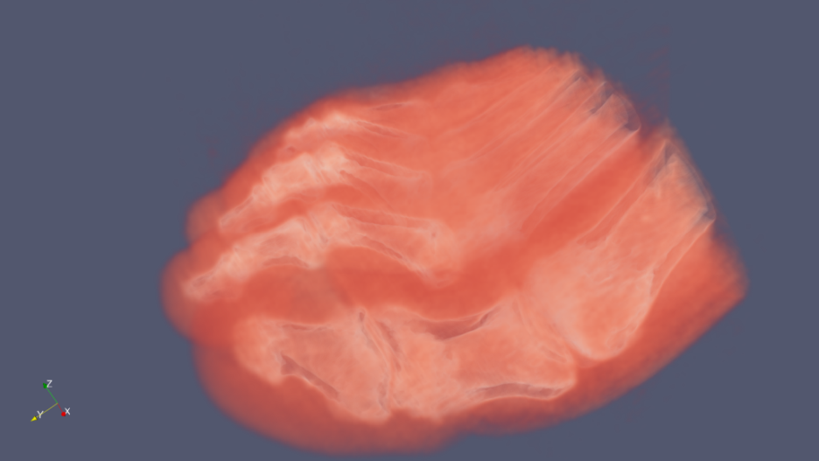
VTK
Mature well-documented framework
Could work in distributed manner
Special output device support could be provided by
3rd party libraries
Ready-made solutions:
  Paraview
  VisBox
  VisIt
Foot tomography result rendered with ParaView

Slide 20
Equalizer
Provides flexible configuration management
Supports advanced sorting and compressing algorithms
Provides a load-balancing feature
Compatible with VirtualGL
Works perfectly with scene graph structure
Lacks of out-of-core scenario support

Slide 21
OpenSceneGraph

Slide 22
Eq + OSG test case
Molecular structure viewer
Protein Data Bank format support (.pdb)
Beta-galactosidase (5A1A) used for rendering
  ≈33 000 of atoms
  ≈4 000 000 of polygons
Test on 360 degree rotation

Slide 23
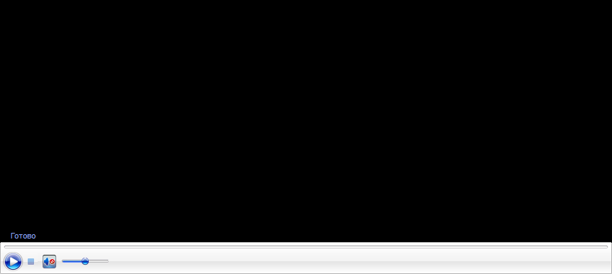
Test results

Slide 24
Conclusion
Analysis of distributed rendering area is provided
Examples of interaction with deployment ready tools and libraries for development are provided
Results of several tests are evaluated
Possible further work directions:
Test Tesla K40-K80 GPGPU for rendering tasks
Development of infrastructure solution for visualization

Slide 25
Questions?

