Slide 1
Construction of visualization system for scientific experiments
Supervisor: D.Sc., Prof. Alexander Bogdanov
Reporter: Evgeniya Milova
Authors: Alexander BOGDANOV, Andrei IVASHCHENKO, Evgeniya MILOVA, Konstantin SMIRNOV
GRID’16

Slide 2
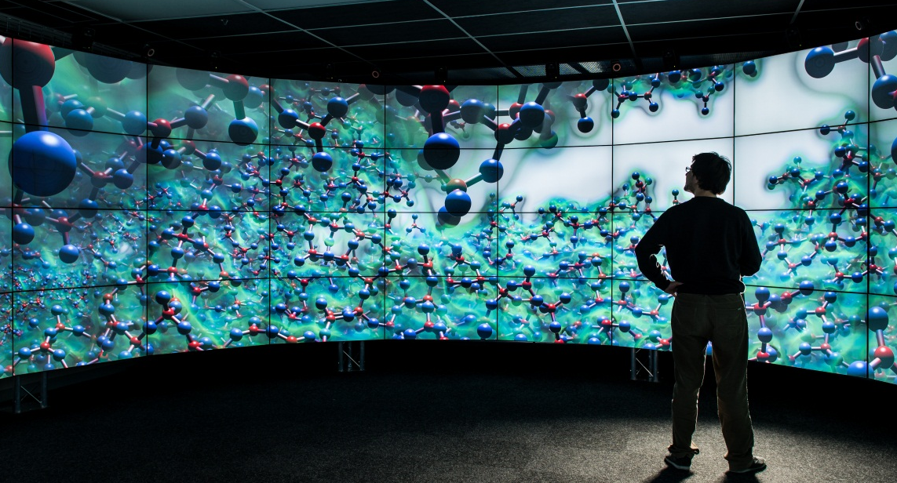
Scientific visualization
complex data structures;
large amount of data;
does not use quantitative methods of analysis;
stimulation of perception: pattern recognition.

Slide 3
Contents
Construction of visualization system;
Hardware;
Output devices;
Software.

Slide 4
Goals of the system
to boost performance of CAD-software;
fulfilling the tasks of rendering videos, animations, images;
using scientific packages such as ParaView;
providing processing power for simulation programs;
including research and visualization of large data sets obtained during the computation.

Slide 5
Possible usage
CAD and 3D editors;
I-ray server;
Scientific visualization packages(e.g. ParaView);
Developing real-time applications.

Slide 6
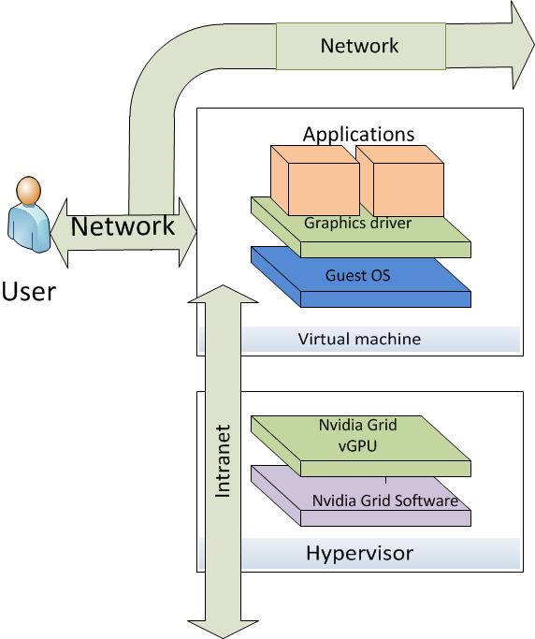
VDI solution

Slide 7
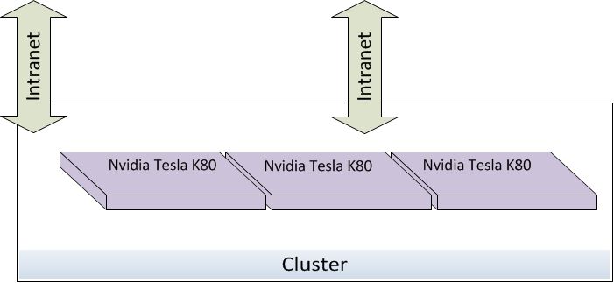
Rendering cluster

Slide 8
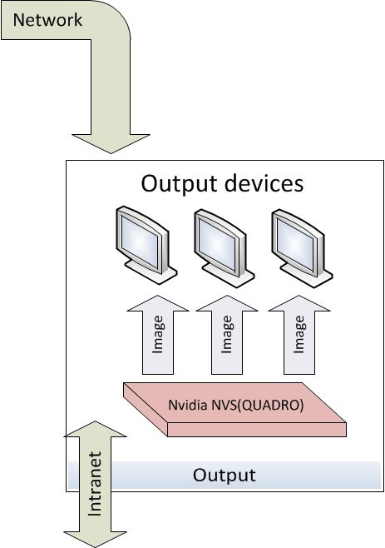
Output system

Slide 9
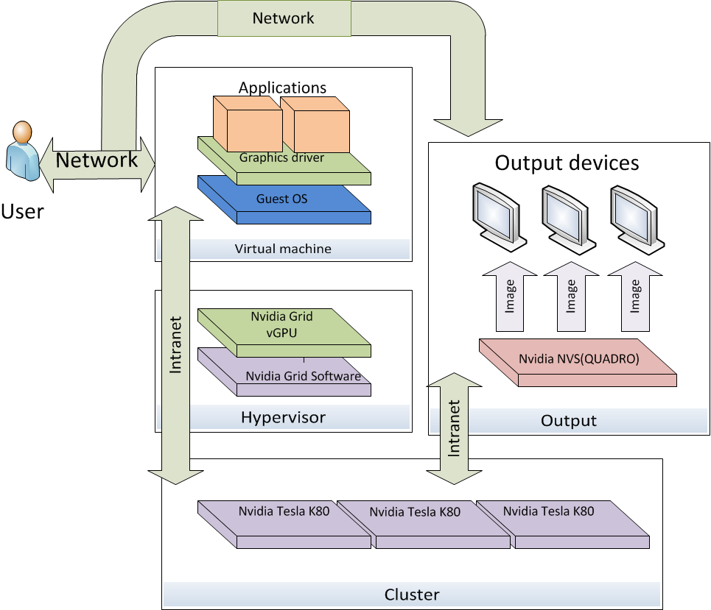
Scheme of the system

Slide 10
Network consumption
Resolution | Amount of pixels | Color depth(bit) | Refresh rate(Hz) | Speed (Gbit/sec)
4096 | 8847360 | 32 | 30 | 7,91
2160 |  | 16 |  | 3,96
 |  | 8 |  | 1,98
 |  | 32 | 60 | 15,82
 |  | 16 |  | 7,91
 |  | 8 |  | 3,96
 |  | 32 | 120 | 31,64
 |  | 16 |  | 15,82
 |  | 8 |  | 7,91
Ethernet
10 Gb/sec
40 Gb/sec
InfiniBand(EDR)
Speed: 25 Gb/sec(1x);
Speed: 100 Gb/sec(4x).

Slide 11
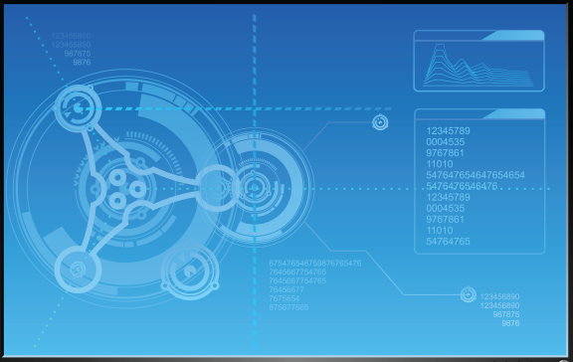
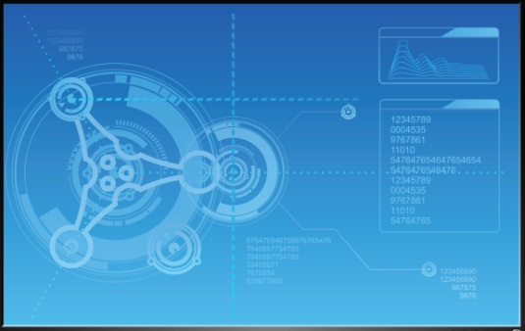

Multi/single displays
a single or multiple displays.

Slide 12

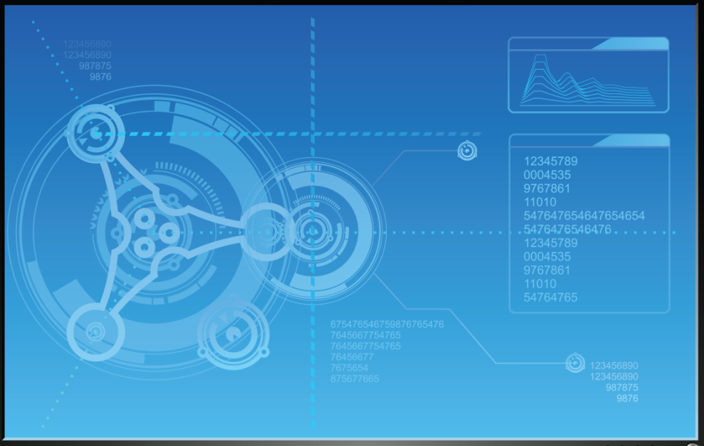
Active wall
a combination of multiple grid displays for large screen;
Example: situational centers.

Slide 13

Holographic display
the illusion of presence in the real volume of the displayed objects due to the stereoscopic effect;
Example: museum exhibits.

Slide 14
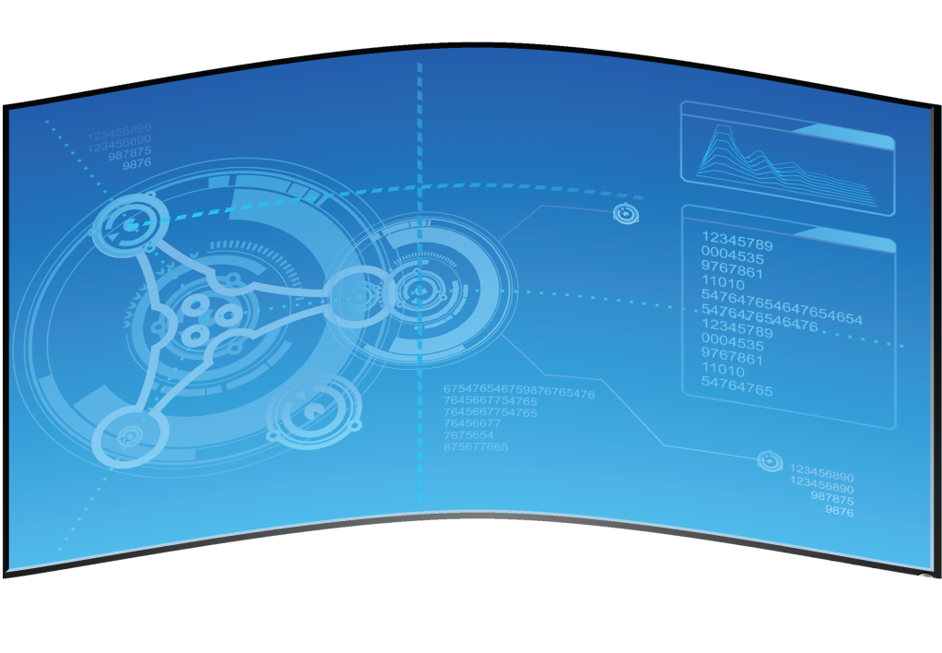
Immersive display
an optical illusion based on the composition of the projections from different angles.

Slide 15
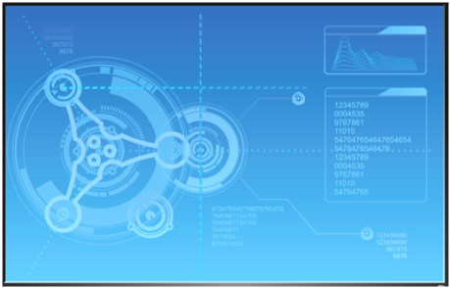
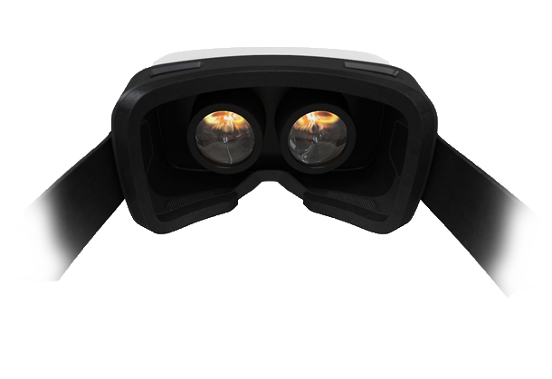
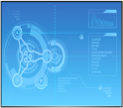
VR glasses
equipped with a dual-screen;
Example: training apparatus.

Slide 16




CAVE
2 to 6 screens in the form of the room;
Example: training apparatus, virtual prototyping.

Slide 17
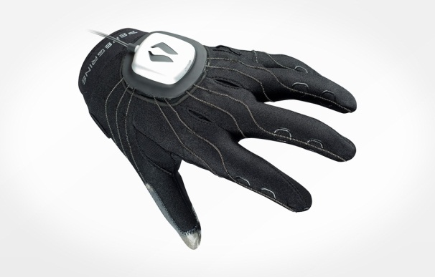
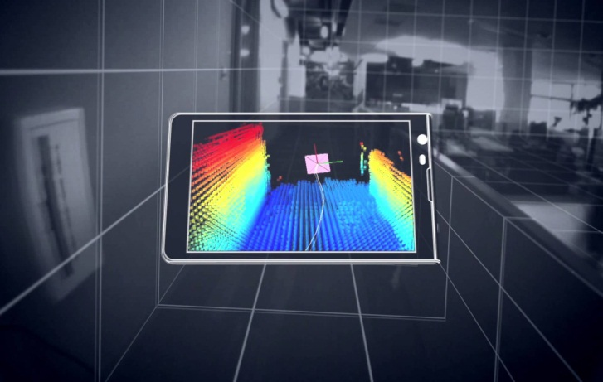
Additional equipment
movement tracking system;
motion capture;
tactile devices;
gloves for interaction;
depth sensors(Google tango).

Slide 18
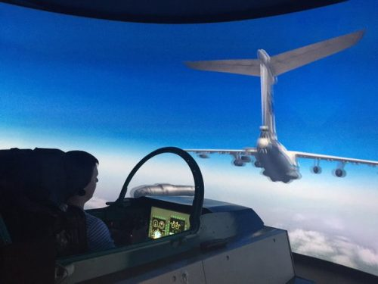
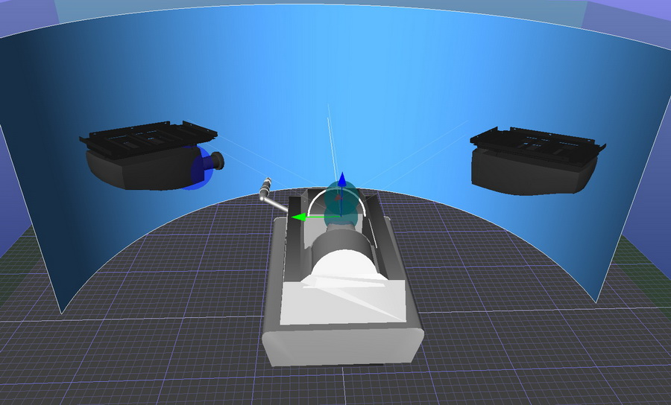
Aircraft simulator and simulator for refueling in the air

Slide 19
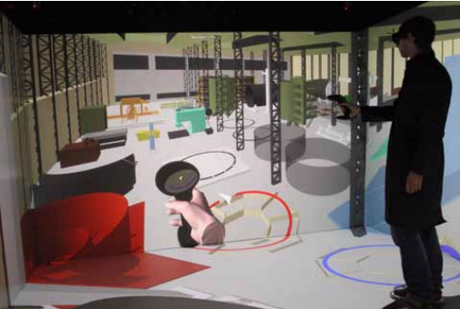
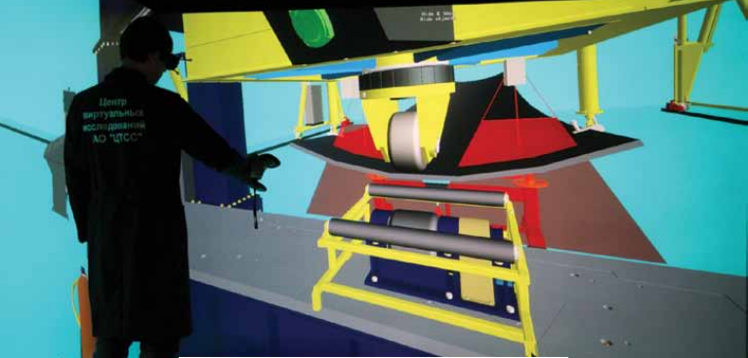
Shipbuilding and ship repair

Slide 20
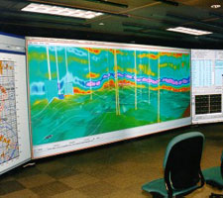
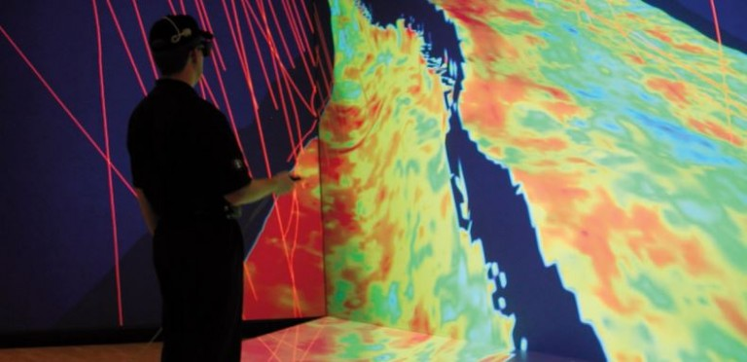
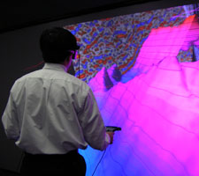
GIS and oil production

Slide 21
Comparison
 | Active wall (Multi/single display) | Holographic display | Immersive display (Cave) | VR glasses
Advantages | simple not expensive | realistic 3D picture | realistic interactive 3D picture high pictures resolution wireless fast tracking | realistic interactive
Disadvantages | no interactivity | not simple no interactivity expensive | demanding to hardware need additional equipment expensive | need additional equipment movement difficulty a complex system of tracking

Slide 22
Conclusion and Plans
Particular some devices have been chosen for involvement into the system’s implementation
Further plans:
active wall;
cave.

Slide 23
Thank you for your attention!

