Slide 1
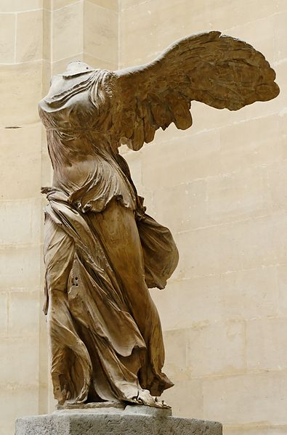
NICA – superconducting heavy ion collider in Dubna
Grigory Trubnikov (JIRN vice-director)

Slide 2
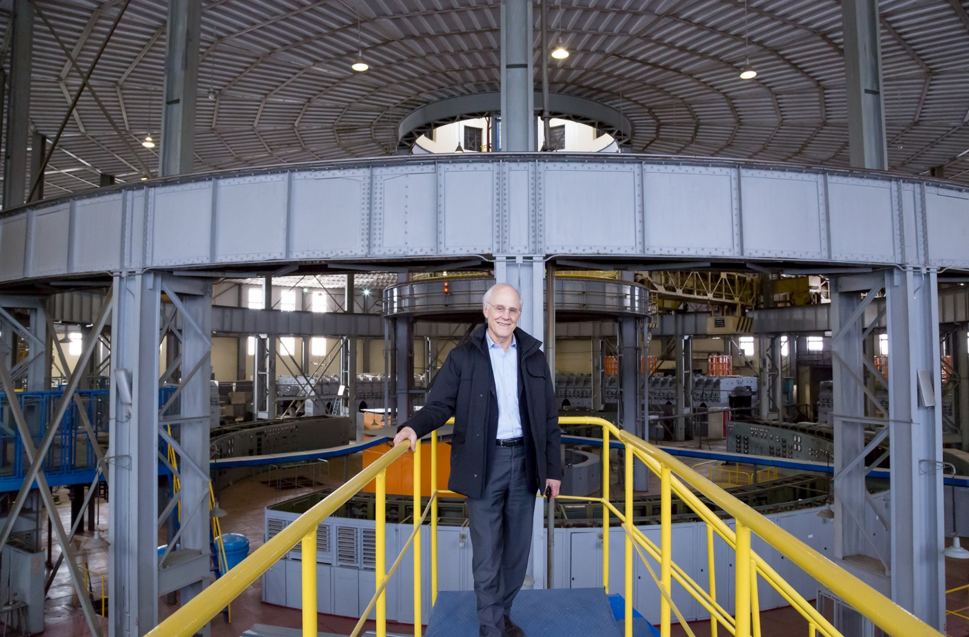
David Gross (Nobel prize in physics for asymptotic freedom), Dubna, 25 March 2016
- NICA will study phenomena, happened at high densities but not so high temperatures. Similar conditions are expected inside neutron stars.
- QCD has strong relations with String theory (which was invented to understand strong interactions). Properties of QCD related not only to quarks and gluons, but also “open strings”, “closed strings”, that could lead us to understanding of Gravitation.
- When you study properties of phase transitions at heavy ion collisions, obtained results could be used for investigation of Black holes.

Slide 3
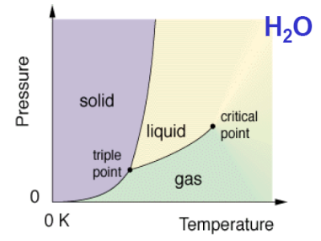
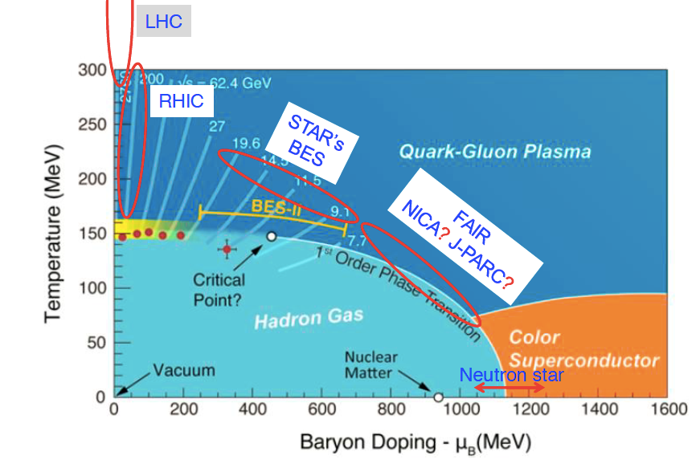
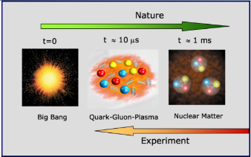
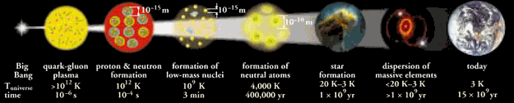
3
Notes:
3

Slide 4

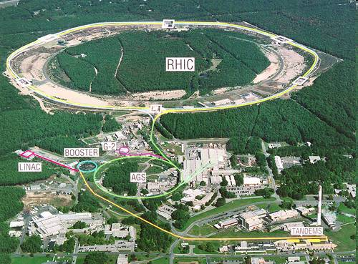
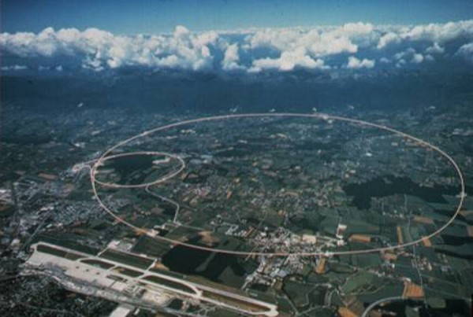
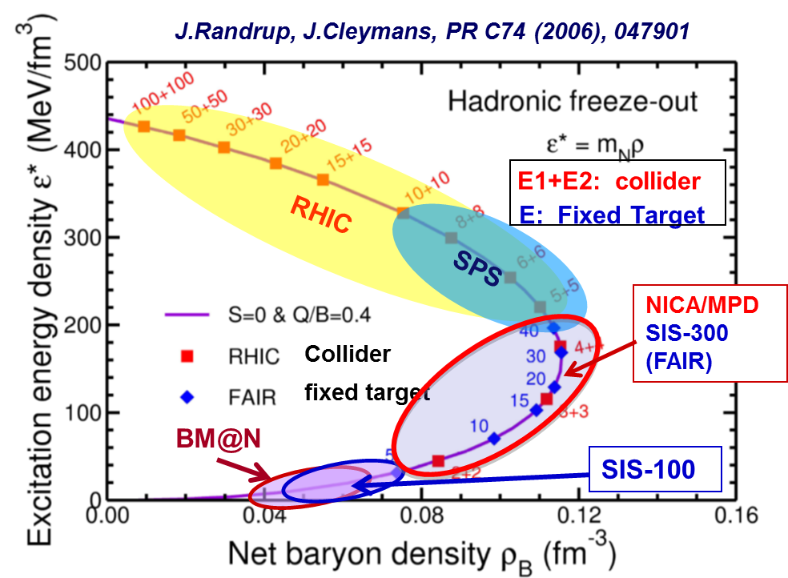
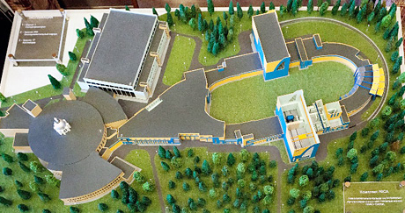
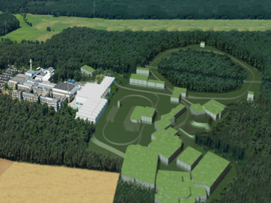
CERN
BNL, USA
NICA
FAIR
√s_{NN} ~ 10 ГэВ
The most interesting and intriguing energy range has NICA:
region of maximal density of nuclear matter,
Nobody yet reached it in lab.conditions
(phase transitions, early Universe, neutron stars)
FAIR (Darmstadt) – fixed target experiment
NICA (ОИЯИ, ДУбна) – colliding beams experiment

Slide 5
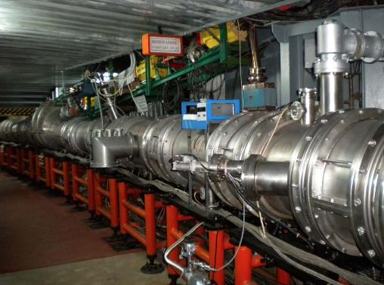

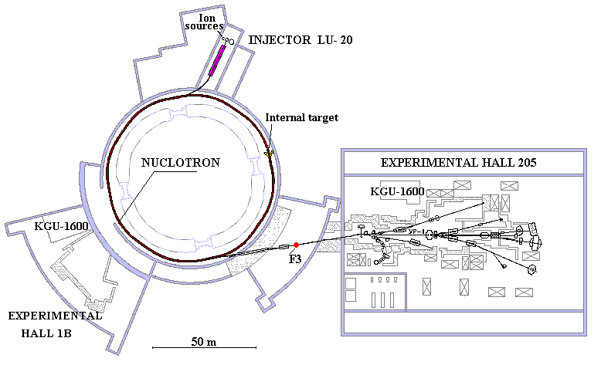
NICA: Nuclotron based Ion Collider fAcility
Ion beam ut to 5.2 ГэВ/н
Ion spices: from protons to Xe
E_max = 5.8 Gev/u (C6+)

Slide 6
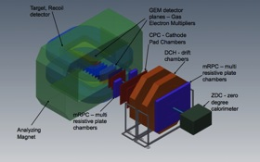
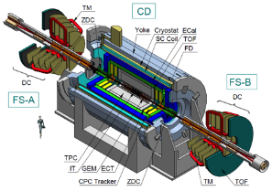
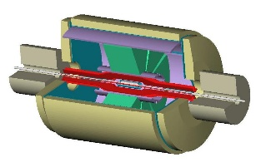
NICA facility
In operation Under construction
Fixed target experiments
Nucloron 0.6-4.5 GeV/u
Linac LU-20 (5 MeV/u)
BM@N
MPD
SPD

Slide 7
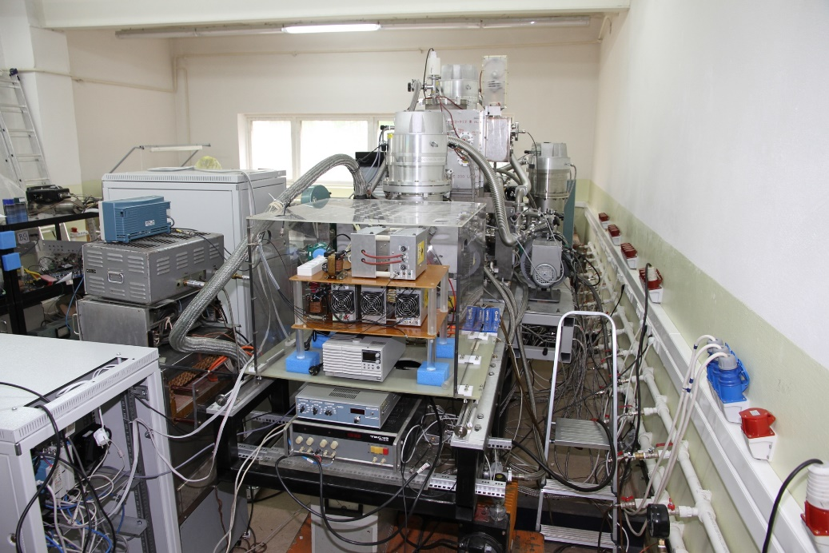
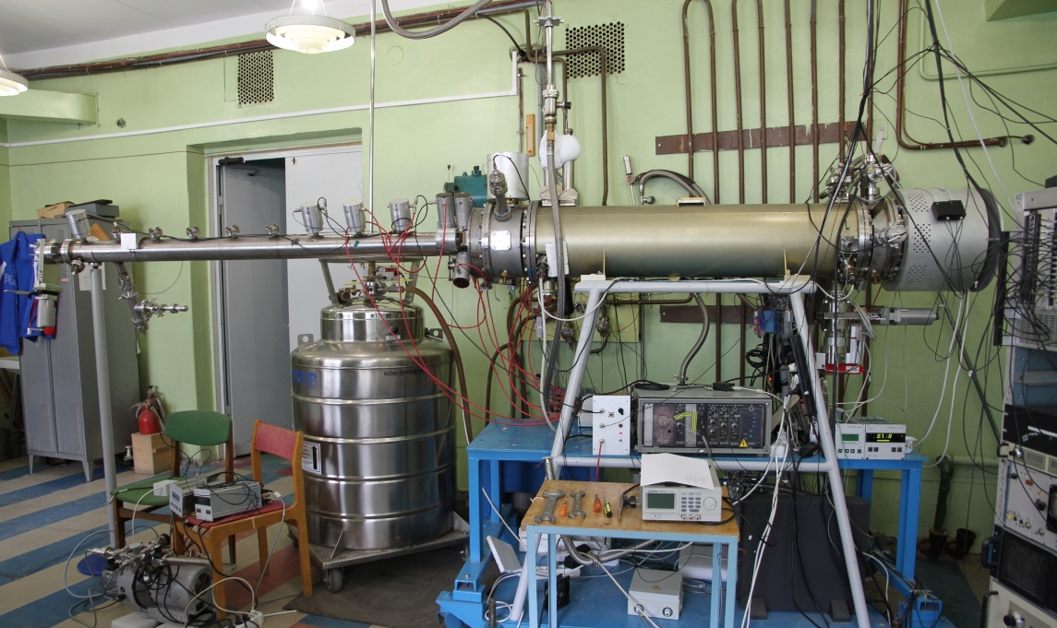
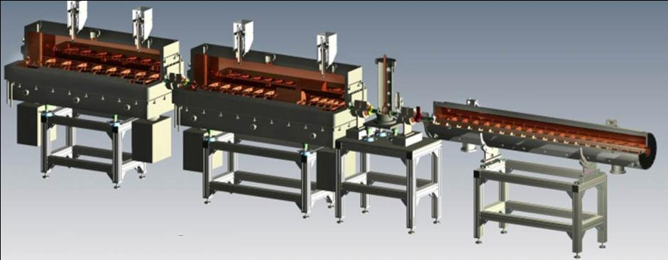

New injection complex of the NICA (Ion sources + HILac)
Source for polarized particles (SPP)
Heavy ion source: Krion-6T ESIS
Source assembled in 2013 now is
commissioned to achieve 10¹⁰ deutrons pp.
First beam run in beg.2016
B= 5.4T reached. Test Au beams produced:
- Au³⁰⁺ ÷ Au32³²⁺, 610⁸, T_{ioniz}= 20 ms for
Au³²⁺ -> repetition rate 50 Hz.
- ion beams Au⁵¹⁺÷ Au⁵⁴⁺ are produced.
Heavy Ion Linac delivered to JINR.
7

Slide 8
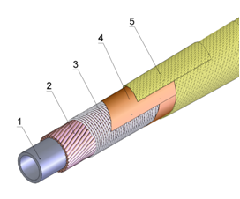
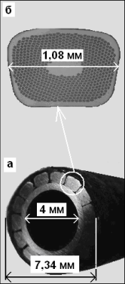
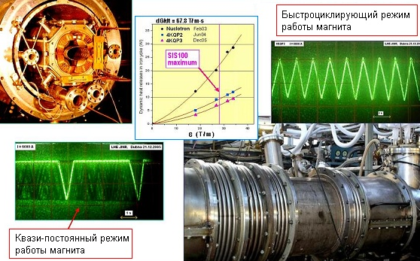
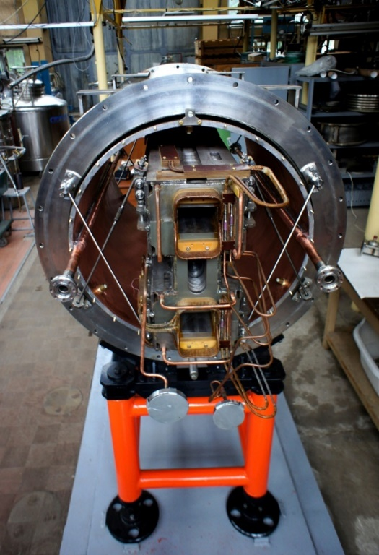
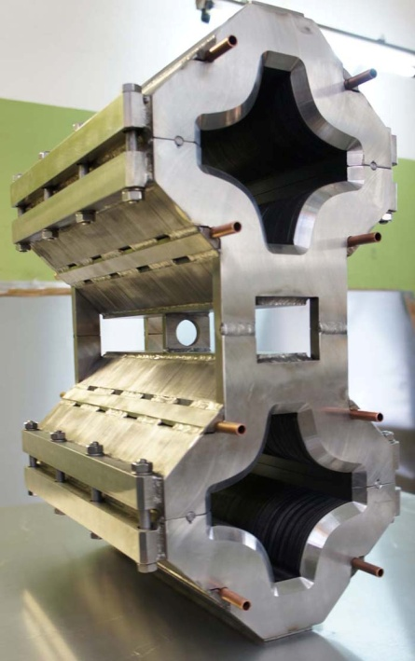
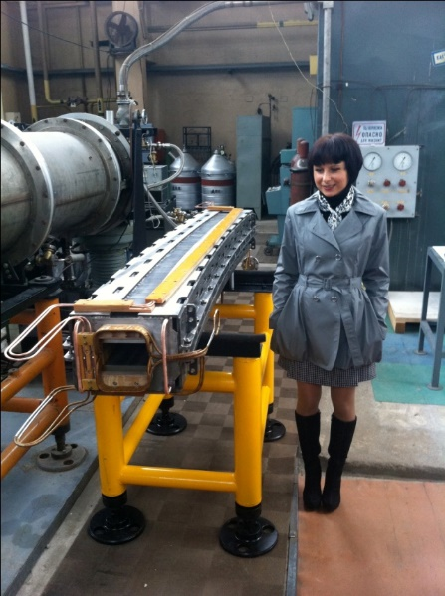
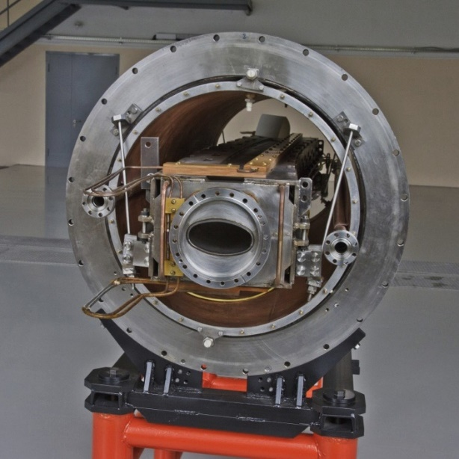
Superconducting superferric “Dubna magnets”
“Nuclotron” SC hollow cable
Max. B field = 2T
Ramp rate – up to 4 T/s @ 1 Hz
two-phase LHe @ 4.5K

Slide 9
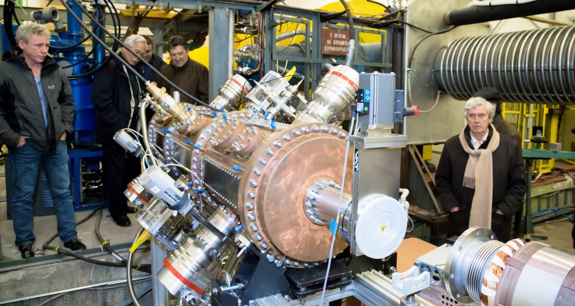
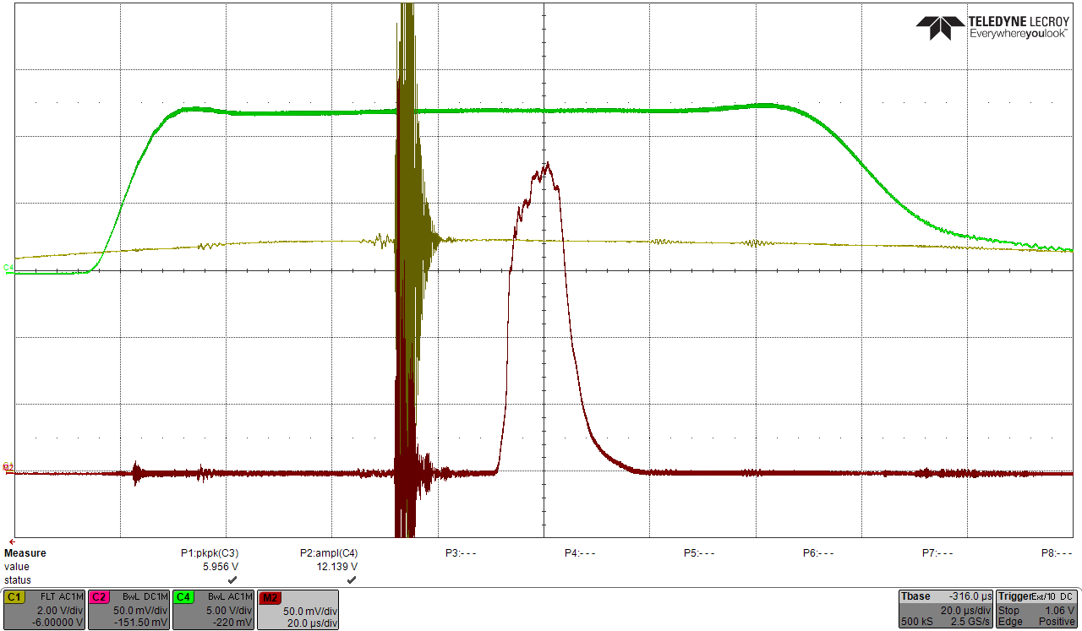
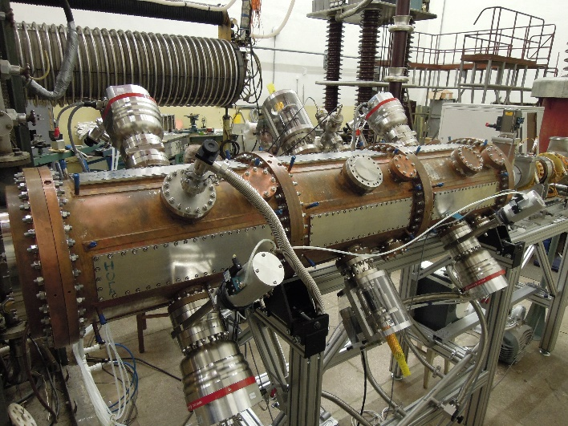
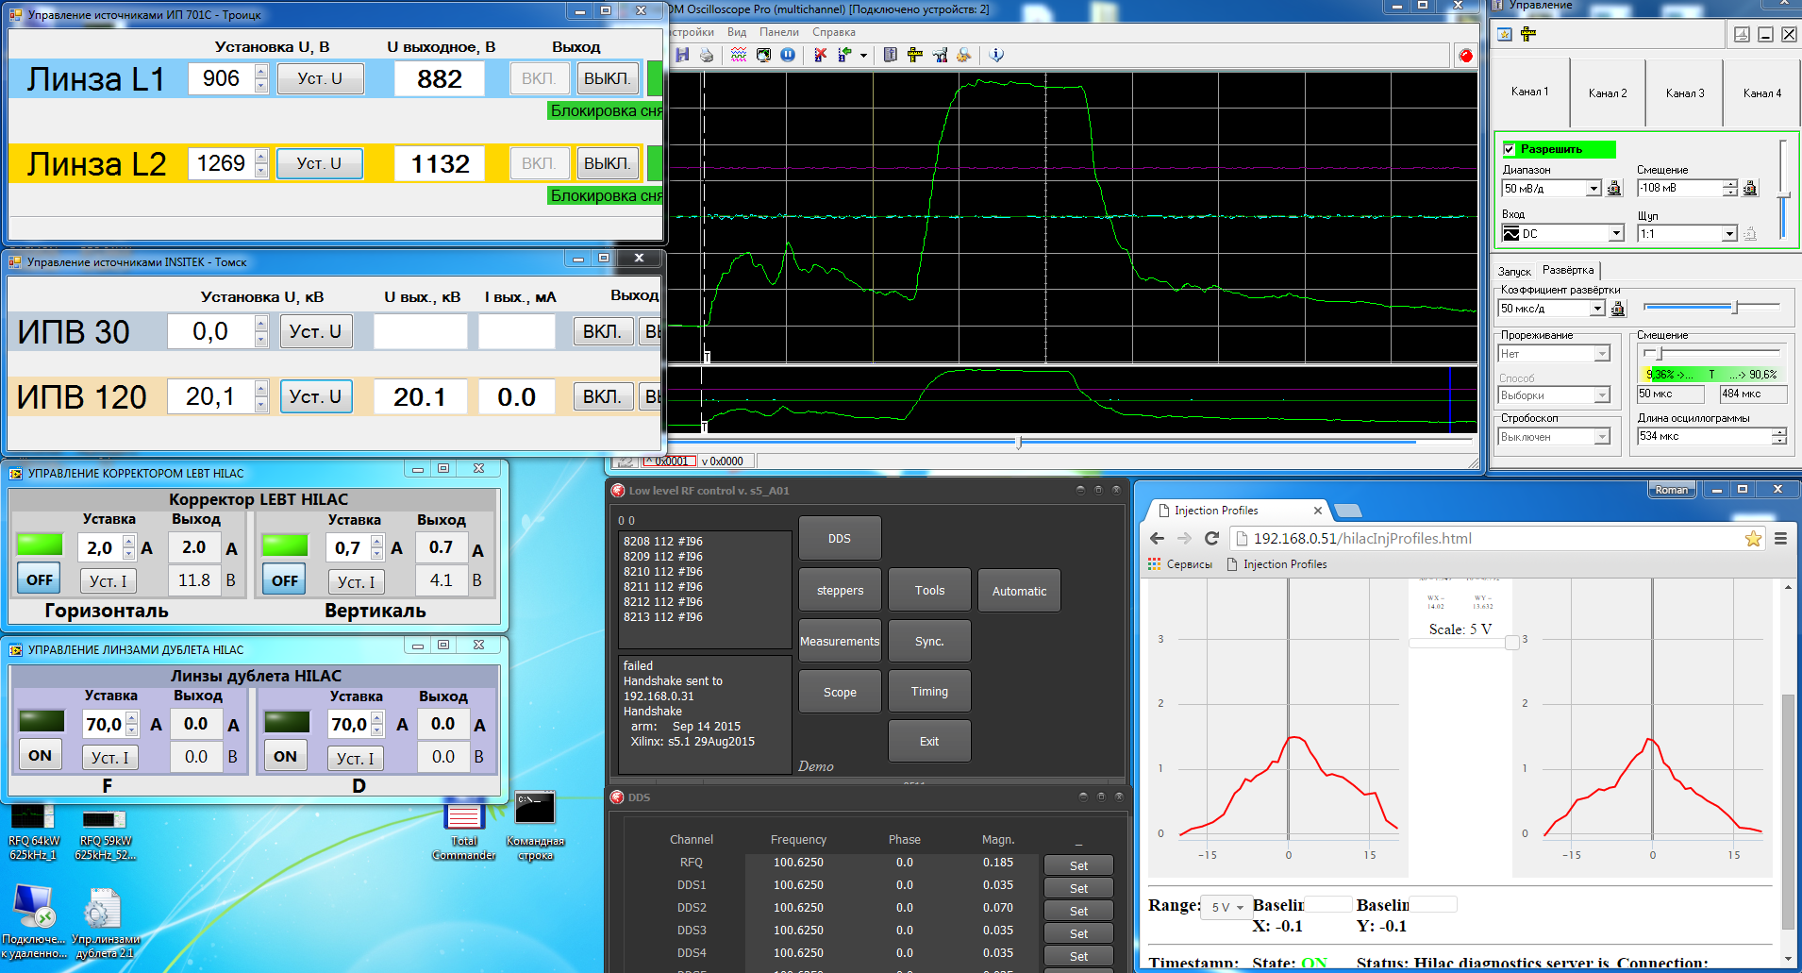
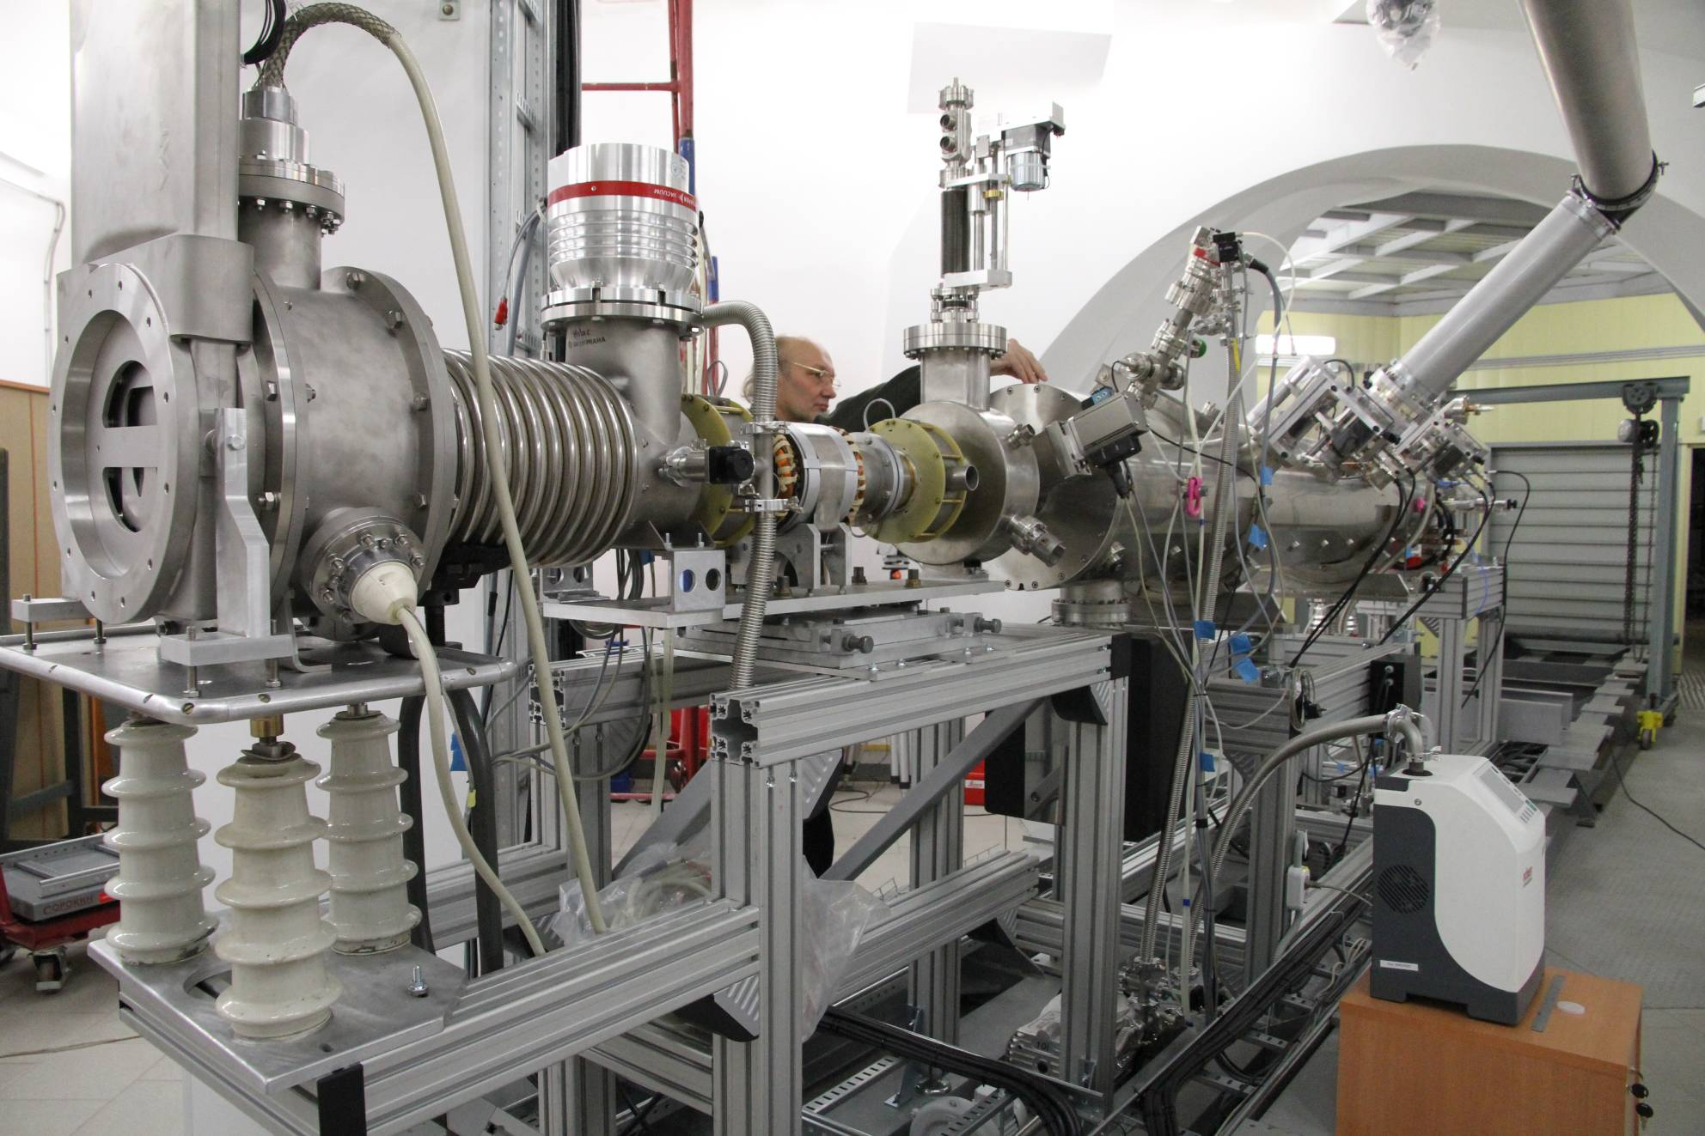
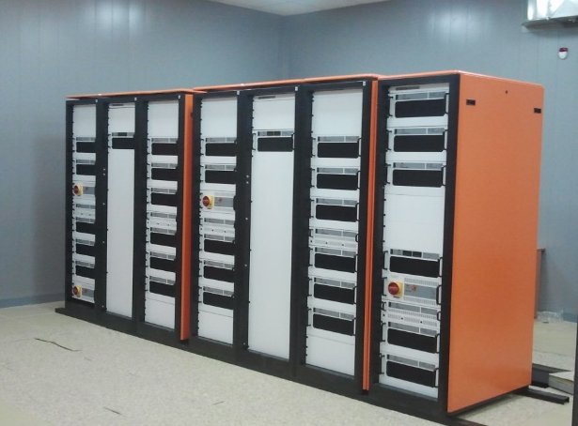
Injection complex: 2 linacs
RFQ resonator. Production started in 2013 (ITEP, MEPHI, VNIITP Snezhinsk)
JINR-ITEP-MEPhI-Snezhinsk
NICA Heavy ion injector
(HILAC)
HILAC RFQ + RFQ DTL

Slide 10
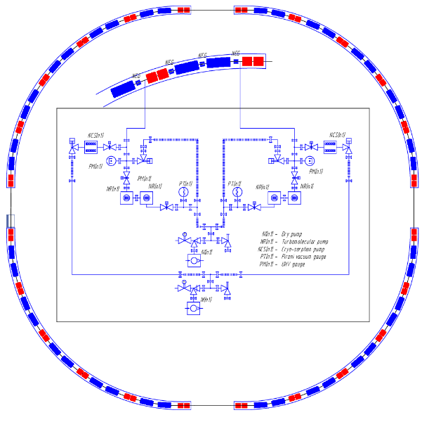
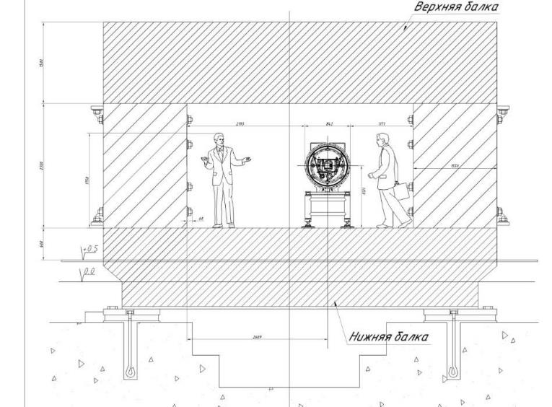
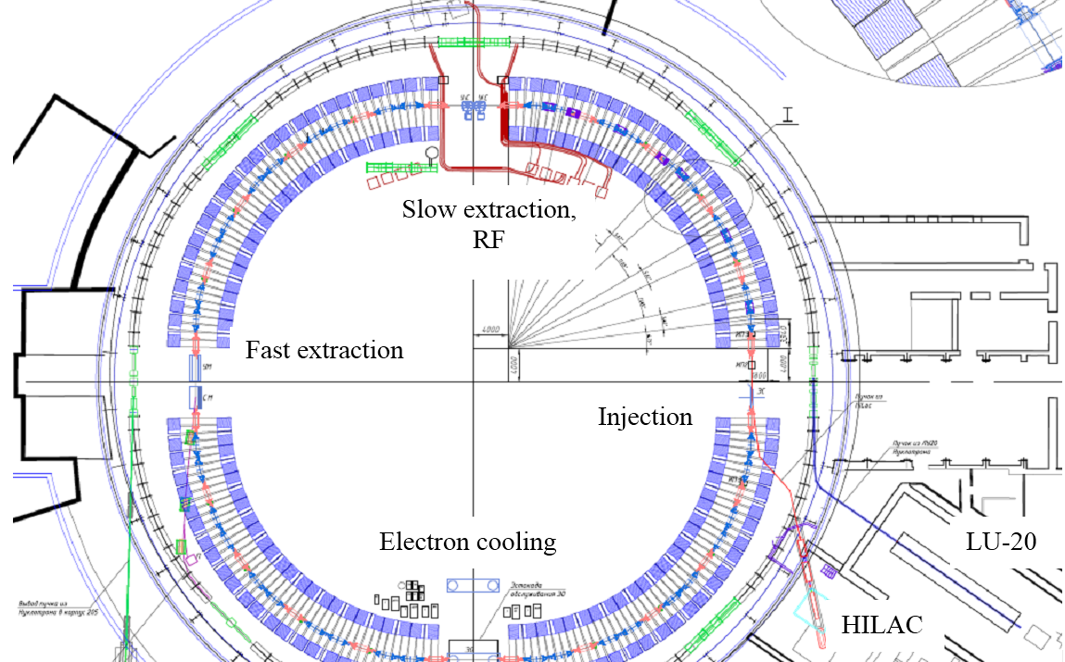
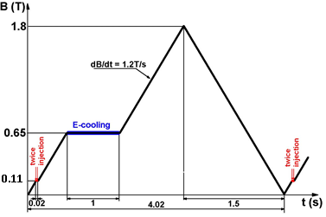
Particles | p | ¹⁹⁷Au³¹⁺
Injection energy, MeV/u | 3.2
Max.kinetic energy, GeV | 6.4 | 0.58
Circumstance | 211.2

Slide 11
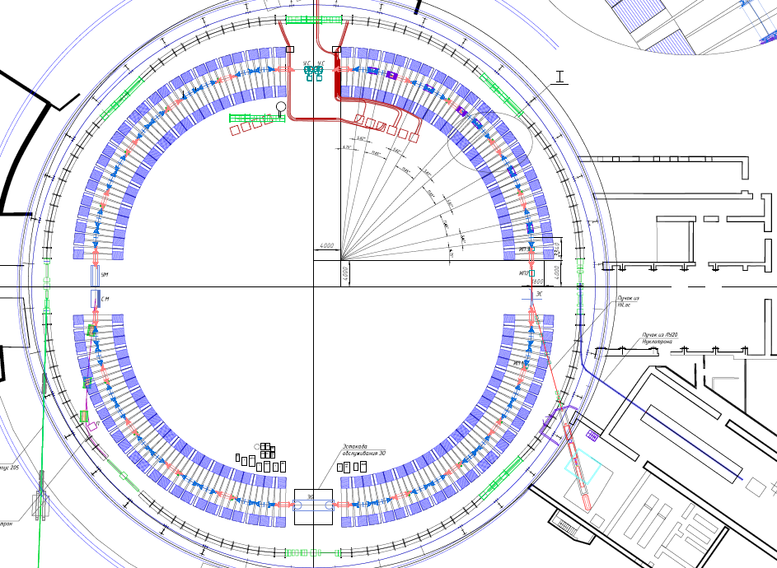
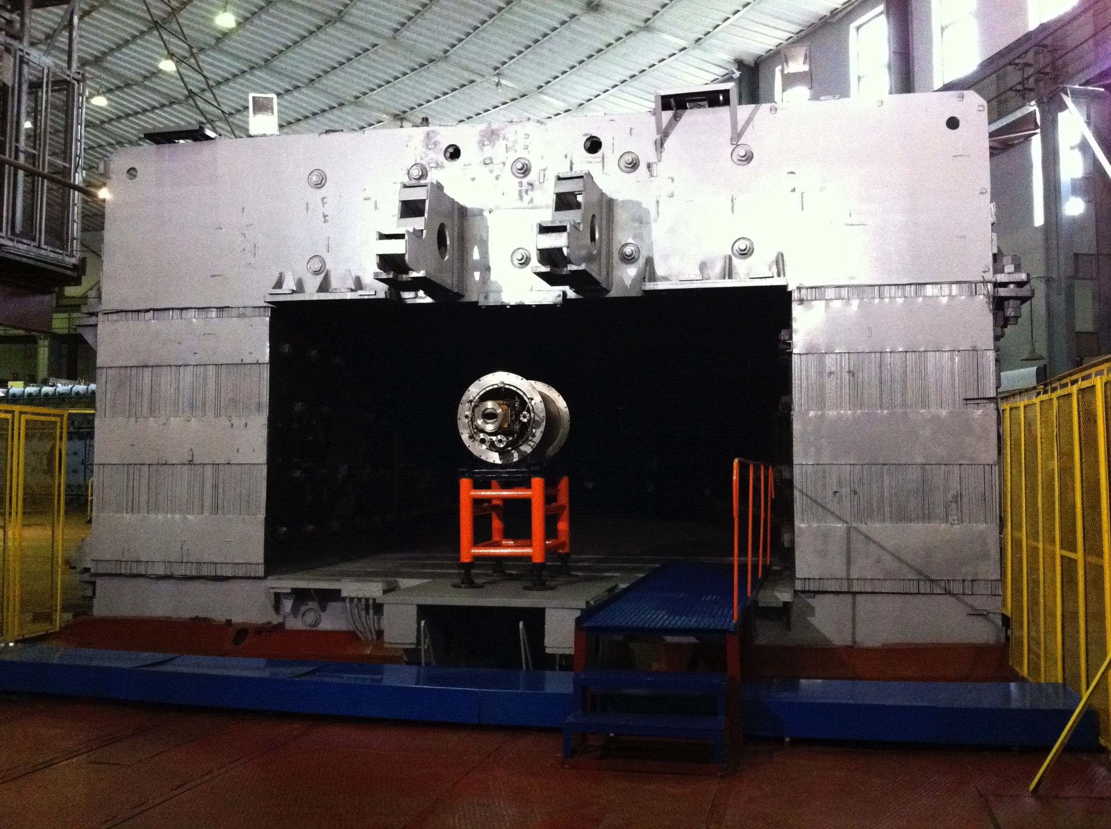
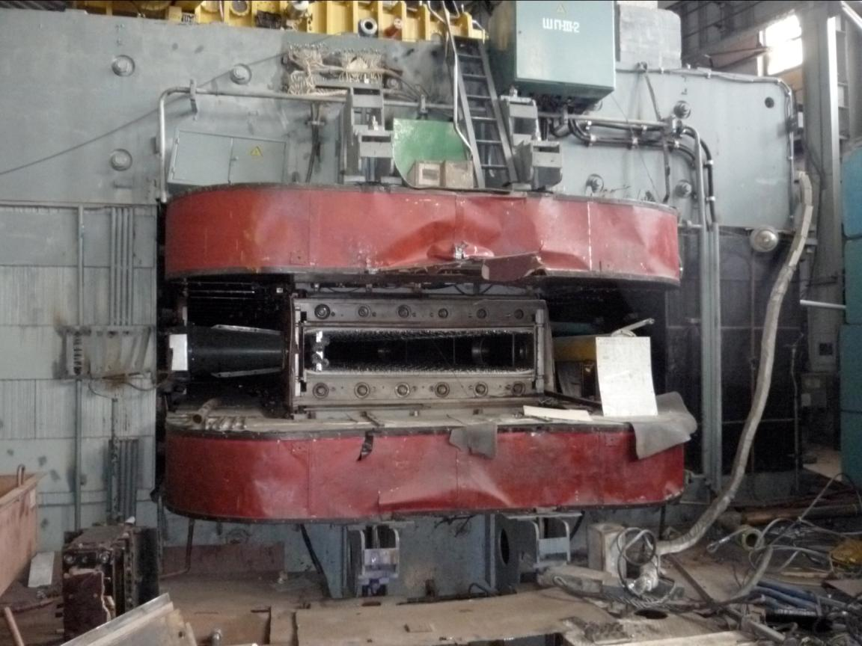
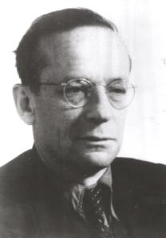
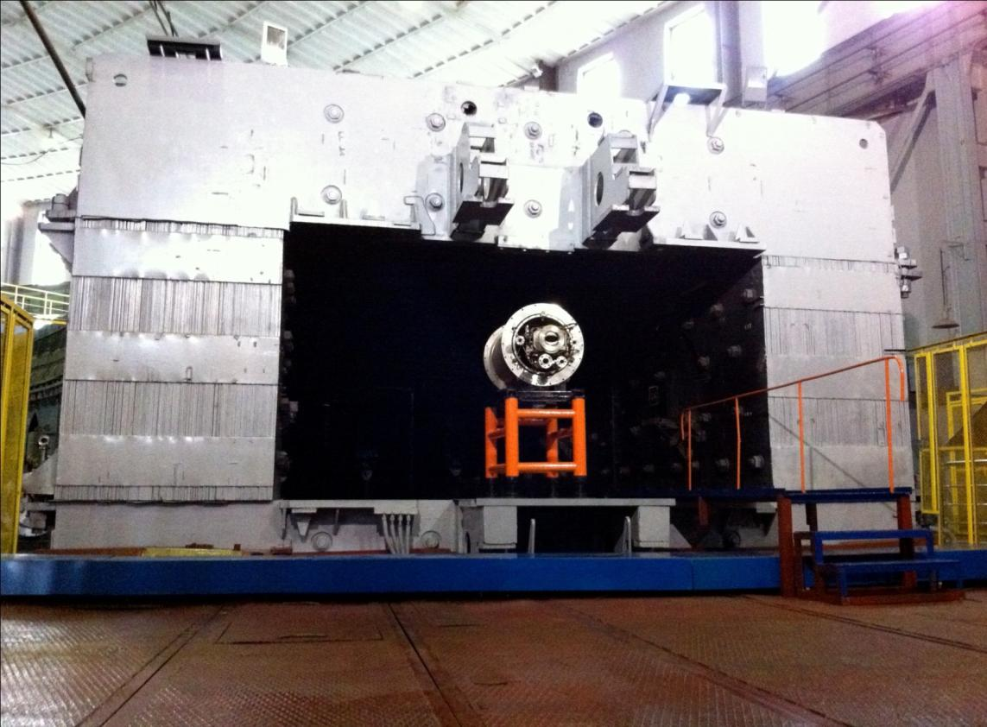
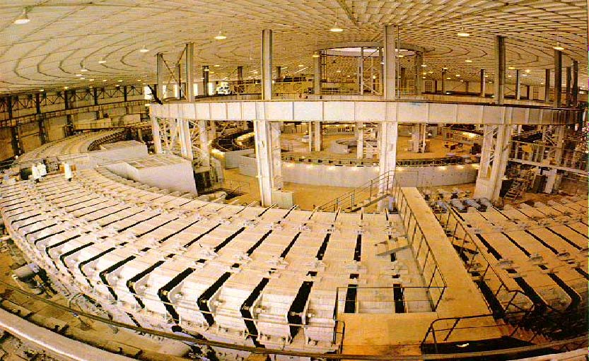
NICA Booster synchrotron
The best method to measure phase space size
Prototype of the Booster dipole
V. Veksler
2.4 m
2.3 m
4.0 m
4.0 m

Slide 12
Nuclotron Beams
Parameter | Achieved |  | Project (2017 2019)
Magnetic field, T | 2.0 |  | 2.0 (Bρ = 42.8 T⋅m)
Field ramp, T/s | 0.8 |  | 1.0
Repetition period, s | 8.0 |  | 5.0
 | E, GeV/u *) | Ions/cycle | Energy, GeV/u | Ions/ cycle
Light ions ⇒ d | 5.8 | 2⋅10¹⁰ | 6.0 | 5⋅10¹⁰
Heavy ions | With KRION-2 |  | With KRION-6T & Booster
⁴⁰Ar¹⁸⁺ | 3.5 | 5⋅10⁶ | 4.9 | 1⋅10⁸ 2⋅10¹⁰
⁵⁶Fe²⁶⁺ | 2.5 | 2⋅10⁶ | 5.4 | 1⋅10⁸ 1⋅10¹⁰
¹²⁴Xe^{48/42+} | 1.5 | 1⋅10³ | 4.0 | 1⋅10⁷ 2⋅10⁹
¹⁹⁷Au⁷⁹⁺ | --- | --- | 4.5 | 1⋅10⁷ 2⋅10⁹
Polarized beams | With Polaris |  | With SPI
p↑ | --- | --- | 11.9 | 1⋅10¹⁰ **)
d↑ | 2.0 | 5⋅10⁸ | 5.6 | 1⋅10¹⁰
*) energies are given for Z/A = 1/2)
**) With the Siberian snake

Slide 13
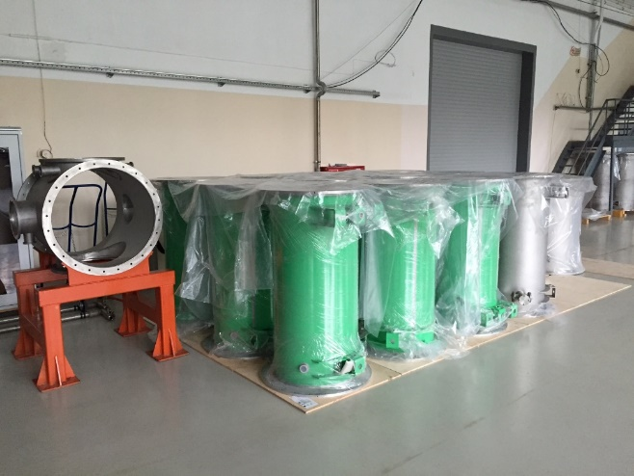
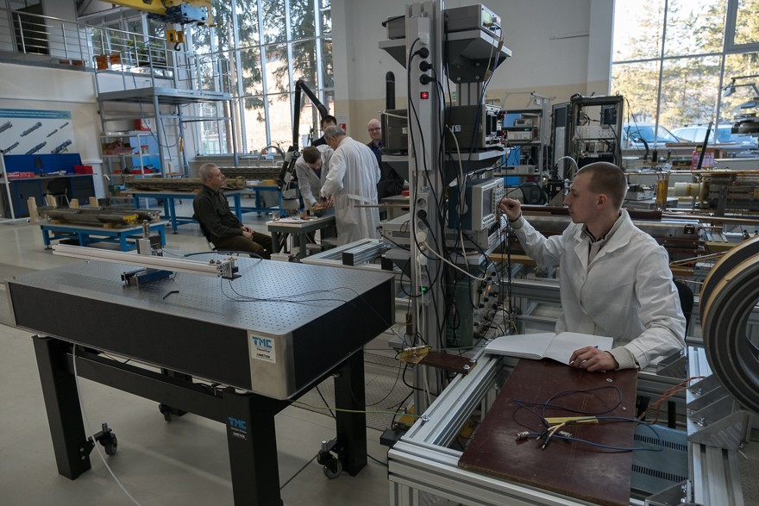
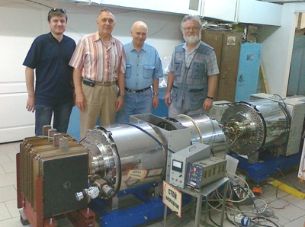
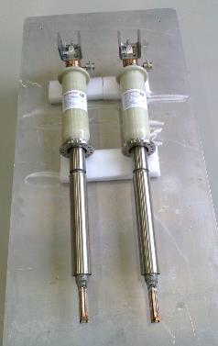
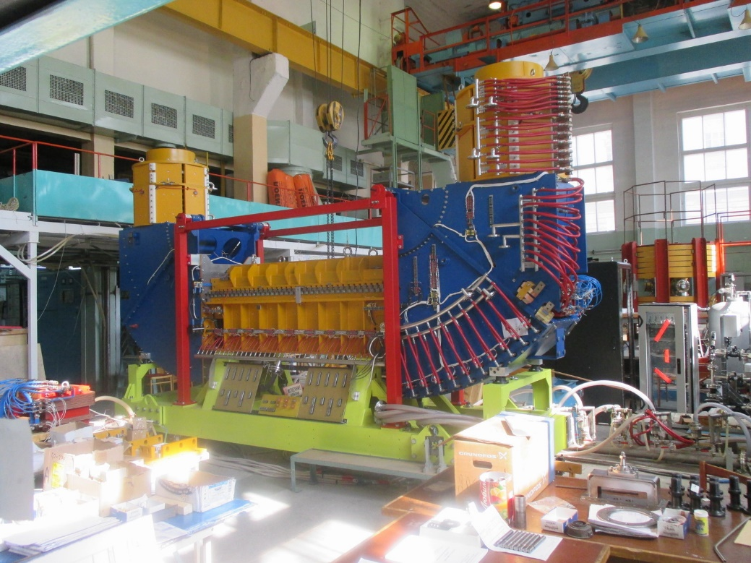
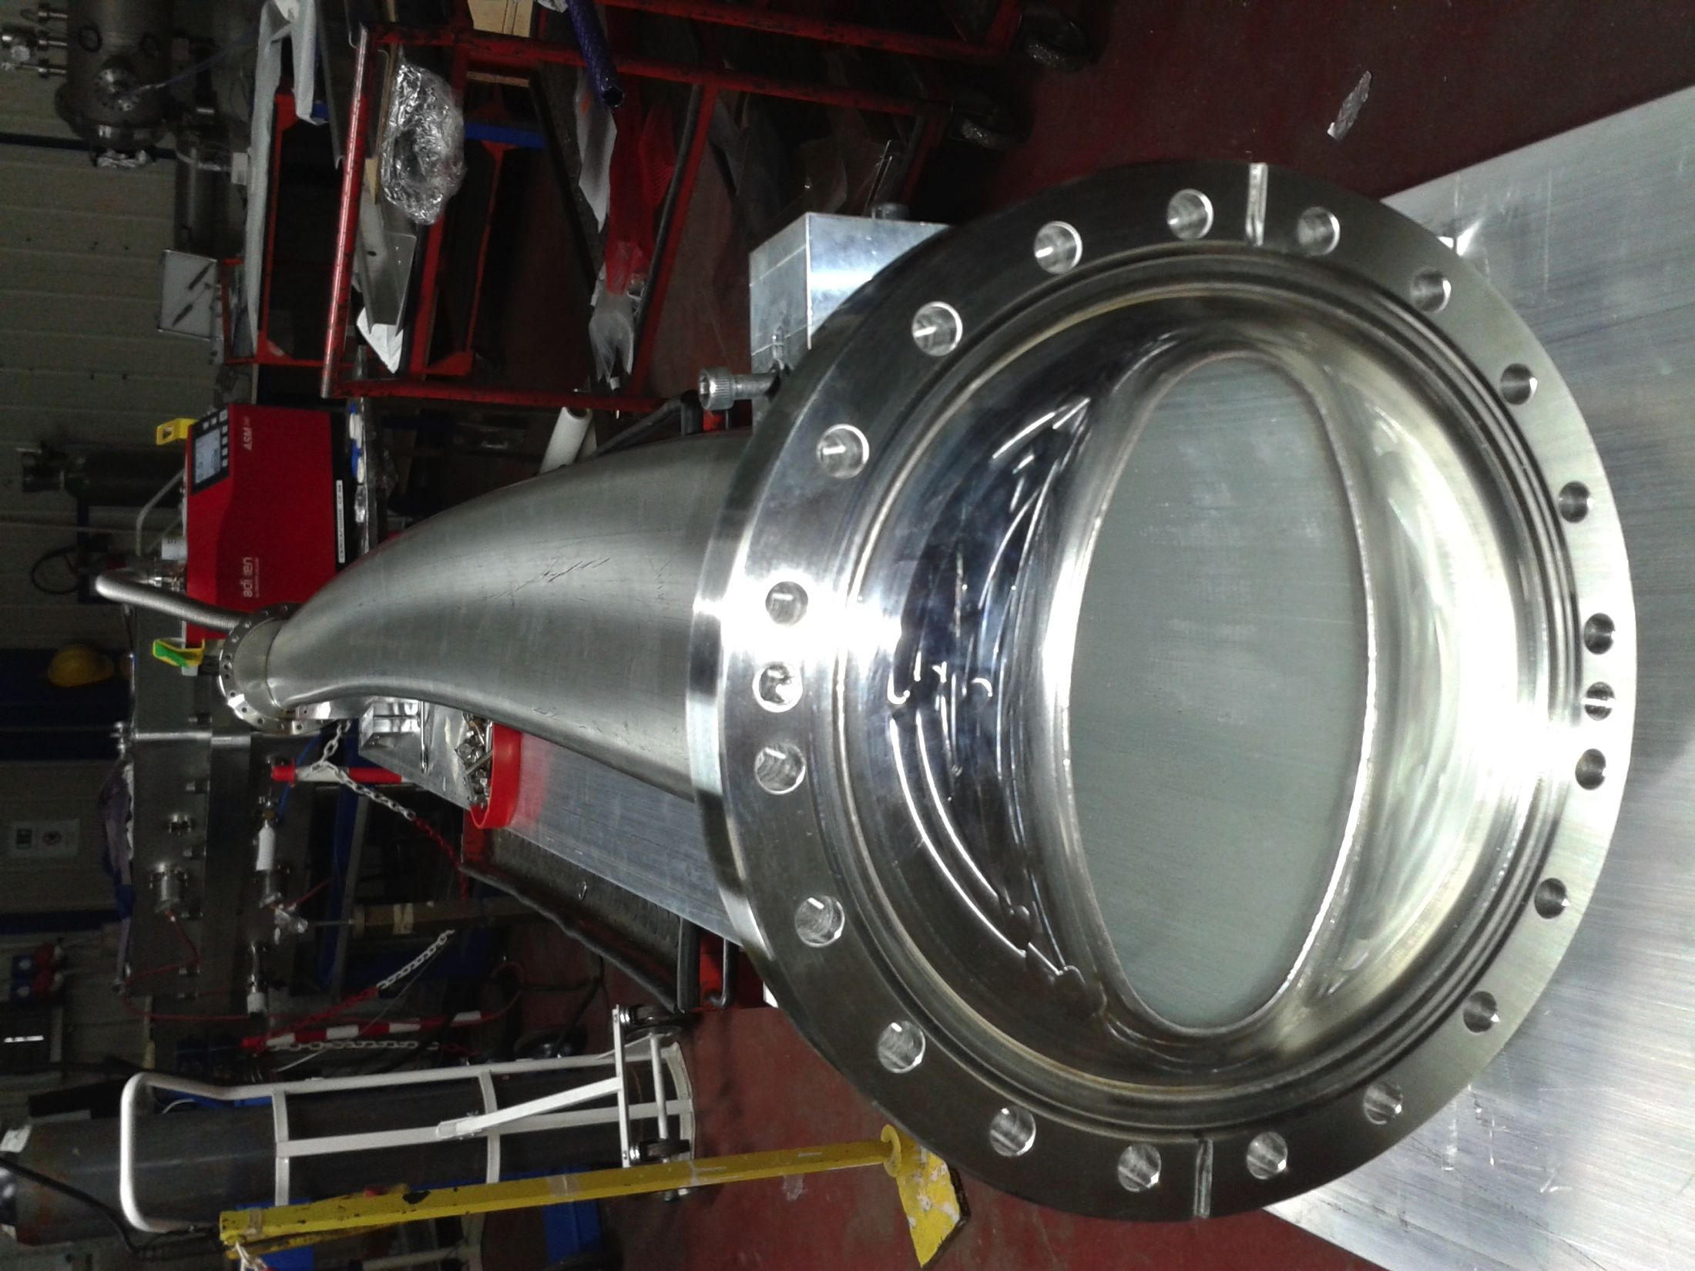
NICA Booster elements. Status
RF stations delivered from Budker INP
All cryostats delivered
4.5K Magnetic meas.system
Electron cooling system (50 keV) commissioned in Novosibirsk (BINP)
HTSC current leads
UHV curved vacuum chambers (10⁻¹² Torr)

Slide 14
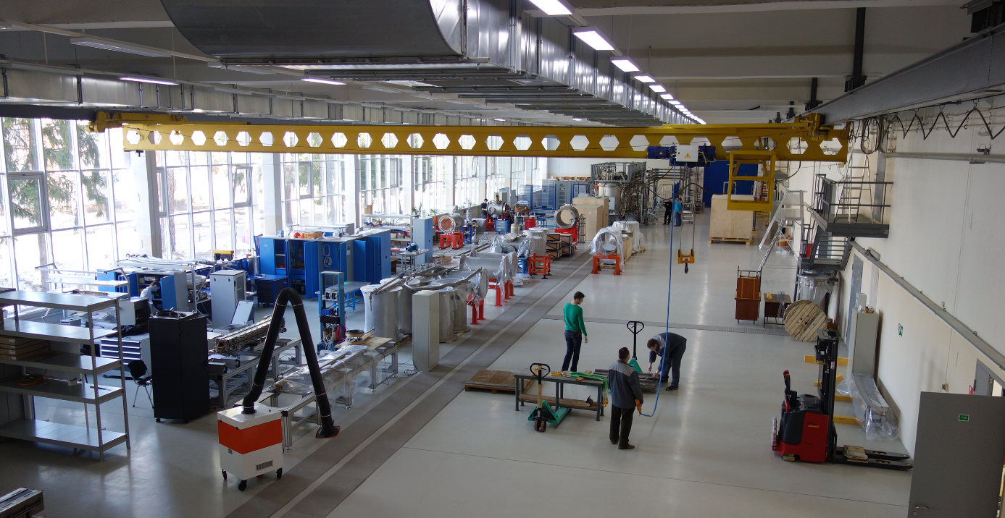
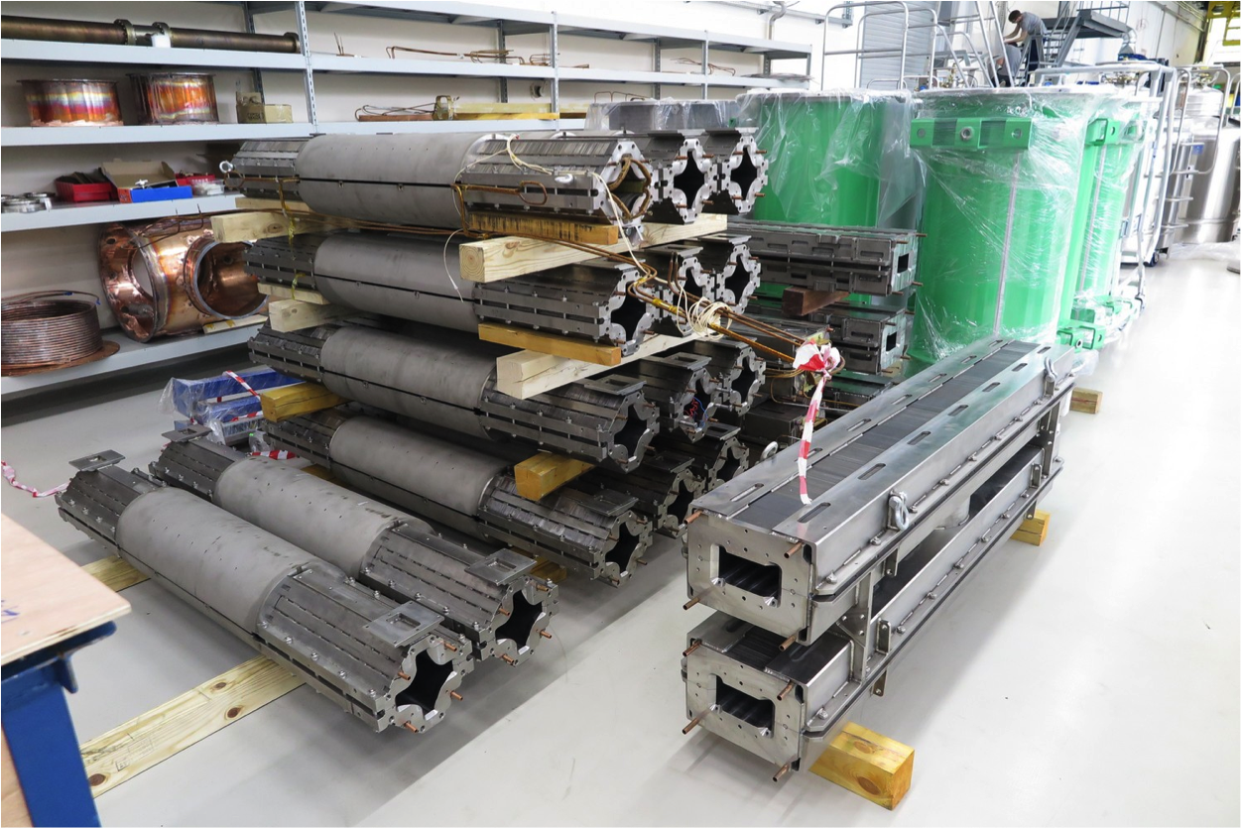


Test Facility for SC magnets of NICA and FAIR: excellent collaboration of JINR and Germany (GSI/FAIR). Start of operation – December’14.

Slide 15




Collider composition (HI mode)
SPD
MPD
[ ] - element length
( ) - distance between elements

Slide 16




NICA @ Heavy Ion mode
Linac HILac (3.2MeV/u)
ESIS KRION
Booster (25 Tm)
1(2-3) single-turn injection,
storage of (2 ÷ 4)×10⁹ ions,
acceleration up to 100 MeV/u,
electron cooling, acceleration
up to 600 MeV/u
Linac LU-20 (5MeV/u)
Ion sources
Fixed Target Area
Stripping (80%) ¹⁹⁷Au³¹⁺ => ¹⁹⁷Au⁷⁹⁺
Nuclotron (45 Tm)
injection of one bunch
of ≤ 2×10⁹ ions,
acceleration up to
1 - 4.5 GeV/u max.
Two SC rings of the collider
L ≥ 10²⁷ см⁻²с⁻¹
~ 2 x 22 injection cycles
22 bunches per ring

Slide 17


Slide 18




Strategy to achieve the luminosity
Effective scheme of ion storage and bunch accumulation
Lifetime on residual atom scattering ~ 10 hours
Suppression of “head-tail” and multibunch instabilities with feed-back systems
Suppresion of the emmitance growth (due to IBS) with beam cooling systems:
1 – 3 GeV/u– electron cooling
3 – 4.5 ГэВ/н – 3D stochastic cooling (longitudinal – by Palmer method)
Budker INP, Novosibirsk
IKP FZ Juelich, FNAL

Slide 19
Luminosity for different ions
Start-up configuration (2019-2020), in comparison to Design (2023 ):
Bunch length ↑2, intensity ↓4, momentum spread ↑2.
I.e. luminosity ⇒ less by 10-50 times, @ level of 5⋅10²⁵ - 5⋅10²⁶
Optimal energy for stochastic cooling: 3.7 GeV/u
 | σ_{p}, 10⁻⁴ | ε, π⋅мм⋅мрад | N_{b} | L
₁₉₇Au⁷⁹⁺ | 4.14 | 0.805 | 1.49⋅10⁹ | 3.05⋅10²⁶
₁₂₄Xe⁴²⁺ | 3.8 | 0.678 | 2.53⋅10⁹ | 8.9⋅10²⁶
₈₄Kr³⁶⁺ | 4.28 | 0.86 | 3.31⋅10⁹ | 1.52⋅10²⁷
₄₀Ar¹⁸⁺ | 4.39 | 0.92 | 6.75⋅10⁹ | 5.53⋅10²⁷
Emmitance growth rates: 50 – 200 seconds

Slide 20


NICA: 3 detectors
Рук. В.Д.Кекелидзе
Baryonic Matter at Nuclotron (BM@N)
the fixed target experiment
at the Nuclotron
Этап I: 2017
MultiPurpose Detector (MPD)
at the Collider
Этап II: 2019
SPD (Spin Physics Detector) at the Collider
Этап III: после 2021
Готовится Концептуальный и технический проект. Организовывается коллаборация

Slide 21


MPD detector for Heavy-Ion Collisions @ NICA
FFD
Tracking: up to |η|<2 (TPC)
PID: hadrons, e, γ (TOF, TPC, ECAL)
Event characterization:
centrality & event plane (ZDC)
Stage 1: TPC, TOF, ECAL, ZDC, FD
Stage 2: IT + Endcaps (tracker, TOF, ECAL)
Superconducting solenoid:
high level (~ 3x10⁻⁴) of magnetic
field homogeneity
B₀=0.66 T
Correction coils
(warm)
Magnet status:
technical design – completed;
survey for producers

Slide 23






TPC assembly tools, cooling & laser calibration system
outer thermal
screen
front thermal
screen

Slide 24









RPC deam test at NUCLOTRON: cooperation with SPb, China
FFD tested with beam: achieved time resolution (38 ps) is better than required
Preproduction ECAL prototypes: co-operation with Ukraine and China
Readout Electronics developed for TPC, TOF, and ECAL (64 ch,13-bit,65 MSPS)
TPC Cylinder C3 manufactured in Dec’13
ZDC coverage confirmed: 2.2<|η|< 4.8
RPC performance : required efficiency, rate capability & time resolution (63 ps) had been reached
The CBM - MPD consortium: development & production of STS for CBM (FAIR), MPD & BM@N
mock-up carbon-fiber ladder (15 g / 1m)

Slide 25




Clean room (Silicon detectors – Inner trackers)

Slide 26






Computing
Leader: Yu. Potrebenikov
Data processing pipeline
On-line prototype & network rack
160 × 3 GHz CPU cores, 1024 GB RAM,
8.5 TB Flash Memory, 2×10 Gb Ethernet
4 × Permanent Storage nodes in 16U
430 TB raw, triple replication on 4 TB
HDD 4×10 Gb Ethernet
All prototypes are constructed and tested;
design of the whole NICA cluster is in progress
￼
￼
LHEP off-line cluster (prototype)
Data storage (LIT):
> 10 PB RAW data p/y after 2020
Needs:
Comp. CPU – 5 000 GHz
CPU cores – 1600
Comp. RAM – 10 000 GB
Disc storage – 2 200 TB
Mass storage – 20 PB/year
15 servers: 4 interactive,
11 batch hosts, 350 CPU cores
130TB disk space (replicated)

Slide 27






Complex NICA – civil construction
The project has passed through the State Expertise in 2013
For the first time at JINR the international tender has been implemented
experiments with
fixed targets
bld. 205
SPD
MPD

Slide 28



Contract for civil construction (JINR-Strabag. September 2015)
http://nucloweb.jinr.ru/nucloserv/205corp.htm

Slide 29
NICA time-line
 | 2015 |  |  |  | 2016 |  |  |  | 2017 |  |  |  | 2018 |  |  |  | 2019 |  |  |  | 2020 |  |  |  | 2021 |  |  |  | 2022 |  |  |  | 2023
Injection complex
Lu-20 upgrade
HI Source
HI Linac
Nuclotron
general development
extracted channels
Booster
Collider
startup configuration
design configuration
BM@N
I stage
II stage
MPD
solenoid
TPC, TOF, Ecal (barrel)
upgraded end-caps
Civil engineering
MPD Hall
SPD Hall
collider tunnel
HEBT Nuclotron-collider
Cryogenic
for Booster
for Collider
running time

Slide 30












Megaproject NICA
Innovative Perspectives
Space Technologies
Power saving, nuclear energetics, industrial accelerators, ecology
Security
Radiobiology
Nuclear medicine Radiation medicine (oncology therapy)

Slide 31


Slide 32




The Particle Physics accelerators are capable of investigating one of the basic questions of high-energy Nuclear Physics, which is the formation of quark-gluon plasma (QGP) in heavy ion collisions. ….... The study of the hadron-QGP phase transition and the investigation of the properties of strongly interacting baryonic matter will be extended to the lower energy range by the CBM fixed-target experiment at the ESFRI Landmark FAIR and the colliding-beams experiment at NICA in Dubna.
The synergy and complementarity of the NICA and of the ESFRI Landmark FAIR and to some extent of the ESFRI Landmark SPIRAL2 make it very desirable to develop a joint coordinated effort for identifying a strong programme and for offering the best opportunities to international nuclear experimental physics. To this end ESFRI encourages these Ris both to work closely together and to pay special attention to developing NICA as a Global Research Infrastructure concept.

Slide 33












NICA collaboration
17 Russian Institutions and 24 Labs from all over the world
MEPhI, MEI, MSU, SPbSU, MPTI,...
IHEP (Protvino):
beam dynamics, RF,
Feed-back systems
Budker INP, Novosibirsk:
Booster RF system, e-cooler
Collider RF system
HV e-cooler for collider
Electronics
FZ Juelich (IKP):
Stoch. Cooling
HV Electron cooler
CERN
SC magnets and technologies, energetics, precise metrology, beam cooling and beam dynamics
INR RAS (Troitsk): polarised source,
Linacs, beam diagnostics
FNAL:
HV Electron cooler
Beam dynamics,Stoch.cooling
AREI:
HV Electron cooler
GSI/FAIR
SC dipoles for Booster/SIS-100
beam cooling, diagnostics
BNL:
Beam dynamics,
stoch.cooling, e-cooling
ITEP:
RF, beam dynamics in the collider, RFQ linac, SC p-linac
VNIITF, VNIIEF
IMP CAS, ASIPP, IHEP, Tsinghua U., Fudan U.

Slide 34

Статус мегасайенс проекта NICA в ОИЯИ
В период 2013-2016 проект NICA успешно прошел несколько стадий международных экспертиз, собрал вокруг себя широкую коллаборацию участников из 95 институтов и научных организаций 25 стран мира. Важным этапом явилось признание международным научным сообществом проекта NICA и его включение в 2016 году в ESFRI Strategy Report on Research Infrastructures и ESFRI Roadmap 2016 Update в качестве complimentary project to ESFRI landmark FAIR
Соглашение содержит базовые принципы создания и деятельности международной коллаборации «Комплекс NICA», все капитальные вложения участников проекта в новый комплекс становятся собственностью ОИЯИ. Мы рассчитываем, что в ближайшие годы подобные Соглашения будут подготовлены и подписаны со странами и международными научно-исследовательскими организациями, выразившими интерес к участию в мегасайенс-проекте NICA и свою готовность внести целевой вклад в проект.
К участию в международном мегапроекте NICA приглашены ведущие научные центры и университеты РФ, а также крупнейшие зарубежные центры (CERN,FNAL,FAIR, …)
Соглашение РФ-ОИЯИ по проекту NICA – прообраз документа для двухсторонних форматов взаимодействия элементов глобальной исследовательской инфраструктуры

Slide 35

NICA: этап III
Столкновения поперечно и продольно поляризованных пучков p & d с энергией до √S = 27 GeV
Two SC
collider rings (↑p x ↑p)
√s_{pp} = 25 GeV
↑p,d
CDR - 2016
MMT (Drell-Yan) processes
J/ψ production processes
Spin effects in inclusive high-pT reactions
Spin effects in 1- and 2-hadron production processes
Polarization effects in heavy ion collisions

Slide 36




NICA: этап IV
Создание сверхкритических Кулоновских полей: попутные пучки ядер урана (E ~ 0.6 - 1 GeV/u)
“Collector ring”,
C~150-200m
Радиоактивные ионы
e- пучок
СП линак,
1 ГэВ, ~ 30m
Мишень
Фрагмент-
сепаратор
(~30м)
1. Масс-спектрометрия радиоактивных ионных пучков в коллайдере;
2. Попутные пучки фрагментов радиоактивных ионов в коллайдере;
3. Изучение PDF адронов/ядер с помощью электронного пучка (~1 ГэВ/н);
Попутные пучки ⁹²⁺U²³⁵
E~ 0,6 GeV/u
~ 11 Tm ring

Slide 37




NICA: этап V
µ-мишень
Two collider rings
SC magnets ~ 5 T;
~ 100 T⋅m
E ~ 30 GeV (p)
Intensity ~ 1e13
СП протонный линак (~10 MВ/м)
p
Протонный пучок большой мощности, например, для
генерации потоков нейтрино

Slide 38
Concluding remarks:
- NICA complex has a potential for competitive research
in dense baryonic matter and spin physics.
- NICA has large international and fruitful cooperation with GSI/FAIR, FZJ, CERN, FNAL, BNL, CAS, others.
- The construction of the NICA collider complex and both
detectors BM@N & MPD is going close to the schedule
- The inclusion of the NICA project to the ESFRI and BRICS
RI RoadMaps gave a boost in attracting new participants.
- On 29th April 2016 Russian Government doubled NICA
budget providing State funding for NICA by special Decree.
We welcome new partners !

Slide 39


Спасибо за внимание !

