Slide 1
The era of hyper convergence
Fedor Pavlov
Storage technology consultant
fedor_pavlov@dell.com

Slide 3
a Node

Slide 4
x600

Slide 6
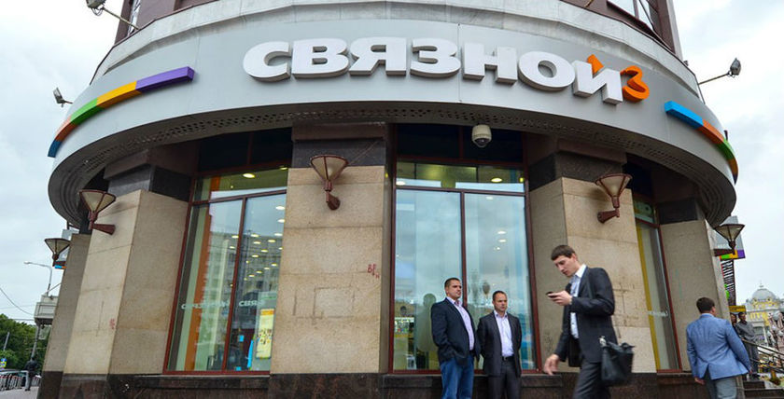
Pioneers of hyper-convergence adoption

Slide 7
The Agenda
A brief History of Storage
Hyper-Convergence
Three phases of Data Center Evolution
Conclusion. The software defines it all. And it always did.

Slide 8
1: A brief history of storage

Slide 9
Dell+Nutanix
OEM agreement
(Dell XC)
Disclaimer:
non of these slides represent Dell’s view. Dell’s official position and views on the matter might be completely different. Further provided information is a private subjective opinion, showing someone’s unique view and way of thinking...
RAID
VMware GSX & ESX
EMC Symmetrix
The first array-based replication
The first 1TB-array
The first platform independent storage
(Mainframe + Open Systems)
Market to support
the HCA hype:
VCE VxRail
VMware VSAN 6.2
Cisco HyperFlex
HPE CSA
Intel x86 in Symm
Storage Federation
Nutanix
HDS focused
on storage arrays
1987
1990
1994-95
2000
2001
2009
2014
2016

Slide 10
Dell+Nutanix
OEM agreement
(Dell XC)
…and that’s why it might be interesting for you. This information intents to be a food for thoughts rather then a “single source of truth”
RAID
VMware GSX & ESX
EMC Symmetrix
The first array-based replication
The first 1TB-array
The first platform independent storage
(Mainframe + Open Systems)
Market to support
the HCA hype:
VCE VxRail
VMware VSAN 6.2
Cisco HyperFlex
HPE CSA
Intel x86 in Symm
Storage Federation
Nutanix
HDS focused
on storage arrays
1987
1990
1994-95
2000
2001
2009
2014
2016

Slide 11
Dell+Nutanix
OEM agreement
(Dell XC)
RAID
VMware GSX & ESX
EMC Symmetrix
The first array-based replication
The first 1TB-array
The first platform independent storage
(Mainframe + Open Systems)
Market to support
the HCA hype:
VCE VxRail
VMware VSAN 6.2
Cisco HyperFlex
HPE CSA
Intel x86 in Symm
Storage Federation
Nutanix
HDS focused
on storage arrays
1987
1990
1994-95
2000
2001
2009
2014
2016

Slide 12
Dell+Nutanix
OEM agreement
(Dell XC)
RAID
VMware GSX & ESX
EMC Symmetrix
The first array-based replication
The first 1TB-array
The first platform independent storage
(Mainframe + Open Systems)
Market to support
the HCA hype:
VCE VxRail
VMware VSAN 6.2
Cisco HyperFlex
HPE CSA
Intel x86 in Symm
Storage Federation
Nutanix
HDS focused
on storage arrays
1987
1990
1994-95
2000
2001
2009
2014
2016

Slide 13
Dell+Nutanix
OEM agreement
(Dell XC)
RAID
VMware GSX & ESX
EMC Symmetrix
The first array-based replication
The first 1TB-array
The first platform independent storage
(Mainframe + Open Systems)
Market to support
the HCA hype:
VCE VxRail
VMware VSAN 6.2
Cisco HyperFlex
HPE CSA
Intel x86 in Symm
Storage Federation
Nutanix
HDS focused
on storage arrays
1987
1990
1994-95
2000
2001
2009
2014
2016

Slide 14
Dell+Nutanix
OEM agreement
(Dell XC)
RAID
VMware GSX & ESX
EMC Symmetrix
The first array-based replication
The first 1TB-array
The first platform independent storage
(Mainframe + Open Systems)
Market to support
the HCA hype:
VCE VxRail
VMware VSAN 6.2
Cisco HyperFlex
HPE CSA
Intel x86 in Symm
Storage Federation
Nutanix
HDS focused
on storage arrays
1987
1990
1994-95
2000
2001
2009
2014
2016

Slide 15
Dell+Nutanix
OEM agreement
(Dell XC)
RAID
VMware GSX & ESX
EMC Symmetrix
The first array-based replication
The first 1TB-array
The first platform independent storage
(Mainframe + Open Systems)
Market to support
the HCA hype:
VCE VxRail
VMware VSAN 6.2
Cisco HyperFlex
HPE CSA
Intel x86 in Symm
Storage Federation
Nutanix
HDS focused
on storage arrays
1987
1990
1994-95
2000
2001
2009
2014
2016

Slide 16
Dell+Nutanix
OEM agreement
(Dell XC)
RAID
VMware GSX & ESX
EMC Symmetrix
The first array-based replication
The first 1TB-array
The first platform independent storage
(Mainframe + Open Systems)
Market to support
the HCA hype:
VCE VxRail
VMware VSAN 6.2
Cisco HyperFlex
HPE CSA
Intel x86 in Symm
Storage Federation
Nutanix
HDS focused
on storage arrays
1987
1990
1994-95
2000
2001
2009
2014
2016

Slide 17
Dell+Nutanix
OEM agreement
(Dell XC)
RAID
VMware GSX & ESX
EMC Symmetrix
The first array-based replication
The first 1TB-array
The first platform independent storage
(Mainframe + Open Systems)
Market to support
the HCA hype:
VCE VxRail
VMware VSAN 6.2
Cisco HyperFlex
HPE CSA
Intel x86 in Symm
Storage Federation
Nutanix
HDS focused
on storage arrays
1987
1990
1994-95
2000
2001
2009
2014
2016

Slide 18
Dell+Nutanix
OEM agreement
(Dell XC)
RAID
VMware GSX & ESX
EMC Symmetrix
The first array-based replication
The first 1TB-array
The first platform independent storage
(Mainframe + Open Systems)
Market to support
the HCA hype:
VCE VxRail
VMware VSAN 6.2
Cisco HyperFlex
HPE CSA
Intel x86 in Symm
Storage Federation
Nutanix
HDS focused
on storage arrays
1987
1990
1994-95
2000
2001
2009
2014
2016

Slide 19
2: Hyper-Converged Infrastructure (HCI)

Slide 20
All-in-One micro Data Center
2U
4 servers
24 drives (4 x 6) redundant, virtual, distributed storage
Built-in Backup, Dedup, Replication, Metro-Cluster, File
Scales out linearly from 1 appliance (HCA) up to thousands of nodes (virtually no limit)

Slide 21
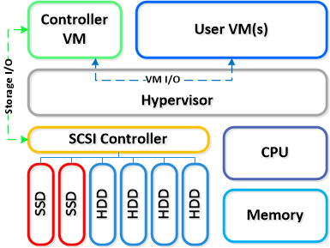
Single Hyper-Converged Node
Single Node

Slide 22
Single Hyper-Converged Node
CVM (control VM)

Slide 23
Scale-Out Architecture

Slide 24
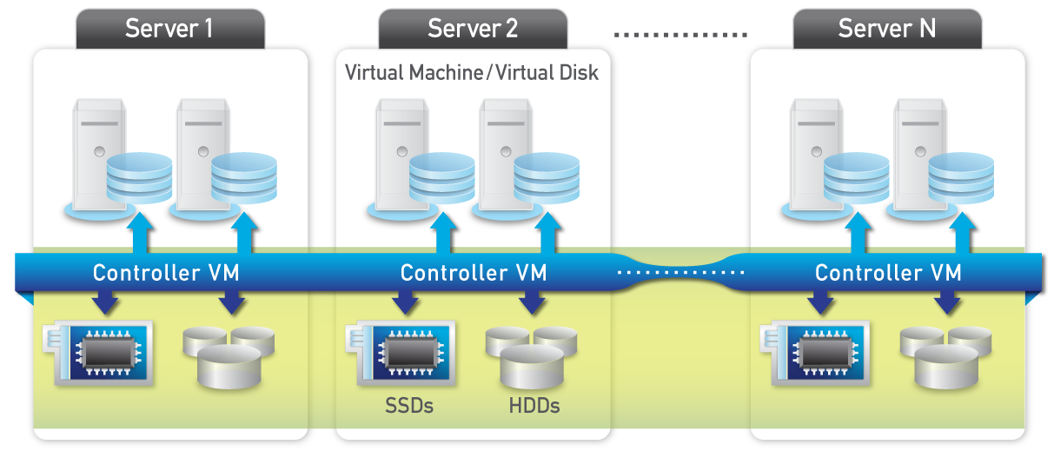
Scale-Out Architecture
Virtual Storage Control
Virtual Storage Control
Flash
HDD

Slide 25
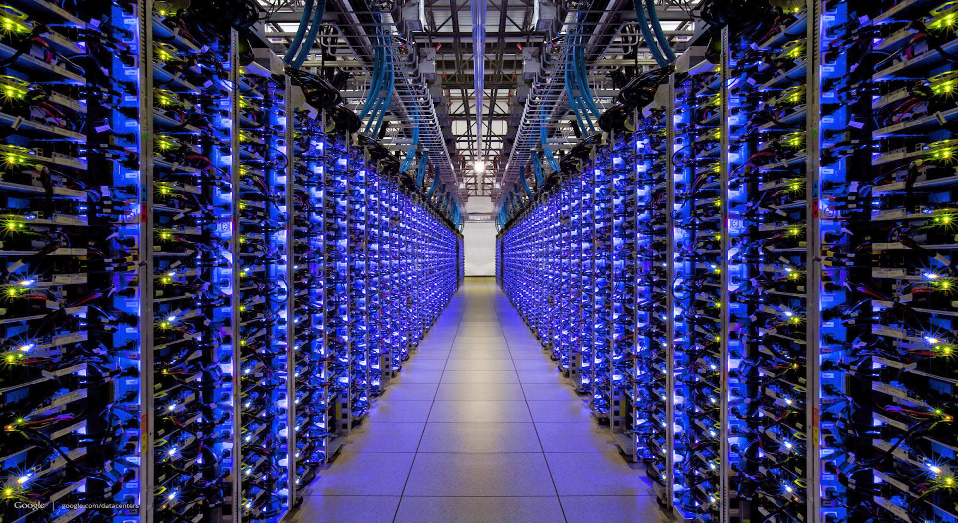

Slide 26
3: three phases of data center evolution

Slide 27
Discretization
Distributed Apps
Cloud-Native
Dell+Nutanix
OEM agreement
(Dell XC)
RAID
VMware GSX & ESX
EMC Symmetrix
Federation
Private Cloud
The first array-based replication
The first 1TB-array
The first platform independent storage
(Mainframe + Open Systems)
Market to support
the HCA hype:
VCE VxRail
VMware VSAN 6.2
Cisco HyperFlex
HPE CSA
Direct Attached Storage
Consolidation:
Storage Area Network, Network Attached Storage
Data Consolidation, Data Protection,
Concentrated workloads
Intel x86 in Symm
Storage Federation
Nutanix
HDS focused
on storage arrays
1987
1990
1994-95
2000
2001
2009
2014
2016

Slide 28
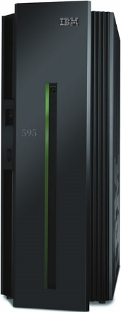
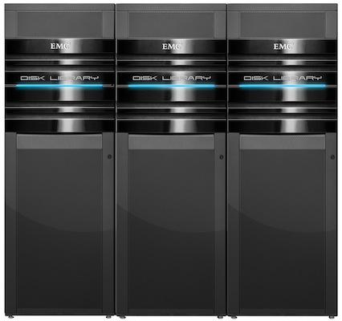
Phase 1: Consolidation
Monolithic systems
Scales “vertically”
Quite expensive
Great for consolidated workloads
Great for “Unparalleled” workloads

Slide 29
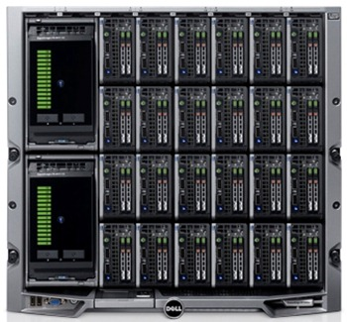
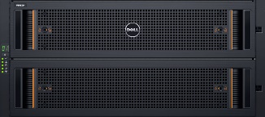
Phase 2: Federation
Data Center consists of individual “Blocks”
Data Center scales-out horizontally
Provides exceptionally high level of availability (99.9990% – 99.9999%)
Main application fields are still from consolidated to semi-distributed workloads and ordinary enterprise tasks

Slide 30
Phase 3: Discretization
Data Center consists of individual “Nodes”
Data Center scales-out horizontally
Great for distributed workloads

Slide 31
Conclusion

Slide 32
Software defines architecture
of IT infrastructure

Slide 33
In other words,
it’s always been defined by software

Slide 34
We just didn’t know it.

Slide 35
For sure,
the future is Software Defined
in one way or another.
As it has always been.

Slide 36
When you design your infrastructure,
analyse the nature of your application:
is it distributed or consolidated,
is it cloud-native or does it require a classic infrastructure.

Slide 37
More over, if you design an application,
keep in a mind that
shared-nothing, scale-out
infrastructures are already available as a mass-produced systems.
By doing so, you may save your company (or your country) a fortune!

Slide 38
fedor_pavlov@dell.com

