Slide 1


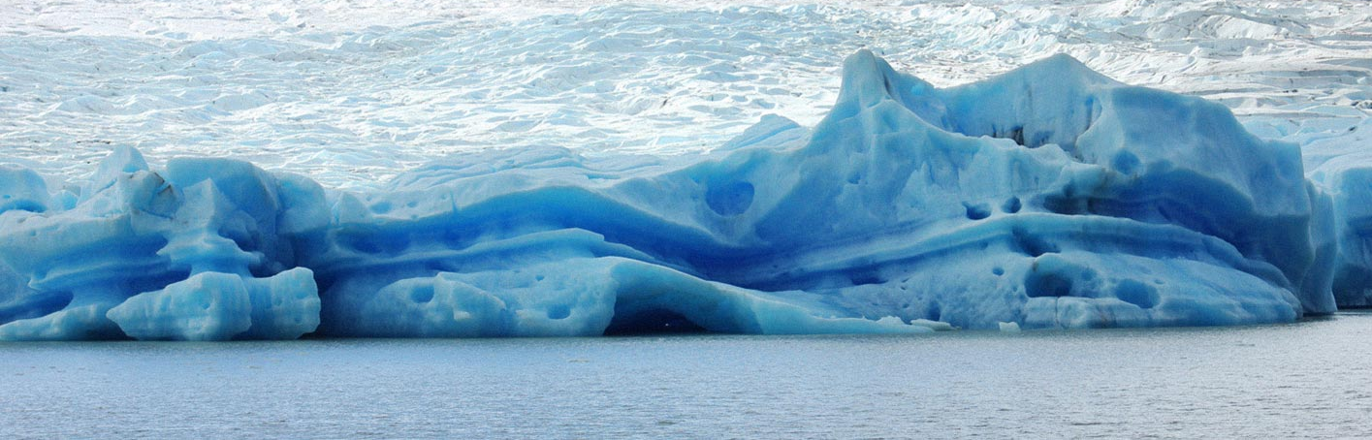
UTFSM/CCTVal Data Center
(10 Years of Experience)
Luís Salinas, Yuri Ivanov*
Universidad Técnica Federico Santa Maria, JINR*
Grid 2016, July 8
Page 1

Slide 2
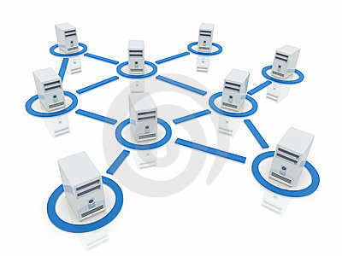

Outline
UTFSM and CCTVal
Research Projects
Data Center
  Brief history
  Current state
HPC computing
Grid computing
  Grid in Latin America
  EELA-UTFSM
Conclusions
◉
Notes:
Introducción
Computación de Alto Rendimiento
Proyectos principales
Computaciones in serie, paralela y GPU
Computación Grid
Conceptos
America Latina
Clúster UTFSM/CCTVal
Historia
Estado actual
Perspectivas

Slide 3
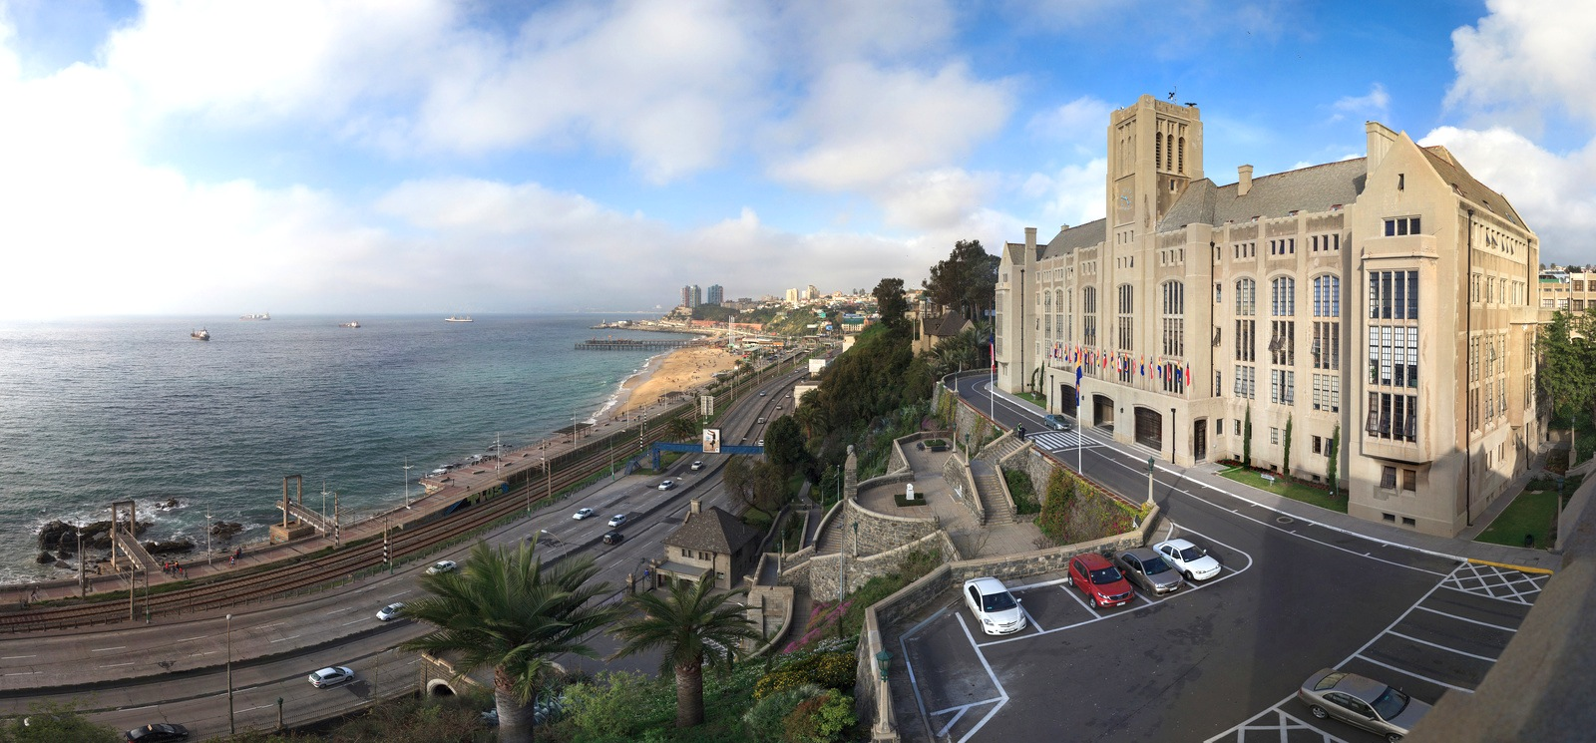

Universidad Técnica Federico Santa María
Since 1931 (according to will and testament of Federico Santa María, died 1926)
Five campuses in Chile and one en Ecuador
Focus on science and engineering
Master’s Degree in around 20 areas
PhD in Physics, Chemistry, Informatics, Electronics Engineering and Biotechnology
Hosts a number of Research Centers, including CCTVal
Notes:
The beginnings of Universidad Técnica Federico Santa María go back to the altruist dream of Federico Santa María, who set the foundation of the Institution in his will and testament in Paris, in 1920. He states his wish to contribute with the progress and increase the cultural horizon of our country to his executors. With these altruist ideas, he pursues to make easier the entrance to the academic life to the low-income compatriots whose merit, aptitudes and high school grades are excellent.
One year after his death on April 27th, 1926, the Foundation under his name is created and an Academic Institution to procure an integral formation of its students was implemented. These should assure academic excellence in the professional, scientific and human education based not only on universal values of man but also on social responsibility. Thus, his dream becomes an earnest testimony of the benefactor`s philanthropy.

Slide 4
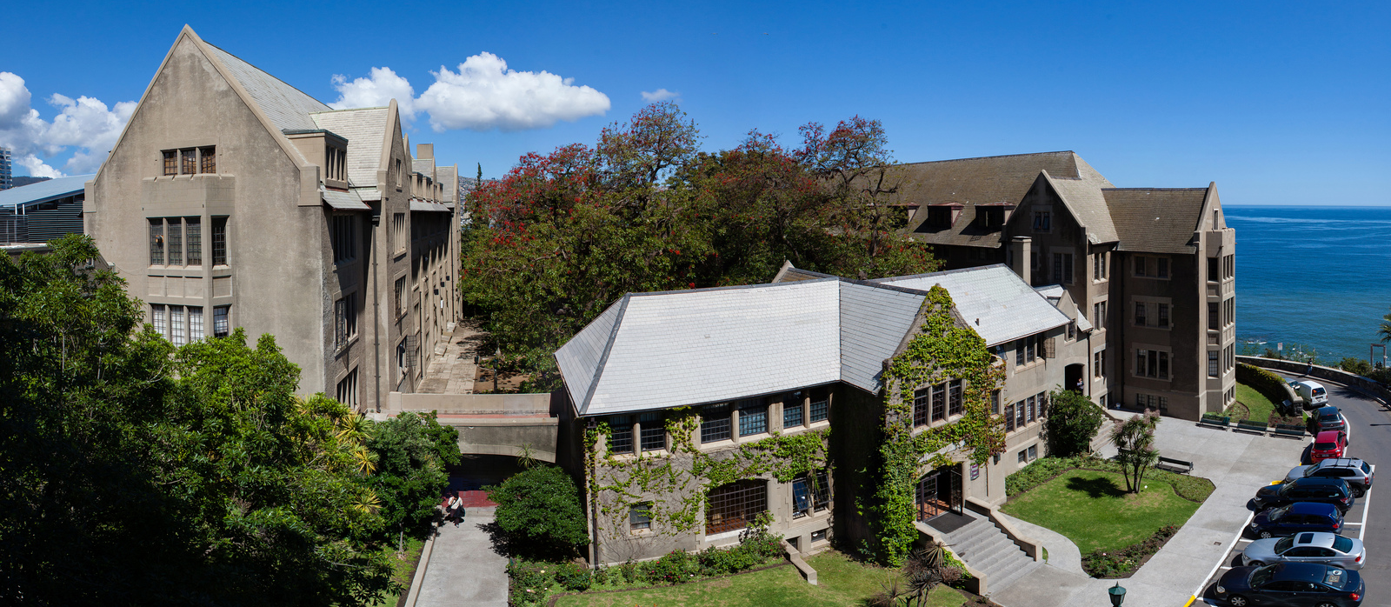
Centro Científico Tecnológico de Valparaíso
CCTVal (Scientific and Technological Centre of Valparaiso) was created and acknowledged by CONICYT (Comisión Nacional de Investigación Científica y Tecnológica - Commission for Scientific and Technological Research) through its backing with the Basal Financing program as a Scientific and Technological Centre of Excellence. The main research groups are: Theoretical Particle Physics, Experimental High Energy Physics, Informatics and Electronics.

Slide 5
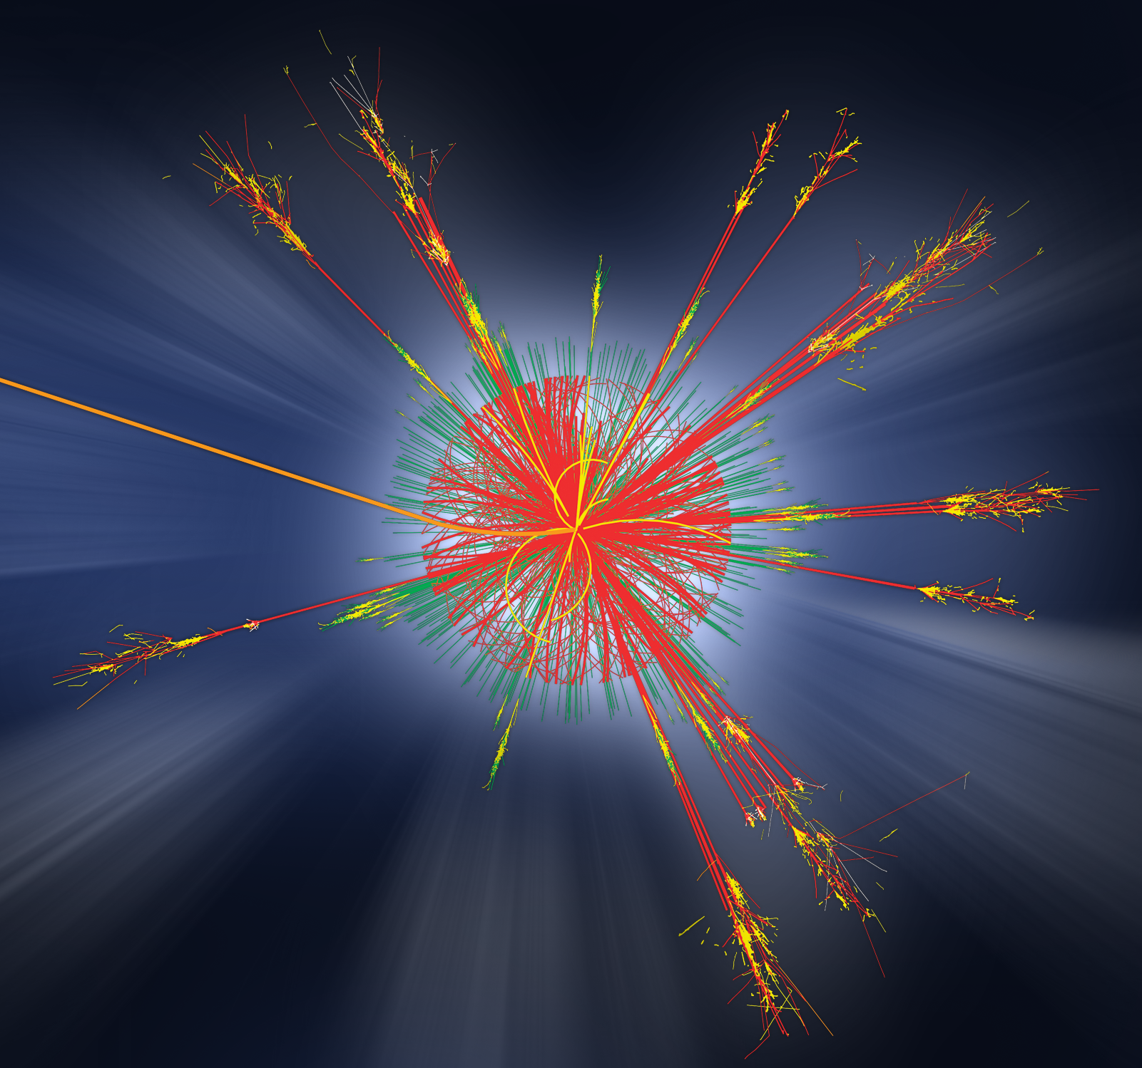
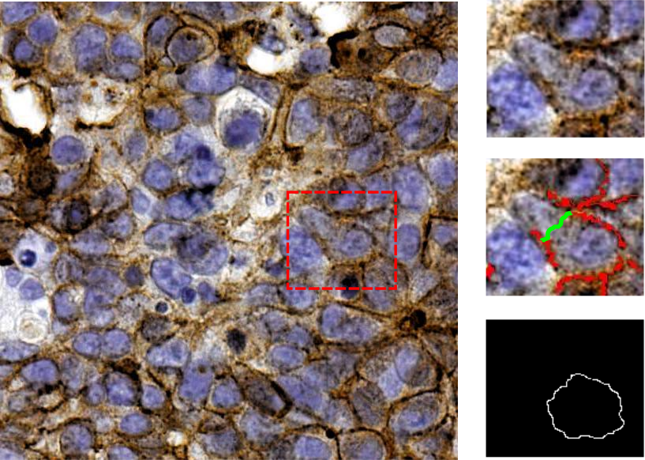
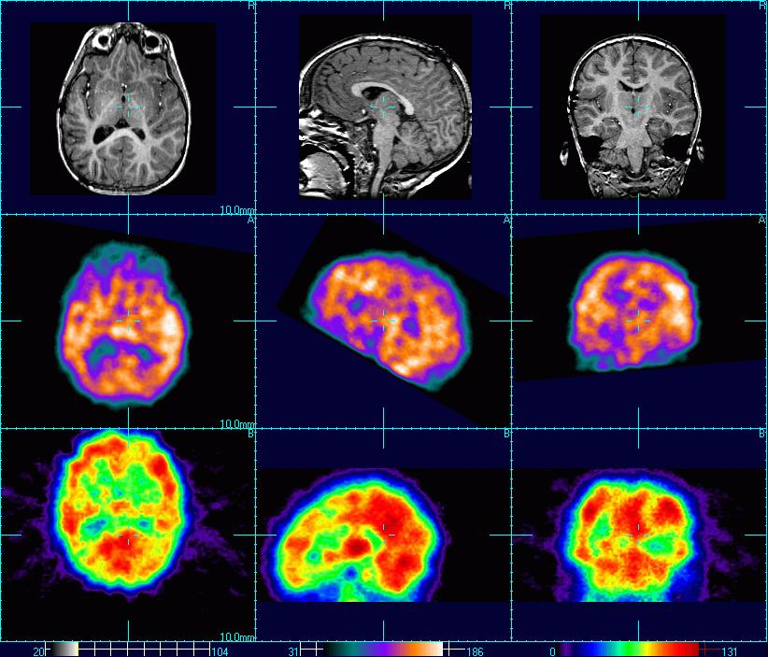
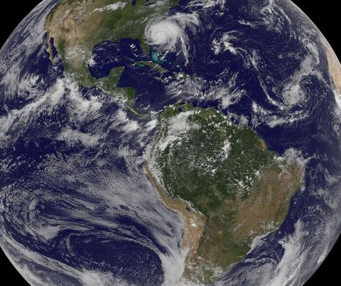
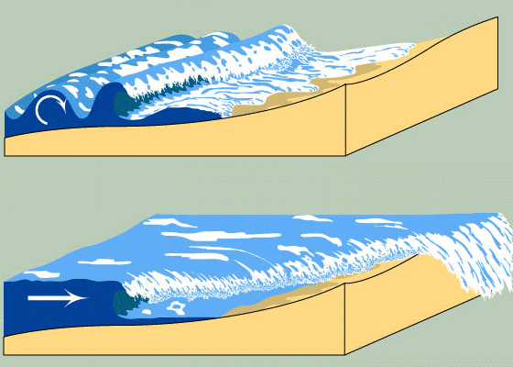
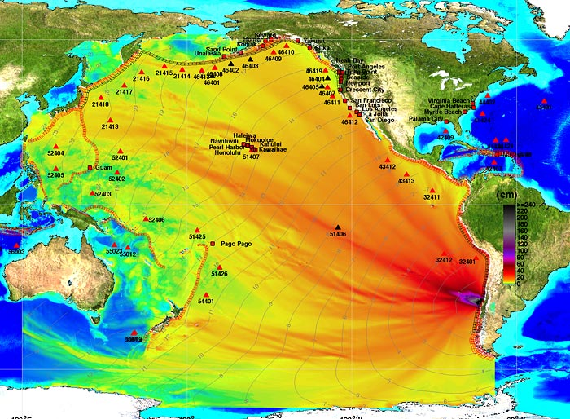
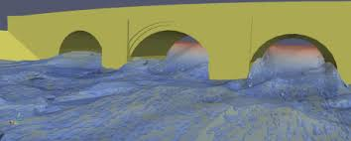
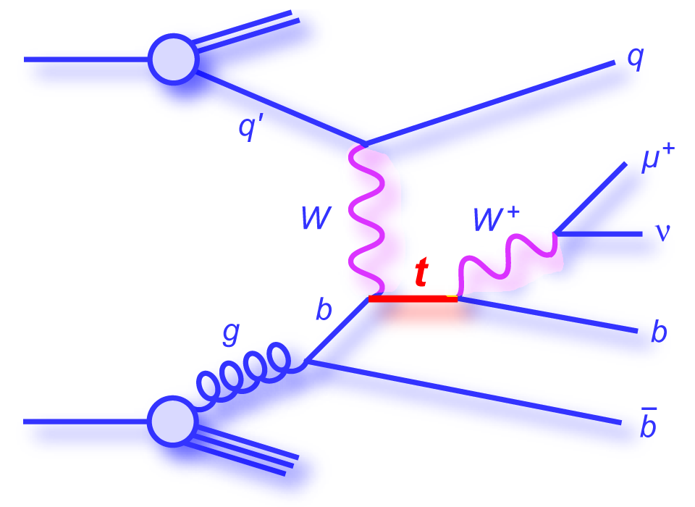
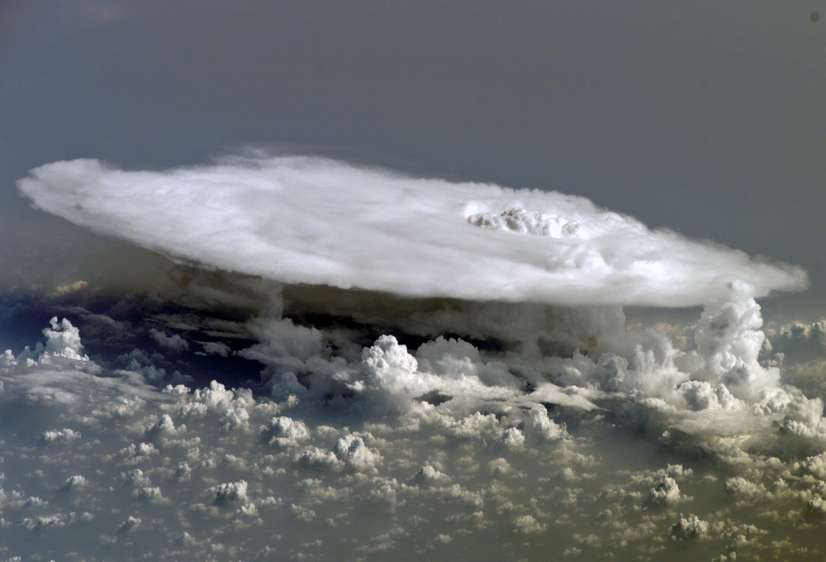
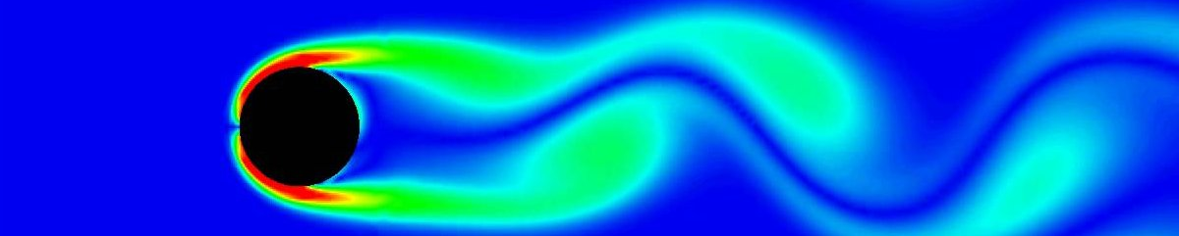
Research Projects
Research projects: UTFSM and other Chilean universities
(U. of Chile, U. La Frontera, U. Santiago de Chile):
Computations in High Energy and Particle physics, including ATLAS analysis
Biomedical image processing (Digital Pathology on breast cancer etc.)
Satellite image processing for Environment protection
Modeling of mechanical constructions (turbulent flow around bridge piers etc.)
Tsunami project: modeling of tsunami hydrodynamics, implementation
of an operational database integrated with the National Tsunami system

Slide 6
Brief History
2006 EELA cluster: 40 CPU cores 1.6GHz, 2TB
2008 Mostly local users, Grid tests
2009 EELA-2, WLCG Tier-3
2011 HPC cluster: 250 cores, 15TB
2012 HPC cluster: 500 cores, 200TB, ATLAS Production
2013 HPC cluster: ATLAS Analysis, WLCG Tier-2
2014 HPC cluster: GPU (Tsunami), NLHPC
2016 HPC cluster: 800 cores, 300TB, 10Gbps internal

Slide 7
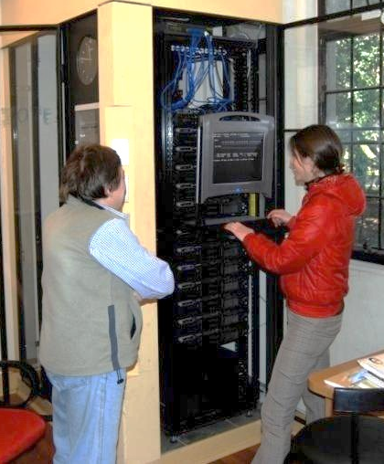
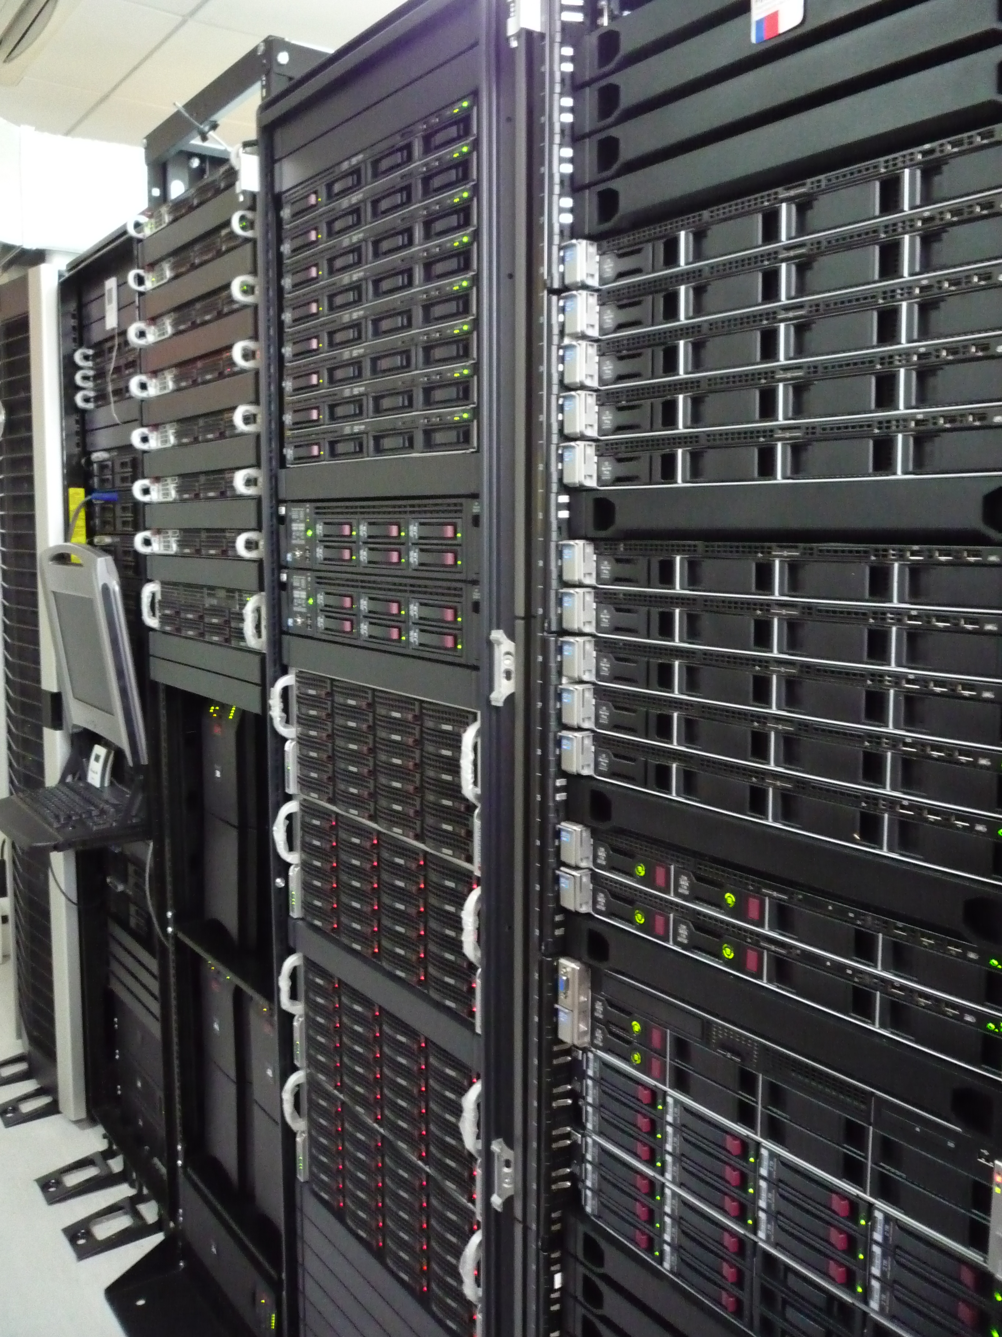
Cluster Evolution
2007
2014
CPU: 40 Cores 1.6 GHz (DELL)
Disk: 2 TB
CPU: ~ 800 Cores 2.8-3.1 GHz (DELL, HP)
Disk: ~ 300 TB (DELL, HP, Supermicro)
GPU: nVidia (C1060, M2050, K20m)

Slide 8
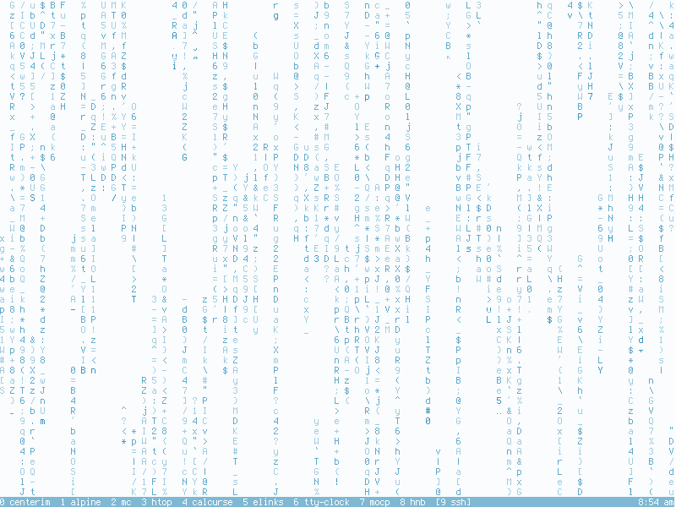
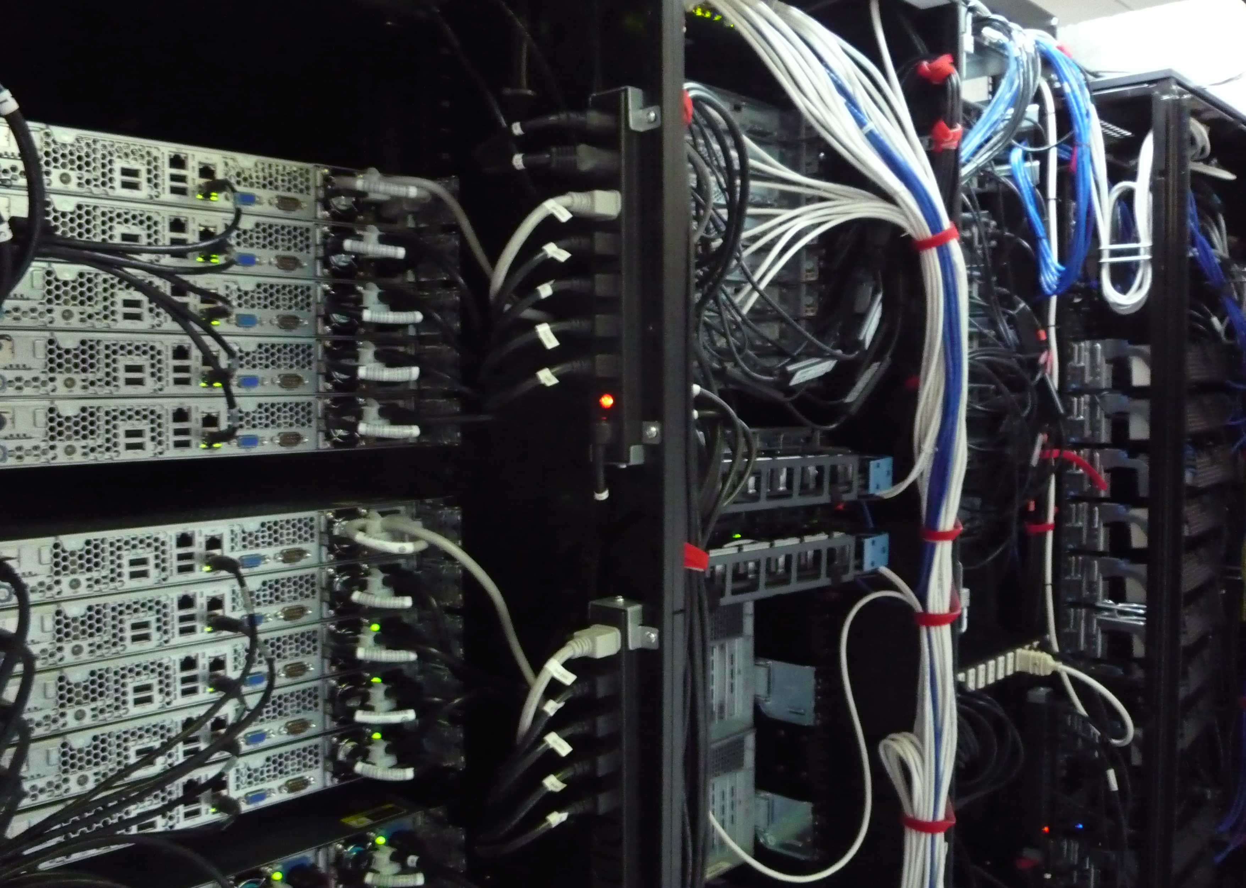
Cluster Layout
“Real” and “Virtual” (KVM, OpenVZ)
Infrastructure
Net: DNS, Proxy, perfSONAR
Info: APEL, Site BDII
Auth: Kerberos, LDAP, ARGUS
Services: Mail, SVN, Web
Compute
User
WN (wn01..wn34)
UI (ui01..ui04)
Batch: PBS, CE
GPU (gp01..gp09)
Storage
FS (fs01..fs09): NFS, ZFS, Gluster
CernVM-FS
SE (se+sp01..sp05): dCache (GridFTP, SRM, WebDAV, xrootd )

Slide 9
HPC Computing
Hardware:
  Hundreds of CPU and enough memory per core
  Big Storage (100 TB and more)
  High speed internal and good external network
Software:
  Compilers: C/C++, FORTRAN, Python, …
  Packages: GEANT, OpenFOAM, Pythia, ROOT, …
  Parallel code: MPI (MPICH, OpenMPI)
  GPU programming: nVidia CUDA
  Operating System (RHEL compatible)

Slide 10
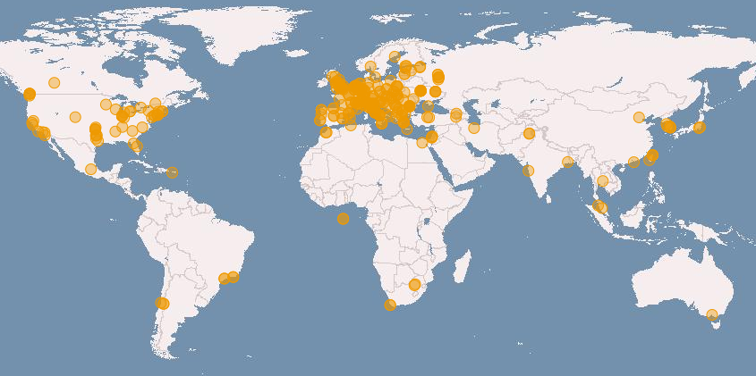
Grid in Latin America
Specificity of Latin American Grid:
Low “density” of sites, no NGIs
Most of sites dedicated only to one experiment or project
Network: far from major computer centers, low external bandwidth
Gstat 2016

Slide 11
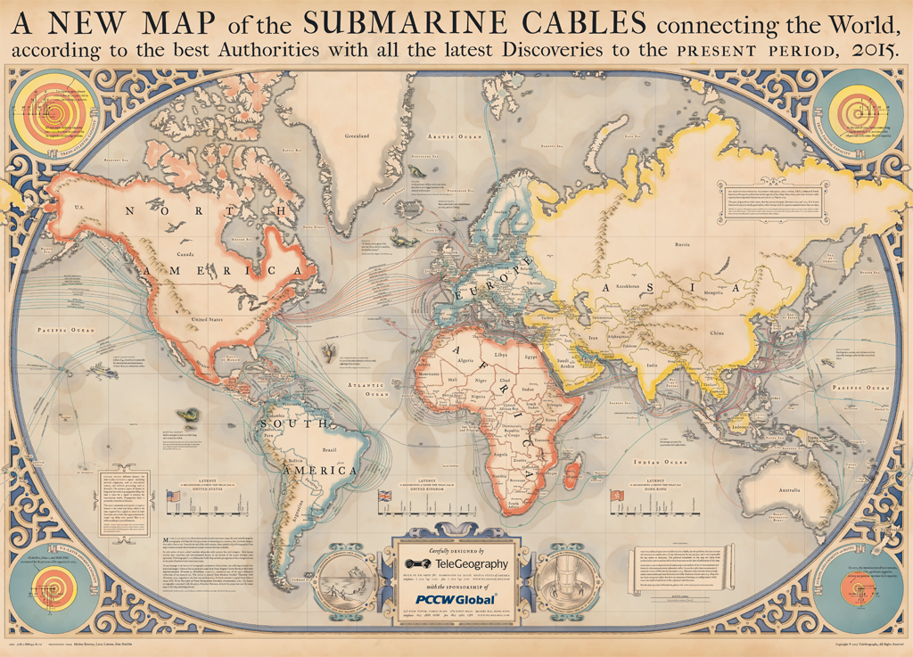
Network cables

Slide 12

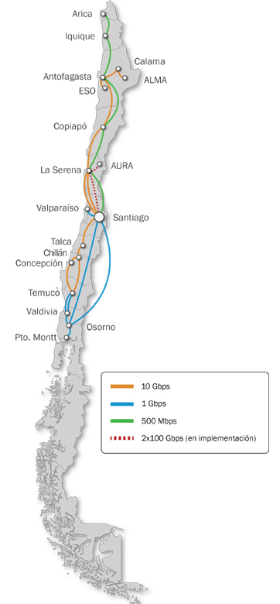
Red CLARA, REUNA
100 + 50 Mbps only!
RedCLARA - Cooperación Latino Americana de Redes Avanzadas (since 2003). Established for regional interconnection and linked to GEANT2 in 2004 via the ALICE Project. Provides regional interconnection and connection to the world through its international links to GEANT2and Internet2 (USA) and, through them, to the advanced networks of the Caribbean (C@ribnet), Asia (APAN, TEIN), among others. Thanks to the ALICE2 Project, between December 2008 and March 2012, RedCLARA could significantly improve the capacity of its network and expand its benefits for its members and regional research communities.

Slide 13
Brief History of Grid in Latin America
2004-2008: Early years
  Standalone: CBPF, UNIANDES (CERN catch-all ROC); SPRACE (OSG)…
  EELA (E-infrastructure shared between Europe and Latin America)
2009-2010: Rising
  EELA-2: EU (CIEMAT, LIP) + LA (UFRJ, EELA-UNLP, EELA-UTFSM, …)
  ROC-LA: CBPF, ICN-UNAM, SAMPA, UNIANDES, EELA-UTFSM
  ROC-IGALC (mostly non LHC projects): CEFET-RJ, UFRJ, …
2011-2016: Production
  GISELA (successor of EELA, EELA-2): sites from ROC-LA and ROC-IGALC
  ROC-LA: LHC (ALICE, ATLAS, LHCb)
  Tier-2 Latin America Federation

Slide 14


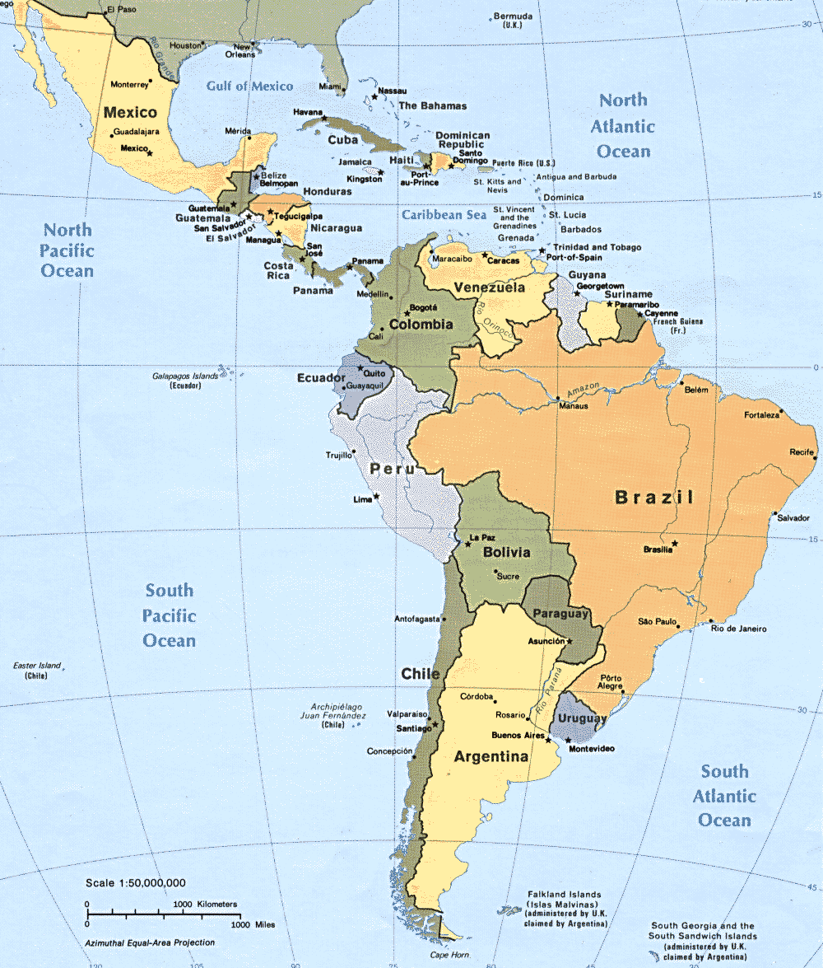
Tier-2 Latin-American Federation
Site Name | Logical CPU | HEP SPEC06 | Disk (TB)
CBPF (ALICE, LHCb) | 536 | 10400 | 200
EELA-UTFSM (ATLAS) | 384 | 4400 | 190
ICN-UNAM (ALICE) | 856 | 9000 | 1600
SAMPA (ALICE, LHCb) | 2400 | 28800 | 90
UERJ (CMS) | 600 | 4800 | > 1
The MoU between Centro Latinoamericano de Física (CLAF) and WLCG has been signed 10 September 2013. CLAF is an international organization aimed to promote and coordinate efforts in development of physics in Latin America (Argentina, Brazil, Colombia, Chile and many others). CLAF maintains special relations with many other international organizations (CERN, JINR, etc.). CLAF will work as an “umbrella” to all ROC-LA sites. The financing is coming from the hosting institutions, not from central sources.

Slide 15
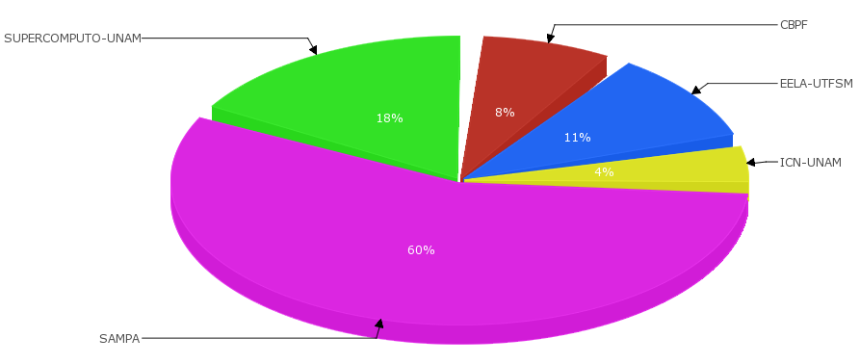
EGI Accounting
Normalized CPU time for ROC-LA sites (January - June 2016)

Slide 16
Conclusions
Installation/configuration stage:
Proper hardware: servers (computing, storage), network etc.
Location, backup power lines, cooling systems etc.
Software: OS (RHEL 3..7, Ubuntu?), packages, services etc.
Maintenance stage:
Regular replacement/reparation (hard drives, UPS batteries, etc.)
Regular hardware and software updates and new installations
Reliable network channel: good ISP required!
Users support: web, tutorials, online etc.
Human resources (always):
Qualified personnel (Don’t know? We’ll train you!)
Some strong internal motivation to keep everything running…

Slide 17
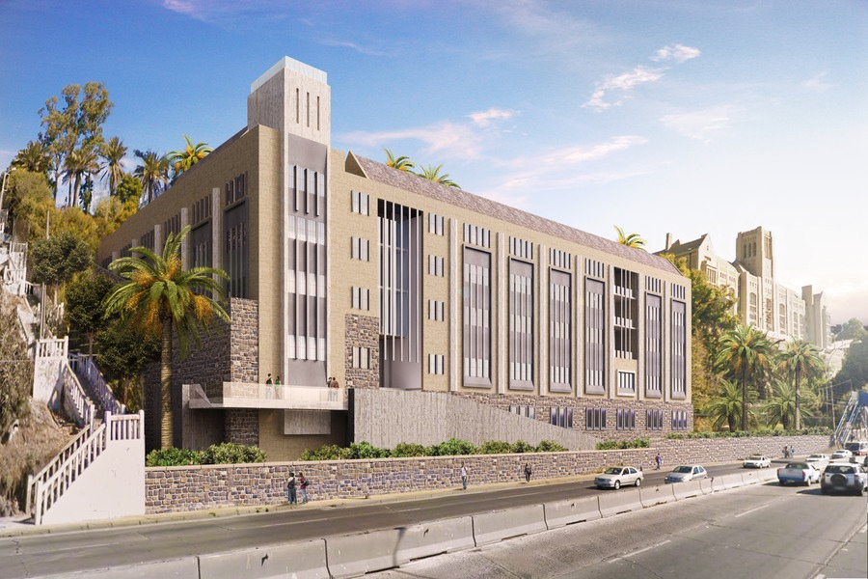
Thank you for your attention!

