Slide 1
Method of terminological system's formation
to determine the level of product development
Valeriya V. Danilova
NRNU MEPhI
The 7th International Conference "Distributed Computing and Grid-technologies in Science and Education" (GRID 2016)
Dubna
Москва 2016
Notes:
Good evening, dear listeners. Today I’d like to present you the report called “…”.

Slide 2
Analysis
Comparison
Model
Urgency:
The need for a unified approach to the identification of the level of product manufacturing development.
Notes:
Development of a competitive equipment with advanced technical characteristics requires a high level of scientific and technological progress, as well as an effective system of controlling the design and operation of advanced machinery during the entire period of its life cycle. To create such a system it is necessary to develop a unified approach to the identification of the development level of technologies and products. In this paper, a model to identify the level of product manufacturing was developed. To achieve this goal the standards of the United states Department of Defense and GOST R 56135-2014 were analyzed.

Slide 3
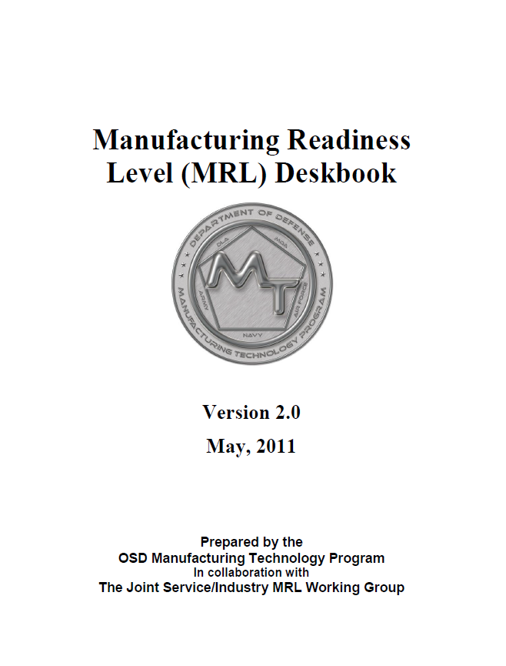
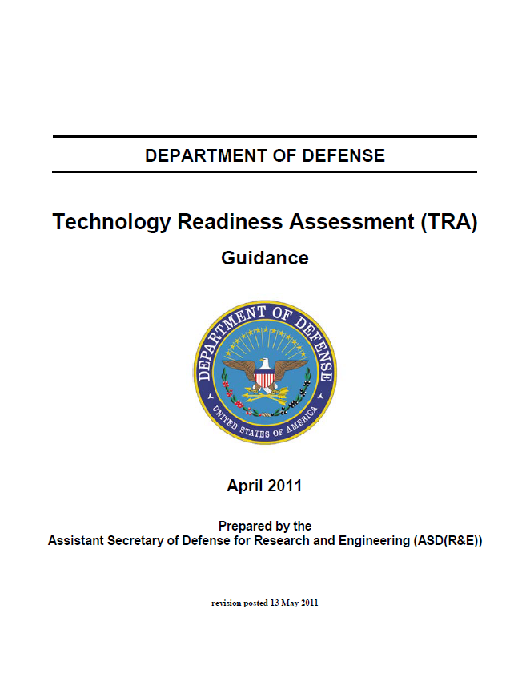
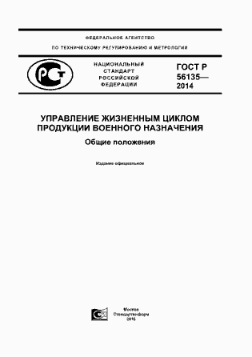
Analysis of Russian and American standards
«Manufacturing readiness
level»
Approved in 2011;
Developed under the aegis of Manufacturing technology program (ManTech)
«Technology readiness
level»
Approved in 2011;
Developed by NASA
Evaluation of the projects’ effectiveness to address the problems of budget overruns
GOST
«Product lifecycle management»
Approved in 2014;
Developed by scientific research center «Прикладная Логистика»
Notes:
In order to achieve the goal and to create a quality model, it is necessary to conduct a comparative analysis of three standards: two American and one Russian.
Американские стандарты были утверждены в 2011 году, УГТ был разработан NASA, для УГП - Программы разработки производственной технологии МО США. ГОСТ был разработан by scientific research center «Прикладная Логистика».
It is important to note that American standards was developed in order to evaluate the project effectiveness to address the problems of budget overruns.

Slide 4
Notes:
American standards are used by a wide range of companies, for example, DARPA, Boeing, Lockheed Martin
In this slide you can see the adaptation of the TRL in NASA.
In total there are 9 levels of technology readiness that characterize the basic research and initial development of devices (in this case, the Chevron nozzle with noise reduction), testing and verification, and final implementation of product into production. Through this example it became obvious that the first stages have lasted much further in comparison with the direct development of the prototype.

Slide 5
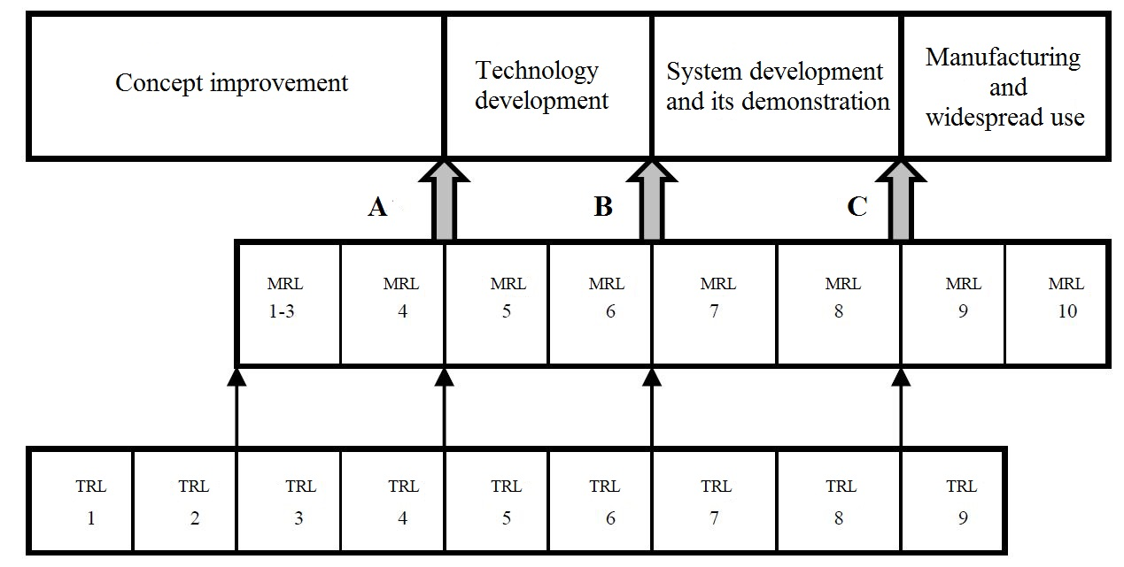
Relationship of the technology and manufacturing readiness levels
!
The best practice – advanced development of technology towards product development
Notes:
Speaking of American standards, TRL and MRL approaches are connected with each other and subordinated to a common goal – the successful establishment of competitive high-tech products.
These systems should be optimally coordinated in time.
For example, if the current MRL estimate is much ahead of TRL, this could lead to the launch of raw, insufficiently mature technology that will lead to loss of investment.
But if the current estimate of TRL is too much ahead of MRL, it could lead to the launch of low quality production with a high price.
The optimal (most profitable) practice for the industry is a an advanced development of technology towards product development.
Говоря об американских стандартах, подходы УГТ и УГП взаимоувязаны друг с другом и подчинены общей цели – успешному созданию конкурентоспособной высокотехнологичной продукции.
Система УГП и УГТ должны быть оптимальным образом согласованы между собой во времени.
Например, если текущая оценка УГП сильно опережает УГТ, то это может привести к запуску в производство сырой, недостаточно зрелой технологии, что приведет к потере инвестиций.
Если же текущая оценка УГТ слишком сильно опережает УГП, то это может привести к запуску в производство продукции низкого качества по завышенной цене.
Оптимальной (наиболее выгодной) практикой для промышленности является немного опережающая разработка технологии по отношению к разработке продукта.

Slide 6
Distribution of the levels in the standards
1. Basic manufacturing implications identified
1. Technology advance development
2. Manufacturing Concepts Identified
3. Manufacturing Proof of Concept Developed
2. Sample concept formation
4. Capability to produce the technology in a laboratory
environment
3. Prototype development
5. Capability to produce prototype components in a production
relevant environment
4. Manufacturing
6. Capability to produce a prototype system in a
production relevant environment
5. Exploitation
7. Capability to produce systems or components
in a production representative environment
6. Capital repair
8. Pilot line capability demonstrated
7. Utilization
9. Capability in place to
begin Full Rate Production
10. Full Rate Production demonstrated and lean production
practices in place
Notes:
In order to create an optimal model for determining the level of product development it is needed to make a comparison of the approaches taken in the United States and Russia. In the left column you can see the American approach, in the right – Russian one.
During the comparison the following similarities were identified:
Identification of the risks of the product manufacturing and technology development occurs in the early stage (УГТ 1-4 и УГП 1-4 и Уровни 1-2);
Уровню 3 which is “Prototype development” of Russian standard is similar to the levels УГП3-УГП8 (УГТ3-УГТ7);
But there is a significant difference: Russian standard provides the possibility of a capital repair and utilization, whereas American standards do not imply these stages of product development.

Slide 7
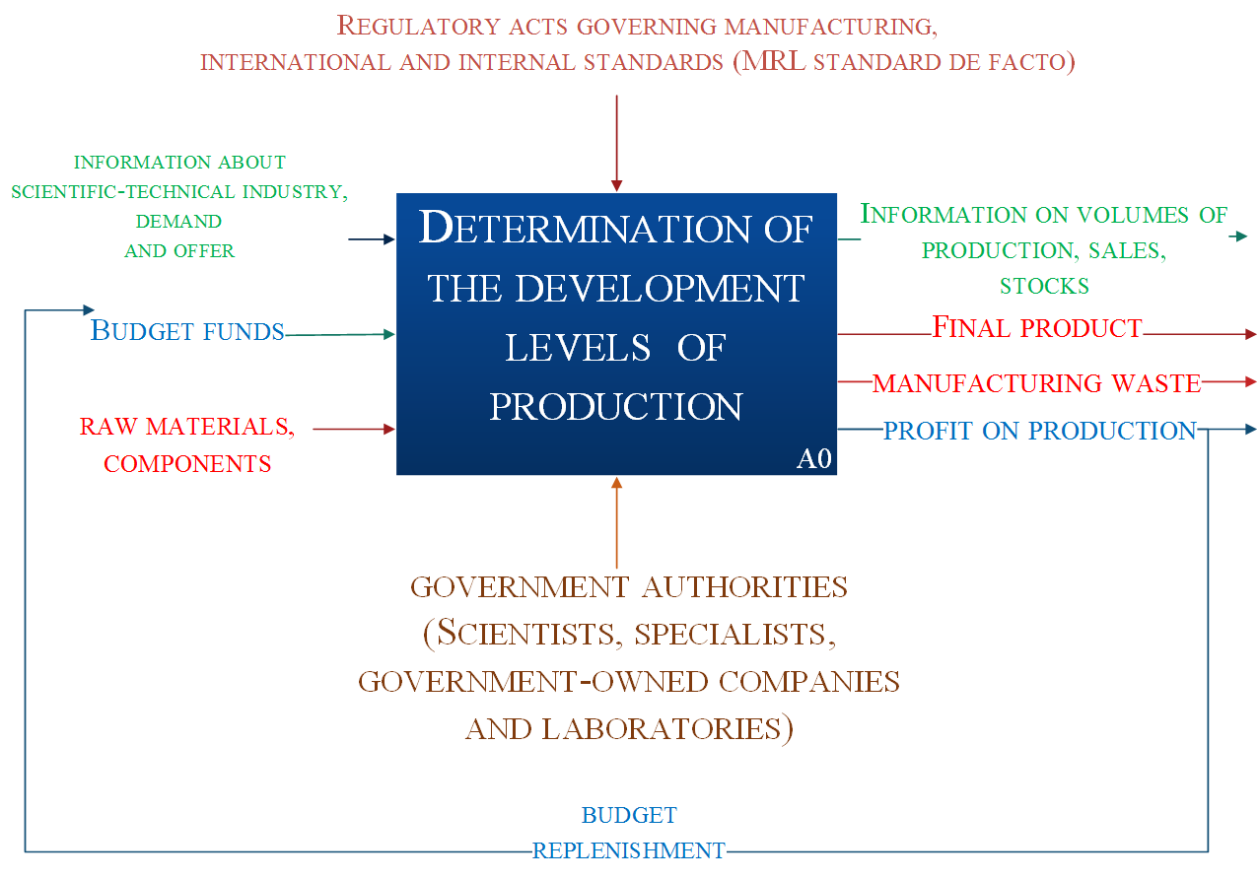
Model of determining the level of product development
Notes:
A detailed consideration and comparison of all levels helped to create a detailed model of the level of development of production to identify a set of attributes that define the moment of transition to the next stage.
To create the model were based on take levels used in the standard MO USA, as they are described in more detail the stages of production.
This slide presents a general model. At the entrance it needs to have information about the state of the n-t sector.., the budget of the U.S. DoD, as well as raw material components. The output is (по слайду). The control mechanism is de-facto the MRL, and the Supervisory authorities are the competent authorities and structure MO USA

Slide 8
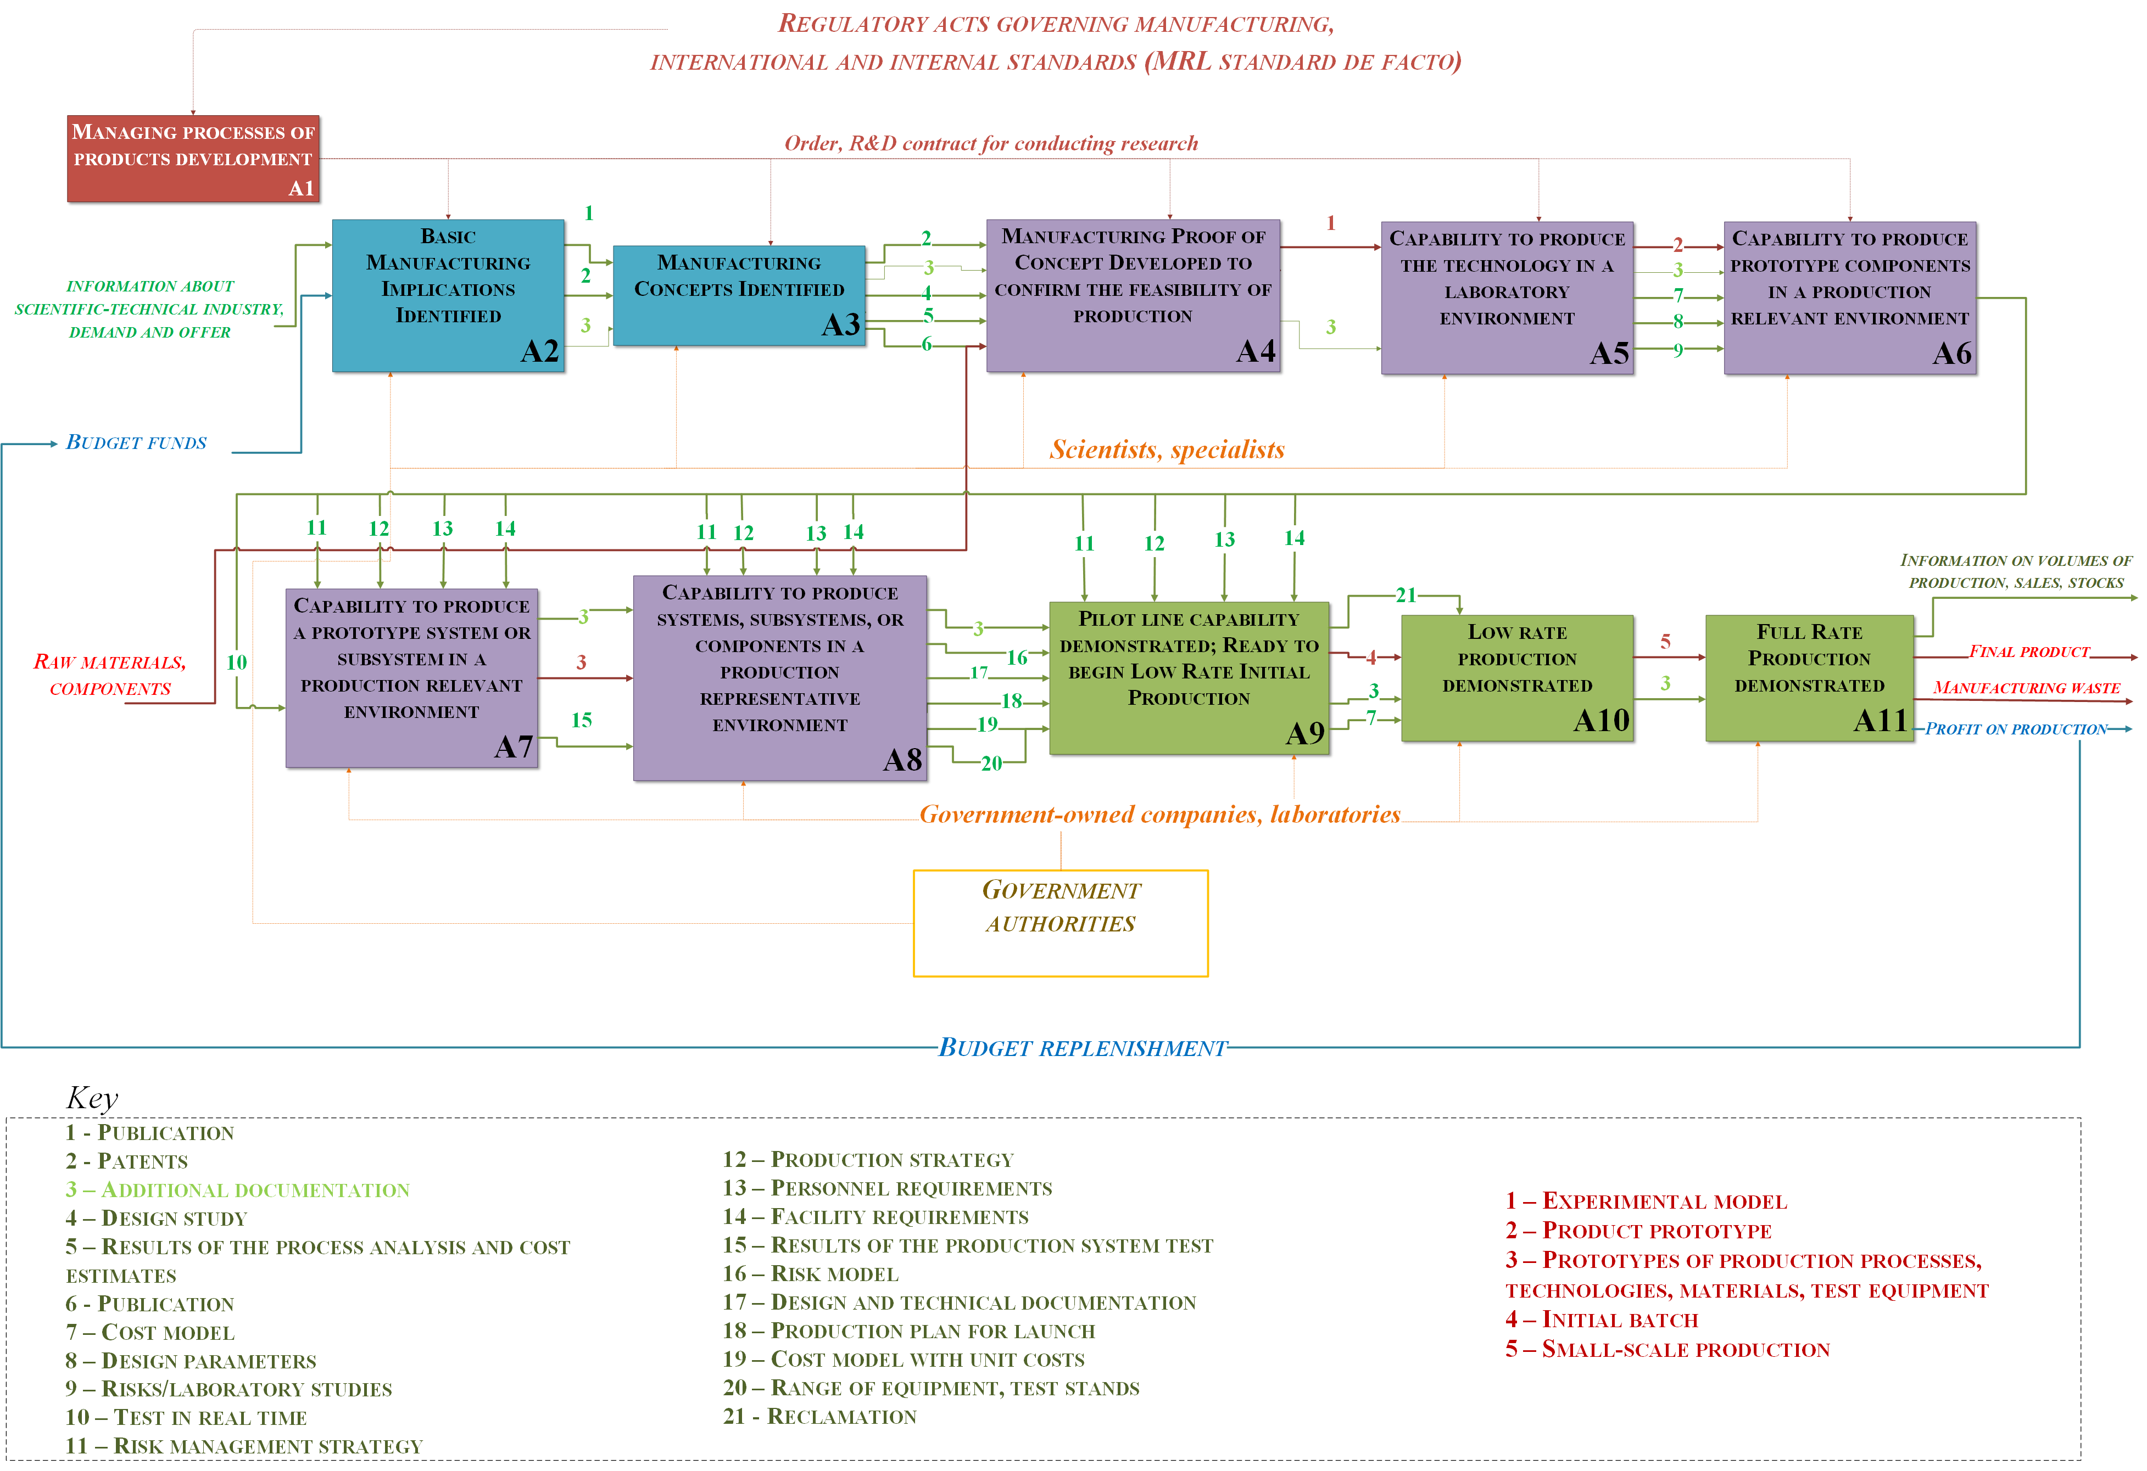
Notes:
This slide presents a detailed model
It is important to note that the process A1 “Managing processes of product development” is situated separately, because it has an impact on at least the first 6 levels of production. So, for example, working with DARPA projects, it became clear that orders and contracts for the development of a product have significant value, ranging from basic research to the development of the prototype. Participants win the tender contracts in the framework of the official competitions and begin the development of the products.
The main stages highlighted with three colors (blue, purple and green) and in the next slides I will tell more about all the levels.

Slide 9
Notes:
The blue color means the concept development phase of production, where output will be patents, publications, as well as the first results of the analysis of processes and evaluation of future costs and risks.

Slide 10
2 - Patents
3 – Additional documentation
4 – Design study
5 – Results of the process analysis and cost estimates
6 - Publication
7 – Cost model
8 – Design parameters
9 – Risks/laboratory studies
10 – Test in real time
11 – Risk management strategy
12 – Production strategy
13 – Personnel requirements
14 – Facility requirements
15 – Results of the production system test
16 – Risk model
17 – Design and technical documentation
18 – Production plan for launch
19 – Cost model with unit costs
20 – Range of equipment, test stands
1 – Experimental model
2 – Product prototype
3 – Prototypes of production processes, technologies, materials, test equipment
Notes:
Purple color highlights the development of the production system, which is tested in laboratory conditions and in realistic conditions. Produce all kinds of requirements to the equipment and personnel is also a risk assessment.

Slide 11
3 – Additional documentation7 - 7 – Cost model
11 – Risk management strategy
12 – Production strategy
13 – Personnel requirements
14 – Facility requirements
16 – Risk model
17 – Design and technical documentation
18 – Production plan for launch
19 – Cost model with unit costs
20 – Range of equipment, test stands
21 - Reclamation
4 – Initial batch
5 – Small-scale production
Notes:
Green color highlights the stages of preparation to launch small-scale and full rate production.

Slide 12
Conclusion
The use of standards allows to dynamically track the level of the technology or product manufacturing readiness and make a decision to the governing body on funding and conducting the next phase of development;
The analysis also showed significant differences in the approaches to the formation levels of the lifecycle of standards of Russia and the USA;
The results of this work will be further used in the development of a full-scale search system for information features of technologies and products on the Internet and databases with restricted access (LexisNexis, Web of Science etc.).
Notes:
To conclude, I would like to say that

Slide 13
Thank you for your attention!

