Slide 1
PAC for Nuclear Physics
April, 2019
Study of deep subcritical electronuclear systems and feasibility of their application for energy production and radioactive waste transmutation
S. Tyutyunnikov, A. A. Solnyskhin
Accelerator Driven Systems – still many challenges (nuclear data, models of spallation reactions, structural materials …)
Big steps in high-intensity accelerators, spallation targets (ESS project)
Important synergies with future spallation sources, fission and fusion systems

Slide 2
The Content
Introduction
Set up “Quinta” for research of deep subcritical system and it base tasks.
Main experimental methods producing by set up “Quinta” (only examples).
  Monitoring of input beam
  Activation techniques – high energy threshold reaction
  New type of detectors (track detectors, passive semiconductor detectors, breakdown structures diamond detectors)
  Thermomeasuring
The main results of experiments on setup "Quinta“
  increase hardness of the energy of the neutrons generated spectrum
  Significant discrepancy between experimental results and model calculations of the neutrons generated spectrum
  Spatial profile of neutron leakage
  Comparison of the energy characteristics of "Quinta" irradiation by deuterons and carbon
The main directions of the project "The quasi infinite target. Stage III. 2017-2019 ":
  Calculations of neutron leakage and energy efficiency
  Experimental investigations on LNP Phasotron, placement the assembly target “Big Uranium Target«
  Experimental research at the Nuclotron-M, power generation on setup "Quinta" on heavy ions.
  Work plan for 2017-2019 timeframe
Conclusion

Slide 3
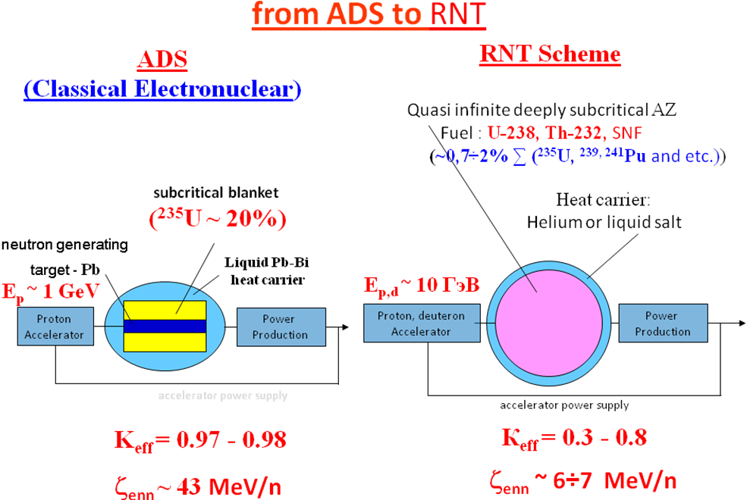
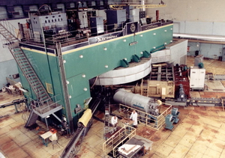
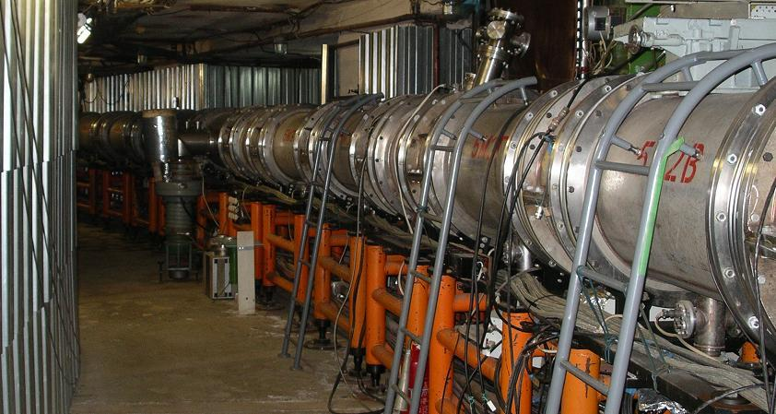
Introduction
JINR Dubna accelerators
ideal tools to test different schemes
Scheme of obtaining nuclear energy with the use of charged particles beams:
Classic electronuclear (ADS - Accelerator Driven Systems) scheme – proton accelerator (~ 1 GeV),
slightly subcritical active zone (project MYRRHA)
RNT (relativistic nuclear technology) - extremely hard neutron spectrum formed by beams
of relativistic particles ~ 10 GeV inside deeply subcritical, quasi infinite active zone.
Usage of heavier ions (~0,5 AGeV) – light element target core, relatively small target,

Slide 4
Basic experimental problems for setup "Quinta"
(Continuation of previous program with E+T set-up)
Determination of the energy spectrum of the neutrons generated in the uranium target with a beam of relativistic particles, a comparison of the experimental data with calculations based on different methods.
Determination of the spatial distribution of neutron leakage, their dependence on the energy of incident particles.
Measuring the energy yield from deeply subcritical assembly, its dependence on the energy of incident particles.
The study of transmutation of minor actinides by neutron spectrum generated in a deeply subcritical assembly.
Important methodical studies connected with beam monitoring
Main scientific goal: Accurate and reliable nuclear data – benchmark and
improvement of models and codes

Slide 5
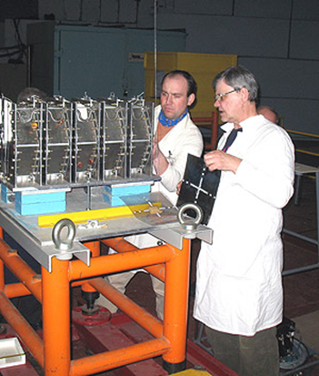
Not only scientific goals
International collaboration:
Russia, Czechia, Poland, Ukraine, Bulgaria, Belorussia, Armenia, Mongolia, Germany, India …
Nice possibility to obtain experience mainly for young people …
Diploma and PhD students education (Czechia):
Defended PhD (last ten years): A. Krása (2008), K. Katovský (2008), M. Majerle (2009), O. Svoboda (2011), L. Závorka (2015), J. Vrzalová (2016) and M. Suchopár (2017)
( + 3 PhD students from other countries)
Present PhD students: R. Vespalec, M. Zeman, P. Tichý, J. Svoboda
More diploma thesis and also student practice
Our previous students (not only Czech):
V. Henzl, L. Závorka – Los Alamos (USA)
A. Krása – SCK-Mol (Belgium)
V. Pronskikh – Fermilab (USA)
Harpool Kumawat – BARC (India)
Lukáš Závorka – one of Czech PhD students and QUINTA

Slide 6
The dependence of the power gain on energy in units of fission (division) numbers per 1 deuteron and 1 GeV.

Slide 7
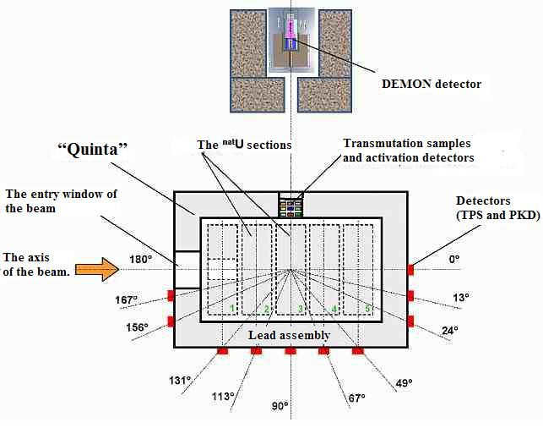
The scheme of leaking-neutron flow measuring with the TDC and PSD detectors and its energy spectra measuring with the DEMON detector. Top view. The detectors are located in the horizontal plane of the deuteron beam.

Slide 8
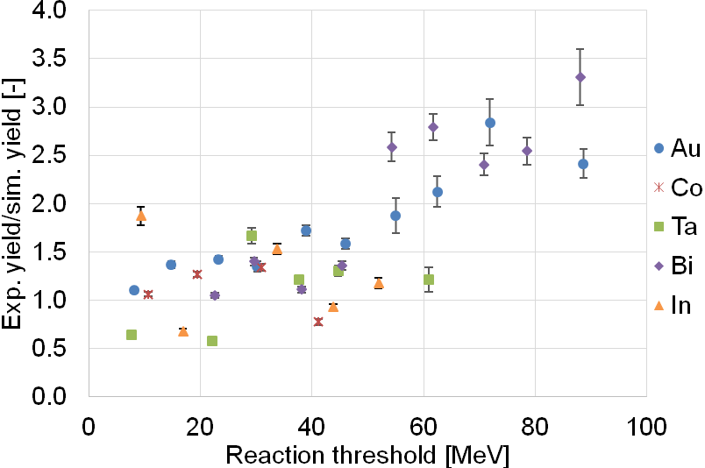
Benchmark of codes and models
MCNPX – up to 40 MeV nice description, higher energies discrepancies
E+T set-up, deuteron beam 4 GeV, extensive set of activation detectors
Average value of experimental to simulated yield ratios as a function of threshold energy (simulation - TALYS 1.6 and MCNPX v2.7 – INCL4.2 and ABLAv3)

Slide 9
Spectral characteristics of leakage neutrons on QUINTA surface
E_{d}, GeV | 1,32 | 2,0 | 4,0 | 8,0
Total numbers of leaked neutrons N, n/(d∙GeV)
N_{En>0,1 MeV} (exp), | 46,8 | 49,1 | 51,0 | 51,8
N_{En>20 MeV} (exp)) | 2,97 | 3,16 | 3,76 | 6,23
N_{total} (calc. MARS-5, FNAL) | 49,2 | 47,9 | 42,8 | 39,1
N_{En>20 MeV} (calc. MARS-5, FNAL) | 0,68 | 0,70 | 0,50 | 0,62
Ratios N_{En>20 MeV} / N_{total} , %
N_{En>20 MeV} (calc) / N_{total} (calc) | 1,38 | 1,46 | 1,17 | 1,60
N_{En>20 MeV} (exp) / N_{En>0,1 MeV} (exp) | 6,35 | 6,43 | 7,38 | 12,0

Slide 10
Experiments with carbon beam
The distributions of capture and fission reaction in natural U probes, placed inside Quinta under irradiation with deuteron and carbon beams at energies 2 and 4 GeV/n was measured with activation technique.
The integrated number of fission and capture reaction in target volume show an almost linear increase with the mass number for beams with the same energy per nucleon. The numbers presented in the table are normalized to the beam energy per nucleon.
The carbon beam produces 5 times more fissions than deuteron with the same energy per nucleon.
The ratio is the same for both studied energies.
Beam | Energy, GeV/n | Capture | Fission
Deuteron | 2 | 22.6 ± 1.2 | 19.2 ± 1.4
 | 4 | 21 ± 1.2 | 19 ± 1.4
Carbon | 2 | 126 ± 8.4 | 90 ± 9.6
 | 4 | 93.6 ± 8.4 | 92.4 ± 9.6

Slide 11
Eight fission products were identified in the ²³⁷Np sample. Reaction rates of all isotopes divided by the fission yield is presented in (a) and the averaged ratio as a function of deuteron beam energy and the same ratio related per GeV/A are presented in (b). Constant value of fission events per GeV/A can be seen within uncertainties.

Slide 12
Programme for the 2017-2019 years.
Conditions:
Phasotron should work at least next two years
Nuclotron should be closed (works connected to NICA project)
Nuclotron will start work after 2 – 3 years
We have PhD students on theme and more possible
Very good spectroscopy laboratory and also other equipment (clover detector)
Good collaboration with Czech universities (Czech direct financial support)
Plans:
Setup Quinta – important additional measurements no Phasotron beam;
Simulation of hybrid nuclear reactor on the basis of a deep subcritical assembly of natural uranium, excited by a beam of high-energy ions. Research possibility of transmutation of radioactive waste under the influence of radiation.
Setup “Big uranium target - BURAN" - extracted beam from Phasotron (LNP);
Later: Setup Quinta and BURAN - Nuclotron extracted beam (205 VBLHEP building) – depends on start of Nuclotron work;

Slide 13
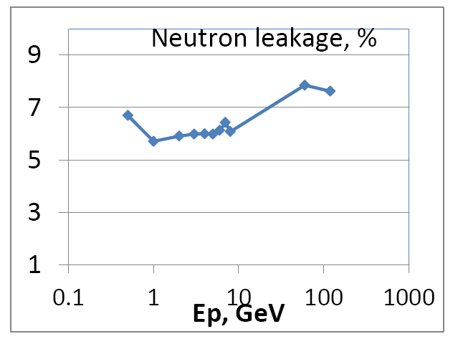
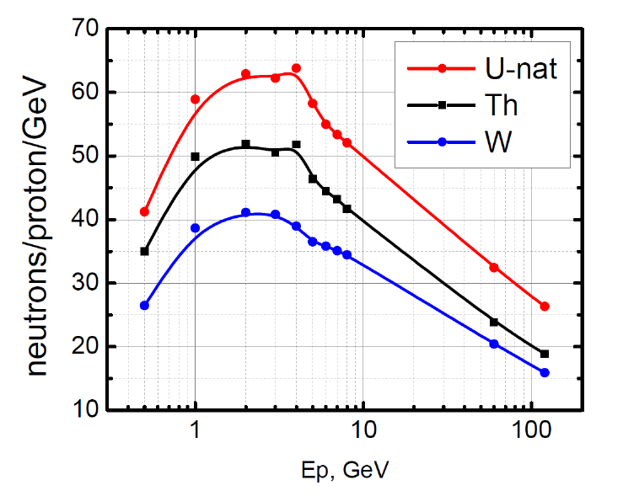
ENERGY PRODUCTION DEMONSTRATOR FOR MEGAWATT PROTON BEAMS
Leakage from the uranium target surface.
Number of neutrons released per one proton per GeV in the target.
Simulations of BURAN like targets used MARS15

Slide 14
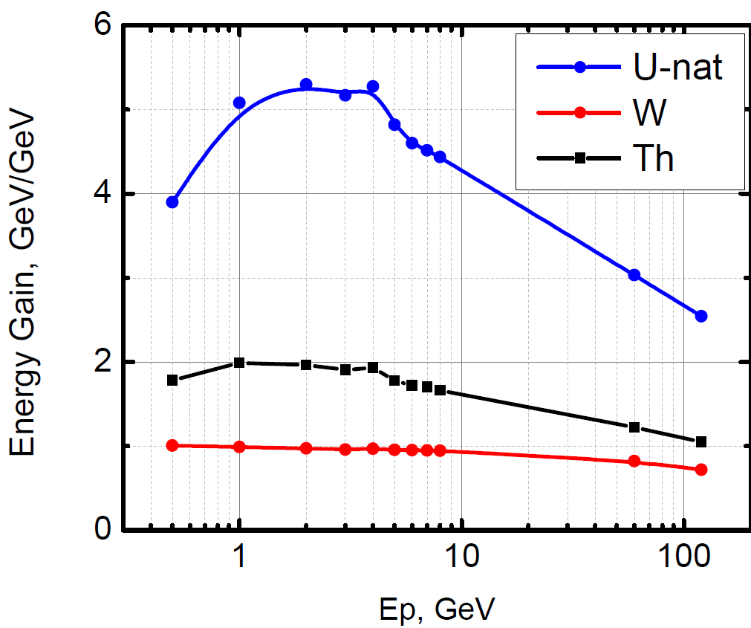
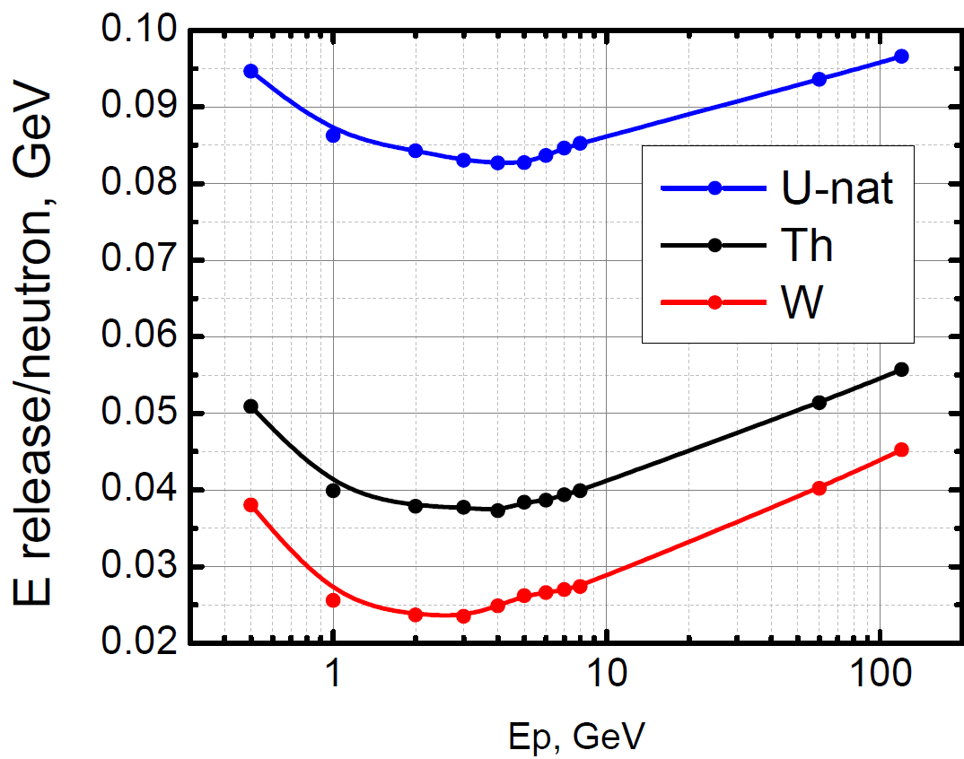
Energy deposition in EPD
Energy gain (amplification)=E_{deposited}/E_{proton}
Only U has a pronounced maximum
The maximum is at 1(2) – 4 GeV
Energy released per neutron has a minimum at 2-4 GeV

Slide 15
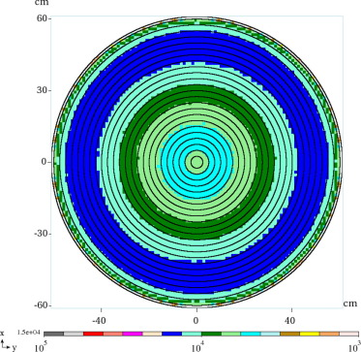
Beam rastered on surface
Ep = 3 GeV,
Beam is steered onto surface
Energy multiplication is ~4.
Neutron leakage is ~45%
(not a full absorption target)
For 1 GW output power,
Ip=2.8 mA is required

Slide 16
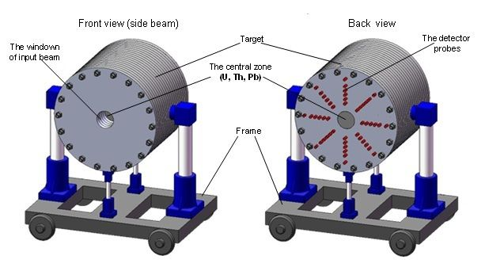
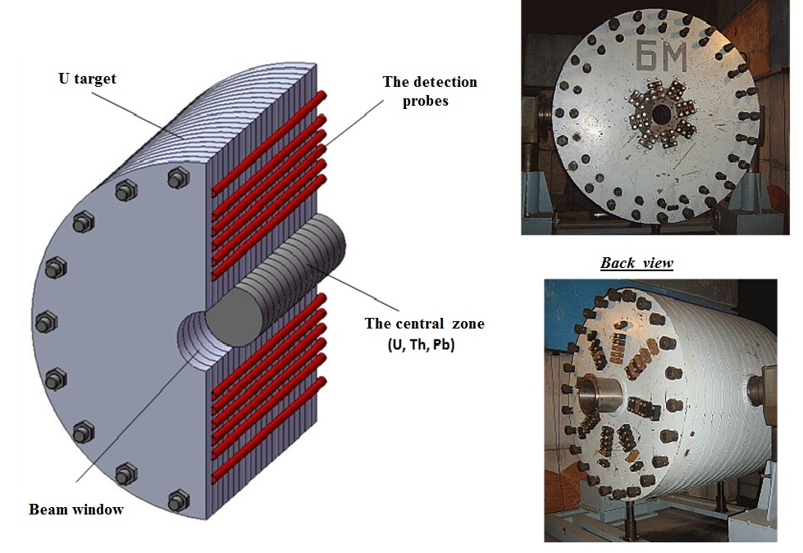
Mass of uranium – 19.5 т. Materials of central zone – U, Th, Pb.
Diameter – 1,2 м. Diameter of central zone – 0,2 м.
Length – 1 м.
General view of the target setup BURAN at the transport-fixing platform.
The scheme of longitudinal section of the TS BURAN with the mounted central zone (top-left) and general view photo (right).
Big uranium target

Slide 17
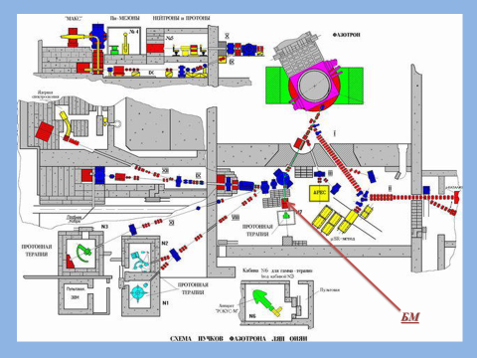
Fig. 2. Scheme of a large uranium target with holes for detector placement
Fig. 3. Layout of the target in the experimental hall of the DLNP Phasotron

Slide 18
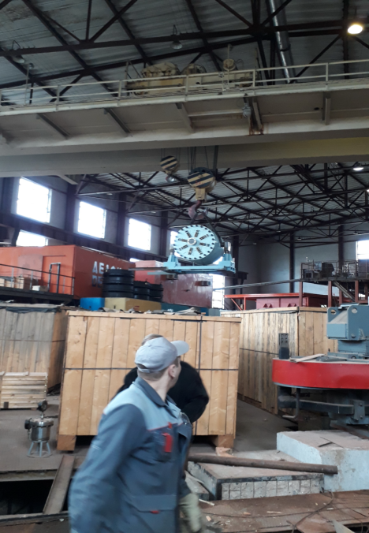
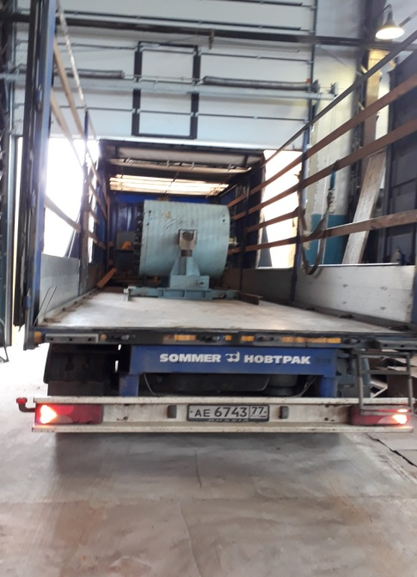
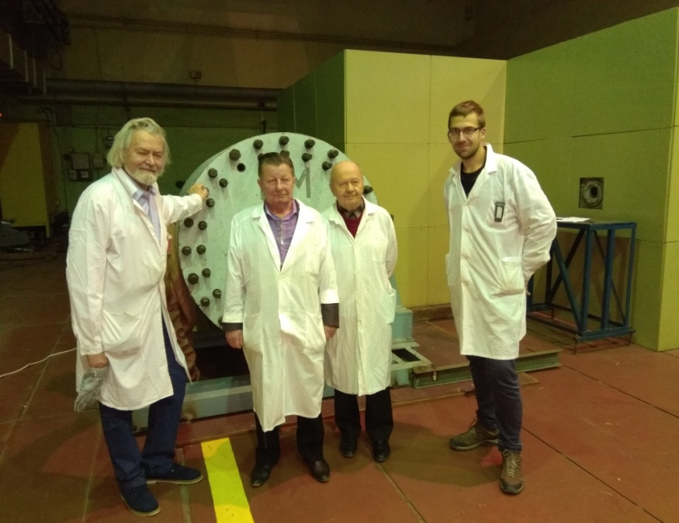
Realization of BURT transportation from VBLHEP to DLNP September 2017, JINR, Dubna
Project Report «E&T»
Our project started in 2017 at the Laboratory of High Energy Physics, topic 1107.
We participated in the First Research Coordination Meeting on Accelerator Driven Systems (ADS) Applications and Use of Low Enriched Uranium in ADS
24 to 29 September 2017 and reported the current results.
Background measurements, DNLP Phasotron, January 2018

Slide 19
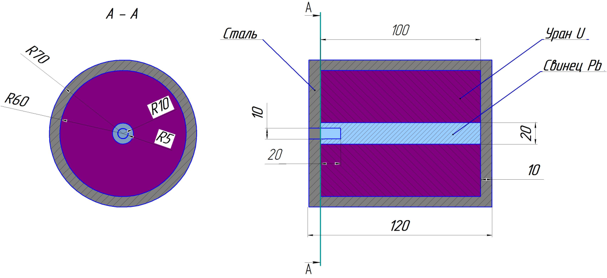
Wiring diagram of the installation and mounting of the target in the hall of the DLNP accelerator
Baseline and calculation methods
The calculations were carried out on the basis of the MCNP and FLUKA codes (the main program used in the calculations). The geometry of the computational model of the BURAN installation is shown in Fig.5
Fig.5. Calculation model of the BURAN installation

Slide 20
1. Some additional data for calculation are given below:
• The target is irradiated with 660 MeV protons;
• The intensity of the proton beam is 1•10¹²p/s;
• Irradiation time ≈ 100 h/year;
• Uranium isotopic composition: Depleted uranium: 99.7% U²³⁸, 0.3% U²³⁵,
• Mass of uranium in the installation (19.2 g / cm3) = 21.563889 tons (in the calculation model),
• Target - lead (10.2 g/cm³), weight ~ 64 kg,
• Reflector - iron (7.8 g/cm³), weight ~ 5.5625 tons.
Nuclear safety. Calculations for installation Buran on the multiplication factor
The main calculated data obtained from the assessment of nuclear safety of the BURAN set up are as follows:
  Effective multiplication factor k_{eff} = 0.34218 +/- 0.00014,
  Multiplication 1/(1-k_{eff}) = ~1.52,
  The lifetime of the prompt neutrons = 2.8E-8 s
  Average neutron energy causing fission = 2.66 MeV,
  Percentage of fission caused by neutrons in the thermal, intermediate and fast energy regions: (<0.625 eV) - 0.00%, (0.625 eV - 100 KeV) - 6.04%, (>100 KeV) - 93.96%,
  Average number of neutrons produced per absorbed neutron = 0.41,
  Average number of neutrons released per fission = 2.739.
  Filling the installation with water does not lead to a noticeable change in the multiplication factor (k_{eff} = 0.34343 +/- 0.00017 ).
Conclusions on the nuclear safety of the facility: a deeply subcritical system with k_{eff}=0.34218 with a small multiplication of no more than two. At the maximum design basis accident caused by the flooding of the installation with water, the multiplication factor remains almost at the same level and significantly less than the allowable (admissible K_{eff}=0.95 as for spent nuclear fuel storage).
Some data on the energy release in the installation and the spectral composition of neutrons and gamma quanta emitted from the installation
Fig. 6 shows the distribution of the energy release density in the BURAN installation from one initiating proton. Fig. 7 shows the spectral composition of neutrons (n/cm²) and gamma-quanta (γ/cm²) emitted from the installation from a single proton of the accelerator.

Slide 21
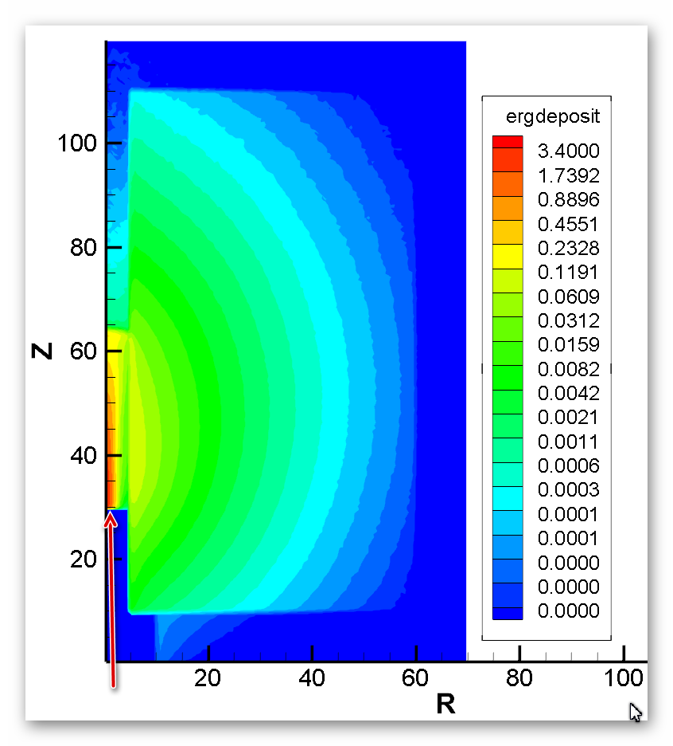
Fig.6 Density of energy release (MeV/cm³) in the installation from a single proton of the accelerator
Fig.7 Spectrum of neutrons (n/cm²) and gamma-quanta (γ/cm²) emitted from the installation from one accelerator proton

Slide 22
Calculation of dose distribution inside and outside the BURAN installation
The working conditions of the installation: irradiation, subsequent exposure, the period of exposure and some other parameters were set in accordance with the requirements of the experiment during the irradiation of the set up.
Radiation doses inside and outside the BURAN set up were calculated in 5 different irradiation options:
Option 1. Doses from promt neutrons and gamma quanta directly in the process of irradiation; the intensity of the proton beam is equal to 1•10¹² p/s;
Option 2. Continuous proton beam irradiation for 100 hours, then exposure; the intensity of the proton beam is equal to 1 • 10¹² p/s;
Option 3. Continuous irradiation with a proton beam for 5 hours, then exposure; the intensity of the proton beam is equal to 1 • 10¹² p/s;
Option 4. Continuous proton beam irradiation for 5 hours, then exposure; the intensity of the proton beam is equal to 1 • 10¹¹ p/s;
Option 5. 10 periods of proton beam irradiation with an intensity of 1 • 10¹¹ p/s for 5 hours, followed by 30 days exposure, then exposure
The fourth and fifth variants differ from all others by a reduced intensity of the proton beam by a factor of 10.

Slide 23
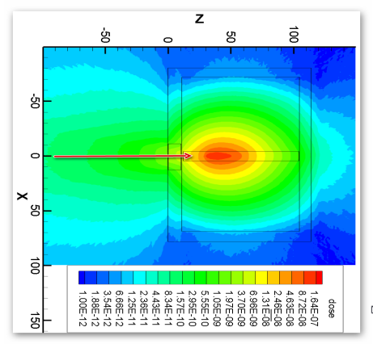
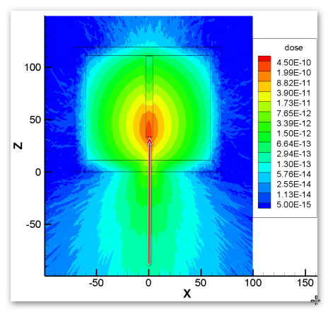
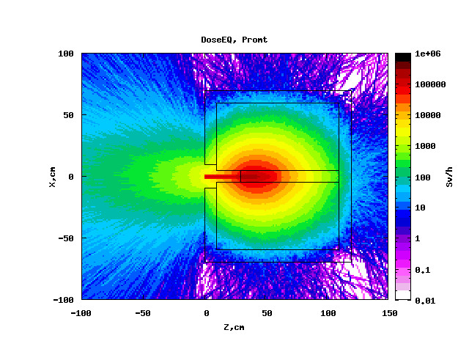
Doses from promt neutrons and gamma quanta directly in the process of irradiation; the intensity of the proton beam is equal to 1•10¹² p/s;
a)
б)
Calculation by MCNPX. Distribution doses (Sv/h / proton) from neutrons (c) and gamma quanta (b) in the set up and around it from a single proton accelerator during operation
Calculation for FLUKA. The distribution of the effective dose rate (Sv/h) from all particles in the installation and around it during operation of the accelerator

Slide 24
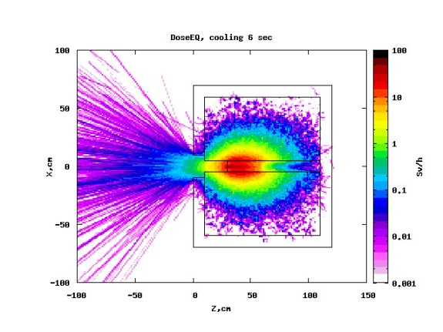
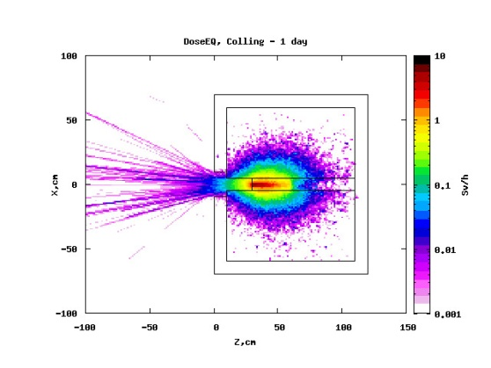
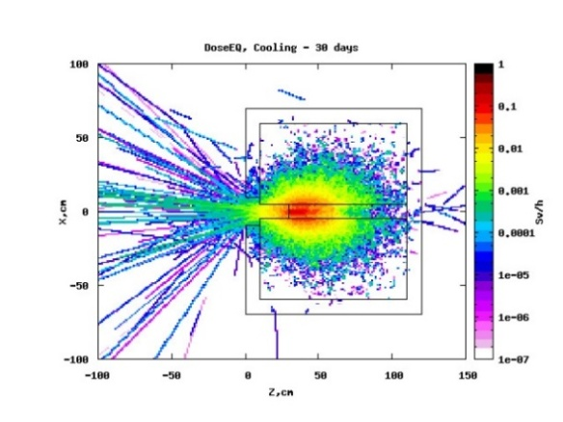
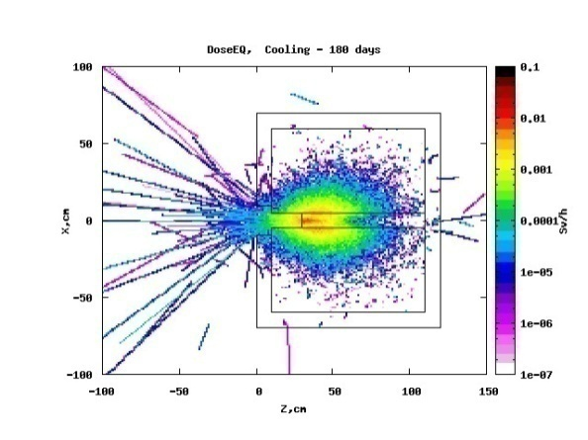
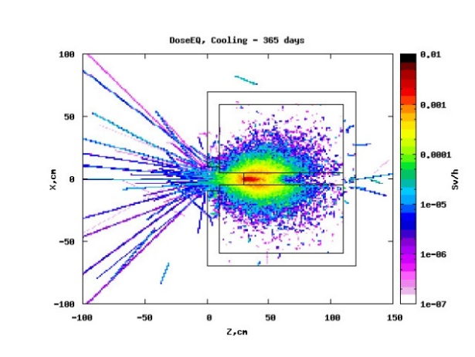
Conclusions for the effective dose rate during proton irradiation:
The maximum effective dose rate from neutrons at a proton source intensity S = 1.0e+12 p/s is ~ 1.6e+5 Sv/h
The maximum effective dose rate of all particles at a proton source intensity S = 1.0e+12 p/s is ~ 2.6e+5 Sv/h
  Continuous irradiation with a proton beam for 100 hours, then exposure; proton beam intensity is 1 • 10¹² p/s
The distribution of doses (Sv/h) from all particles in the installation and around after the discontinuation of irradiation is shown in Fig.10 and the installation activity (Bq/cm³) is shown in Fig.11
1)
2)
3)
4)
5)
Calculation by FLUKA. The drop in the full dose rate (Sv/hour) from all particles in the installation and around it after irradiation for 100 hours at different exposures: 1–6 s, 2–1 days, 3–30 days, 4–180 days, 5 – 1 year.

Slide 25
Maximum dose, Sv/hour
Maximum dose, Sv/hour
days
days
Decrease of the maximum dose rate around the BURAN facility as a function of the exposure time when the installation is irradiated for 100 hours with a proton beam intensity of 1•10¹² p/s
Table 1. Changes in the maximum effective dose rate around the BURAN set up during the during a downturn in the activity of set up after its irradiation for 100 hours with a proton beam intensity of 1•10¹² p/s
Exposure Time, Days | 0 | 6 sec | 1 | 30 | 180 | 365
Maximum Dose Rate, Sv/hour | 266400 | 47 | 5,7 | 0,2 | 0,01 | 0,004

Slide 26
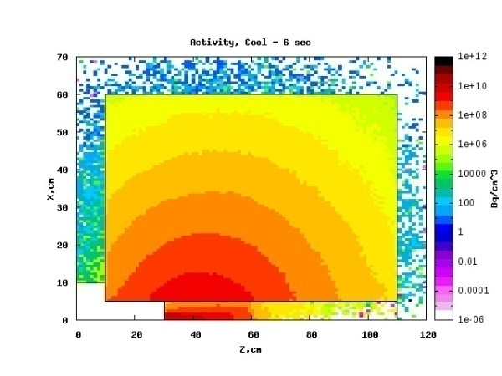
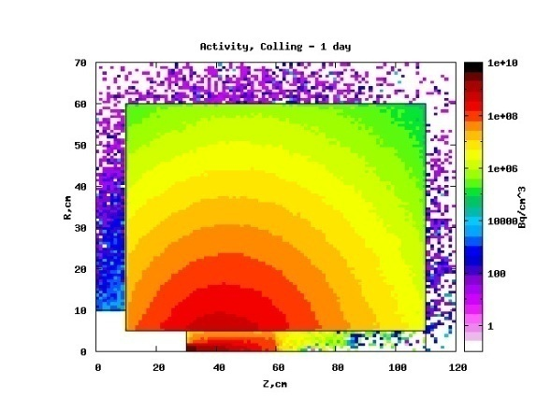
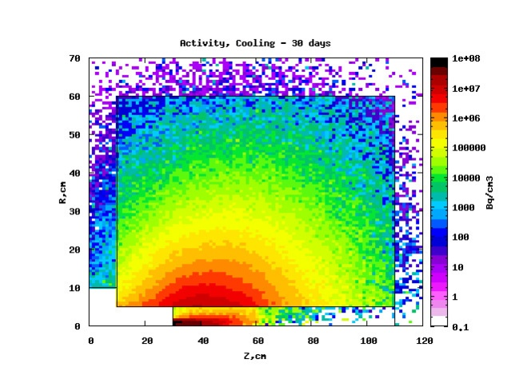
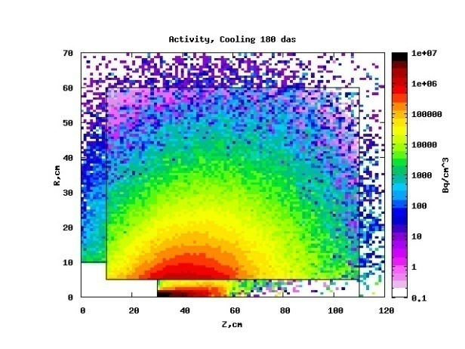

1)
2)
3)
4)
5)
Activity slowdown of the structural elements of the BURAN installation after irradiation for 100 hours at certain exposure values: 1–6 s, 2–1 days, 3–30 days, 4–180 days, 5–365 days.

Slide 27
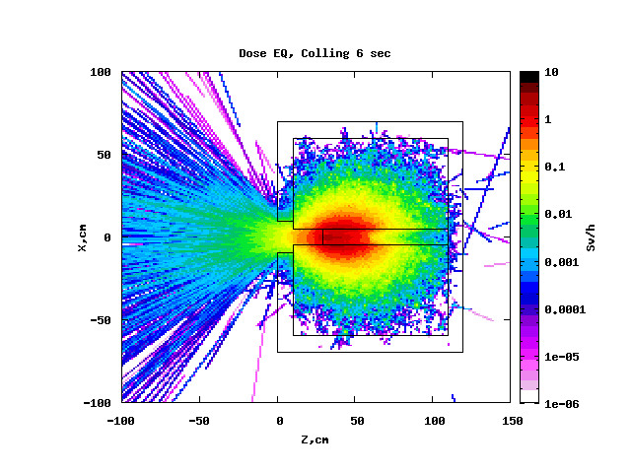
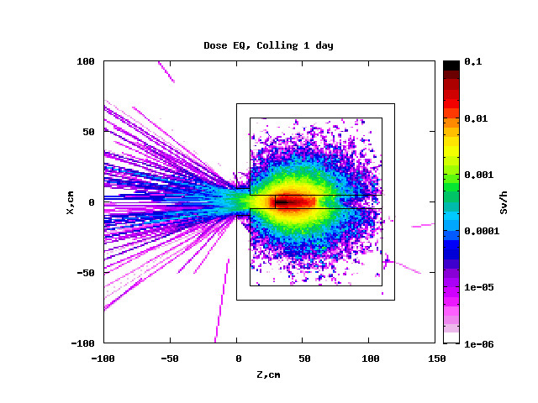
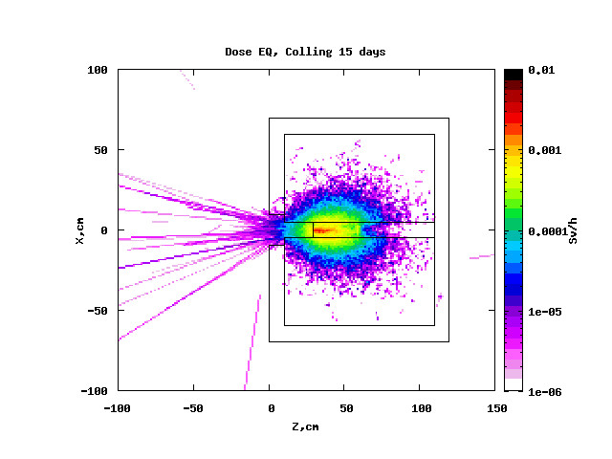
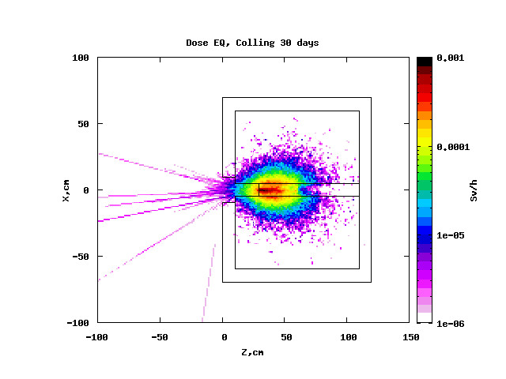
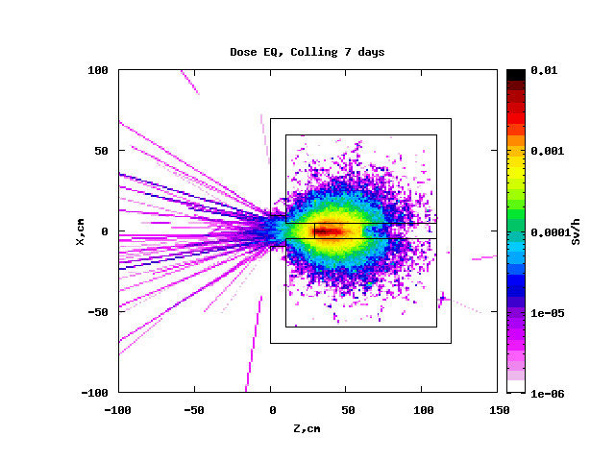
  Continuous proton beam irradiation for 5 hours, then exposure; proton beam intensity is 1•10¹²p/s
The distribution of the effective dose rate (Sv/h) from all particles in the BURAN set up and around it after stopping the irradiation of protons for 5 hours with an intensity of a proton beam of 1•10¹² p/s is shown in Fig. 13 and installation activity is shown in Figure 14.
1)
2)
3)
4)
5)
Fig.13. Calculation by FLUKA. The decrease in the total effective dose (Sv/h) from all particles in the BURAN set up and around it after irradiation for 5 h with a proton beam intensity of 1•10¹² p/s at different exposures: 1 - 6 s, 2 - 1 day, 3 - 7 days, 4 - 15 days, 5 - 30 days.

Slide 28
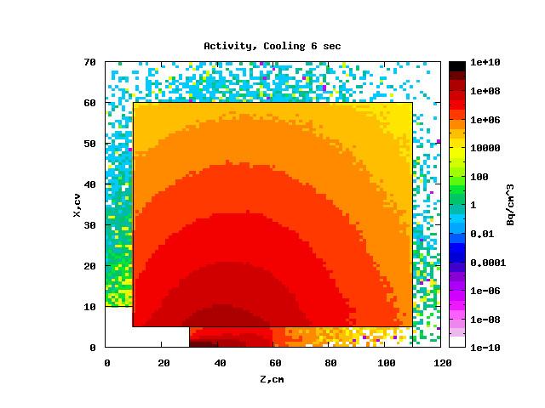
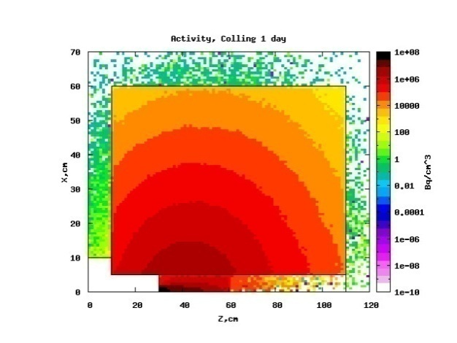
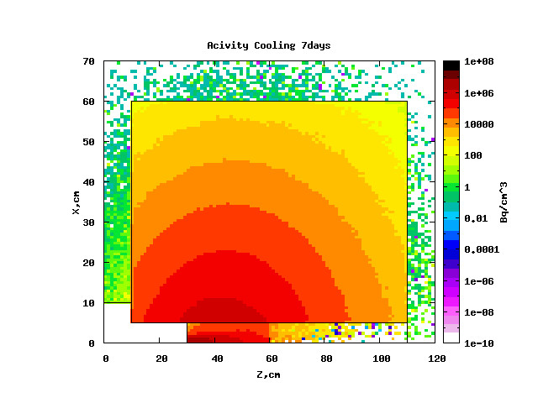
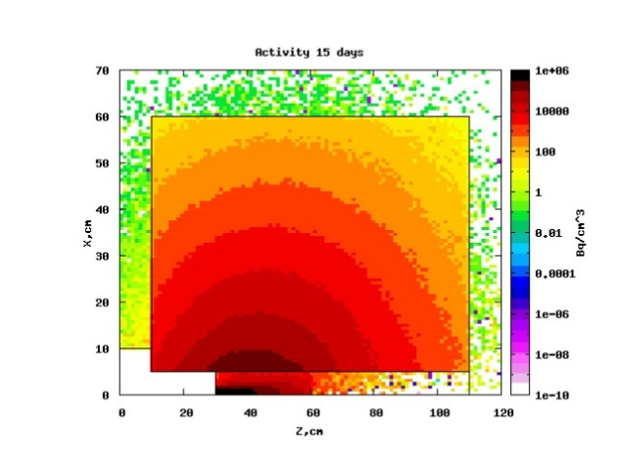
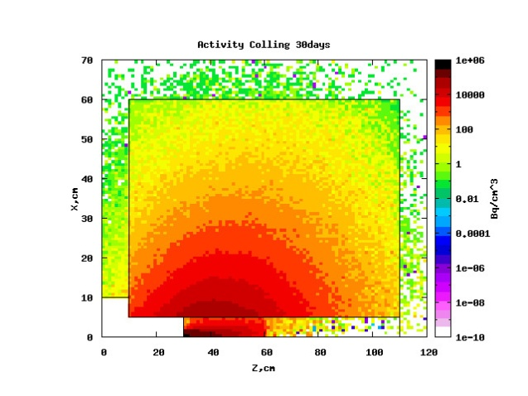
1)
2)
3)
4)
5)
Fig.14 Activity slowdown of the structural elements of the BURAN installation (Bq/cm³) at different exposures:
1 - 6 sec, 2 -1 days, 3 - 7 days, 4 - 15 days, 5 - 30 days

Slide 29
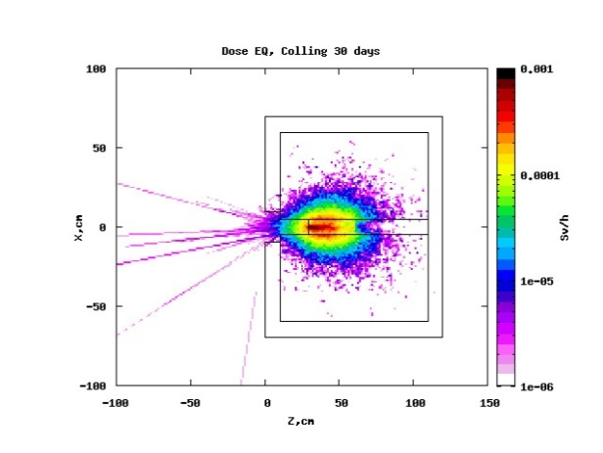
  Continuous proton beam irradiation with an intensity of 1•10¹¹p/s for 5 hours, then exposure
The decrease of the maximum effective dose rate after irradiation of the BURAN facility for 5 hours at a proton beam intensity of 1•10¹¹p/s is shown in Fig. 15, and in Fig. 16 - decline in installation activity (Bq/cm³). The change in the maximum dose rate during the decline of activity is shown in Figure 17 and Table 2.
1)
2)
4)
5)
3)
The decrease in the maximum effective dose rate after irradiation of the BURAN facility for 5 hours at a proton beam intensity of 1•10¹¹p/s

Slide 30




1)
2)
3)
4)
5)
Activity slowdown of structural elements of the BURAN installation (Bq/cm³) after irradiation of the installation for 5 hours at a proton beam intensity of 1•10¹¹p/s at different exposures:
1 - 6 s, 2 - 1 day, 3 - 7 days , 4 - 15 days, 5 - 30 days

Slide 31
Maximum dose rate, Sv/hour
Exposure, day
Fig.17 The change in the maximum effective dose rate around the BURAN set up in the process of the decline in the activity of the installation after its irradiation for 5 hours with a proton beam intensity of 1•10¹¹ p/s
Table2. Changes in the maximum effective dose rate around the BURAN set up during the decline in the activity of the installation after its irradiation for 5 hours with a proton beam intensity of 1•10¹¹ p/s
Exposure Time, Days | 6 sec | 1 | 7 | 15 | 30
Maximum Dose Rate, Sv/hour | 3,141 | 0,0598 | 0,00648 | 0,00226 | 8,23·10⁻⁴

Slide 32
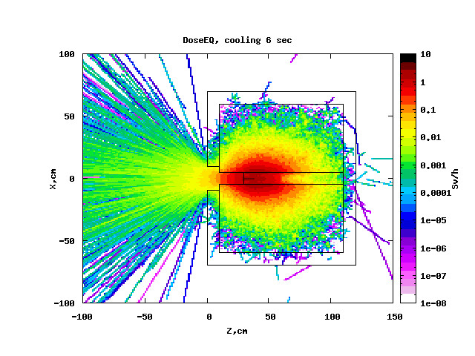
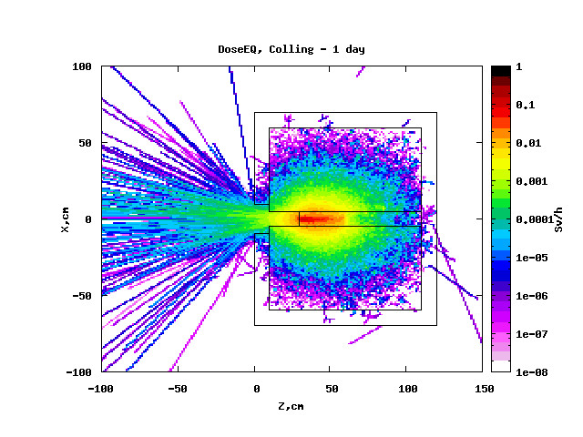
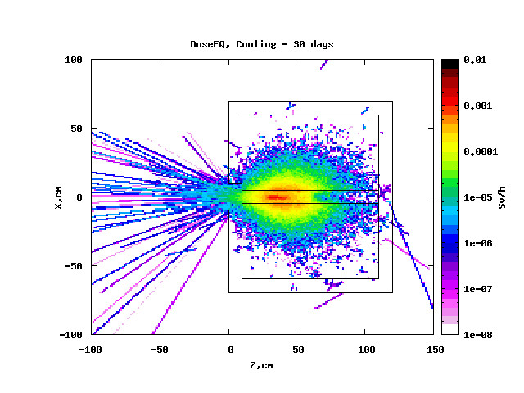
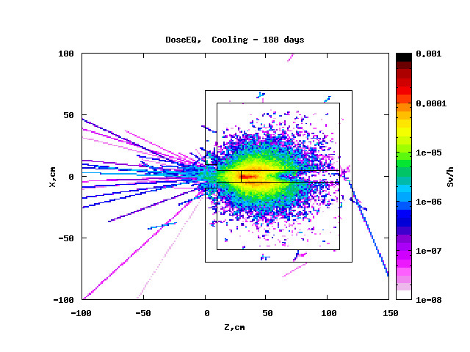
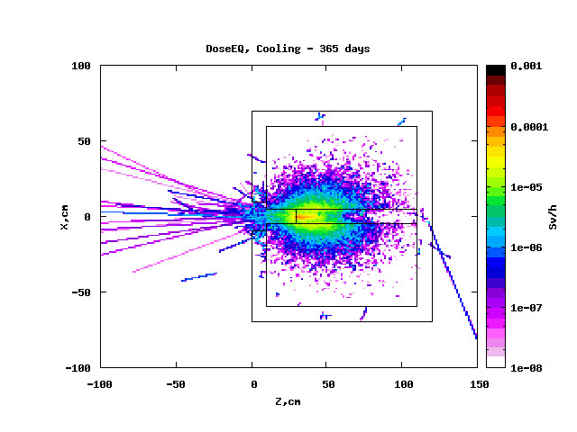
Option 5. 10 cycles of proton beam irradiation with an intensity of 1•10¹¹p/s for 5 hours, followed by 30 days exposure, then exposure
The decrease in the maximum effective dose rate after irradiation of the BURAN set up for 10 cycles with 5-hour exposure and 30-day exposure in each cycle is shown in Fig. 18, and in Fig. 19 - decline in installation activity. The change in the maximum dose rate during the activity slowdown is shown in Figure 20 and in Table. 3.
1)
2)
3)
4)
5)
Fig.18. The change in the maximum effective dose rate around the BURAN set up in the process of decreasing activity after irradiating the installation for 10 cycles (5 hours of irradiation with a proton intensity of 1•10¹¹p/s followed by 30 days exposure) at different exposures.

Slide 33
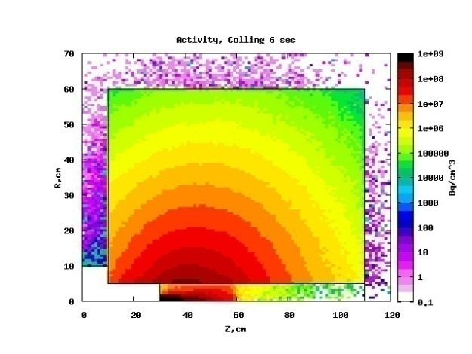
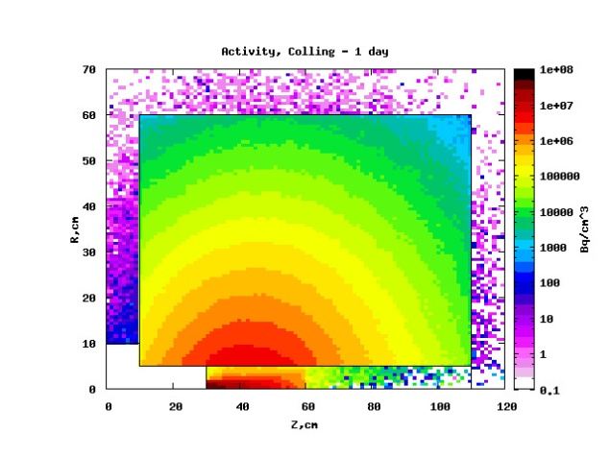
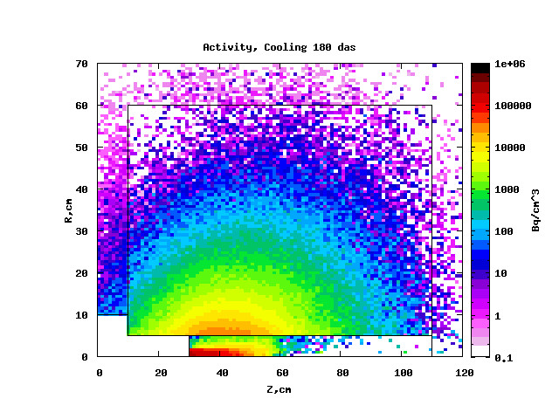

1)
2)
3)
4)
Fig. 19. Activity slowdown of structural elements of the BURAN installation (Bq/cm3) after irradiation of the installation for 10 cycles (5 hours of irradiation at a proton beam intensity of 1•10¹¹p/s followed by 30 days exposure) at different exposures: 1 - 6 sec., 2 - 1 day, 3 - 7 days, 4 - 15 days, 5 - 30 days

Slide 34
Maximum dose rate, Sv/hour
Exposure, day
Fig.20. The change in the maximum effective dose rate around the BURAN set up in the process of decreasing activity after irradiating the installation for 10 cycles (5 hours of irradiation with a proton beam intensity of 1•10¹¹p/s followed by 30 days exposure) at different exposures

Slide 35
Table. Changes in the maximum effective dose rate around the BURAN set up in the process of decreasing activity after irradiating of the set up for 10 cycles (5 hours of irradiation at a proton beam intensity of 1•10¹¹ p/s followed by 30 days exposure) at different exposures
Exposure Time, Days | 6 sec | 1 | 30 | 180 | 360
Maximum Dose Rate, Sv/hour | 3,132 | 0,102 | 0,00138 | 2,38E-4 | 7,53E-5

Slide 36
Estimation of the shielding for "Buran" setup
Buran is a cylindrical target from natural uranium, with diameter 120 cm and length 100cm.
The length of the beam window was taken 20 cm.
The target was irradiated with protons with energy 0.66 GeV.
1.08·10⁻¹⁵ Sv/p
7.03·10⁻¹⁵ Sv/p
1.6·10⁻¹⁶ Sv/p
6.42·10⁻¹⁵ Sv/p
4.08·10⁻¹⁵ Sv/p
3.19·10⁻¹⁵ Sv/p
4.97·10⁻¹⁷ Sv/p
1.5·10⁻¹⁵ Sv/p
Beam
The angular distribution of the dose for Buran and Quinta targets, irradiated with 0.66 GeV protons. The red color is for Buran, and the black for Quinta.
The spectrum of escaped neutrons at 2 m from the target, irradiated with 0.66 GeV protons.
The effective dose for neutrons
In table are presented the doses per incident proton, and the corresponding annual doses calculated for a beam intensity of 1·10¹² and a period of work of 100 h/year.
 | Distance, m | Dose, Sv/p | Dose, Sv/y
floor 1 | 7 | 2.37·10⁻¹⁷ | 8.53
 | 30 | 1.02·10⁻²¹ | 3.64·10⁻⁴
ground floor | 7 | 4.28·10⁻¹⁸ | 1.54
 | 30 | 3.65·10⁻²² | 1.31·10⁻⁴
 | 100 | 4.51·10⁻²³ | 1.62·10⁻⁵

Slide 37


The geometry used in the simulation
The dose inside the phasotron building is unacceptable. We would need 4-5.5 m concrete for the shielding in the proximity of the target (depending on the distance from the target at which the shielding is placed) if we want to keep the dose inside the room in the acceptable limits.
The spatial dose distribution under irradiation of the target Buran with 0.66 GeV protons

Slide 38
The test results of MOS transistors on the effects of relativistic particles

Slide 39


Experimental Technique
The experiments were carried out on high-power vertical field-effect transistors with the metal-oxide-semiconductor structure, made in a serial technological process using double diffusion technology
Instruments were investigated in different plastic packages.
In the experiment, the devices were located in the zone of the particle beam so that the plane of the semiconductor crystal, in which the active region of the device was formed, was oriented perpendicular to the direction of motion of the particles. The scheme of orientation of the active region of the device relative to the direction of the particle beam is shown in Figure 1.
During the experiments, particles (deuterons) fell on the device from the heat sink side. The active region of the device during the experiments is exposed to both the deuteron beam and the products of nuclear reactions occurring in the environment with the participation of deuterons.
gate
Source
Gate dielectric (silicon oxide)
р
n⁺
Epitaxial n−type
n⁺-type substrate
Base of the case (heat sink) - copper
drain
The orientation of the active region of the device relative to the direction of the particle beam
Particle beam

Slide 40
Results on the production of radioactive isotopes during irradiation (9 h) of the transistor by deuterons
with an energy of 4 GeV (2 GeV/Nuk) are given in Table 1 and in Fig. A, B, C.
Production of radioactive isotopes
isotop | Type of decay | half-life | The number of nuclei accumulated during irradiation | Activity at the end of irradiation, Bq
Co-57 | %EC=100 | 271.79 d | 3.17E+09 | 94
Ni-57 | %EC+%B+=100 | 35.60 h | 3.68E+08 | 1990
Sc-47 | %B-=100 | 3.3492 d | 3.63E+08 | 869
Sc-48 | %B-=100 | 43.67 h | 1.07E+08 | 472
V-48 | %EC+%B+=100 | 15.9735 d | 1.50E+09 | 754
Co-56 | %EC+%B+=100 | 77.27 d | 1.12E+09 | 116
Sc-44m | %IT=98.80, %EC+%B+=1.20 | 58.6 h | 7.06E+08 | 2320
Sc-44 | %EC+%B+=100 | 3.927 h | 1.13E+08 | 5540
Cr-48 | %EC+%B+=100 | 21.56 h | 2.28E+08 | 2036
Cr-51 | %EC=100 | 27.7025 d | 2.84E+09 | 823
K-43 | %B-=100 | 22.3 h | 1.93E+08 | 1666
Y-87 | %EC+%B+=100 | 79.8 h | 1.68E+08 | 405
Mn-52 | %EC+%B+=100 | 5.591 d | 9.23E+08 | 1325
Co-58 | %EC+%B+=100 | 70.86 d | 3.56E+09 | 406
Mn-54 | %EC+%B+=100, %B-<2.9E-4 | 312.3 d | 3.66E+09 | 94
Sc-46 | %B-=100 | 83.79 d | 9.09E+08 | 95
Na-24 | %B-=100 | 14.9590 h | 7.20E+08 | 9267
Au-196 | %EC+%B+=92.80, %B- =7.20 | 6.183 d | 8.27E+07 | 107

Slide 41
The test results of MOS transistors on the impact of the deuteron beam
Experiment No. Date | Number of bursts of pulses | Test transistor number | housing | Crystal size | Nucleon energy GeV | Number of nucleons, N | Nucleon fluence, N/cm² | Pulse duration s | The duration of the gap between the packets, s | Duty cycle | Total nucleon energy per crystal, GeV | I_{cu}, nА | U_{проб} В | U_{пор}, В | Test Scheme | Fixed charge, pQ
1 13.03. 2013 | 1 | 63 | ТО220 | 4,32× 4,57 | 2 | 1*10¹⁰ | 1,41*10⁹ | 3 | 12 | 4 | 5,5*10⁸ | 5 | 60 | 2,85 | рис.1 U_{пит}= 10В
 | 10 |  |  |  |  | 1*10¹¹ | 1,41*10¹⁰ |  |  |  | 5,4*10⁹ | 5 | 60 | 2,85
 | 100 |  |  |  |  | 1*10¹² | 1,41*10¹¹ |  |  |  | 5,4*10¹⁰ | 5 | 60 | 2,85
 | 150 |  |  |  |  | 1,5*10¹² | 2,12*10¹¹ |  |  |  | 8,1*10¹⁰ | 5 | 60 | 2,85
2 13.03. 2013 | 1 | 51 | ТО218 | 6,53× 6,53 | 2 | 1,4*10¹⁰ | 2,04*10⁹ | 3 | 12 | 4 | 1,74*10⁹ | 5 | 200 | 3,28 | рис.2 U_{пит}= 40В | 9550
 | 10 |  |  |  |  | 1,8*10¹¹ | 2,58*10¹⁰ |  |  |  | 1,75*10¹⁰ | 5 | 200 | 3,28 |  | 7,3*10⁴
 | 114 |  |  |  |  | 1,6*10¹² | 2,3*10¹¹ |  |  |  | 1,96*10¹¹ | 5 | 200 | 3,28 |  | 7,4*10⁵
3 13.03-14.03. 2013 | 1 | 132 | КТ97С | 5,8× 7,7 | 2 | 1,4*10¹⁰ | 2,04*10⁹ | 3 | 12 | 4 | 1.74*10⁹ | 5 | 200 | 3,2 | рис.2 U_{пит}= 40В
 | 10 |  |  |  |  | 1,85*10¹¹ | 2,64*10¹⁰ |  |  |  | 2,25*10¹⁰ | 5 | 200 | 3,2
 | 21 |  |  |  |  | 3,7*10¹¹ | 5,3*10¹⁰ |  |  |  | 4,7*10¹⁰ | 5 | 200 | 3,2
4 16.03-17.03. 2013 | 1 | 2 | КТ97С | 5,8× 7,7 | 4 | 1,82*10⁹ | 2,6*10⁸ | 1 | 12 | 12 | 4,64*10⁸ | 10 | 200 | 3,2 | рис.2 U_{пит}= 95В
 | 1768 |  |  |  |  | 2,07*10¹² | 2,93*10¹¹ |  |  |  | 5,23*10¹¹ | 10 | 200 | 3,2

Slide 42



Slide 43









INTERNATIONAL WORKSHOP
Sub-critical nuclear systems and nuclear power issues
19-22 March 2019
Tashkent, Uzbekistan

Slide 44
Thank you for attention !

