Slide 1
Centrality at MPD: fast look at problem.
A.Ivashkin
Institute for Nuclear Research RAS, Moscow
on behalf of the FHCal group (INR, MEPhI, JINR…)
Tools for the centrality measurements.
MC results
Approaches for the experimental data

Slide 2
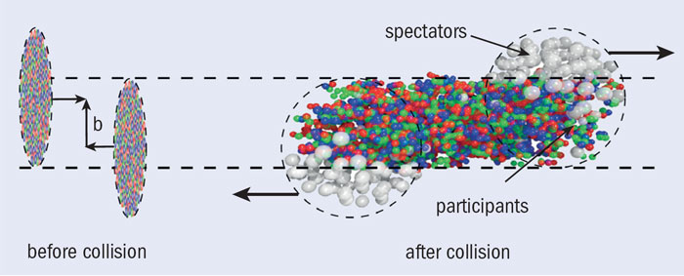
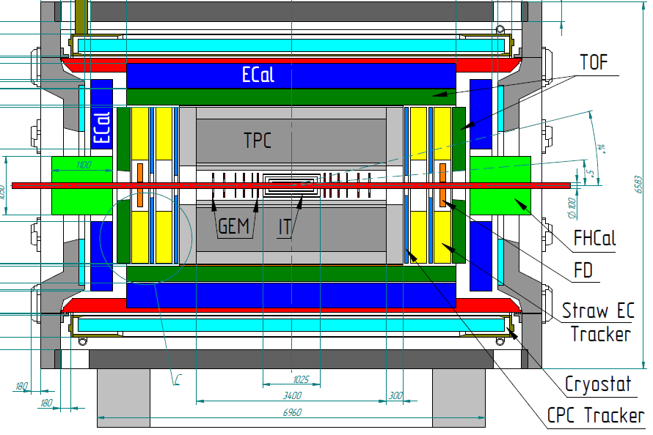
Tools for centrality measurements.
Two types of measurements:
Participant region (TPC/TOF)
Spectator region (FHCal)
Two approaches for centrality measurements.
Combination of two approaches.

Slide 3
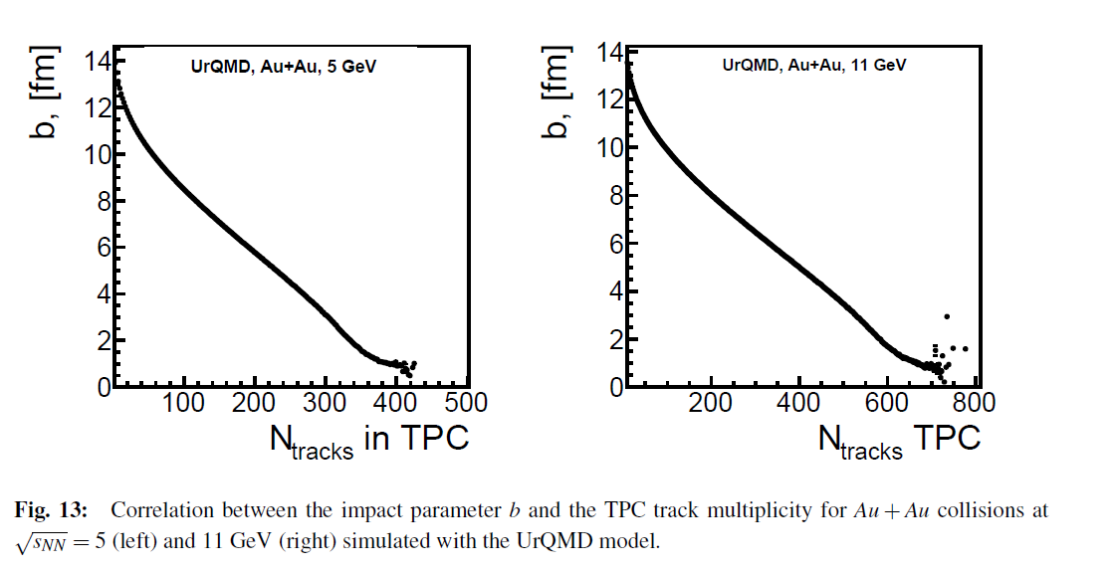
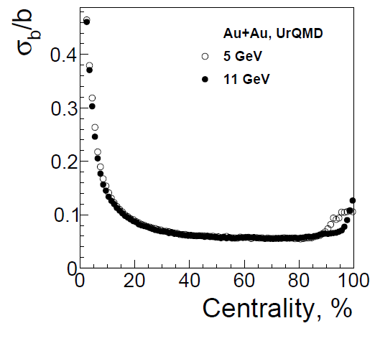
Centrality with TPC (MC simulation).
FHCal TDR
Use of TPC track multiplicity can estimate the impact parameter with accuracy <10% for mid-central events.

Slide 4
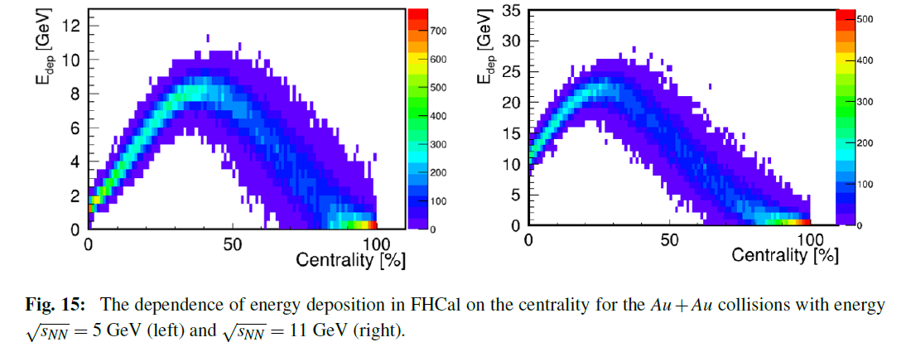
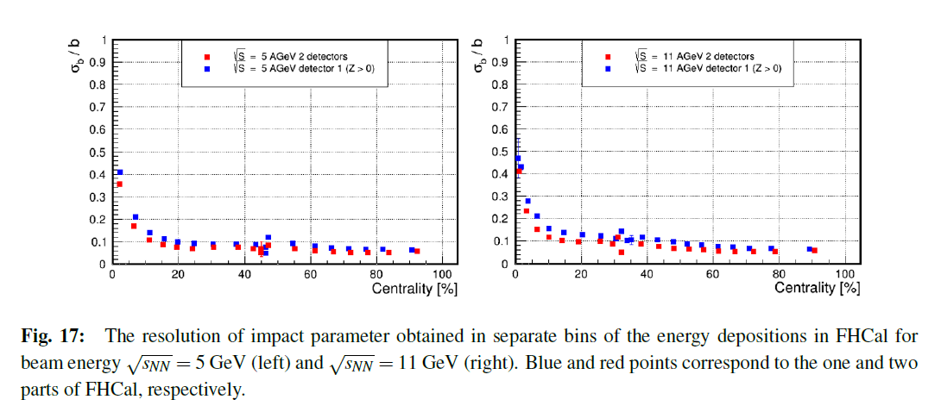
Centrality with FHCal (MC simulation).
FHCal TDR
Ambiguity in the centrality measuremens (Beam hole).
To resolve the ambiguity other approaches are needed!

Slide 5
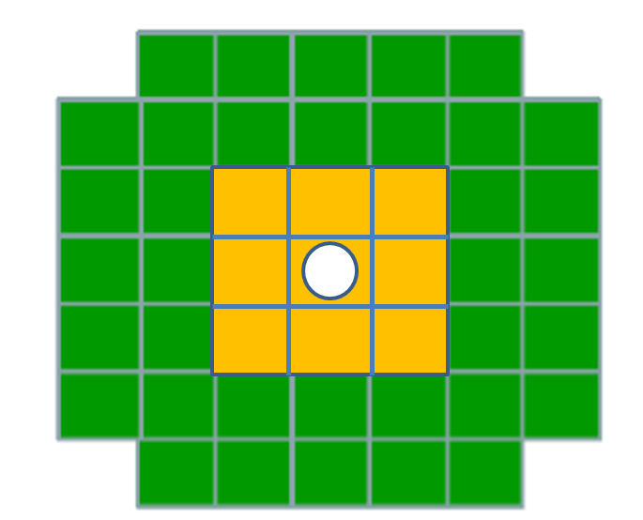
Spectators spots in FHCal have different distributions for different centralities.
b<6 fm
b<6 fm
b>6 fm
b>6 fm
R, cm
Cone for central events
E_{out}
The energy deposition in inner and outer parts of calorimeter must be different for different centralities.
Cone for peripheral
events
E_{in}
Let’s introduce energy asymmetry:

Slide 6
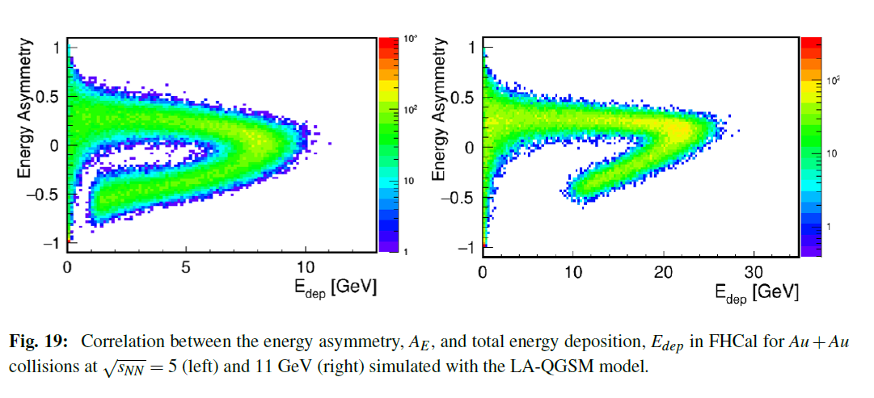
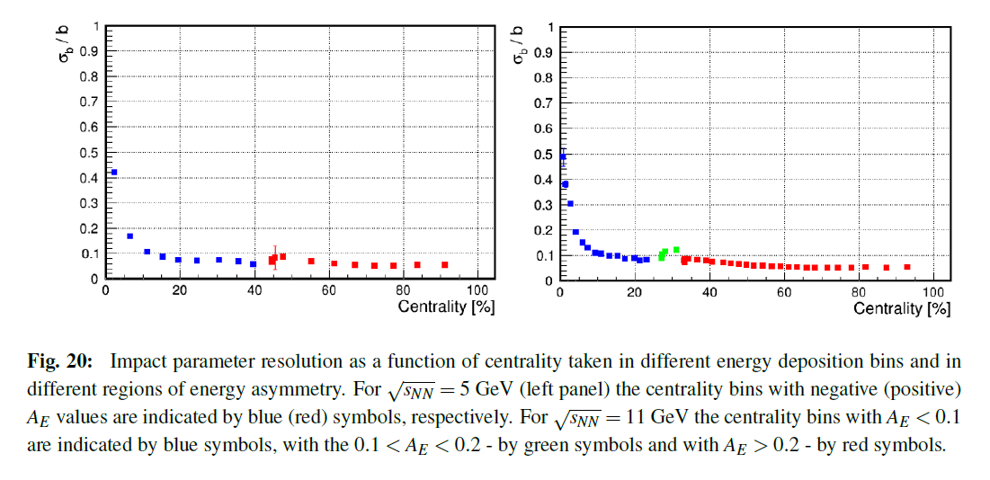
Centrality with FHCal (asymmetry approach).
FHCal TDR
Ambiguity is resolved with some accuracy!

Slide 7
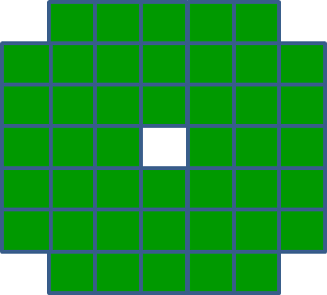
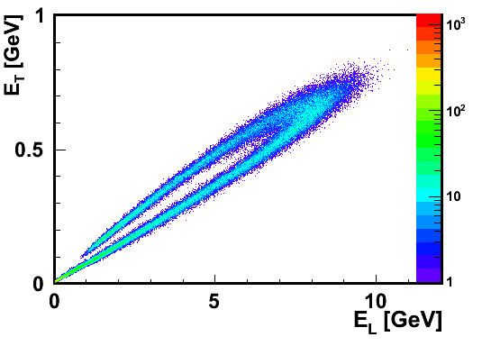
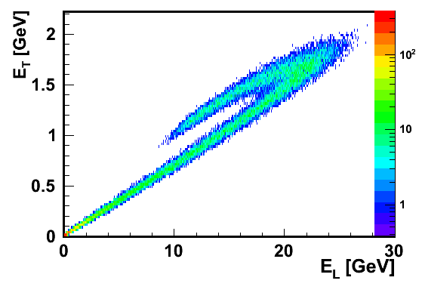
Construction of other observables in FHCal for the centrality measurement.
$$Ei$$
Transverse energy: $ET=\sum{Ei sinθi}$
and
Longitudinal energy: $EL=\sum{Ei cosθi}$
$$θ$$
Cone of spectators
$$Ei$$
A bagel structure in E_{T}, E_{L} correlations.

Slide 8
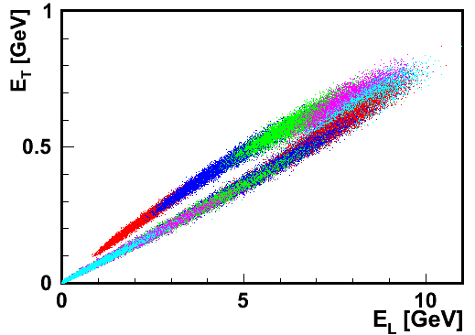
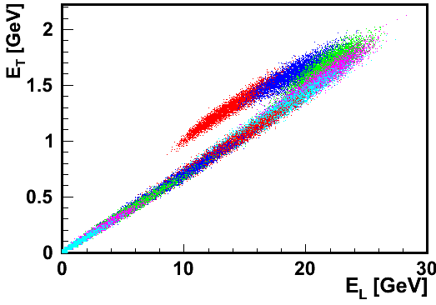
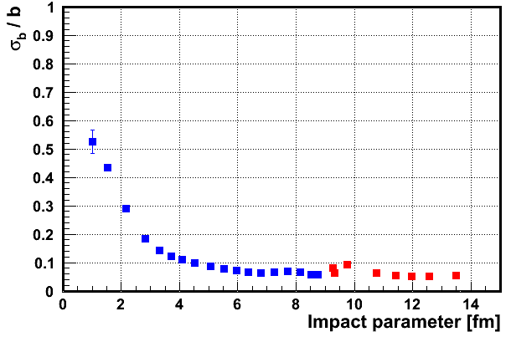
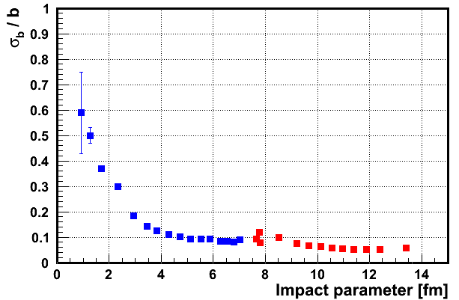
Centrality measurements with E_{T} and E_{L}.
Central events
Central events
Peripheral events
Peripheral events
Each color bin is 10% of centrality.
Each color bin is 10% of centrality.
One can construct other observables for better separation of central/peripheral events!

Slide 9
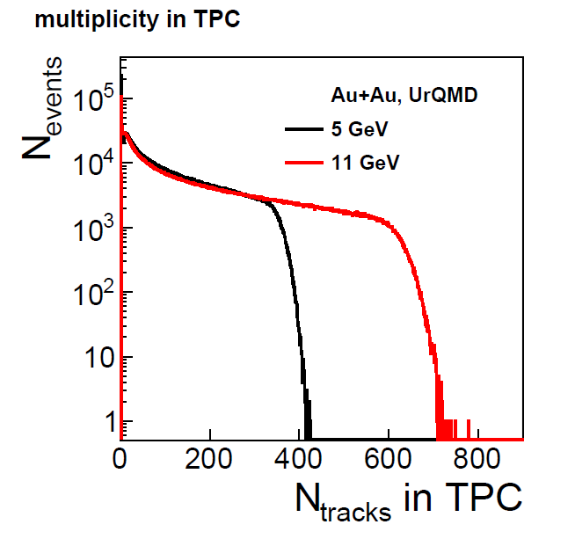
Experimental situation.
The above results were obtained from MC simulation, where the impact parameter is precisely known.
How to proceed in experimental data?
TPC case.
MC Glauber model fit of the experimental multiplicity would provide the correspondence between the geometry of collision and track multiplicity.
Other approach with only experimental data (without Glauber model) is suggested:
Sruthy Jyothi Das, Giuliano Giacalone, Pierre-Amaury Monard, and Jean-Yves Ollitrault
Relating centrality to impact parameter in nucleus-nucleus collisions
PHYSICAL REVIEW C 97, 014905 (2018)

Slide 10
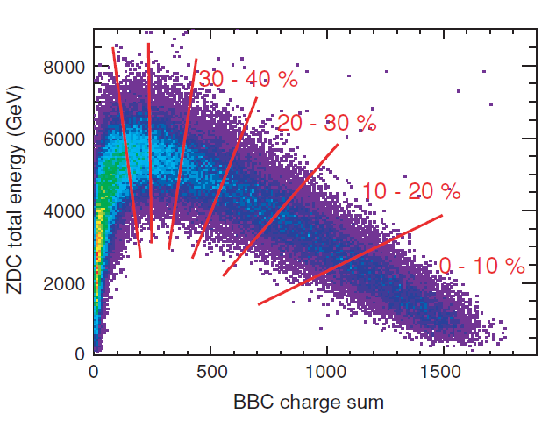
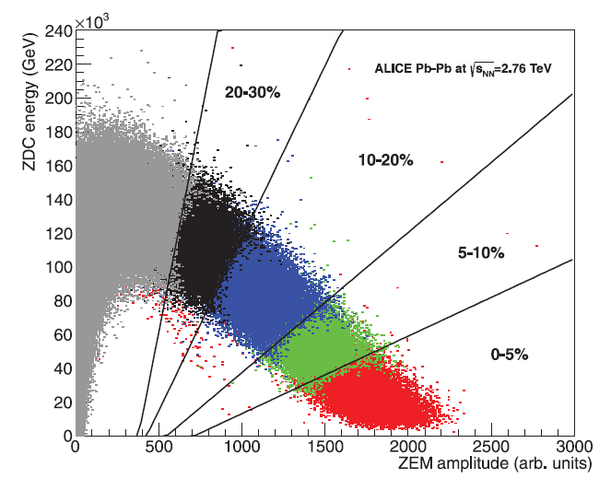
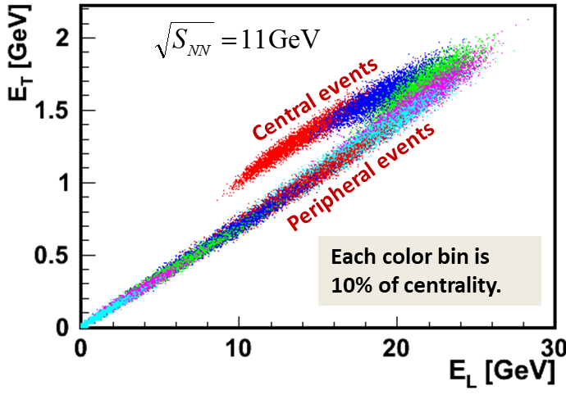
Experimental situation (FHCal case).
Is it possible to apply MC Glauber model fit to FHCal? PHENIX did it for ZDC and BBC!
One can apply the TPC multiplicity correlation with the FHCal energy. Use of TPC multiplicity centrality classes would provide the centrality classes for FHCal energy. (ALICE like solution).
PHENIX
ALICE
In MPD the situation must be understood.
The corresponding techniques are to be developed!
New FHCal observables can be found!

Slide 11
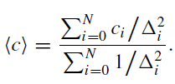
Experimental situation (Combined case).
If there are a few independent methods of centrality estimation, one can combine them statistically in iteration procedure:
ALICE like
Can the Machine Learning (ML) be applied? Such approach is under development at ALICE: EPJ Web of Conferences 137, DOI: 10.1051/epjconf/201713711001
At MPD we should have at least two methods: TPC and FHCal.
Can FD contribute to centrality?
BBC counters?

Slide 12
Outlook
The measurement of centrality is a necessary task at MPD.
TPC and FHCal are dedicated detectors here.
What is about other detectors?
The situation with TPC is straightforward but the methods must be developed.
The situation with FHCal is more complicated and a few approaches can be considered:
MC Glauber model fit,
correlation between TPC multiplicity and FHCal observables,
...
Combination of TPC and FHCal measurements can be done in a few ways:
statistical combination or
ML- technique.
A dedicated physics group must be arranged.
Who will do it?

Slide 13
Thank you!

