Slide 1




Decay $B→φℓ^{+}ℓ^{−}$ in the covariant quark model
Issadykov Aidos

Slide 2
HIGH ENERGY PHYSICS
The Higgs sector
The Dark Matter
The New Physics :
  confinement, exotic hadrons,
dense hadron matter.

Slide 3
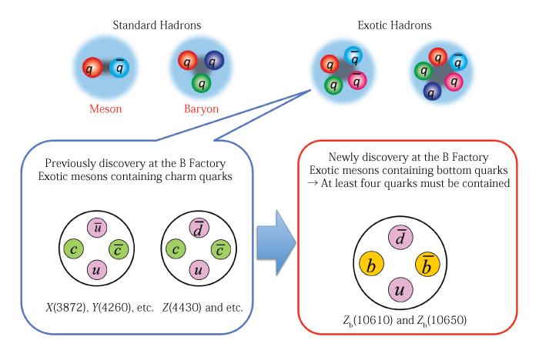
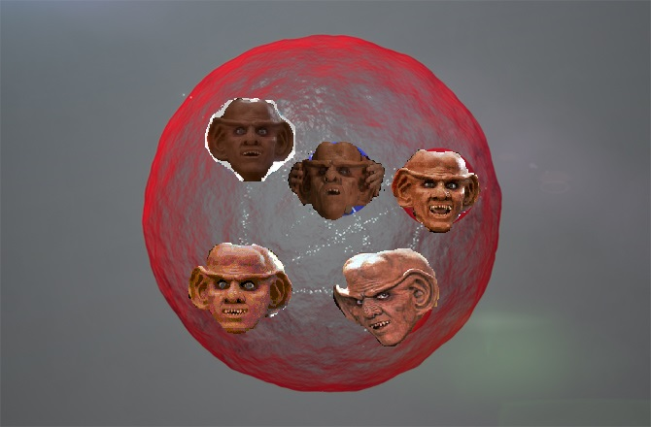

EXOTIC HADRONS
13 July 2015, the LHCb collaboration

Slide 4
DOES SM DESCRIBE ALL EXPERIMENTAL DATA?
The pool of the EW data

Slide 5
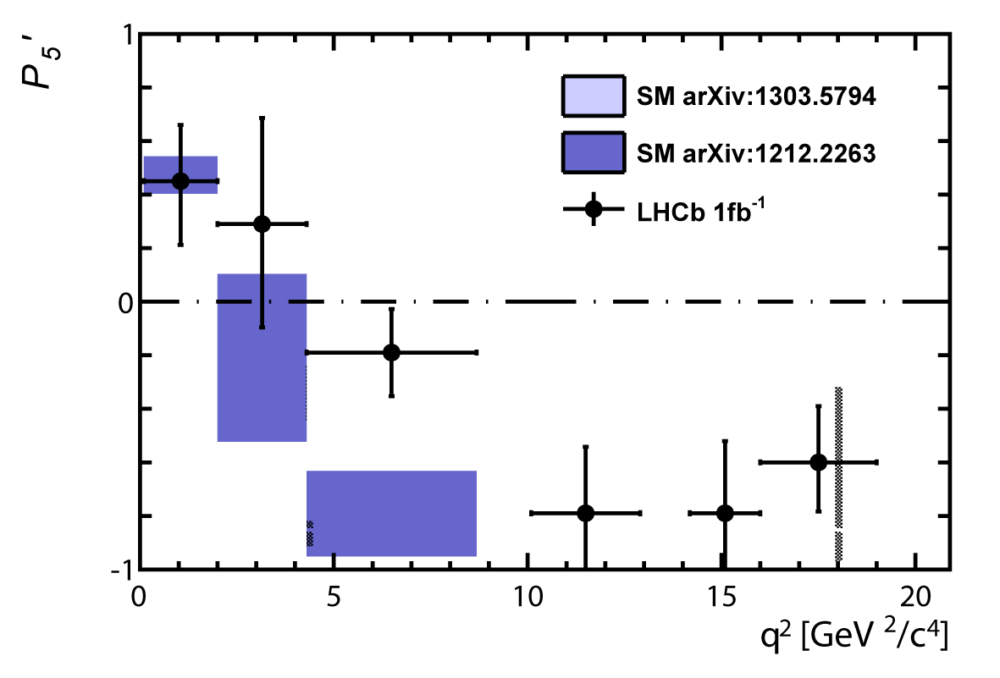
THE LHCB COLLABORATION REPORT
3.7 σ
~ 3 σ

Slide 6

b-s anomaly
up to 3,7 σ
up to 3,1 σ
up to 5 σ !!!
up to 2 σ
В→K* 𝜇⁺𝜇⁻
В→ $φ$𝜇⁺𝜇⁻
В→𝜇⁺𝜇⁻
В→X_{s} 𝜇⁺𝜇⁻

Slide 7
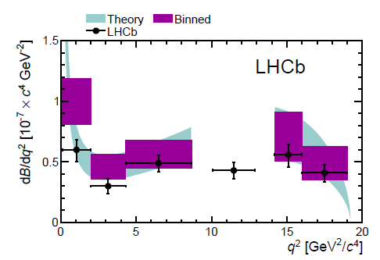
В→K*(K𝜋) 𝜇⁺𝜇⁻

Slide 8
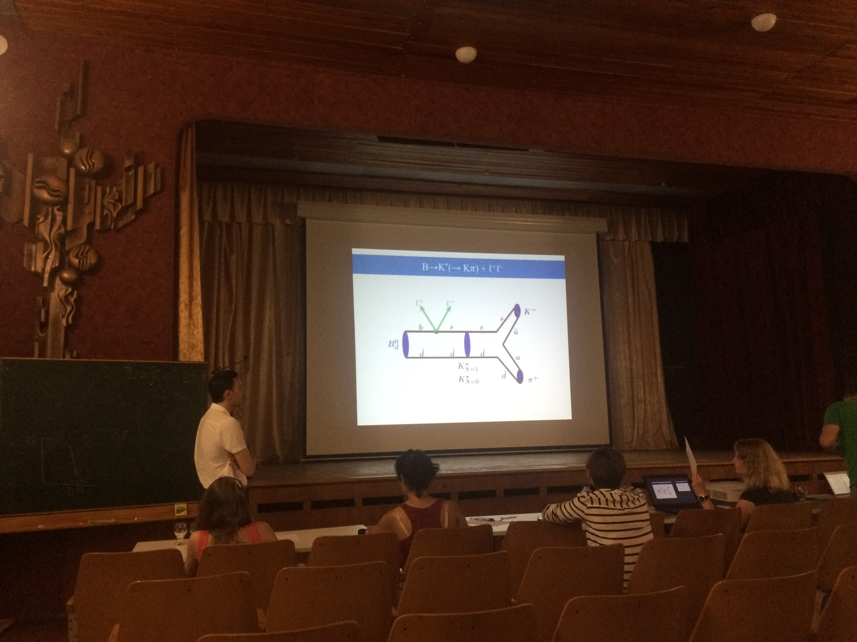
ALUSHTA 2015

Slide 9
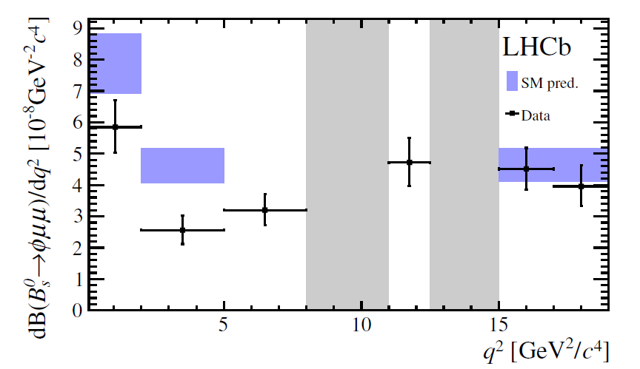
$$B→φℓ^{+}ℓ^{−}$$

Slide 10
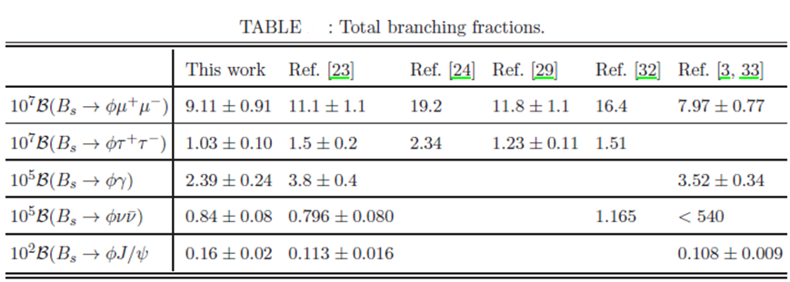
THE VALUES OF BRANCHING FRACTIONS

Slide 11
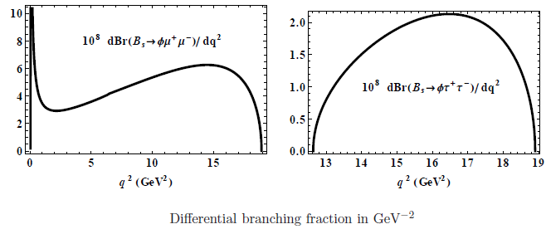
BRANCHING FRACTION

Slide 12
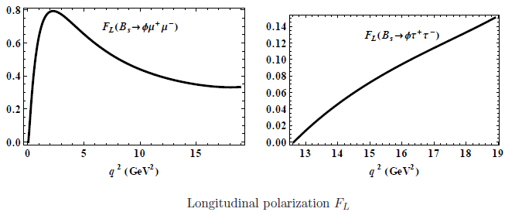
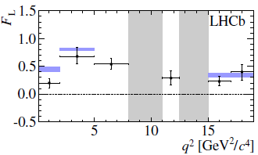
$F_{L}$OBSERVABLE

Slide 13
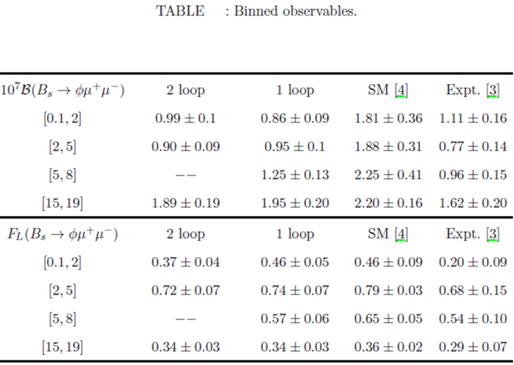
ANGULAR OBSERVABLES AND DIFFERENTIAL BRANCHING

Slide 14
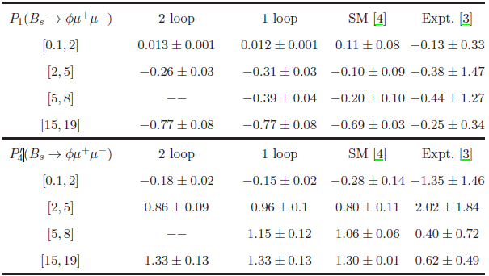
ANGULAR OBSERVABLES AND DIFFERENTIAL BRANCHING

Slide 15
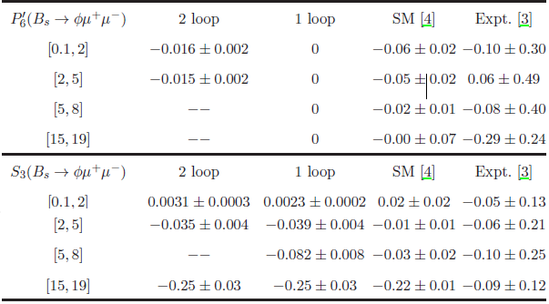
ANGULAR OBSERVABLES AND DIFFERENTIAL BRANCHING

Slide 16
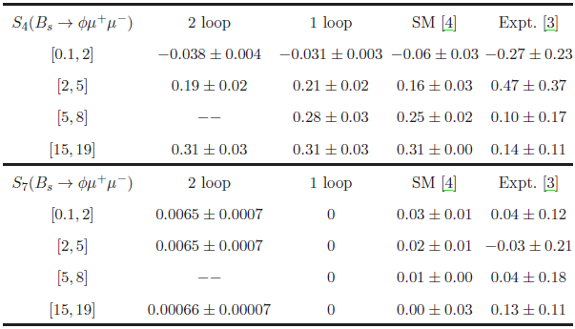
ANGULAR OBSERVABLES AND DIFFERENTIAL BRANCHING

Slide 17

APPLAUSE !
Thank you!

