Slide 1
On the possibility of determining the moisture content in coke (fuel) with a BGO scintillation gamma-detector and a ²³⁹Pu-Be neutron source
D.N. Grozdanov
F.A. Aliyev, C. Hramco, Yu.N. Kopatch, V.M. Bystritsky,
V.R. Skoy, N.A. Gundorin, I.N. Ruskov

Slide 2
Theoretical considerations: Interaction of neutrons with water
Fast neutron Inelastic scattering
Neutron capture
compound nucleus
Hydrogen
¹H (2223.25 keV)
Oxygen
¹⁶O (6129 keV)

Slide 3
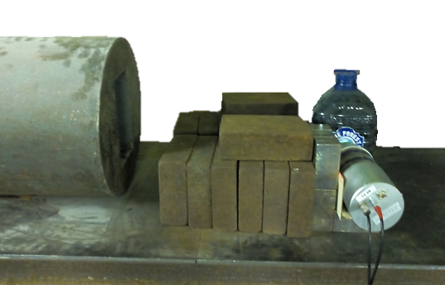
Experimental setup
Shielding
Fe (30 cm)+Bi (5cm)
-Top view-
-Side view-
Shielding
Fe (30 cm)+Bi (5cm)
²³⁹Pu-Be
(5*10⁶ n/s)
Coke (fuel)
BGO
45 cm
8 cm
2 cm
15 cm
15 cm
²³⁹Pu-Be
(5*10⁶ n/s)
BGO
Table

Slide 4
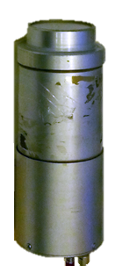
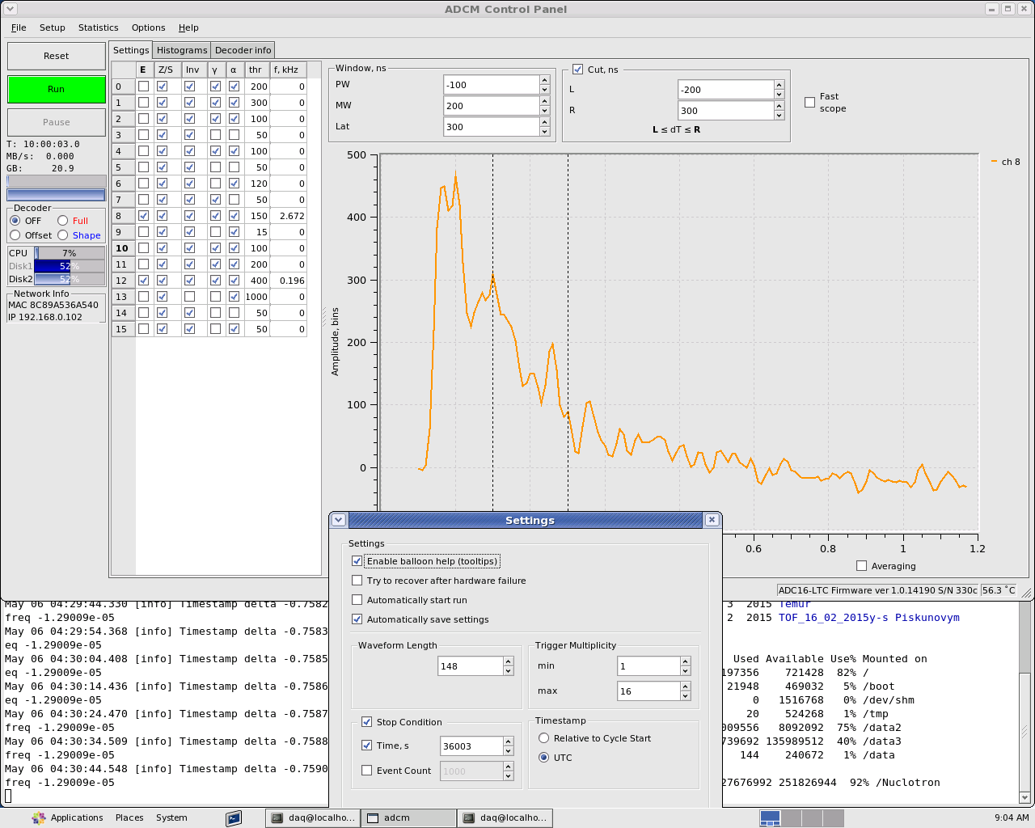
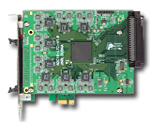
Scintillation detector, electronics and data acquisition
BGO (Ø76 x 65 mm)
ADCM16-LTC, 16-channel/14-bit/100MHz
ADC-boards from AFI Electronics.

Slide 5
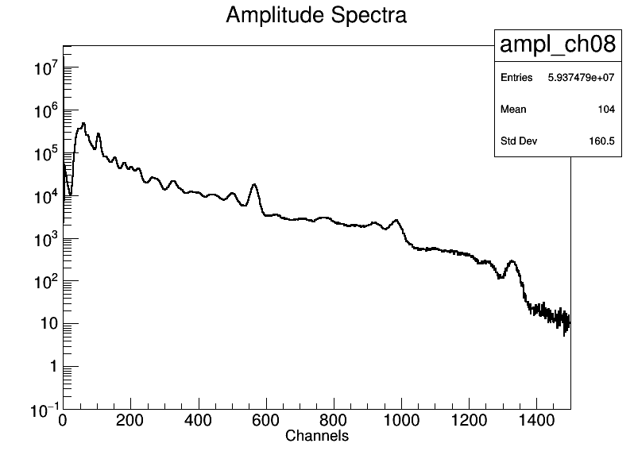
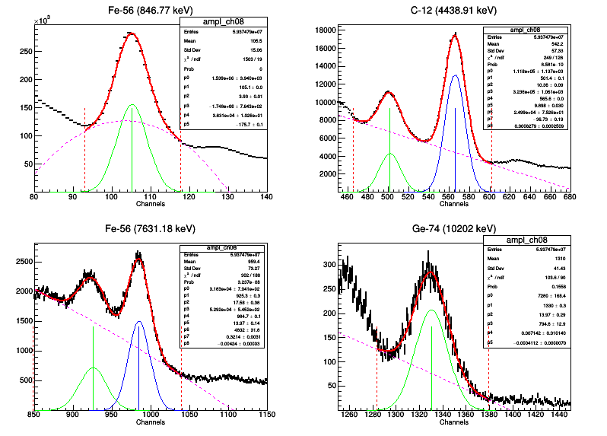
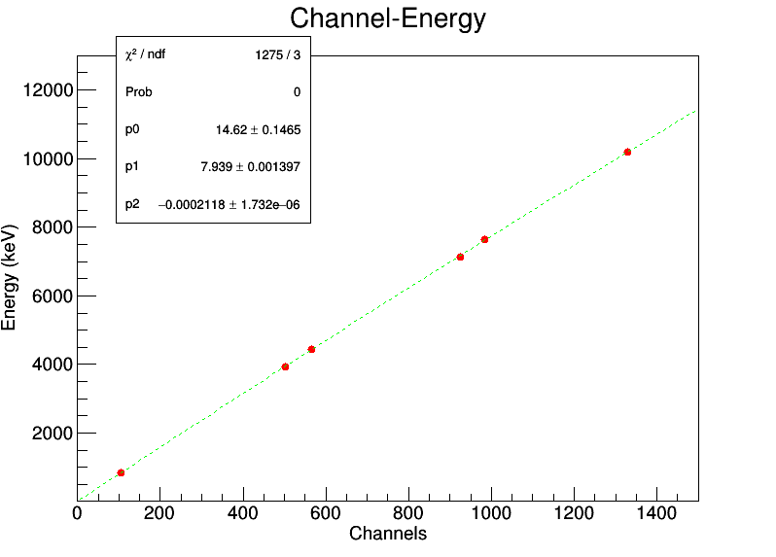
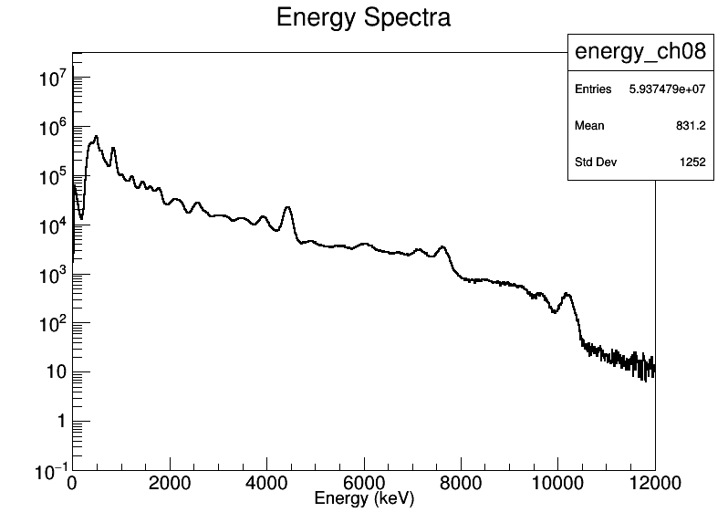
Energy calibration

Slide 6
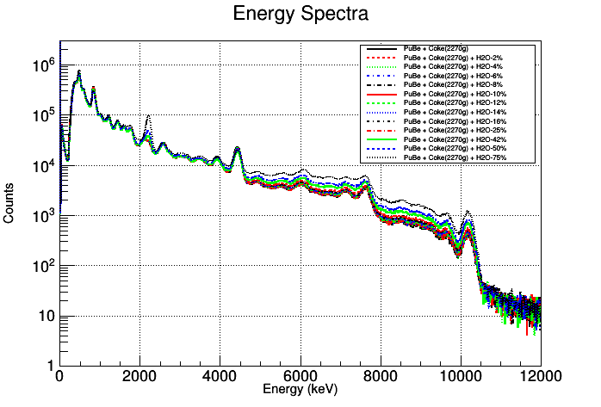
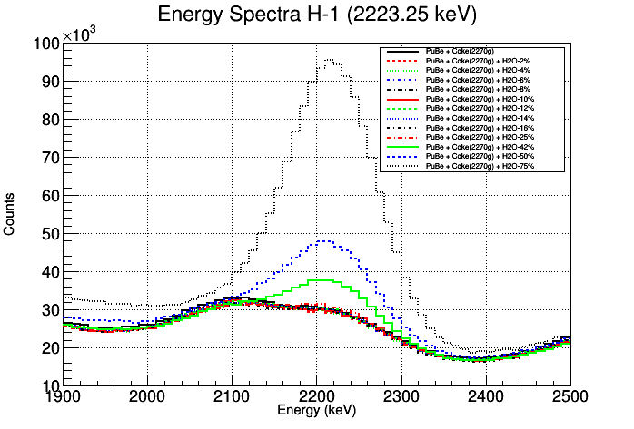
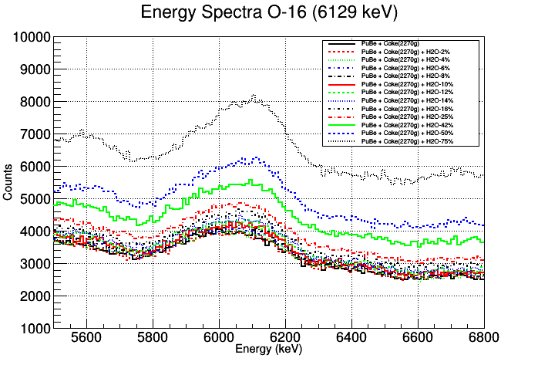
Measuring conditions and some experimental results
A 2 kg coke sample, containing a variable amount of water (from 2% up to 80%),
was irradiated
with ²³⁹Pu-Be neutrons
every time for 10 hours

Slide 7
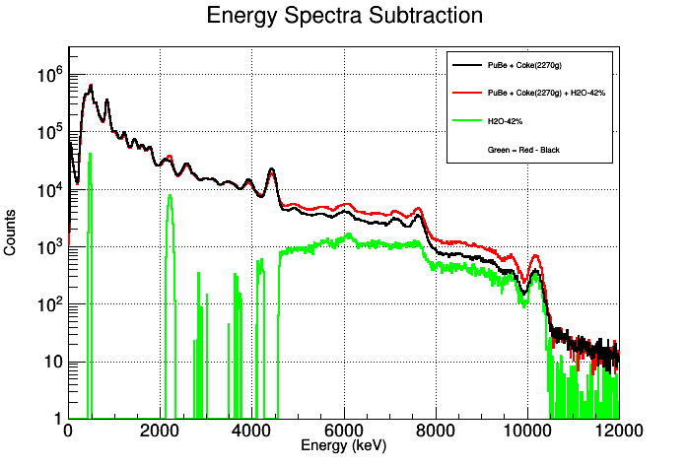
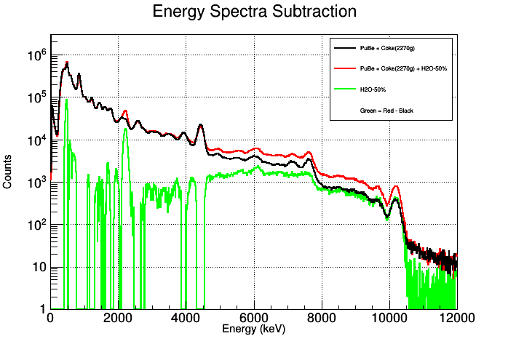
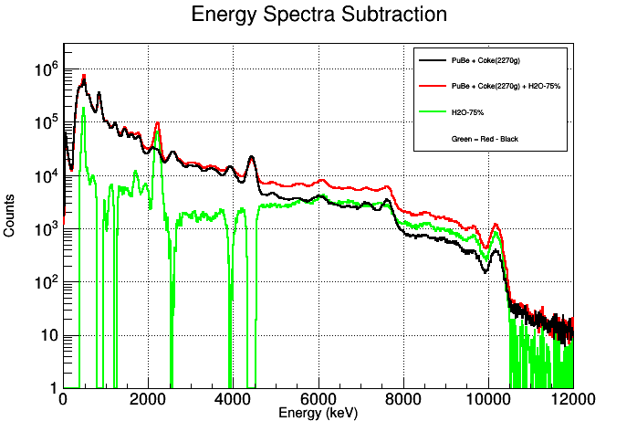
Radiation background subtraction

Slide 8
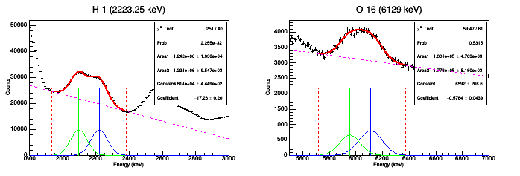
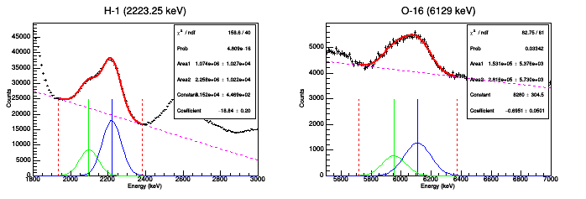
Fit of the experimental data (H₂O) without background subtraction
H₂O - 6 %
H₂O - 42 %

Slide 9
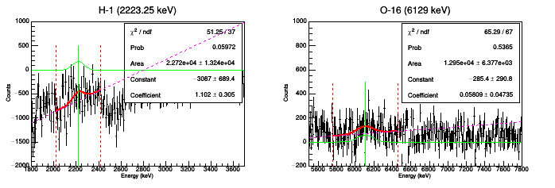
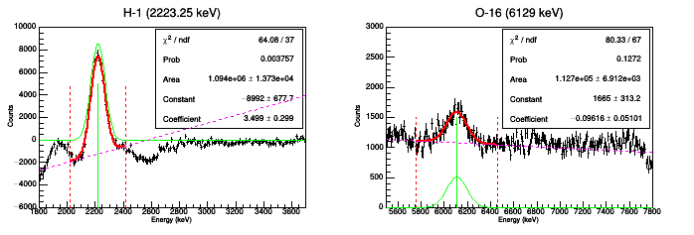
Fit of the experimental data (H₂O) after background subtraction
H₂O - 6 %
H₂O - 42 %

Slide 10
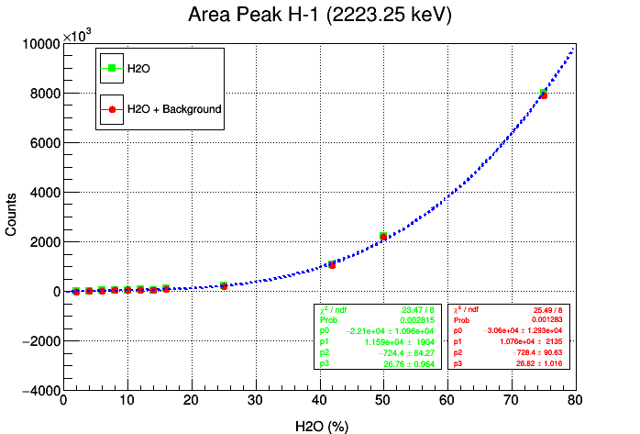
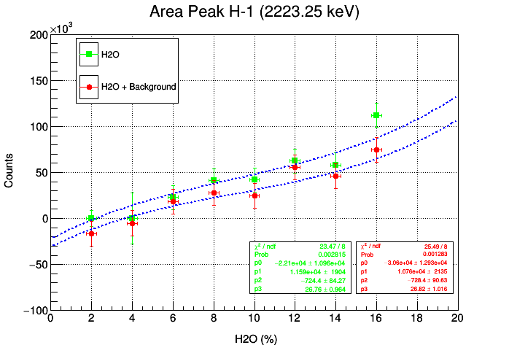
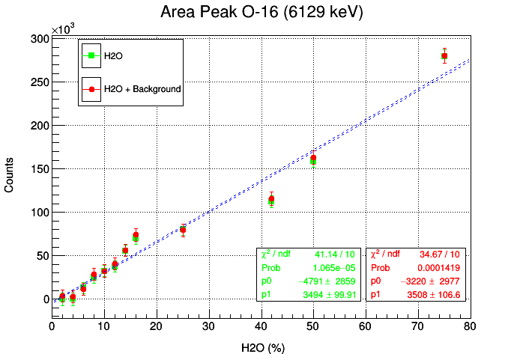
Dependence of the Hydrogen and Oxygen peak areas as function of the amount of water added into the coke sample

Slide 11
Conclusions & outlook
These measurements show that we can determine the amount of water, added into the coke sample, from the characteristic gamma-ray spectra with and without radiation background subtraction.
For more accurate determination of small amount of water in coke samples, new experiments are needed.

Slide 12
Thank you for your attention

