Slide 1
Grid technologies for large-scale projects
N. S. Astakhov, A. S. Baginyan, S. D. Belov, A. G. Dolbilov, A. O. Golunov, I. N. Gorbunov, N. I. Gromova, I. A. Kashunin, V. V. Korenkov, V. V. Mitsyn, V. V. Palichik, S. V. Shmatov, T. А. Strizh, E. А. Tikhonenko, V. V. Trofimov, N. N. Voitishin, V. E. Zhiltsov
Laboratory of Information Technologies
JINR
Alushta, Crimea
2016

Slide 2
Grid technologies - a way to success
On a festivity dedicated to receiving the Nobel Prize for discovery of Higgs boson, CERN Director professor Rolf Dieter Heuer directly called the grid-technologies one of three pillars of success (alongside with the LHC accelerator and physical installations).
Without implementation of the grid-infrastructure on LHC it would be impossible to process and store enormous data coming from the collider and therefore to make discoveries.
Nowadays, every large-scale project will fail without using a distributed infrastructure for data processing.

Slide 3
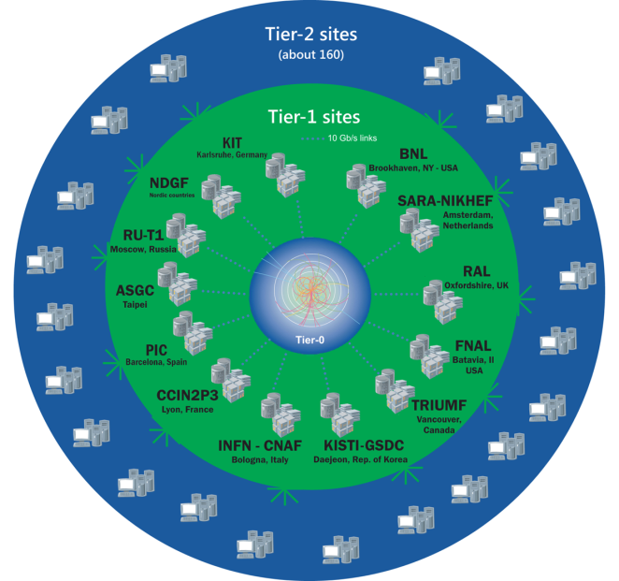
LHC Computing Model
Tier-0 (CERN):
Data recording
Initial data reconstruction
Data distribution
Tier-1 (11→14 centres):
Permanent storage
Re-processing
Analysis
Simulation
Tier-2 (>200 centres):
Simulation
End-user analysis
Dubna, JINR

Slide 4
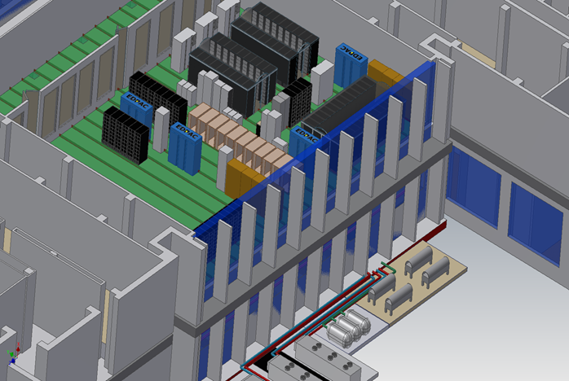
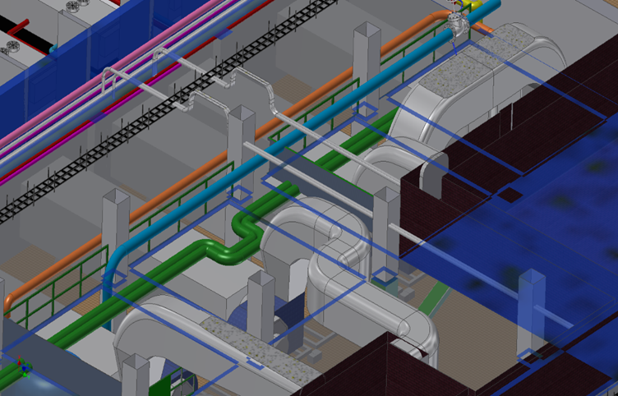
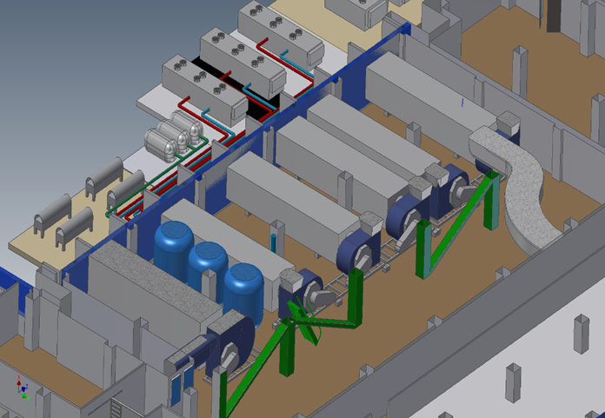
Creation of CMS Tier1 in JINR
Engineering infrastructure (a system of uninterrupted power supply, climate - control);
High-speed reliable network infrastructure with a dedicated reserved data link to CERN (LHCOPN);
Computing system and storage system on the basis of disk arrays and tape libraries of high capacity;
100% reliability and availability.

Slide 5
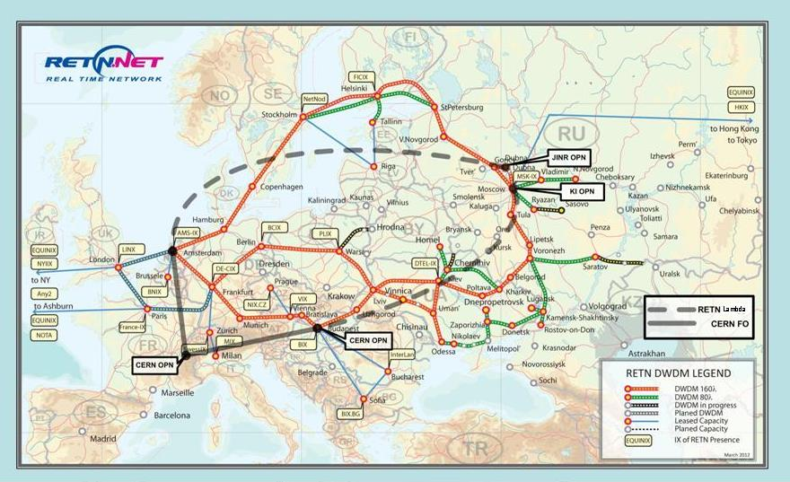
JINR Tier-1 Connectivity Scheme
Notes:
This slide shows the JINR’s Computing Center Scheme of equipment.
Here you can see the JINR Tier 1 connectivity plan with Tier0.
5

Slide 6
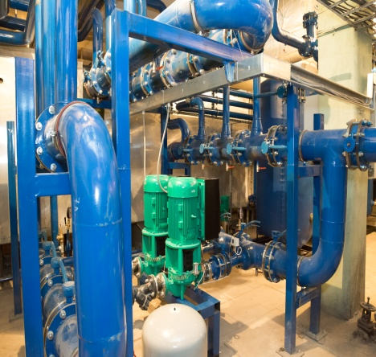
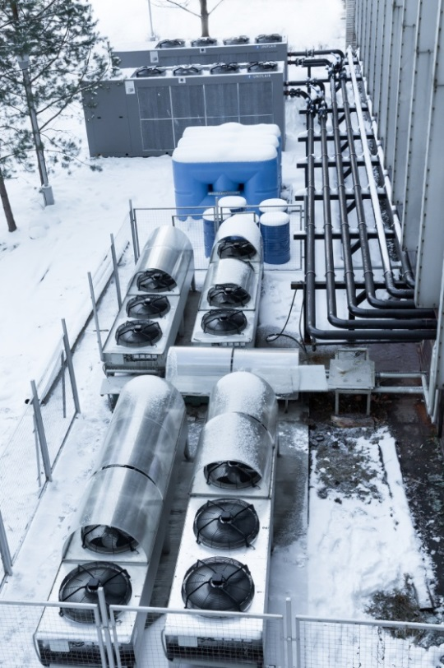
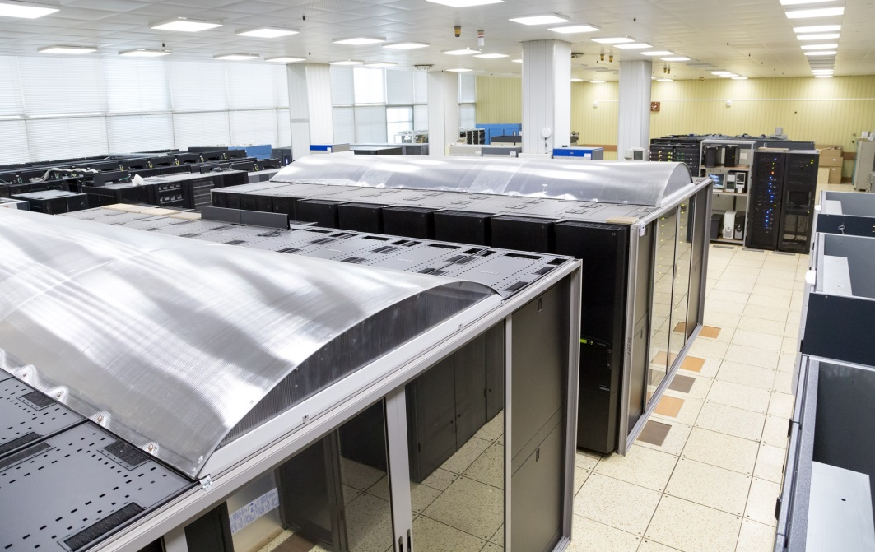
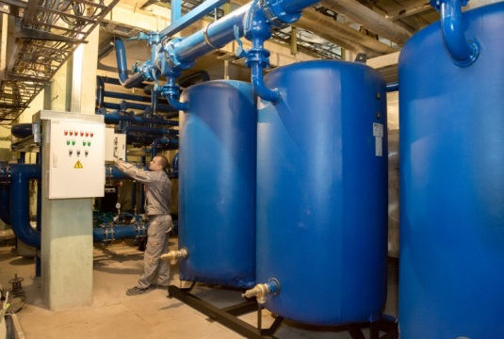
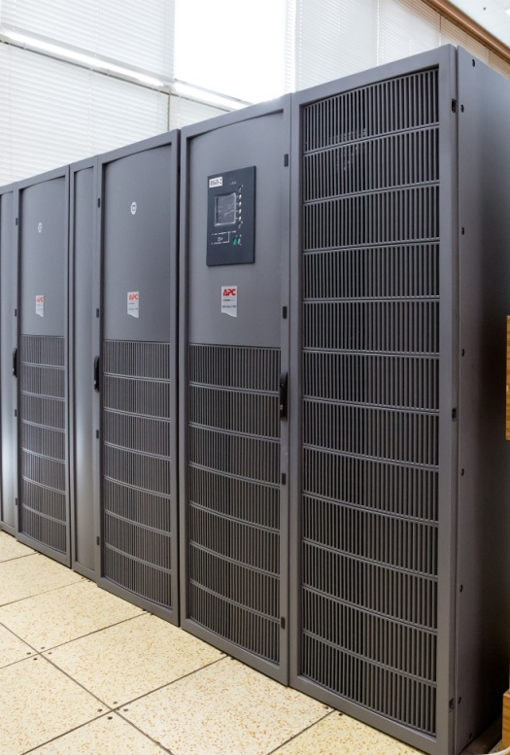
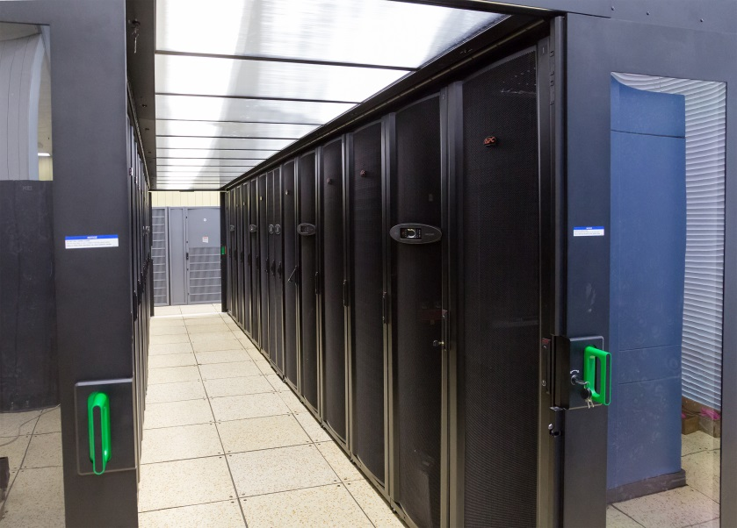
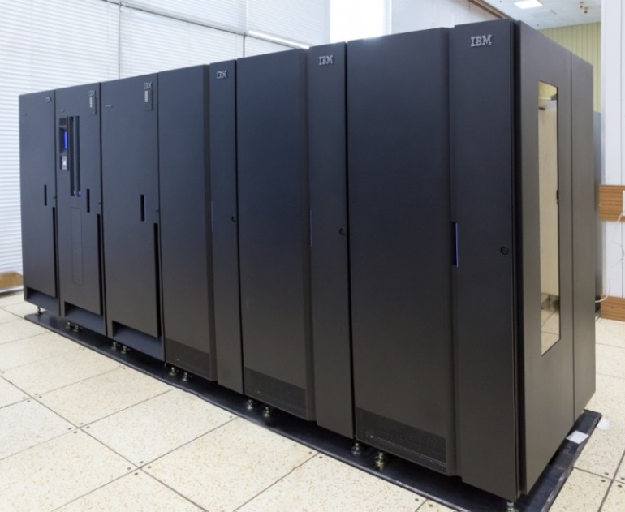
Components of the Tier1
Cooling system
Computing
elements
Tape Robot
Uninterrupted power
supply
Notes:
На базе Центрального информационно-вычислительного комплекса ОИЯИ (ЦИВК ОИЯИ) развивается Многофункциональный центр хранения, обработки и анализа данных, который призван обеспечить широкий спектр возможностей пользователям на основе входящих в него компонент: грид-инфраструктура уровня Tier1 и Tier2 для поддержки экспериментов на LHC (ATLAS, Alice, CMS, LHCB), FAIR (CBM, PANDA) и других масштабных экспериментов; вычислительный кластер общего назначения; инфраструктура «Облачных вычислений»; вычислительный гетерогенный кластер HybriLIT; учебно-исследовательская инфраструктура для распределенных и параллельных вычислений.
В 2014 году проводились интенсивные работы по модернизации инженерной инфраструктуры Многофункционального центра, была введена в эксплуатацию новая система охолождения, установлен новый источник бесперебойного питания, установлен ленточный робот и вычислительные модули.
The existing Central Information and Computing Complex of JINR (CICC JINR) is evolving into a Multifunctional Centre for Data Storage, Processing and Analysis aimed at providing to its users a wide range of possibilities through its main components: a grid-infrastructure at Tier1 and Tier2 levels devoted to the support of the LHC experiments (ATLAS, ALICE, CMS, LHCb), FAIR (CBM, PANDA) and other large-scale experiments; a general purpose computing cluster; a cloud computing infrastructure; the heterogeneous computing cluster HybriLIT; an education and research infrastructure for distributed and parallel computations.
In 2014 works on the modernization of the underlying engineering infrastructure of the Multifunctional Center were done: a new cooling system was brought into operation; there were installed a new uninterruptible power supply unit, a tape robot, and computing modules.
6

Slide 7
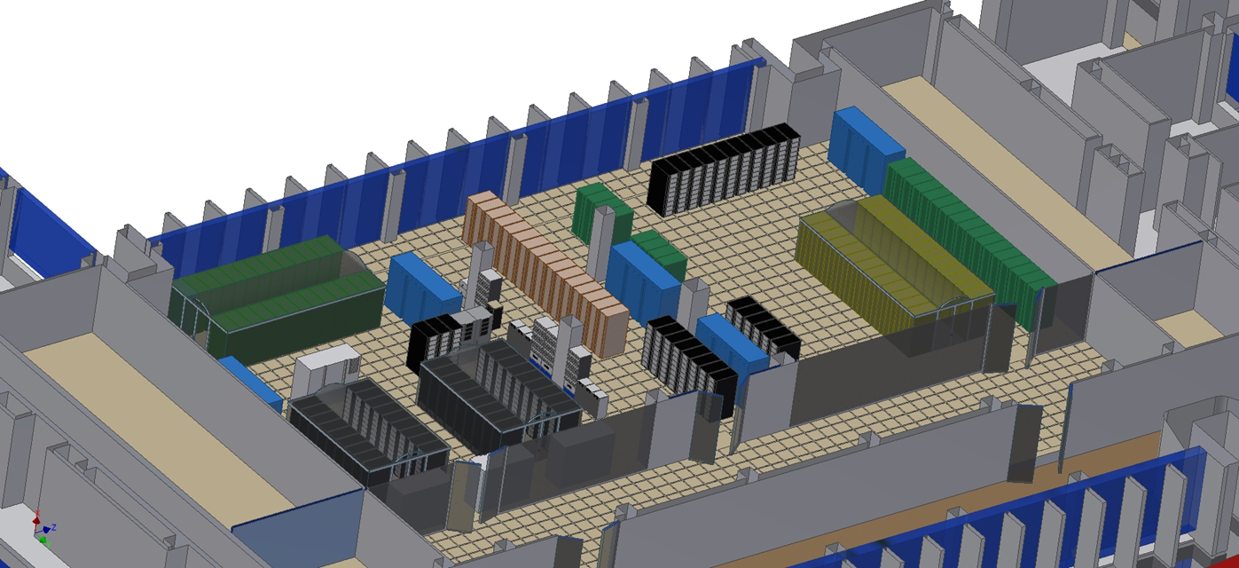
Current configuration and plans
3600 cores (~ 45 kHS06)
5 PB tapes (IBM TS3500)
2,4 PB disk
Annual increase
11,5 kHS06
1,6 PB tapes
0,9 PB disk

Slide 8
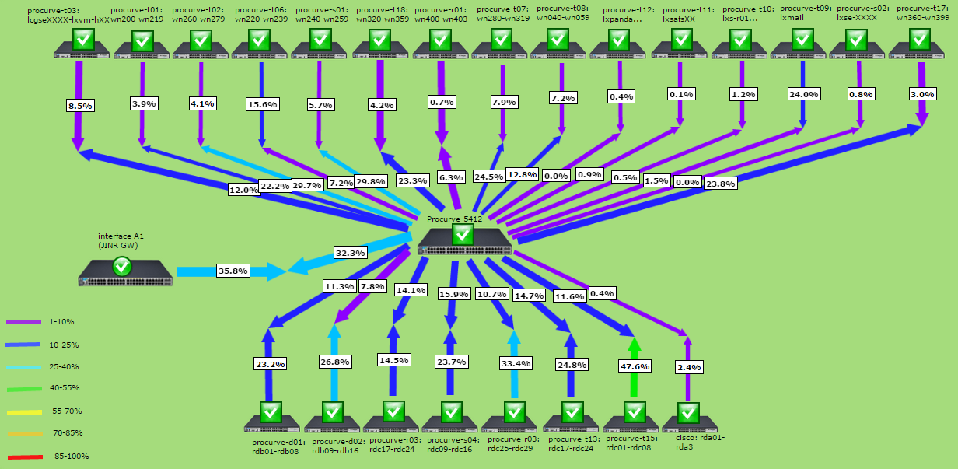
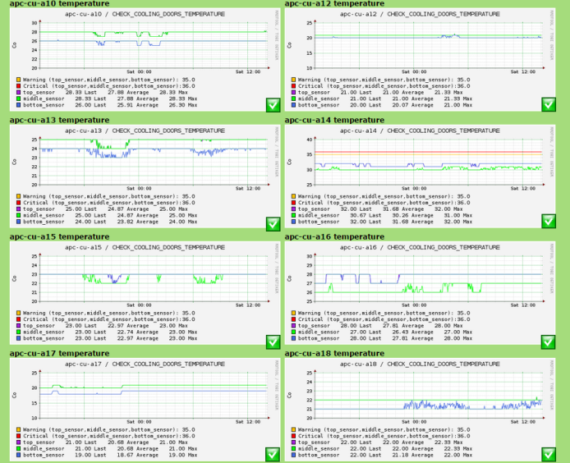
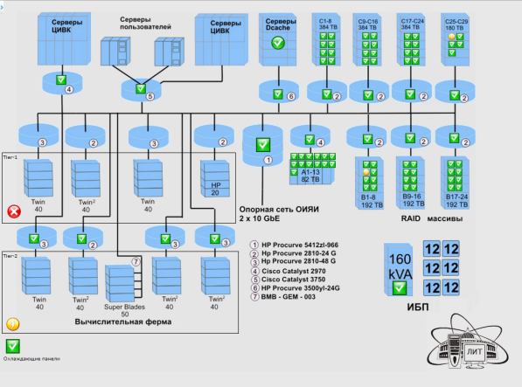
JINR Tier-1 monitoring system
JINR Tier-1 monitoring system provides real-time information about:
work nodes;
disk servers;
network equipment;
uninterruptible power supply elements;
cooling system.
It also can be used for creating network maps and network equipment load maps, for drawing state tables and different plots.

Slide 9
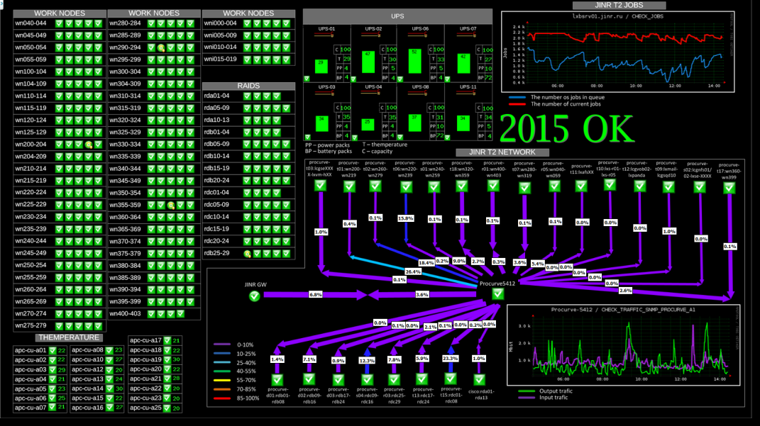
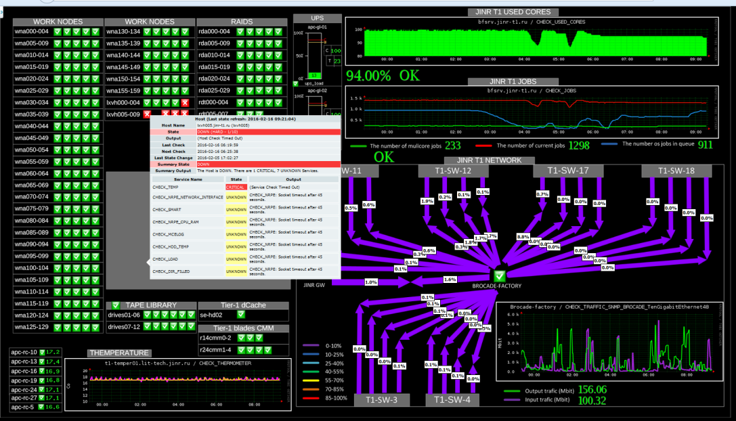
JINR Tier’s Dashboard

Slide 10
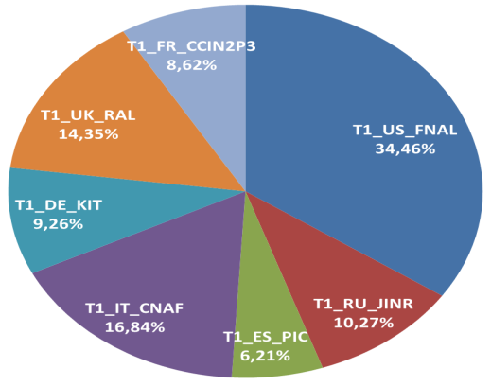
Usage of Tier1 centers by the CMS experiment (last month)
JINR Tier-1 CMS
617 413 jobs

Slide 11
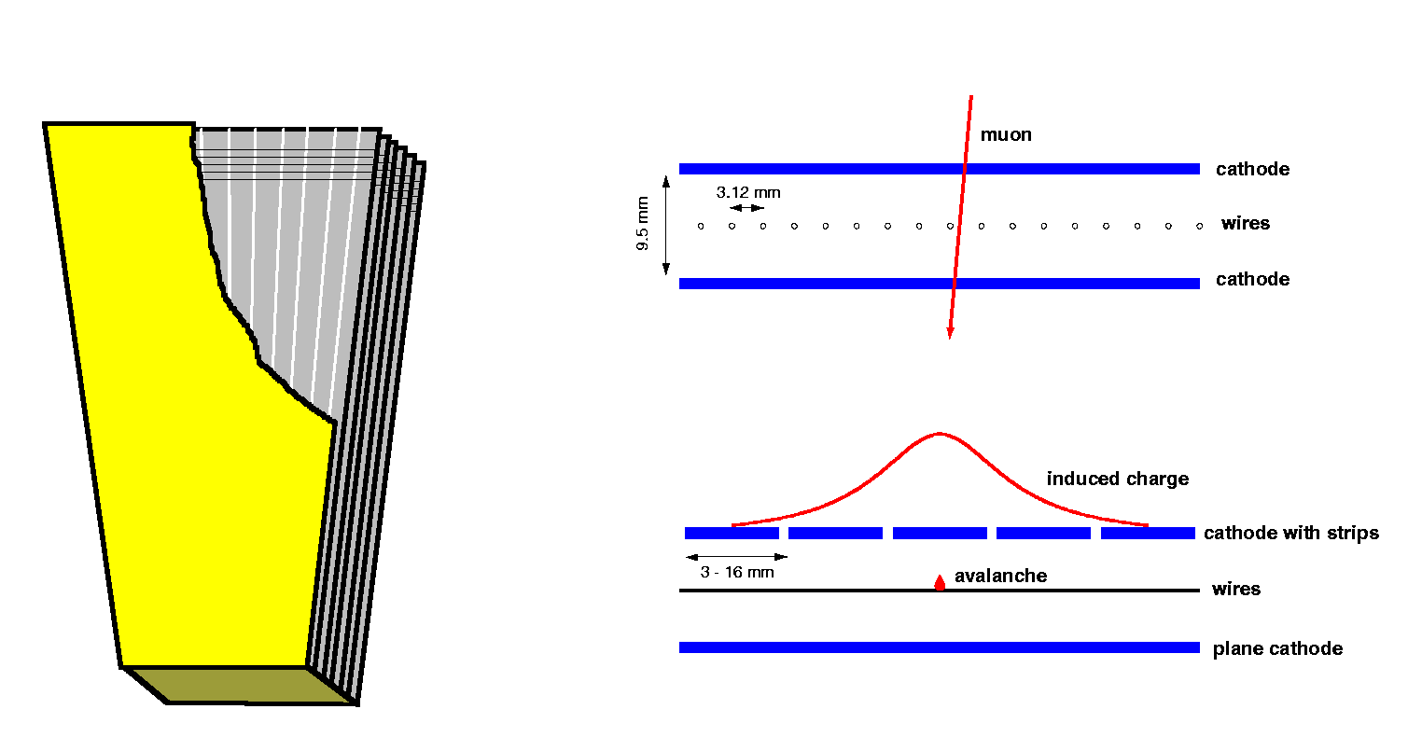
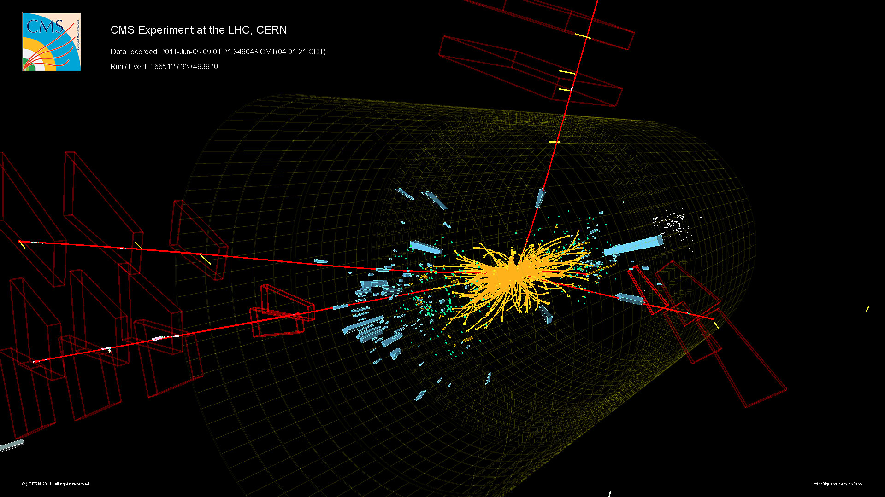
JINR LIT CMS group Cathode Strip Chambers (CSC)

Slide 12
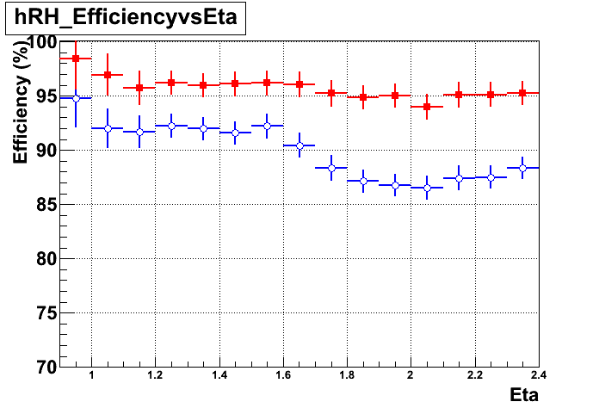
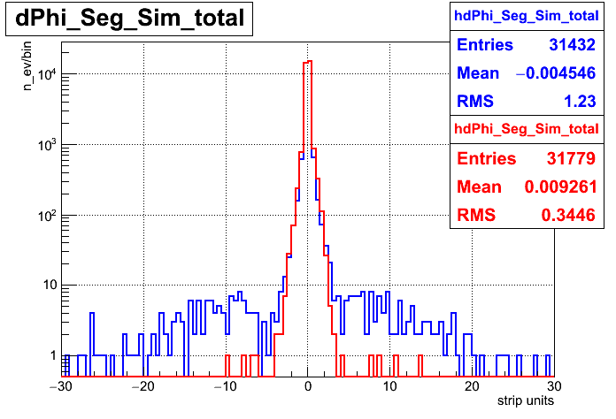
JINR LIT CMS group Development of a new CSC segment building algorithm
The new CSC segment building algorithm takes into account the interaction point
1 TeV MC muons
Reconstruction efficiency vs pseudorapidity
Difference in angles of the reconstructed and simulated segments (strip_unit ~ 3mrad)
~5000 CRAB jobs
~5TB skimmed datasets

Slide 13
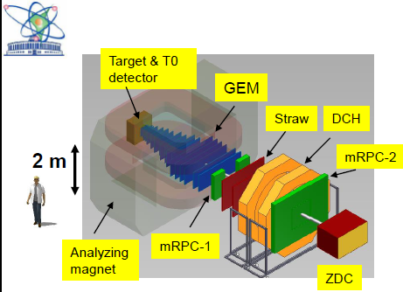
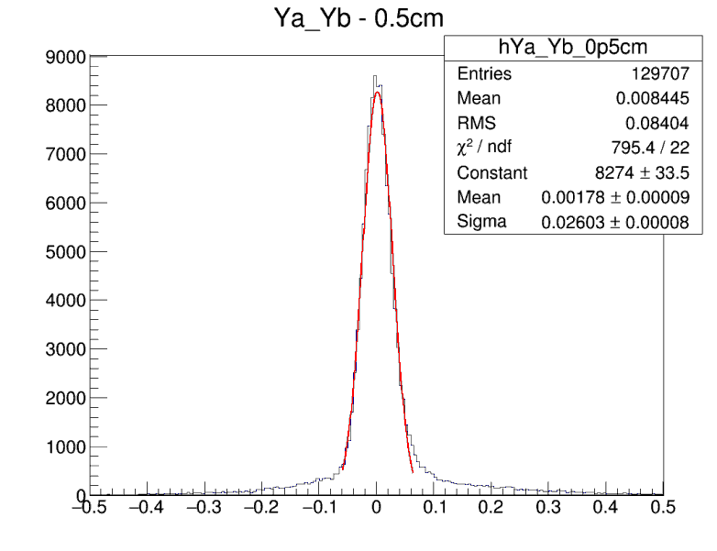
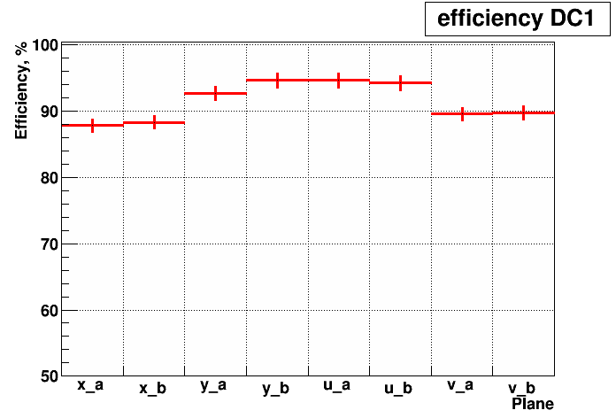
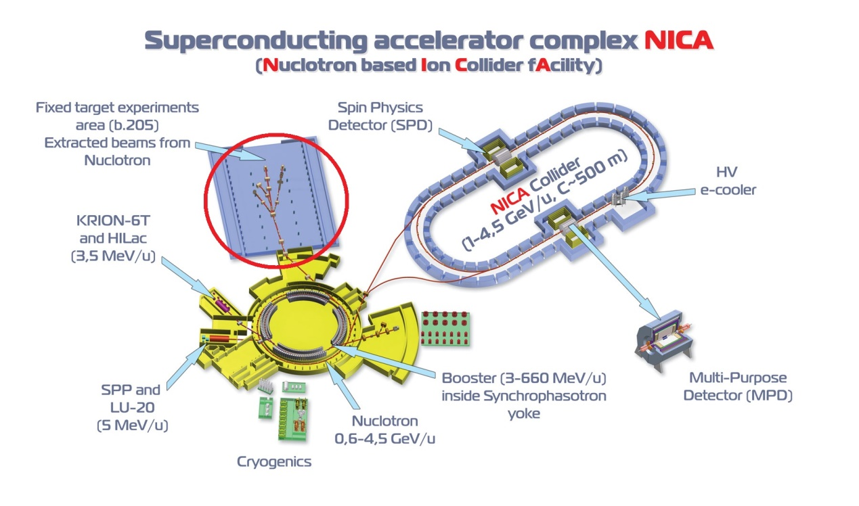
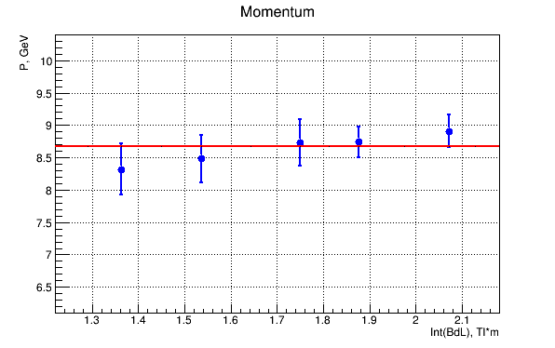
Baryonic Matter at Nuclotron
DCH Detector Resolution
DCH Detector
Efficiency
184 μm
Fixed target experiment
Proton and gold beams
1-6 GeV per nucleon
184 μm
BM@N
Momentum measurement:
8.68 GeV/c ± ^{2.6%}
4.3%

Slide 14
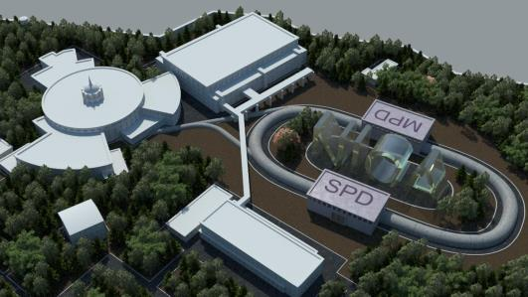
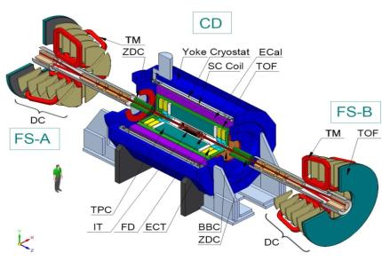
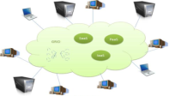
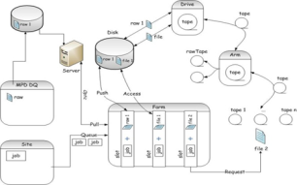
NICA Project
NICA project data amount estimation:
High frequency of registered events (up to 6 КHz);
in Au-Au collisions at the expected energies more than 1000 charged particles per event will be produced;
overall number of events – 19 billions;
overall amount of data produced per year – 30 PB and 8.4 PB more after analysis.
The model of a distributed computer infrastructure
The model for detailed investigation and estimation:
Tape robot,
Disk array,
CPU Cluster.

Slide 15
Conclusions
The concept of grid perfectly fits the LHC project, making possible tremendous amounts of data transfers and job processing.
The JINR Tier-1 site along with the Russia Tier-2 sites gives the possibility for physicists from JINR, member states to fully participate in processing and analysis of the LHC experimental data.
An enormous experience in building and maintaining big data processing and storing center was obtained that can be very useful for the development of large scale projects at JINR and other member states.

Slide 16
Thank you for your attention!

Slide 17
Back-up slides

Slide 18
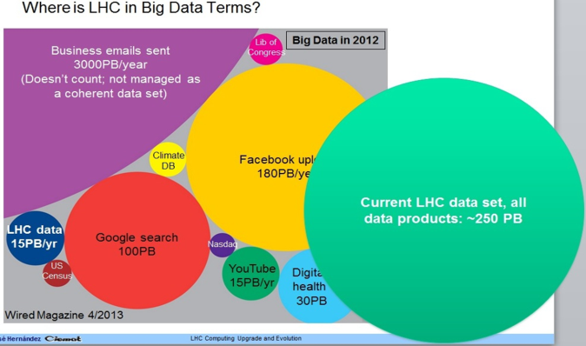
Stepping into Big Data era
The comparison plot of the worldwide processed data shows that the amount of data that comes from the LHC fits the term of Big Data.
The expected amount of data received from LHC should become 2.5 times bigger in Run2, that will require the increase in resources and the optimization of their usage.

