Slide 1
Production of Λ hyperons
in interactions
of the 4A GeV carbon beam
with C, Al, Cu targets
A.Zinchenko, Yu.Gornaya, M.Kapishin,
G.Pokatashkin, I.Rufanov, V.Vasendina
for the BM@N collaboration
VBLHEP, JINR, Dubna, Russia
BM@N collaboration
analysis meeting
30.05.2019

Slide 2
Outline
Technical run with carbon beam (March 2017)
BM@N detector set-up
Data analysis (C+C, C+Al, C+Cu at 4A GeV)
Selection criteria
Reconstructed signal of Λ (dN/dY & dN/p_{T} spectra)
Data ˗ MC agreement: multiplicity, momentum spectra
Decomposition of Λ reconstruction efficiency
Trigger and mean impact parameters
Cross section and yields of Λ
Reconstructed p_{T} spectra of Λ and extracted temperature
Systematic errors and extrapolation factors
Summary and plans

Slide 3
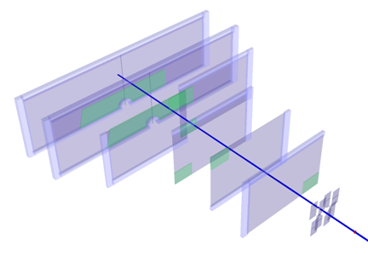
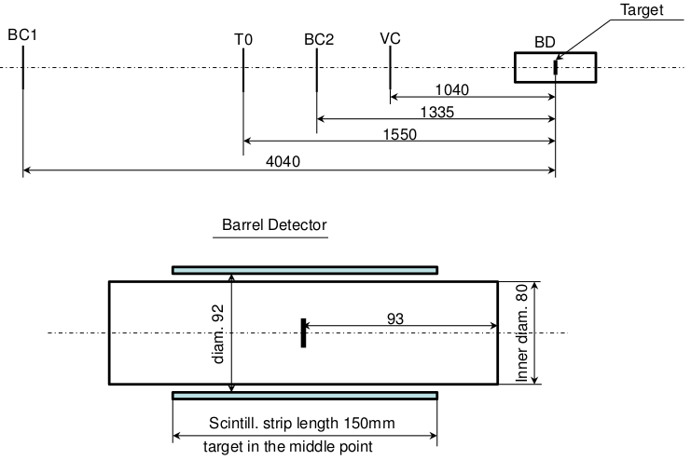
BM@N set-up in carbon run
ECAL
MWPC
GEM
T₀T
BM
Outline
ZDC
Analyzing magnet SP-41
DCH-1,2
Si plane
ToF-400,700
Central tracker in carbon run.
Schematic view and positions of the beam counters,
barrel detector and target.

Slide 4
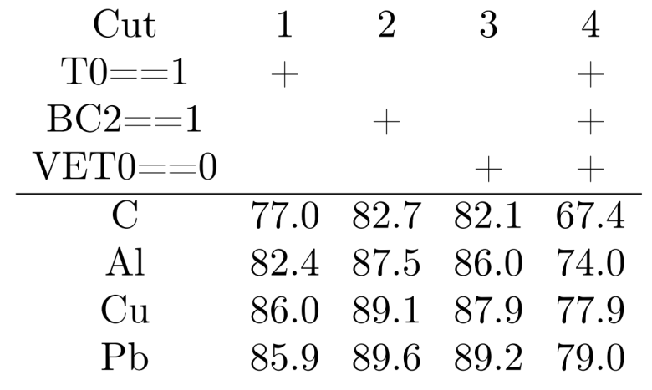
Event selection criteria
Number of tracks in selected events: pos>=1, neg>=1;
Beam halo, pile-up suppression within the readout time window: number of signals in the start detector: T0=1, number of signals in the beam counter: BC2=1, number of signals in the veto counter around the beam: Veto=0;
Trigger condition in the barrel multiplicity detector: number of signals BD>=2 or BD>=3 (run dependent).
Table 1. Number of triggered events, beam fluxes and integrated luminosities collected in the carbon beam of 4A GeV.
Interactions (target thickness) | Number of triggers / 10⁶ | Integrated beam flux / 10⁷ | Integrated luminosity / 10³⁰ cm⁻²
C+C (9mm) | 4.57 | 6.99 | 7.16
C+Al (12mm) | 5.35 | 4.41 | 3.11
C+Cu (5mm) | 5.31 | 4.57 | 1.98

Slide 5
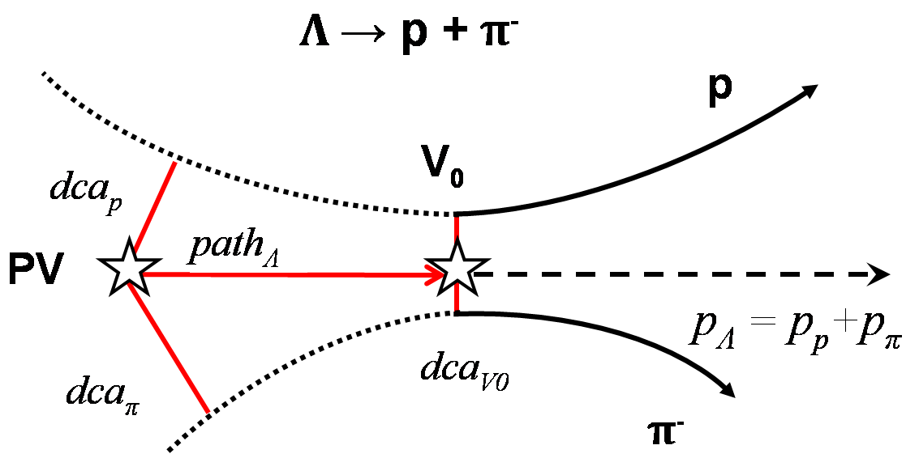
Λ hyperon selection criteria
Number of hits in 1 Si + 6 GEM per track > 3
Momentum range of positive tracks: 0.5 <p_{pos}< 3.9 GeV/c
Momentum range of negative tracks: 0.3<p_{neg}< 1.8 GeV/c
Distance of minimum approach of V0 tracks: dca< 1 cm
Distance between V0 and primary vertex: path > 2.5 cm
Event topology:
PV – primary vertex
V₀ – vertex of hyperon decay
dca – distance of the closest approach
path – decay length
Table2. Reconstructed signals of Λ in p_{T} and y bins.
Target Interval | Y intervals |  |  | Target Interval | p_{T} intervals
 | C | Al | Cu |  | C | Al | Cu
1.2-1.45 | 103±32 | 265±54 | 591±83 | 0.1-0.3 | 454±82 | 652±101 | 625±103
1.45-1.65 | 250±52 | 510±70 | 601±72 | 0.3-0.55 | 296±53 | 717±96 | 797±97
1.65-1.85 | 338±69 | 550±87 | 576±93 | 0.55-0.8 | 128±37 | 462±78 | 379±74
1.85-2.1 | 253±61 | 443±87 | 371±81 | 0.8-1.05 | no | 96±47 | 133±53

Slide 6
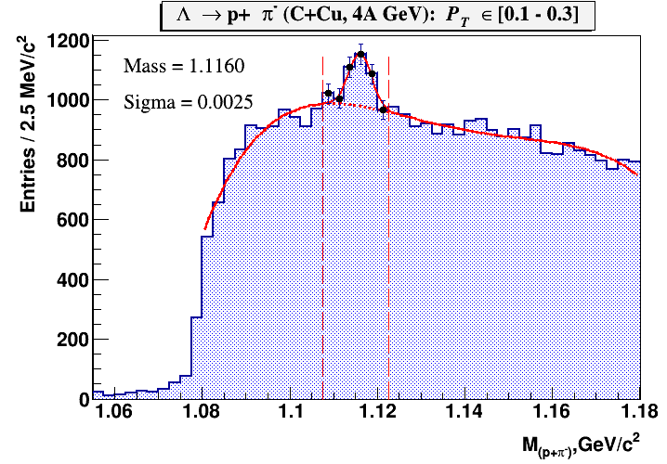
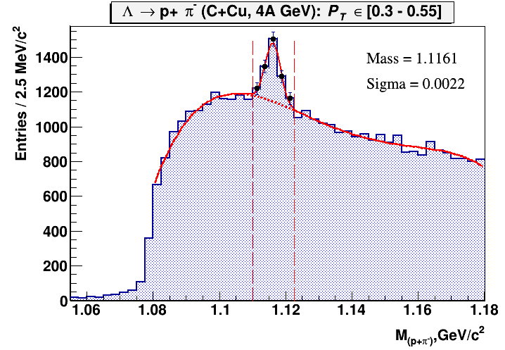
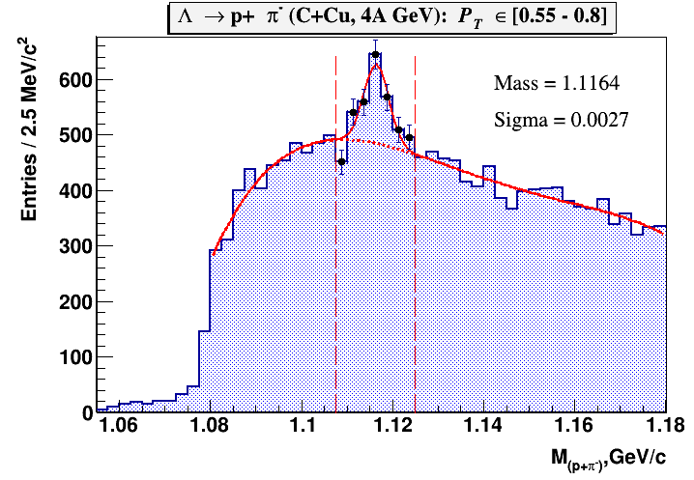
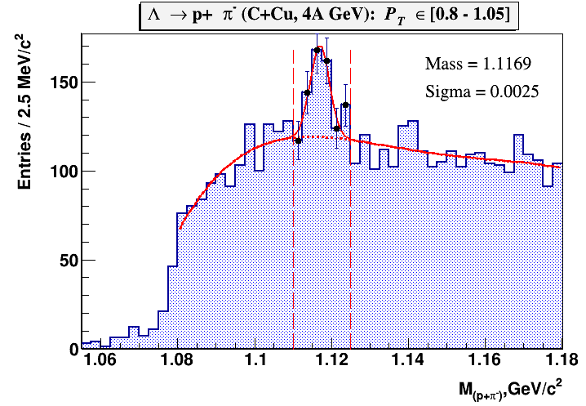
Signal of Λ in C+Cu interaction
Fig. 4. Λ→pπ⁻ signal reconstructed in C+Cu interaction in bins of the transverse momentum p_{T}. The signal is fitted by a Gaussian function, the background is fitted by the 4th degree polynomial.

Slide 7
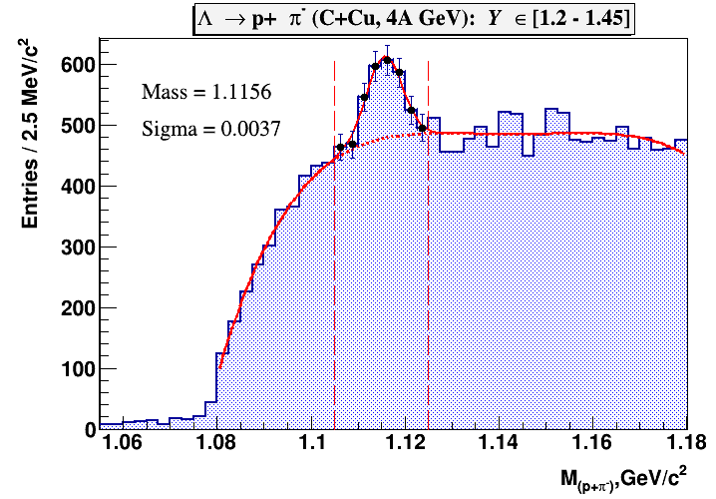
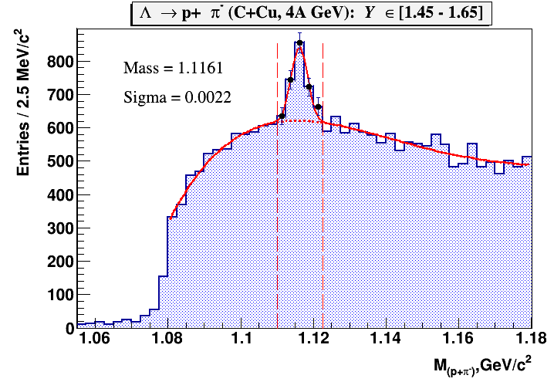
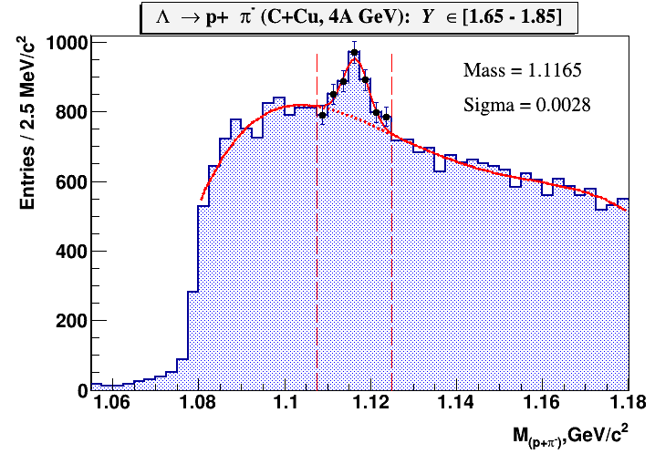
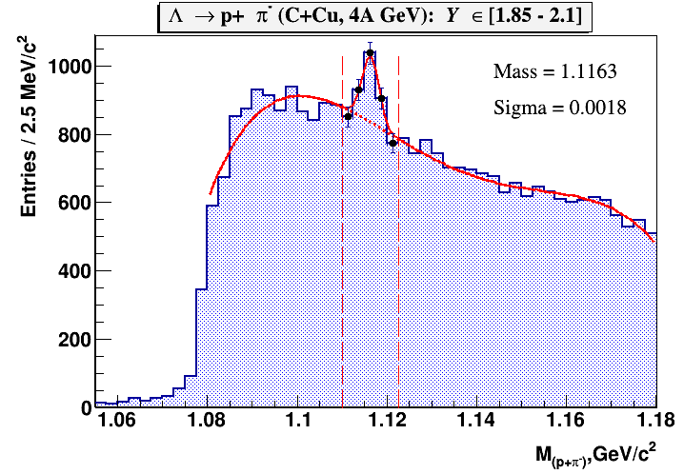
Signal of Λ in C+Cu interaction
Fig. 7. Λ→pπ⁻ signal reconstructed in C+Cu interaction in bins of the rapidity y. The signal is fitted by a Gaussian function, the background is fitted by the 4th degree polynomial.

Slide 8
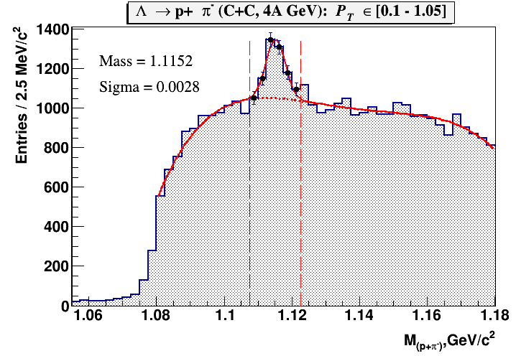
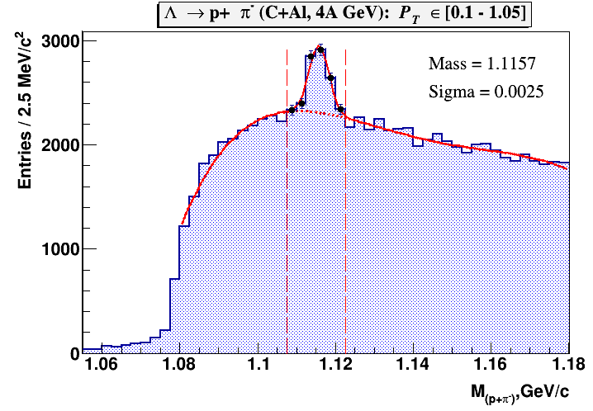
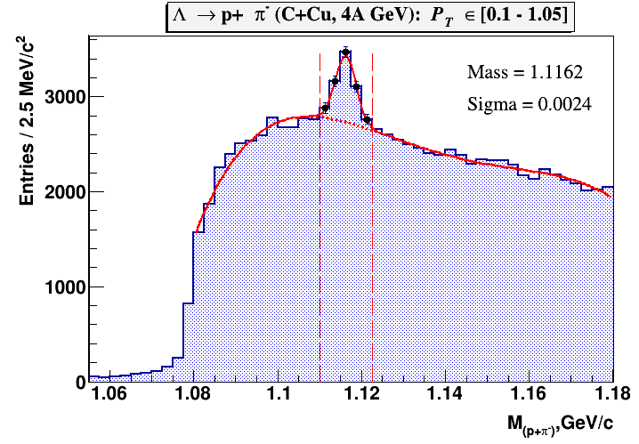
Signal of Λ in C+C, C+Al, C+Cu interactions
Fig. 8. Λ→pπ⁻ signal reconstructed in interactions of the carbon beam with targets: C, Al, Cu.

Slide 9
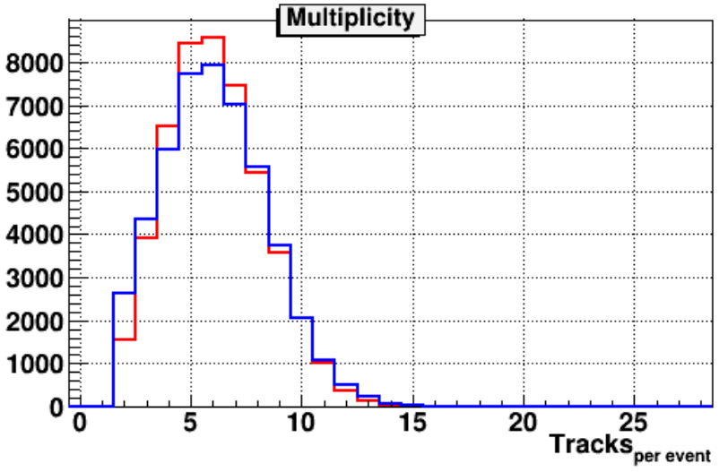
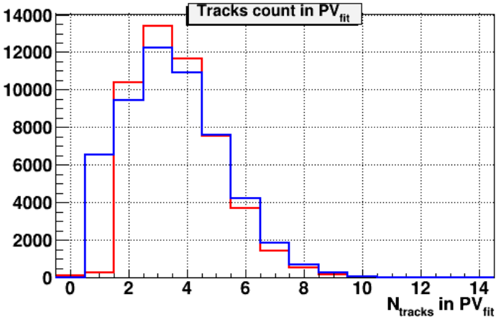
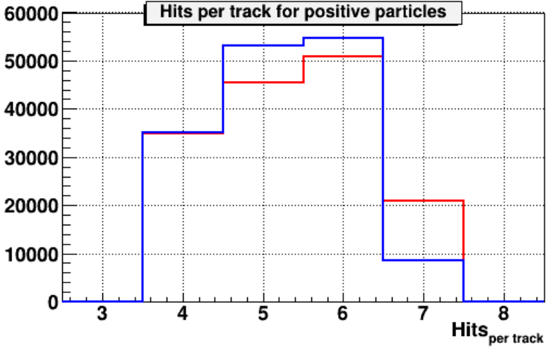
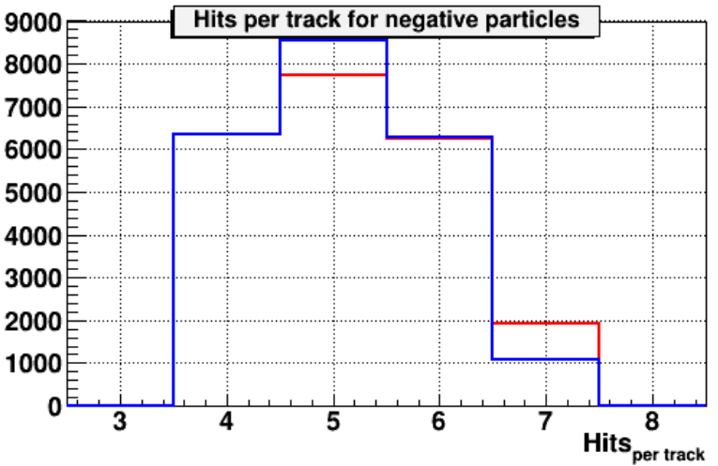
Comparison of experimental data and MC
Fig.9. Comparison of experimental distributions (red lines) and MC (DCM-QGSM) (blue curves) in C+Cu interaction: track multiplicity per event; number of tracks reconstructed in the primary vertex; number of hits per positive particle reconstructed in 1 Si + 6 GEM detectors; number of hits per negative particle.

Slide 10
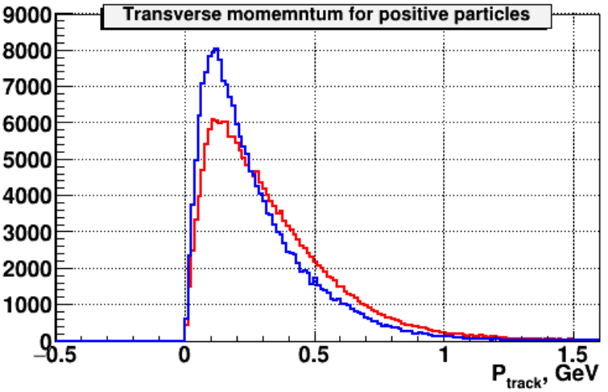
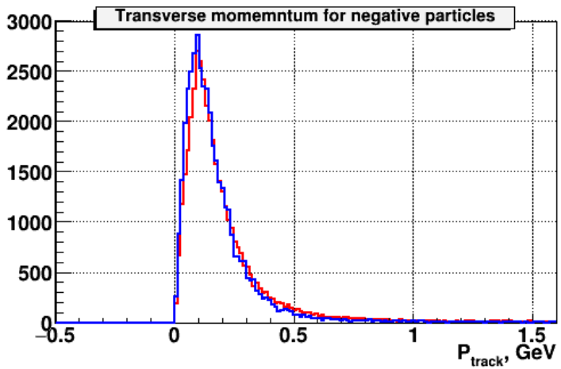
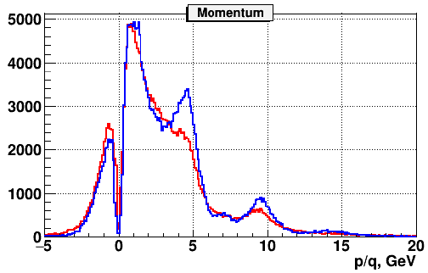
Comparison of experimental data and MC
Fig. 10. Comparison of experimental data (red curves) and MC (DCM-QGSM) simulation (blue curves) in C+Cu interaction: transverse momentum of positive particles; transverse momentum of negative particles; total momentum of negative (p/q<0) and positive particles (p/q>0).

Slide 11
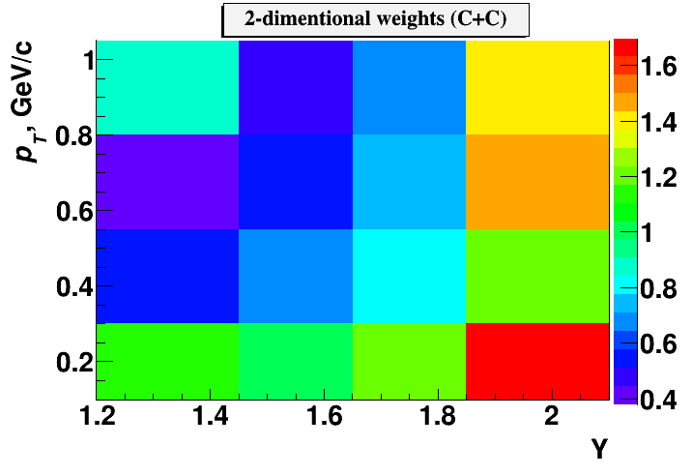
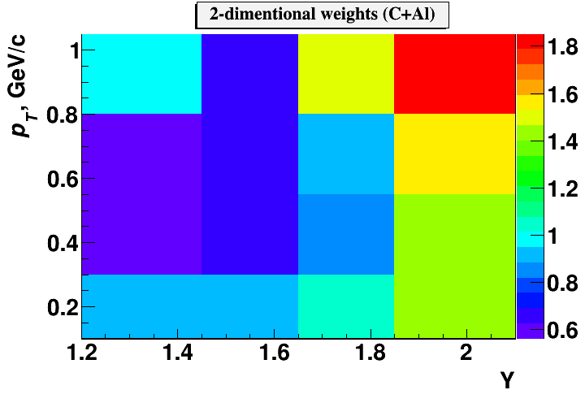
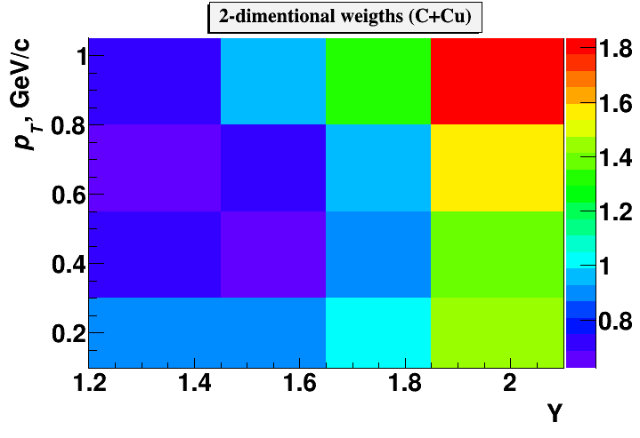
Decomposition of efficiency
Table 3. Decomposition of Λ reconstruction efficiency.
Reconstruction efficiency | ε _{rec} = ε_{acc} ·ε_{emb}· ε_{cuts}
Λ geometrical acceptance in GEM detectors | ε_{acc} = N_{acc} (y,p_{T}) / N_{gen} (y,p_{T})
Efficiency of reconstruction of embedded Λ | ε_{emb}= N_{emb}(y,p_{T}) / N_{acc}(y,p_{T})
Efficiency of Λ selection: kinematical and spatial cuts | ε_{cuts} = N_{rec}(y,p_{T}) / N_{emb}(y,p_{T})
2-dimentional (p_{T},y) distributions of reconstructed Λ decay candidates in data and Monte Carlo do not perfectly agree in the shape. To adjust the Monte Carlo to the data, weights were calculated as a ratio of the normalized spectra of experimental data to the normalized spectra of simulated events: w(y,p_{T}) = N_{data}(y,p_{T})/N_{rec}(y,p_{T}).
The 2-dimentional weights are shown in Fig.14. These weights were used to obtain 1-dimentional efficiencies according to the formula:
ε_{rec} (p_{T}) = Σ_{y}(N_{rec} (y,p_{T})∙w(y,p_{T})) / Σ_{y}(N_{gen} (y,p_{T})∙w(y,p_{T}))
ε_{rec} (y) = Σ_{pT}(N_{rec} (y,p_{T})∙w(y,p_{T})) / Σ_{pT}(N_{gen} (y,p_{T})∙w(y,p_{T}))
Fig.14. 2-dimentional weights w(y,p_{T}).

Slide 12
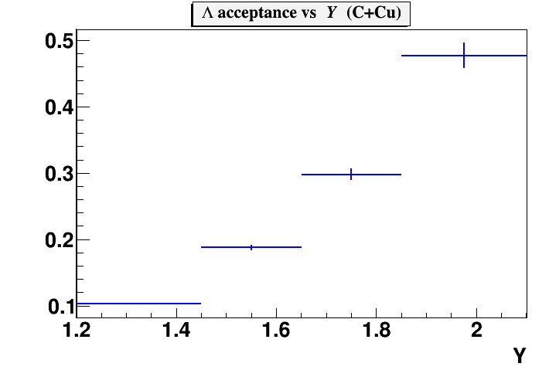
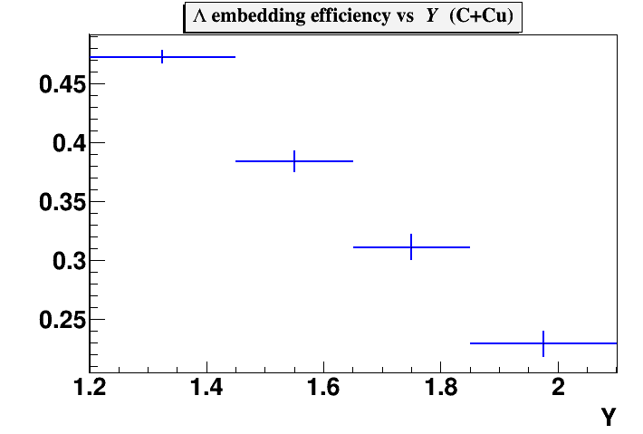
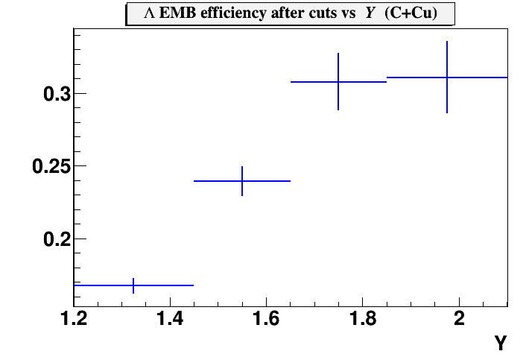
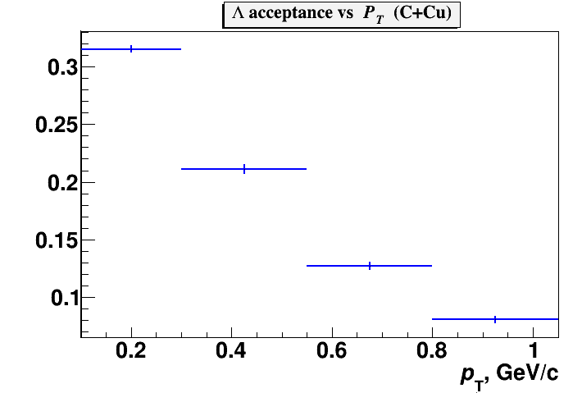
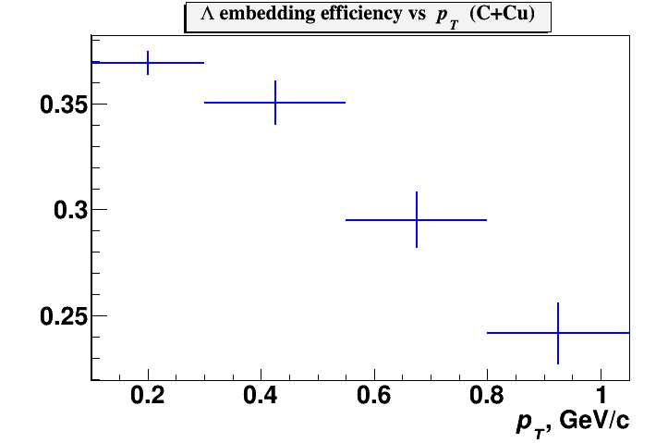
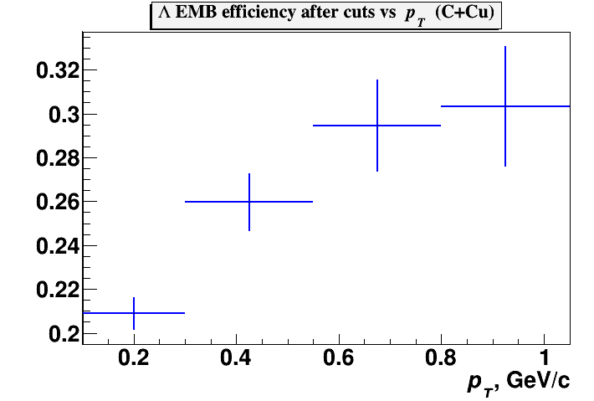
Efficiency in C+Cu interaction
Fig.18. Λ geometrical acceptance (ε_{acc}); efficiency of reconstruction of embedded Λ (ε_{emb}); efficiency of kinematical and spatial cuts applied for Λ reconstruction (ε_{cuts}) as functions of rapidity y (top plots) and p_{T} (bottom plots). Results are shown for C+Cu interaction.

Slide 13
Triggers and impact parameters
.
Table 4. Trigger efficiency evaluated for events with reconstructed Λ hyperons in interactions of the carbon beam with C, Al, Cu targets. The systematic errors take into account the uncertainty due to the delta electron background. The last row shows the trigger efficiency averaged over the data samples with trigger conditions BD>=2 and BD>=3.
Trigger / Target | C | Al | Cu
ε_{trig} (BD>=2) | 0.906±0.010 | 0.955±0.010 | 0.904±0.01
ε_{trig} (BD>=3) |  | 0.923±0.020 | 0.883±0.02
ε_{trig} averaged |  | 0.940±0.015 | 0.893±0.015
Table 5. Mean impact parameters of min. bias C+C, C+Al, C+Cu interactions.
MC | b, fm (C+C) | b, fm (C+Al) | b, fm (C+Cu)
All min bias events | 3.76 | 4.36 | 5.13
Events with gen. Λ | 2.80 | 3.08 | 3.58
Events with rec. Λ | 2.71 | 3.18 | 3.88

Slide 14
The Λ yields and production cross section
Table 11.
Interacting nucleus / reference | Beam momentum, kinetic energy (T₀) | Λ cross section, mb | Λ yield, ·10⁻²
He₄+Li₆ | 4.5 GeV/c (3.66A GeV) | 5.9± 1.5 | 1.85 ± 0.5
C+C | 4.2 GeV/c (3.36AGeV) | 24 ± 4
C+C, propane chamber | 4.2 GeV/c (3.36A GeV) |  | 2.8 ± 0.3
p+p | 4.95 GeV/c (4.1 GeV) |  | 2.3 ± 0.4
C+C, HADES | 2A GeV | 8.7±1.1±^{3.2}_{1.6} | 0.92±0.12±^{0.34}_{0.17}
Ar+KCl, HADES | 1.76AGeV |  | 3.93±0.14±0.15
Ar+KCl, FOPI | 1.93A GeV |  | 3.9±0.14±0.08
Ni+Ni, FOPI, central 390 mb from 3.1 b | 1.93A GeV |  | 0.137±0.005±^{0.009}_{0.025}
Ni+Cu, EOS, full b<8.9 fm / central b<2.4 fm | 2A GeV | 112±24 / 20±3
Ar+KCl, central b<2.4 fm | 1.8A GeV | 7.6±2.2

Slide 15
Cross section and yields of Λ hyperon
The cross section σ_{Λ} and yield Y_{Λ} of Λ hyperon production in C+C, C+Al, C+Cu interactions are calculated in bins of y and p_{T} according to the formulae:
where L is the luminosity,
N_{rec}^{Λ}–the number of reconstructed Λ hyperons,
ε_{rec}–the combined efficiency of the Λ hyperon reconstruction,
ε_{trig}–the trigger efficiency,
σ_{inel}– the cross section for minimum bias inelastic C+A interactions.
σ_{Λ}(y,p_{T})=N_{rec}^{Λ}(y,p_{T}) / (ε_{rec} (y,p_{T})·ε_{trig}·L); | Y_{Λ} (y,p_{T}) = σ_{Λ} (y,p_{T}) / σ_{inel}
Interaction | C+C | C+Al | C+Cu
Inelastic cross section, mb | 830±50 | 1260±50 | 1790±50
The cross sections for inelastic C+Al, C+Cu interactions are taken from the predictions of the DCM-QGSM model which are consistent with the results calculated by the formula: σ_{inel} = π R₀² (A_{P}^{1/3} + A_{T}^{1/3})², where R₀ = 1.2 fm is an effective nucleon radius, A_{P} and A_{T} are atomic numbers of the beam and target nucleus.

Slide 16
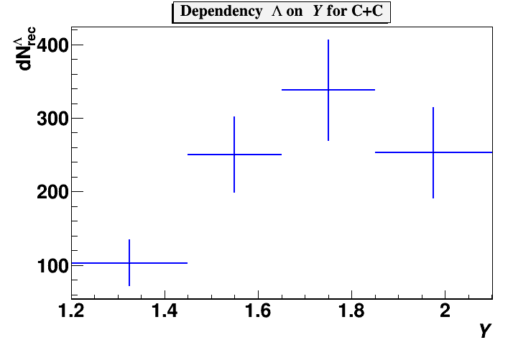
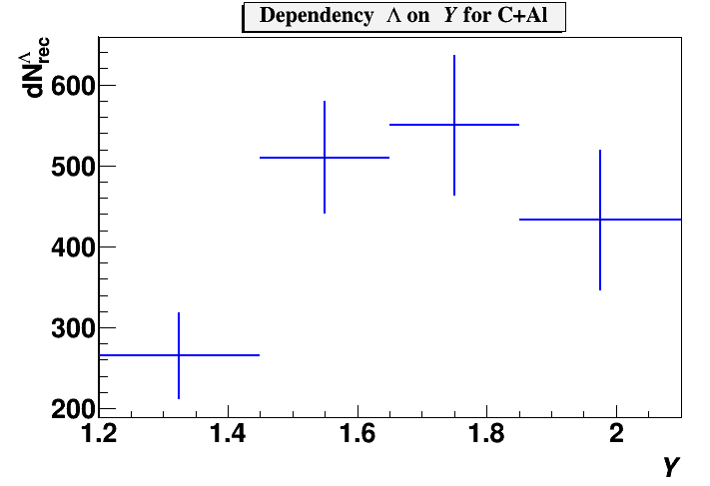
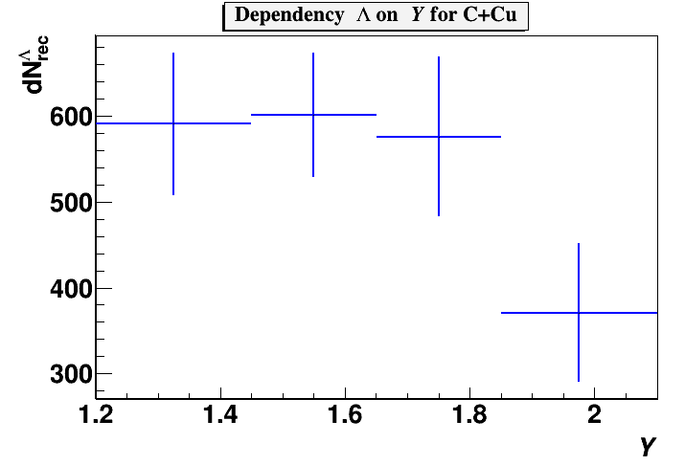
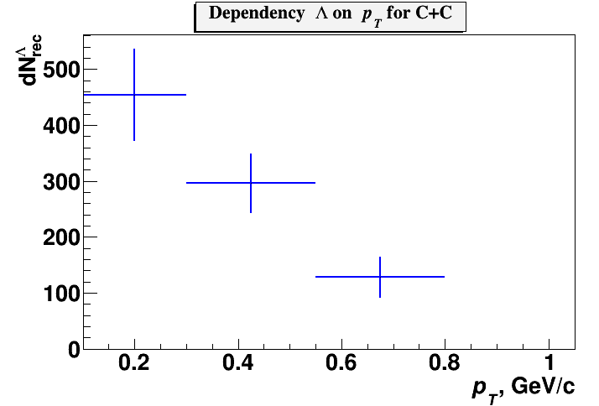
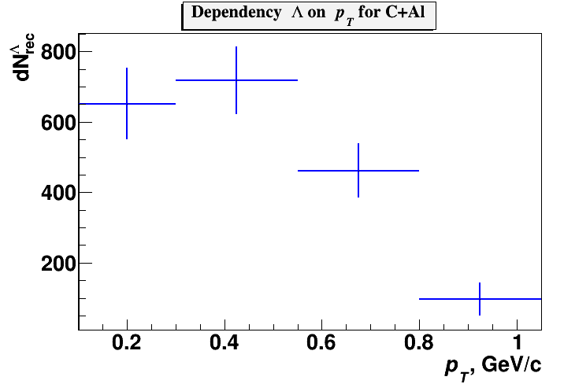
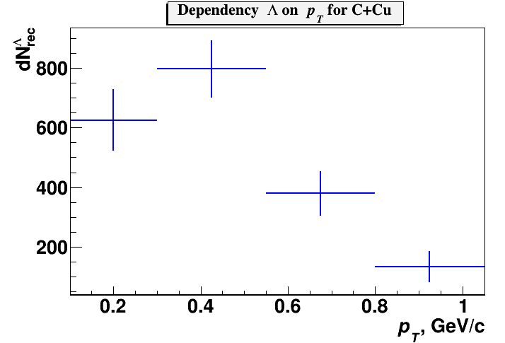
Number of reconstructed Λ hyperons
Fig.15. Number of reconstructed Λ hyperons in C+C, C+Al, C+Cu data samples in bins of y.
Fig.15. Number of reconstructed Λ hyperons in C+C, C+Al, C+Cu data samples in bins of p_{T}.

Slide 17
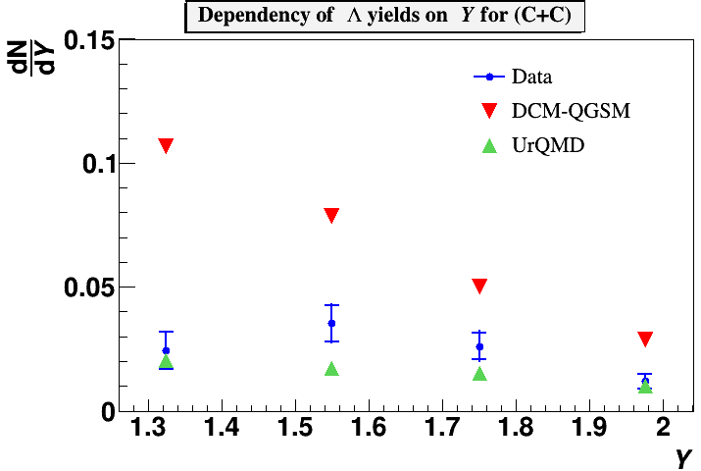
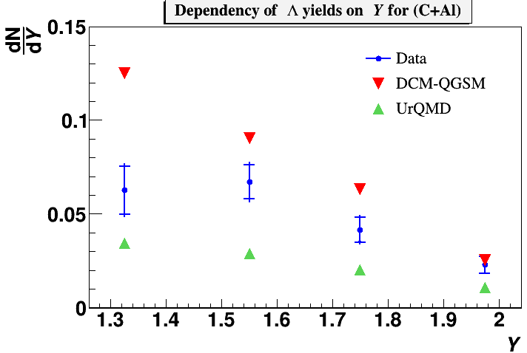
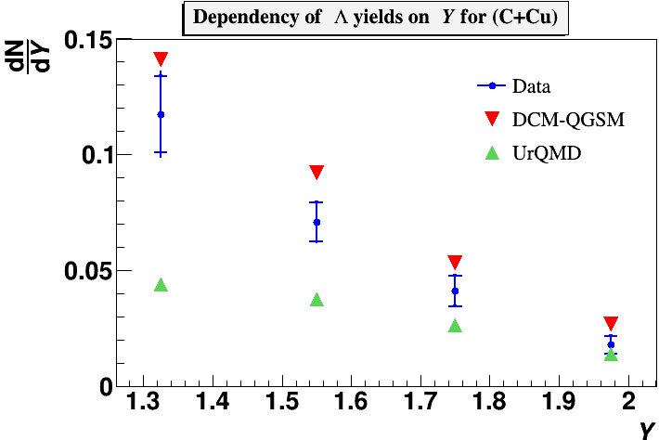
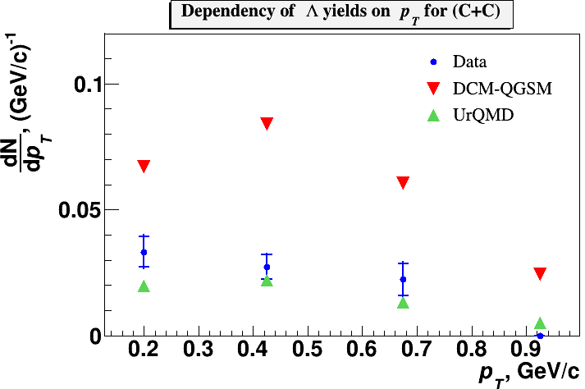
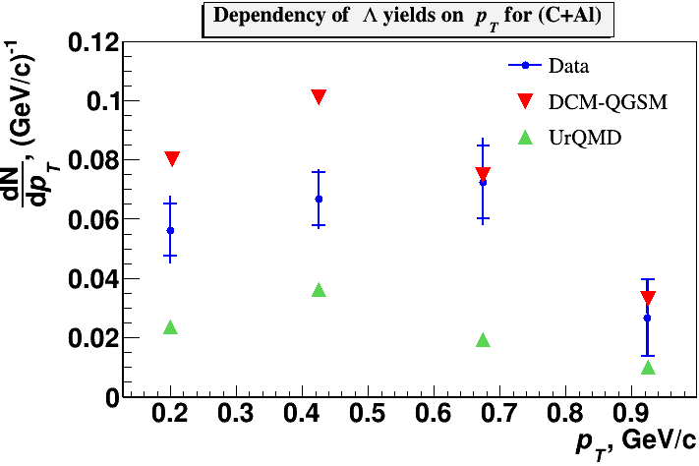
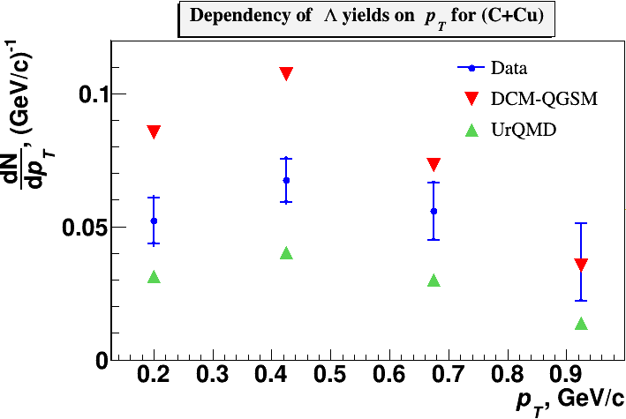
Reconstructed yields of Λ hyperons
Fig. 20-22. Reconstructed yields of Λ hyperons in minimum bias C+C, C+Al, C+Cu interactions vs rapidity y and transverse momentum p_{T} (blue crosses). Predictions of the DCM-QGSM and UrQMD models are shown as red and green crosses.

Slide 18
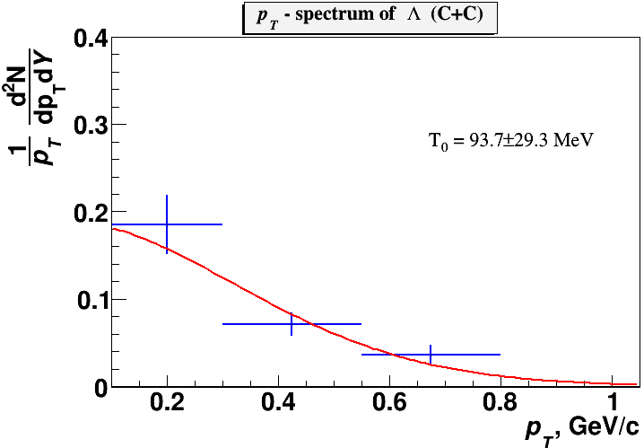
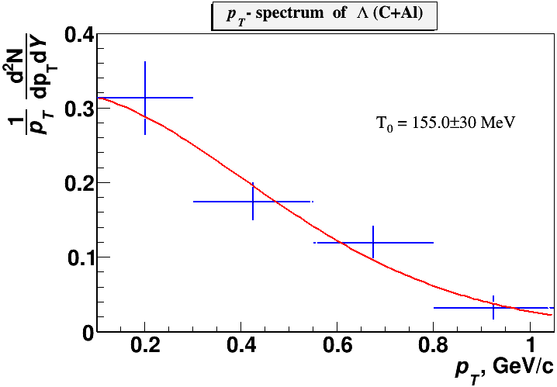
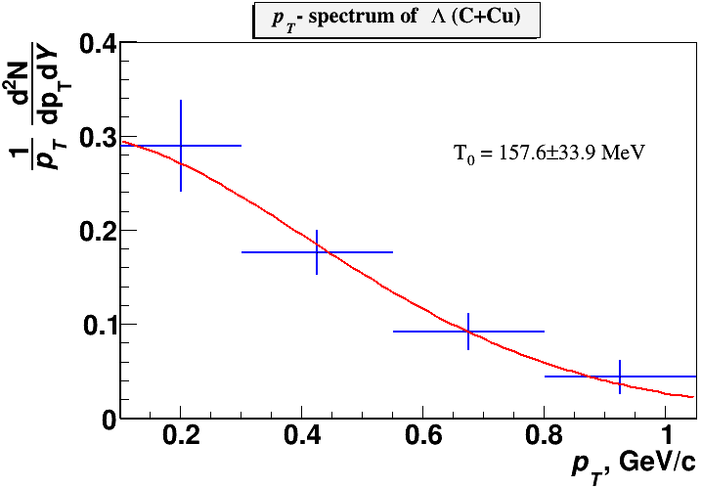
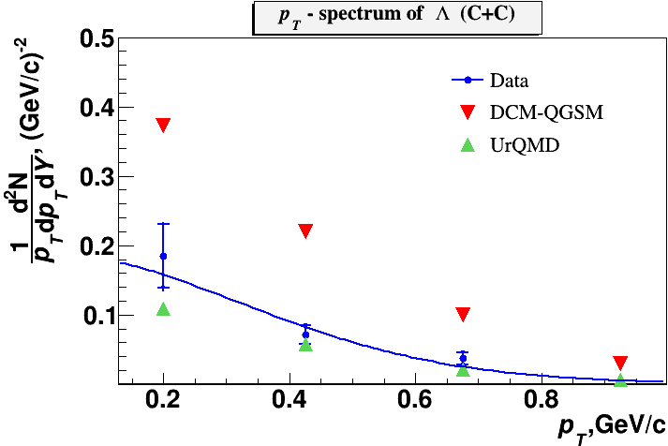
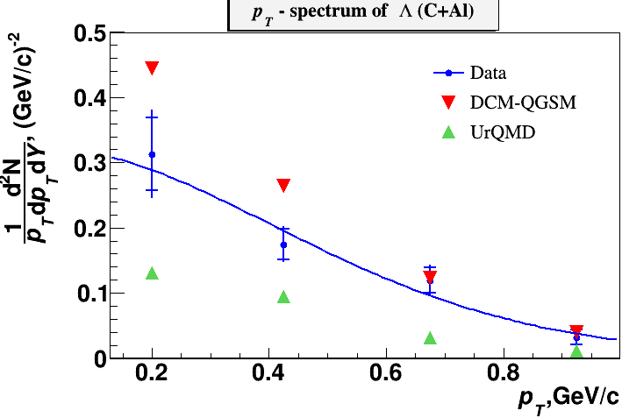
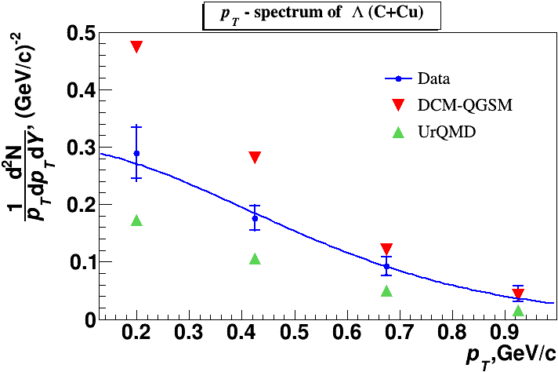
Reconstructed p_{T} spectra of Λ and extracted T₀
 | T₀, MeV (C+C) | T₀, MeV (C+Al) | T₀, MeV (C+Cu)
Experiment χ² /ndf | 93.7±29.3±12.7 2.38/1 | 155.0±30.0±19.4 2.05/2 | 157.6±33.9±9.5 0.43/2
DCM-QGSM | 121.9 | 129.4 | 130.5
UrQMD | 107.3 | 126.7 | 131.8
Table 6. Temperature parameter extracted from the fit of the p_{T} spectra.
Fig. 23. Thermal fit results with the inverse slope parameter T₀: data and predictions of models.

Slide 19
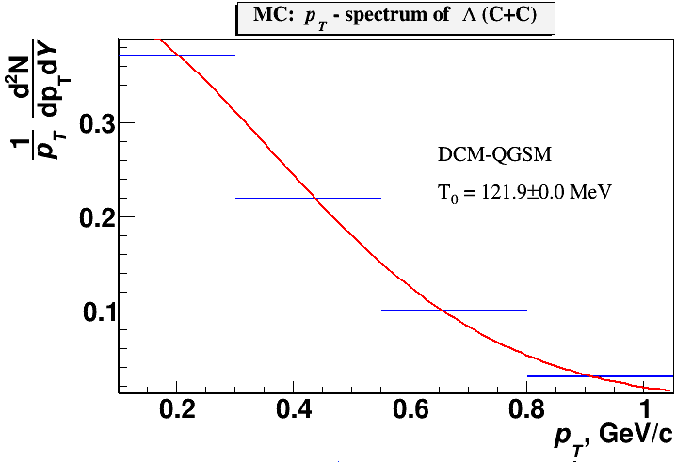
p_{T} spectra of Λ: MC predictions
Fig. 24. Fit of the DCM-QGSM and URQMD spectra. The inverse slope parameter T₀ is shown, extracted from the fit.

Slide 20
Systematic errors
The systematic error of the Λ yield in every p_{T} and y bin is calculated via a quadratic sum of uncertainties coming from the following sources: Systematic errors of the embedding efficiency estimated by embedding the Λ decay products into data samples collected in different run periods;
Table 7. Systematic uncertainty of the embedding efficiency.
Target Interval | Y |  |  | Target Interval | p_{T}
 | C, sys% | Al, sys% | Cu, sys% |  | C, sys% | Al, sys% | Cu, sys%
1.2-1.45 | 2.09 | -4.22 | -2.93 | 0.1-0.3 | -4.94 | -9.37 | -6.61
1.45-1.65 | 1.75 | -4.11 | 3.31 | 0.3-0.55 | -3.07 | 0.64 | -1.30
1.65-1.85 | -7.96 | -4.78 | -4.19 | 0.55-0.8 | -4.59 | 0.34 | 0.078
1.85-2.1 | -5.44 | -1.24 | -6.09 | 0.8-1.05 | 3.03 | -6.28 | -2.36
Systematic errors estimated by two methods of reweighting the Monte Carlo (y,p_{T}) distribution to adjust it to the measured (y,p_{T}) distribution: 1) using 2-dimentional weight w(y,p_{T}) in the measured (y,p_{T}) bin; 2) using product of 1-dimentional weights calculated as w(p_{T})∙w(y).
Table 8. Systematic uncertainty of the total reconstruction efficiency.
Target Interval | Y |  |  | Target Interval | p_{T}
 | C, sys% | Al, sys% | Cu, sys% |  | C, sys% | Al, sys% | Cu, sys%
1.2-1.45 | 7.39 | 8.50 | 6.57 | 0.1-0.3 | 8.70 | 8.20 | 5.85
1.45-1.65 | 7.80 | 6.39 | 3.40 | 0.3-0.55 | 7.14 | 6.05 | 5.21
1.65-1.85 | 9.08 | 7.60 | 4.26 | 0.55-0.8 | 11.23 | 10.48 | 3.19
1.85-2.1 | 7.34 | 7.35 | 5.01 | 0.8-1.05 | 2.06 | 7.16 | 2.32

Slide 21
Systematic errors
Table 9. Total systematic uncertainty.
Target Interval | Y |  |  | Target Interval | p_{T}
 | C, sys% | Al, sys% | Cu, sys% |  | C, sys% | Al, sys% | Cu, sys%
1.2-1.45 | ±7.68 | ±9.48 | ±7.19 | 0.1-0.3 | ±10.00 | ±12.45 | ±8.82
1.45-1.65 | ±7.99 | ±7.60 | ±4.74 | 0.3-0.55 | ±7.77 | ±6.08 | ±5.36
1.65-1.85 | ±12.07 | ±8.97 | ±5.97 | 0.55-0.8 | ±12.13 | ±10.48 | ±3.19
1.85-2.1 | ±9.14 | ±7.45 | ±7.88 | 0.8-1.05 | ±3.66 | ±9.52 | ±3.31
Normalization | ±6.0 | ±4.0 | ±2.8 | Normalization | ±6.0 | ±4.0 | ±2.8

Slide 22
Extrapolation factors
Table 10. Extrapolation factors to the full kinematic range, yields and cross sections.
 | C | Al | Cu
DCM-QGSM URQMD extrapolation factors | 6574/2474 1827/639 | 10539/3413 3248/1056 | 15817/3545 5509/1360
Yields in the measured kinematic range 0.1<p_{T}<1.05 GeV/c, 1.2<y_{lab}<2.1 | 0.0190±0.0022±0.0036 | 0.0528±0.0045±0.0098 | 0.0503±0.0042±0.0062
Yields in the full kinematic range | 0.0524±0.0062±0.0100 | 0.163±0.014±0.030 | 0.214±0.018±0.026
Λ cross section in min. bias interactions, mb | 41.9±4.9±7.7 | 205.0±17.6±37.4 | 383.2±31.5±49.2

Slide 23
Summary
Production of Λ hyperons in interactions of the 4A GeV kinetic energy carbon beam with C, Al, Cu targets was studied with the BM@N detector at the Nuclotron.
The analysis procedure has been presented and described.
Results on Λ hyperon yields have been obtained and compared with model predictions and data available.
Request for BM@N preliminary.
Outline
Thank you for attention!

Slide 24
Backup
24

Slide 25
Residual distributions of GEM hits
Fig. 12. Residual distributions of GEM hits with respect to reconstructed tracks: left) experimental data, right) reconstructed tracks of embedded Λ decay products.
25

Slide 26
DCA and PV position
Fig. 12b. Distance of the closest approach of V0 decay tracks (DCA) and Z,X,Y distributions of the primary vertex.
26

Slide 27
The invariant mass spectrum
Fig. 13. The invariant mass spectrum of (p,π⁻) pairs reconstructed in the experimental events of C+Cu interactions with embedded Λ hyperon decay products (left); The invariant mass spectrum of (p,π⁻) pairs reconstructed in C+Cu interactions (right).
27

Slide 28
Efficiency distributions in GEMs
Fig. 11. Two-dimensional X/Y efficiency distributions in 6 GEM stations measured with experimental tracks and implemented into Monte Carlo simulation.
28

