Slide 1


Positron studies of defects in ion-implanted materials
Dr. Krzysztof Siemek
Institute of Nuclear Physics PAN, Cracow, Poland
Joint Institute for Nuclear Research, Dubna, Russia

Slide 2
Outline
Introduction - ion implantation
Positron Annihilation Spectroscopy
Results
Summary

Slide 3
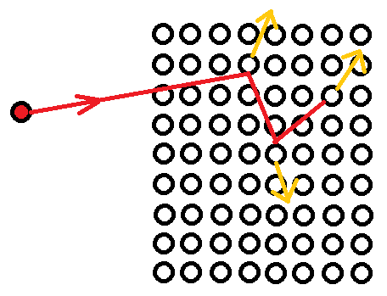
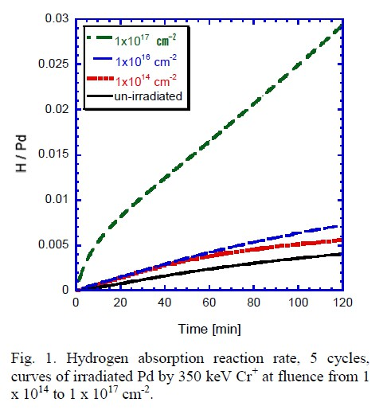
Ion implantation
Ion implantation is process by which ions of one element are accelerated into a solid target, thereby changing the properties of the target.
Adventages:
Low temperature processing
Good control and reproducibility of impurity implanatation depth
Solubility limits can be exceeded without precipitations of excess atoms
Applications:
Modyfing surfaces to improve properties
Fabrication of semiconductor devices
H. Abe, et. Al.. Trans. Mat. Res. Soc. Japan 36 (2011) 133

Slide 4
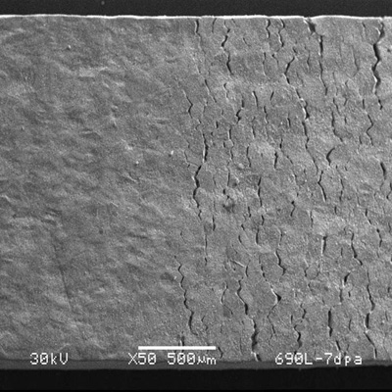
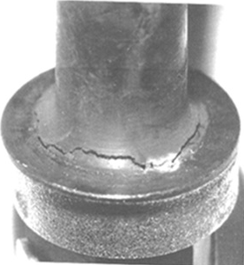
Disadventages:
Irradiation induces a large number of structural defects, such as vacancies, their clusters, dislocation loops, voids etc. As a result, swelling, hardening, creep and embrittlement appear and leads to a faster wear.
Amaya, M. et al., J. Nucl. Sci. Technol. 45(3) (2008) 244

Slide 5
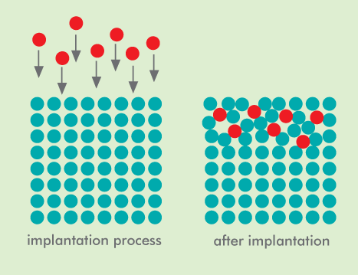
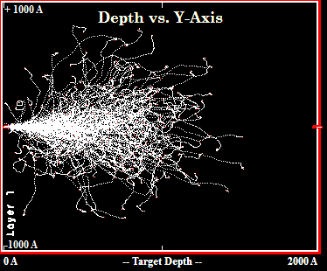
Monte Carlo simulations using SRIM/TRIM*
TRIM calculations for silcion implanted with 25 keV Nitrogen
*software available on www.srim.org

Slide 6
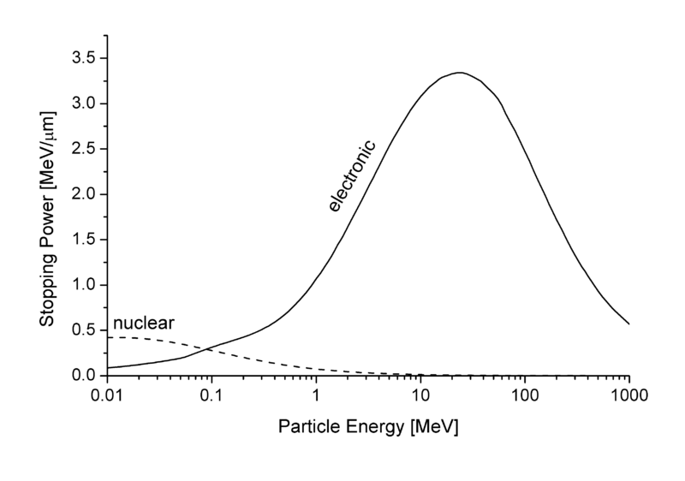
Energy deposition
a)
b)
*https://www-nds.iaea.org/stopping/

Slide 7
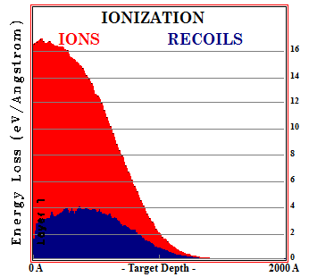
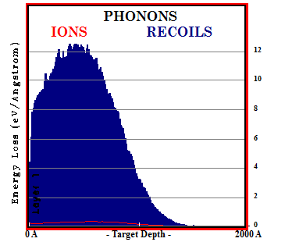
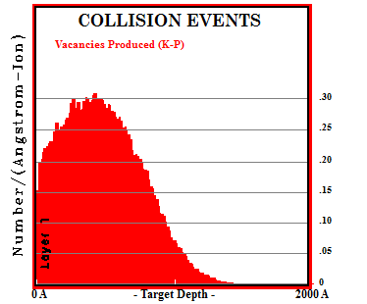
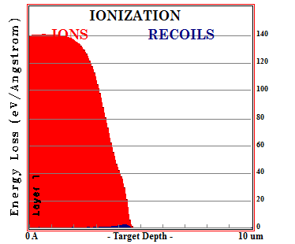
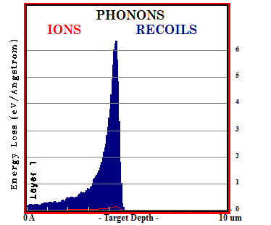
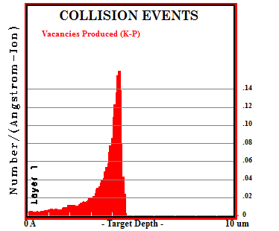
Energy deposition
Nuclear collisions
a) TRIM calculations for silcion implanted with 25 keV Nitrogen
b) TRIM calculations for silcion implanted with 5 MeV Nitrogen

Slide 8
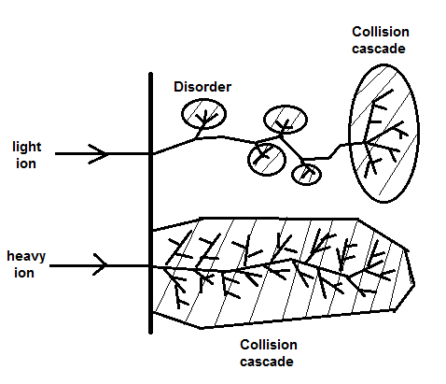
Schematic representation of the disorder produced by ion implanation
Cascade region
Not implanted region
Track region

Slide 9
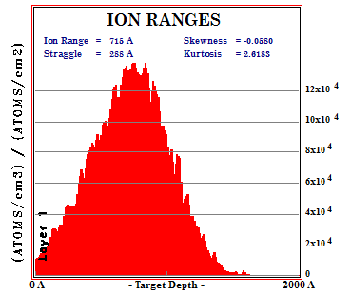
Ion ranges and vacacncies distribution

Slide 10
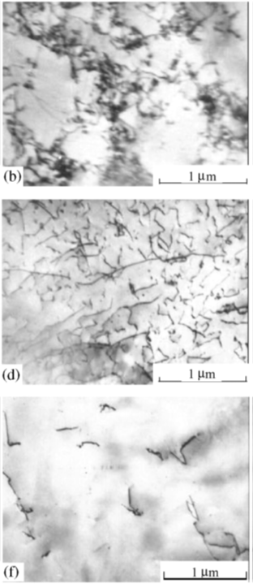
Long Range Effect
10 um
Dislocation structures formed in Cu implanted with the Ni ions.
Implantation range was about 20 um.
50 um
unirradiated
* Yu.P. Sharkeev, E.V. Kozlov, Surf. Coat. Technol. 158-159 (2002) 219

Slide 11
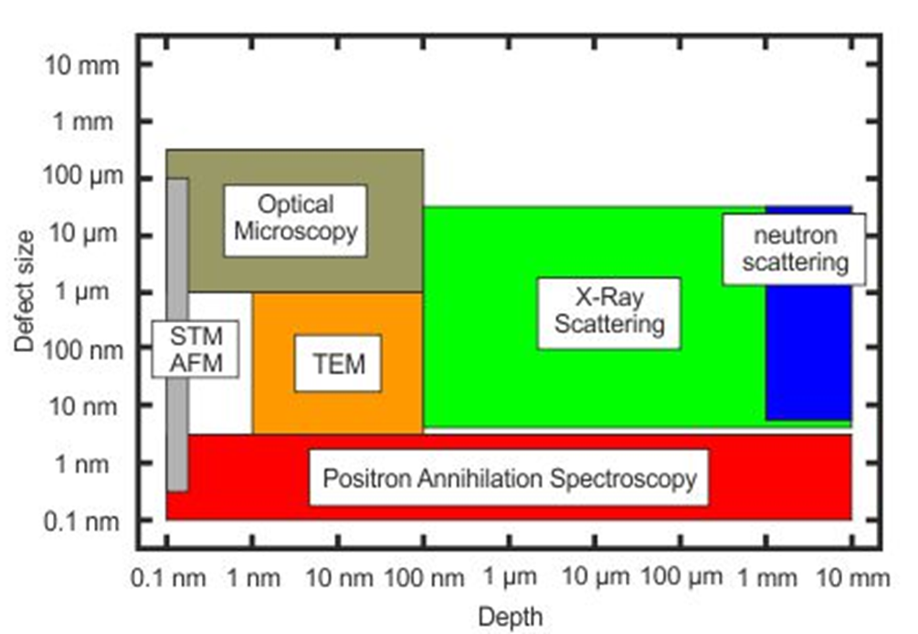
Positron annihilation spectroscopy
PAS techniques allow us to find defects with the size ranging from 0.1 to 3 nm with the concentration up to 10⁷ ppm
PAS makes possible the detection of defects in the wide range of depths from single nanometers up to milimeters
^{*)} https://www.hzdr.de/db/Cms?pNid=3581

Slide 12
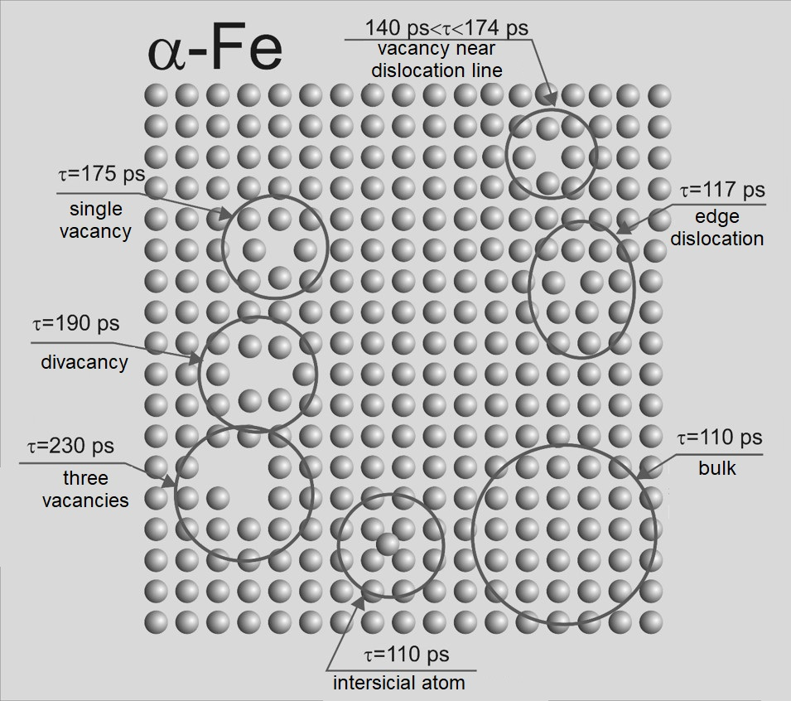
Positron annihilation spectroscopy
PAS techniques:
angular correlations of gamma quanta
Doppler spectroscopy (DB)
positron lifetime spectroscopy (LT)
Possibilities:
determination of defect concentration
evaluation of defect concentration profile
detection of the kind/size of defects
Applications:
solid body physics
material and surface engineering
metals, semiconductors, thin layers
* http://www.ifj.edu.pl/~mdryzek/

Slide 13
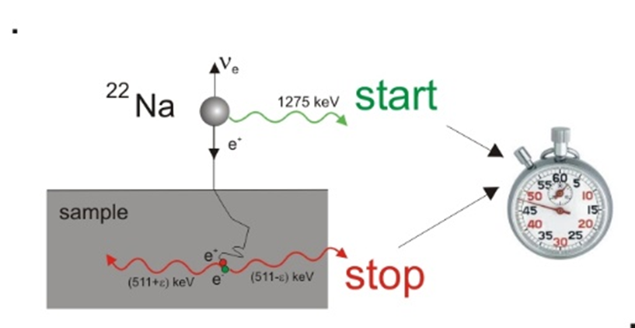
Positron Annihilation Spectroscopy
The annihilation rate λ - the reciprocal value of mean positron lifetime
r₀ – electron radius, c – velocity of light
Bi
electron density inside the defect is lower in comparison to bulk area what finds a reflect in the mean positron lifetime
e.g. for pure Fe τ = 110 ps in nondefected structure while positron trapped inside vacancy lives τ = 174 ps

Slide 14
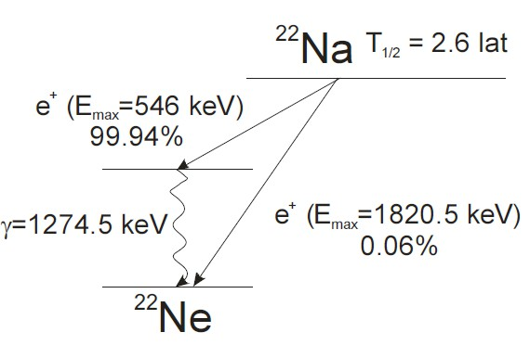
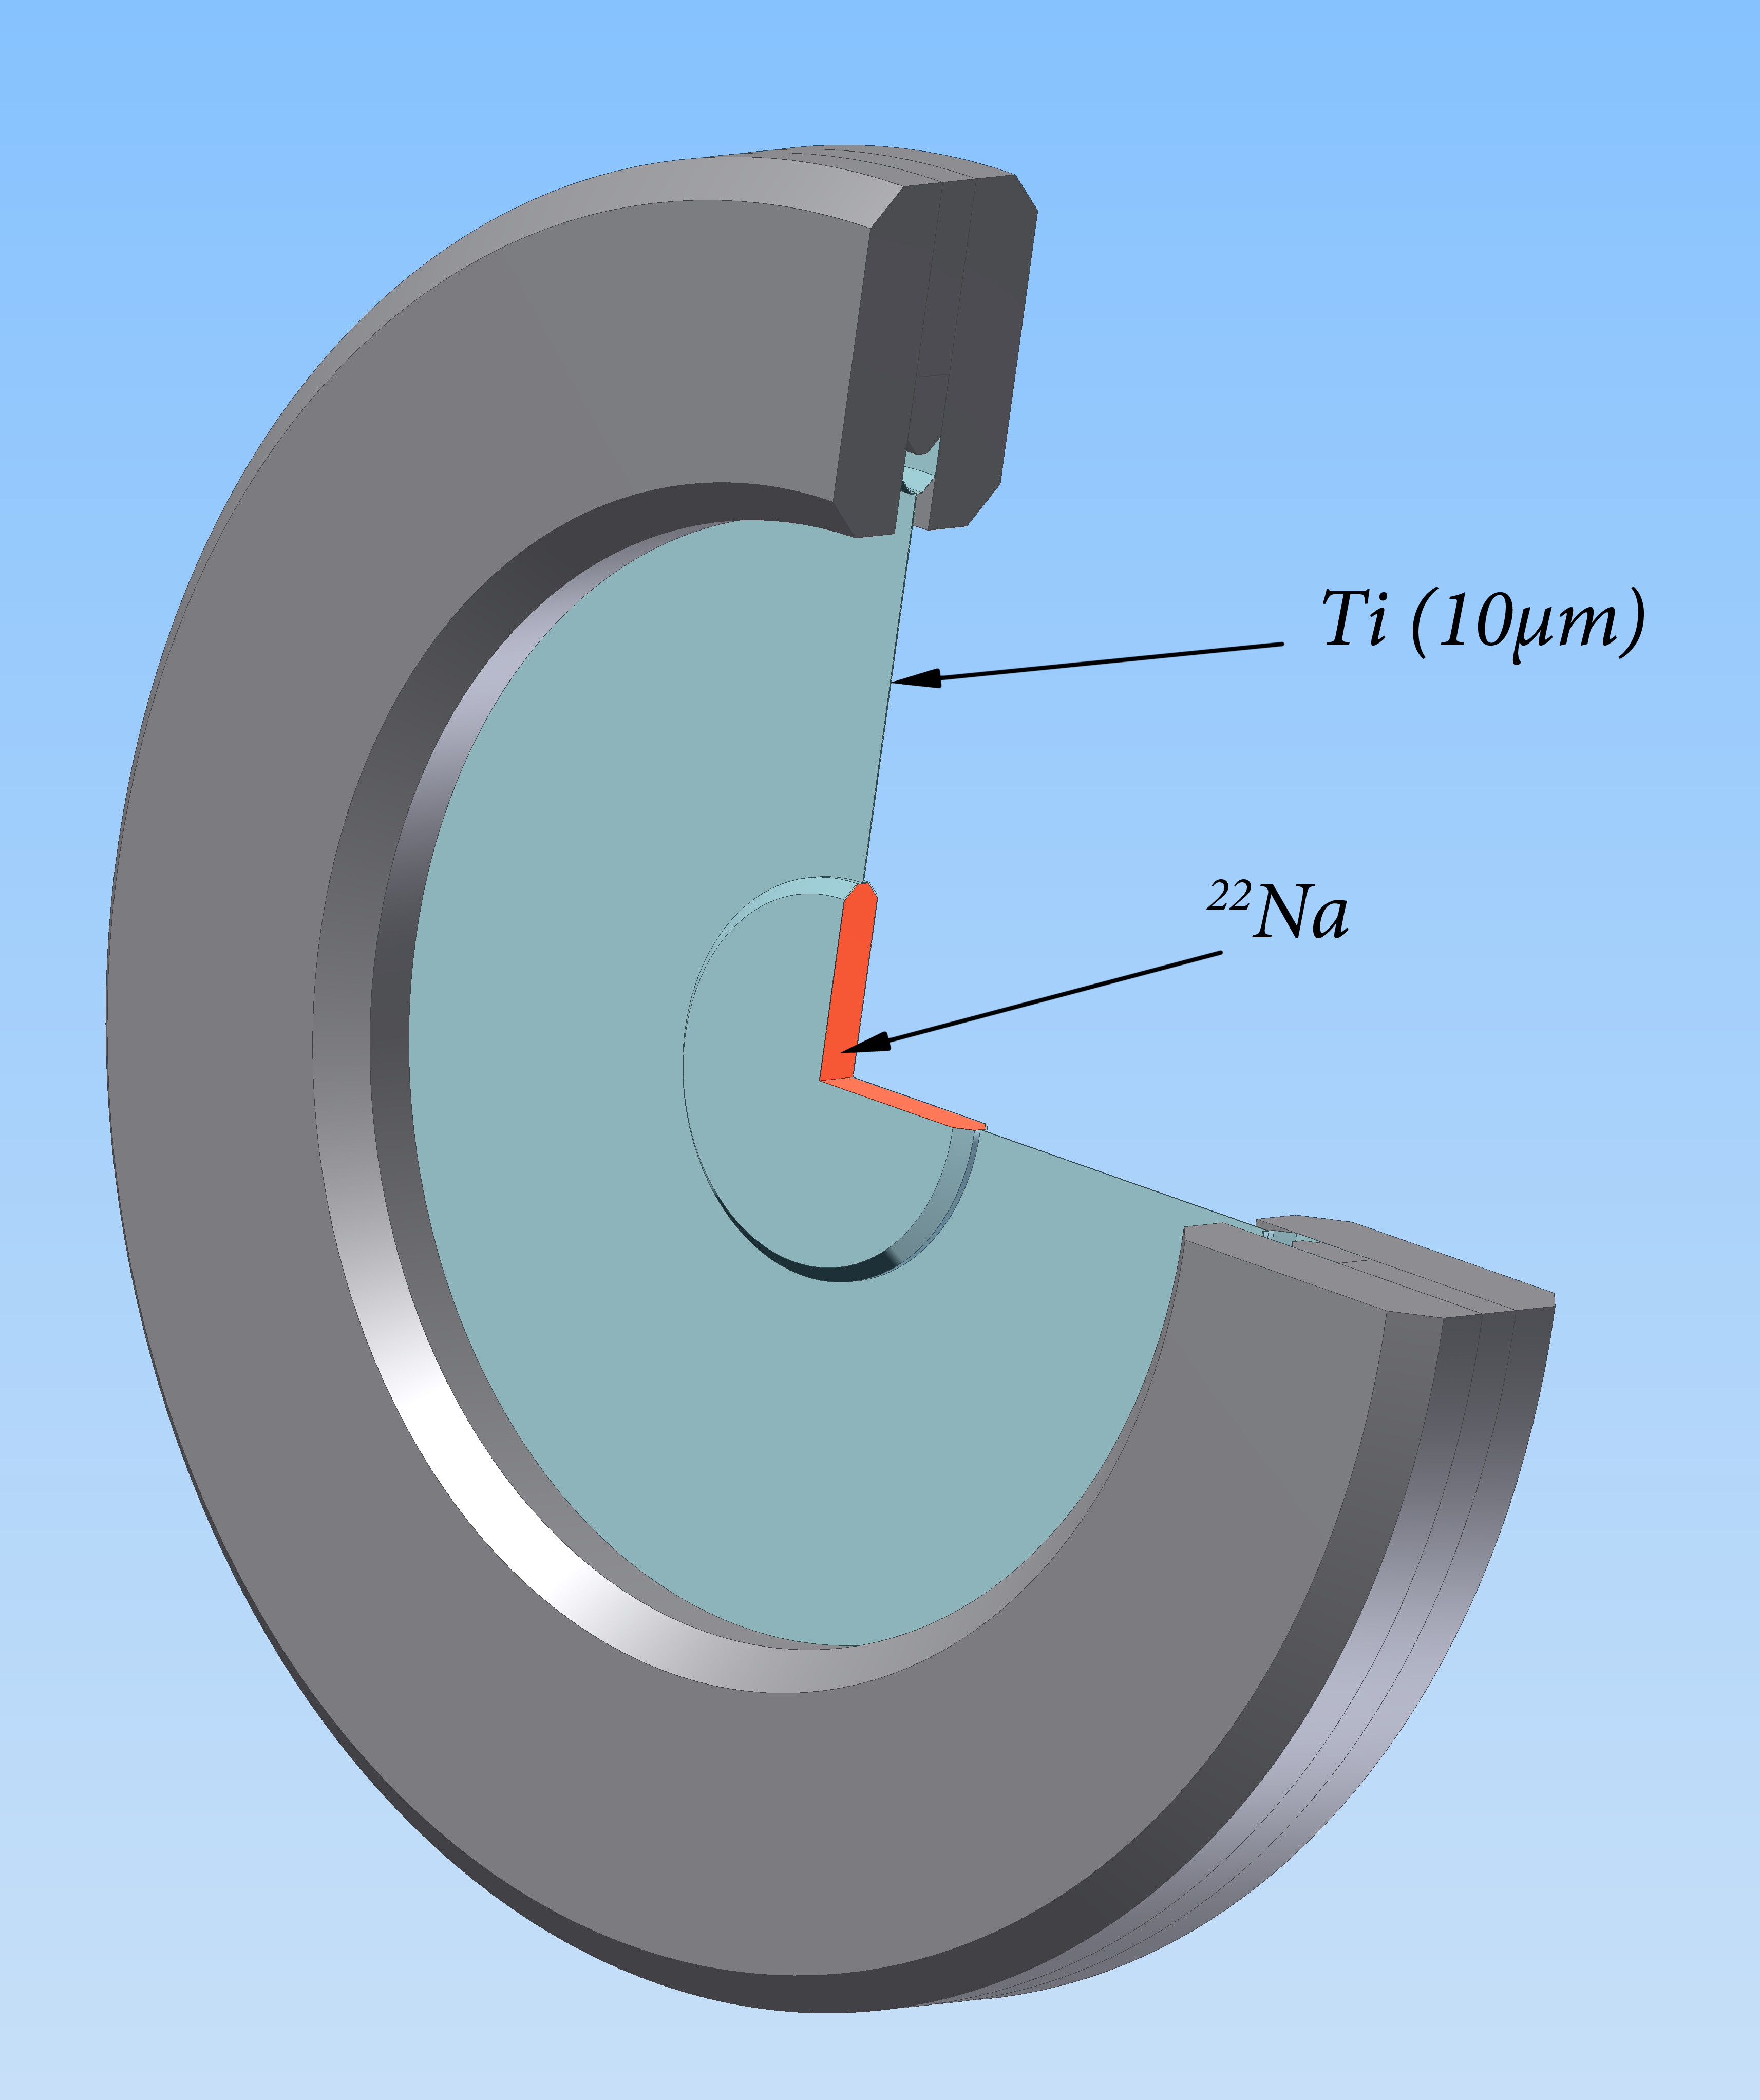
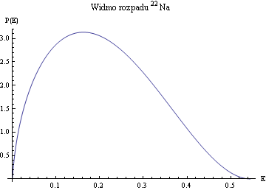
Positron ²²Na source
positron source: ²²Na with activity of 1 MBq enclosed into a 10 μm Ti foil

Slide 15
The conventional pas experiment
Disadvantages of experiment are a long range of positron implantation and a lack of possibility to locate positrons precisely on the given depth.
P. Horodek, J. Dryzek, Nukleonika 55 (2010) 17

Slide 16
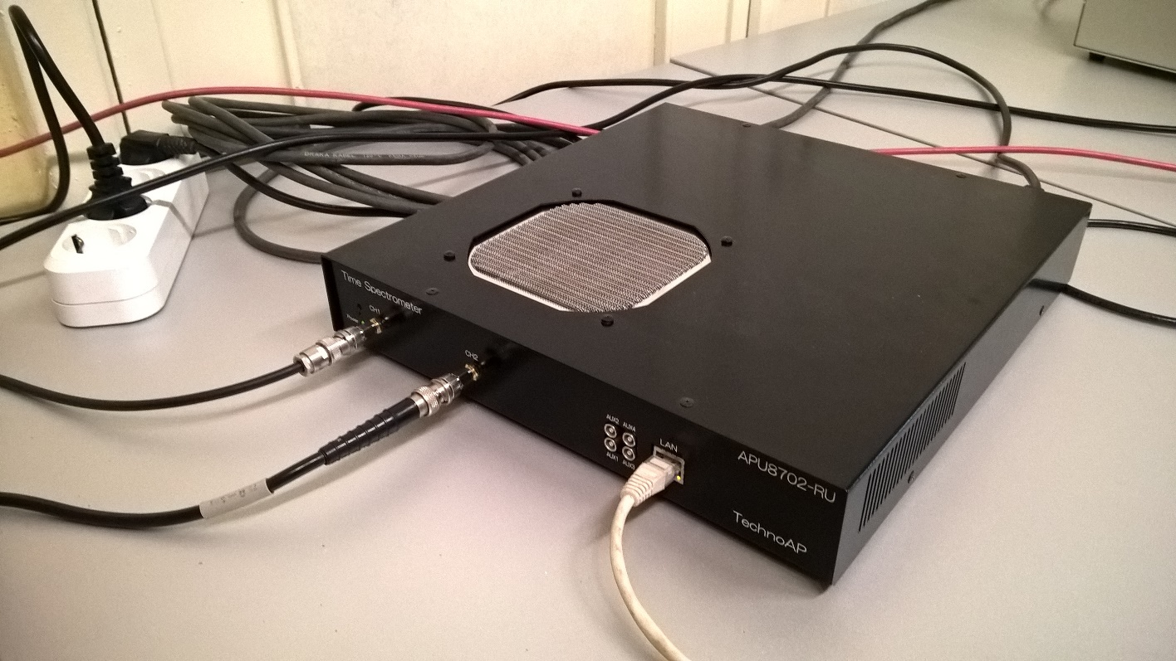
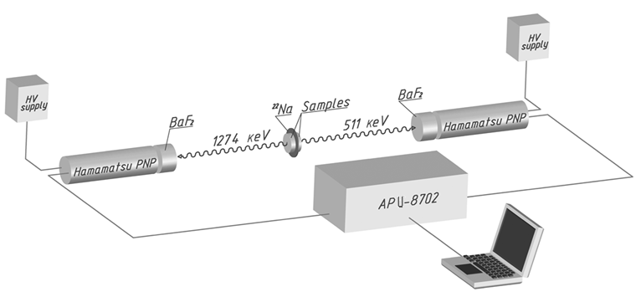
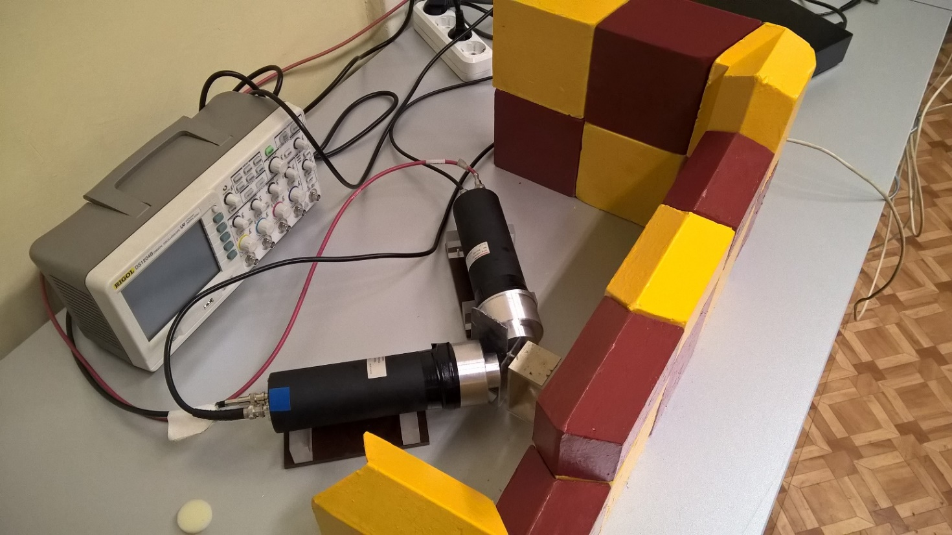
Positron annihilation spectroscopy
digital spectrometer: BaF₂- based detectors and APU8702 unit
spectra including 10⁶ counts were deconvoluted by LT code [*], substracting the background and the source components
^{*)} J. Kansy, Nucl. Instrum. Method. Phys. Res. A 374 (2) (1996) 235

Slide 17
Experimental techniques: LT spectroscopy
The positron lifetime spectroscopy
positron lifetime spectra consists of the exponential decay components
positron trapping in the open-volume defects leads to long lived components
longer life time due to lower electron density
analysis by non-linear fitting: lifetimes τ_{i} and intensities I_{i}
The positron lifetime spectrum
The mean positron lifetime
The example of positron lifetime spectrum.

Slide 18


The conventional pas experiment
HERE EXPERIMENTS WITH SLOW POSITRONS ARE REQUIRED !!
There are some areas i.e. thin layers, ion implantation, semiconductors where the application of conventional PAS experiments is strongly limited
https://www.hzdr.de/db/Cms?pNid=3581

Slide 19
The Variable energy positron beam

Slide 20
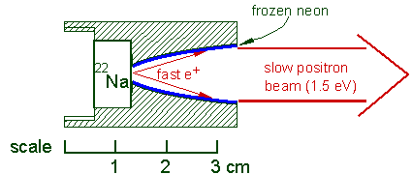
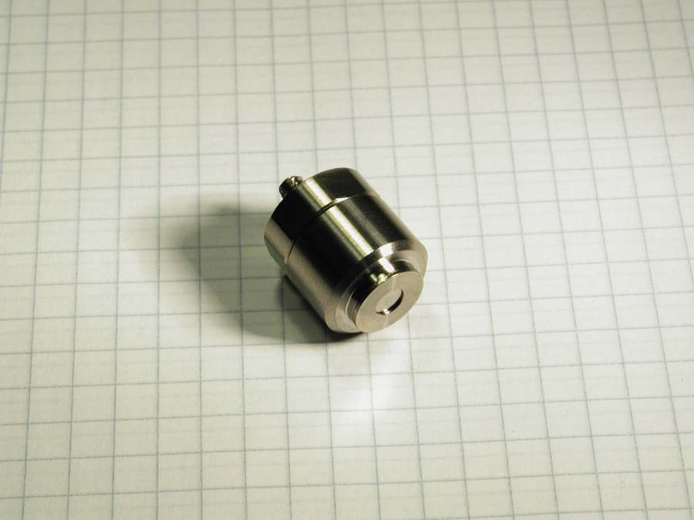
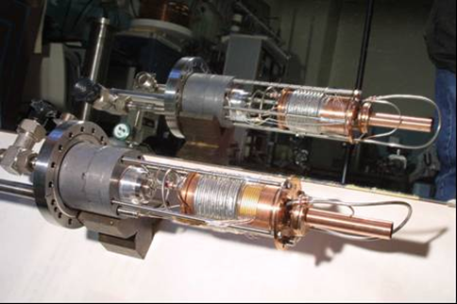
The Variable energy positron beam
from iThemba LABS (RSA)

Slide 21
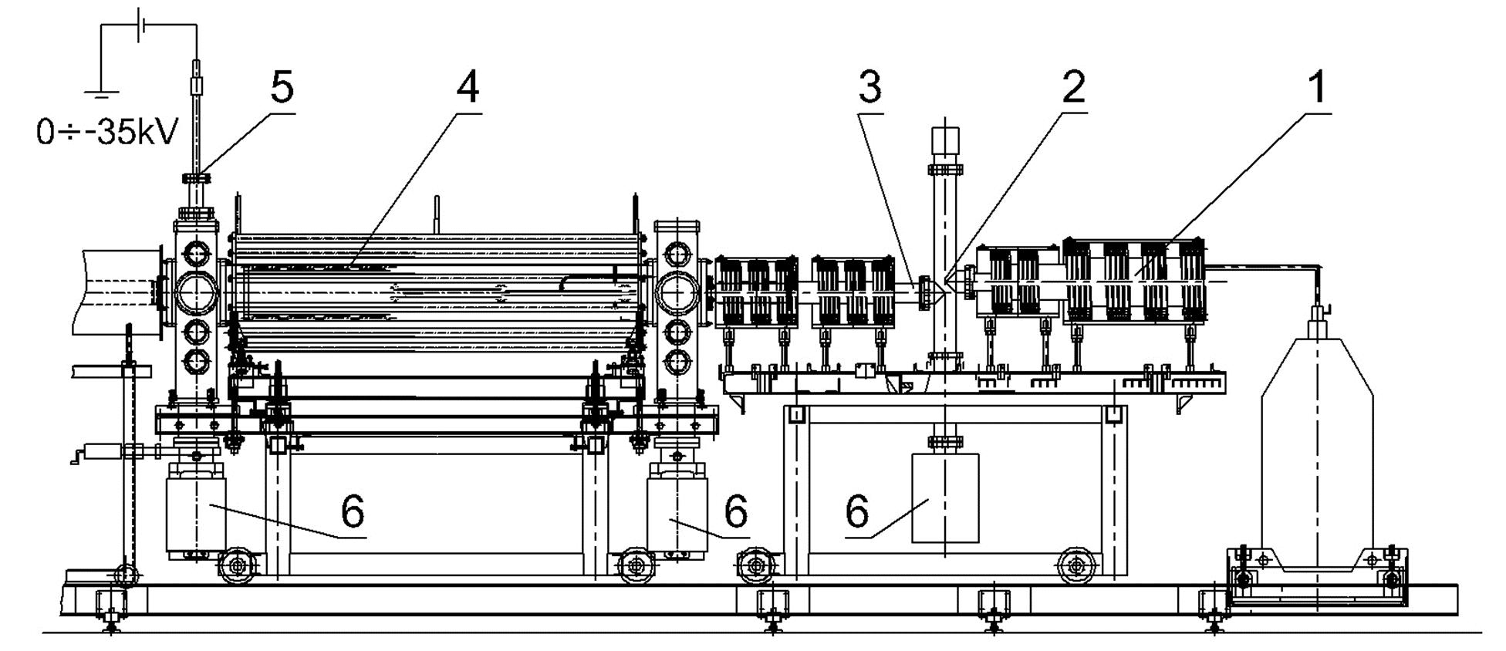
The Variable energy positron beam

Slide 22
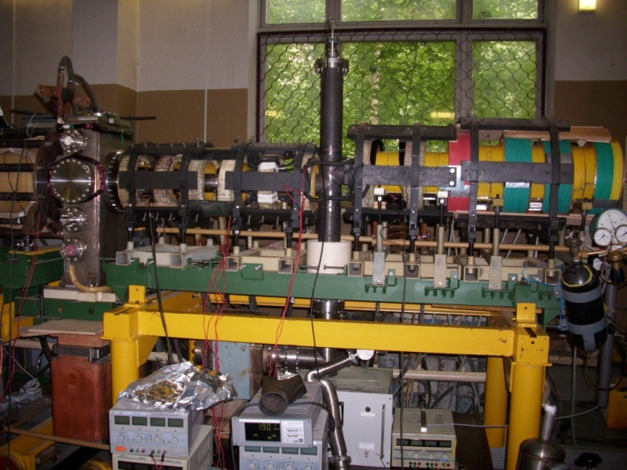
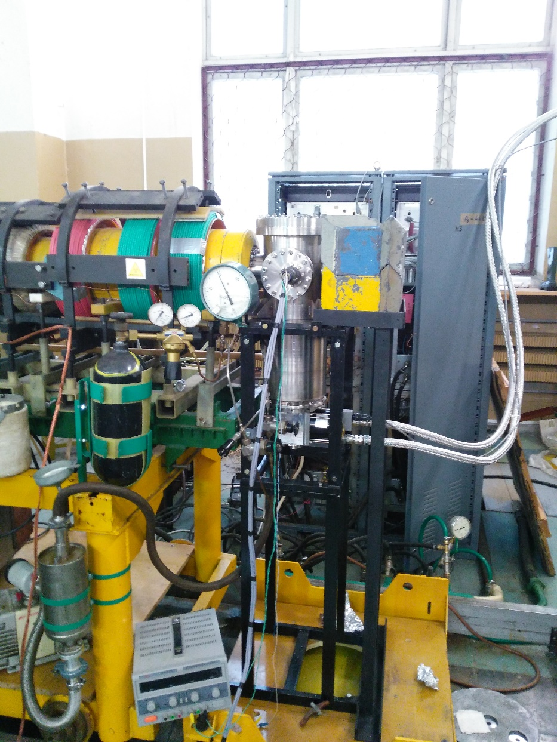
The Variable energy positron beam

Slide 23
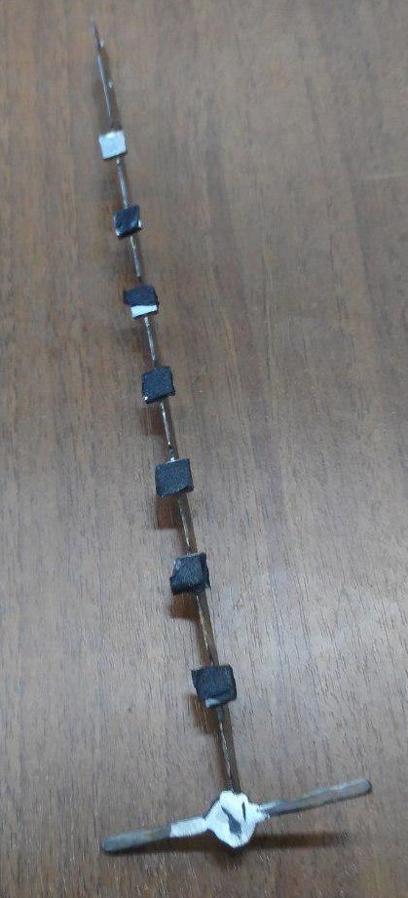
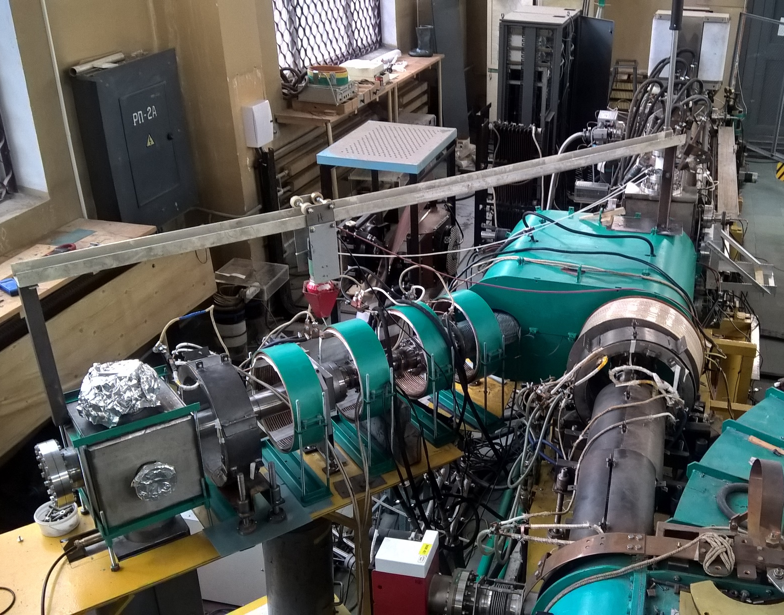
The Variable energy positron beam

Slide 24
The Variable energy positron beam
Feature | Value
activity of ²²Na isotope | ~30 mCi
moderator | frozen Ne (7K)
magnetic field | 100 Gs
vacuum conditions | 10⁻⁹ Torr
intensity | ~10⁶ e⁺/s
energy range | 50 eV ÷ 40 keV
diameter of the flux | 5 mm

Slide 25
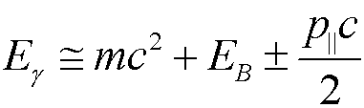
Positron Annihilation Spectroscopy
The change of photon energy by relativistic Doppler effect in the laboratory system
S parameter
ratio of area under the central part of 511 keV line to whole area below this line
defines the participation of e⁺e⁻ pairs with low momentum
higher value means bigger concentration of such defects as vacancies
where E_{B} is binding energy e⁺e⁻ in the pair surrounding, p|| – momentum of annihilating pair, m – electron mass, c – speed of light in the vacuum.

Slide 26
Positron Annihilation Spectroscopy
The change of photon energy by relativistic Doppler effect in the laboratory system
S parameter
ratio of area under the central part of 511 keV line to whole area below this line
defines the participation of e⁺e⁻ pairs with low momentum
higher value means bigger concentration of such defects as vacancies

Slide 27
Positron Annihilation Spectroscopy
The change of photon energy by relativistic Doppler effect in the laboratory system
W parameter
ratio of area under the wing part of 511 keV line to whole area below this line
defines the participation of e⁺e⁻ pairs with high momentum
together with S parameter gives limited information about kind of defects

Slide 28

ABINIT calculations
ABINIT is a package whose main program allows one to find the total energy, charge density and electronic structure of systems made of electrons and nuclei (molecules and periodic solids) within Density Functional Theory (DFT), using pseudopotentials (or PAW atomic data) and a planewave basis.
We have to know:
Pseudopotenitials
Information about stucture
Proper aproximation and settings
*https://www.abinit.org/about

Slide 29
Results

Slide 30
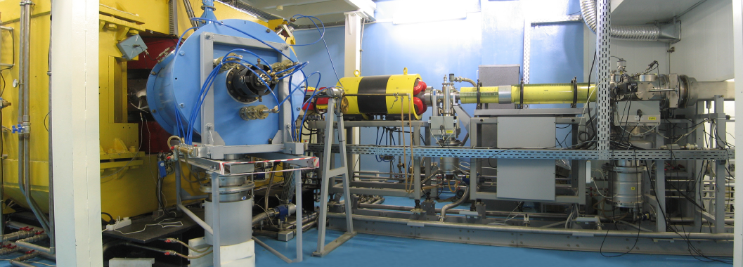
IRRADIATION
The irradiation was performed at IC-100 cyclotron at Flerov Laboratory of Nuclear Reactions at JINR in Dubna. Xe²⁶⁺ heavy ions with energy 167 MeV and different doses were applied. The average ion flux was 5×10⁹ cm⁻² s⁻¹. Temperature did not exceed 80 ˚C.

Slide 31
Results: Pd
^{*)} P. Horodek, V.A. Skuratov, Surf. Coat. Technol. 296 (2016) 66.

Slide 32
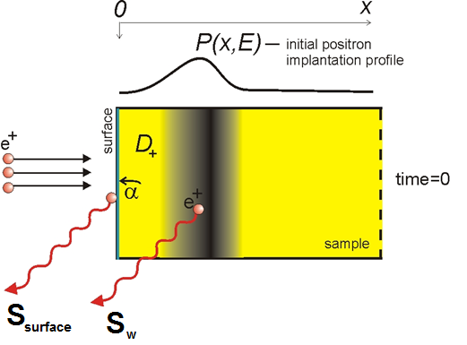
Results: Pd
The mean implantation depth for given energy E is estimated from
where A=3.67 μgcm⁻²keV^{-n}, n=1.579 and ρ is density equal 12.023 g/cm^{3.}
Diffusion equation
^{*)} P. Horodek, V.A. Skuratov, Surf. Coat. Technol. 296 (2016) 66.

Slide 33
Results: Pd
Defect concentration
where:
- trapping coefficient (for given type of defect)
τ_{bulk} - positron lifetime in bulk
L_{bulk} - positron diffusion length
^{*)} P. Horodek, V.A. Skuratov, Surf. Coat. Technol. 296 (2016) 66.

Slide 34
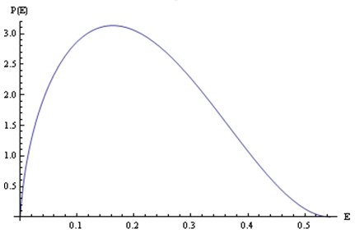
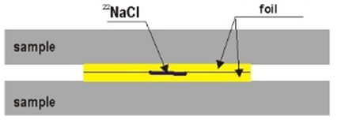
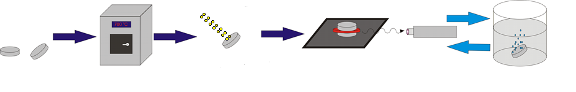
Etching experiment

Slide 35
Results: Fe
^{*)} P. Horodek, et al., Rad. Phys. Chem. 122 (2016) 60.

Slide 36
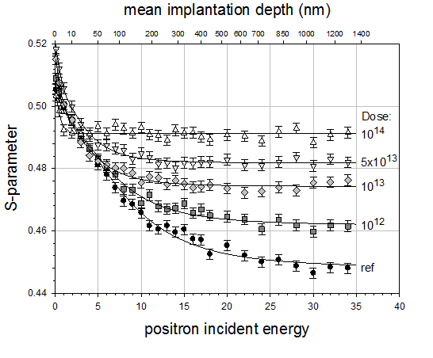
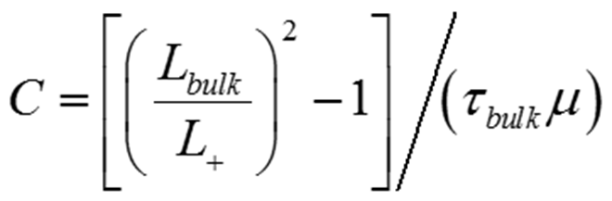
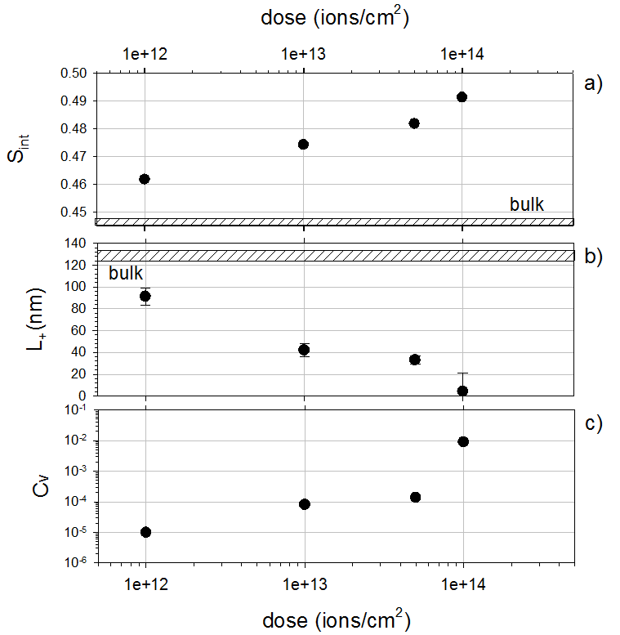
Results: Fe
Defect concentration
where τ_{bulk} is lifetime in non defected structure and μ is the trapping coefficient
where: S_{surface} - S value for surface, S_{bulk}- S value for saturation, P(x,E) – implantation profile, L₊ - positron diffusion length, a- the positron absorption coefficient at the surface, λ_{bulk} - the annihilation rate, x - depth
^{*)} P. Horodek, et al., Rad. Phys. Chem. 122 (2016) 60.

Slide 37
Results: Fe
Dis
Mean positron lifetime
V₂₇
V₁₅
^{*)} P. Horodek, et al., Rad. Phys. Chem. 122 (2016) 60.

Slide 38
Results: Cu
*) P. Horodek et al., Vacuum 138 (2017) 15–21.

Slide 39
Results: Cu
*) P. Horodek et al., Vacuum 138 (2017) 15–21.

Slide 40
Results: Cu
*) P. Horodek et al., Vacuum 138 (2017) 15–21.

Slide 41
Results: Cu
Dis
*) P. Horodek et al., Vacuum 138 (2017) 15–21.

Slide 42
Results: Ag

Slide 43
Results: Ag
^{*)} J. Dryzek, et al. Acta Pchys. Polon. A 132, 1585 (2017).

Slide 44
Results: Ag
V+Dis
^{*)} J. Dryzek, et al Acta Pchys. Polon. A 132, 1585 (2017).

Slide 45
Results: Ti
^{*)}P. Horodek, et al Surf. Coat. Technol. 355, 2018, 247.

Slide 46
Results: Ti
Dis
V₆
^{*)}P. Horodek, et al. Surf. Coat. Technol. 355, 2018, 247.

Slide 47
Results: Ti
^{*)}P. Horodek et al Surf. Coat. Technol. 355, 2018, 247.

Slide 48
Results: Bi
^{*)}J.Dryzek, K.Siemek. Appl Phys A 125 2019 85

Slide 49
Results: Bi
^{*)}J.Dryzek, K.Siemek. Appl Phys A 125 2019 85

Slide 50
Results
PAS is the sensitive method for detection the structural defects
in dependency on used PAS technique the evaluation of defect profile, approximation of defect concentration or determination of type of defect is possible
the modern application of PAS focuses around slow positron beam studies
PAS studies of irradiated various metals exposed to 167 MeV Xe²⁶⁺ ions were reported. The aim of investigations was observation of the so called “the long range effect”. This was observed in Fe and Bi samples where defected zone was twice as deep as the implanted depth. In Cu and Ti defects introduced by irradiation occupied theoretically predicted depths

Slide 51
Thank you for attention!

