Slide 1


PANDA Muon System
Alexander Verkheev
DLNP, JINR
4 June 2019

Slide 2
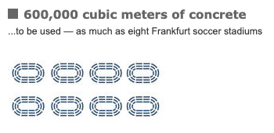
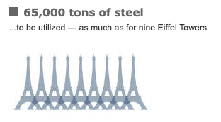
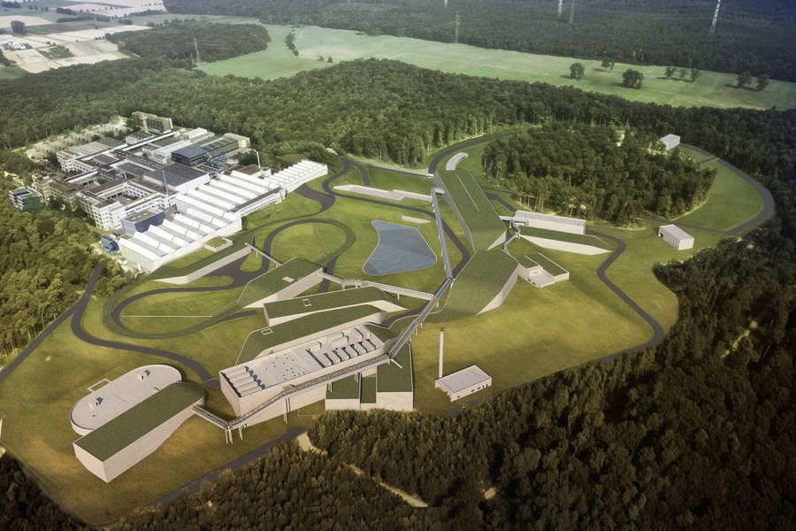
Outline
FAIR & PANDA Experiment
Muon System Detector
Panda Muon System Prototype at CERN
Geometry modeling of Muon System
Results of the
Muon System Prototype
test beams
Notes:
In my talk I will give a short overview of the 1).
I will show the suggested 2)
Also I will present the preliminary results for the 3)

Slide 3

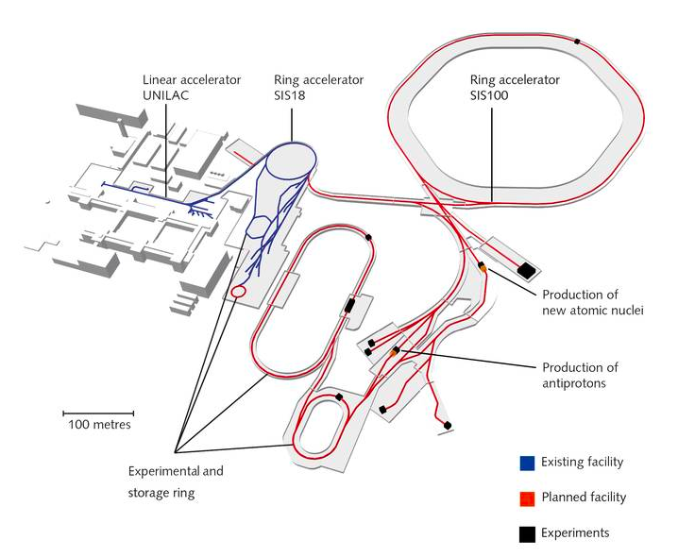
Facility for Antiproton and
Ion Research in Europe
Primary beams:
p and heavy ion beams (up to U⁹²⁺)
Secondary beams:
pbar, radioactive beams
PANDA @ FAIR:
located at High Energy Storage Ring
stochastic and elecron cooling of
ppbar beam
ppbar, pbarA collisions
p = 1.5 – 15 GeV/c ,
(√s from 2.25 up to 5.46 GeV)
Luminosity up to 2·10³² cm⁻²s⁻¹

Slide 4
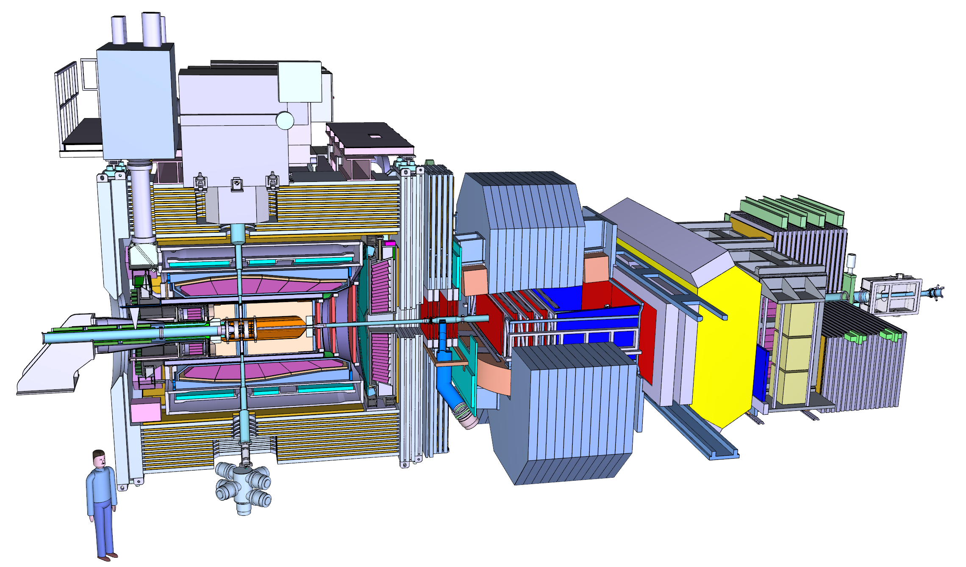
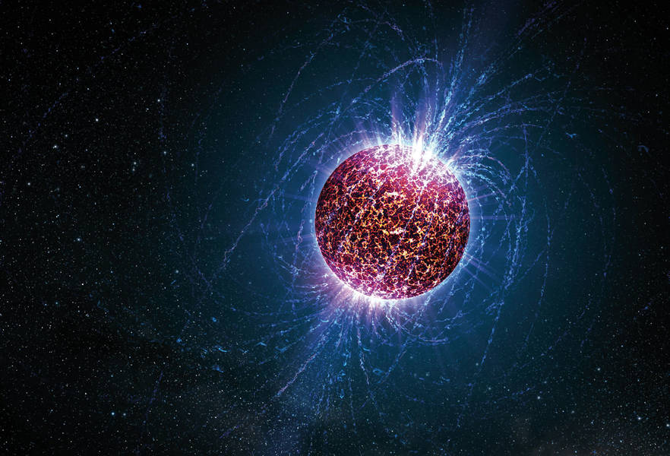
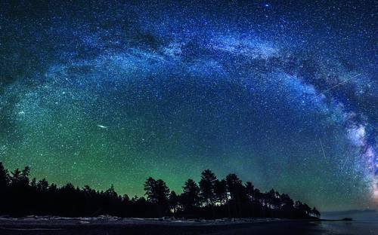
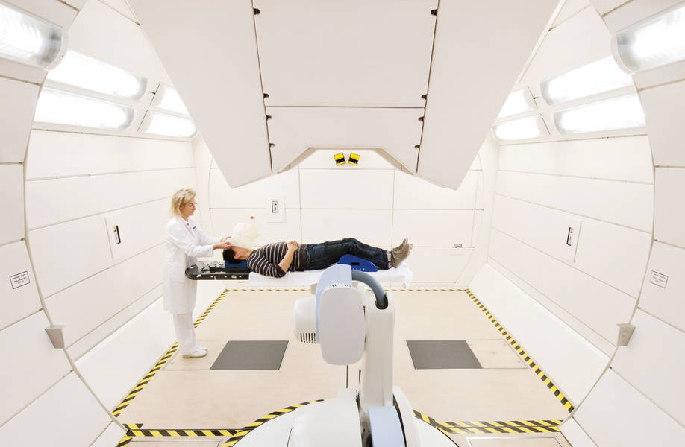
4 Pillars of FAIR
PANDA — Antimatter research
CBM — Inside a neutron star
NUSTAR — Stars and nuclei
APPA — From atoms and planets
to cancer therapy
Notes:
NUclear STructure Astrophysics Reactions – структура атомных ядер, экзотич ядра и их свойства, ядерные реакции, происходящие в звездах
Atomic Plasma Physics and Applications – фунд процессы в атомах до прикладных исслед (как клетки реагир на косм лучи, изуч материалов на тяжелые ионы)
Compressed Barionic Matter
https://www.gsi.de/en/researchaccelerators/fair/research.htm

Slide 5
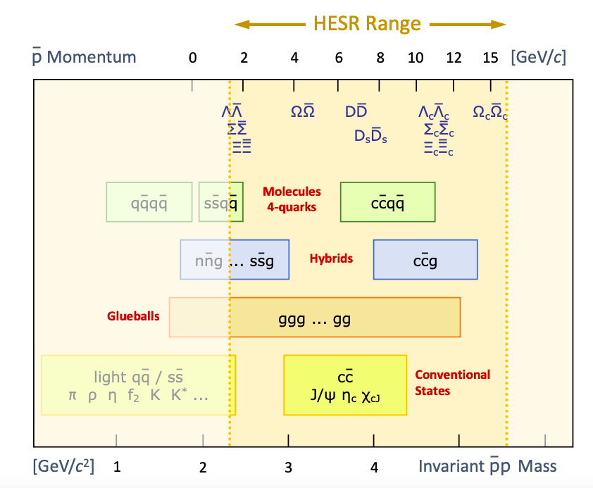
PANDA
Research Program
Topics of research:
hadron spectroscopy (XYZ, exotic QCD states)
nucleon structure (GPD, Drell-Yan, formfactors)
strange and charm physics
hypernuclear physics with anti-proton beams.
Notes:
FoA I’d like to say few words about PANDA experiment.
This Experiment will be one of the key experiments at the Facility for Antiproton and Ion Research (FAIR)
The PANDA Collaboration unites more than 450 scientist from 17 countries.
The main topics of interests are various topics around the weak and strong forces, exotic states of matter and the structure of hadrons.
PANDA is quite unique fix target experiment which will operate with pabr in wide range of momentum.
The max luminosity is up to …

Slide 6
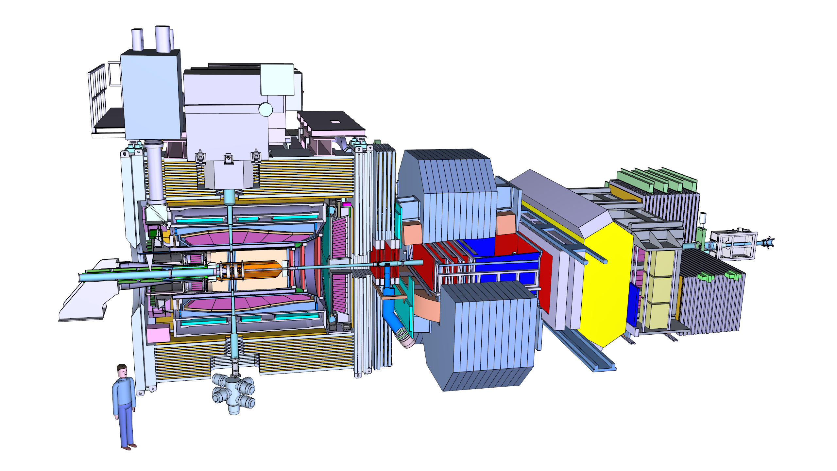
PANDA Detector
Target System
Solenoid Magnet
Muon System
Dipole Magnet
FTOF
FRS
LMD
BE EMC
Beam pipe
Barrel
DIRC & TOF
MVD
STT
Barrel EMC
GEM
FE EMC
Disc DIRC
FTS
FRICH
FSC
Nearly 4π solid angle for large acceptance
Tracking : ~50 μm vertex resolution
Different PID techniques for π±, K±, e±, μ±, γ identification
Good momentum resolution ~ 1%
Notes:
To resolve the physics question PANDA detector has to get a good acceptance, momentum and vertex resolution and different PID techniques for charge and neutron particles

Slide 7
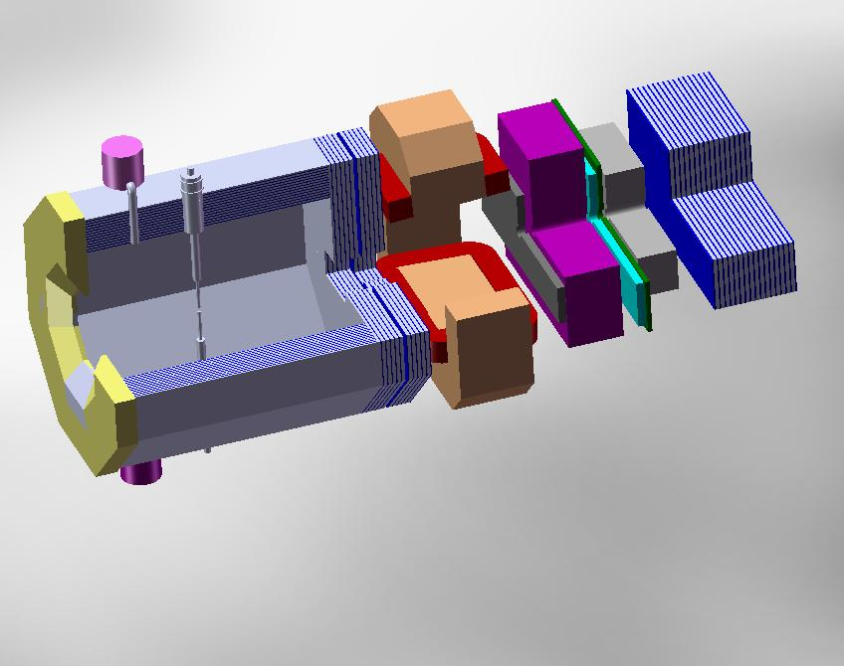
PANDA Muon System
Target Spectrometer
2600 MDTs
Dipole
RICH
ECAL
FRS
900 MDTs
TOTAL: about 4200 MDTs
µ - Filter / EC
700 MDTs
Muon System indicated in blue
Notes:
On the slide you can see a sketch of PANDA exp setup.
One of the key detector of PANDA is MS.
PMS consists of 3 main parts (Barrel Part, MF + EC and FRS) In total about 4200 MDTs will be installed.
Muon and Hadron Detection in PANDA by Range System
The main purposes are … chorse hadron calo
The most interesting sources of muo are
The most suitable technology for detecting the muons – is Range System with proper granularity close to muon’s straggling in the iron absorber

Slide 8
Muon System as PID
PANDA Muon System, based on the range system technique, is a good PID system for muon-to-hadron separation.
It works in full energy range of secondary particles at PANDA
(0.5 ÷ 10 GeV).
It resolves muons and hadrons with ~ 100% efficiency (zero hadron contamination) above ~ 1 GeV by obviously different response pattern.
Separation of muons vs pions (the main rival) below 1 GeV is less efficient and requires test beam measurements for calibration.
Range system will used as a coarse hadron calorimeter – > very important for neutron registration (the only system in PANDA)!
Notes:
FofAll PANDA MS 1)
2)
We have to resolve 3)
4)
I have to note that 5)
The Muon Range System structure is a well known solution for detecting the muons stopped by the absorber and those crossing the iron
In first case, one may even roughly estimate the energy of muon. The stopping power of iron is about 1.5 GeV per meter of absorber for the relativistic muons with dE/dx = 2 MeV/g.
The barrel part iron absorber sampling is 3 cm, in the EC 6 cm sampling is selected for better detection of muons with higher energies.

Slide 9
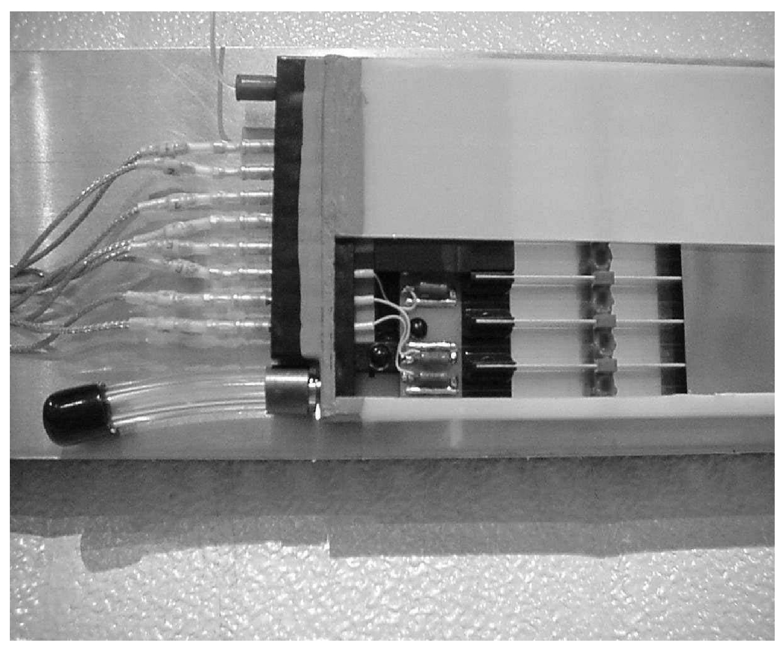
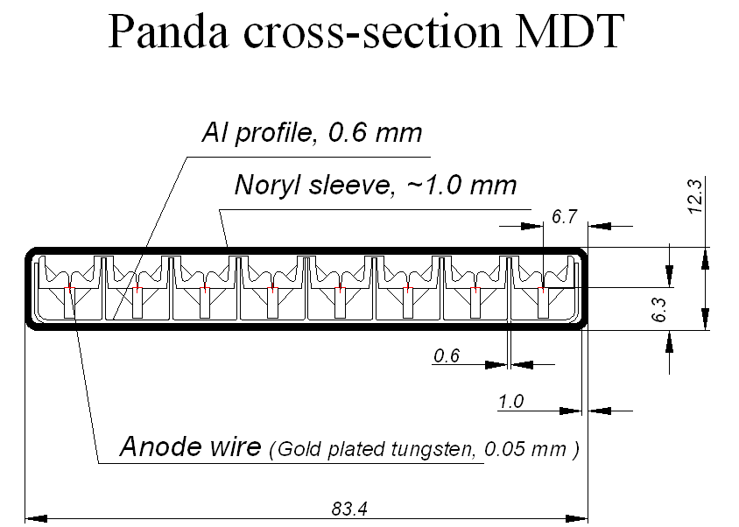
Mini-Drift Tube (MDT) Detector as
Basis for the Muon System
MDT with cut/”window” in plastic sleeve
HV/ground pin
8 signal connectors
Gas pipe connector
Notes:
The most suitable technology for detecting the muons – is Range System with proper granularity close to muon’s straggling in the iron absorber
Muon tracking detector is based on mini-drift tubes 1x1cm² drift cell:
8 cell aluminum extrusion comb with 0.6mm thick walls (to reduce dead zones),
50 micron gold-plated tungsten wires,
plastic sleeve provides electrical field configuration and gas tight volume,
external strips (cut on G10 fiberglass board) run perpendicular to the wires.

Slide 10
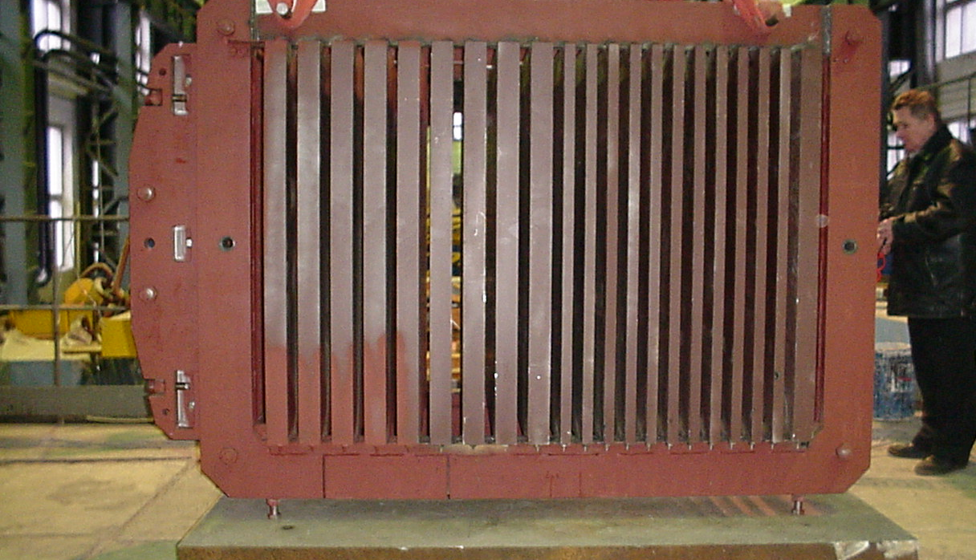
Range System Prototype @ CERN
The absorber structure in horizontal position
Notes:
On the picture you can see the absorber structure in horizontal (beam test) position for Muon System prototype assembled in Dubna
The Range System Prototype comprises all PANDA structures (Barrel, End Cap, Muon Filet and Forward Range System) and weights about 10 ton.
We have built a 10-ton prototype, its dimensions are 2.2x1.5x1.7m
Then we put MDT detecting layers and strips between absorber plates
it total approximately 4000 readout channels (2000 – for wires and 2000– for strips) we have in prototype.

Slide 11
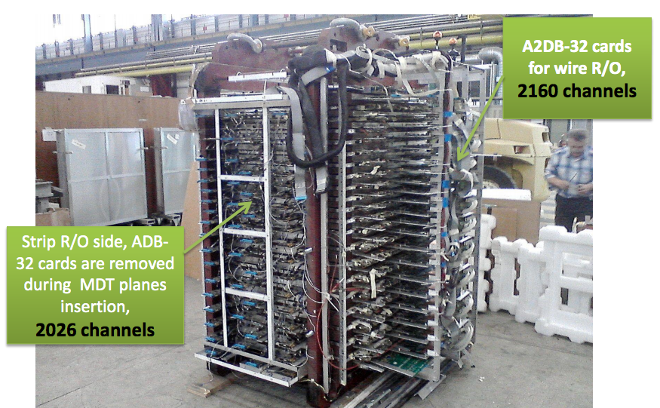
Main Tasks of Range System Prototype Study @ CERN
Calibration of the system’s response to the different particles and energies.
Test of algorithms for μ/π separation
Tune digitization algorithm
Technical issues
Range System:
absorber plates;
detecting layers of MDTs;
strips between the plates;
“zero” bi-layers.
Notes:
Obtaining and analyzing data from the Muon Range System Prototype is a crucial task for a PANDA Muon System – it permits a direct beam calibration of the system’s response to the different particles and energies.
1)Direct beam calibration of the system’s response to the different particles (μ and hadrons) and energies.
2)test of algorithms for μ/π separation
3)use information from the prototype to tune digitization algorithm
4)different technical issues
RS: 30 mm and 60 mm absorber plates reproduce different parts of the Muon System;
detecting layers of MDTs and strips are positioned in between the plates;
two types of “zero” bi-layers are put outside the absorber.

Slide 12
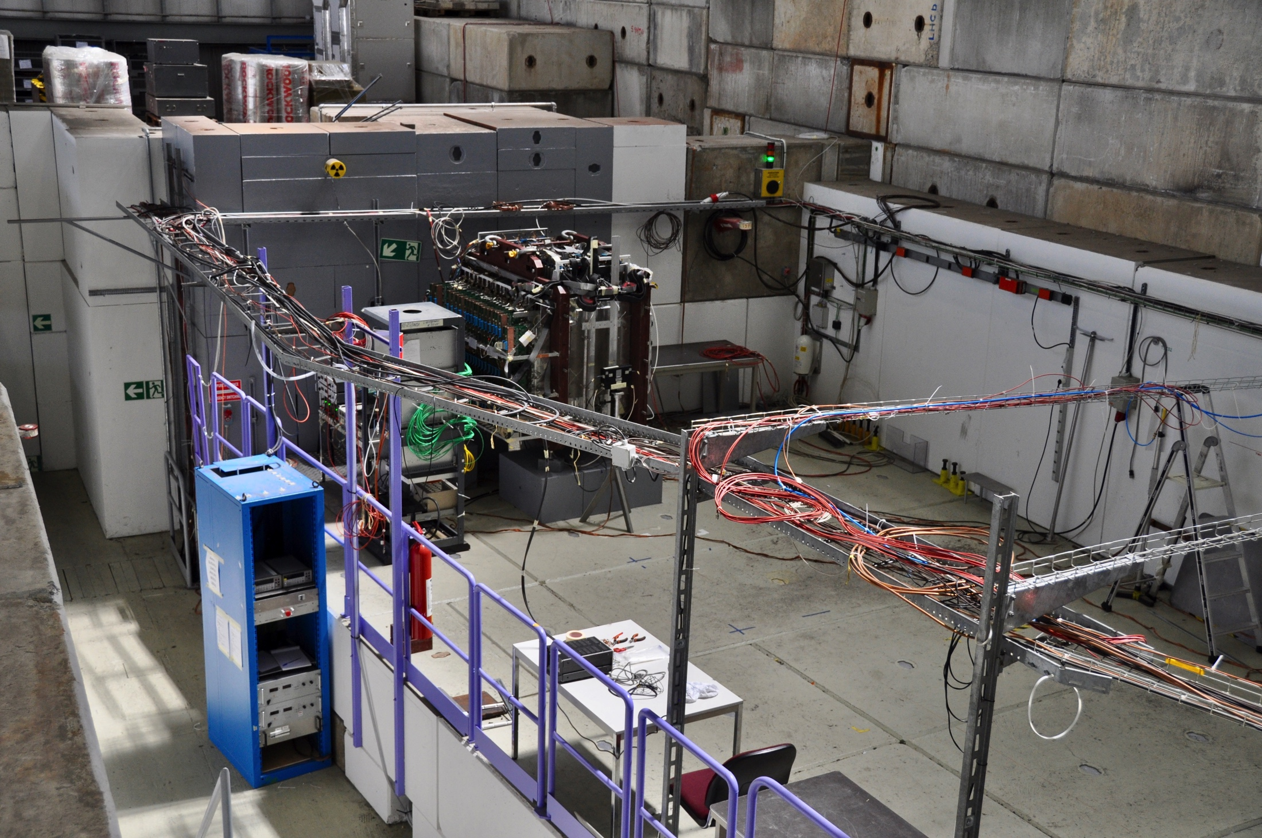
PANDA Muon System Prototype @
PS/T9/CERN Beam Line
Prototype
DAQ
Beam
Notes:
In 2017 and 2018 we have performed few test beam runs at CERN.
Full setup of prototype (with readout DAQ electronics and scintillation counters) at T9/PS/CERN beam line of secondary particles (e, µ, π, p of both signs; momentum range: 0,5 – 10 GeV/c) is shown on the slide.
Two scintillation counters have been placed in the focus positions along the T9 beam.

Slide 13
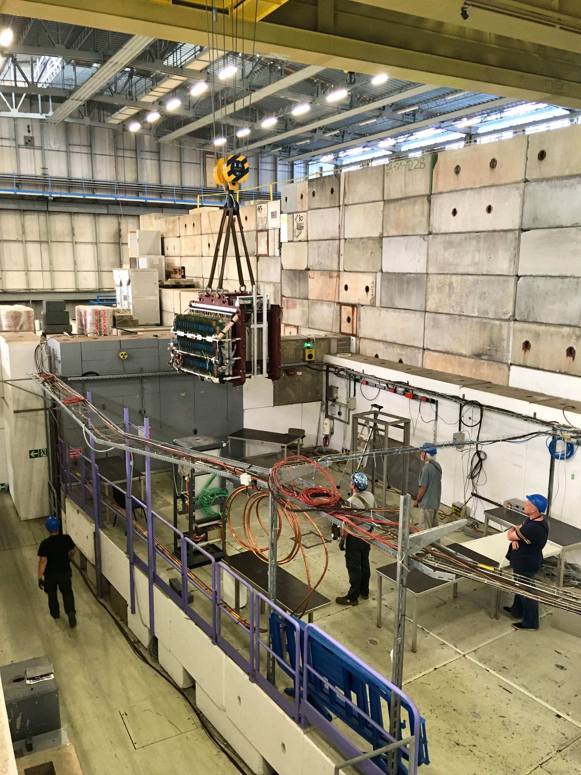
PANDA Muon System Prototype
Status
Test beam runs in 2017-2018
Calibration of the Prototype using
μ, π, p and n of different (+/-) momentum
2 years of PS shutdown and T9 beam line area renovation (since 2019)
Prototype is relocated to COMPAS area
Cosmic tests in 2019
New high pressure Čerenkov counter (60 atm) is ready and will be install in spring 2021 (π/μ rejection up to 1.5-2.0 GeV/c)

Slide 14
Simulation and analysis steps of experiments
Determine particle properties
at target vertex
Event Generator
Transport
Transport particles through
the detector material
MC tracks & points
Simulation
SIM
Digitizer
Determine detector response
digits
RAW
Determine physical space point
parameters from detector hits
Storage
Levels
Hit Finder
hits
Reconstruction
Track finding & fitting
Determine momentum vector
and PID for all tracks
tracks
& vertex
Analysis
Physics Analysis

Slide 15
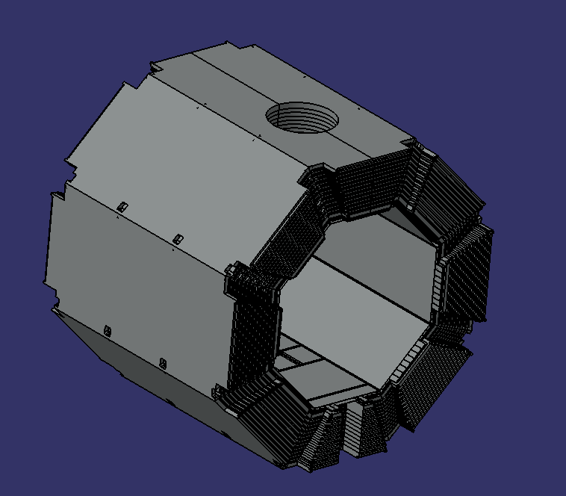
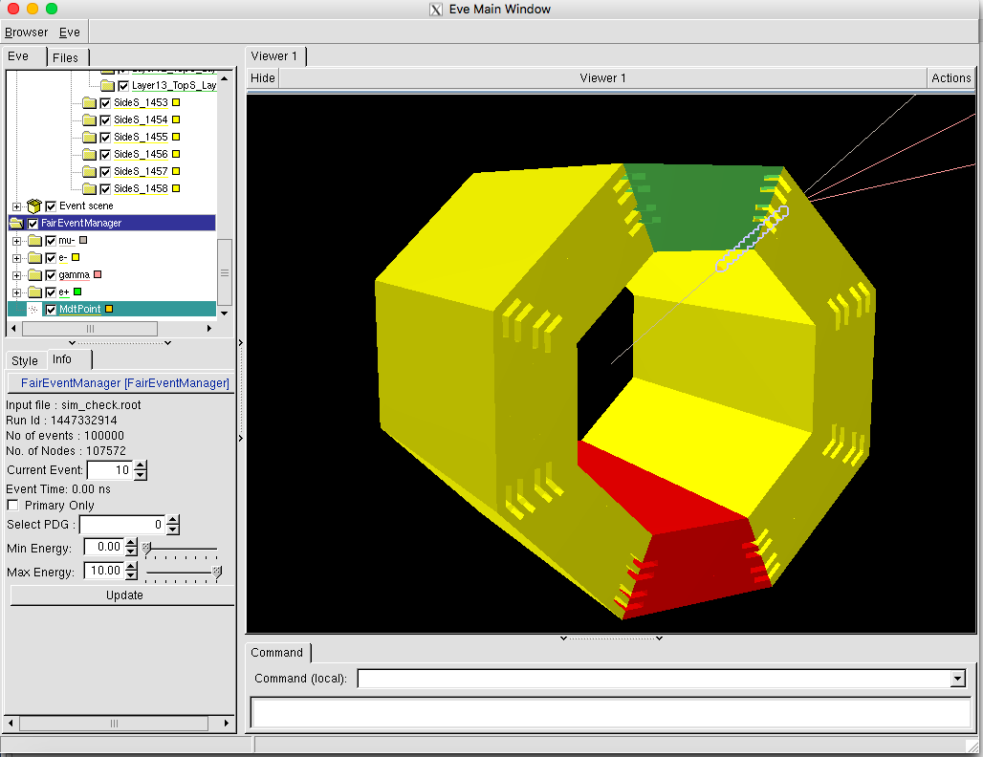
CAD and ROOT Models of
Muon System (Barrel part)
It is important to have the model of the Muon System in PandaRoot software for full MC simulation of PANDA setup.
Transfer of the detector geometry from Computer-Aided Design (CAD) systems to particle transport Monte Carlo codes like GEANT4 and ROOT is always an issue due to geometry description incompatibility.

Slide 16
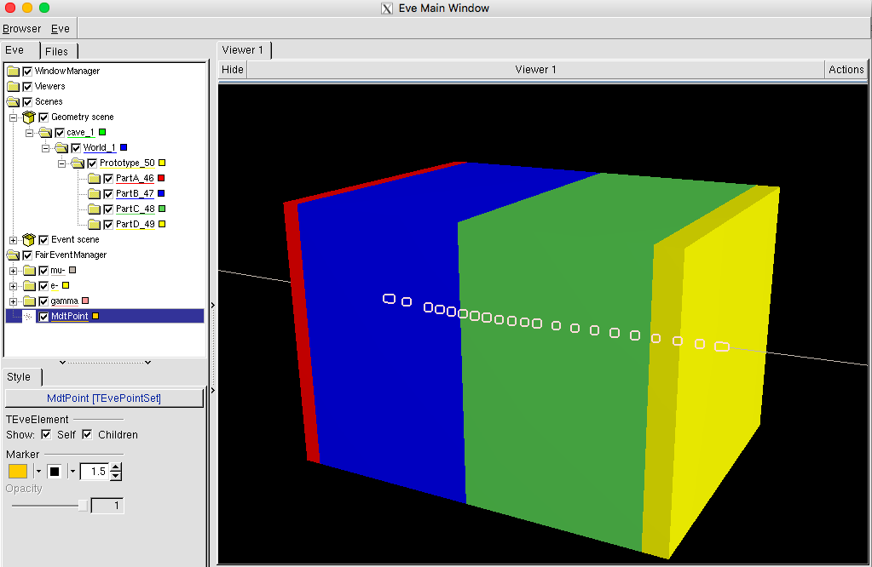
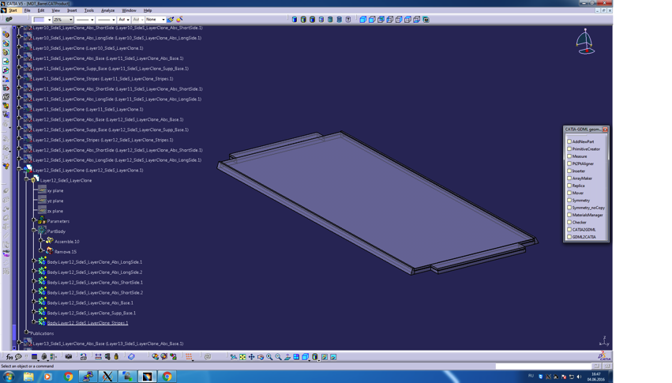
CAD and ROOT Models of
Muon System (Prototype)
Detector geometry in CAD systems
Physical model - particle transport Monte Carlo codes (ROOT)
Notes:
Now I can switch to my work
It is important to have the physical model of the MS in PandaRoot software for full MC simulation of Panda setup
There is no direct way to transfer geometry from CAD systems to geant4 or Root

Slide 17
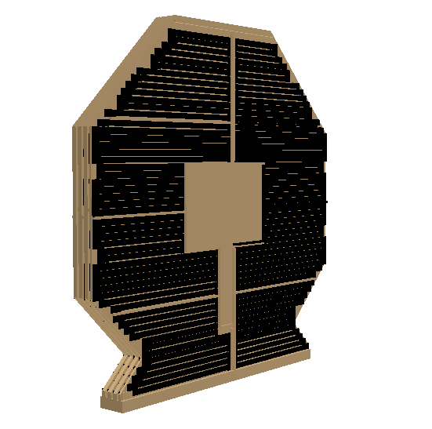
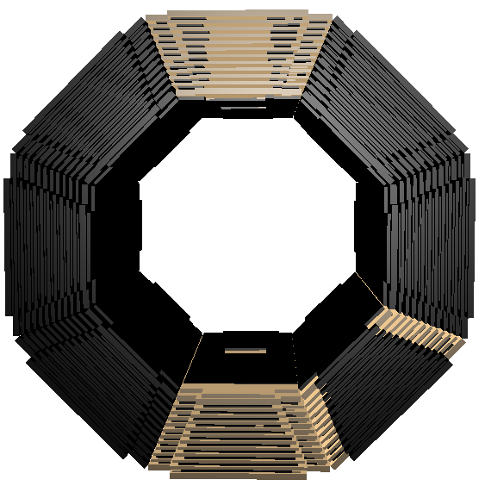
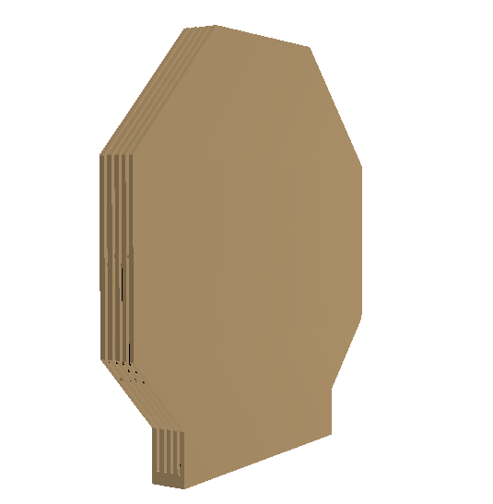
Models of Muon System
MF
EC
Barrel part

Slide 18
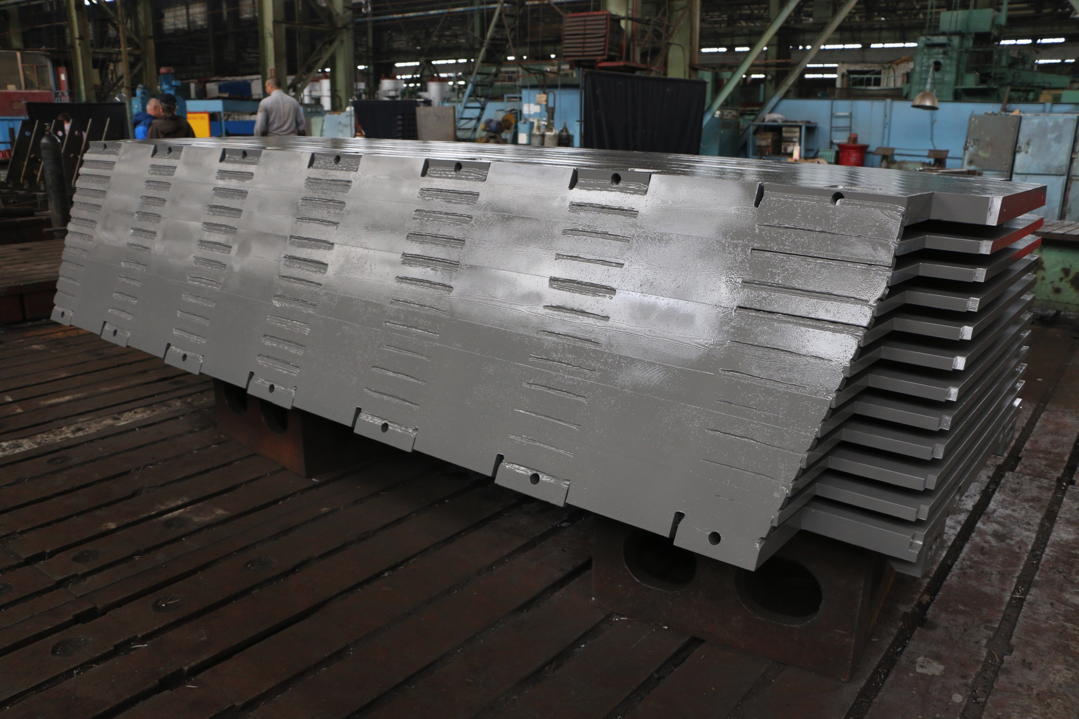
Geometry Status
The first octant of the PANDA Solenoid Magnet Yoke is completed in Novosibirsk in August 2018
Geometrical model of Muon System is changed significantly
(ex. size of installation, number of detecting layers)
New Barrel, MF, EC Muon System physical models are ready for integration to PandaRoot.
Model for FRS will be updated after discussions with BINP colleagues and developing of 3D final mechanical models.

Slide 19
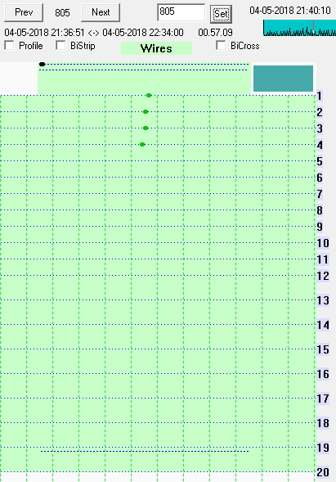
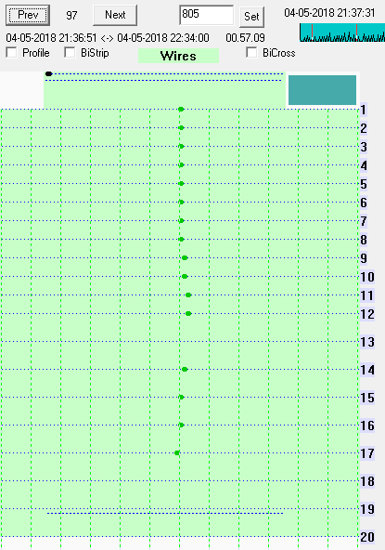
Event Examples (Run 822, P = 1 GeV/c)
p
μ
Notes:
Now I’d like to present a few preliminary results from the CERN test beam runs.
First of all here and on the next few slides you can see the examples of real events for different momentum.
Proton is shown on the left plot and mu on the right.
It’s obvious that low energy proton (momentum 1 GeV/c) stops at the first layers of prototype
while the muon looks like a needle.

Slide 20
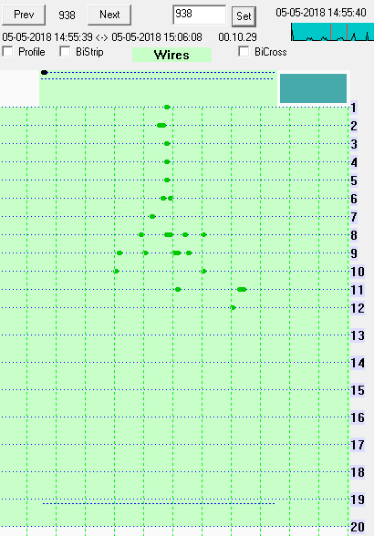

Event Examples (Run 829, P = 5 GeV/c)
p
μ
Notes:
For 5 GeV/c momentum proton gives a hadronic shower
while muon still looks like a needle.

Slide 21
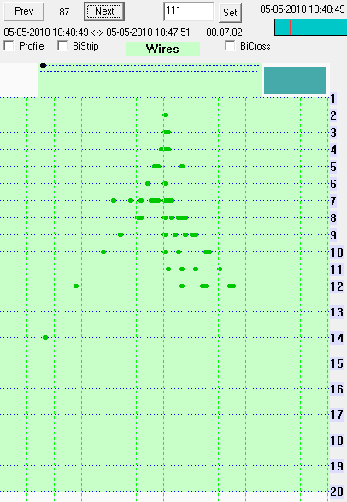
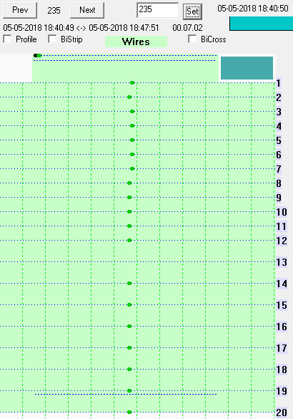
Event Examples (Run 835, P = 10 GeV/c)
p
μ
Notes:
For 10 GeV/c momentum proton produces even bigger shower, muon is the same as for lower energies.
We confirm that for energies greater 1 GeV we can separate muons from hadrons using patterns for particle shape.
Still there is an open question how to separate low energy mu from pi

Slide 22
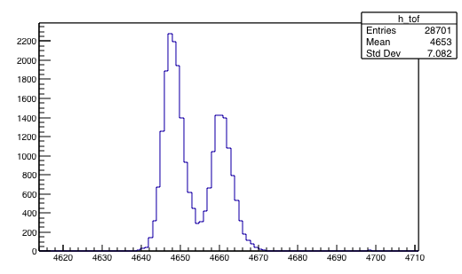
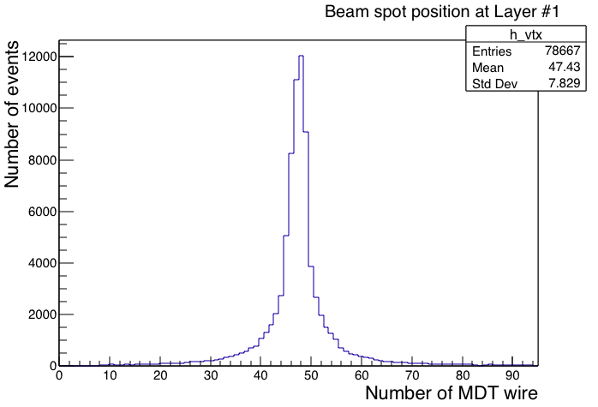
Selection Criteria for protons and antiprotons
For calorimetry we estimate the energy of protons (antiprotons) by measuring the number of hits in an event.
Two scintillation counters of the TOF system (up to 5 GeV/c)
Čerenkov counters (> 5 GeV/c)
Čer(A): 2 bar of CO₂ <-> reject e/π/μ
Beam entrance spot
Run 829, P = 5 GeV/c
relativistic
peak
p
Number of channel
Notes:
Also we have performed some tests using data from prototype.
FoA we calculate the energy deposition of particles in the different parts of prototype.
For Calorimetry we …
For distinguishing the secondary particles in the test beam (mu from protons and other particles) we use
Two scintillation counters of the TOF system information for ... and
Cherenkoff counters
Two scintillation counters of TOF system (positioned at 26 m of each other) allow observing peaks of the particles in the beam (electrons, muons, pions and protons).
Protons may be indicated by TOF scintillators up to 5 GeV/c.
Above 5 GeV/c protons are "detected" by Cherenkoff counter through the absence of a signal
To reduce the background from the background particles in the event we set the cut for the beam entrance spot in prototype.

Slide 23
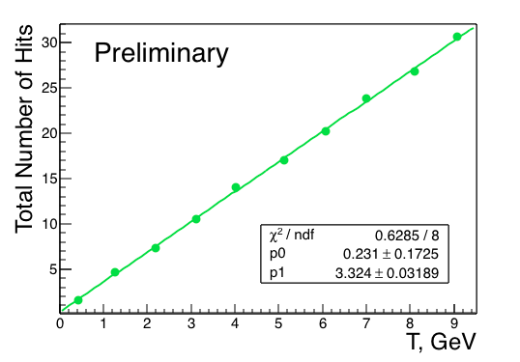
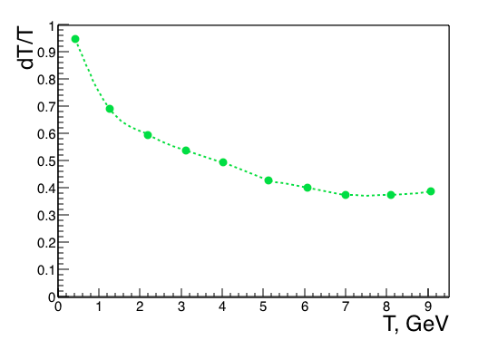
Calorimetry for protons:
PANDA FRS Structure
Various combination of layers can be used to represent different parts of Muon Range System.
Sampling: 60 mm / Fe
Nuclear interaction length λ_{I} ≈ 5.2
Notes:
Left plot shows the distribution of total number of hits deposited in PANDA FRS Structure as a function of kinetic energy protons.
Right plot shows the energy resolution in PANDA FRS Structure.
I’d like to point that PANDA FRS Structure has 60mm of Fe sampling and corresponds ~ 5 Nil
From the left plot we can say that for every 1 GeV we have 3.3 additional hits in detector.

Slide 24
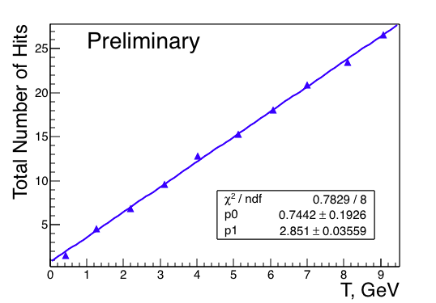
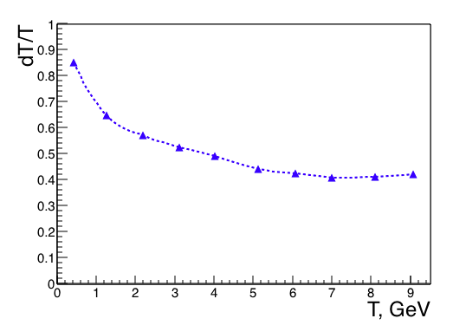
Calorimetry for protons:
PANDA MF+EC Structure
Sampling: 60 mm / Fe
Nuclear interaction length λ_{I} ≈ 3.4
Notes:
The analogous results for PANDA MF+EC Structure (the same sampling but less layers)

Slide 25
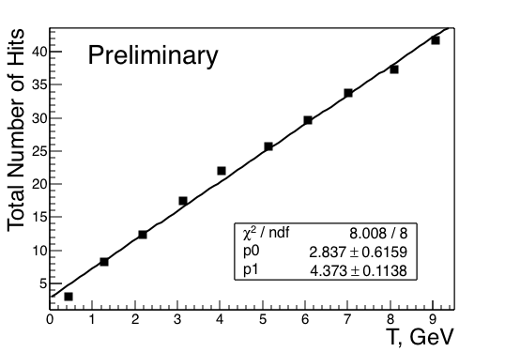
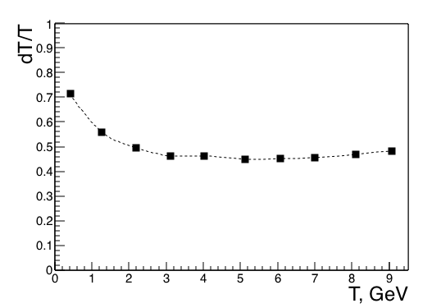
Calorimetry for protons:
PANDA Barrel Structure
Sampling: 30 mm / Fe
Nuclear interaction length λ_{I} ≈ 2.3
Notes:
The final plots for calorimetry are for PANDA Barrel Structure with 30 mm sampling and 2.3 Nil
To analyze all prototype structures we can say that for low energies we have better resolution for barrel structure and FRS for high energies.
→ In barrel structure we have the leak of hadron shower.

Slide 26
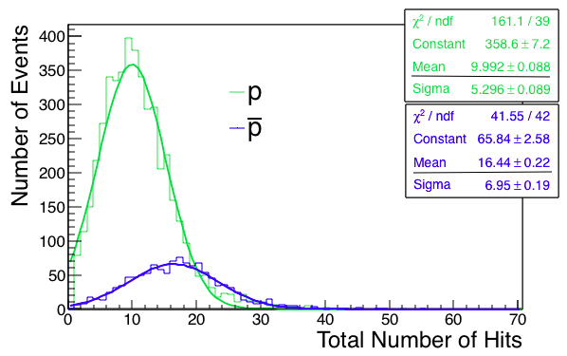
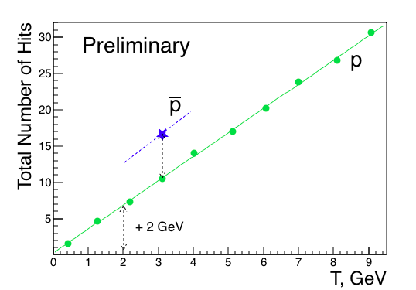
Protons vs Antiprotons
PANDA FRS Structure, T = 3.1 GeV (P = 4 GeV/c)
Notes:
One more interesting results concerning the measurement of total number of hits for antiprotons.
We estimate the total number of hits for p and pbar in FRS Structure and kinetic energy 3.1 GeV
Left plot shows the number of events as a function of total number of hits for p and pbar.
Right plot shows the calorimetry for protons (the same plot as in page 15) and point for antiprotons.
You can see that for pbar we have more hits due to ppbar annihilation and the different
Between number of hits for p and pbar the same energy corresponds to deposit of protons with energy 2 GeV
Two additional measurements were recently made for antiprotons which will allow to estimate the calibration line. Work in progress.

Slide 27
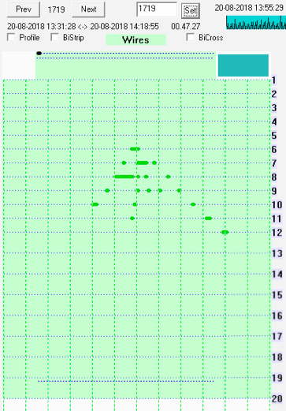
Event Examples (P = 5 GeV/c)
Range System will also be used as a coarse hadron calorimeter – >
very important for neutron registration (the only system in PANDA)!
μ
p
n
Run 829
Run 829
Run 951
Notes:
Another important feature of the Range System is a possibility to identify neutrons.
Use of the same charged particles monochromatic beam @ T9/PS;
Carbon target as a neutron source;
Scintillators for vetoing protons.

Slide 28
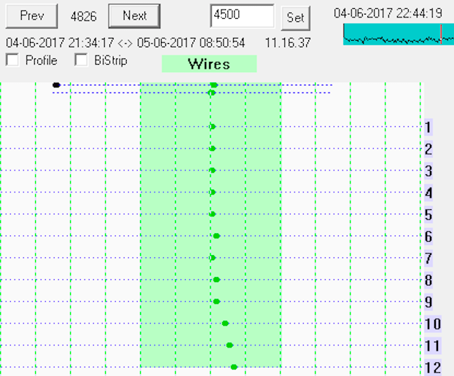
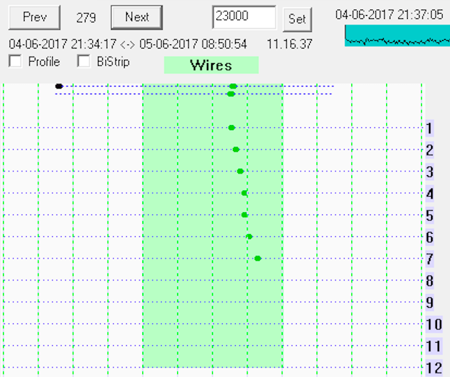
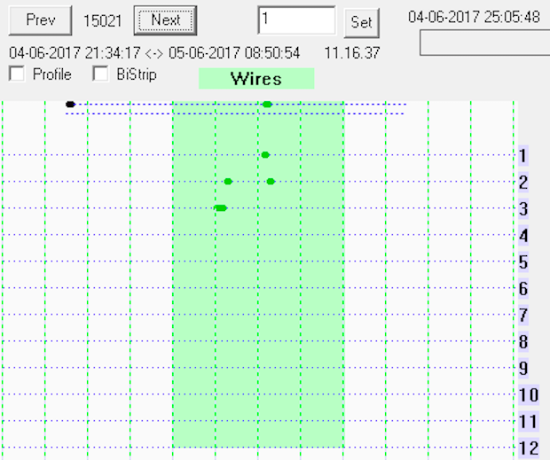
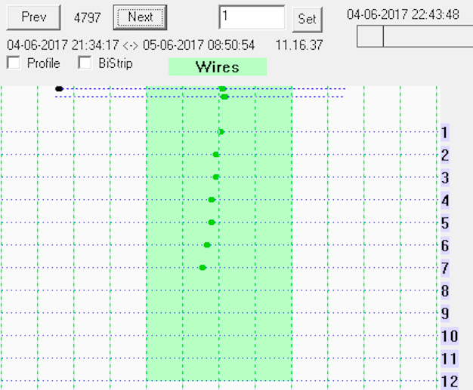
Prototype Data (μ vs π)
Run 605
P = 0.5 GeV/c
μ
μ
“Standard” π – shower
“μ-like” π
Barrel sampling, 30 mm
Notes:
A hit profile in RSP corresponding to a particular kind of particles with a certain momentum has a specific pattern. Low momentum pions (p < 1.0 GeV/c) almost indistinguishable from muons with the same momentum.
The increasing energy of pions significantly changes the profile of hits, forming a hadron shower of secondary particles for pions with momentum up to 10.0 GeV/c

Slide 29
Preliminary Test Beam Results
EPJ WoC, Volume 177 (2018) 04001
Run 605, autumn 2017
P = 0.5 GeV/c
Selection -> after layer #7:
22% - pion contamination and
93% - muon efficiency
FairBoxGenerator, PandaRoot
P = 0.5 GeV/c
Selection -> after layer #7:
27% - pion contamination and
99% - muon efficiency
Barrel sampling, 30 mm
Notes:
As an illustration, Figs. show the normalized distributions of events containing muons (green line) and pions (black triangles) as a function of the last number of triggered (fired) layer in the prototype in data and MC, respectively.
Distributions in data and MC have a similar shape, although they are a bit different in numerical terms. The experimental data permit us to make a preliminary rough estimate of the pion-to-muon separation at very low (~0.5 GeV/c) momentum.
So, the overlap of the pionic and muonic spectra after the layer # 7 of the Range System (to keep efficiency for muon registration ~90%) gives us ~20% of pion contamination.
Whereas for the MC model we have contamination of pions 27% at 99% for muon detection efficiency.
We assume now that the observed difference is caused by the secondary muons present in the beam due to pion-to-muon decay, and we plan to improve the result by discriminating them in further runs by direct measurement of incoming momenta at the final focus of the beam.
-----------------------
Finding variables sensitive to differences in such patterns, is directly connected to the possibility of separation between muons and pions, e.g. the depth of the full energy deposition of the particles in the layered structure of the Range System (can be used as an input to various ML techniques).
Only (20 − 25) % of pions reach the 7th plane, while almost all of the muons have the energy exceeding the threshold. The presence of hits above the 8th layer with a high degree of probability suggests that the particle is a muon, since no more than (1 − 2) % of pions reach the 9th plane.

Slide 30
Summary and Plans
Preliminary calorimetry of PANDA Muon System Prototype for protons and antiprotons is performed with test beam data.
Processing of pionic data is in progress
Identification of neutrons is demonstrated.
Plans:
Finalizing 3D mechanical model of FRS Muon System (detector geometry).
Transferring the detector geometry from CAD system to particle transport Monte Carlo code like (ROOT).
Digitization / pattern recognition of hadrons and muons using test beam data 2017-2018.
Cosmic tests at CERN (2019-2021).
Notes:
To summarize I’d like to stress the next points

Slide 31
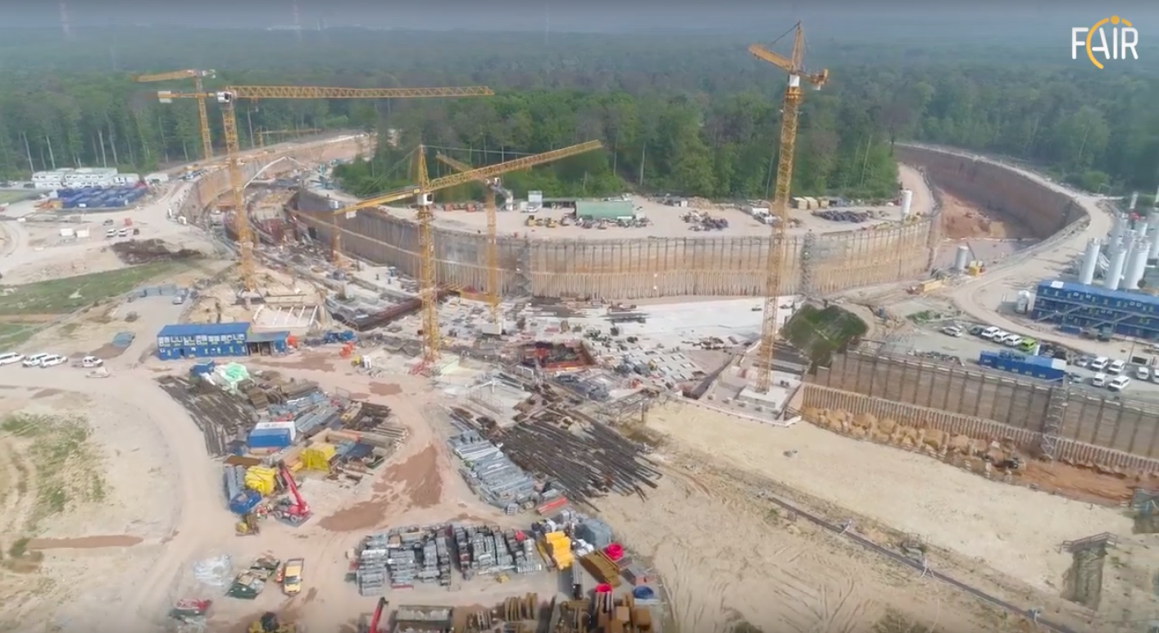
Backup Slides

Slide 32
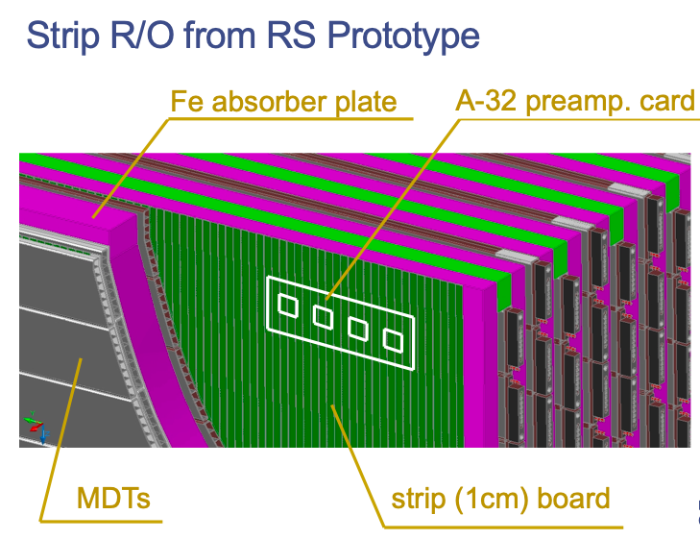
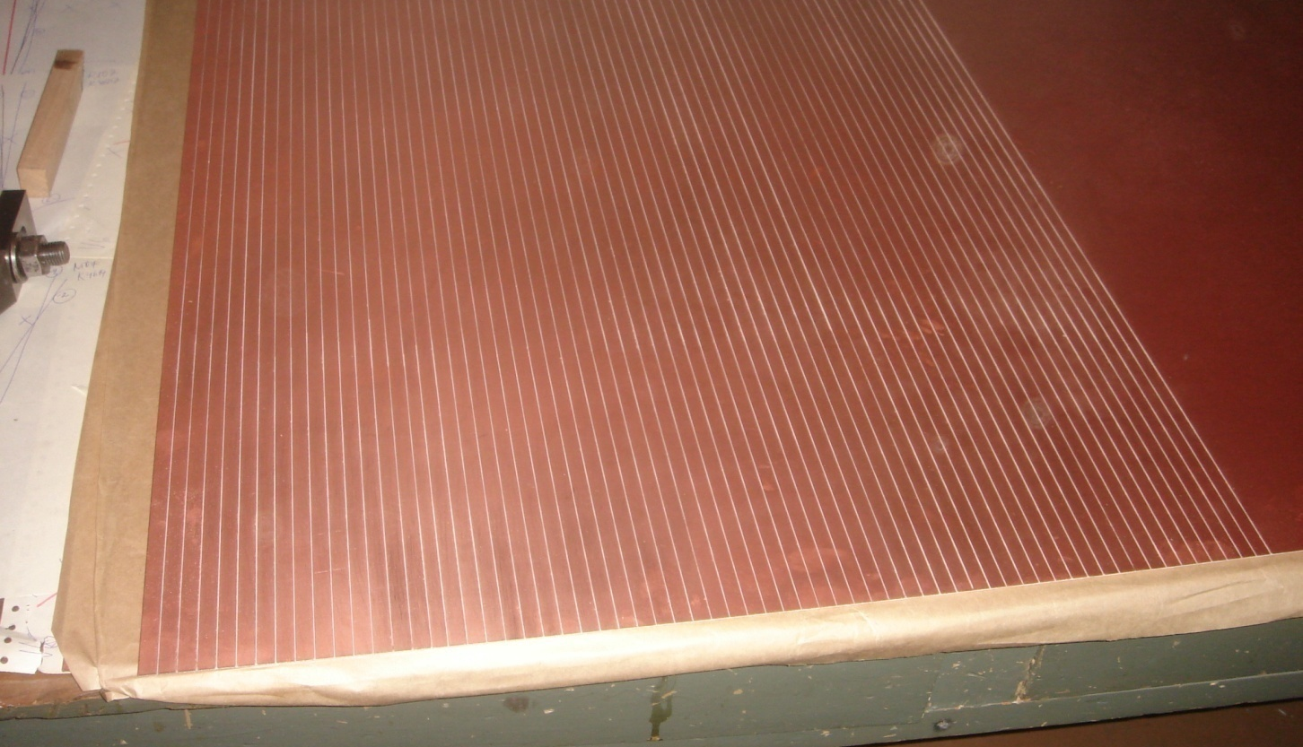
G10 Fiberglass Strip Board
1 cm wide strips

Slide 33
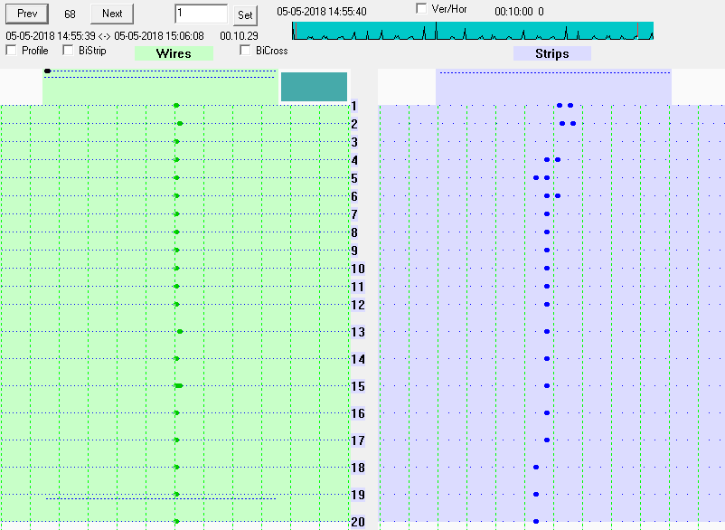
Event Examples (Run 829, P = 5 GeV/c)
μ

Slide 34
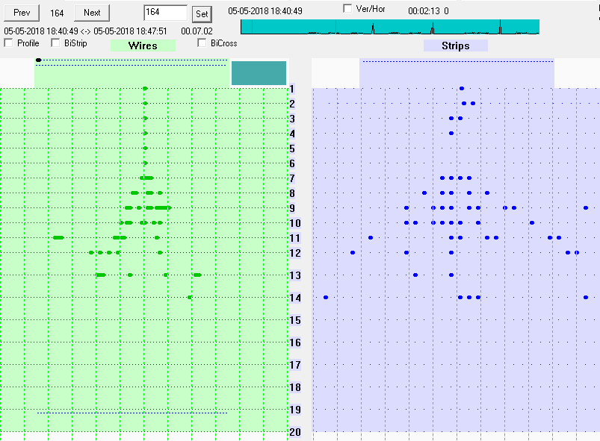
Event Examples (Run 835, P = 10 GeV/c)
p

Slide 35


Estimated maximum flux in beam @ T9

