Slide 1
Proposal for intermediate tests and process of assembly BM@N STS module
Aleksei Sheremetev

Slide 2
Main stages of assembly process of STS BM@N module
Inspection of the cable set
Inspection of the ASIC
Inspection of the Si – sensor
Inspection of the PCB
Bonding Cable to ASIC (same procedure for both rows)
Bonding “CABLE – ASIC” to Sensor (same procedure for both rows)
Installing of the ASIC to the PCB
Bonding of the ASIC to the PCB
Assembly of the shielding layers on module
Testing of completely assembly module
Testing of completely assembly module: https://cernbox.cern.ch/index.php/s/yCtBinxqw5p8sxS

Slide 3
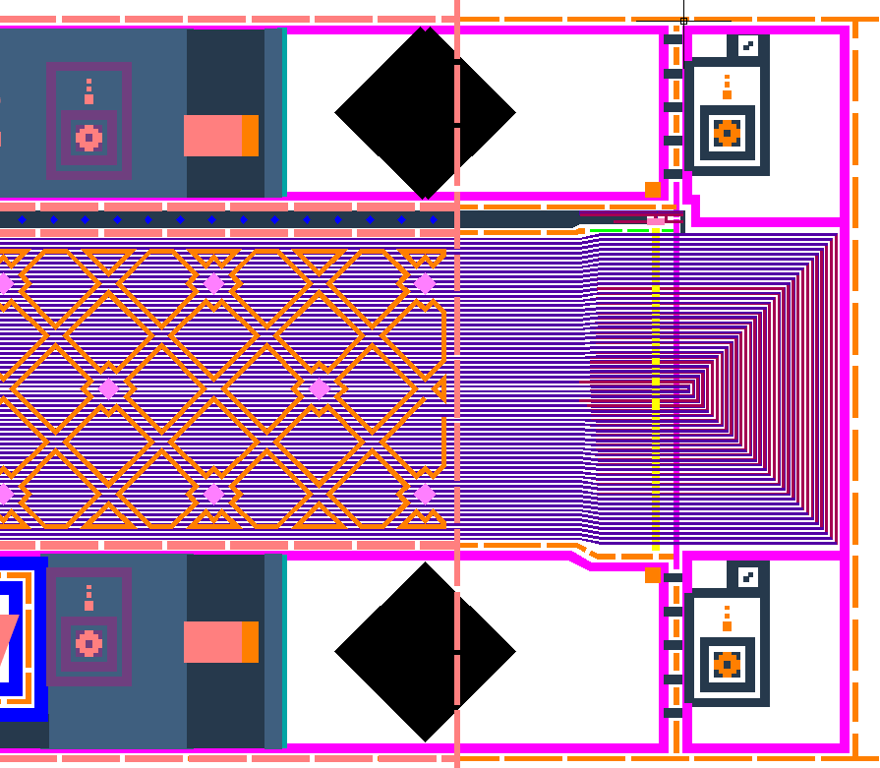
Inspection of the cable set
Visual inspection after delivery (Several cable sets can be inspected).
Measuring of the resistance of signal lines (Could be used with tail of cable).
Load photos and data to local database.

Slide 4
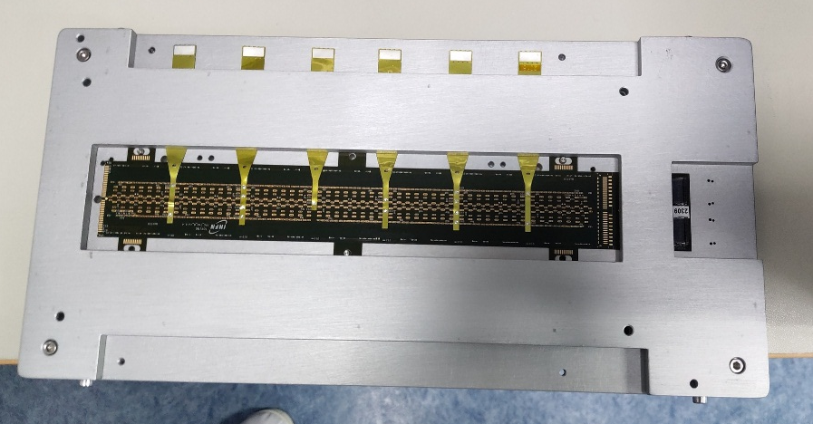
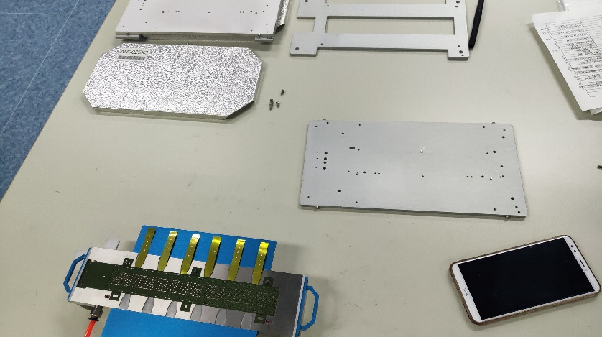
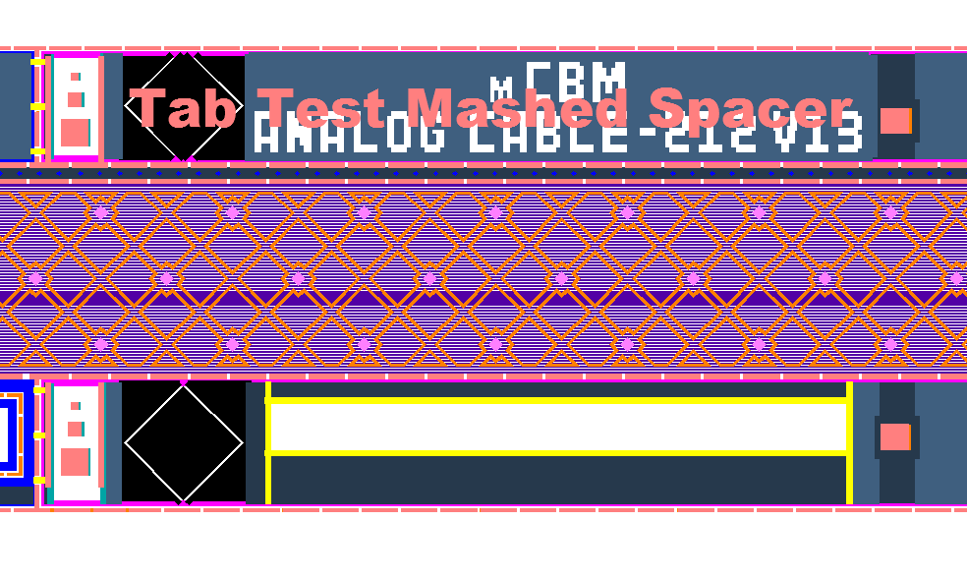
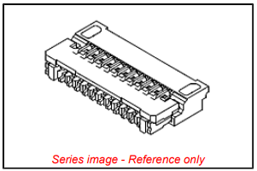
Proposal for inspection of the cable set
Manufacturing of new transport jigs for set of the microcables
Design a new device for the test of resistance using tail of the cable (The connector for tail Molex 503419-0710)

Slide 5
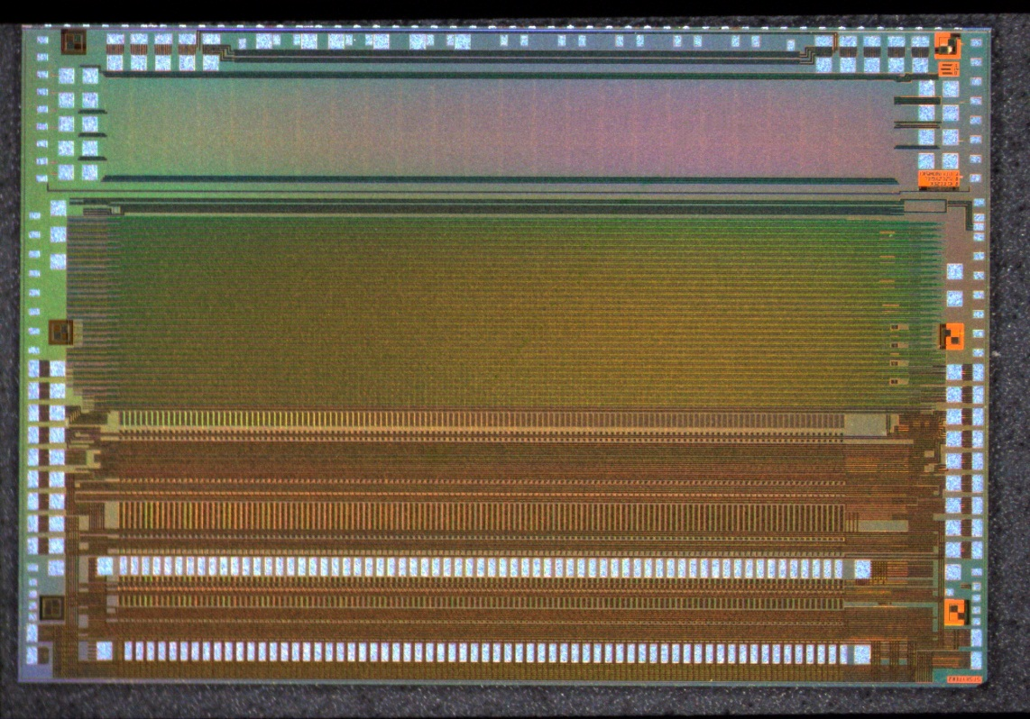
Inspection of the ASIC
Visual inspection (Before assembly).
Testing of the ASIC with POGO pin tester.
Preparation of the chips in ultrasonic bath (optional)
Storage photos and data to local database.

Slide 6
Proposal of the inspection of the ASIC
Redesign base for the bonding «chip-cable» tooling
Using the tail of the cable for intermediate testing during assembly of the "chip-cable“

Slide 7
Inspection of the Si – sensor
Visual inspection (Before assembly).
Tests with Probe station
Storage photos and data to local database.

Slide 8
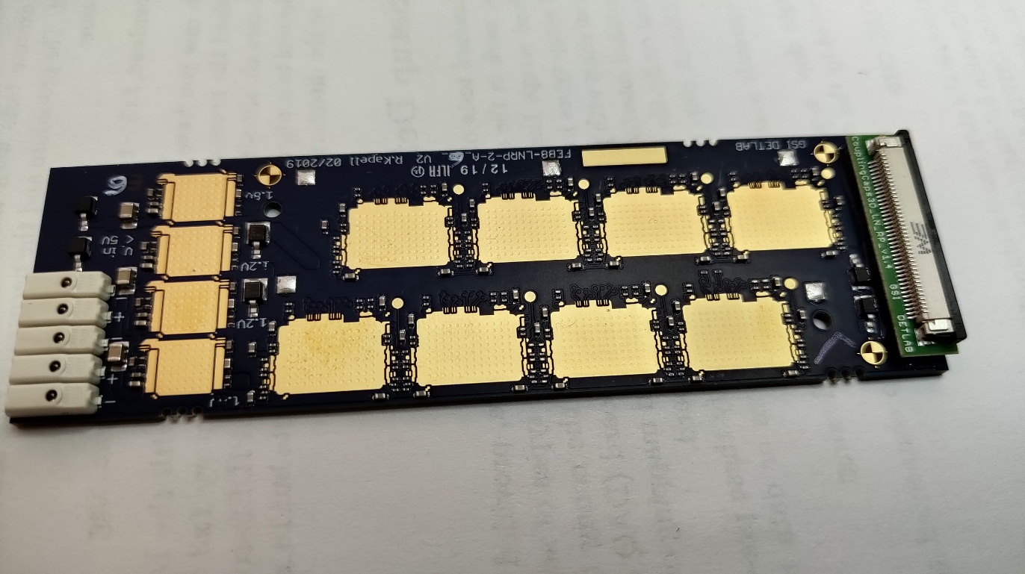
Inspection of the PCB
Prepare PCB with ultrasonic bath (Vigon US and Alcohol)
Visual inspection of bonding pads.
Electrical test of the PCB
Storage photos of bonding pads and places for glue ASIC to the local database.

Slide 9
Bonding “Cable to ASIC” (same procedure for both rows)
Adjustment of the bonding machine (Cutting of the test areas on the cable. Selection of the optimize parameter of bonding).
Pull test with DOGE4000 (Storage of the log file to database).
Bonding cable to ASIC (Storage of the log file on Delvotec G5 to database and load the photo of bonding).
Test of the “ASIC – CABLE” (Measuring noises with test tail on the cable with special jig and Arduino).
Bond row protection with glue Fuller Epolite FH-5313 (Storage photo of the protected row to the database).

Slide 10
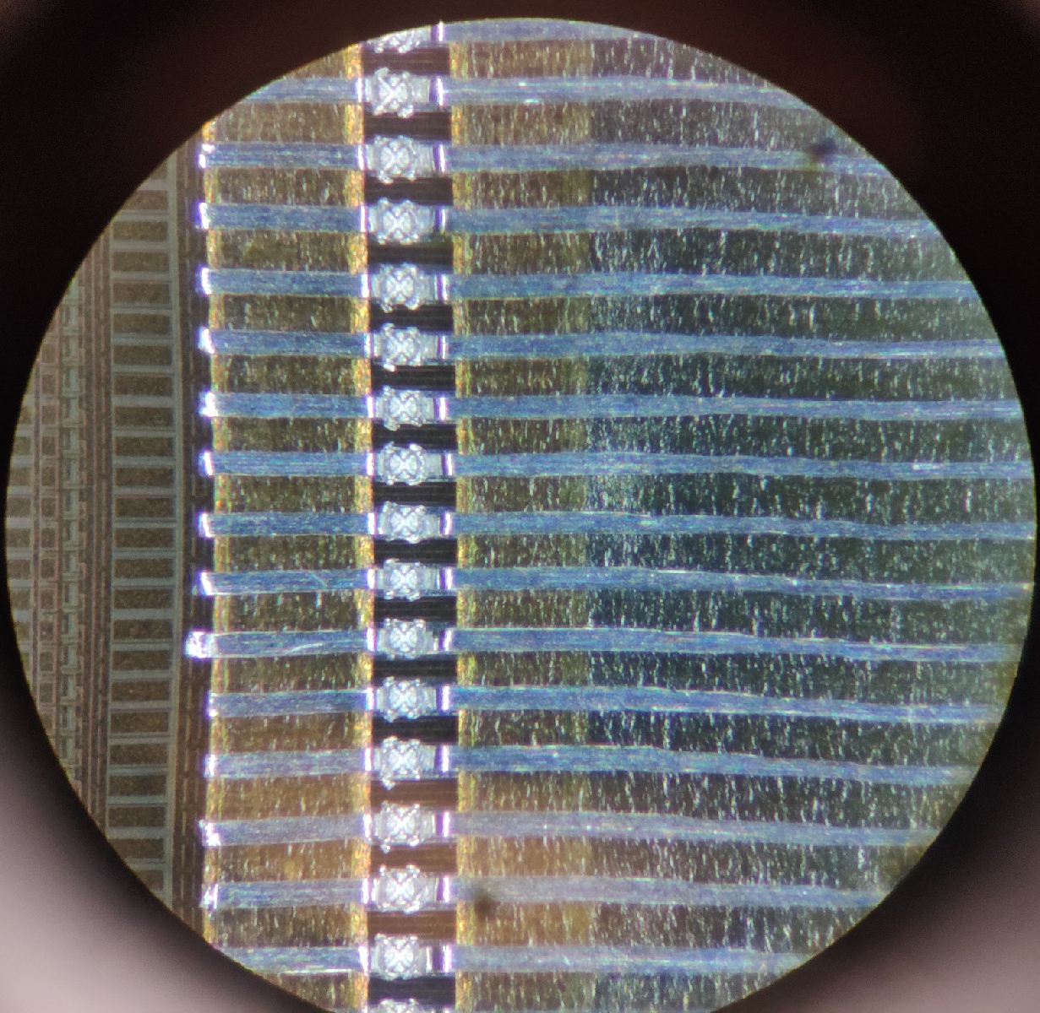
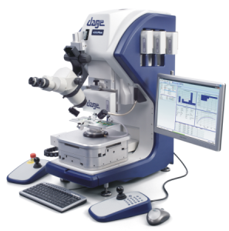
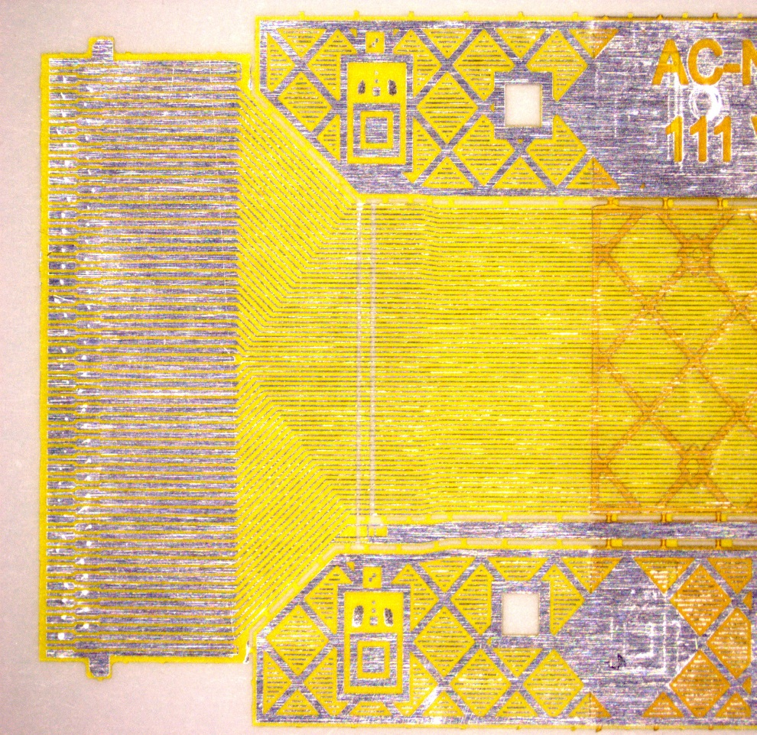
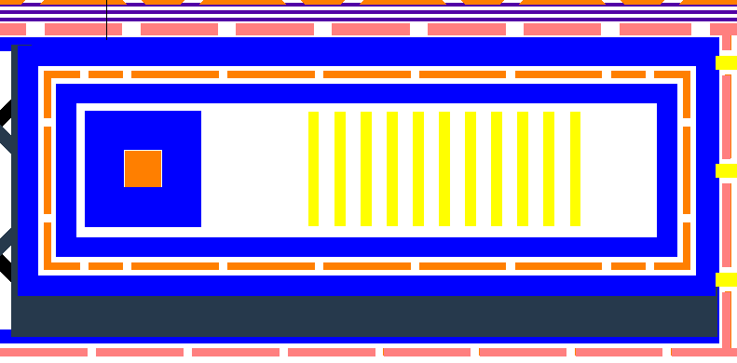
Proposal of the bonding Cable to ASIC (same procedure for both rows)
Redesign of the test area on the cable for optimize to pulltest machine

Slide 11
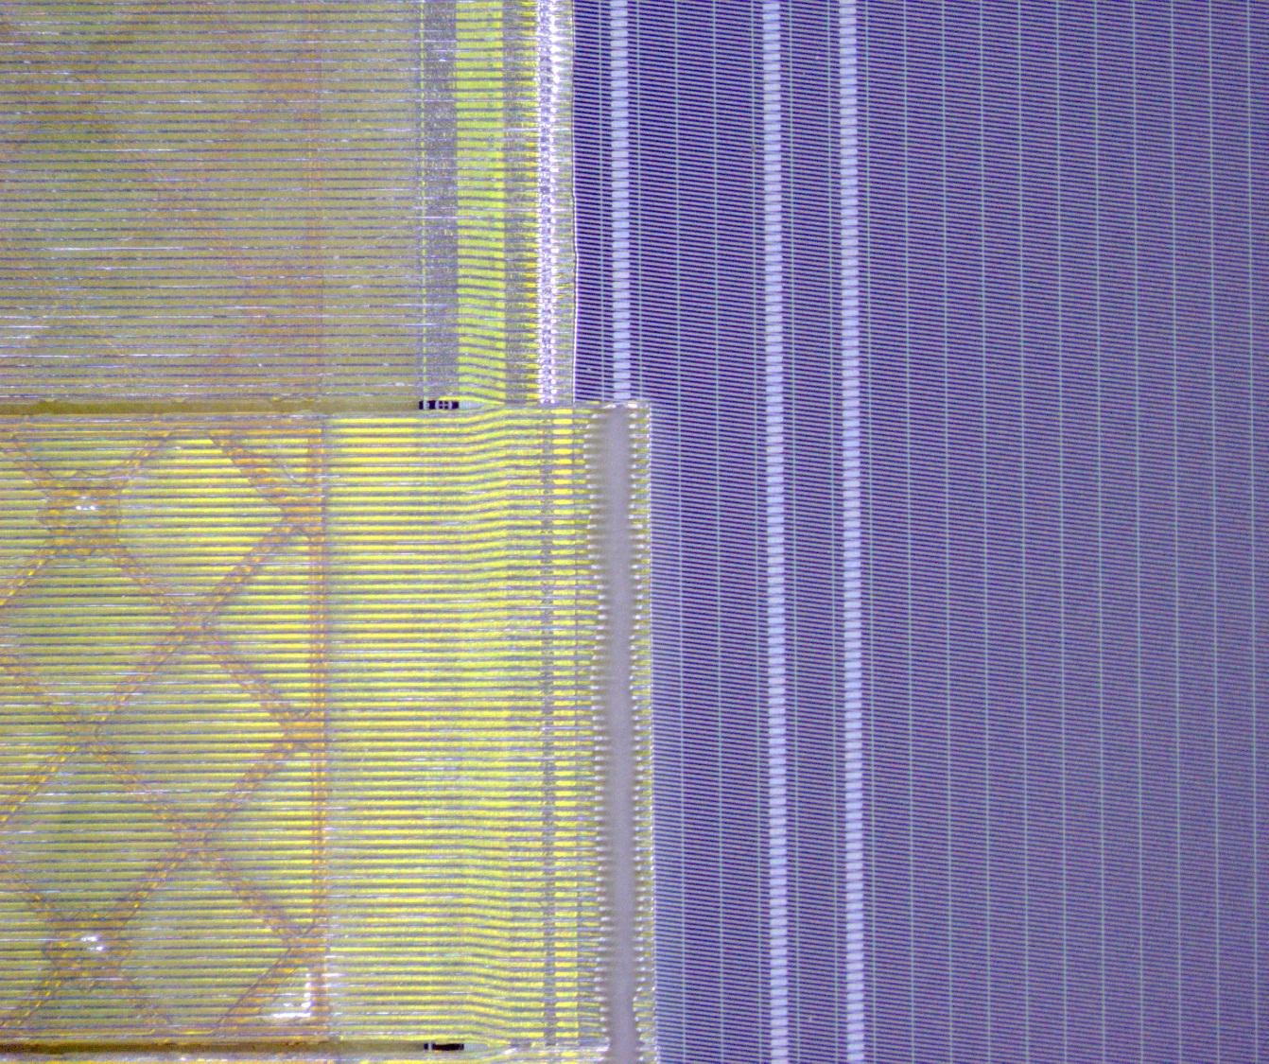
Bonding “CABLE – ASIC” to Sensor (same procedure for both rows)
Adjustment of the bonding machine (using previously selected parameters for bonding cables).
Bonding of first row “CABLE – ASIC” to Sensor (Storage log file on Delvotec G5 to database and save photo of bonding).
Test of the “ASIC – CABLE – SENSOR” first bonding row (used POGO pin tester).
Bonding of the firth row protection with glue Fuller Epolite FH-5313 (Storage photo of the protected row to database).
Bonding of the second row “CABLE – ASIC” to Sensor (Storage of the log file on Delvotec G5 to the database and load photo of bonding).
Test of the “ASIC – CABLE – SENSOR” second bonding row (used POGO pin tester).
Bond row protection with glue Fuller Epolite FH-5313 (Storage photo of the protected row to the database).

Slide 12
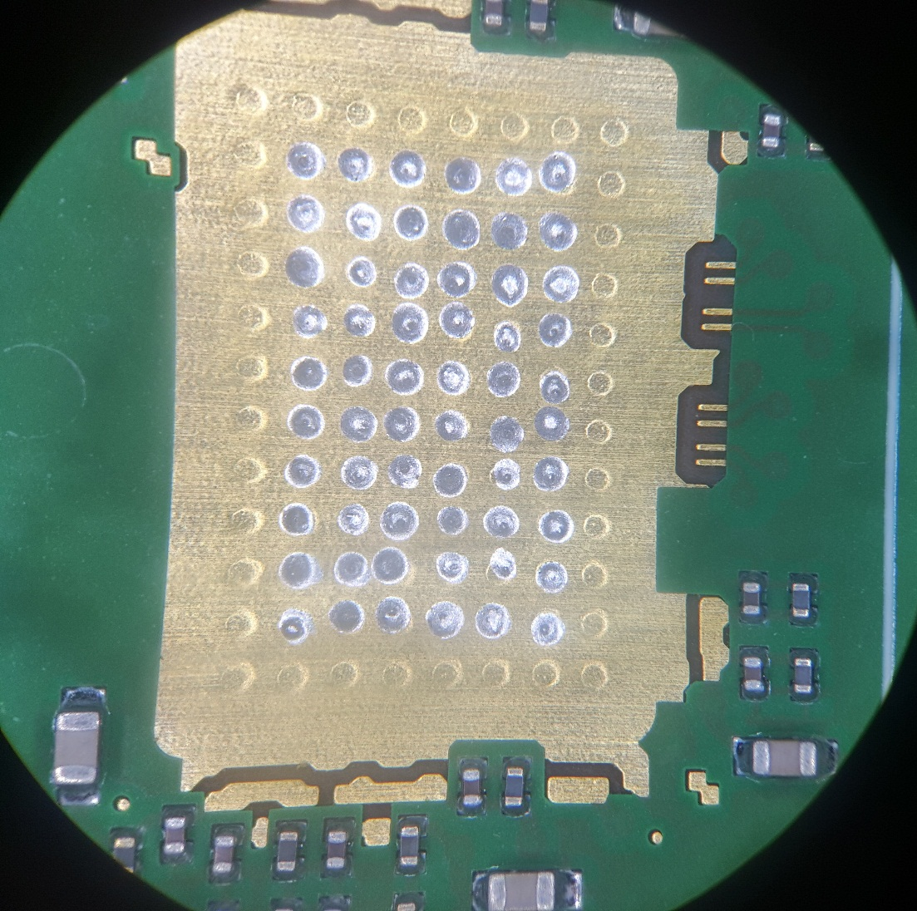
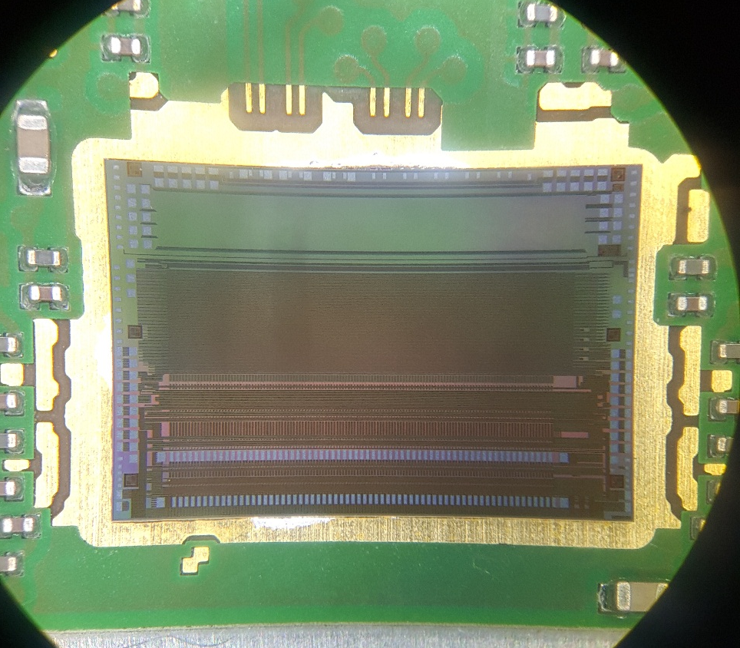
Installing of the ASIC to the PCB
Glue preparation with mixer Thinky ARE-250
Encapsulation with glue EpoTex T4110 in oven 60 ºC
Photos of each ASIC’s (Storage in database)

Slide 13
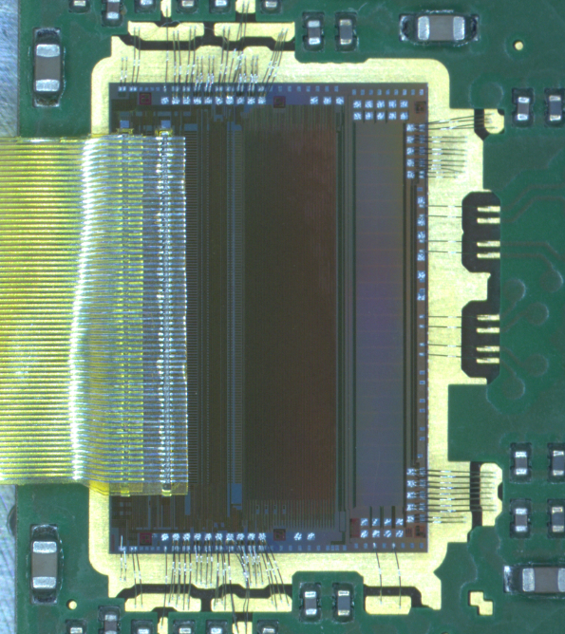
Bonding of the ASIC to the PCB
Adjustment of the bonding machine (used test pads on PCB).
Pulltest on DOGE4000 (The log file will be storage to database).
Wire bonding “ASIC – CABLE” (Storage of the log file on Delvotec G5 to the database and load photo of bonding).
Test of the “ASIC – CABLE” (load photos each bonding ASIC to database).
The ASIC protection with Polytec UV 2257 and Polytec UV2249 glue (save photo of the protected chips to the database).

Slide 14
Assembly of the shielding layers on module
Soldering of the shielding cables to the PCB
Protected of glue shielding cables to the PCB
Assembly of the shielding layers for P- and N-side on STS module (with araldite 2011).

