Slide 1
Current status of the assembled at JINR modules
A. Kolozhvary for JINR STS team

Slide 2
Outline
Description of the assembled at JINR modules
Results of the tests for each module
Number of the not-bonded channels during assembly
Number of the dead channels during the assembly
Lubricant in Pogo-pin
Summary

Slide 3
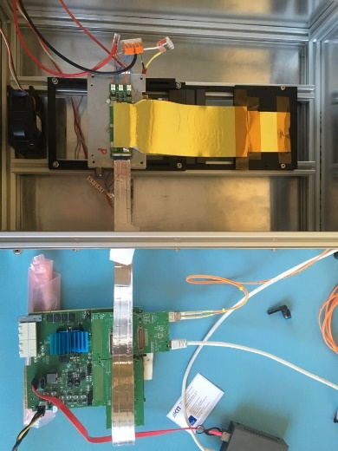
Assembled modules
Description of the assembled modules
Test bench for the tests of the modules
Module # | Sensor | Micro-cables | ASICs | FEBs | QA with pogo-pin
0 | 62*62 Hamamatsu | 236 mm, v. 11 (? – old design) | v. 2.0 | FEB8-2_LN_RP-A; FEB8-2_LP_RN-B; | No
1 | 22*62 CiS | 184 mm, v. 12 | v. 2.0 | FEB8-2_LP_RN-B; FEB8-2_LP_RN-B; | Yes
2 | 62*62 Hamamatsu | 184 mm, v .12 | v. 2.0 | FEB8-2_LN_RP-A; FEB8-2_LP_RN-B; | Yes
Current status:
Three modules were assembled at JINR assembly site.
Number of the assembled modules was limited due to the lack of the components and modifications of the assembly process which were implemented after each assembled module
Water cooling
Module
Readout
electronics
Readout chain is based on AFCK with dedicated firmware with implemented e-link module.

Slide 4
Module 0: test results
After assembling of the N-side:
ASICs #5,7 were not operational.
Total number of not bonded channels: 127 out of 768 (6 operational ASICs) – 17%
Total number of dead channels: 6 out of 768 (6 operational ASICs) – 0.8%
After assembling of the whole module:
N-side:
Only 2 ASICs are partially operational
Configuration of AFE is not possible for all ASICs – always “0” values in the registers in row range 0-130 (with the exception of registers to assign the thresholds of the ADC ).
P-side:
4 ASICs are partially operational
Configuration of AFE is not possible for all ASICs

Slide 5
Module 0: test results
Bonding quality during the assembly of the N side of the sensor was low due to the incorrect operation of Planar tab-bonding machine.
Only 6 ASICs on both FEBs are operable after assembling of the whole module.
SOS signal from each ASIC was measured with oscilloscope at ZIF connectors on the FEBs. It was found, that additional 3 ASICs on the P-side and 2 ASICs on the N-side send SOS signal. However, signal level on the connector is very low. The most probable reason is the mechanical damage of the vertically mounted capacitors bellow connector mezzanine board. The reason of the silence of other 5 ASICs is not clear.
AFE of all ASICs cannot be configured (“0” value of registers)
There is an overcurrent on AVDD 1.8 LDOs, output voltage is 0.9V instead of 1.8V. Direct powering from power supply was not tested.

Slide 6
Module 1: test results
N-side:
5 ASICs are fully operational
for one ASIC synchronization is not stable (problem with AC-capacitor?)
Total number of not bonded channels: 25 out of 640 – 3.9%
Total number of dead channels: 15 out of 640 - 2.3%
P-side:
7 ASICs are fully operational
Total number of not bonded channels: 18 out of 896 – 2%
Total number of dead channels: 5 out of 896 – 0.6%

Slide 7
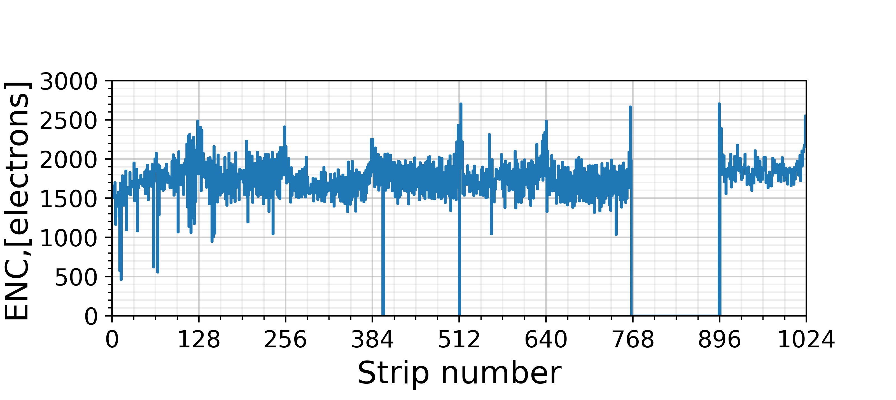
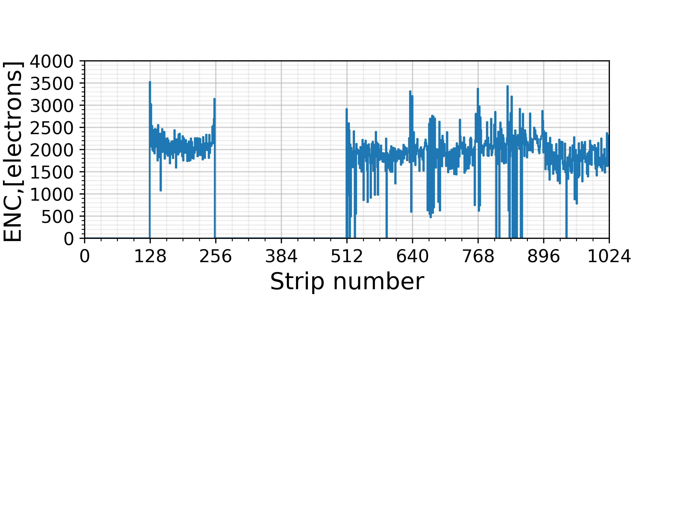
Noise measurements: module 1
P-side, Vbias = 100V
N-side, Vbias = 100V

Slide 8
Module 02: test results
N-side:
7 ASICs are partially operational
Configuration of AFE is not possible for all ASICs
Overcurrent on AVDD 1.8 and VDD 1.8 LDOs
Total number of not bonded channels (before wire-bonding): 3 - 0.3%
Total number of dead channels (before wire-bonding): 36 – 3.5%
P-side:
Overcurrent on AVDD 1.8 LDO – ASICs starts to operate after direct powering from power supply
7 ASICs are operational
Total number of not bonded channels: 29 – 3.2%
Total number of dead channels: 6 – 0.7%

Slide 9
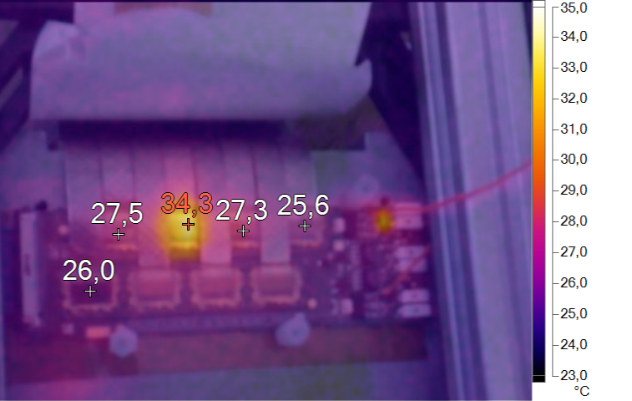
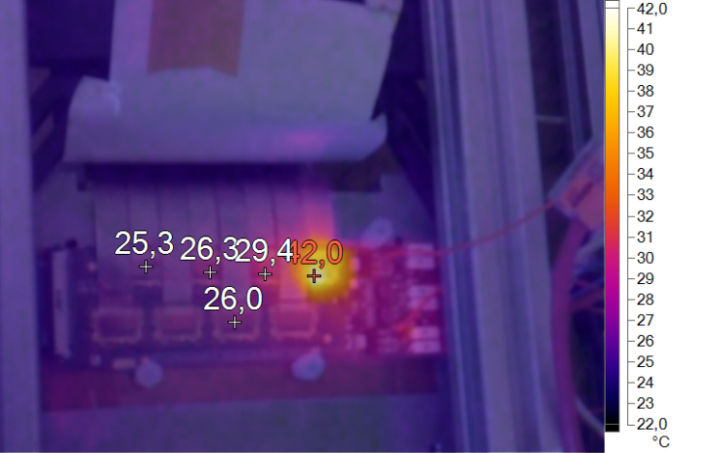
LDOs overcurrent
During the assembly of the N-side of the module 02
photos of wire-bonded ASICs before and after encapsulation were stored.
To identify the reason of the overcurrent mode of LDOs IR scan of operated FEB with direct powering from power supply was done. Shortcuts were localized in two different ASICs. After visual inspection of the photos most probable reason of the shortcut on VDD1.8 was found. The reason of the shortcut on AVDD 1.8 was not identified.
IR picture of the FEB on the N-side
AVDD 1.8 direct powering from power supply
Probable shortcut:
bonding was done
at the corner of the pad
IR picture of the FEB on N-side
VDD direct powering from power supply

Slide 10
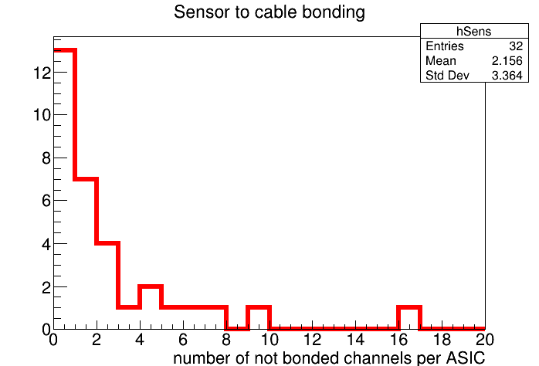
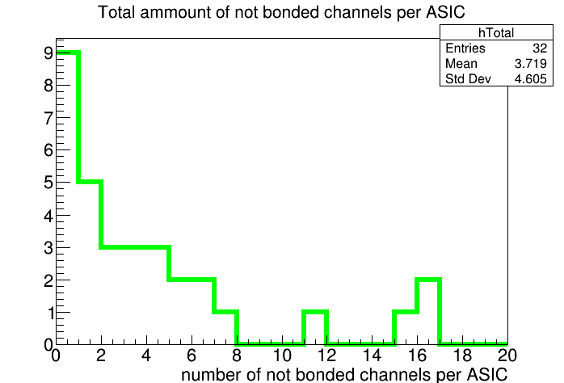
Not bonded channels
Number of not bonded channels per ASIC
ASIC + two micro-cables
Number of not bonded channels per ASIC
Only micro-cables + sensor bondings
Total number of not bonded channels per ASIC
This figures presents the numbers of not bonded channels after each step of the assembly. Bonding was testes with pogo-pin test bench. Results are presented for the module 01 & 02. Module 00 was not tested during the assembly.

Slide 11
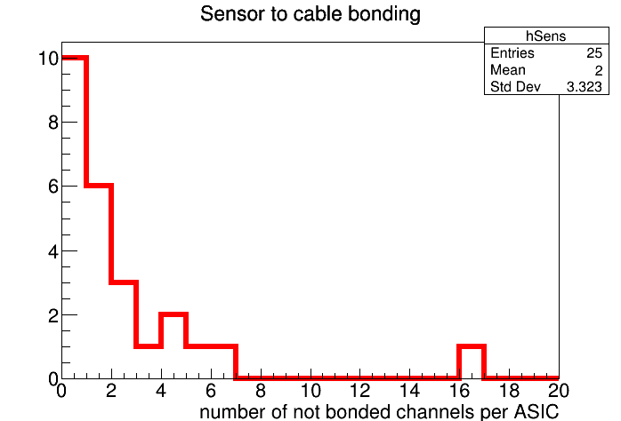
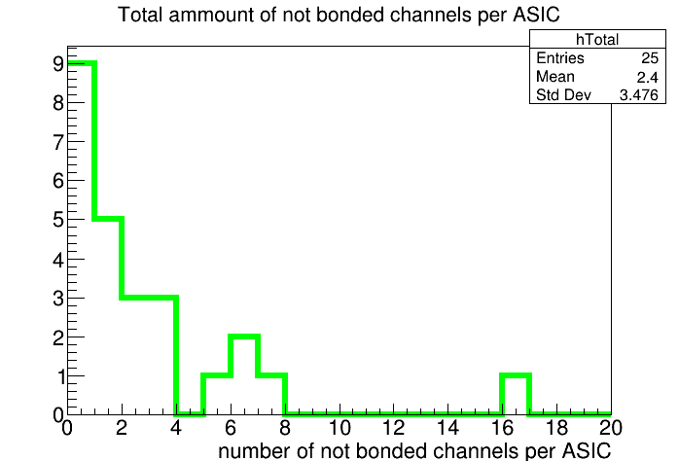
Not bonded channels
78% of ASICs
<3 not bonded channels per ASIC
with cut
with cut
Number of not bonded channels per ASIC
ASIC + two micro-cables
Number of not bonded channels per ASIC
Only micro-cables + sensor bondings
Total number of not bonded channels per ASIC
After assembly of the ASIC with micro-cables we can reject some assemblies after bonding tests. Here the following cut was applied: <3 not bonded channels per ASIC after assembling of the ASIC with microcables.
Applying of such cut can improve the average total number of not bonded channels per ASIC by 35%:
2.4 of not bonded channels per ASIC (1.9% of channels)

Slide 12
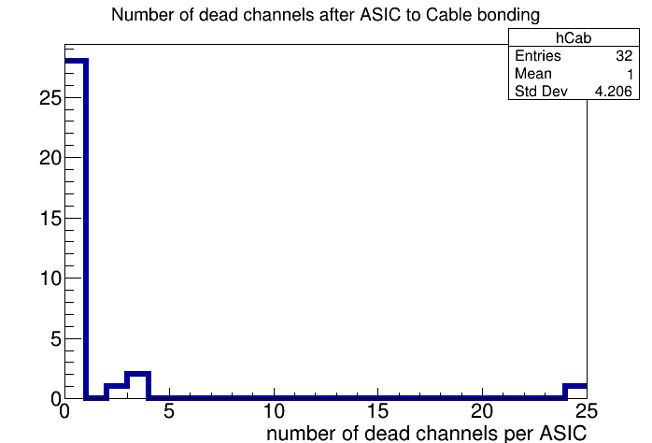
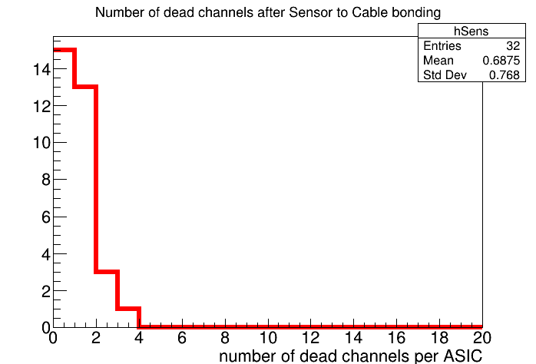
Dead channels
Number of dead channels per ASIC
ASIC + two micro-cables
Number of dead channels per ASIC
killed after micro-cables + sensor bonding
Total number of dead channels per ASIC
Most of the dead channels appears after the assembly of the micro cables with the sensor, ASIC cannot be rejected at this stage
Probably, using of antistatic fans during the assembly can improve the number of dead channels

Slide 13
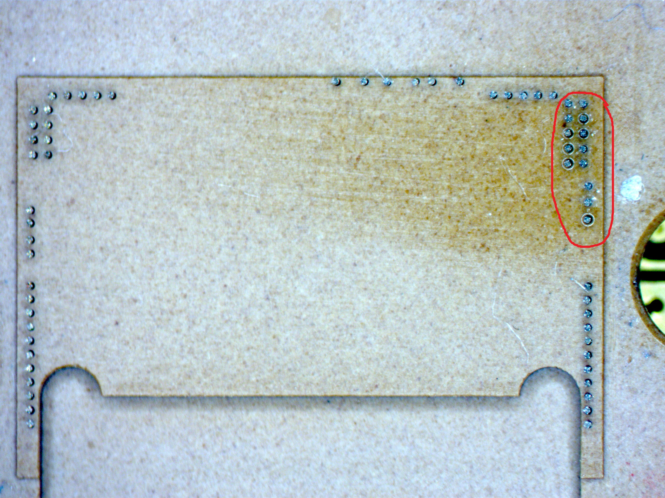
Suggestion about the possible reason of the shortcuts
During tests with pogo-pin, we have found that some-times
The reason of the lost connection to the ASIC is a lubricant,
which comes from the pins in Pogo-pin.
Most probably it is electrically conductive lubricant, which can cause a shortcuts on the ASIC
All ASICs should be cleaned before wire-bonding
Information about the lubricant is needed
Oil spots
Photo of the Pogo-pin circuit with oil spots around the pins

Slide 14
Summary: Problem Statement
Three modules were assembled and tested. Only one of them is operated. None of them satisfy CBM STS grade quality. Analysis of the reasons is needed. The following problems were identified:
Dead channels appeared on all stages of assembly
Not-bonded channels
Mechanical damage of the connector mezzanine board with AC-coupled capacitors – loss of the e-links
Not operable ASICs. In most cases ASICs stop to operate after wire bonding on the FEB
ASICs stop to operate after some time. ( That was found on two bare FEBs )
Overcurrent of AVDD LDOs – AFE of the ASIC cannot be configured

Slide 15
Summary: Future Plans
To improve the quality of the assembly process we suppose to implement the following things:
For ESD protection:
To produce aluminum baseplate for pogo-pin test jig instead of plastic
To use antistatic fans during the assembly
Additional tests:
Measuring of the value of AC capacitors on the FEB PCBs
Measuring of AVDD & VDD LDO’s output to Gnd resistance before ASIC encapsulation (typical value is 500 Ω, in all cases of overcurrent measured value was on the level of 5 Ω)
IR measurements in case of overcurrent to localize the reason
Endurance tests for the assembled modules are needed
For the data storage:
Using of CBM STS logbook during the assembly
Storing of photos of all wire-bonded ASICs before and after encapsulation
Any input which can help to improve the assembly process is very welcome!
Thank you for your attention!

