Slide 1
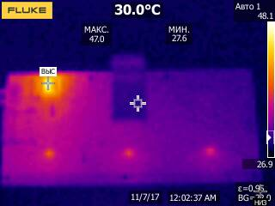
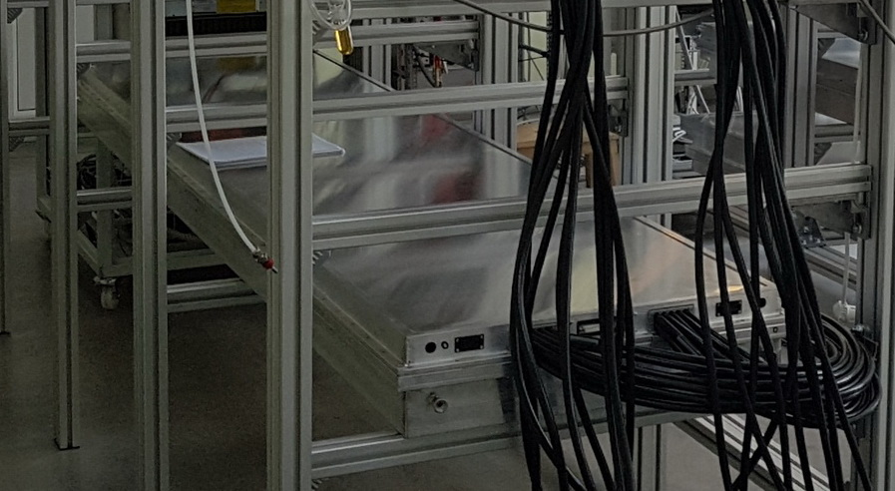
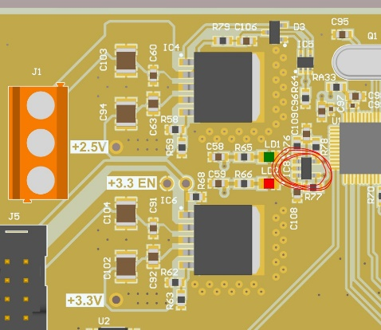
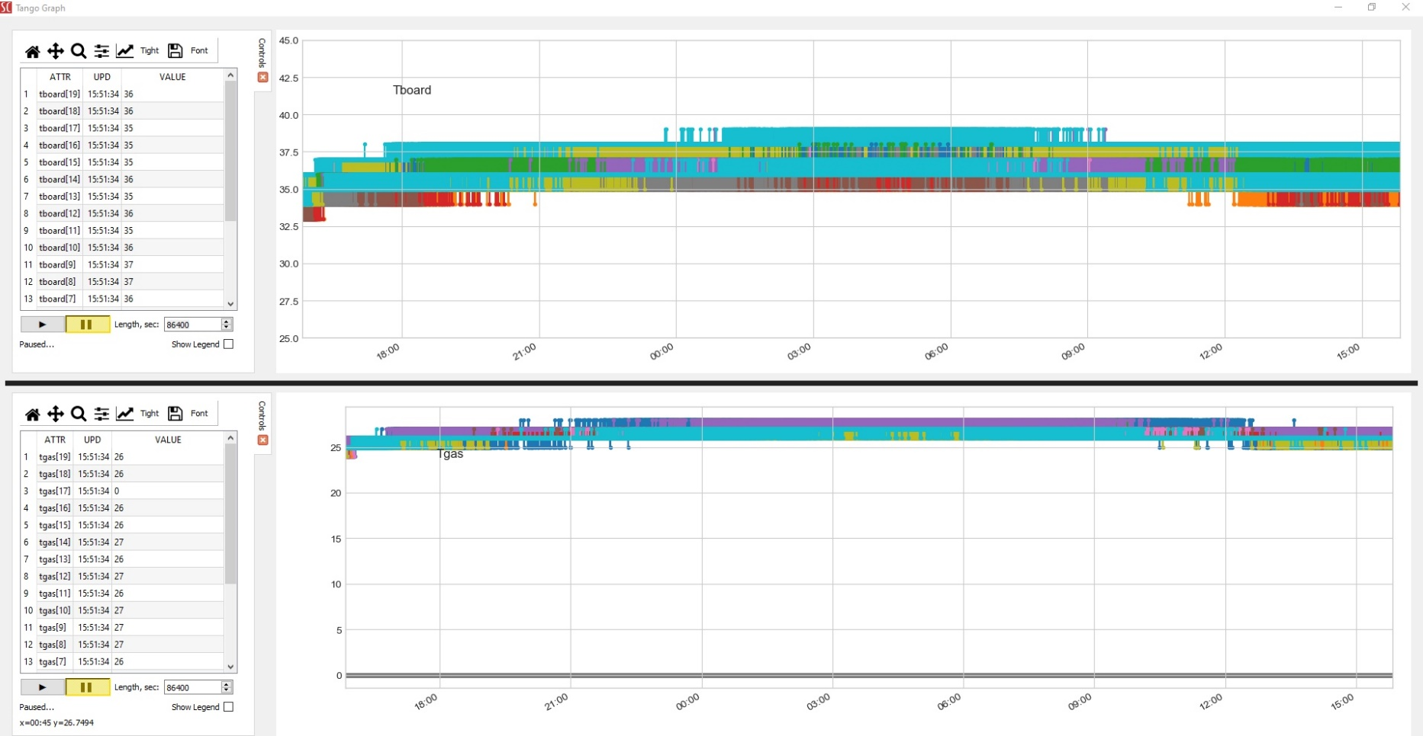
The TOF heat dissipation
Bld.42, TOF cosmic test stand
TOF subsystems power consumption
Part | Power, W
Power of FEEs with LV cables heating | 1150
LV modules, crates | 400
Power of Readout Electronics (TDC) | 4200
Power of HV modules | 600
Power of slow control devices | 800
Power of the gas system | 1000
Total | 8000
≈ 23W/m²
LDO
47
35
35
35
1.8 m²
40°
24 hours, t_{out}= 21°C
18-19/06/19
30°
2.05 W
25°

Slide 2
