Slide 1
Integration of new FHCAL and Forward Hodoscope
A. Ivashkin
INR, Moscow
4th BM@N Collaboration meeting, October 14-15, 2019

Slide 2
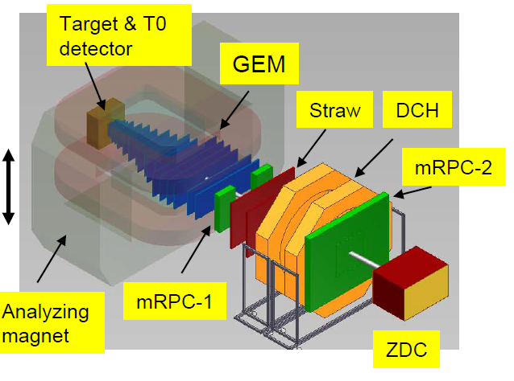
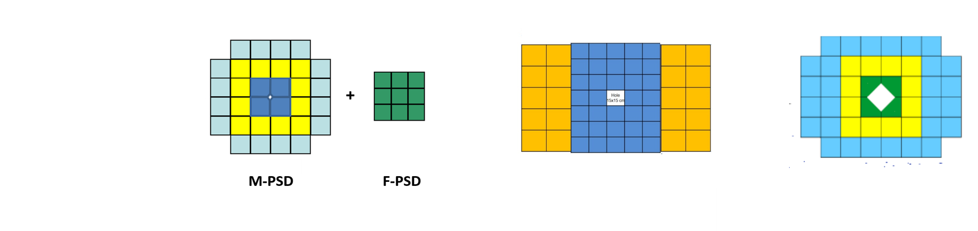
FHCal at BM@N
Previous ZDC is replaced by new FHCal .
Central hole for high intensity ion beam.
Central part – 34 MPD-like modules with 15x15 cm² transverse sizes. Longitudinal segmentation - 7 sections.
Outer part – 20 CBM modules with 20x20 cm² transverse sizes. Longitudinal segmentation – 10 sections.

Slide 3
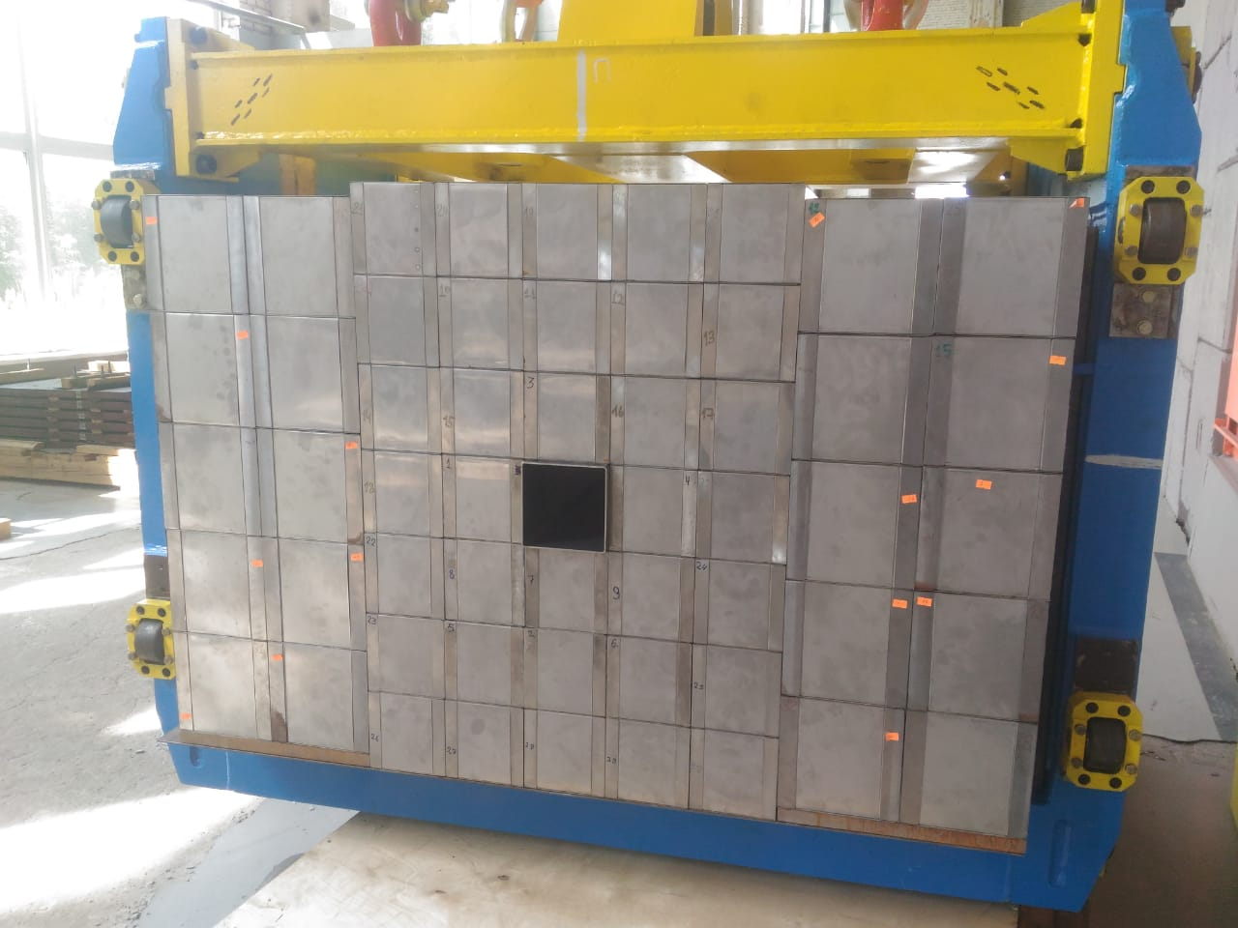
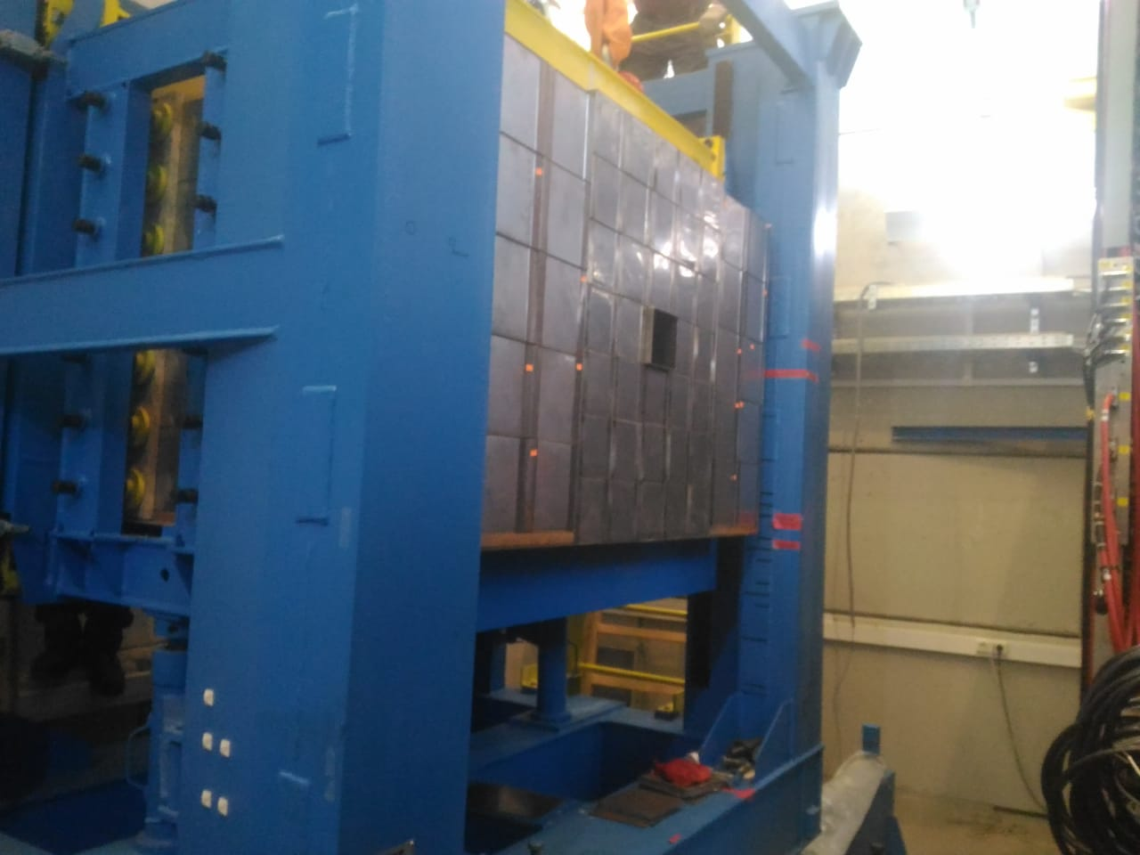
Front view of FHCal
Assembly of the FHCAL (Sep. 2019)
FHCal is already in BM@N experimental area!

Slide 4
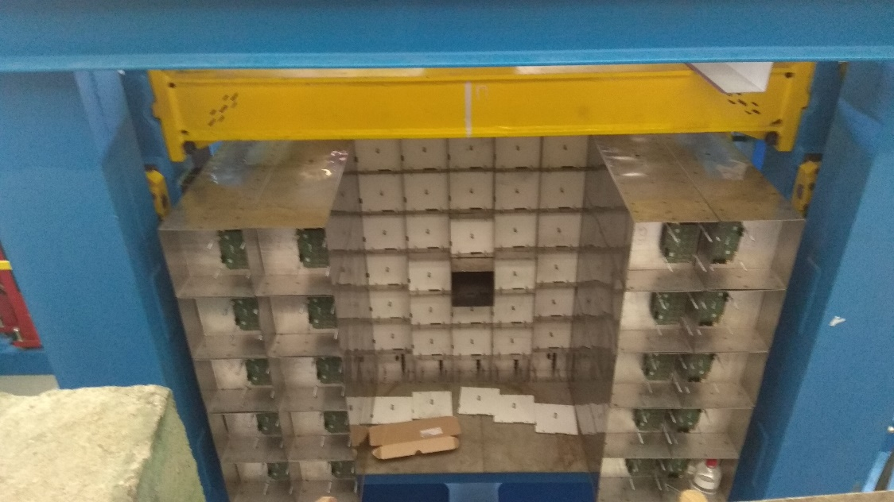
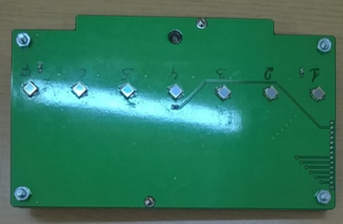
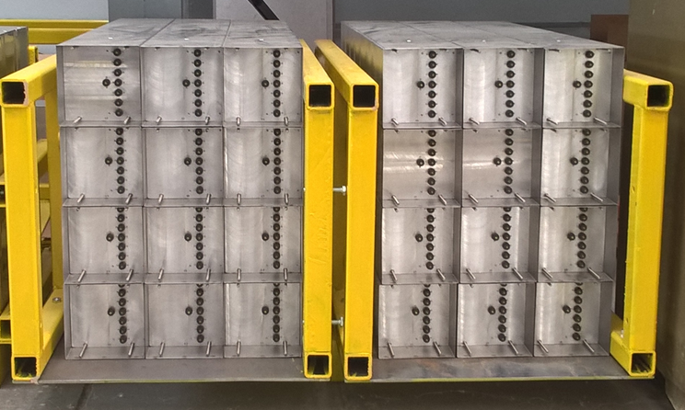
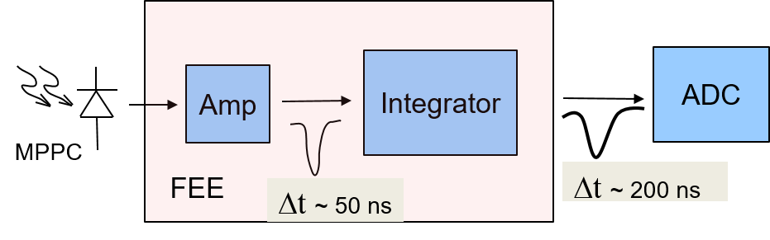
FEE of FHCal - already installed.
Assembly of the FHCAL (Sep. 2019)
MPD module - 7 channels;
CBM module – 10 channels;
Photodetectors – MPPCs;
two-stage amplifiers;
HV channels;
LED calibration source.
Optical connectors

Slide 5
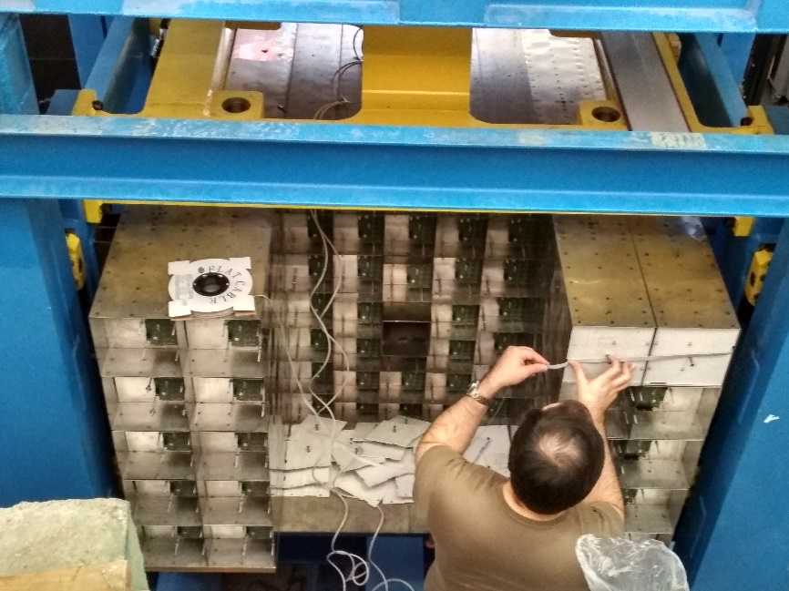
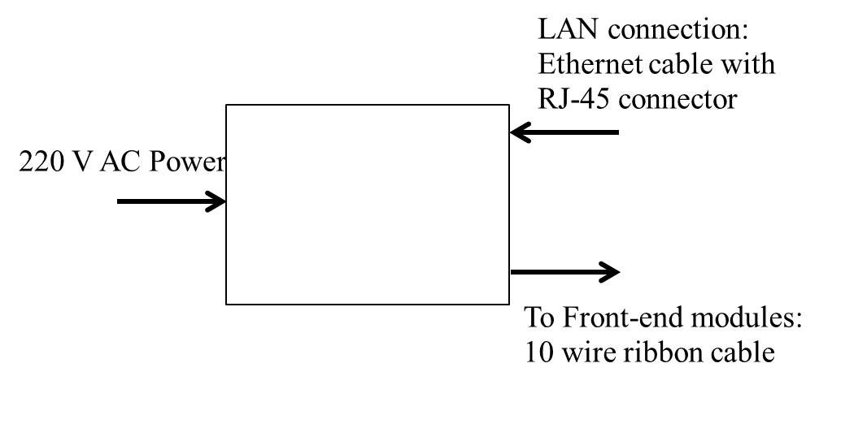
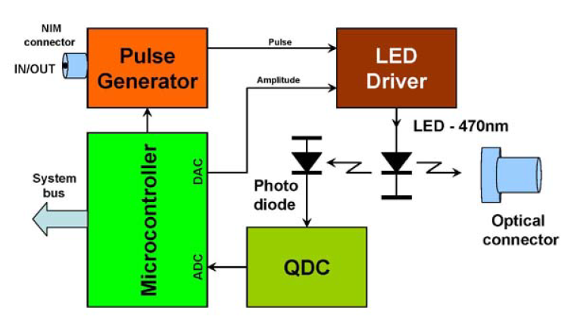
Slow Control of FHCal - in progress.
SC System module
LED stabilized source
Control of HV at photodetectors (MPPC);
Temperature control of photodetectors;
Compensation of temperature drift of MPPC gain;
Monitoring of MPPC gain with stabilized light source.

Slide 6
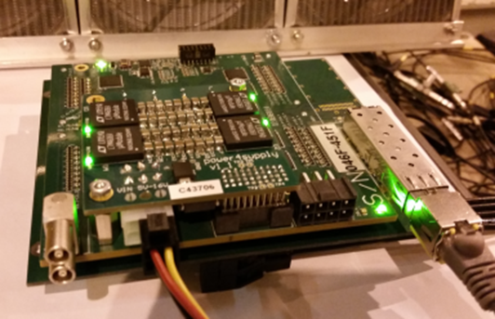
Readout of FHCal – to be done.
The readout electronics: FPGA based 64 channel ADC64 board, 62.5MS/s (AFI Electronics, JINR, Dubna).
One ADC board for 9 central modules
or
One ADC board for 6 outer modules
Requested:
8 ADC boards;
Cooling of ADC boards;
Power supply for 8 ADC boards;
Remote control on power supply;
Data Acquisition.

Slide 7
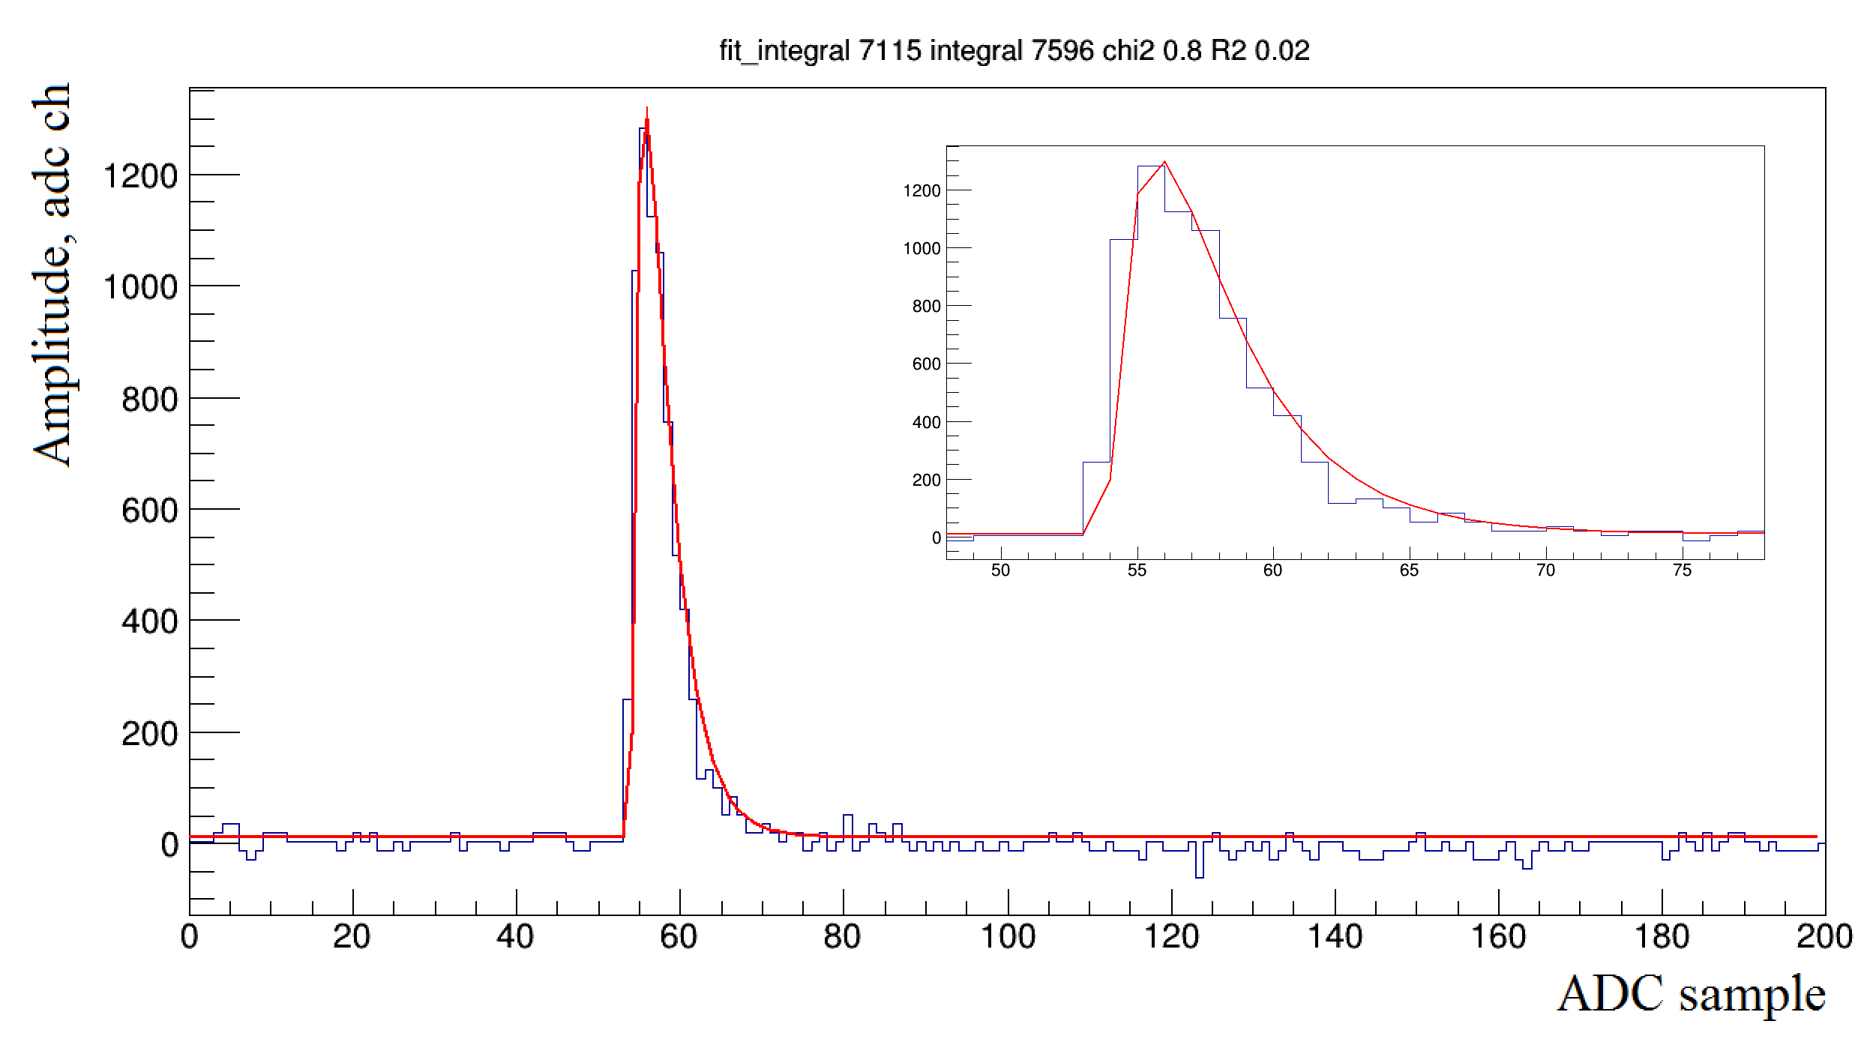
Data Flow from FHCal.
Number of ADC readout channels – 440;
Number of samples per one ADC channel – 100;
Size of one ADC sample – 2 Bytes;
Size of one event: ~100 kB;
Trigger rate ~ 10⁵.
FHCal Data Flow - 10 MB/sec.
Minimum 20 ADC samples are needed to digitize the signal.
About 100 ADC samples are needed to reject the pile-up.
Occupancy ~100% for heavy ion beam.

Slide 8
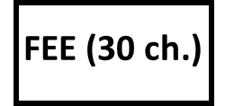
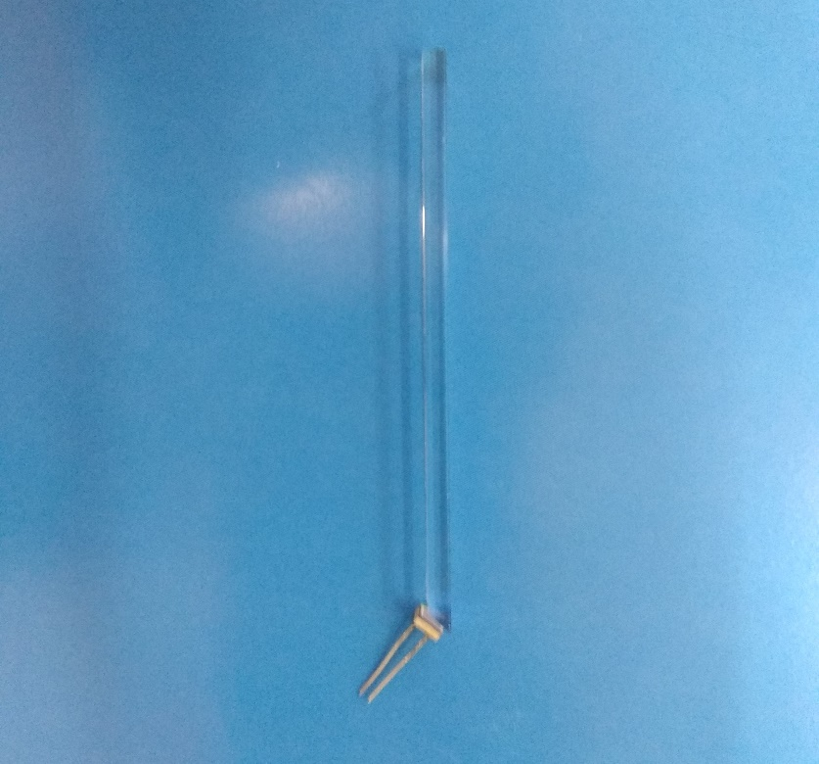
Forward Hodoscope in FHCal beam hole – in development
30x2=60 quartz strips;
5x80x4 mm³;
It covers beam hole 15x15 cm².
PCB with 30 SiPMs
ADC
quartz strips 5x80x3 mm.
Light readout by Hamamatsu MPPC.
One ADC board is needed.
Slow control and DAQ would be the same as for FHCal.
PCB with 30 SiPMs

Slide 9
Summary and open issues.
Next year FHCal and Forward Hodoscope must be integrated to BM@N setup.
Data Acquisition is the most sensitive issue.
9 ADC boards and power supplies are needed.
Cooling system.
Integration to general DAQ.
Trigger? Centrality – FHCal? Minimum bias - Forward Hodoscope?
Collaboration with other detector groups is strongly appreciated!

Slide 10
Thank you!

