Slide 1
BM@N + MIPT Software
Alexander Nozik

Slide 2
MIPT-NPM team and status
Current (BM@N) projects:
BM@N scheduler multiplatform GUI
Slow control data visualization
Next generation event display
Funding:
Basic funding from 5top100 program
Research grant from JetBrains company

Slide 3
Scheduler-GUI

Slide 4
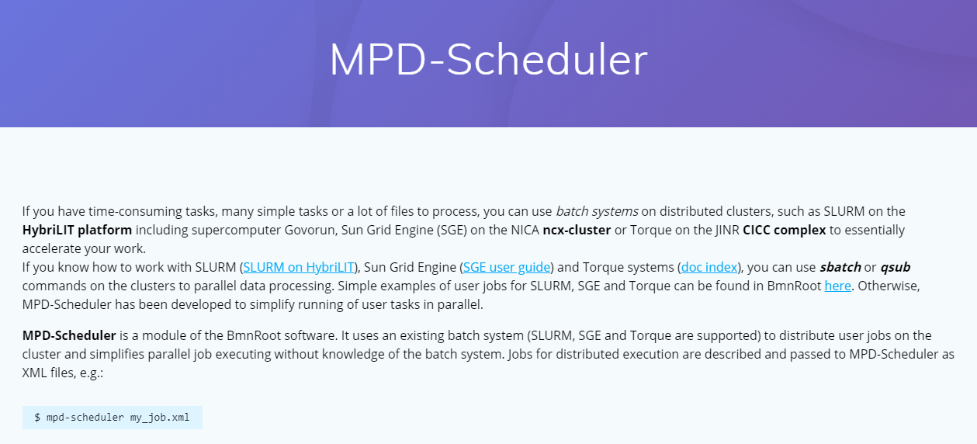
NICA Scheduler Configurator: Task
MPD-Scheduler is a module of MpdRoot and BmnRoot software
Uses existing batch system (SLURM, SGE, Torque) to distribute user jobs on the cluster
Jobs for distributed execution are described and passed as XML file: $ mpd-scheduler my_job.xml
Details: http://bmn.jinr.ru/nica-scheduler/
Task: Create a GUI editor for scheduler XML files

Slide 5
Example of MPD-Scheduler Job
It is perfectly fine to create such a file using a text editor.
You have to remember or look up XML attribute names though since there is no schema.
<job name="reco_job">
<macro path="$VMCWORKDIR/macro/mpd/reco.C" start_event="0" event_count="1000" add_args="local">
<file input="$VMCWORKDIR/macro/mpd/evetest1.root" output="$VMCWORKDIR/macro/mpd/mpddst1.root"/>
<file input="$VMCWORKDIR/macro/mpd/evetest2.root" output="$VMCWORKDIR/macro/mpd/mpddst2.root"/>
<file sim_input="energy=3,gen=urqmd" output="~/mpdroot/macro/mpd/evetest_${counter}.root"/>
</macro>
<run mode="global" count="25" config="~/mpdroot/build/config.sh"/>
</job>

Slide 6
Going multiplatform
JVM
First choice: JVM
Cross-platform on desktops
Easy to develop and maintain
In future can support direct task control via local process.
Problems with deployment on systems without JVM
JavaScript GUI with the same model
Does not require installation. Could be run from site or from local page
Shares model with desktop via Kotlin-multiplatform technology
Has almost the same functionality.
JS

Slide 7
Implementation Details
Written as a Kotlin Multiplatform application
Runs as JavaScript in browser, or in JVM
Using the same data model defined in Common part
Libraries used:
Kotlinx-HTML (https://github.com/Kotlin/kotlinx.html)
xmlutil (https://github.com/pdvrieze/xmlutil)
Bootstrap (https://getbootstrap.com/)
Available at https://git.jinr.ru/nica_modules/mpd-scheduler-gui
Further work
Improve design
Full execution control from the desktop version

Slide 8
Slow control visualization tools

Slide 9
Slow control viewer
SC data
Run data

Slide 10
Slow control viewer
All components prepared and tested
Repository available at https://git.jinr.ru/vchernov/bmn-visualisation
Some good will from network administrators is required for deploy

Slide 11
Event display
Sponsored by
next generation

Slide 12
A problem with monolith
All components use tight coupling -> a lot of errors
Everything must be deployed as a single bundle/framework -> slow feature implementation
Must be one size to fit them all -> no customization

Slide 13
Service-based architecture
Harder to implement, but much easier to maintain
Services could be developed or replaced without changing core functionality
Fast service development cycle
Easy to move to new infrastructure or scale
https://dev.to/alex_barashkov/microservices-vs-monolith-architecture-4l1m

Slide 14
Visualization as a service
Visualization runs as a stand-alone service.
It communicates with other services via specialized protocol.
The service itself uses plugin system to include new visualization types.
Adapters are made to convert ROOT/GEANT/whatever format into visualization tree.

Slide 15
Visual object structure
VisualGroup3D
position(x, y, z)
rotation(x, y, z)
scale(x, y, z)
templates [VisualGroup]
…
stylesheet
…
children
Box
…
Proxy
VisualGroup3D
…
…

Slide 16
Results

Slide 17
Results
Design of intermediate representation for geometric objects
Working Three-JS rendering engine.
Caching and template usage for performance optimization
Styling capabilities
layering
Implementation for all primitives needed for BM@N geometry
Basic online object manipulation capabilities
Complete reader for GDML format

Slide 18
Current work an plans
Current work (to be finished in 2019)
Plans
Remaining ROOT/GEANT primitives
ROOT plugin to convert TGeoManager to json inside the framework
Visual tree optimization plugins
Visualization update API + backend server
Redesign for properties editor
Complete build & deploy instructions
ROOT plugin publication
VR via Three-JS
OpenGL backend
Non-3D plugins

Slide 19
Addendum

Slide 20
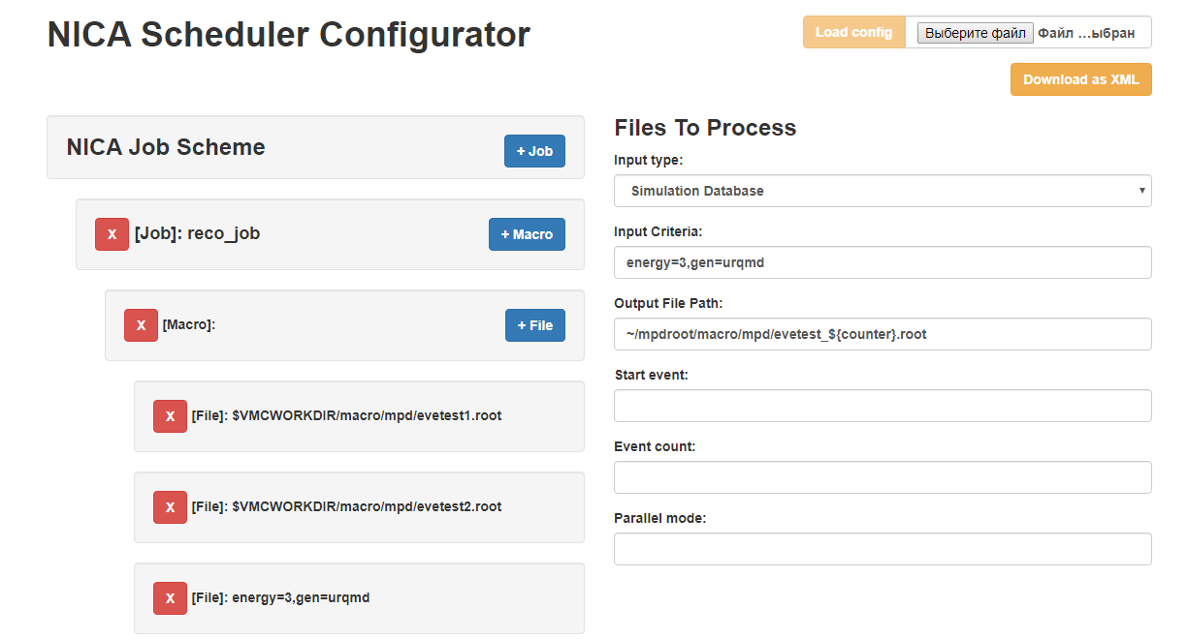
NICA Scheduler Configurator JS

