Slide 1

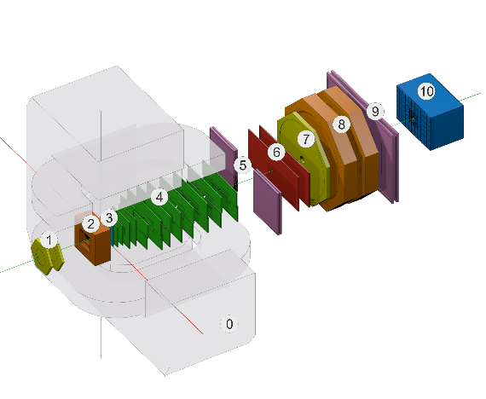


Development of a geometry database for the BM@N experiment of mega-project NICA
Akishina E.P.¹, Alexandrov E.I.¹, Alexandrov I.N.¹,
Filozova I.A.¹, Gertsenberger K.V.¹, Ivanov V.V. ^{1,2},
Pryahina D.I. ¹, Shestakova G.V. ¹
¹JINR, Dubna
²MEPhi, Moscow
BM@N
Joint Institute for Nuclear Research

Slide 2
Motivation
Variety of detector modules
Flexibility: combine the modules for different setups
Each module can be located in different placement
Evolution of geometries in accordance with the phases of experiments
Administration of the geometries variety in a fail-safe, reproducible and transparent way
User has the possibility to choose a predefined setup as a set of module geometries.
Change of ROOT macro when set or any module implementation class is changed.

Slide 3
Guidlines
manage module geometries as ROOT binary objects
for each module keep: tag, version, transformation matrix, mother module
manage the pre-defined setups as combinations of module geometries
manage module version
Tasks
Store the modules of BM@N
Load the geometry modules for setup construction
Construct setup from the stored modules
Present the BM@N setup
Support different versions of module

Slide 4
CBM & BM@N
Common features | Deferencies
Approaches to the methods of simulations and reconstructions | The sets of Detectors
Software: FAIRSOFT, FAIRROOT RunManager: FairRunSim for the simulation runs FairRunAna for the reconstruction or analysis runs
FairRoot
CBM GeometryDB
BM@N GeometryDB
CBMRoot
BMNRoot

Slide 5

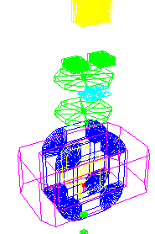
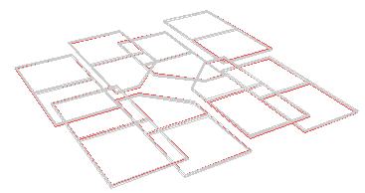
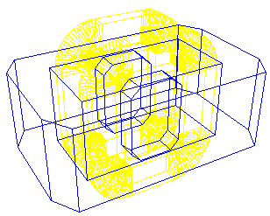
RunManager & Geometry
Simulation
Reconstruction
Other detectors
MWPC
Full Geometry
Silicon
Magnet
Import
FairRunSim
Import
Export
FairRunAna
Full Geometry

Slide 6
Basic Definitions
Geometry Module
File in ROOT format with content of detector geometry
Setup Module
Geometry module, link to the mother geometry module, its placement in the mother module (transformation matrix or object of class TGeoMatrix)
Setup
Combination of setup modules which represents the full geometry

Slide 7
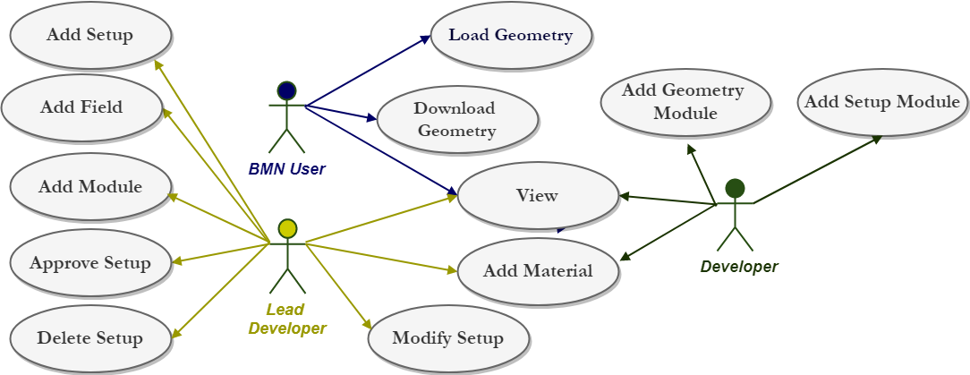
Geometry Database. Use Cases

Slide 8
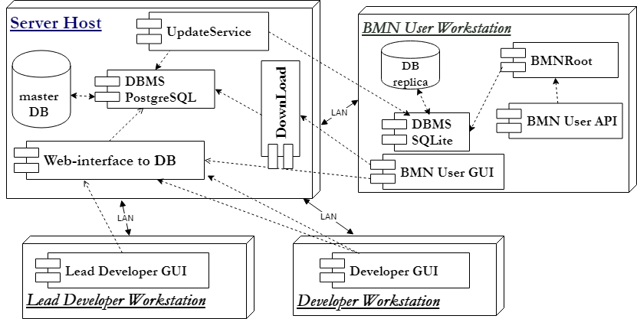
BM@N Component Diagram

Slide 9
The implementation
GUI (Graphical User Interface) implemented as Web-interface.
  View;
  Edit;
  Download.
API (Application Programming Interface) implemented as macros of the ROOT environment.

Slide 10
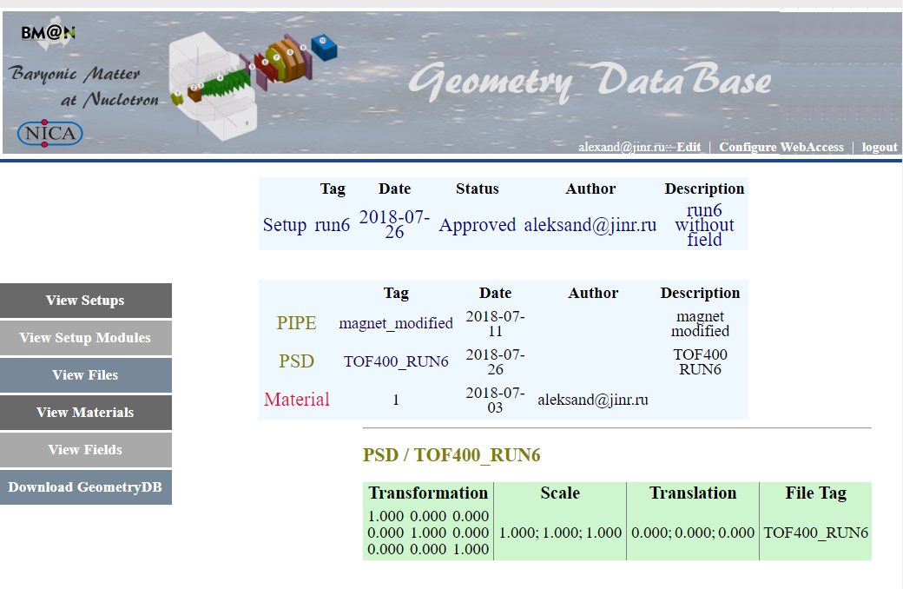
Web-interface. View Mode

Slide 11
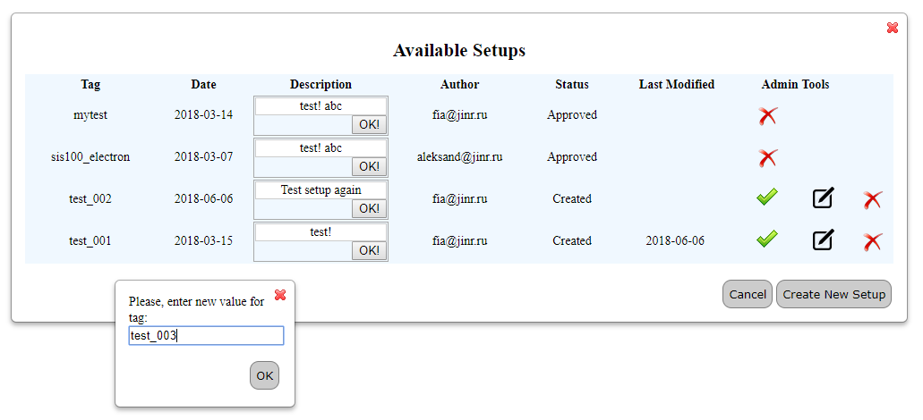
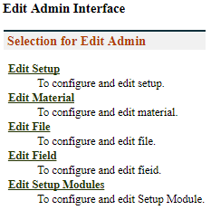
Web-interface. Edit Mode
Delete this setup: make this setup unavailable for usage
Approve this setup: change the status to Approved
Modify this setup: go to modification form
√
Go to the Form for Setup Compiling →

Slide 12
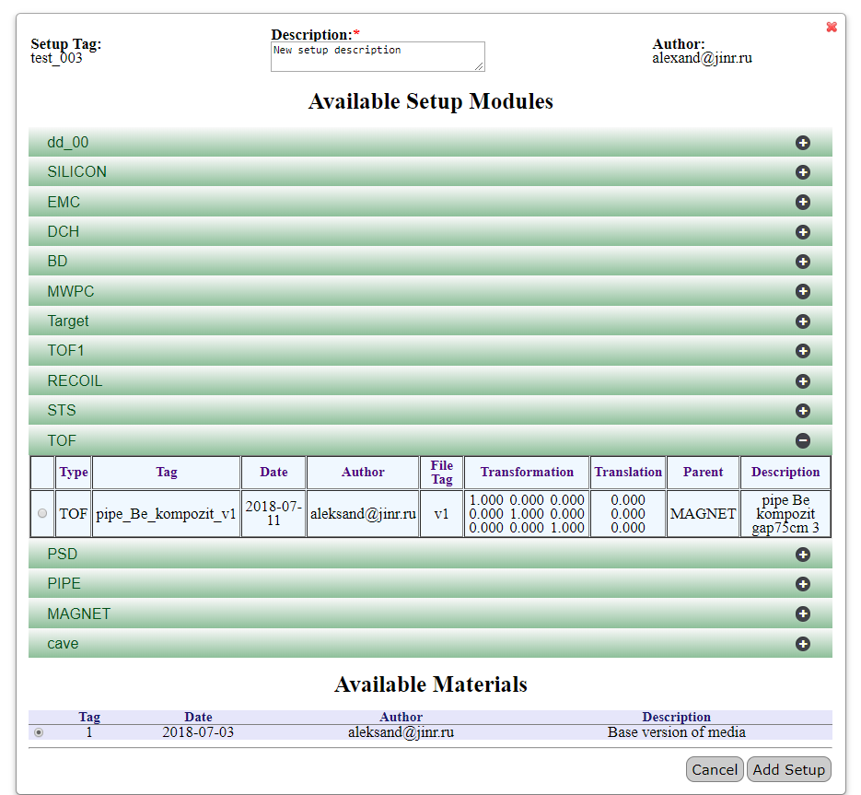
Web-interface. Setup Compiling
(Add New Setup)

Slide 13
Macros
Signature | Description | Call Example | Comment
void installLocalDB(); | Install local database from server to client. Download replica of central database to client computer. | installLocalDB(); | Require set variable DBL_FILE_PATH before use.
void getSetupList(); | Get the list of available setups. Print the list of available setups including tag, date of creation, author and description parameters for each approved setup. | getSetupList.c(); | Return the available setups’ list

Slide 14
Macros
Signature | Description | Call Example | Comment
bool loadSetup(const char* setupTag, const char* moduleName); | Load setup into the BM@N ROOT framework. The Geometry can be used in ROOT framework afterwards. Return FALSE if setup is not loaded, and TRUE if the loading is successful. | bool res = loadSetup(“run6”, “*”); | “*” – all setup modules to be loaded
bool loadSetupByURL(const char* setupTag, const char* url); | Load setup from Server into BM@N ROOT environment to load setup from server into the CBM ROOT framework.. Return FALSE if setup is not loaded, and TRUE if loading is successful. | bool res = loadSetup(“run6”,””http://cbmdb.jinr.ru/geometry/bmn”);
bool loadSetup(const char* setupTag, const char* moduleName, const char* xml); | Load setup into the ROOT environment. Geometry can be used in the ROOT environment after this operation. User can use xml file in order to move any setup module during loading. Return false if setup was not loaded because of errors and true if load is successful. | loadSetup(“run6", ”*”, "local.xml") | xml file contains information on the setup modules and their shifts.

Slide 15
Inheritance diagram of FairModule
FairModule
- SetGeometryFileName
FairTarget*
FairCave*
FairDetector**
FairMagnet*
FairPipe*
BmnTOF**
CbmSts**
…
* It has constructor with 1 String parameter (name)
** It has constructor with 1 String parameter (name) and 1 Boolean parameter (active)

Slide 16
Load FairModule
Create FairModule use name and parameter active
  FairModule *obj=(FairModule*)gInterpreter->Calc(command);
  Command:
  new BmnTOF1(“TOF1”, kTrue)
  new FairMagnet(“MAGNET”)
Set path to geometry file
  obj->SetGeometryFileName(path);
Add to FairRunSim this module
fRun->AddModule(obj);
Notes:
PSD is uniq detector

Slide 17
Verification of BM@N database (1)
Verification using simulation:
Filling Geometry DB with BM@N modules for Run6
Run simulation using Geometry DB
Comparison of the original geometry and geometry from DB
Original geometry
Geometry from DB

Slide 18
Verification of BM@N database (2)
Verification using reconstruction:
Reconstruction using original geometry
Reconstruction using geometry file from DB
Comparison of the reconstructions results
Reconstruction for run 6 (10000 events) using original geometry
Reconstruction for run 6 (10000 events) using geometry from DB with simulation

Slide 19
Conclusion
Geometry DB prototype for storing and retrieving the geometry of BM@N has been developed:
DB (DBMS PostgreSQL, SQLite) in use
GUI (Graphical User Interface) tools implemented
API (Application Programming Interface) tools as a set of ROOT macros done
Verification procedure of BM@N database produced
Version independent macros for load DB implemented
Next steps
Improvements of the Geometry DB API and WEB interfaces on response of BM@N users
Move into production

Slide 20
Backups

Slide 21
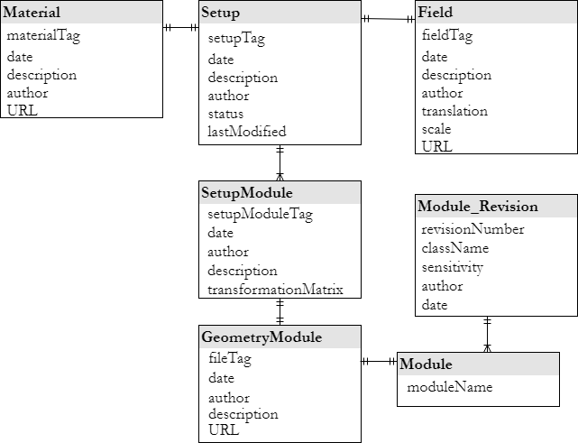
Object model of the Geometry DB

Slide 22
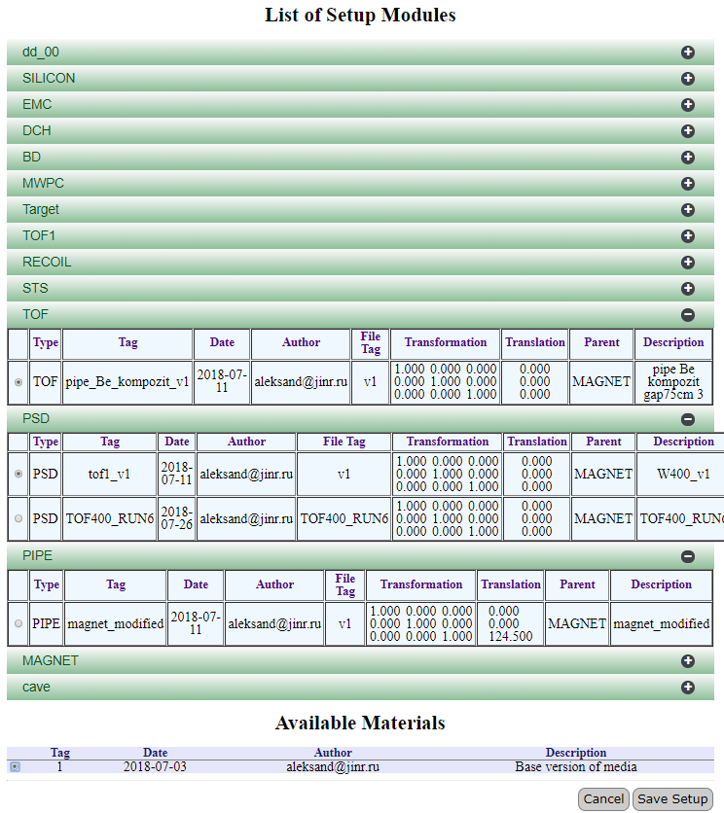
Web-interface. Setup Modifying
(Change the Selected Setup)

Slide 23
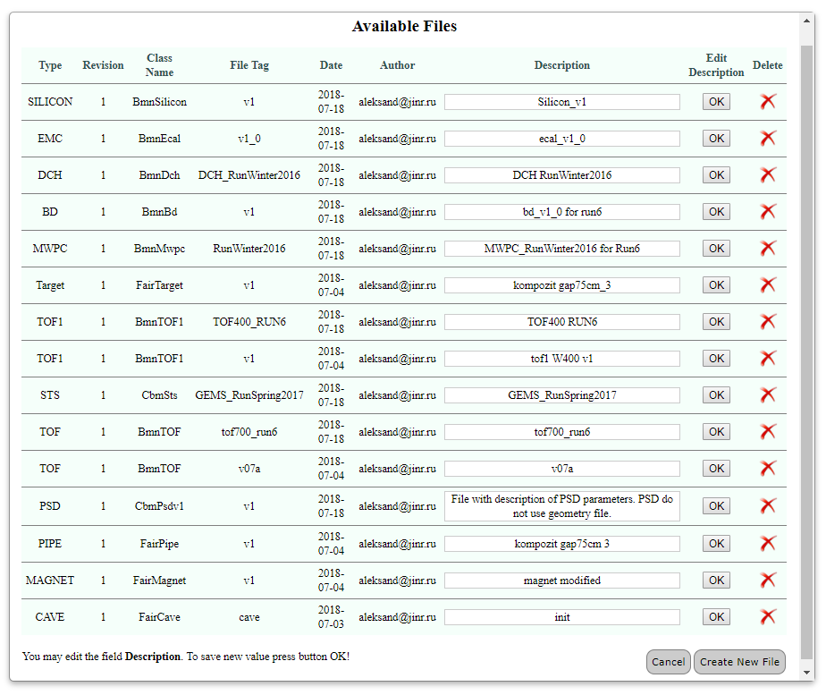
Available files in edit mode

