Slide 1
4th Collaboration Meeting of the BM@N Experiment at the NICA Facility
Analysis of data obtained from the BM@N/NICA Electromagnetic Calorimeter
Kh. Abraamyan, S. Afanasev, P. Alekseev, B. Dobrovska, D. Dryablov, D.Kirin, L. Kovachev, M. Kozhin, A. Kuznetsov, D. Sakulin, A. Stavinskii,
I. Tyapkin, N. Zhigareva
14.10.19

Slide 2
Schematic drawing of the location of the Electromagnetic Calorimeter on the BM@N setup
4th BM@N Meeting
14.10.19
ECAL Group: Abraamyan Kh.U. et al.

Slide 3
Schematic and general view of a single cell of the calorimeter
4th BM@N Meeting
14.10.19
ECAL Group: Abraamyan Kh.U. et al.

Slide 4
Amplitude spectrum in one of the cells of the calorimeter in the experiment on a carbon beam, using a lead target, in the 55th run of the Nuclotron (March-April 2018)
4th BM@N Meeting
14.10.19
ECAL Group: Abraamyan Kh.U. et al.

Slide 5
Amplitude spectrum in a separate cell of the calorimeter (in photon energy equivalents) in the reaction C(4 GeV/nucleon)+C: Model QGSM, Min. bias.
4th BM@N Meeting
14.10.19
ECAL Group: Abraamyan Kh.U. et al.

Slide 6
Block scheme of the system for monitoring of the ECAL in the measurements (relative calibration) on cosmic muons
4th BM@N Meeting
14.10.19
ECAL Group: Abraamyan Kh.U. et al.

Slide 7
Average amplitudes in individual calorimeter cells before (left) and after (right) the introduction of energy equivilent coefficients, depending on their distance to the beam axis in the experiment on a beam of Kr(2.6 GeV/n), using a tin target, in the 55th run of the Nuclotron (March-April 2018).
4th BM@N Meeting
14.10.19
ECAL Group: Abraamyan Kh.U. et al.

Slide 8
A typical amplitude spectrum in a single cell of the Calorimeter (left), and in the cell N 467 with poor performance.
4th BM@N Meeting
14.10.19
ECAL Group: Abraamyan Kh.U. et al.

Slide 9
Distribution of clusters by energy and number of cells in a cluster in the experiment on a beam of Kr nuclei with an energy of 2.6 GeV per nucleon using a tin target. Coordinates of the сenter of the Calorimeter: Z = 262 cm, X = 55 cm (Position 4).
4th BM@N Meeting
14.10.19
ECAL Group: Abraamyan Kh.U. et al.

Slide 10
Effective mass distributions of photon pairs (pairs of clusters) in the reaction Kr (2.6 GeV / nucleon) + Sn
4th BM@N Meeting
Location of the ECAL in the 55th run of the Nuclotron, on a beam of Kr nuclei with an energy of 2.6 GeV per nucleon, using a tin target.
14.10.19
ECAL Group: Abraamyan Kh.U. et al.
Notes:
Effective mass distributions of photon pairs (pairs of clusters) without (upper panel) and with (bottom panel) the background subtraction, in the reaction Kr (2.6 GeV / nucleon) + Sn, under minimal selection conditions (shown in the figure). The top shaded histogram shows the background contribution. The background is obtained using the event mixing method and normalized to the number of pairs in a range of masses M < 100 MeV/c^2. The curve is the Gaussian approximation of the experimental points in the range M < 200 MeV/c^2 .

Slide 11
The background estimation
4th BM@N Meeting
To see a possible structure of the invariant mass spectra, a background should be subtracted.
The so-called event mixing method was used to estimate the combinatorial background: a photon in one event from the Right arm of the Calorimeter is combined with photon in other events from the same arm.
In the mixing are involved events in which there are two or more photons satisfying the criteria applied to clusters and to the pairs of clusters.
14.10.19
ECAL Group: Abraamyan Kh.U. et al.

Slide 12
Effective mass distributions of photon pairs (pairs of clusters) in the reaction Kr (2.6 GeV / nucleon) + Cu
4th BM@N Meeting
Location of the ECAL in the 55th run of the Nuclotron, on a beam of Kr nuclei with an energy of 2.6 GeV per nucleon, using a copper target.
14.10.19
ECAL Group: Abraamyan Kh.U. et al.

Slide 13
The Background suppression
4th BM@N Meeting
Θγγ < 16⁰ => Eπ > 1 GeV
14.10.19
ECAL Group: Abraamyan Kh.U. et al.

Slide 14
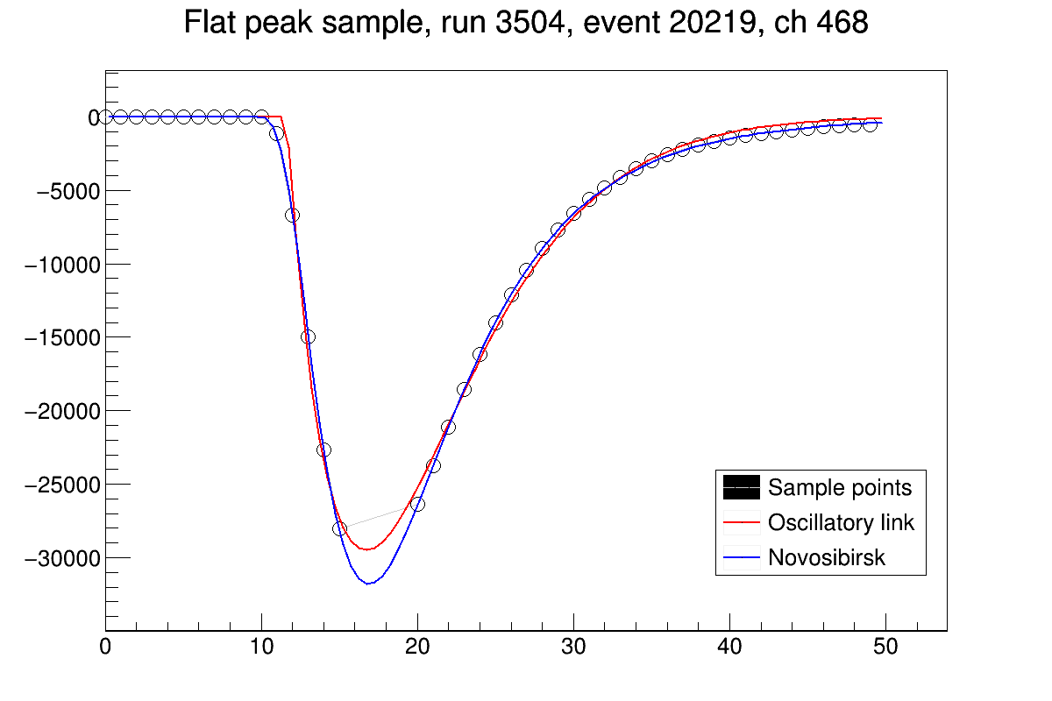
4th BM@N Meeting
Time analysis of the signals
T₀
A. Voronov, “ Theory of automatic control”,
http://edu.alnam.ru/book_v_tau1.php?id=26
T_{P}
Adrian Bevan, Fergus Wilson, “AFit User Guide”,
http://pprc.qmul.ac.uk/~bevan/afit/afit.pdf
9
14.10.19
ECAL Group: Abraamyan Kh.U. et al.
Notes:
Использование только амплитудной информации с ячеек калориметра оказалось недостаточно для выделения гамма квантов на общем большом фоне.
Дополнительно мы использовали временной анализ приходящих сигналов.
Записанный дискретный сигнал апроксимировался с помощью фунцкий приведенных на слайде. Мы фиксировали две временные характеристики: время начала сигнала и его максимума.
14

Slide 15
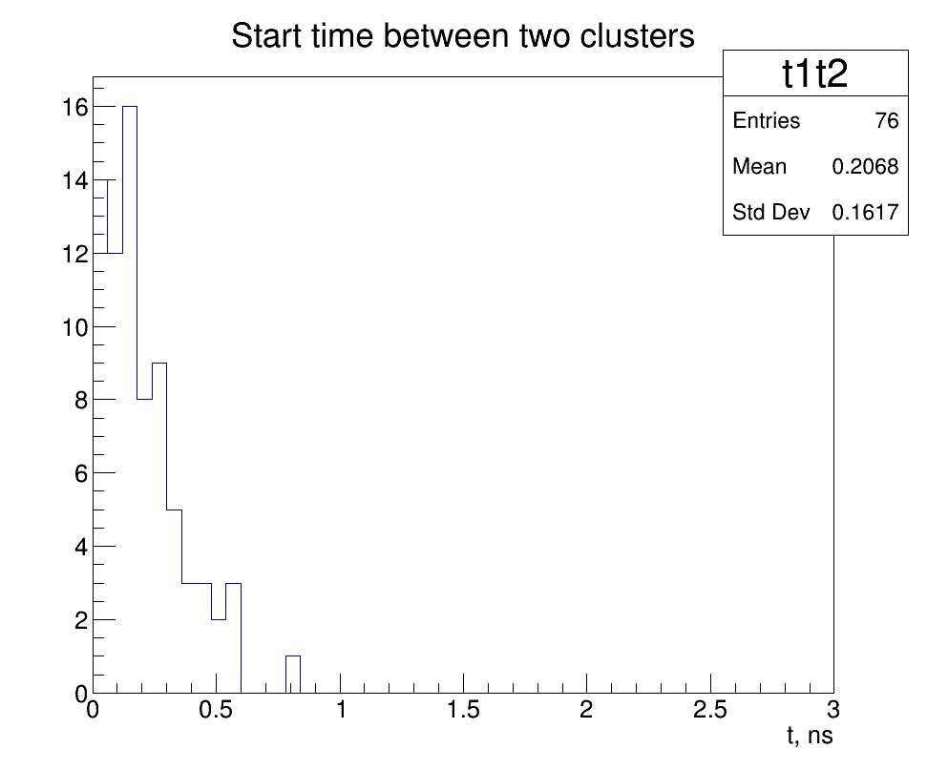
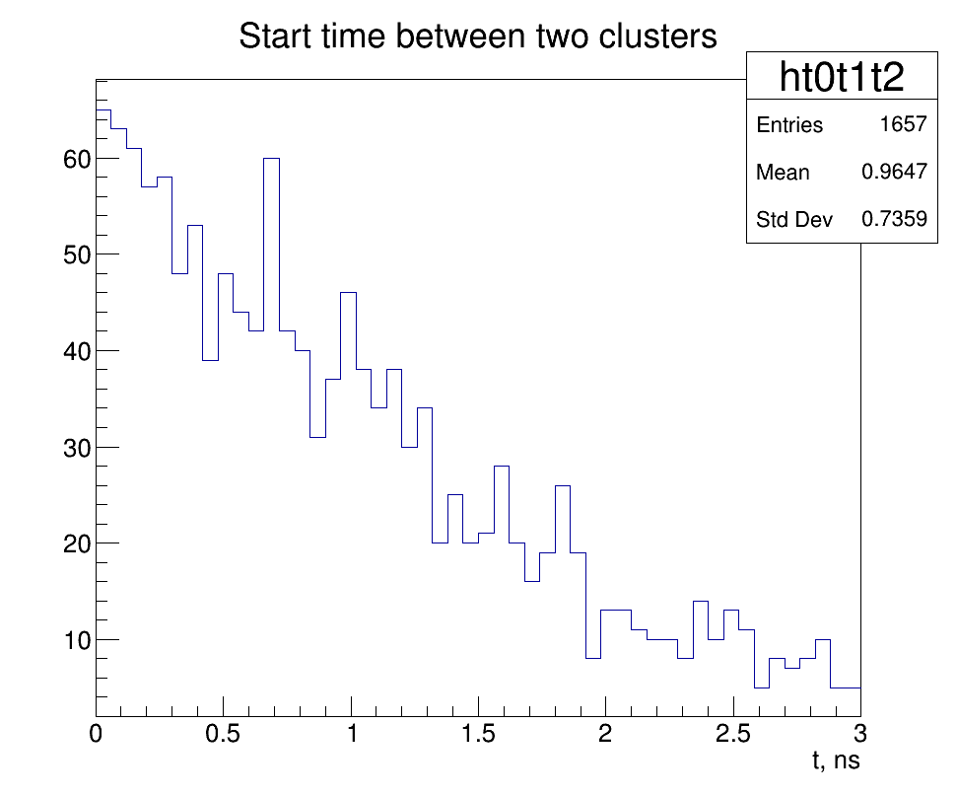
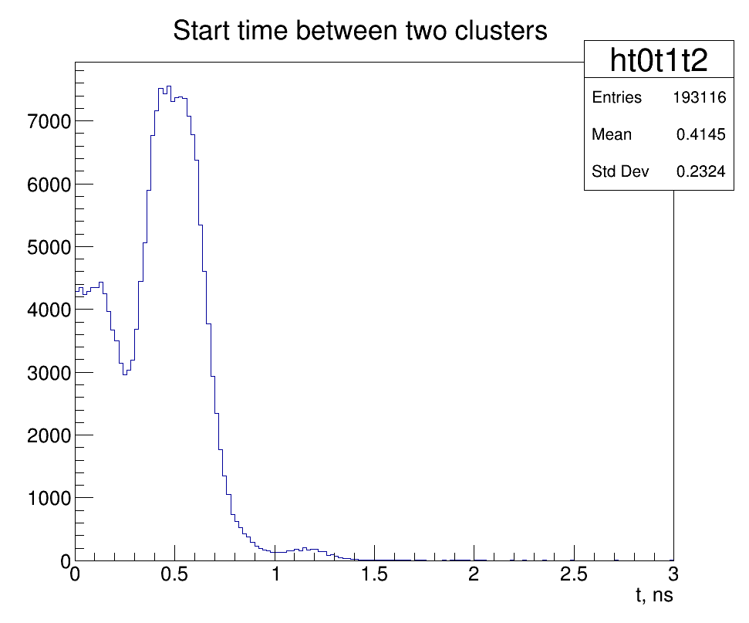
4th BM@N Meeting
Two characteristic of time analysis
1. Time between incoming gammas is around zero
SIM
only π⁰
SIM
All data
Real
data
14.10.19
ECAL Group: Abraamyan Kh.U. et al.

Slide 16
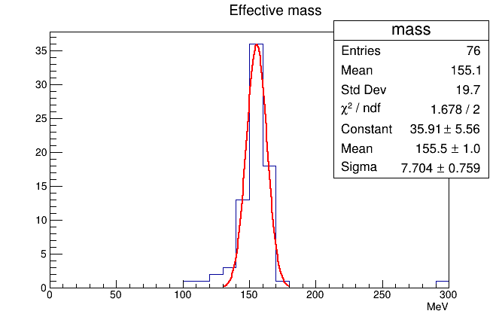
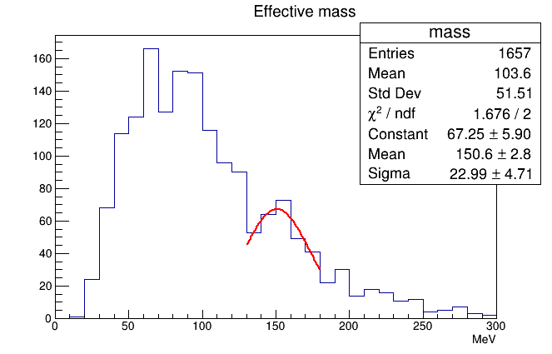
4th BM@N Meeting
Effective mass for simulation data
E_{γ}>0.1GeV
SIM
only π⁰
SIM
All data
14.10.19
ECAL Group: Abraamyan Kh.U. et al.

Slide 17
Conclusion
4th BM@N Meeting
The electromagnetic calorimeter of the BM@n/NICA is calibrated on the carbon beam of the Nucleotron. The signal from charged particles passing through the calorimeter cell radiator without interaction (the so-called minimum ionizing signal) was used for calibration. The energy equivalent of this signal is determined by Monte Carlo simulation and is ≈ 220 MeV in units of gamma-quantum energies.
The experimental data obtained in 55th run of the Nuclotron (March-April 2018) are analyzed. The effective mass distributions of photon (clusters) pairs are obtained. There is an excess over the background, in the region that is well consistent with the table value of the mass of π⁰-meson.
14.10.19
ECAL Group: Abraamyan Kh.U. et al.

Slide 18
Outlook
4th BM@N Meeting
Further analysis of the data using the results of time analysis of the clusters;
Data simulation and estimation of efficiency of detection of π⁰ and other particles;
To engage all 504 channels of the Right arm of the Calorimeter;
For further investigations of two-photon spectra in a wide range of masses up to the mass of η meson, it is necessary to collect and install the second – the Left arm of the Calorimeter.
14.10.19
ECAL Group: Abraamyan Kh.U. et al.

Slide 19
Thank you!
14.10.19
ECAL Group: Abraamyan Kh.U. et al.

Slide 20
Типичный профиль сигнала в отдельной ячейке калориметра (лев.), и в одной плохо работающей ячейке калориметра (N263) (прав.), в 55-м сеансе работы Нуклотрона (март-апрель 2018 г.).

Slide 21
До и после нормировки фона, шаг 8 МэВ

Slide 22
До и после нормировки фона, шаг 6 МэВ

