Slide 1
14.09.2019 Ivan Slepov, JINR, Dubna
4th Collaboration Meeting of the BM@N Experiment at the NICA Facility
Web-services for the BM@N experiment

Slide 2
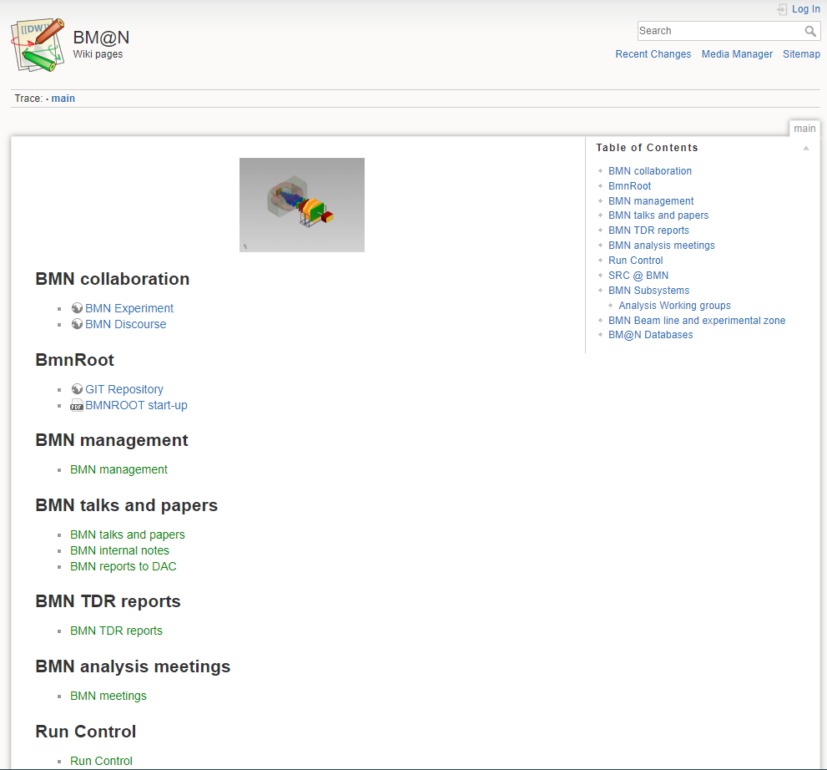
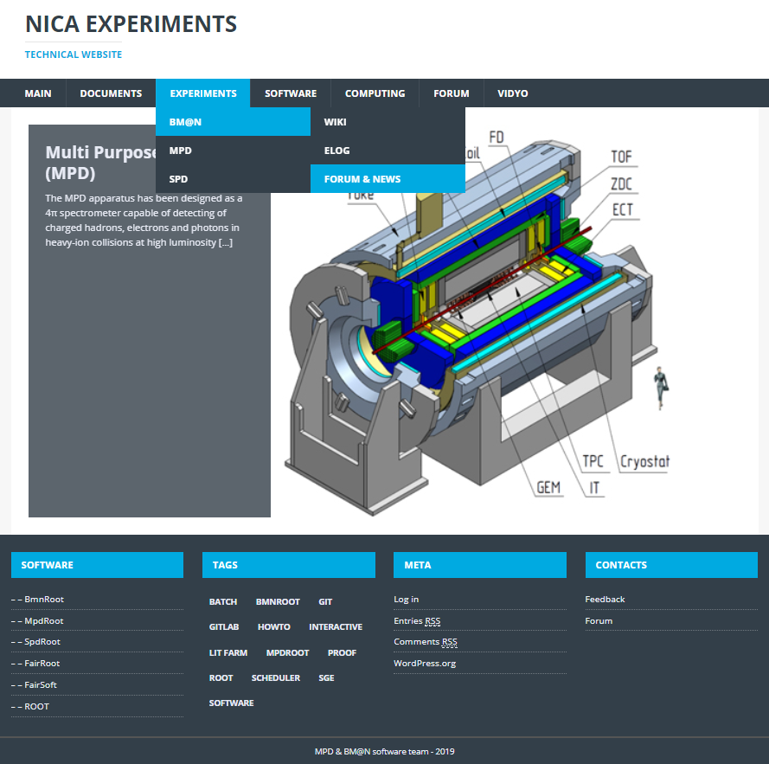
Main sources of information about the BM@N
bmnshift.jinr.ru
mpd.jinr.ru ->

Slide 3
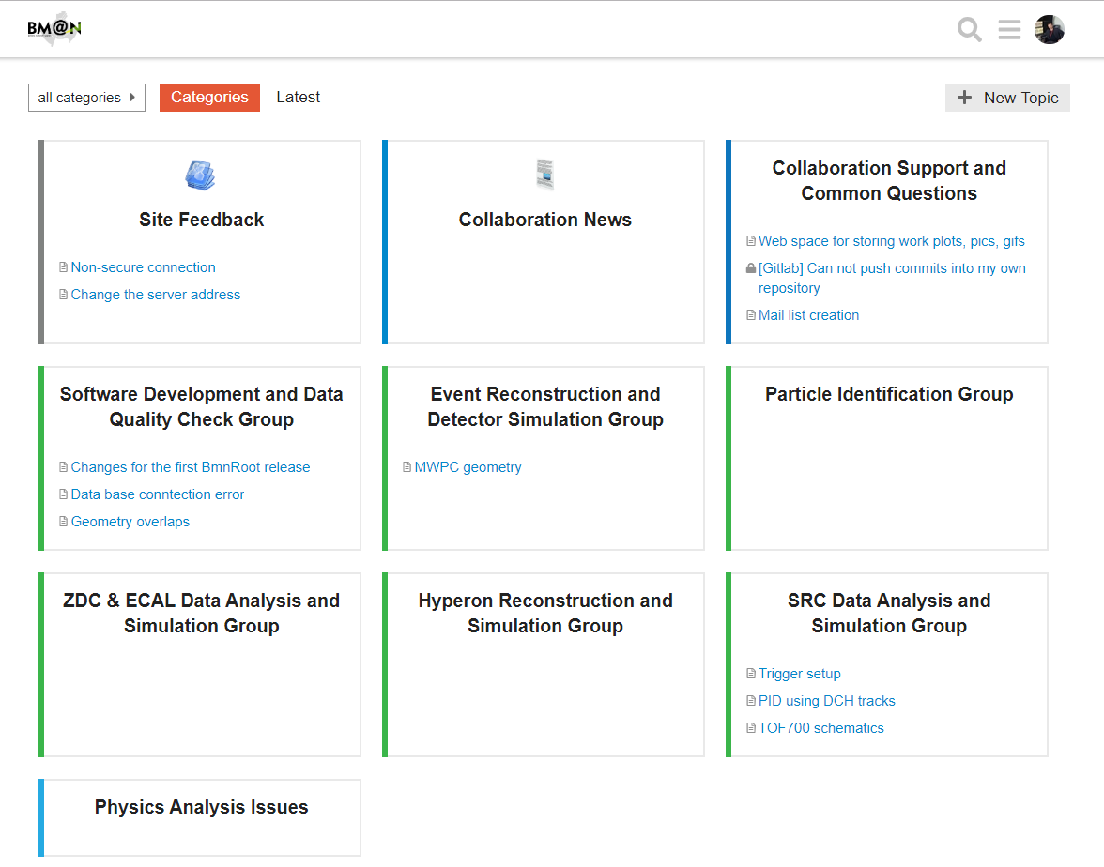
Discourse forum for the BM@N

Slide 4
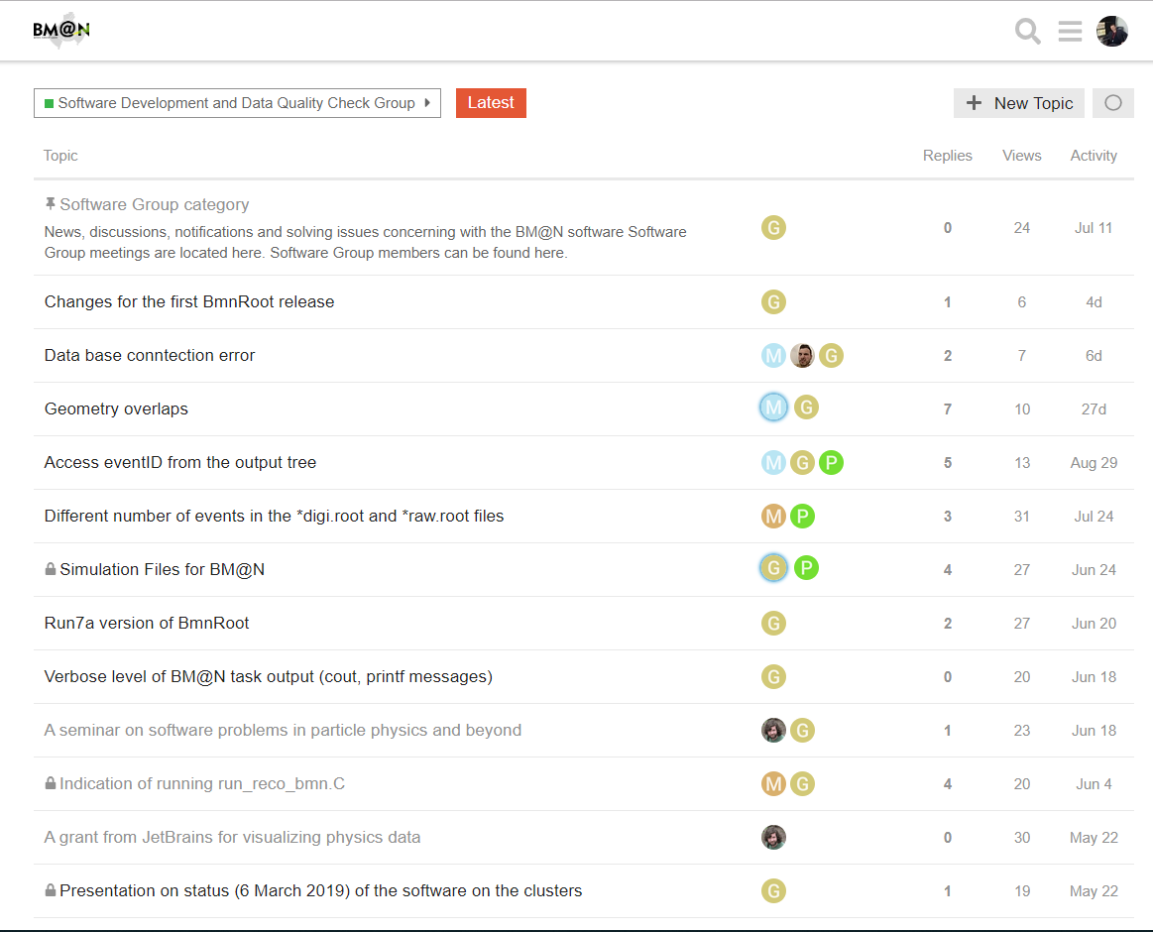
Discourse forum for the BM@N

Slide 5
BM@N web-services
BM@N web-services | About
http://bmnshift.jinr.ru/wiki/ | Technical information website Wiki pages
http://bmn.jinr.ru/experiment/ | Collaboration website
http://se49-48.jinr.ru/ | Forum on the Discourse platform
http://se51-98.jinr.ru/bmn_elog/ | E-log interface
https://git.jinr.ru/nica/bmnroot | GIT software repository
http://bmn-web.jinr.ru:4200/ | Database interface
BMN.JINR.RU | Not used. Redirect on wiki pages

Slide 6
Web-services new structure
bmn.jinr.ru
Wiki
Git
DataBase
E-log
Forum

Slide 7
Proposals for the pooling of resources
Web-services | Proposal
bmn.jinr.ru | Main website
*/experiment | Transfer information to the main domain, and delete this
*/wiki | Technical wiki pages
*/forum | A discourse platform will be available at this link
Bmnshift.jinr.ru | Delete domain as unnecessary
Other resources | Make links from the main website

Slide 8
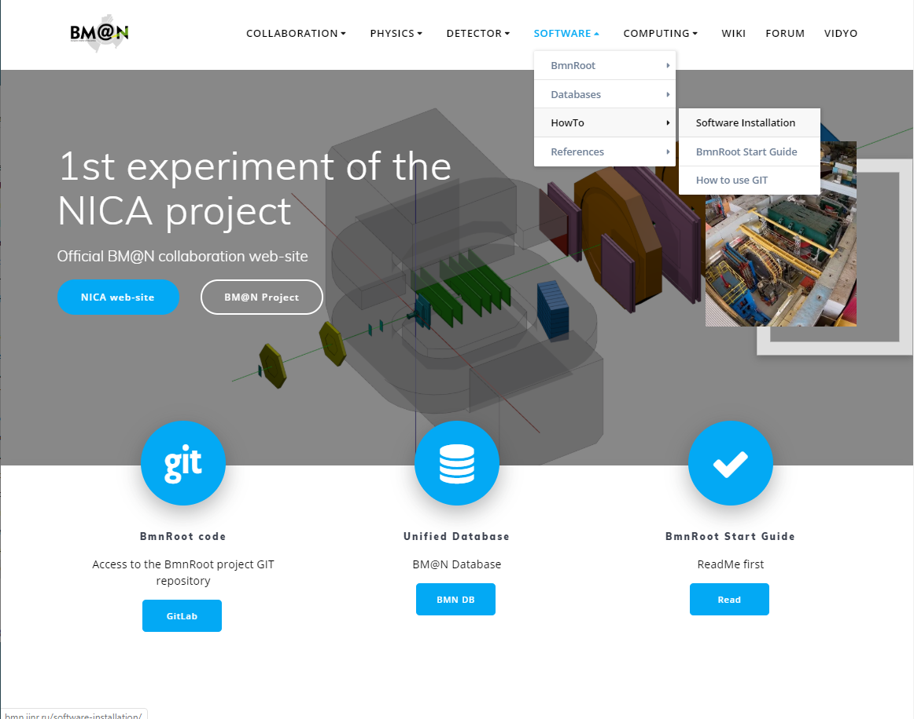
BM@N main website – bmn.jinr.ru

Slide 9
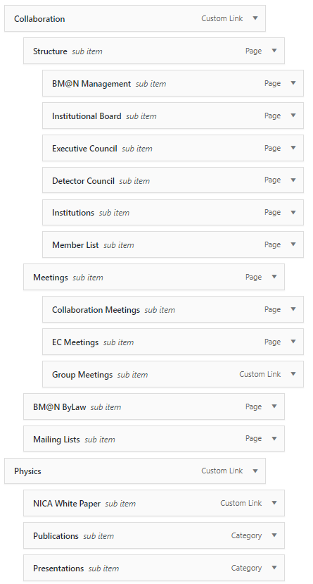
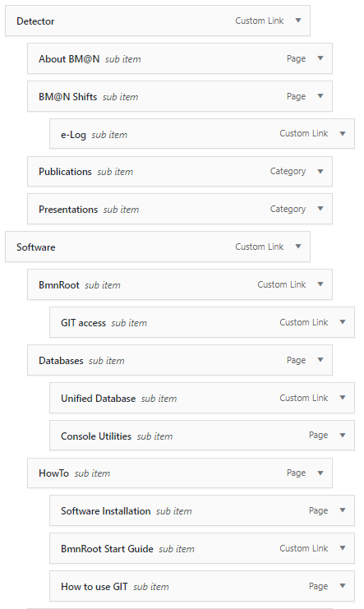
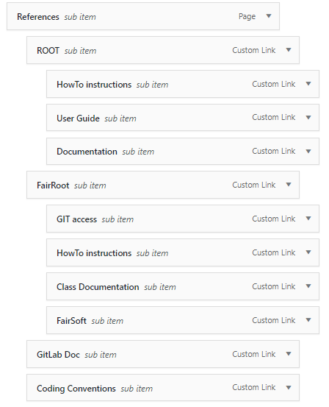
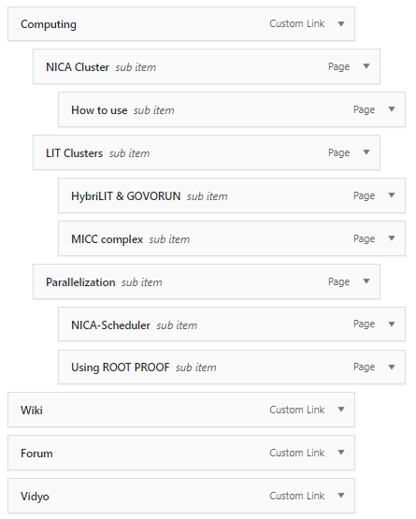
BM@N main website menu structure

Slide 10
Wiki pages migration
From simple
DokuWiki platform
to smart
Xwiki platform

Slide 11
Thank you for your attention!

Slide 12
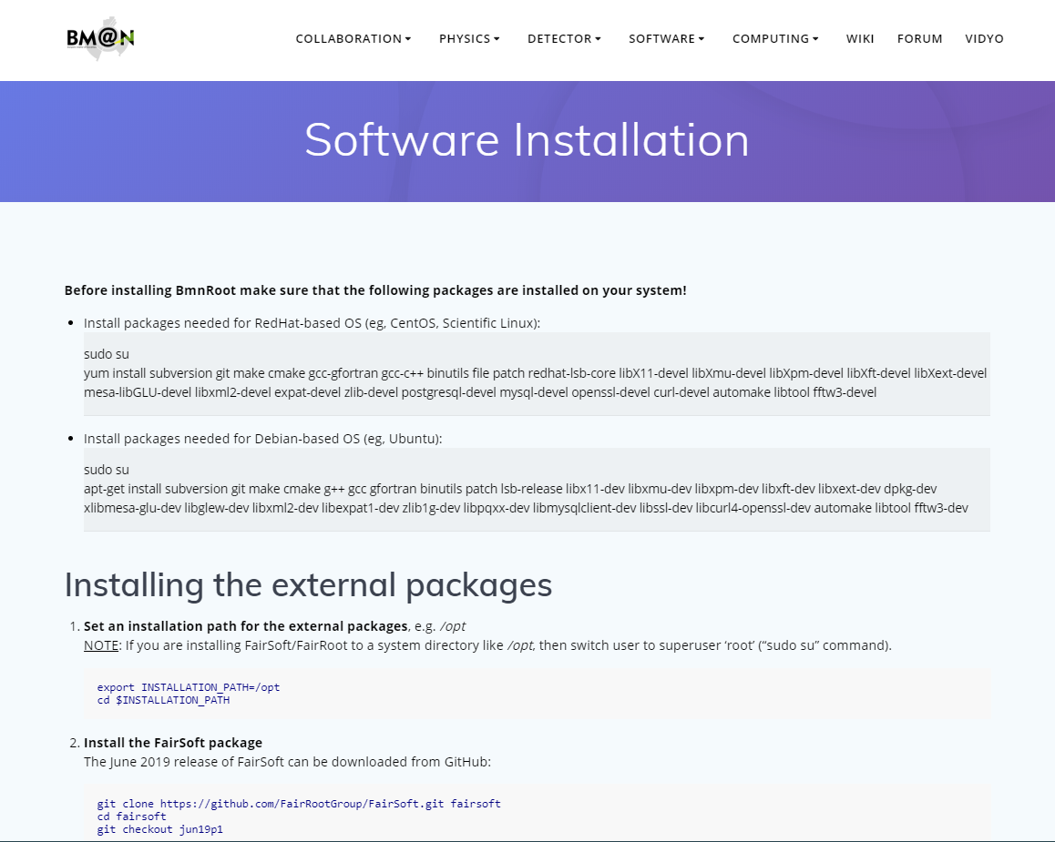
BM@N main website – bmn.jinr.ru

