Slide 1
Relativistic Heavy Ion and Spin Physics
Sub-group of the JINR Strategy Long Range Plan International Working Group
Notes:
Tittle page and out line

Slide 2
Strategy of the Laboratory of High Energy Physics
Locally developed document by a group of ~30 people under the coordination of R. Tsenov and after a laboratory-wide discussion (June – Dec. 2017)
Web site (also with audio records) https://indico.jinr.ru/conferenceDisplay.py?confId=296, passwd: ask me!

Slide 3
Core research areas of the JINR scientific program and SLRP sub-groups
Particle Physics
Relativistic Heavy Ion and Spin Physics
Nuclear Physics
Condensed Matter Physics
Theoretical Physics
Nuclear Biophysics
Information Technologies & High Performance Computing
Education
Nuclear Physics Applications and Societal Benefits

Slide 4
Mandate of the WG:
Based on a broad consultation with the JINR member states and with wide international physics community, the SLRP WG is asked to:
    Identify physics scientific venture, priorities and research infrastructure that should be pursued by JINR and that would ensure continuous JINR global scientific leadership.
    Formulate a coherent plan of the best way to develop the institute in period beyond the running JINR 7-years Plan and include a look ahead to 2030.
    Prepare a set of recommendations directed to JINR scientists and to JINR governing bodies of member States.

Slide 5
Relativistic Heavy-Ion and Spin Physics sub-group
Alessandro Bachetta (Uni Padova)
Alexander Kovalenko (LHEP JINR)
Alexander Sorin (JINR)
Gennady Zinovjev (LTP JINR)
Horst Stoecker (GSI)
Itzhak Tserruya (Weizmann Inst.)
Luisa Cifarelli (INFN Bologna)
Oleg Teryaev (LHEP JINR)
Richard Lednicky (JINR)
Roumen Tsenov (LHEP JINR) – local coordinator
Sergey Shmatov (LHEP JINR)
Vladimir Kekelidze (LHEP JINR) - chairman

Slide 6
Results of our sub-group work
We have produced a concise document (8 pages) containing the physics potential and feasibility of the research directions that are worth to pursue in the following 10 – 20 years in the LHEP.
Available at: https://indico.jinr.ru/conferenceDisplay.py?confId=296, passwd: ask me!
First priority in the next decade is the realization of the NICA scientific program based on:
  Heavy ion (up to Au⁺⁷⁹) collisions at center-of-mass energy in the range 2 – 11 AGeV;
  Collisions of transversely and longitudinally polarized protons and deuterons at center-of-mass energy up to 27 GeV

Slide 7
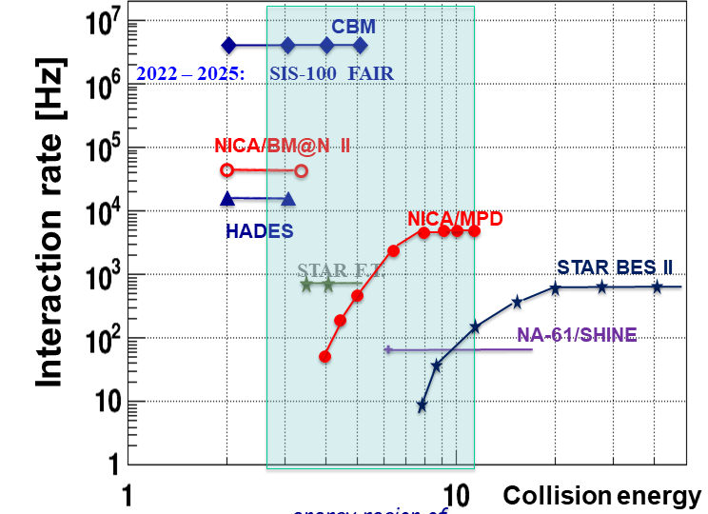
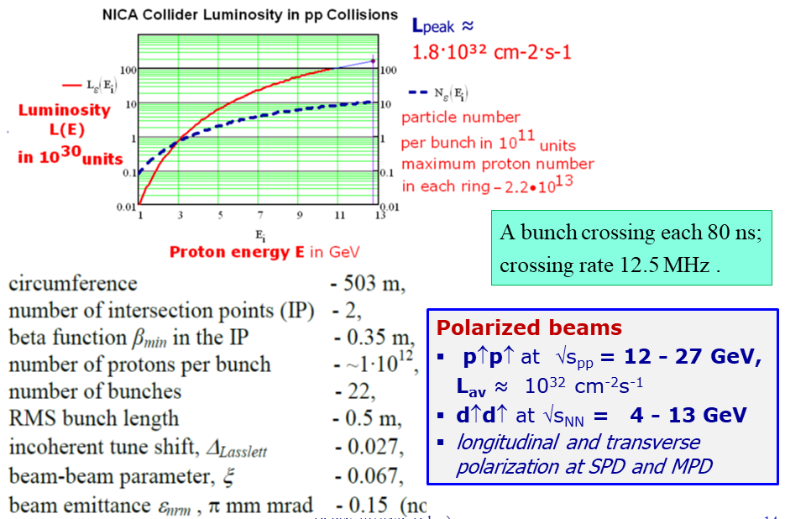
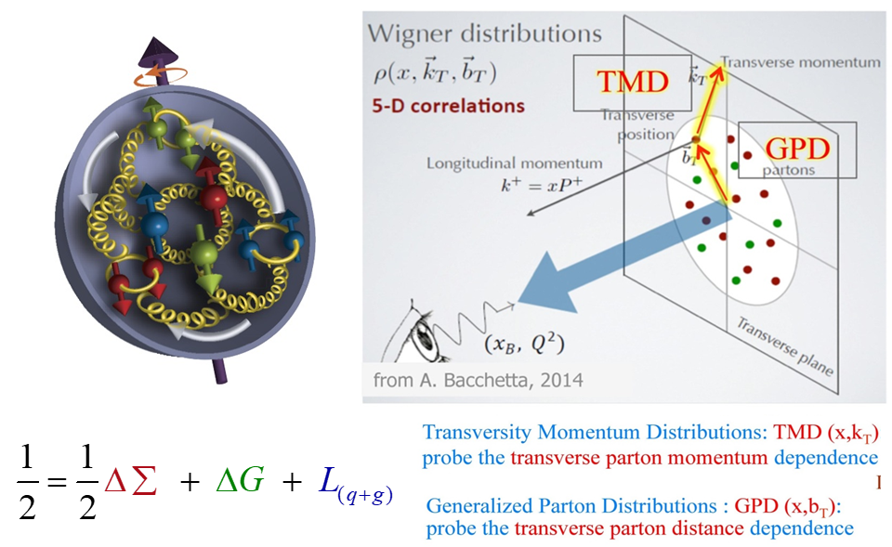
NICA scientific program
Investigation of hot and dense strongly interacting matter, search for a mixed phase and critical point in the QCD phase diagram in the poorly explored region of high baryon chemical potential.
In the next 25-30 years, the potential of the NICA accelerator complex should be fully exploited and further developed.
Study the nucleon spin structure and polarization phenomena by performing experiments with colliding polarized proton and deuteron beams with center-of-mass energy up to 27 GeV.
Meanwhile, upgrade of the Nuclotron beam extraction channels based on superconducting technology shall take place. It will be supplemented by construction of superconducting magnetic energy storage device (SMES). R&D and project preparation for upgrading of the magnetic system of the Nuclotron using, in particular, high-temperature superconductor is also envisaged.
The NICA facility shall be open not only to JINR and member state scientists but also to the international scientific community at large.

Slide 8
Future lines of development of the NICA accelerator complex
For beyond 2030, we have identified four directions that are scientifically promising, technically feasible, and can be seen as natural extensions of the planned NICA program:
Upgrading of the NICA rings to obtain asymmetric heavy ion collisions and collisions of polarized protons with polarized deuterons and also pA and dA collisions;
A feasibility and design study for an electron accelerator of a few GeV energy and, possibly, for a high-energy photon beam. The latter could be based, for example, on backward Compton scattering of a laser beam off a few GeV electron beam.
A feasibility and design study for search for the proton and deuteron electric dipole momenta (EDM) with the NICA rings.

Slide 9
Future lines of development of the NICA accelerator complex (1)
New electron accelerator: The study of ep and eA collisions, in particular with polarized beams, offers the possibility of conducting numerous studies on the internal structure of the nucleons and nuclei.
Polarized beams offer the possibility to study crucial aspects of hadronic and nuclear structure beyond the reach of most of present-day facilities. Polarized beams of deuterons give access to a rich set of measurable structure functions.
Comparison of pp, ep and eA data → access to the multidimensional structure of the nuclei and to the mechanisms generating single-spin asymmetries in nuclear collisions.

Slide 10
Future lines of development of the NICA accelerator complex (2)
The γ-p beams may allow to study the photo-production of J/ψ and ϒ, the latter being presently studied with limited statistics or in symmetric systems such as p-p, preventing an unambiguous rapidity, and hence Bjorken-x, determination. Depending on the proton beam energies, these studies could shed light on the J/ψ and ϒ formation at threshold and on the gluon structure of the nucleon.
In addition, the production of di-lepton pairs in eA and γA interactions is of great interest, allowing studies of the electromagnetic interactions in the region of strong fields. The coupling Z√α is large, so conventional perturbative calculations of the processes are questionable and higher-order terms may become important.

Slide 11
Future lines of development of the NICA accelerator complex (3)
The NICA collider rings are very suitable for attempting measurement of the proton and deuteron EDMs due to the possibility of transformation of the two storage rings into an 8-shape accelerator structure and use of so-called spin transparency mode, also known as spin-frozen mode, for the spin control.
Search for the proton and deuteron EDMs could be tried after the first round of experiments with the MPD and SPD.

Slide 12
Involvement in external experiments
Traditionally, the HEP scientific program of JINR includes participation in experiments at accelerator centers around the world (CERN, BNL, DESY, GSI) that provide unique conditions to perform studies in the fields of high-energy heavy-ion physics and spin physics. The key factor here is a mutual benefit from the exchange of new scientific information and know-how. JINR participation will depend on the discovery potential of the experiments and leading role in them of the JINR researchers
The continuing participation in the experiments NA61 and COMPASS at SPS, ALICE at LHC and STAR at RHIC is of invaluable importance for preparation and realization of the physics program at the NICA complex. Strategically important is the JINR participation in experiments at future electron-ion collider (EIC) facility to be built in US and in fixed-target experiments at FAIR-GSI.
The JINR strategy for cooperative research at other accelerator centers should be linked closely to the updated European Strategy for Particle Physics, expected to be available in 2020.

Slide 13
NICA staff and users
(estimation of the NICA management)
JINR
RF
other
People

Slide 14



2030
We have a strategy!

Slide 15
Add-ons

Slide 16
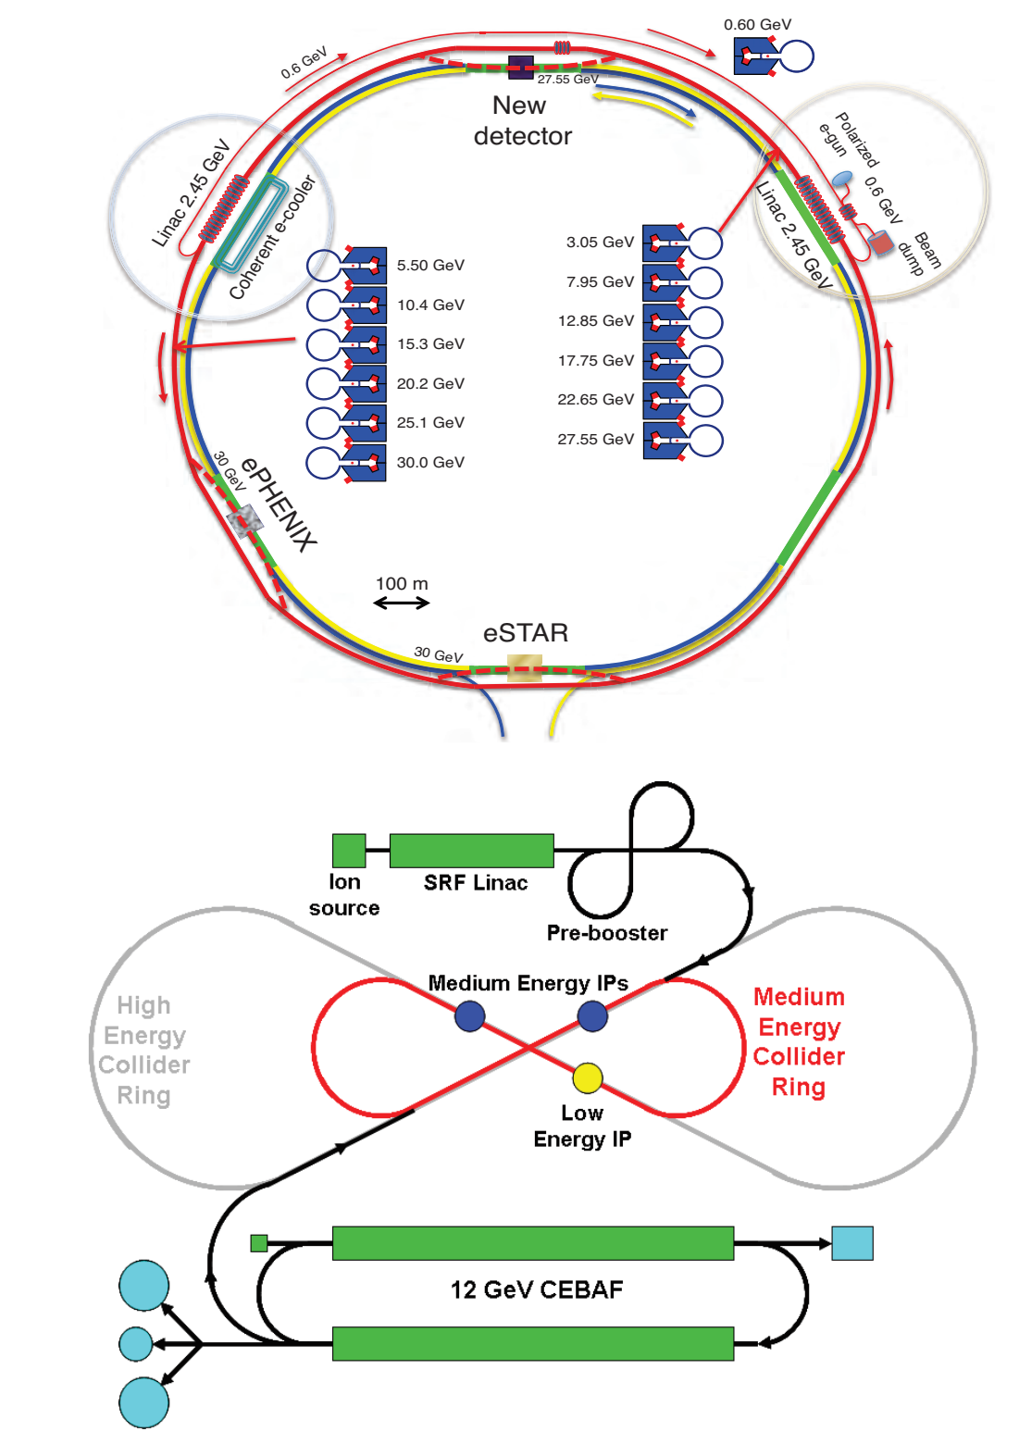
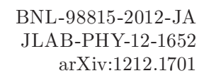
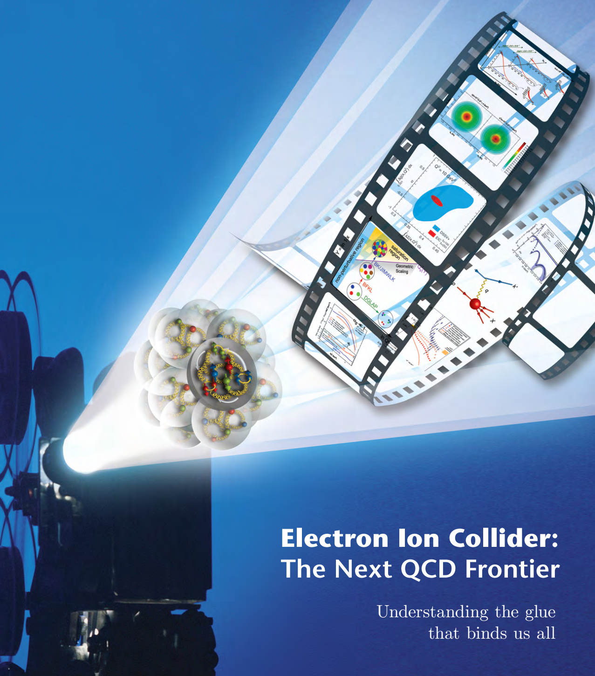
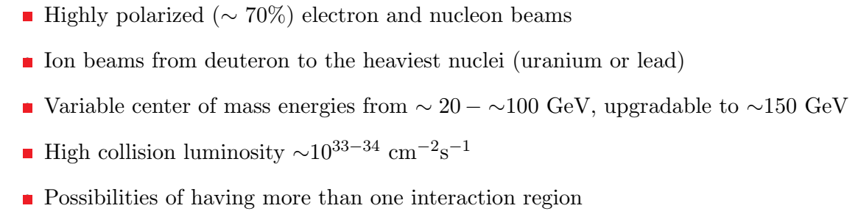
Electron-ion collider: USA projects
BNL
JLab

Slide 17
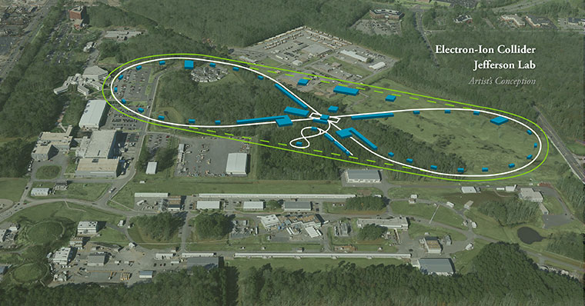

Slide 18
Electron-ion collider: China plans…

Slide 19
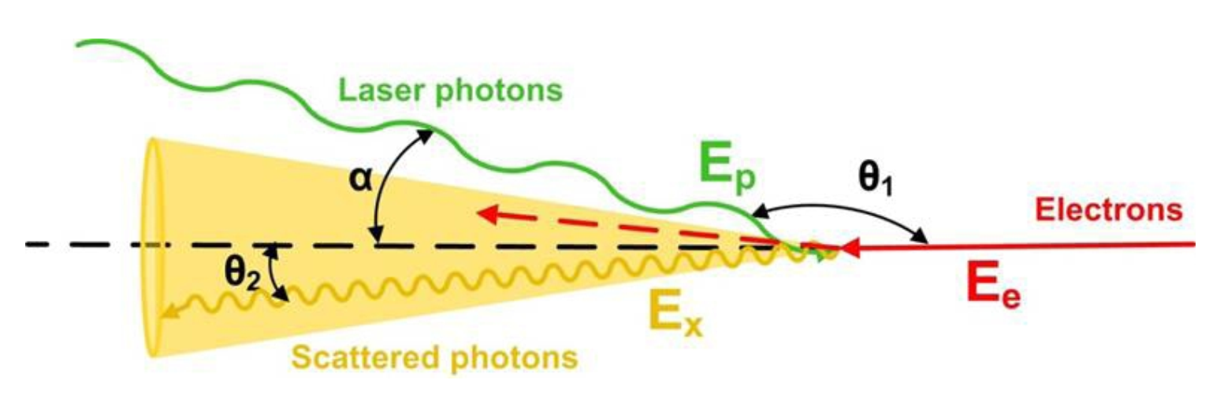
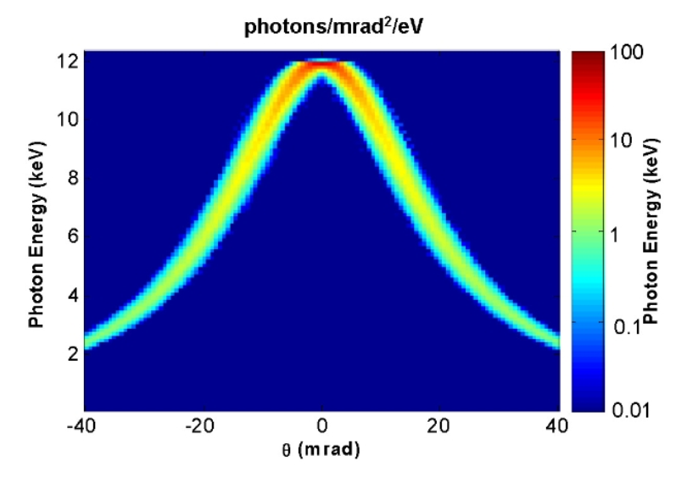
Backward Compton Scattering Source

Slide 20
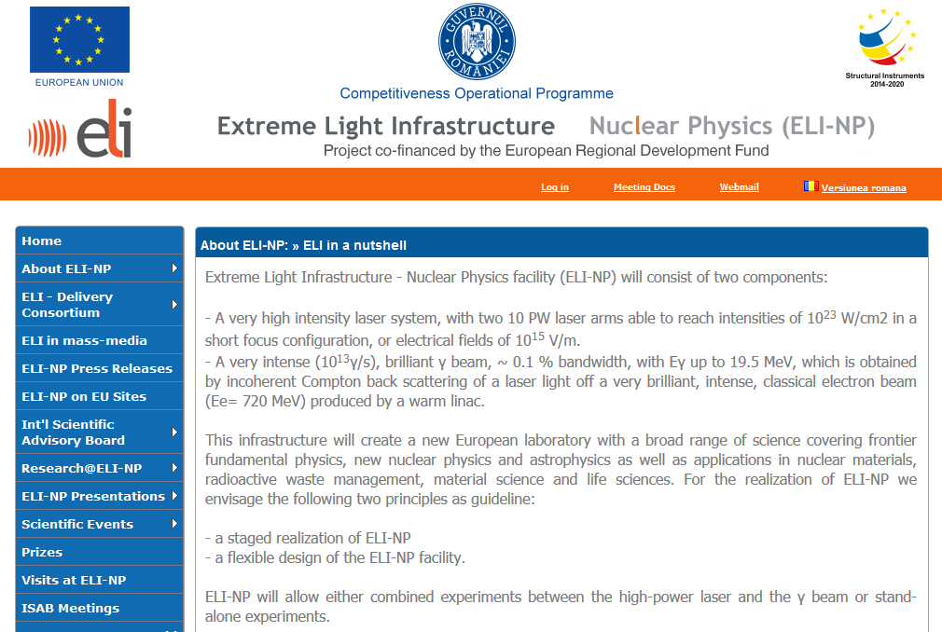
ELI-NP in Romania

Slide 21
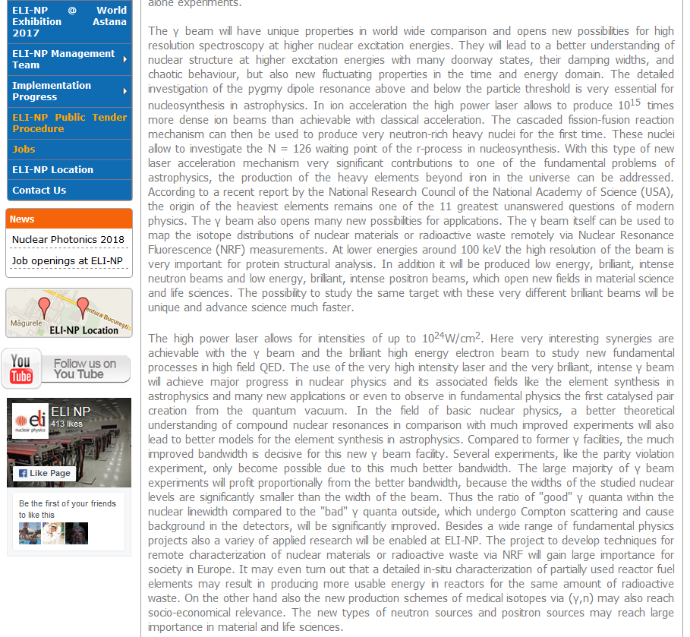
ELI-NP in Romania

