Slide 1


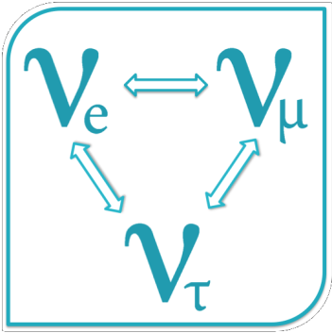
The Bruno Pontecorvo Centre in Pisa and the scientific collaboration JINR/Pisa: status and future develpments
Universita’ di Pisa
Centro Pontecorvo Pisa
Vincenzo Cavasinni
Physics Department, University of Pisa, INFN
and coordinator of the “Bruno Pontecorvo Centre”

Slide 2
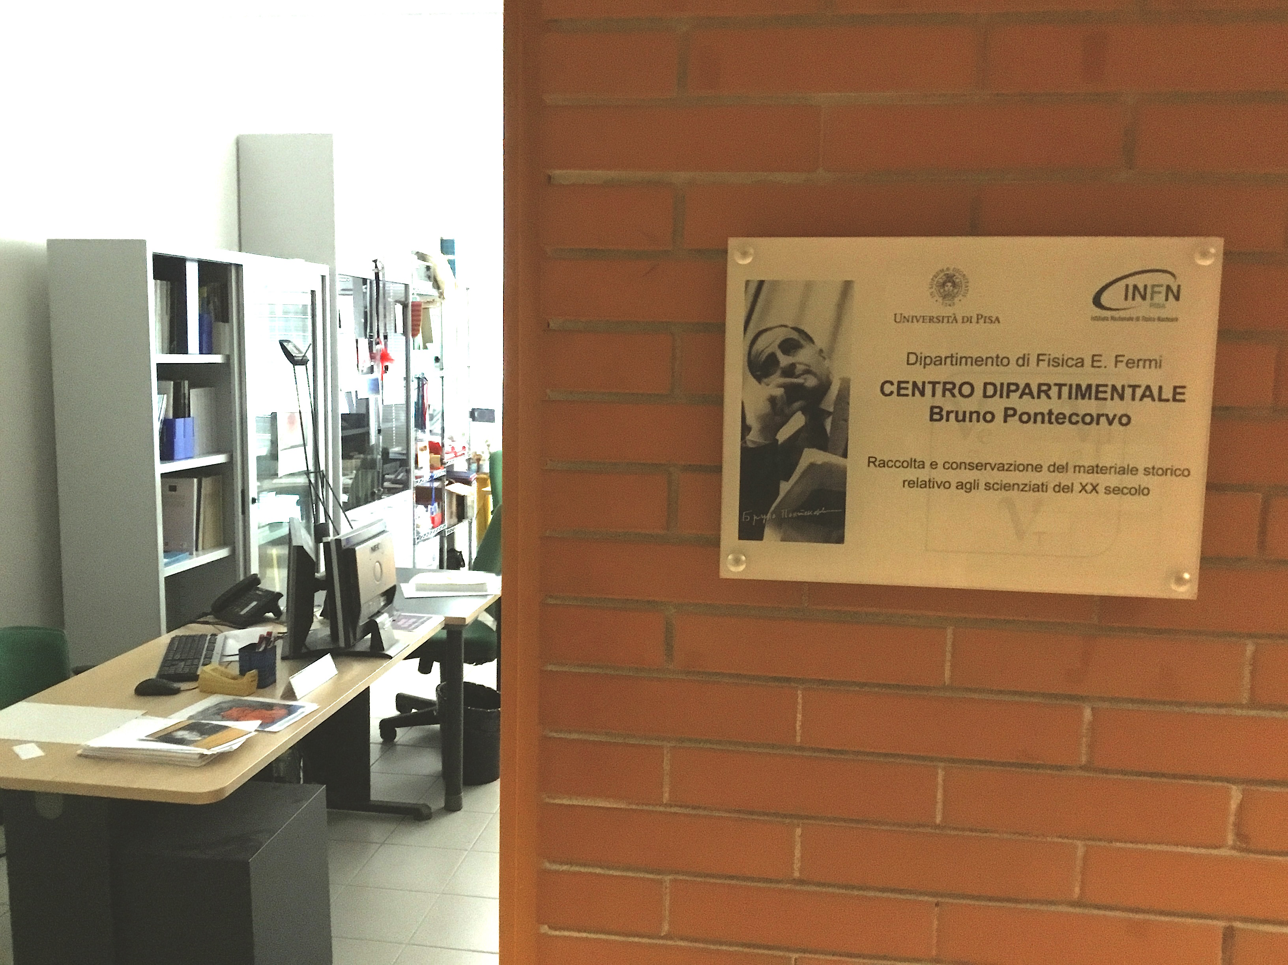
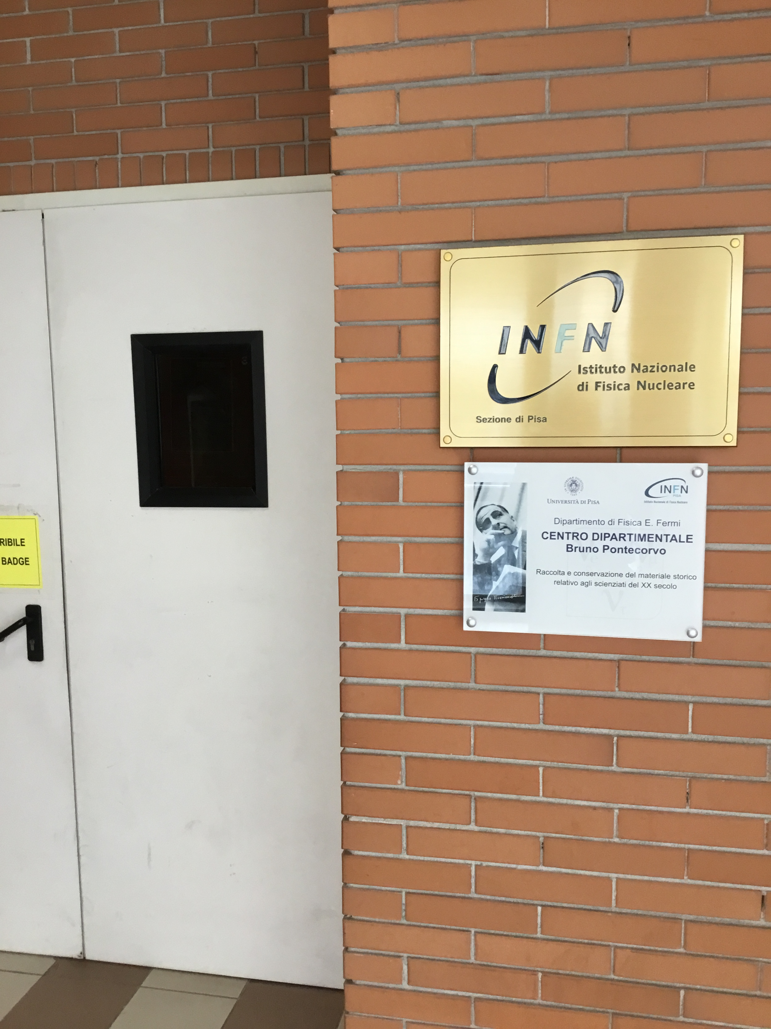
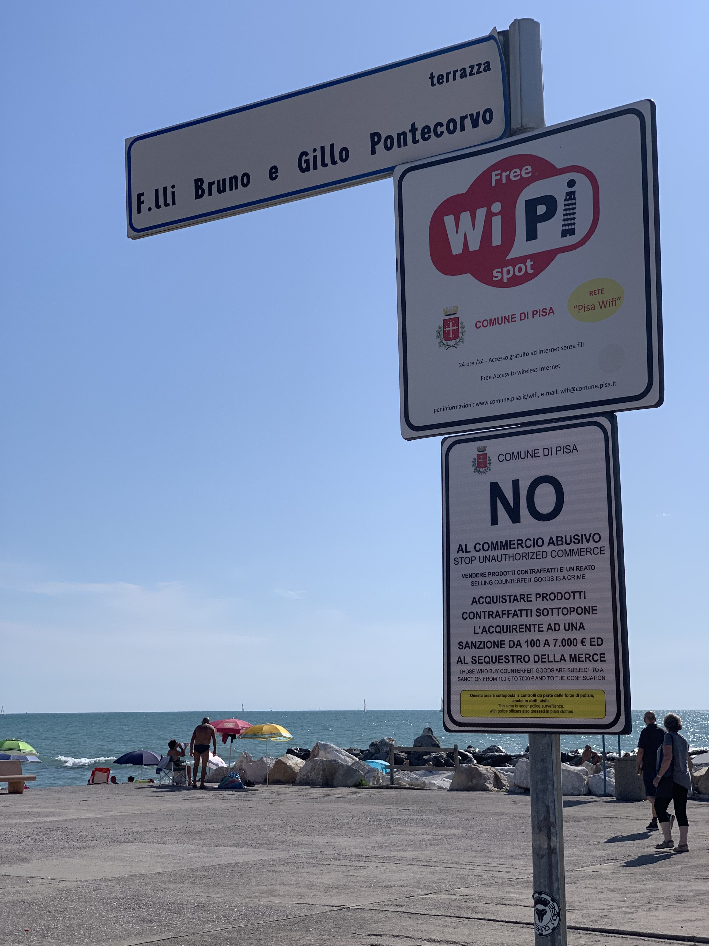
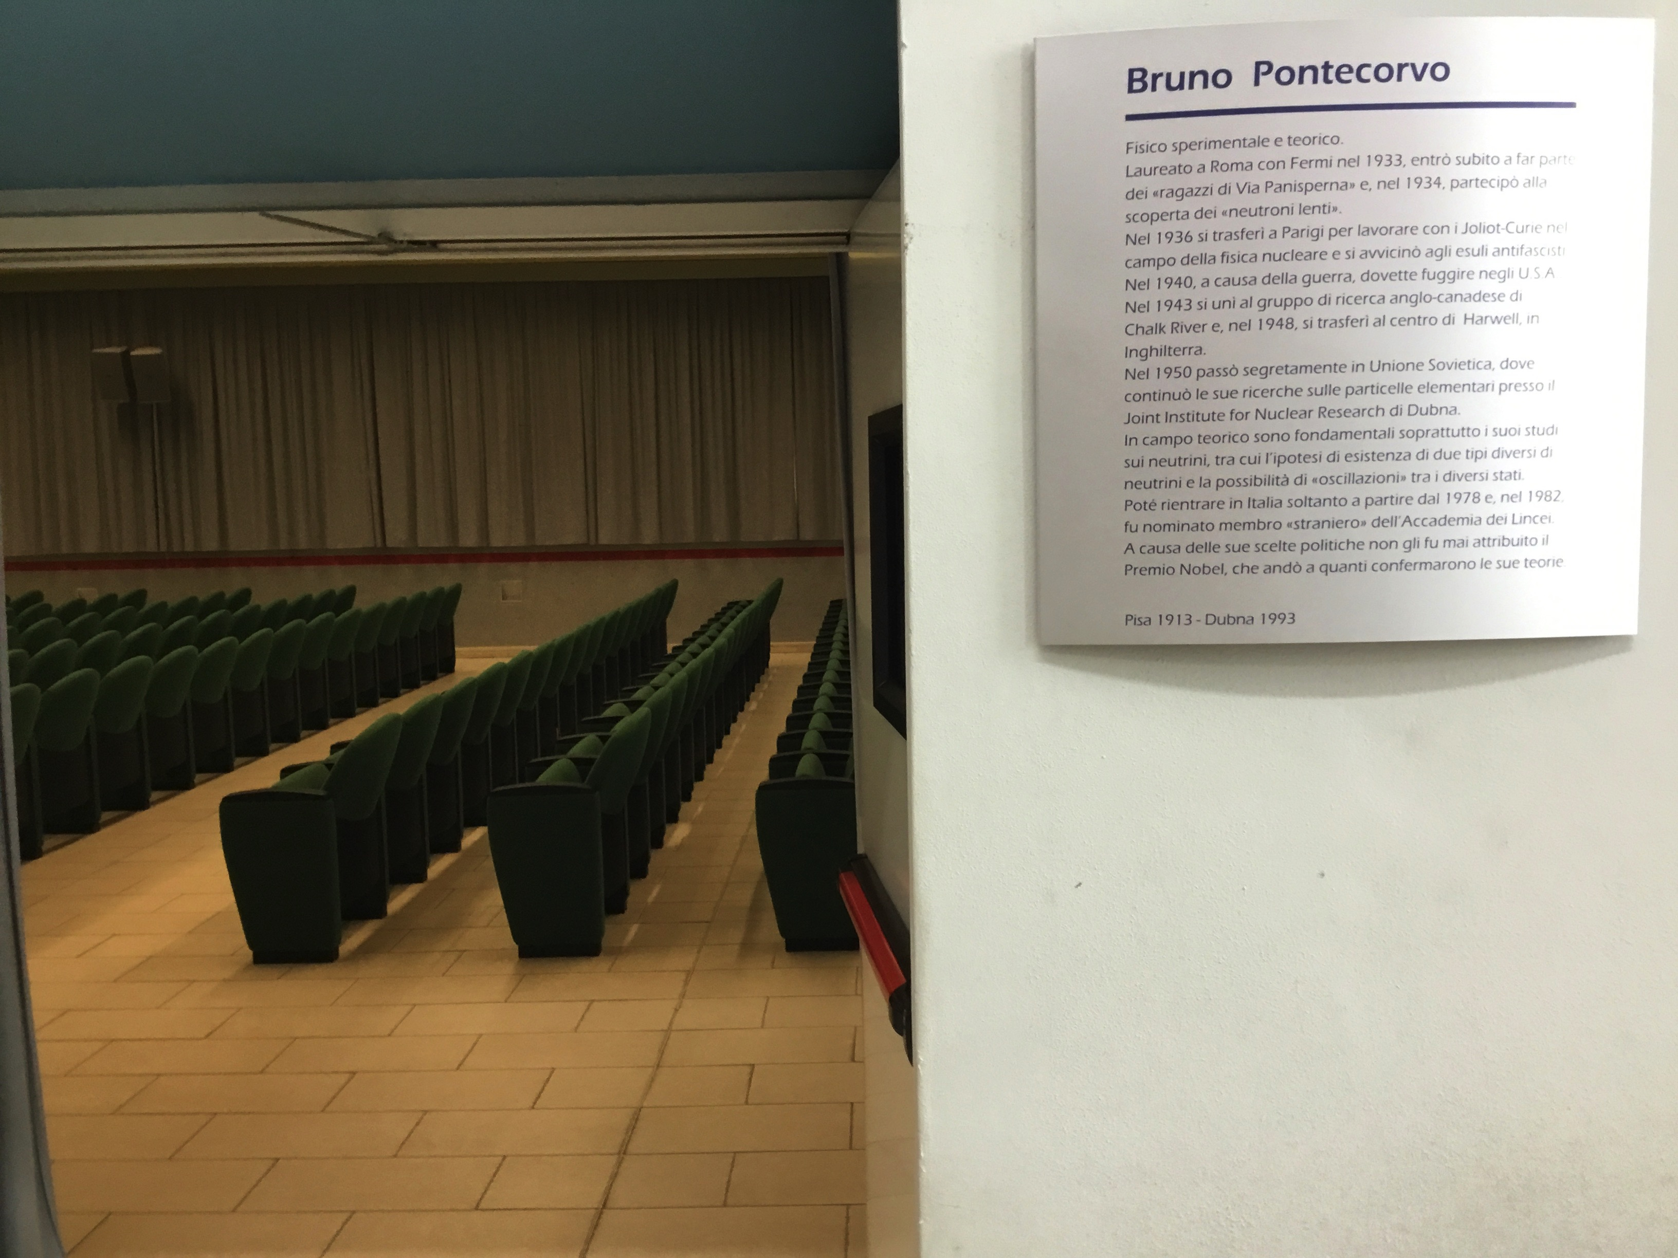
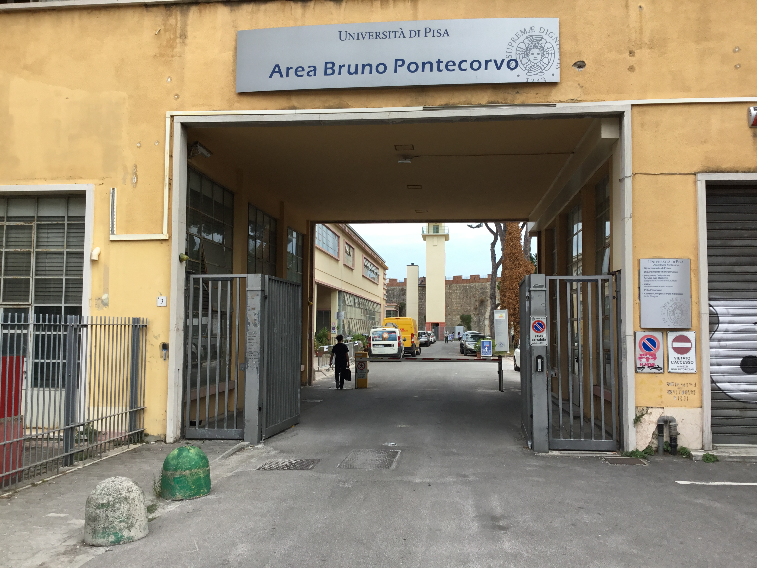
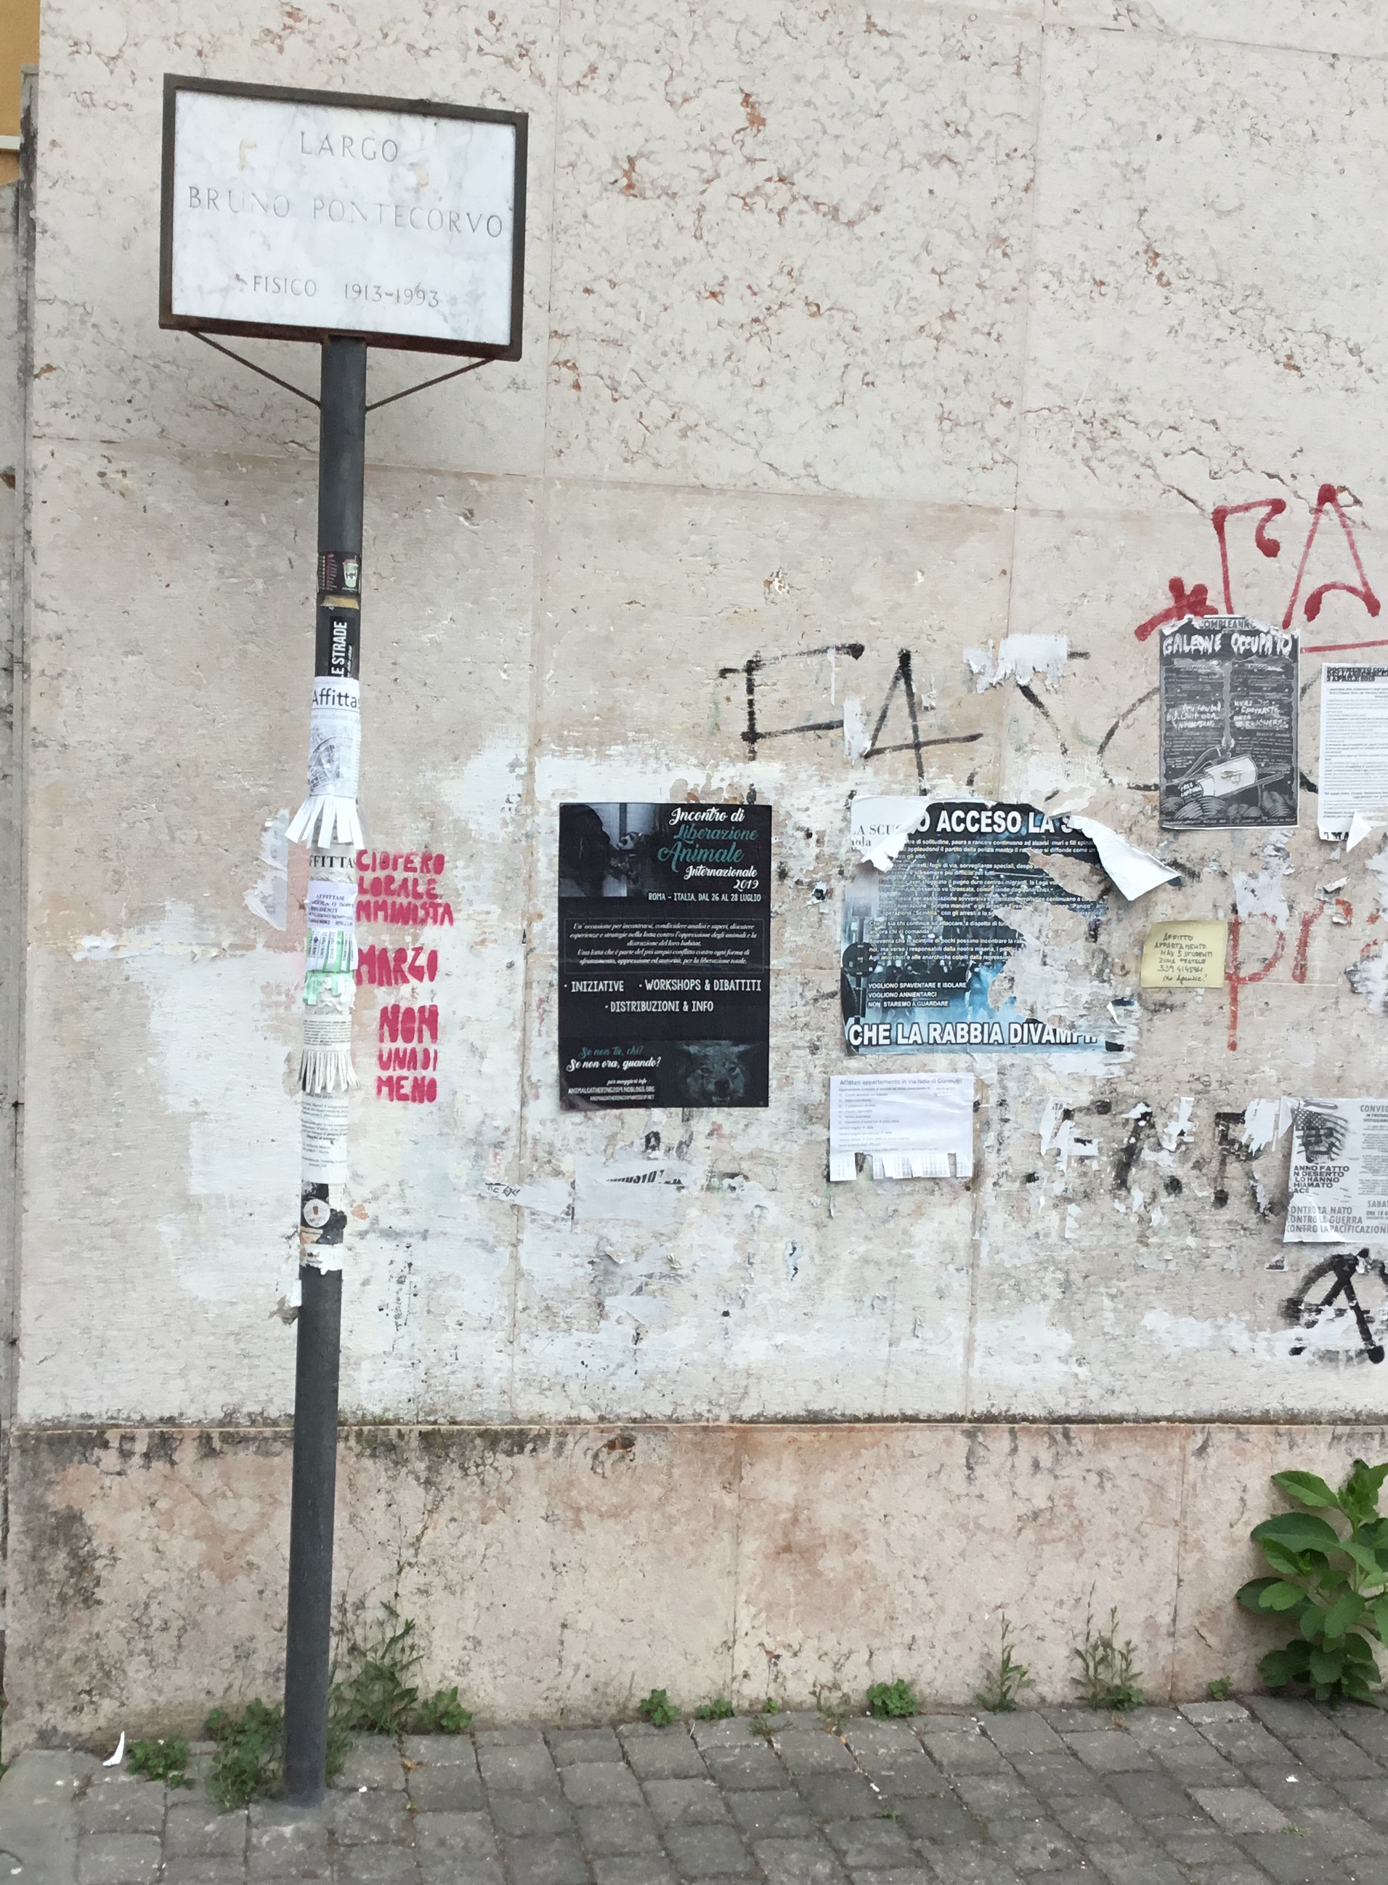
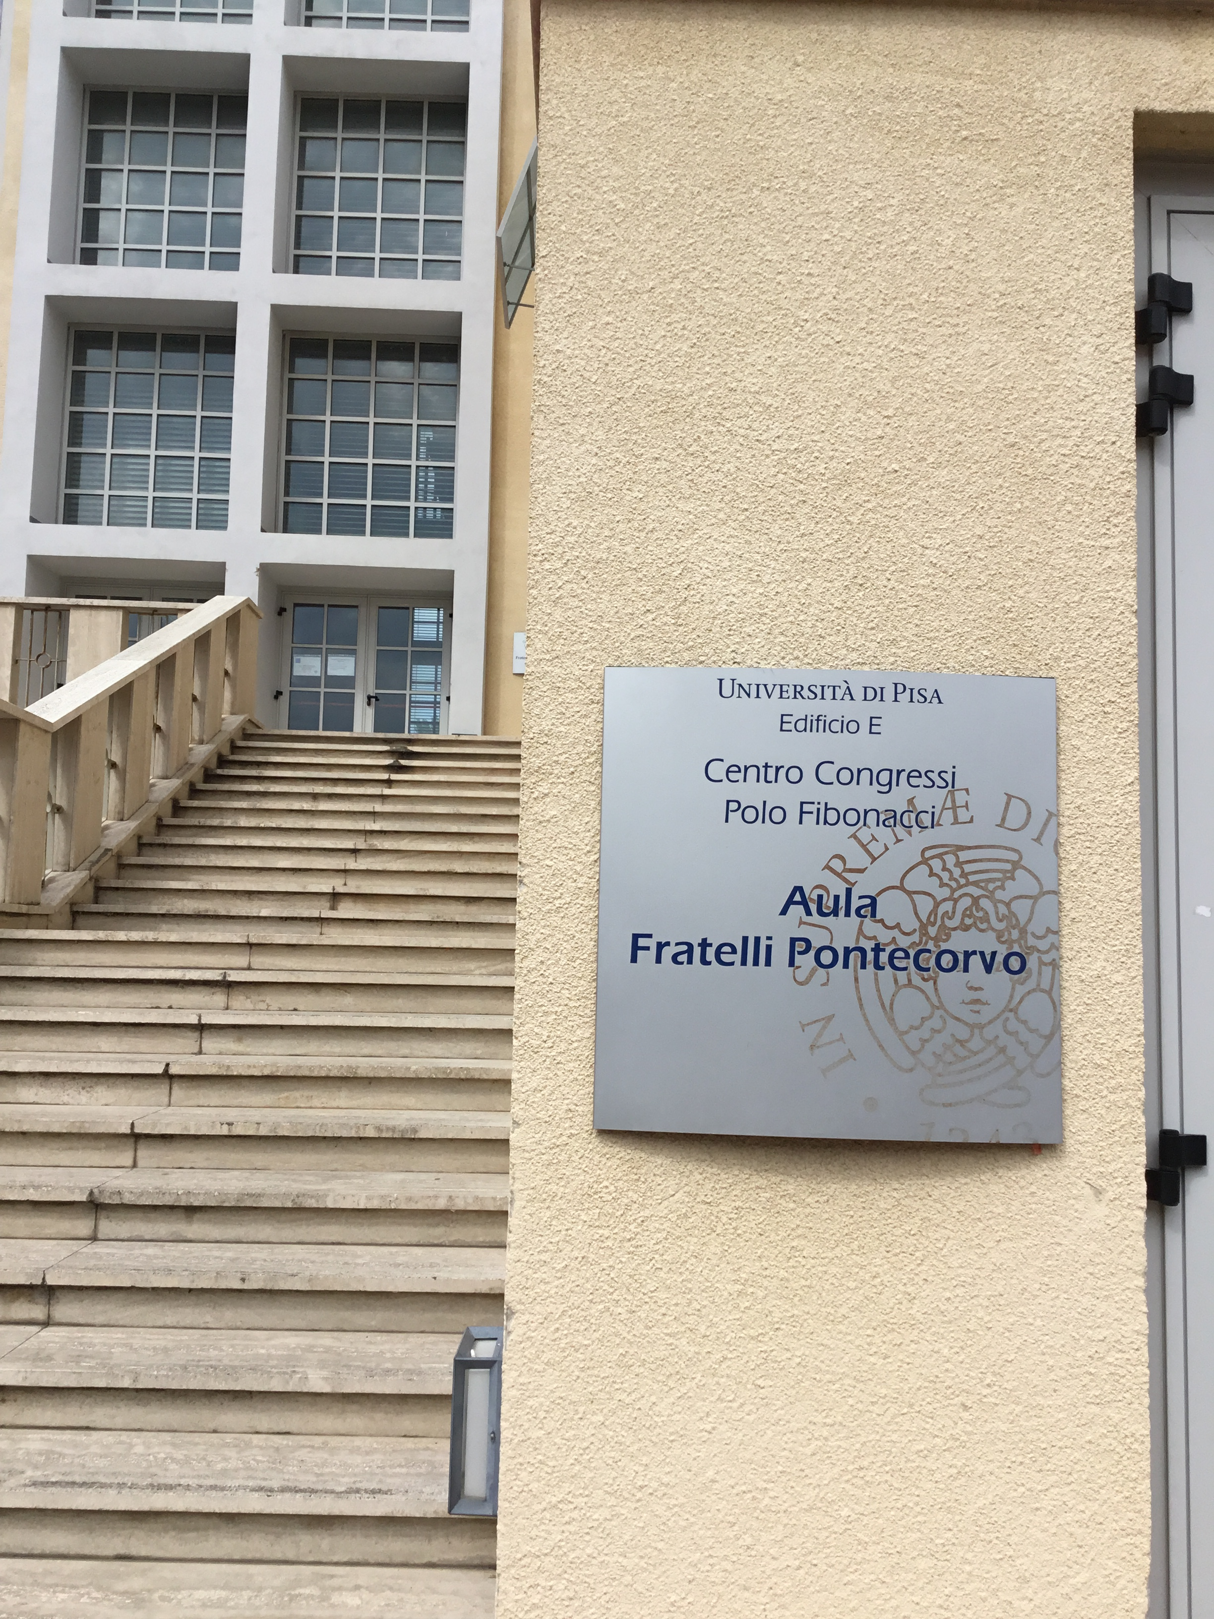
In Pisa we have a passion for Pontecorvo!
Terrace Bruno and Gillo Pontecorvo,
Marina di Pisa
The Pontecorvo’s square

Slide 3
“Centro Bruno Pontecorvo” (CDP)
The CDP is a body of the Physics Department of the University of Pisa
The CDP aims to promote the acquisition, preservation and study of documentation relating to scientists and their research in the field of Physics and its links with other sciences, with particular attention to the twentieth century. To this end, the CDP may also promote research projects, conferences and initiatives of a popular nature.
The CDP will be able to coordinate its activities, also through agreements approved by the Department of Physics, with those of institutions and bodies that pursue similar goals even in the more general context of Science, both at the University level and at national and international level.
Particular emphasis is devoted to collect the
documentation of Bruno Pontecorvo

Slide 4
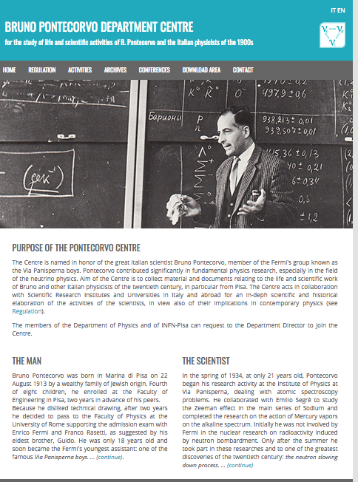
The Pontecorvo’s Centre Web page: http://centropontecorvo.df.unipi.it/EN/index.php
We are collecting
here material
on BP's life
and scientific
activity :
articles,
letters,
photos,
documents,
…
in the various
locations where
he has lived and
worked:
Italy,
France,
USA,
Canada,
UK,
Russia

Slide 5
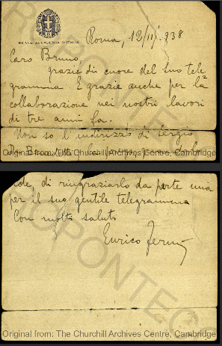
Ex: letter of Enrico Fermi to Bruno Pontecorvo: 1938
In this letter from Rome, Fermi
thanks Bruno
for the help provided by him
for the work done 3 years before;
this is the work on radioactivity
induced by slow neutrons, for which
Fermi was awarded
in the same year with the Nobel prize.

Slide 6
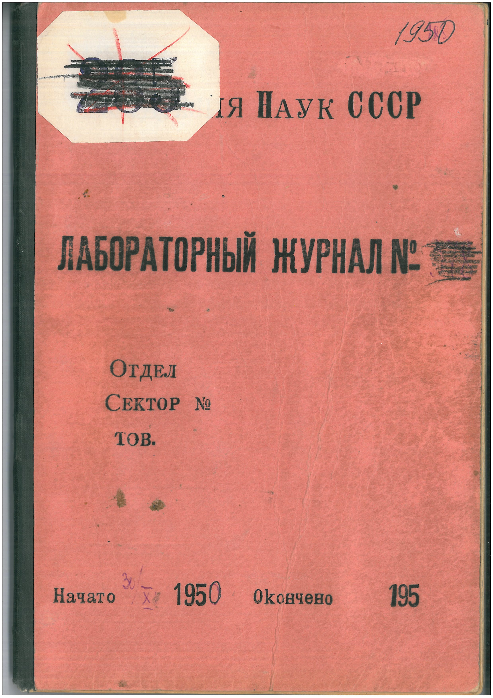
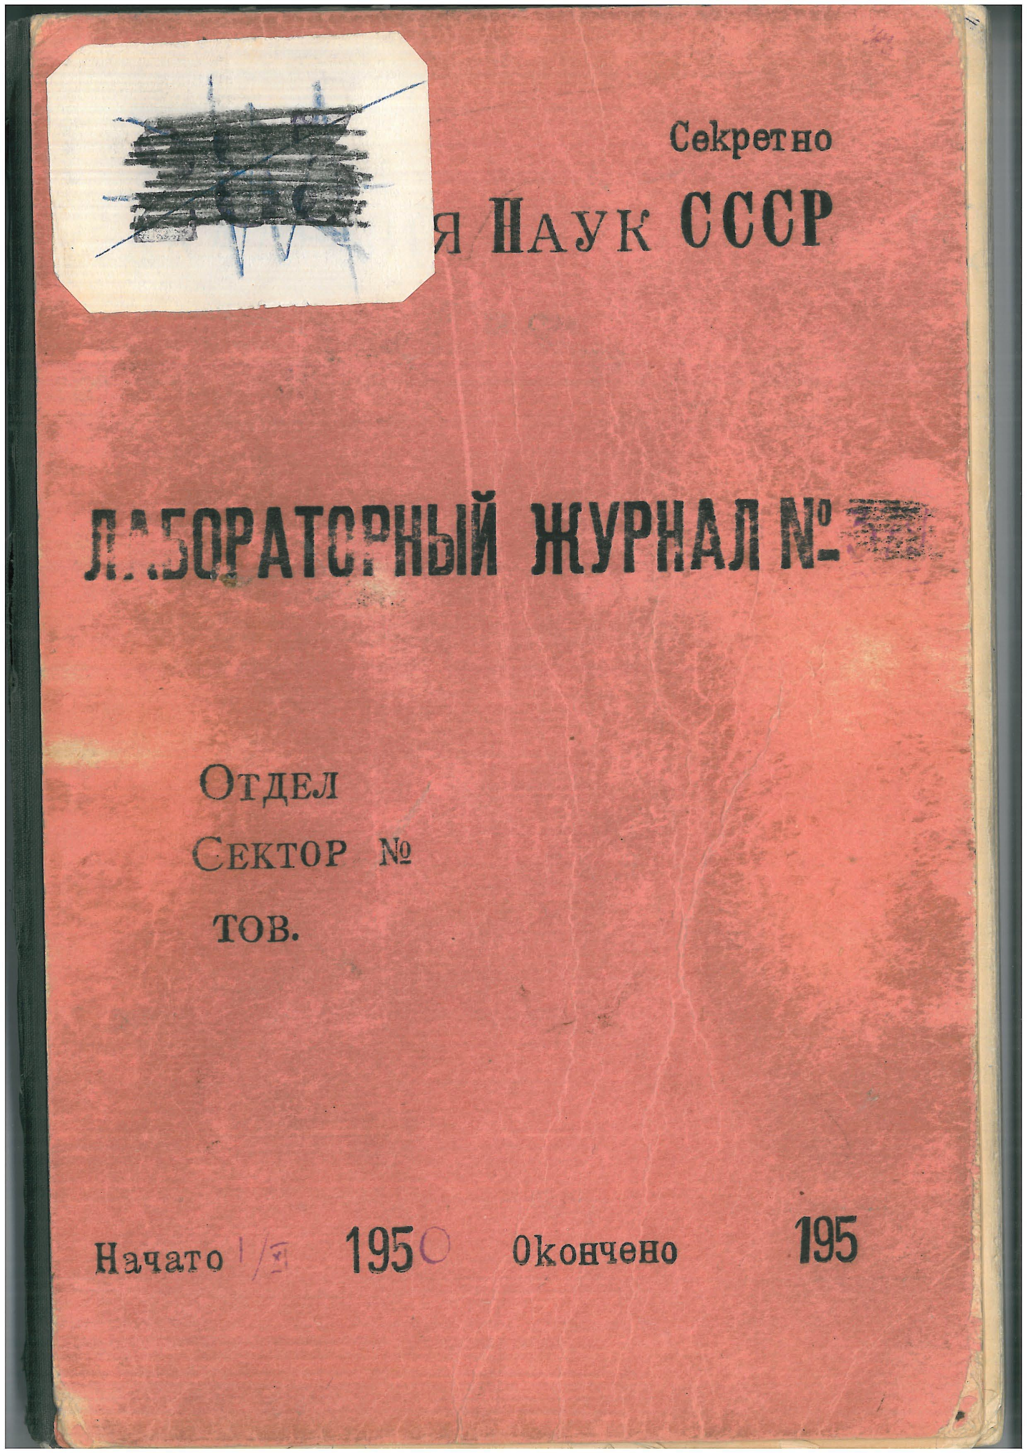
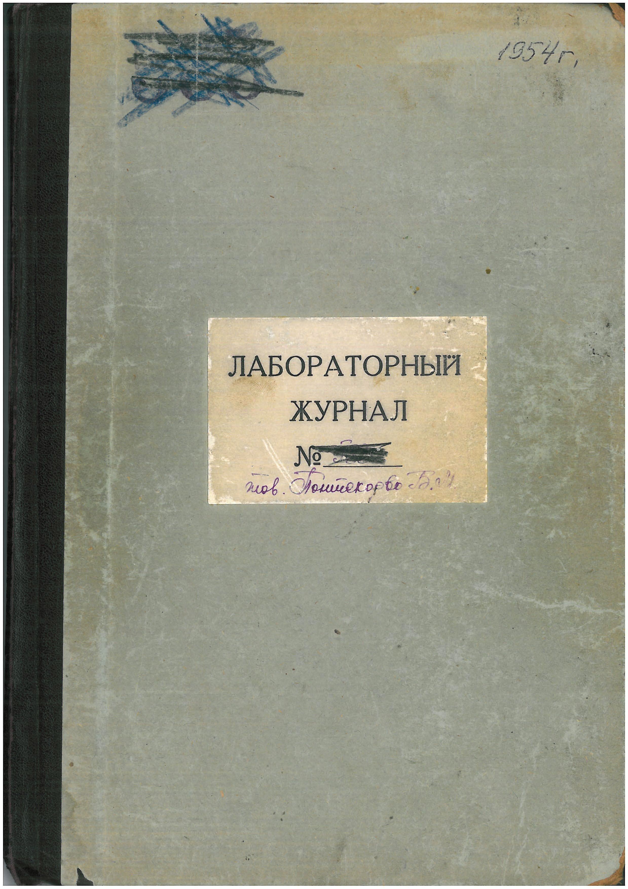
Study of Pontecorvo’s notebooks in Dubna in the 50’s

Slide 7
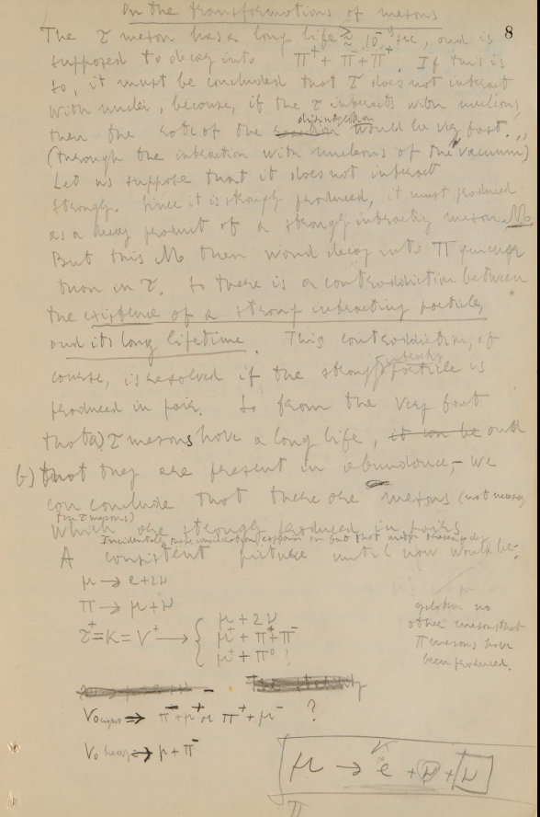
“The unpublished notebooks of Bruno Pontecorvo in Russia”,
Rino Castaldi, Gloria Spandre
INFN, Sezione di Pisa, Pisa, Italy and
“Centro B. Pontecorvo” Universita’ di Pisa.
“Il Nuovo Saggiatore”, vol31 / no5-6 / anno2015…
Two important Pontecorvo’s intuitions:
Strange particles are produced in pairs:
“So there is a contradiction between
the existence of a strong interacting particle,
and its long lifetime. This contradiction
of course, is resolved if the strong interacting
particle is produced in pair” (fig. 3)”.
The two neutrinos fro the muon decay are different:
“..he rewrites the decay as “μ → e + ν + ν“, highlighting the two neutrinos with different signs.Does Pontecorvo already suspect the different nature of the two neutrinos from the
muon decay process? The note comes twelve years before this hypothesis is experimentally
validated.”
Fig. 3 A very interesting page of the first notebook, page n. 8.Pontecorvo writes these annotations on November 1950.

Slide 8
Thanks to Gil Pontecorvo the third logbook has been
translated from Russian to English and we are starting studying its contents.
Gil has also provided the English version of of 3 papers
of Bruno not yet traslated:
-Total interaction cross sections of negative -mesons
with hydrogen in the interval of energies
from 140 up to 400 MeV*
B. Pontecorvo together with A.E.Ignatenko, A.I.Mukhin, E.B.Ozerov
Production of π⁰-mesons in hydrogen and deuterium by neutrons at
the energy of 400 MeV*
B.Pontecorvo together with G.I.Selivanov
Scattering of π⁺⁻mesons on hydrogen. II.
Discussion and interpretation of results*
B. Pontecorvo together with A.I.Mukhin

Slide 9
A book on the Pontercovo’s legacy?
The ambitious plan of this recollection of the Pontecorvo’s scientific work
would be to present in a single book his great scientific achievements
and intuitions obtained in the different labs where he has worked, i.e.
-The Institute of Physics of Rome University Rome led by E. Fermi;
-The Collège de France in Paris with Irene and Frederic Joliot Curie;
-The Tusla Lab, Oklaoma, USA
-The Chalk River Laboratories in Canada
-The Harwell Lab, UK
-The JINR Lab in Dubna, Russia
We would also aim at an evaluation of how much of the Pontecorvo’s
ideas are still alive and still leading the modern physics.
( the “Pontecorvo’s legacy”)

Slide 10
How to relaunch the collaboration between Pisa and JINR Dubna
G. Pontecorvo has been regularly invited in the last years to spend a month in Pisa for the translation and study of documents of Bruno.
Are there other “unknown” documents in Dubna about the scientific activity of Pontecorvo, and on on his teaching activity.
Are there other physicists in Dubna interested
in deepening this work and help in studying
those documents, including the 3-rd logbook?
We have a master physics student at the university of Pisa who will write his thesis on Pontecorvo:
can this student be hosted in Dubna lab and helped in his work of studying the Pontecorvo’s scientific story?

Slide 11
Dubna/ Pisa scientific collaboration
MeG experiment
ATLAS experiment
CDF experiment to be continued at FCC-CepC
Theory

Slide 12
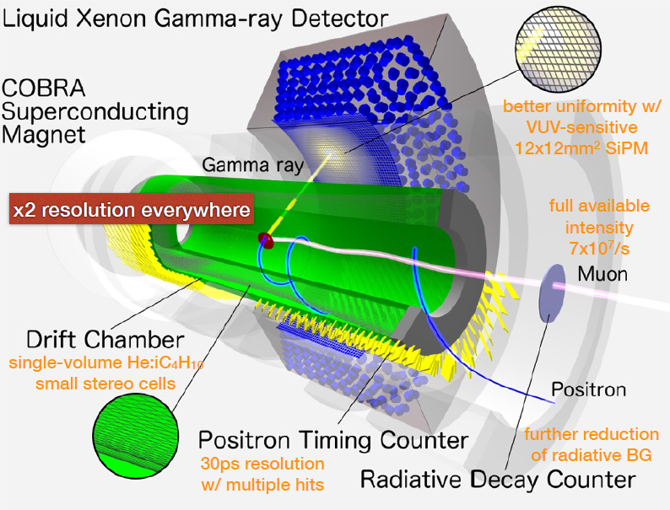

The MEG II experiment at PSI
-> e γ search with 6x10⁻¹⁴ sensitivity
(one order of magnitude better than MEG)
(tracking
energy
timing)

Slide 13
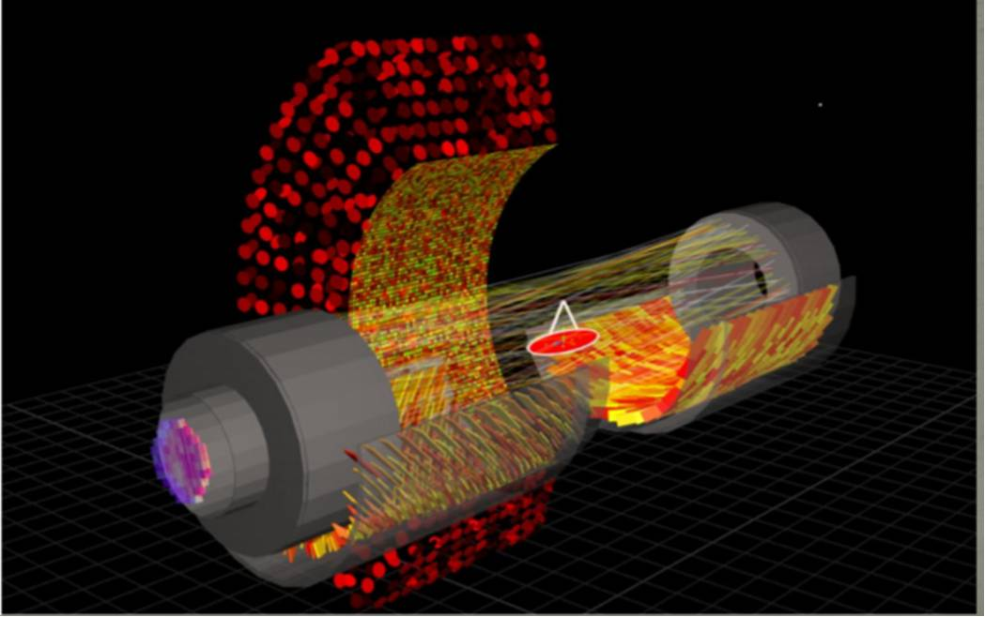
The Dubna participation
* V. Baranov
* V. Glagolev
* N. Khomutov
* A. Kolesnikov
* N. Kravchuk
* V. Krylov
* N. Kuchinski
* V. Malyshev
* A. Rozhdestvensky
* A. Simonenko
* I. Titkova
Drift chamber construction and operation
Participation in assembly of DAQ crates
DLNP (Dzhelepov Laboratory of Nuclear
Problems) computing cluster for MEG II
simulation (and for data analysis in the future)
Event Display of the experiment
We are really happy of collaborating with Dubna. We would very much welcome in the forthcoming years an exchange of personnel between Pisa and Dubna to accomplish the very demanding task of running and analysing the data of this very important experiment.

Slide 14
Long Standing Collaboration between Pisa and Dubna
in calorimetry at ATLAS and KLOE
Legacy of 20 years collaboration since last millenium fall….
Dubna collaborators visiting Pisa for the KLOE and ATLAS experiments
Solid expertise exchange in calorimeter techniques
Collaboration for setting-up the qualification test bench of the ATLAS PMTs for
hadron calorimeter readout (Tilecal)
Tilecal construction and continuing maintenance supported at CERN
by Pisa technicians under supervision of Dubna personnel.
Common interest in future calorimetry developments:
===> increase readout granularity of present Tilecal for HL-LHC without mechanical
modifications of the detector
===> high granularity Tilecal-like calorimeter for Future Circular Collider(s) (FCC)
People involved : Dubna :I. Minashwili, O. Solovyanov, G. Starcenko, ...
Pisa: V. Cavasinni, G. Chiarelli, G. Di Gregorio, S. Leone, C.Roda, …

Slide 15
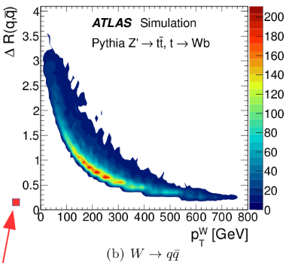
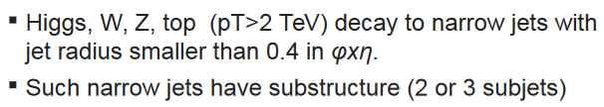
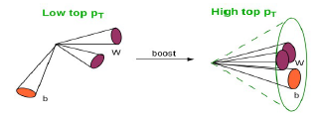
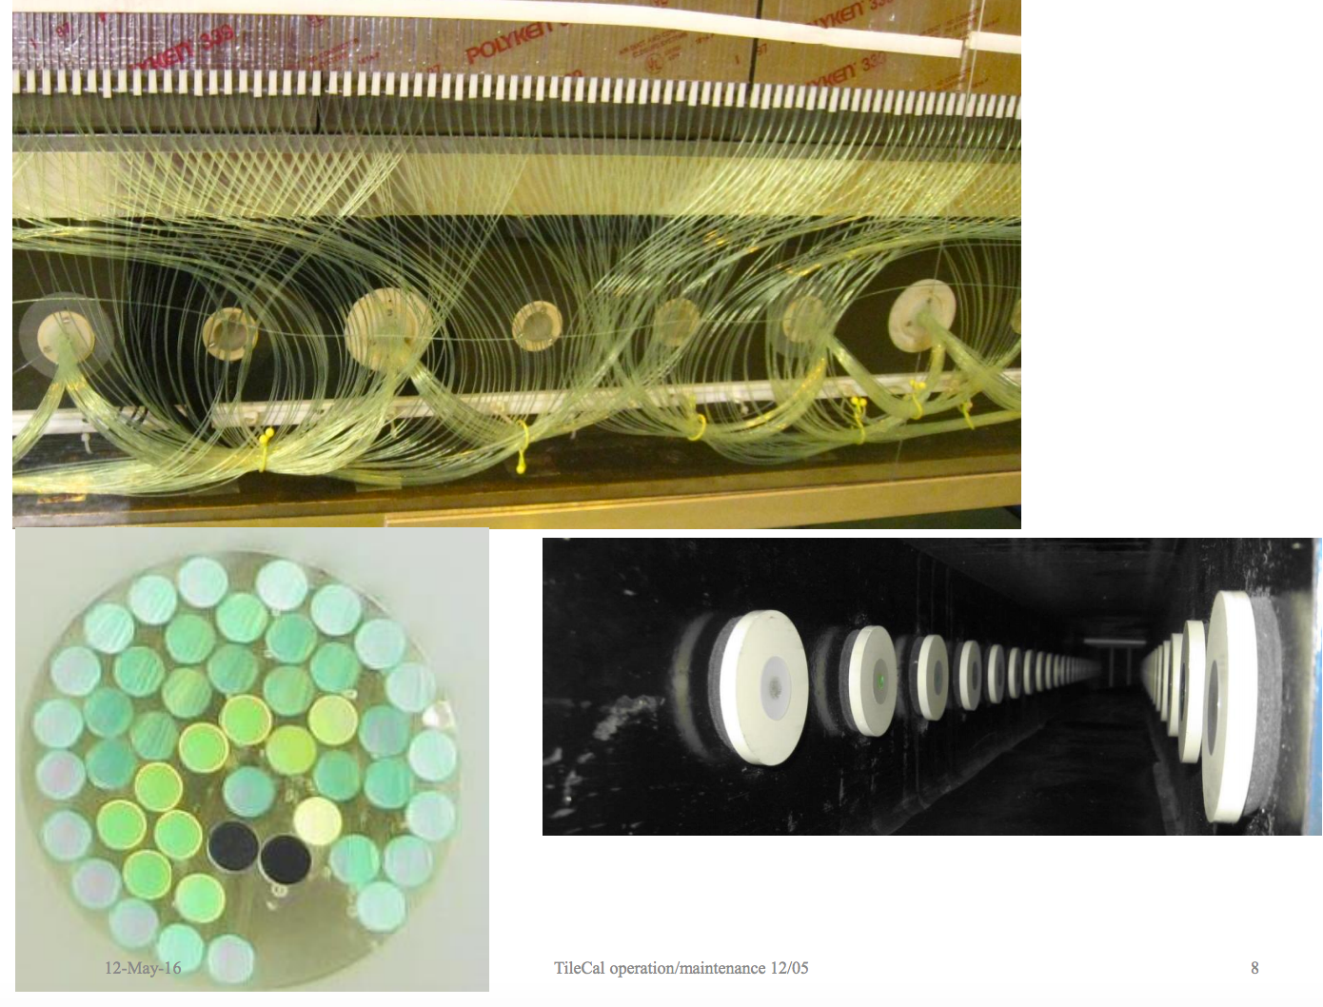
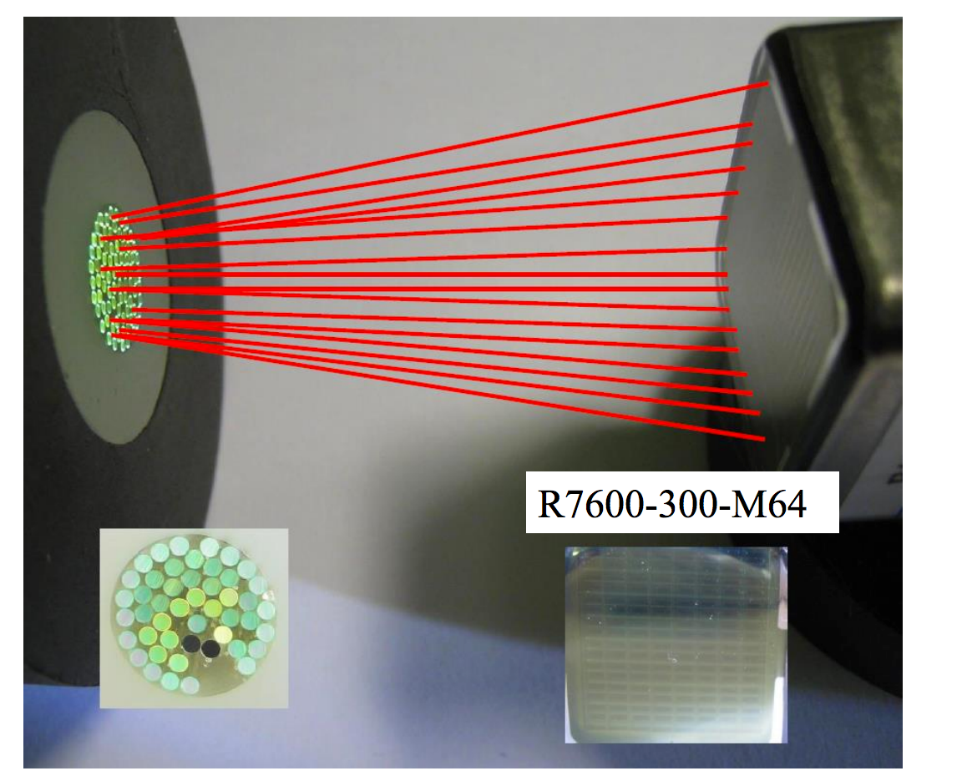
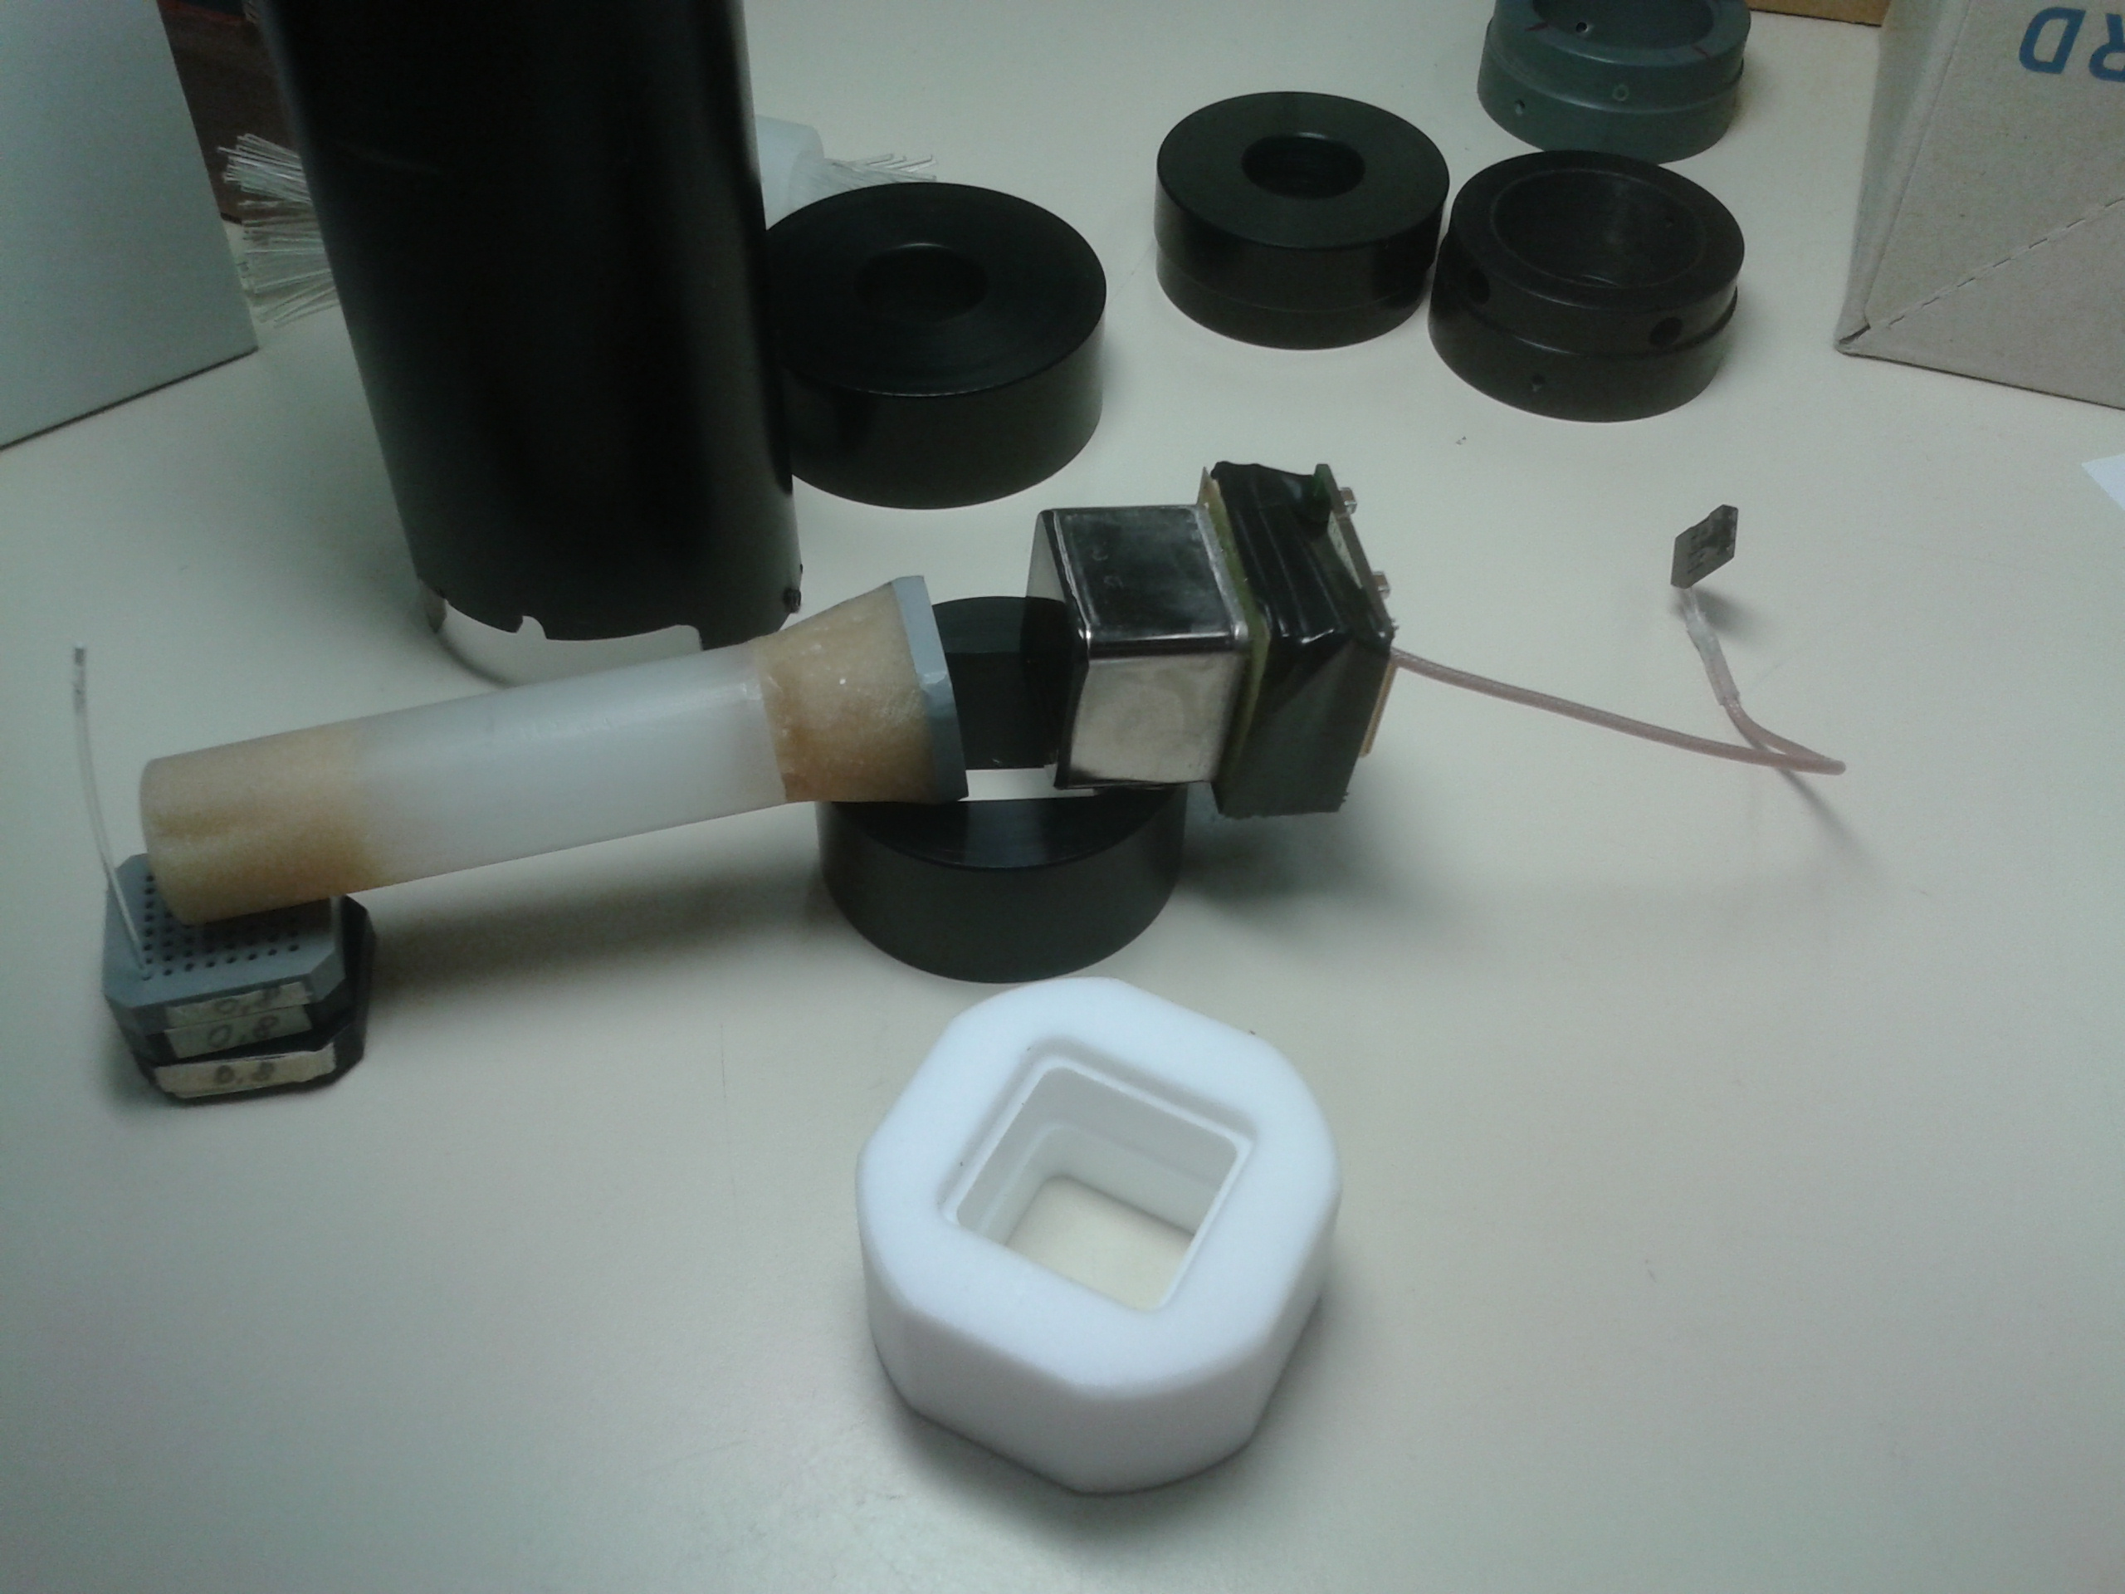
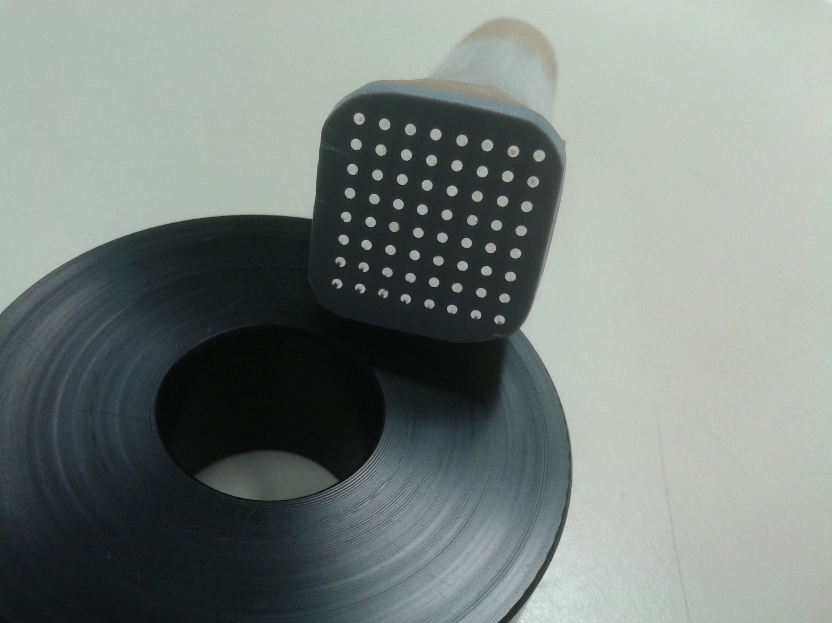
WHY TO INCREASE TILECAL READOUT GRANULARITY ?
Boosted jet physics will become more and more relevant from the HL-LHC era…….
Boosted jets
Present Tile cell size (0.1x0.1) is comparable with the typical
Separation between two quarks from high Pt W decays
Tilecal fiber bundle mapping
Fibers cells are random
mixed in bundles
need to sum light from individual fibers cell-by-cell in a configurable way
programmable sum of pixel readout devices (MA-PMT or SiPM)

Slide 16
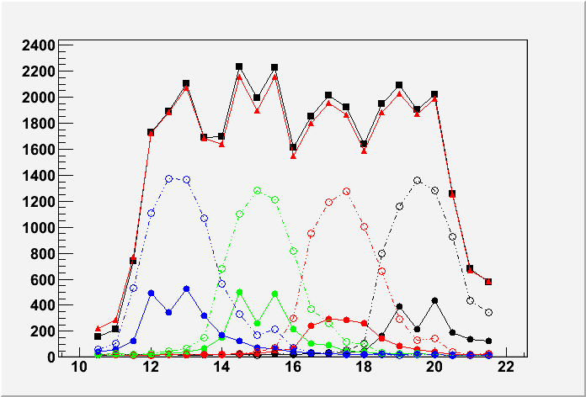
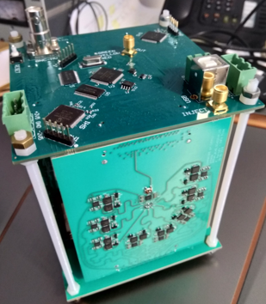
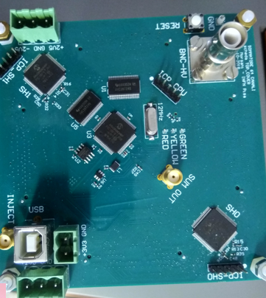
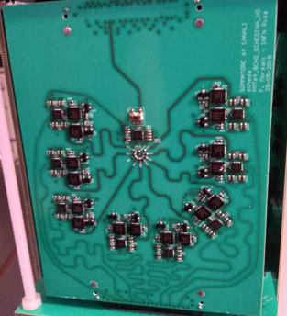
Programmable analog sum
of Multi-Anode PMTs (MAPMT) anode outputs
Pisa – Protvino – Dubna - CERN
Underlying idea:
a dynamically configurable readout of fiber light patterns on the MAPMT cathode
Analog sum of individual anode signal faster and cheaper w.r.t. single channel digital sum
Challenging goals to achieve:
- response linearity below 1% after channel sum with
analog switches and programmable fast amplifiers
- individual channel time alignment within 100 ps
Encouraging results from 1st prototype
(16 ch sum) with discrete IC components (Pisa)
Second prototype (64 ch sum) ready to be tested
Test on real calorimeter modules planned
(CERN-Protvino-Dubna)
Development in ASIC technique foreseen
for next years (Pisa)
Laser scan: red triangles, analog sum
black squares, digi sum of each channel
others, individual anode response

Slide 17
Looking even more forward:
IDEA: detector concept for FCCee/CepC include a 4π DR calorimeter for excellent energy resolution and particle ID
DR calorimeter
  ~ 130 x 10⁶ fibers (2 m each)
    50% clear (130,000 km)
    50% scintillating (130,000 km)
  Metal matrix
    Steel or copper capillary tubes (1 for each fiber) – 260,000 km
      1.9 mm diameter
      1.1 mm inner hole
  Construction
    Controlled gluing fixtures
Barrel calorimeter
End plug
calorimeter
More information: Franco.Bedeschi@pi.infn.it

Slide 18
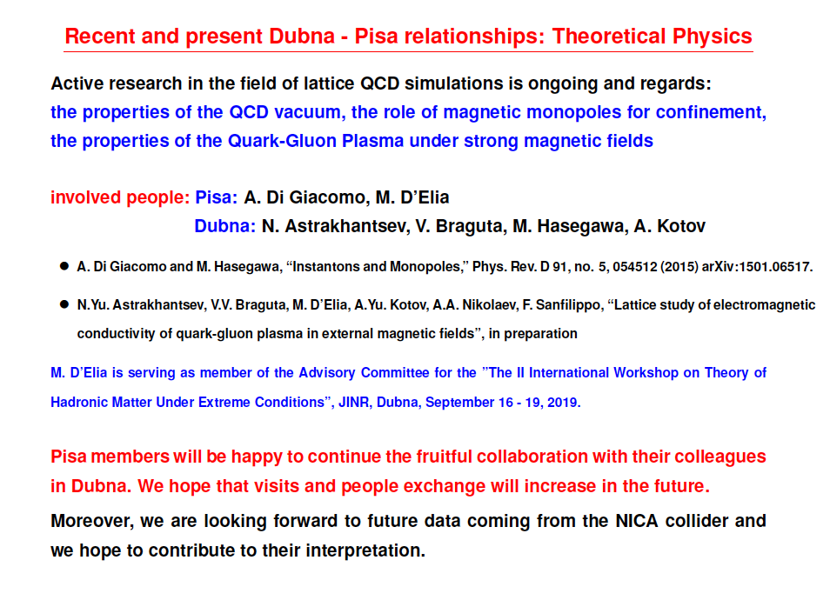
More information:massimo.delia@unipi.it

Slide 19
Thank you

Slide 20
Back up slides

Slide 21
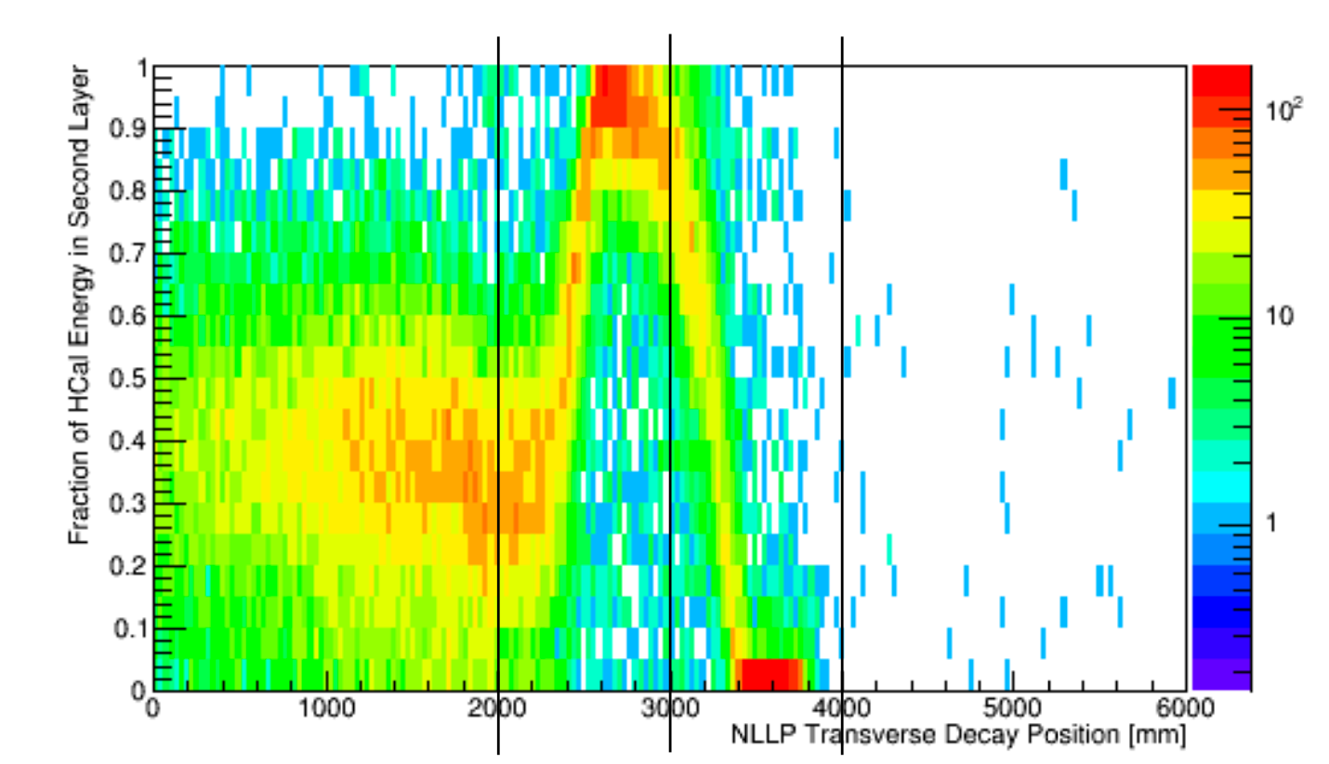
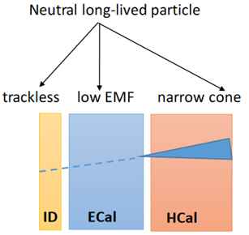
WHY TO INCREASE TILECAL READOUT GRANULARITY ?
Boosted jet physics will become more and more relevant from the HL-LHC era…….
Boosted jets
Present Tile cell size (0.1x0.1) is comparable with the typical
Separation between two quarks from high Pt W decays
Neutral Long lived particles
Fraction of energy deposit in the midle HCAL layer vs NLLP decay point

Slide 22
WHY TO INCREASE TILECAL READOUT GRANULARITY ?
Boosted jet physics will become more and more relevant from the HL-LHC era…….
Boosted jets
Present Tile cell size (0.1x0.1) is comparable with the typical
Separation between two quarks from high Pt W decays
Tilecal fiber bundle mapping
Fiberscells are random
mixe in bundles
need to sum light from individual fibers cell-by-cell in a configurabl e way
programmable sum of pixel readout devices (MA-PMT or SiPM)

Slide 23
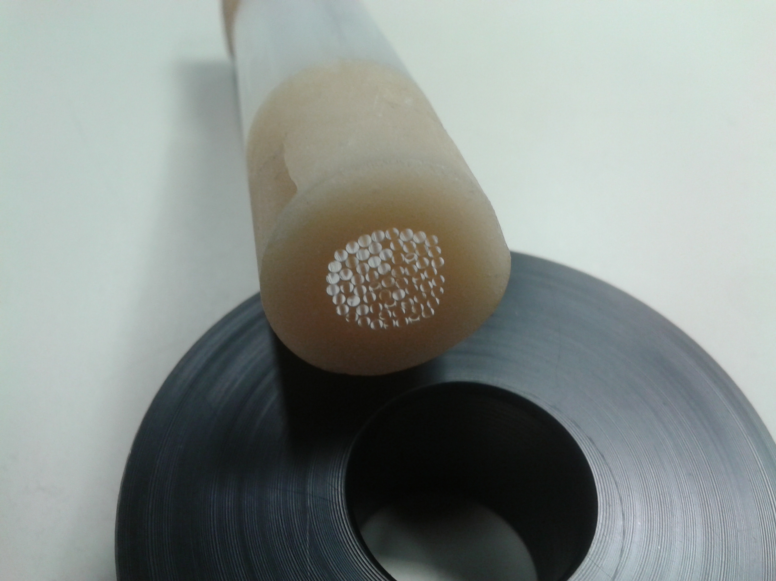
Tilecal fiber bundle mapping
OPTICS:
- Optimising interface fibre bundle-PMT :
“fibre light guide “ or “lens” or few mm air
- Being done in lab (⁹⁰Sr) and modules (¹³⁷ Cs)
Fibers from individual
cells are random mixed
in each readout bundle !
===> need to sum light from individual fibers cell-by-cell in a configurable way!
===> programmable sum of pixel readout devices (MA-PMT or SiPM)

