Slide 1
Simulations of direct photon yield at NICA energies
Dmitry Blau, NRC Kurchatov Institute
Notes:
<number>

Slide 2
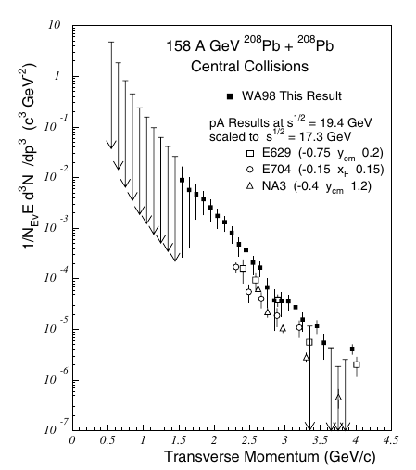
Motivation
Thanks to large electromagnetic calorimeter of MPD, it is possible to measure neutral mesons and photons in previously not-well-discovered region of √s_{NN}: 4-11 GeV.
Previous studies of AA collisions at low energies mainly concern WA98 experimental results (√s_{NN} = 17.2 GeV) which served as a reference for simulations, see:
M M Aggarwal et al, (WA98 Collaboration), Phys. Rev. Lett. 85, 3595 (2000)
B. Bäuchle and M. Bleicher, PhysRevC 81 (2010) 044904 – UrQMD simulations with hybrid approach
See also nice review by T. Peitzmann: “Direct photon production in heavy-ion reactions at SPS and RHIC” Pramana – J. Phys. V. 60 Issue 4 pp 651-661 (2003)
Notes:
<number>

Slide 3
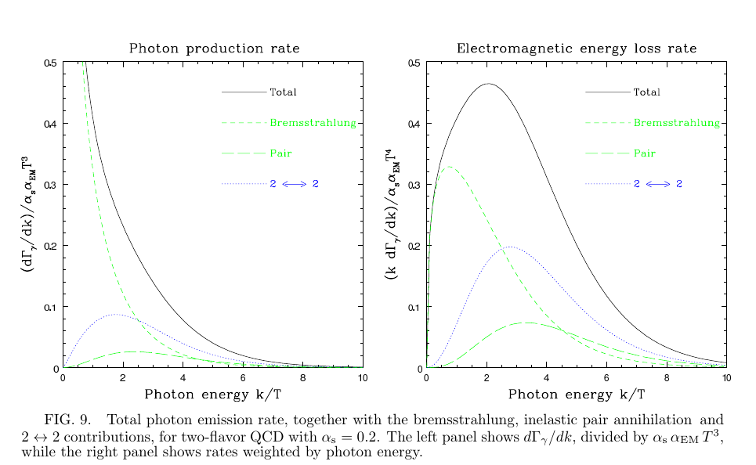
Ingredients: QGP rate
“Photon Emission from Quark-Gluon Plasma: Complete Leading Order Results”
Peter Arnold, Guy D. Moore, Laurence G. Yaffe JHEP 0112:009,2001
Notes:
<number>

Slide 4
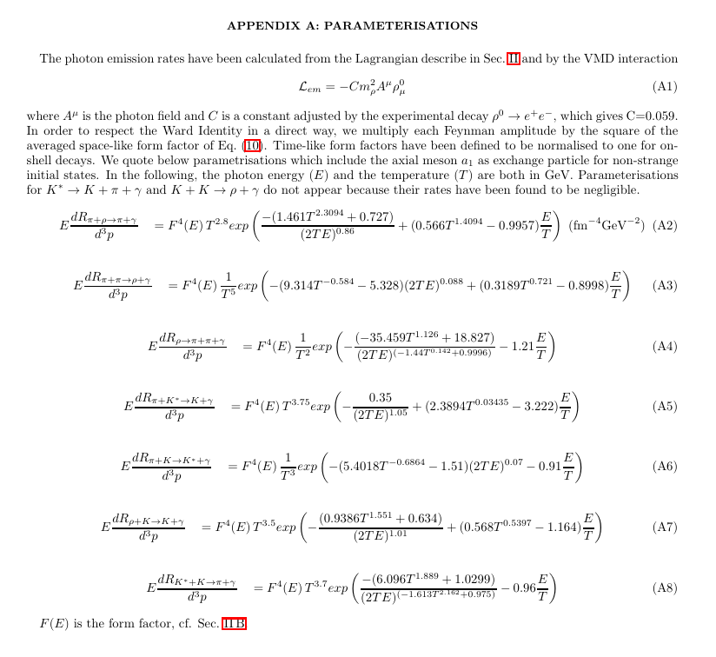
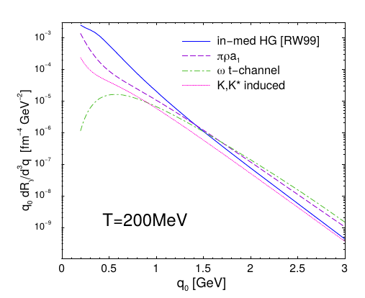
Ingredients: hadronic rate
“Hadronic Production of Thermal Photons”
Simon Turbide, Ralf Rapp, Charles Gale Phys.Rev.C69:014903,2004
Notes:
<number>

Slide 5
Ingredients: UrQMD model
UrQMD model version 3.4: http://uqrdm.org Prog. Part. Nucl. Phys. 41 (1998) 225-370
Hybrid approach: Phys. Rev. C 78 (2008) 044901
Options to choose EOS (cto 47): HG, Chiral or BM
At the moment we use Bag model option
M.Bleicher
Notes:
<number>

Slide 6
Strategy
Calculate π⁰ yield from UrQMD with hydro mode off (cto 45 0). Cut on unit rapidity: |y|<0.5
Calculate decay photon spectrum. Cut on unit rapidity: |y|<0.5
Calculate photon yield from UrQMD with hydro mode on (cto 45 1).
At each timestep calculate QGP and HG rates as integral over volume based on energy density, temperature and baryon mu and QGP fraction values from hydro (oschydro_event function in 1fluid.f).
Sum all timesteps.
To get overall direct photon yield one should sum thermal photons (QGP and HG calculated at previous step) and prompt photons (need pQCD calculation).
Notes:
<number>

Slide 7
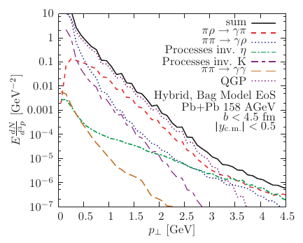
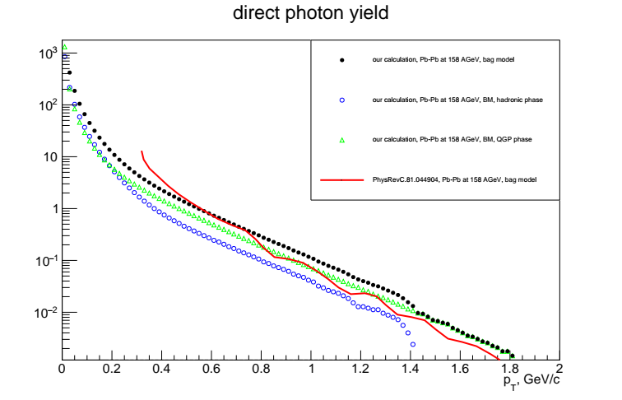
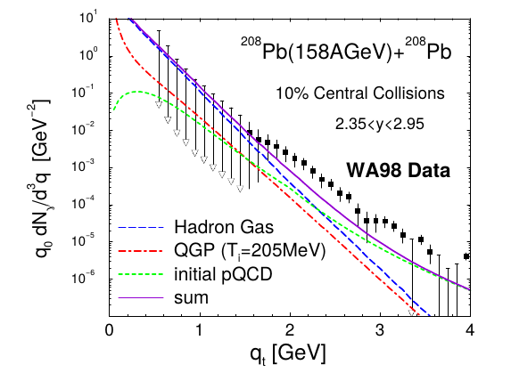
Comparisons at 158 AGeV
Compare yields from hadronic and QGP phases and overall yield with previous calculation from S. Turbide et al and M. Bleicher at al. Note: we have b=0.
“The calculations with the BM-EOS yield a different picture. Here, the dominant contribution comes from the QGP, whose emission magnitude is about two times higher than the combined contribution from all hadronic processes.”
B. Bauhle, M. Bleicher Phys.Rev.C81:044904,2010
S.Turbide, R. Rapp, C. Gale Phys.Rev.C69:014903,2004
Notes:
<number>

Slide 8
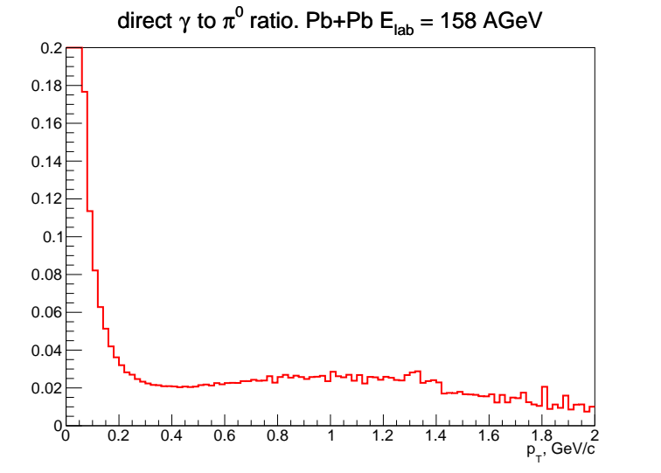
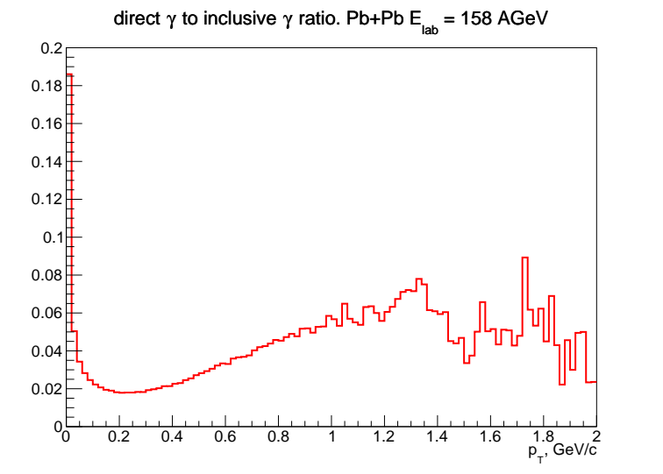
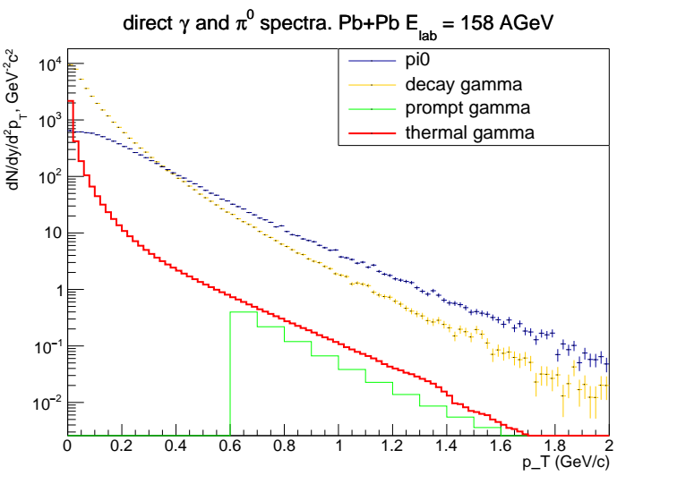
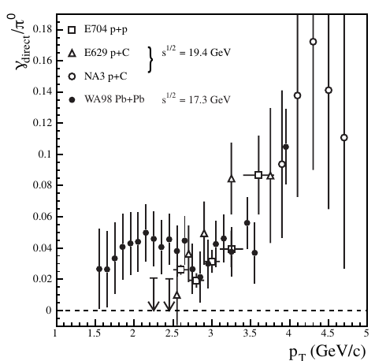
Comparisons at 158 AGeV
Compare direct γ to π⁰ ratio to WA98 results. Note: prompt photons (pQCD) not included yet in the ratio.
Only thermal direct photons now
D. Peresunko pQCD calculations with GRV94 structure functions
T. Peitzmann Pramana – J. Phys. V. 60 Issue 4 pp 651-661 (2003)
Notes:
<number>

Slide 9
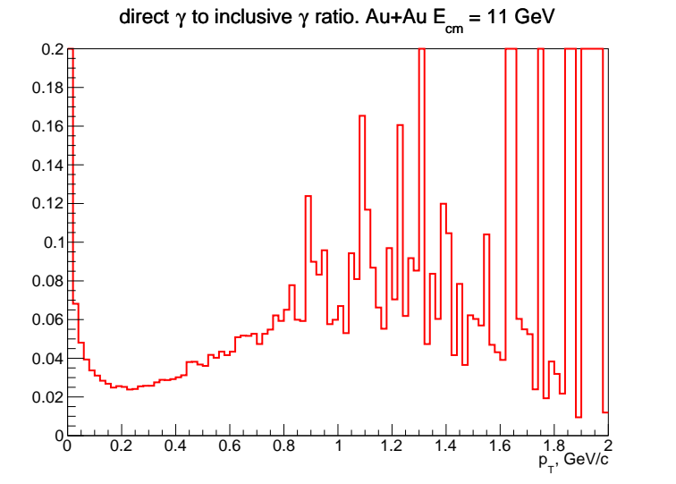
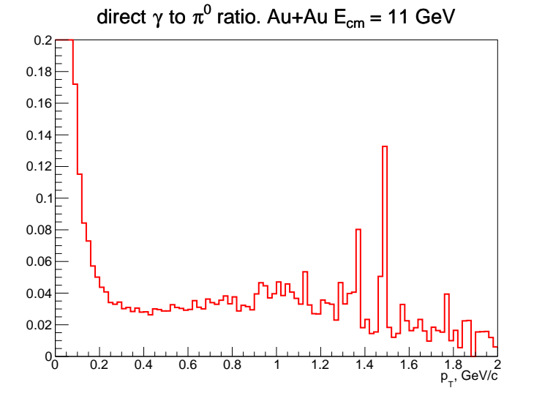
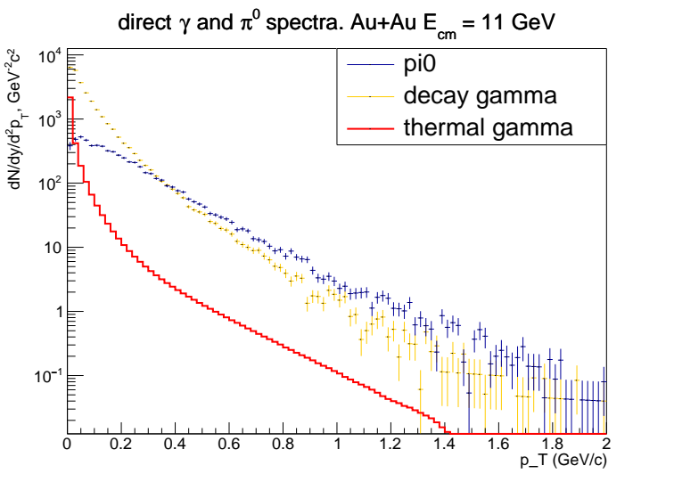
Calculations at √s_{NN} = 11 GeV
Calculate the same dependences at the top NICA energy
Only thermal direct photons now
Notes:
<number>

Slide 10
Conclusions
Direct photon simulations using UrQMD are performed and tested for SPS energy 158 AGeV, compared to WA98 results.
First results of direct gamma spectrum predictions at MPD top energy (√s_{NN} = 11 GeV) are obtained. Direct gamma to π⁰ and direct gamma to decay gamma ratios are calculated.
Todo:
Calculate pQCD fraction with JetPhox
Discuss with UrQMD team (still no contact established…)
Compare different EOS (preliminary studies show big difference!)
Compare with other models?
Notes:
<number>

Slide 11
Backup
Notes:
<number>

Slide 12
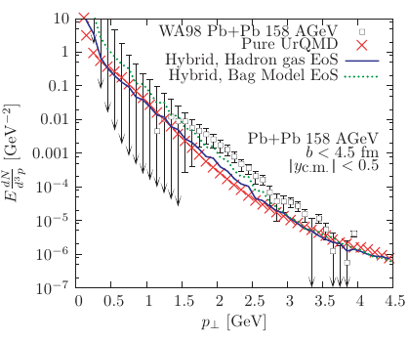
Different models
B. Bauhle, M. Bleicher Phys.Rev.C81:044904,2010
S.Turbide, R. Rapp, C. Gale Phys.Rev.C69:014903,2004

