Slide 1
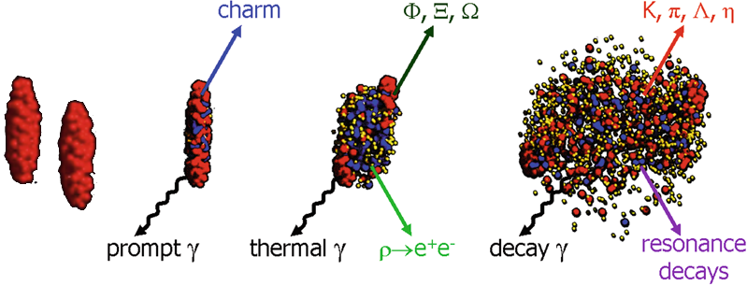
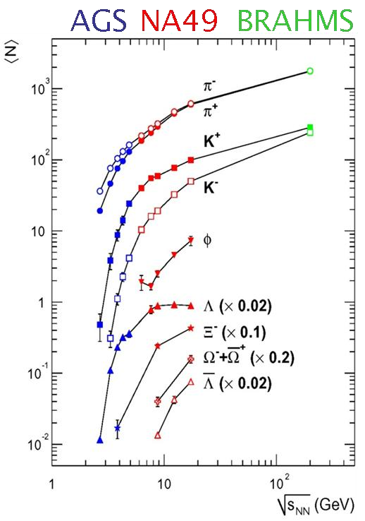
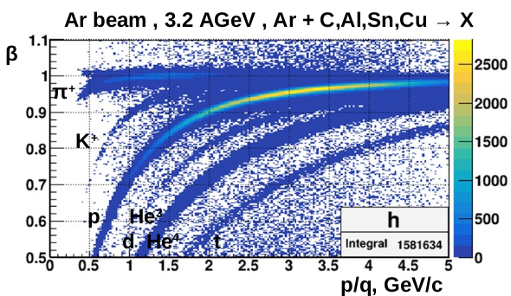
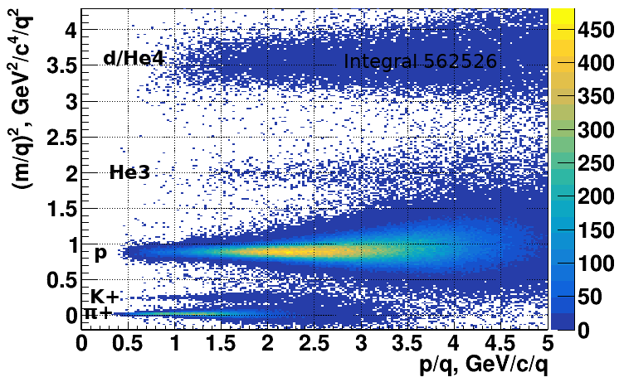
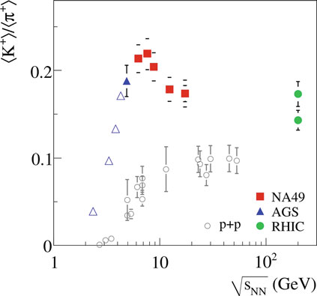
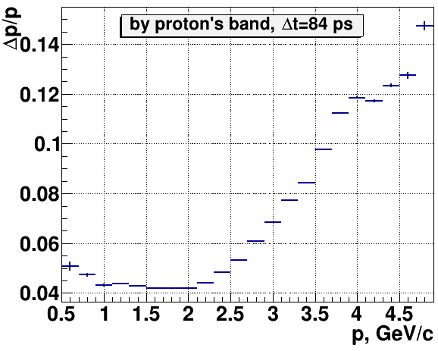
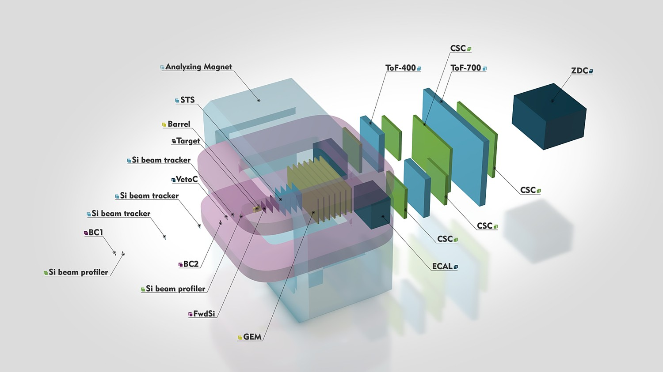
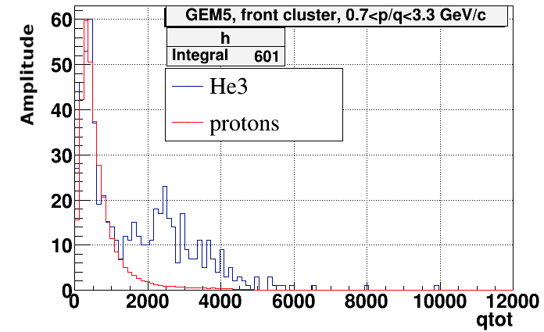
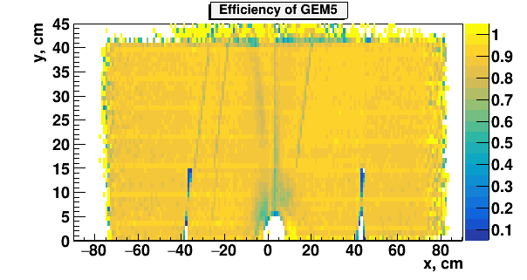
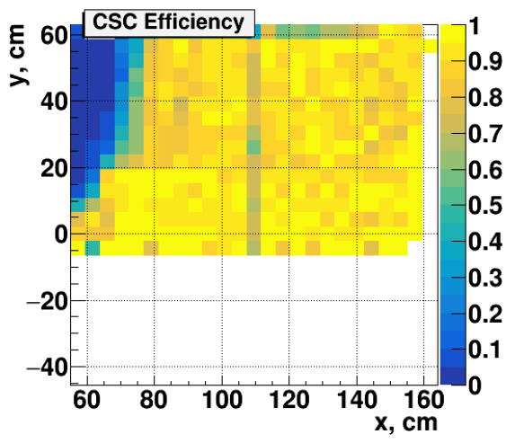
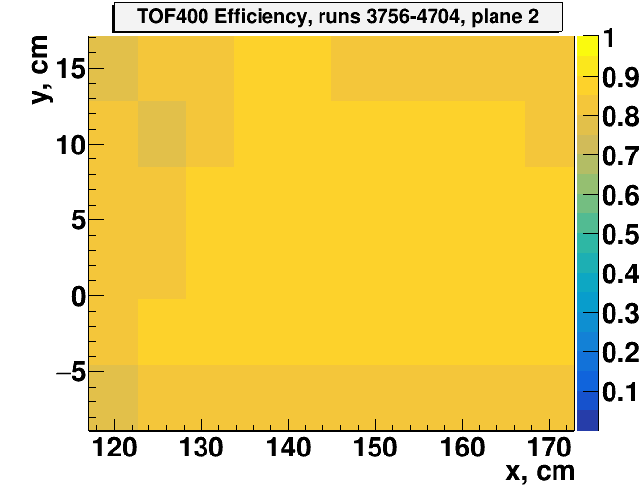
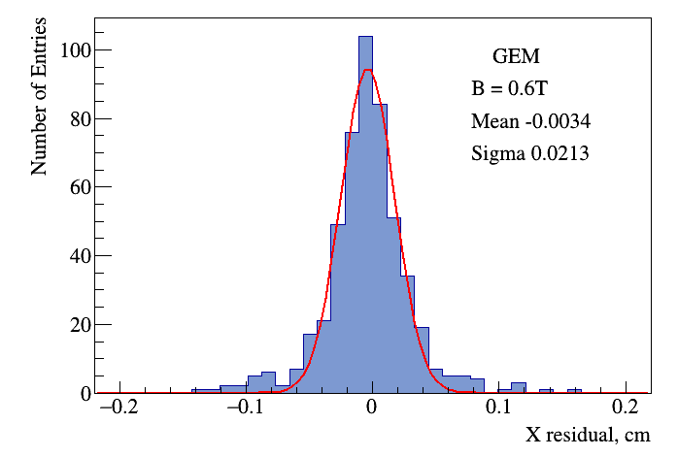
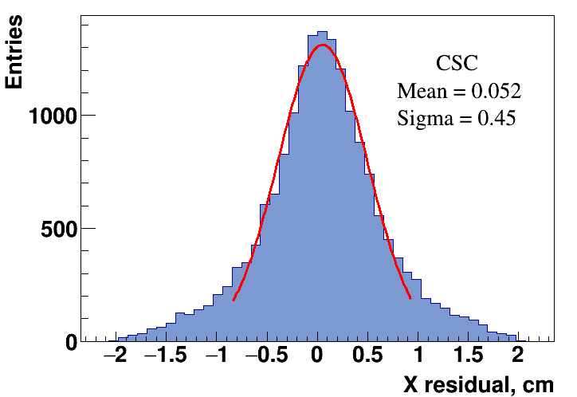
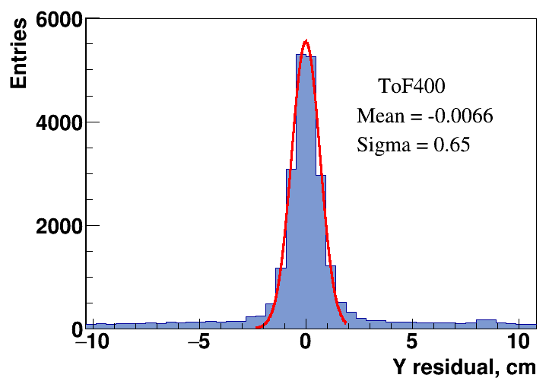
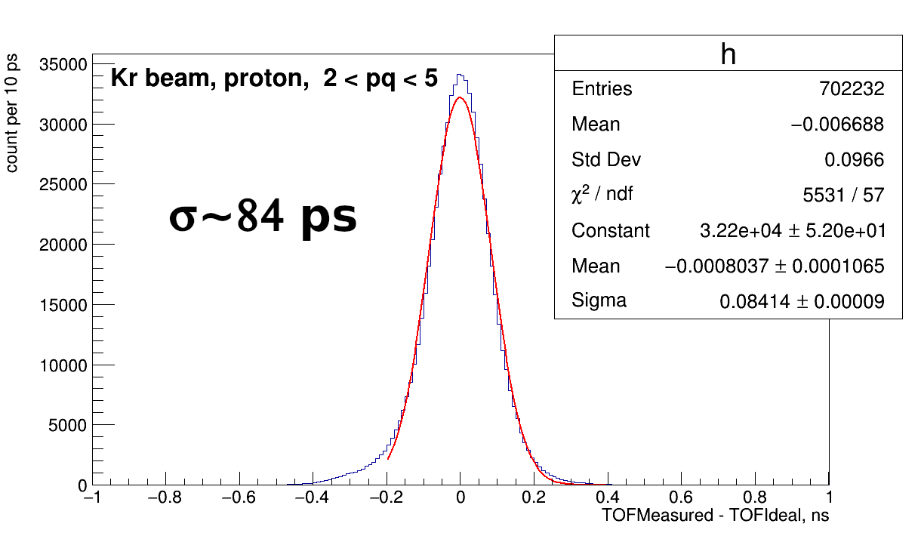
Analysis of K⁺/π⁺ at BM@N for argon run
Vasilii Plotnikov
(BM@N Experiment, JINR, Dubna, Russia)
vplotnikov@jinr.ru
Heavy-Ion Collision
Time of Flight method
Charged particle identification was performed using the Time of Flight method.
$$m=p\sqrt{\frac{1}{β2}−1},β=\frac{L}{ct},$$
m – mass of the particle, p – momentum of the particle, L – length of particle track,
c – speed of light, t – time of flight.
On full Ar data, β vs p/q plot bands for π⁺, K ⁺, p, He³, d/He⁴, t are clearly visible.
We used m² vs p distribution to determine momentum resolution in our experiment.
$$\frac{dm2}{m2}=\sqrt{{\left(\frac{dp}{p}\right)}^{2}+{\left(\frac{2}{1−β2}\right)}^{2}{\left(\frac{dt}{t}\right)}^{2}+{\left(\frac{2}{1−β2}\right)}^{2}{\left(\frac{dL}{L}\right)}^{2}}.$$
For the low momentum, m² uncertainty is determined
by the particle momentum uncertainty, and for the high
momentum, it is determined by the time of flight due to
Lorentz factor.
The relative uncertainty of the track length is
few times less than the relative uncertainty of
the time so we can neglect it.
He³ can be separated from the background
with Z=1 using cluster amplitudes in GEMs.
The same technique can be used to separate
He⁴ from d.
Efficiencies for GEMs and TOF400 from all Ar data (~600 runs) are stable enough.
Efficiency for CSC from 10 “good” runs.
m² distribution is used to extract the number of K⁺ and π⁺.
Two sources of background are taken into account while extracting the number of K⁺: from π⁺ (gaus fit) and from misidentified tracks (p0 fit).
About 2∙10³ K⁺ and 10⁵ π⁺ were identified in full Ar data.
CSC test outer tracker plane shows its good usability. Technique of CSC assembly is set up. CSC detector description is implemented into the reconstruction chain of the BM@N experiment.
Matching of GEM central tracker, CSC outer tracker and TOF400 was successfully performed.
During the analysis process, the TOF400 calibration was improved and high time resolution was achieved.
As a result, good quality of charged particles identification was obtained and despite its smallness, K⁺ were splitted from π⁺.
Such good CSC performance is a reason to use more planes in the next run.
In the nearest future, we plan to include ZDC data to the present analysis to have the opportunity to choose events by centrality.
At √s energies of 2-4.5 GeV, nucleon densities in a collision
zone exceed the saturation density by the factor of 3-4.
At these densities, nucleons start to overlap and form a fireball.
Hadrons with strangeness are early produced in the collision
and not presented in the initial state of two colliding nuclei.
The K⁺/π⁺ ratio shows a rapid rise at energy increasing with
a maximum (“horn”) at incident √s energy of ∼8 GeV and
a saturation at SPS energies.
The “horn” has been interpreted as a possible indication for
the observation of deconfinement in the fireball.
Confirmation of peak-like structure in the K⁺/π⁺ ratio by an
independent experiment would certainly stir up the debate on a possible signature for the deconfinement phase transition.
We focus on:
Gas Electron Multiplier (GEM) system:
To measure momenta of a charged particle
and reconstruct the interaction point.
Time of Flight (TOF400) system – time
of flight of a charged particle.
Cathode Strip Chamber (CSC): filter fake
tracks.
Data were taken in March 2018.
Pitch of GEM strips is 800 μm for vertical strips and strips tilted by 15˚.
The GEM plane thickness is 9 mm. With one drift
gap, two acceleration gaps and one induction gap.
We need to take into account Lorenz shift (variates from 0.9 to 1.5 mm from plane to plane) to reconstruct hits in GEM planes due to the magnet field ~0.5 T.
Aligned by using straight GEM tracks with only
X, Y, Z shifts (without rotation).
Two zones which are electrically separated to get
less fake hits.
Pitch of CSC strips equal 2.5 mm for vertical strips
and strips tilted by 15˚.
TOF400 aligned by using straight GEM tracks with CSC hit with X, Y, Z shifts.
Vertical strips pitch of 1.25 cm, Y-coordinate determined by left-right signal difference.
Experimental Setup
Full detector setup for year 2021
Detector setup for argon run
Efficiencies of GEM, CSC, TOF400
Matching GEM-CSC-TOF400
GEM features
K⁺/π⁺
CSC features
Summary & Outlook
TOF400 features
Time resolution
1
Notes:
1

