Slide 1



The study of b-s anomaly decays in covariant quark model
Issadykov Aidos
BLTP, JINR, DUBNA
18.07-30.07

Slide 2
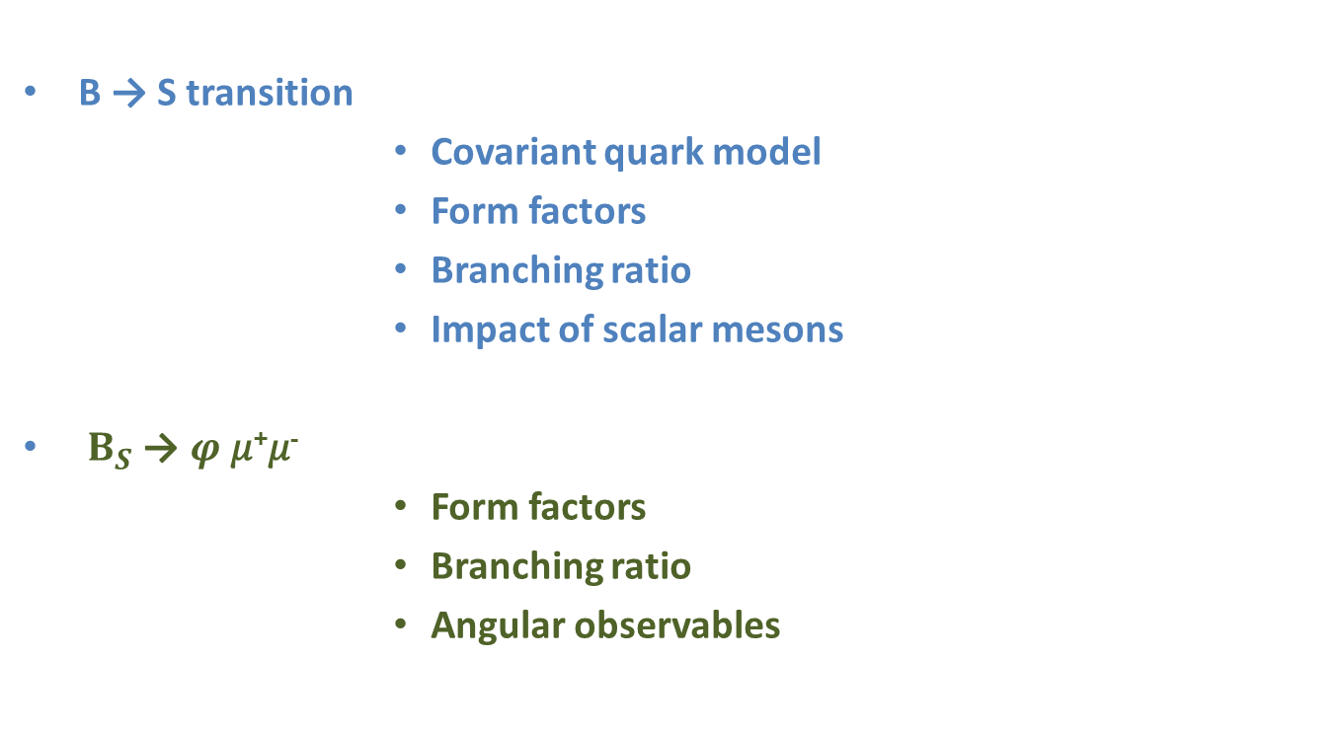
outline:
В → S transition
          Covariant quark model
          Form factors
          Branching ratio
          Impact of scalar mesons
$B_{S}$→ $φ$𝜇⁺𝜇⁻
          Form factors
          Branching ratio
          Angular observables

Slide 3
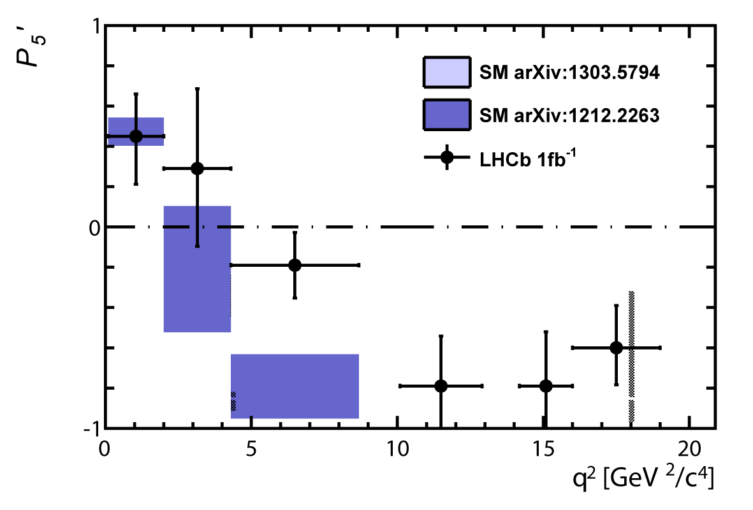
THE LHCB COLLABORATION REPORT
3.7 σ
~ 3 σ

Slide 4
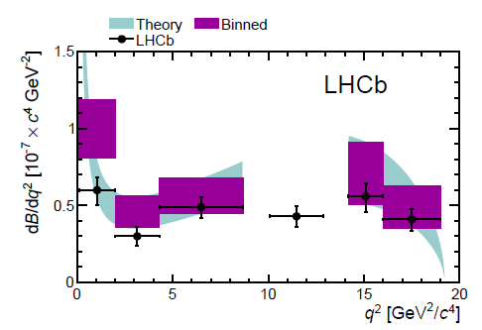

В→K*(K𝜋) 𝜇⁺𝜇⁻
В→K*(K𝜋)𝜇⁺𝜇⁻
Exp/SM = 3.7σ
New Physics ??
*

Slide 5
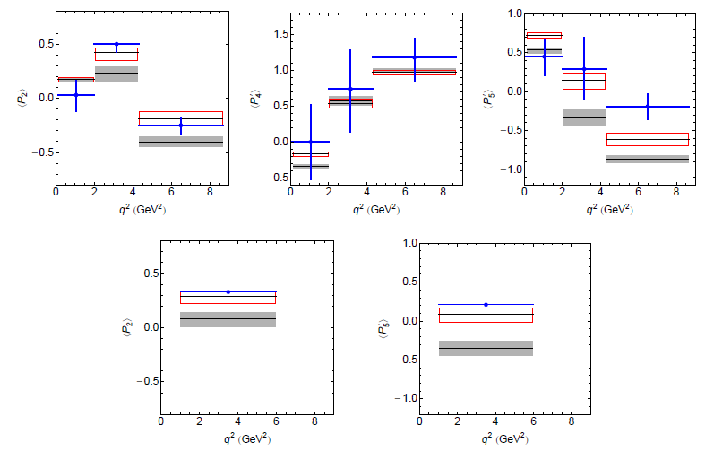
В→K*(892)
*

Slide 6
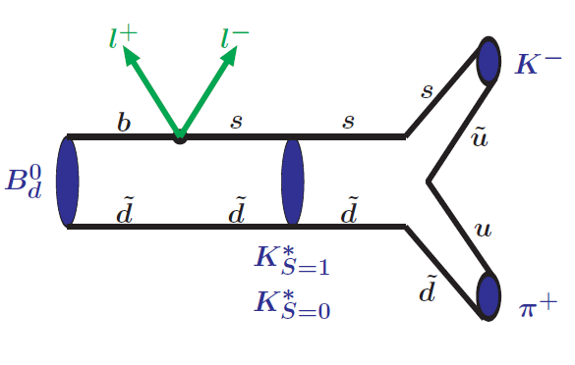
В→K*(→ K𝜋) + ℓ⁺ℓ⁻

Slide 7
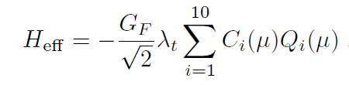

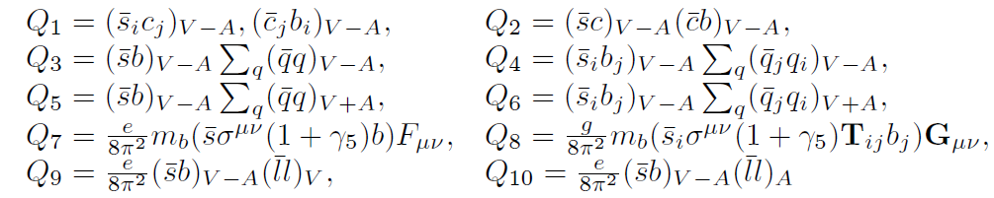
b → s ℓ⁺ ℓ⁻

Slide 8
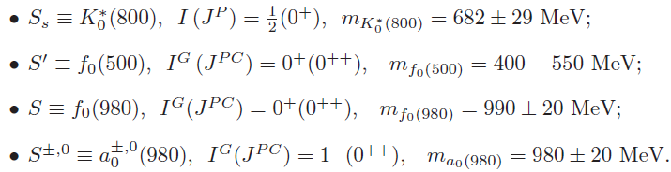
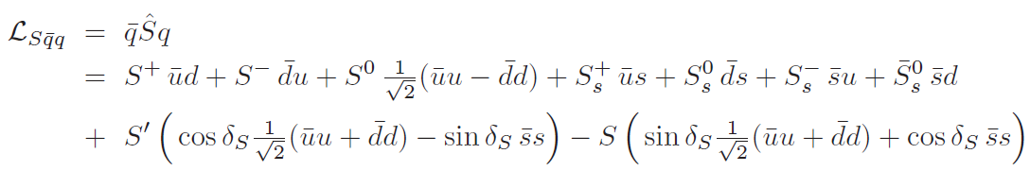
SCALAR MESONS
*http://pdglive.lbl.gov/

Slide 9



COVARIANT QUARK MODEL

Slide 10

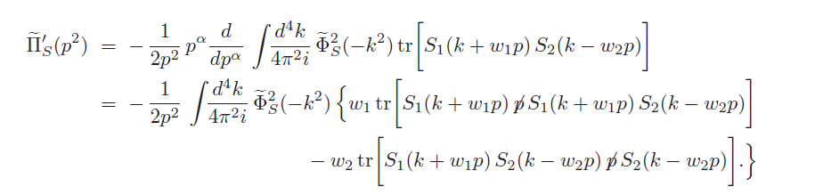
COMPOSITENESS CONDITION IN COVARIANT QUARK MODEL

Slide 11

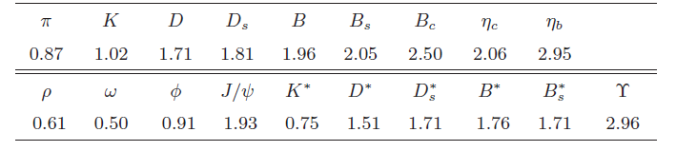
MODEL PARAMETERS
The fitted values of the size parameter Λ in GeV

Slide 12
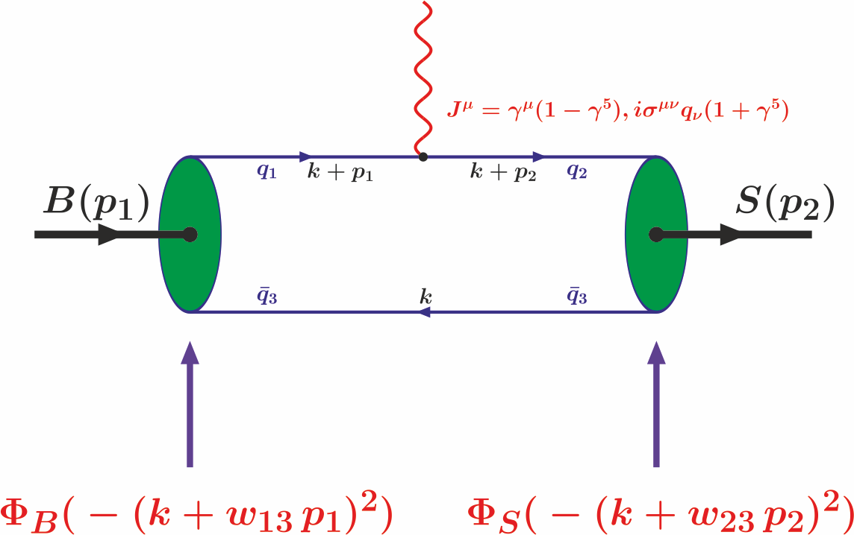
B-S TRANSITION DIAGRAM

Slide 13




B-S TRANSITION MATRIX ELEMENTS

Slide 14
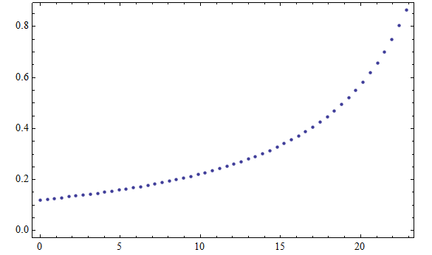
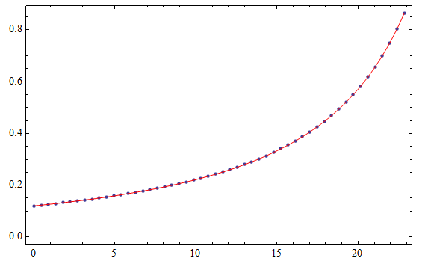

FORM FACTORS OF B-S TRANSITION

Slide 15
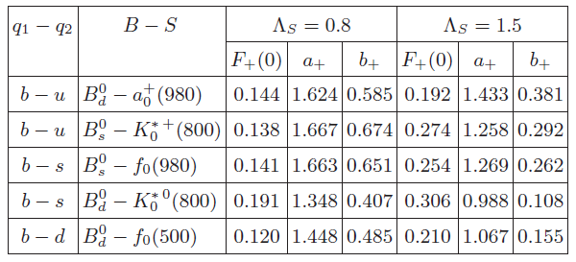
FORM FACTORS OF B-S TRANSITION

Slide 16
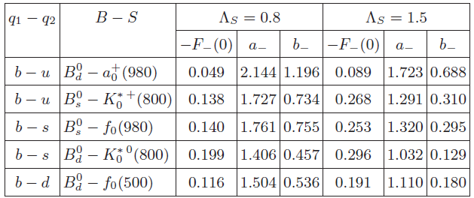
FORM FACTORS OF B-S TRANSITION

Slide 17
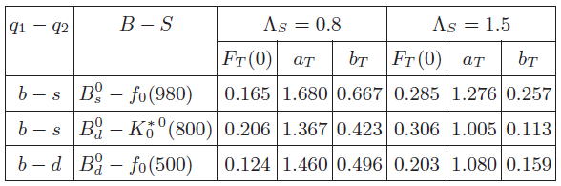
FORM FACTORS OF B-S TRANSITION

Slide 18
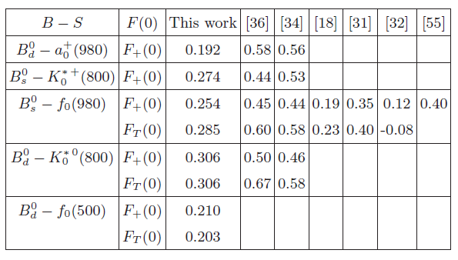
FORM FACTORS OF B-S TRANSITION

Slide 19
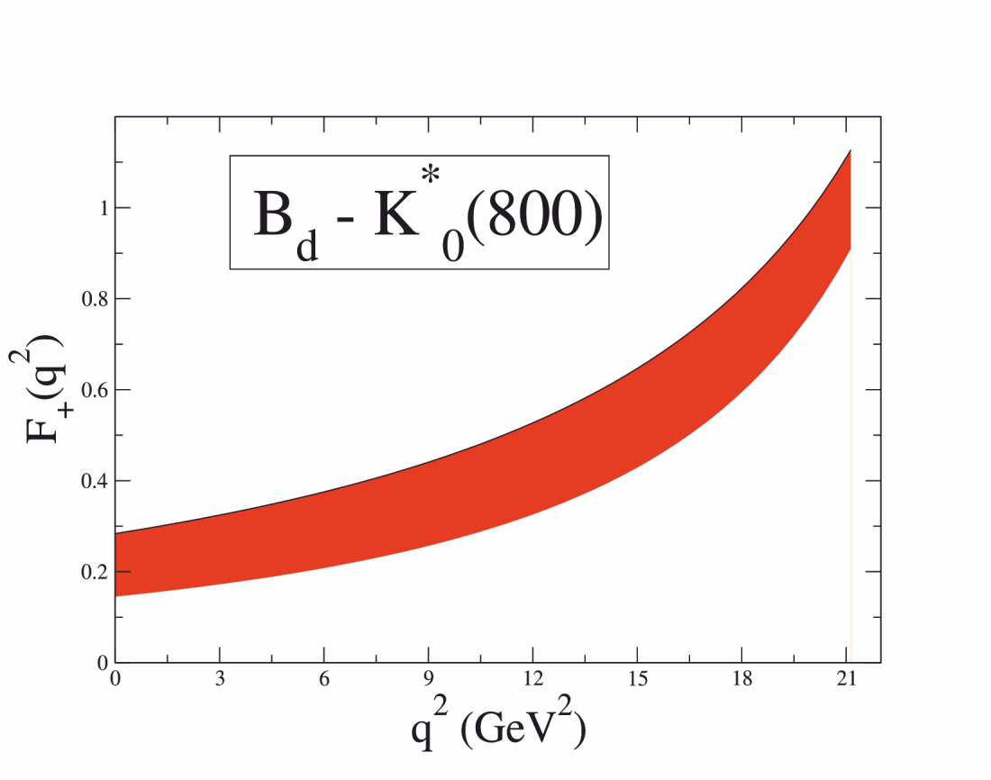
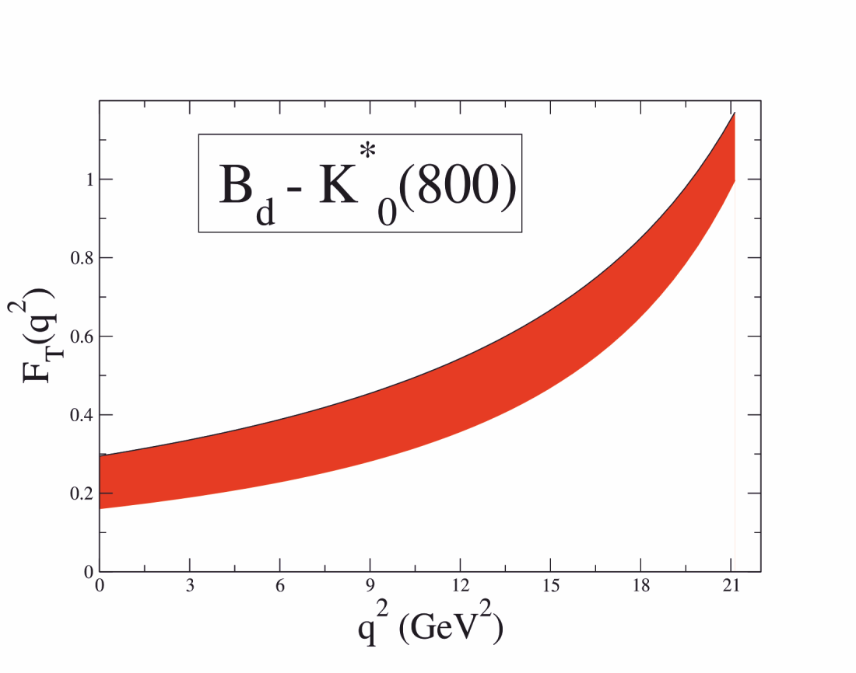
FORM FACTORS OF $B_{d}→{K_{0}}_{}^{∗}$

Slide 20
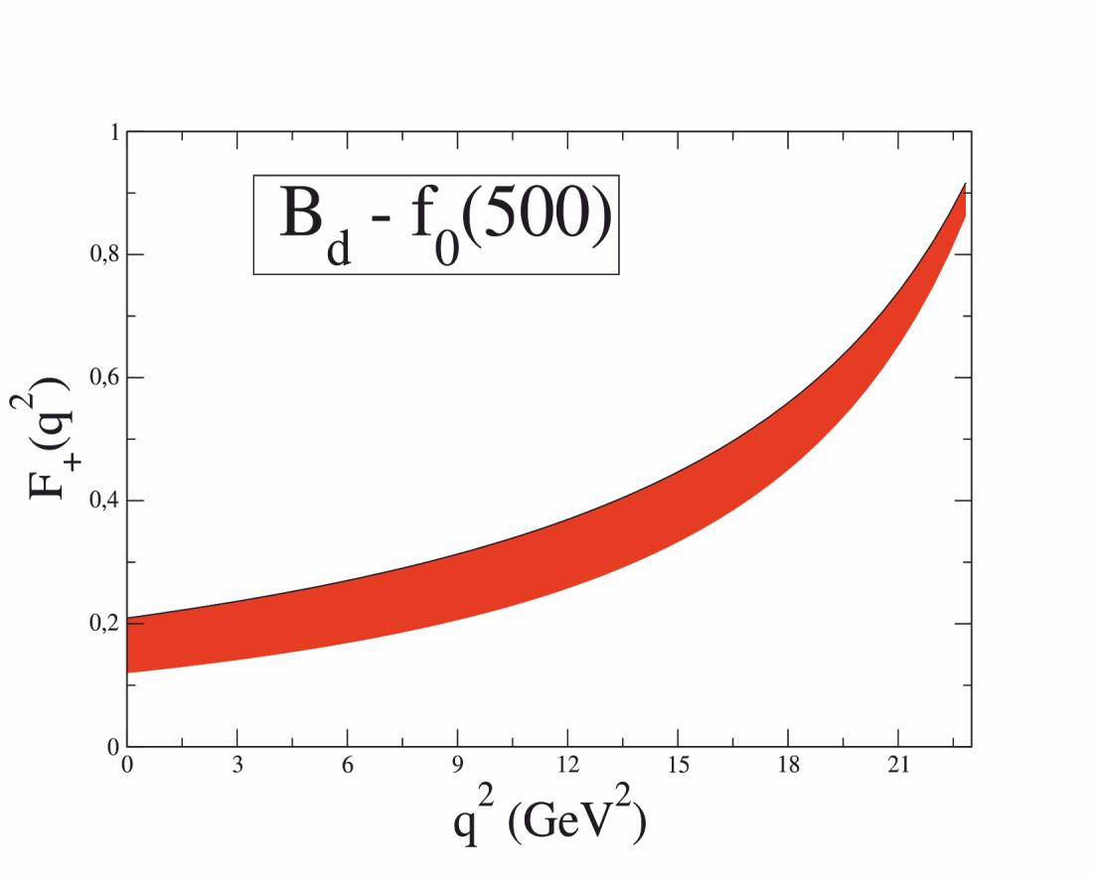
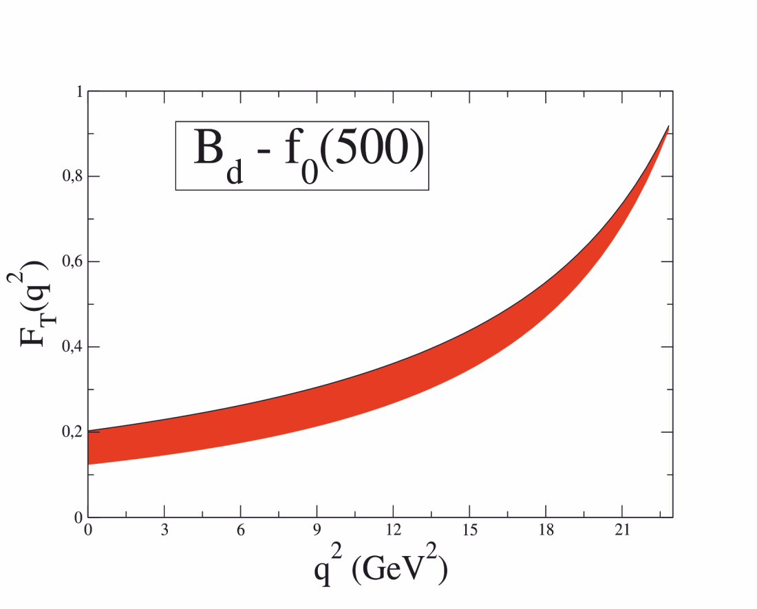
FORM FACTORS OF $B_{d}→f_{0}(500)$

Slide 21
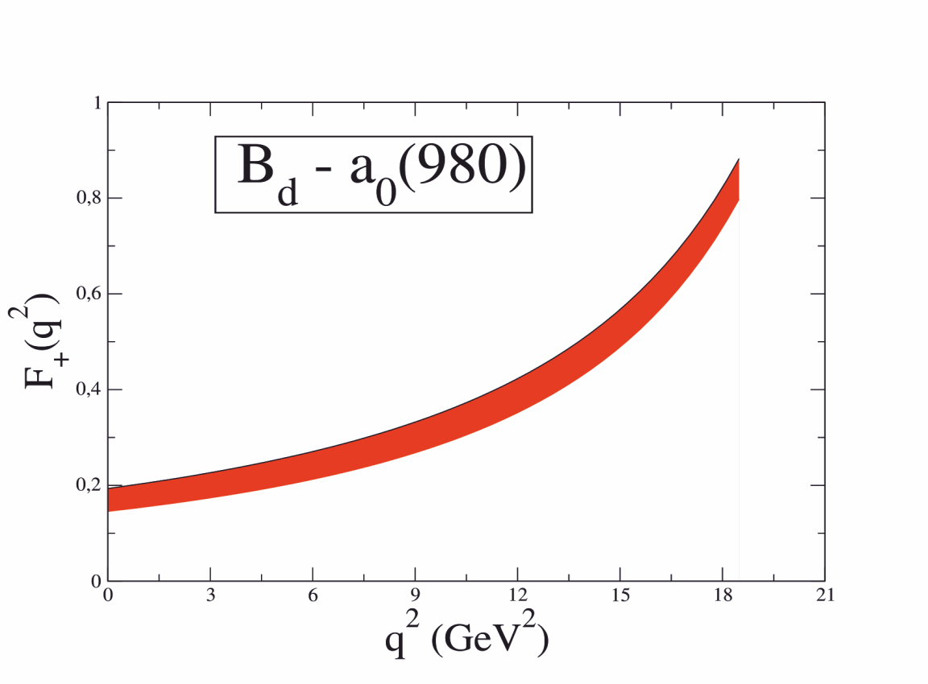
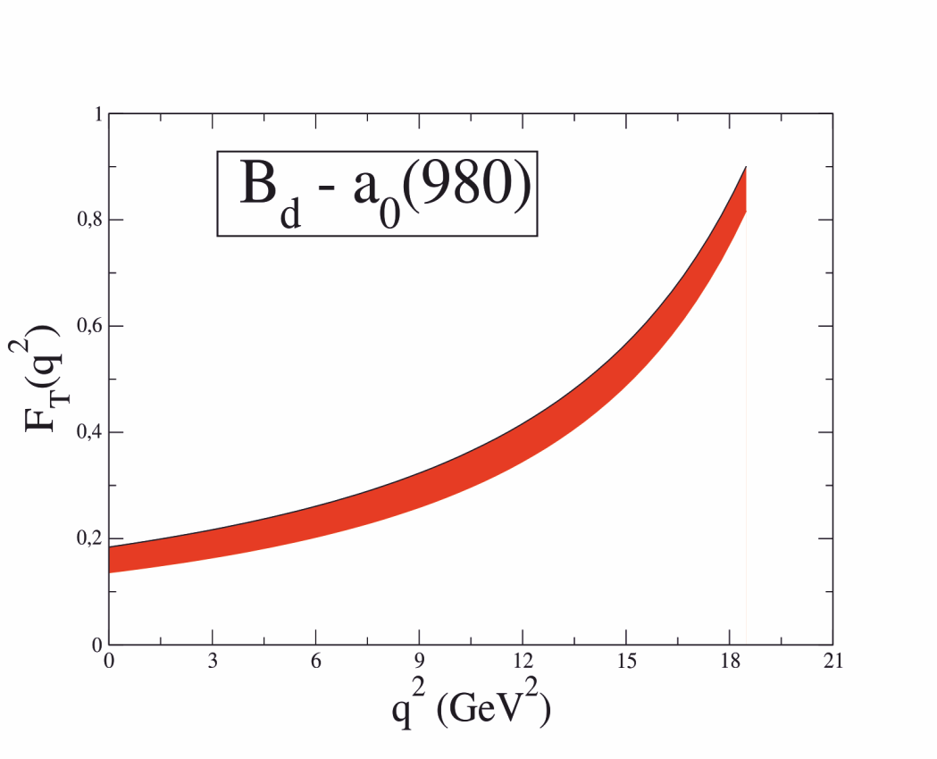
FORM FACTORS OF $B_{d}→a_{0}(980)$

Slide 22
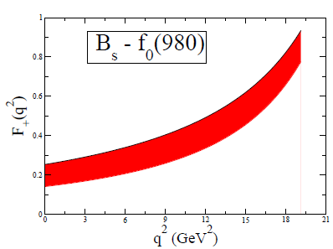
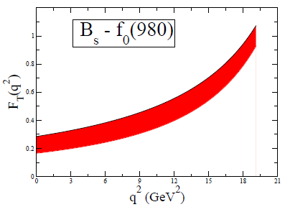
FORM FACTORS OF $B_{s}→f_{0}(980)$

Slide 23
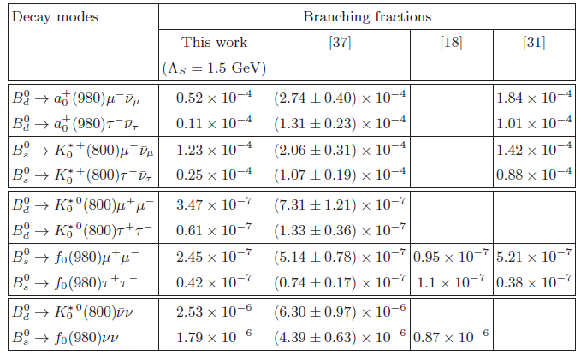
BRANCHING RATIOS

Slide 24


S-WAVE AND P-WAVE CONTRIBUTIONS
IN THE NARROW WIDTH-LIMIT AND K-π LINE SHAPES PARAMETRIZATION
*

Slide 25

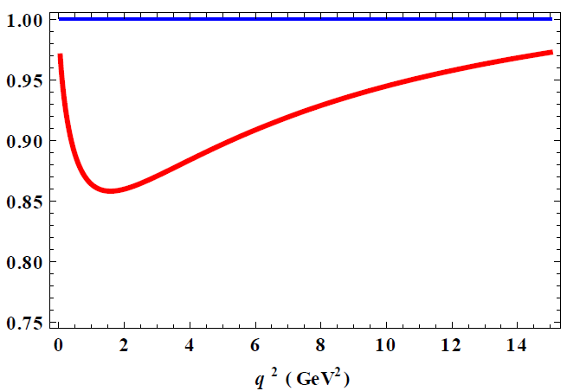
THE RATIO OF THE DIFFERENTIAL DECAY RATE

Slide 26
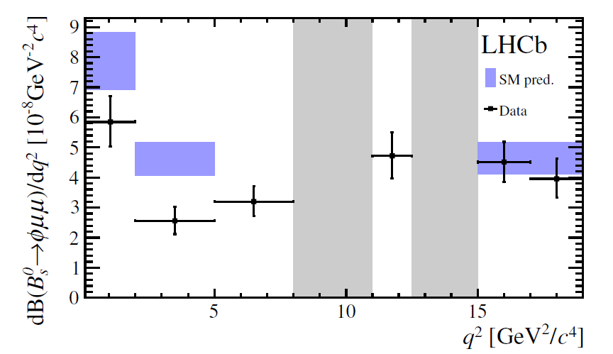
$${B^{0}}_{S}→φℓ^{+}ℓ^{−}$$
*

Slide 27
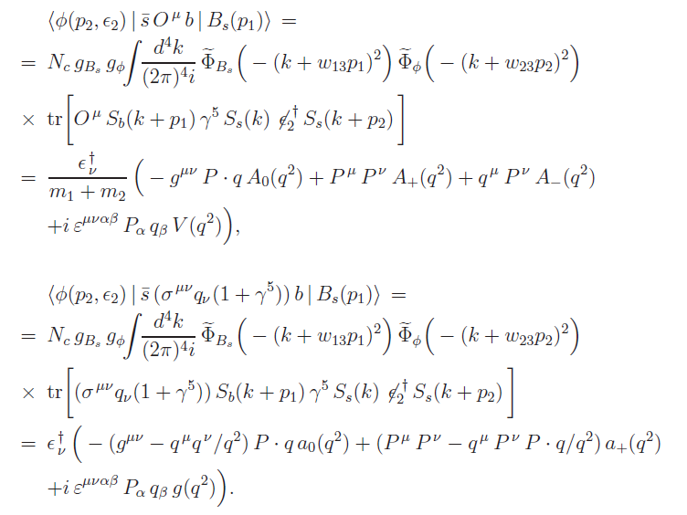
Form factors of the $B_{S}→φ$ transition

Slide 28
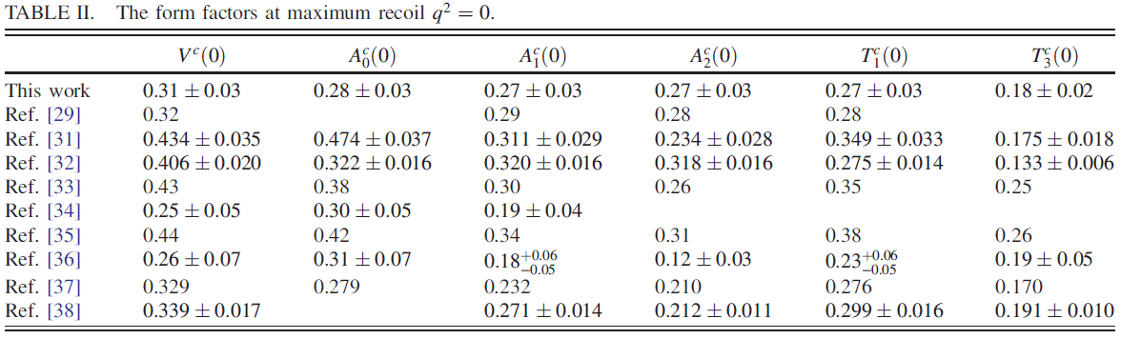
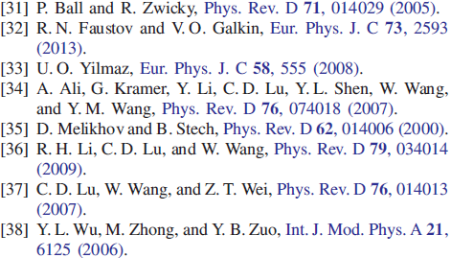
Form factors of the $B_{S}→φ$ transition
*

Slide 29
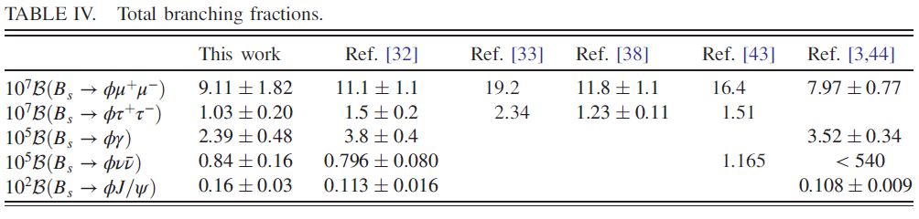

THE VALUES OF BRANCHING FRACTIONS
*

Slide 30
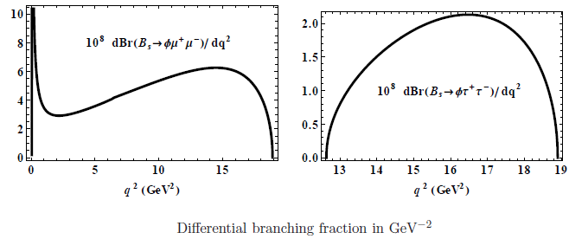
BRANCHING FRACTION

Slide 31
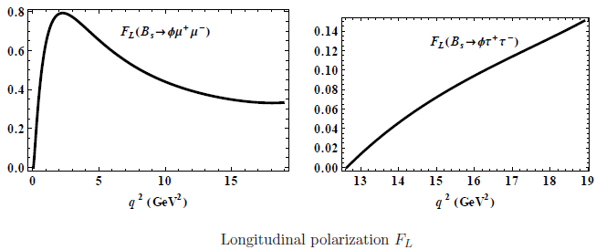
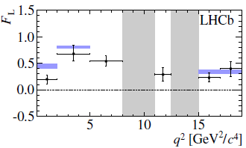
$F_{L}$OBSERVABLE

Slide 32

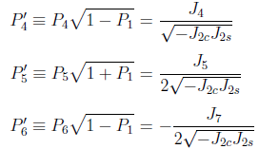


THE ANGULAR DECAY OBSERVABLES

Slide 33


NLL ORDER AND NNLL CORRECTIONS
Next-to-leading logarithmic order:
~ ~0
Next-to-next-to-leading logarithmic corrections:
< < 1
< < 1

Slide 34
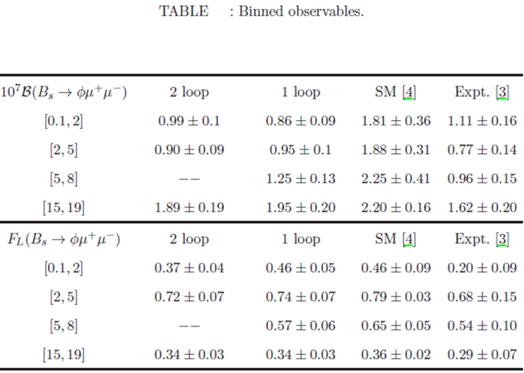

ANGULAR OBSERVABLES AND DIFFERENTIAL BRANCHING

Slide 35
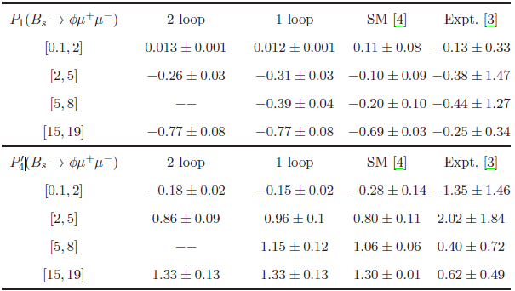
ANGULAR OBSERVABLES AND DIFFERENTIAL BRANCHING

Slide 36
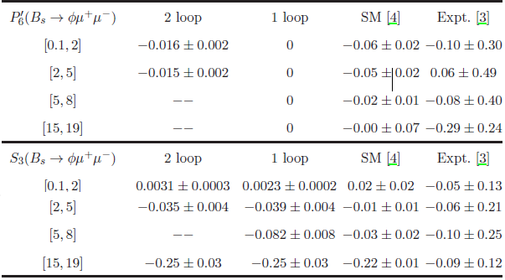
ANGULAR OBSERVABLES AND DIFFERENTIAL BRANCHING

Slide 37
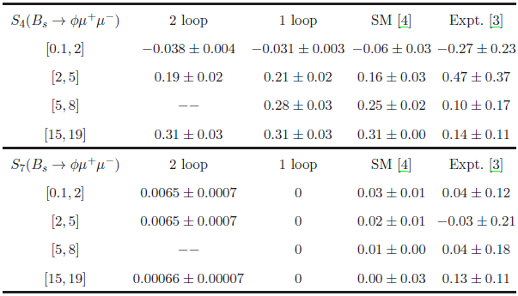
ANGULAR OBSERVABLES AND DIFFERENTIAL BRANCHING

Slide 38
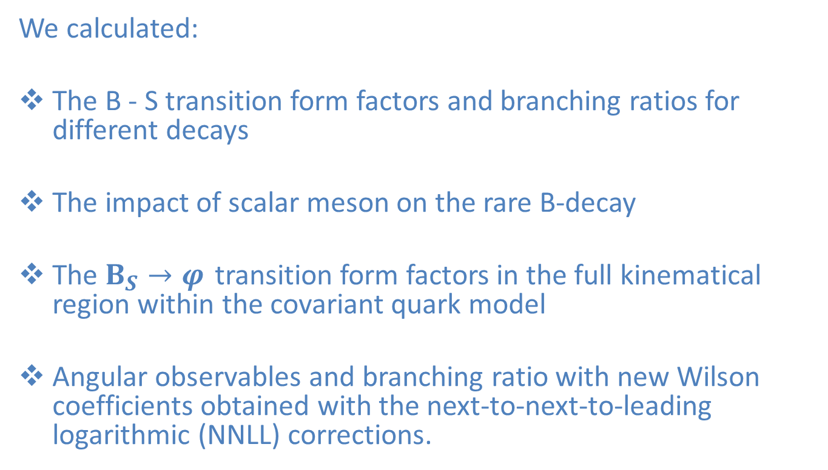
CONCLUSIONS
We calculated:
The B - S transition form factors and branching ratios for different decays
The impact of scalar meson on the rare B-decay
The $B_{S}→φ$ transition form factors in the full kinematical region within the covariant quark model
Angular observables and branching ratio with new Wilson coefficients obtained with the next-to-next-to-leading logarithmic (NNLL) corrections.

