Slide 1
FHCal Slow Control Integration
O.Petukhov
INR RAS, Moscow

Slide 2
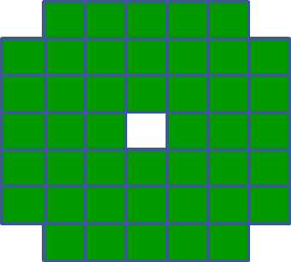
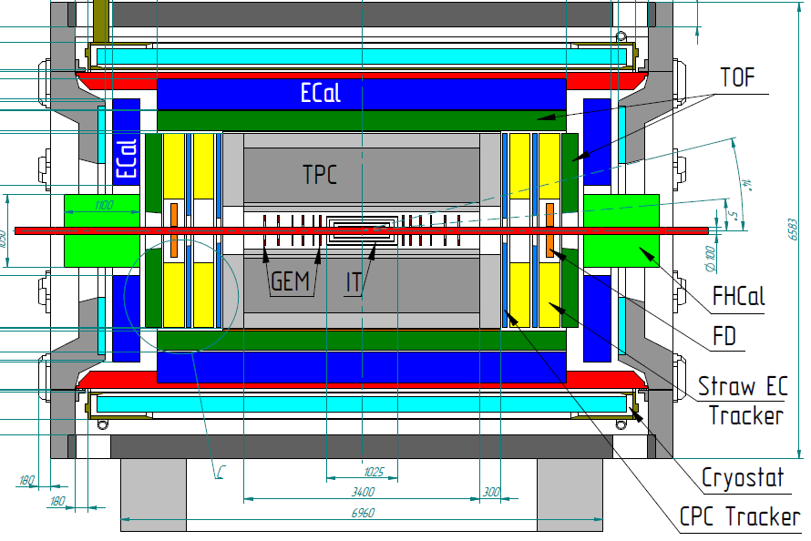
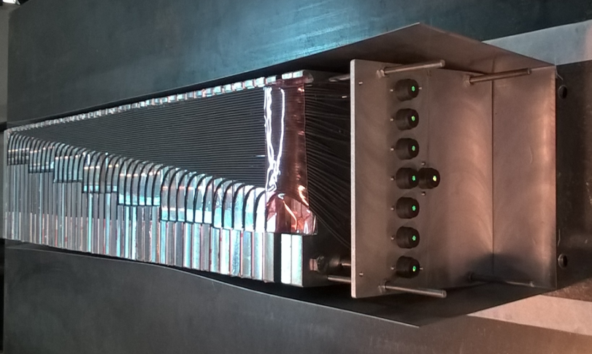
The Forward Hadron Calorimeter in MPD setup
FHCAL
FHCAL consists of 2x44 modules of ~1.1x1.1 m² each part.
7 analog channels in each module

Slide 3
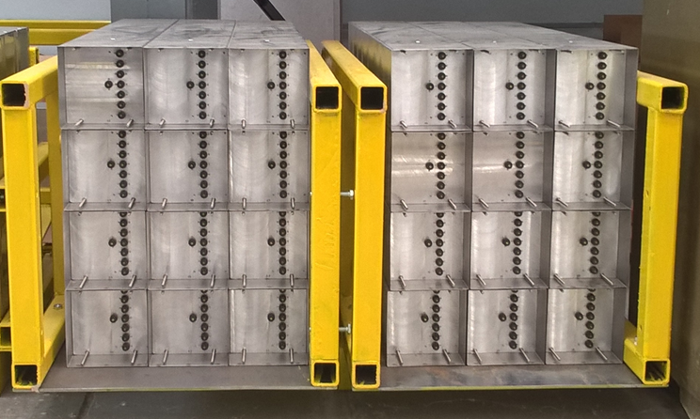
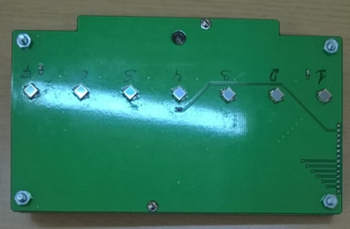
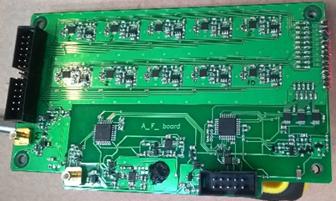
Front-End-Electronics
Connector for analogue signals
Σ
LED
Board with SiPMs
Board with FEE
Connector for slow control
4 pins in each module
Amp
Integrator
ADC
44x7= 308 channels on each side.
Or 608 channels for full calorimeter
MPPC
FEE
Δt ~ 50 ns
Δt ~ 200 ns
τ ~ 20ns

Slide 4
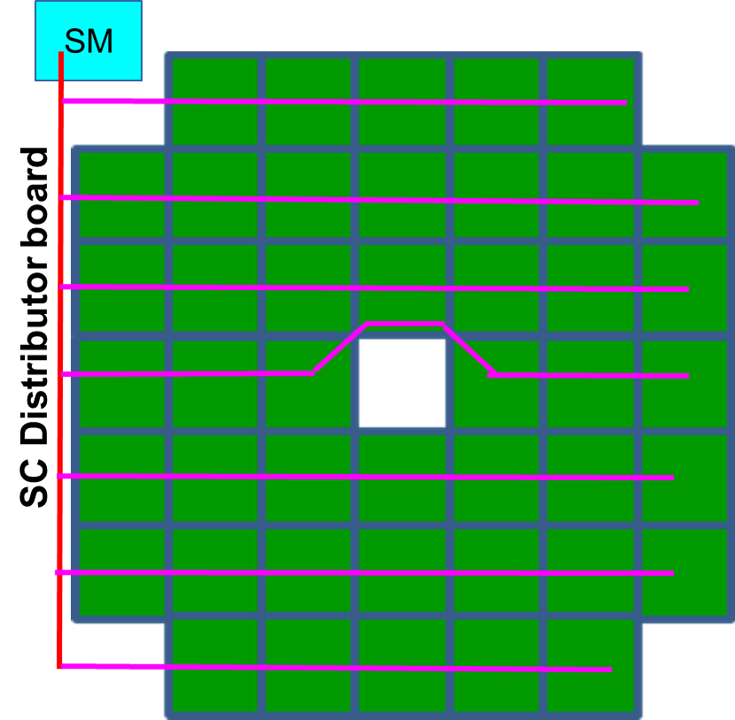
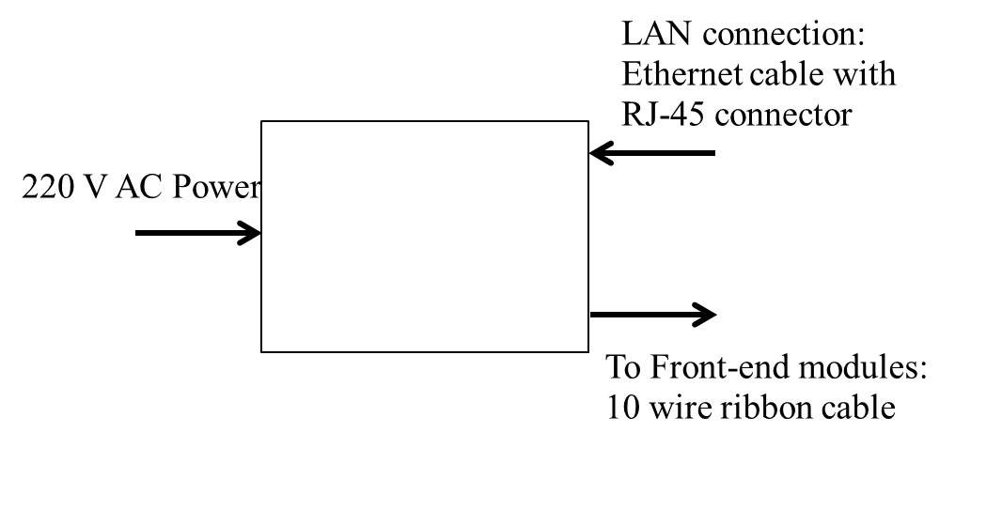
SC System Module position and cable routing
SM
At least one Slow Control System
Module is needed for each side
Needs 220 V AC power
RJ-45 Ethernet cable for network connection
(alternative: connection to a PC
via RS232 )
Slow control

Slide 5
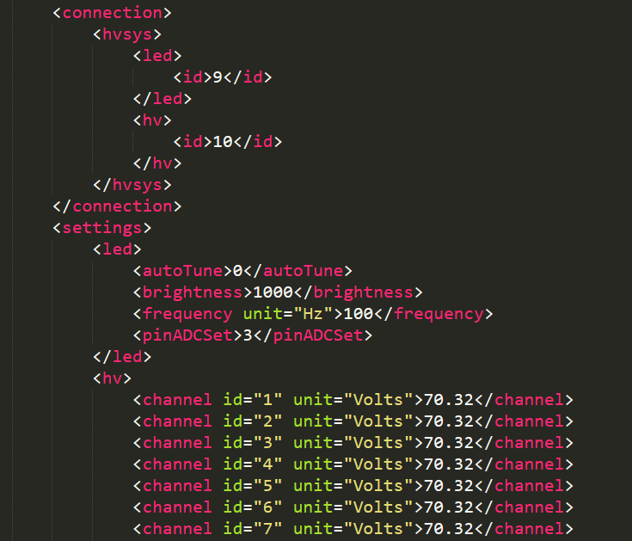
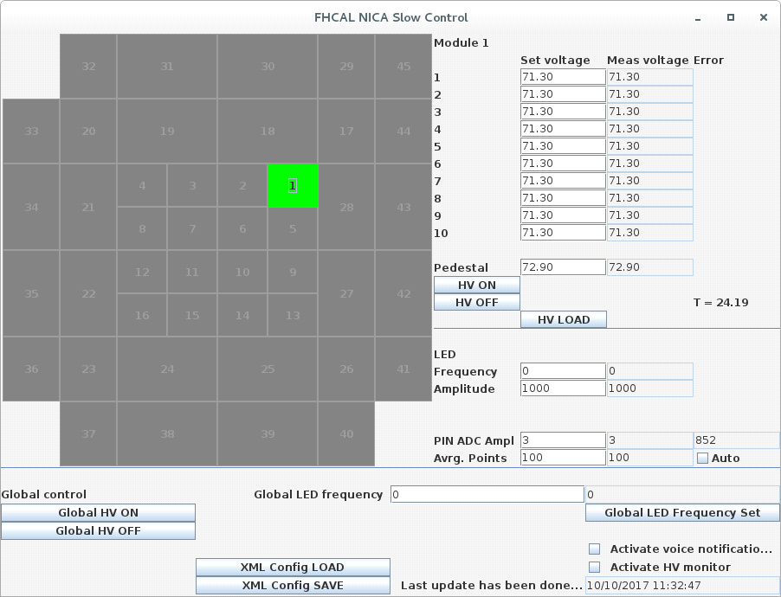
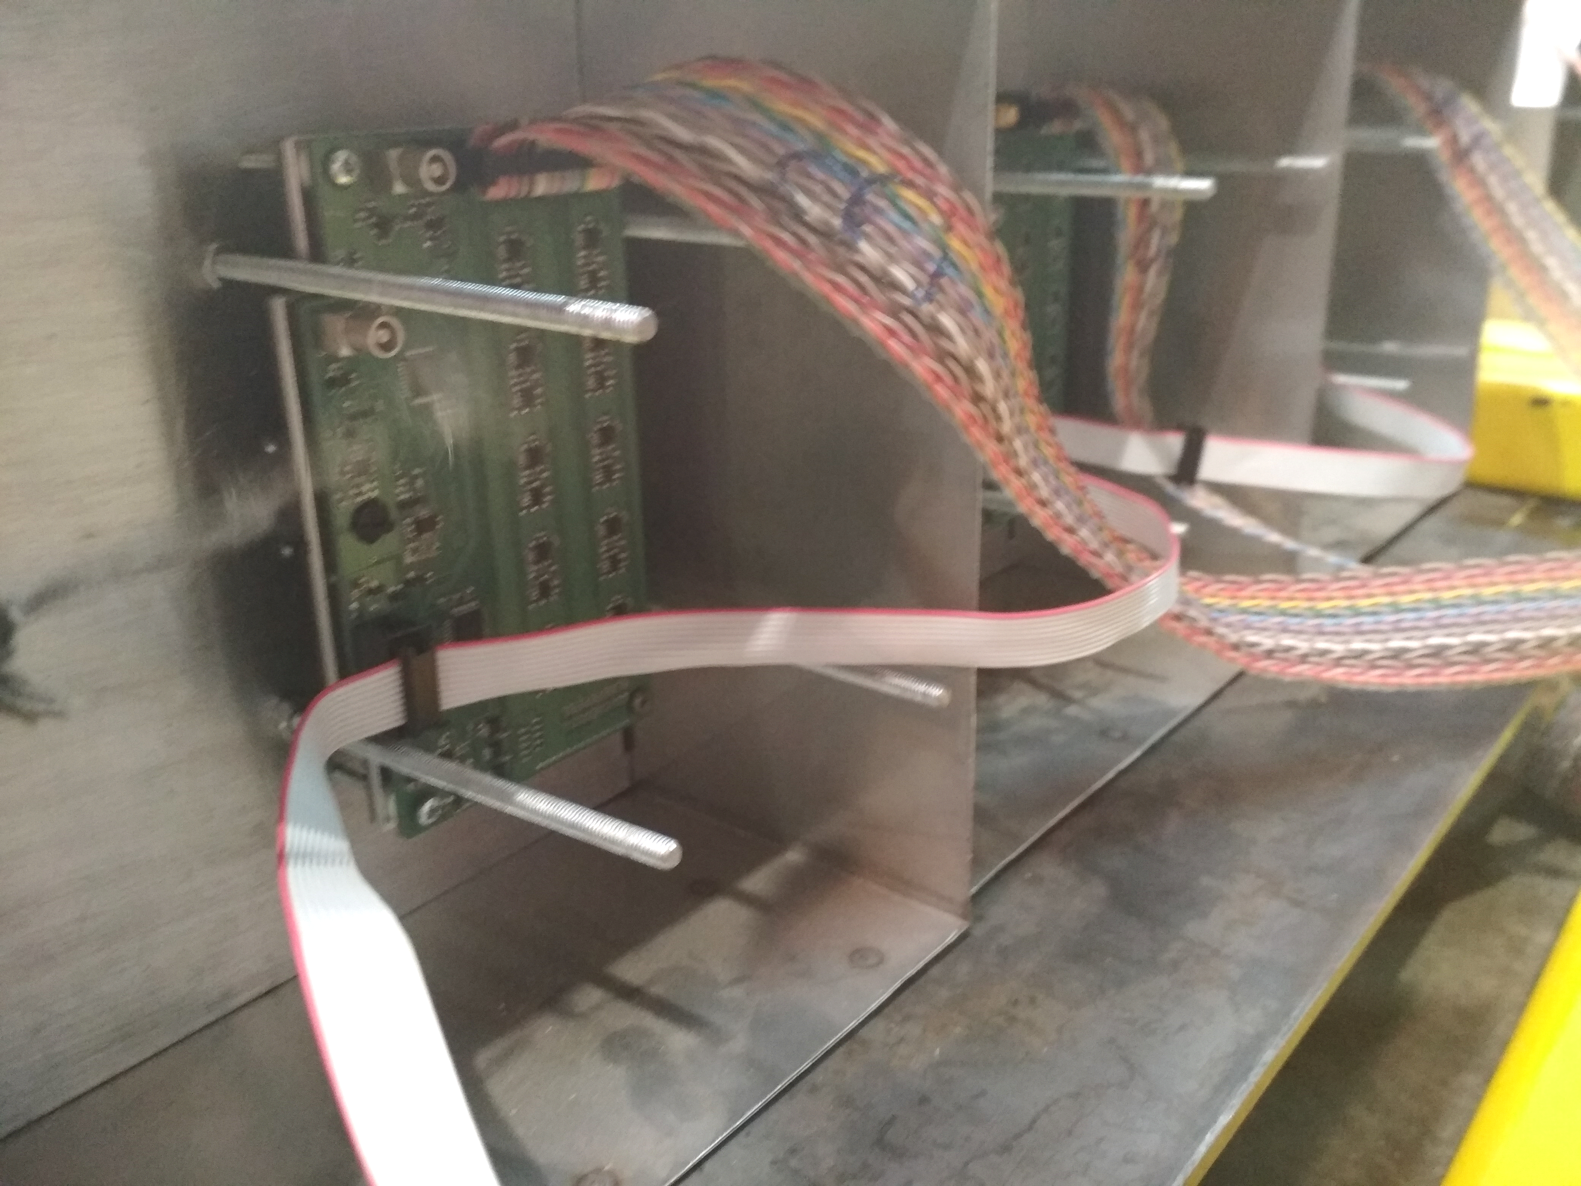
Slow Control Network
SM
Serial RS485-based protocol
with 10-pin flat cable
from System Module to FEE
Serial over TCPIP from
PC to System Module(s)
Software to control HV, LED calibration

Slide 6
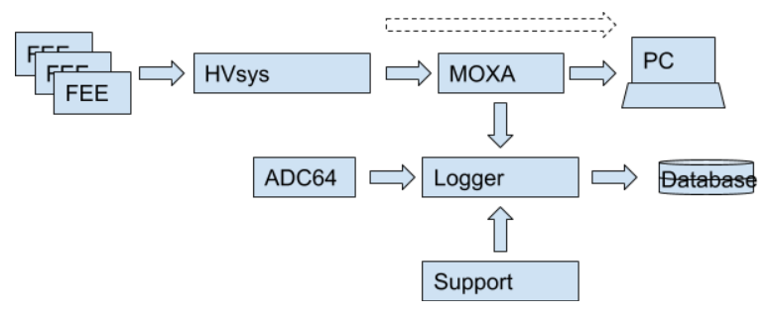
Slow Control Integration
Software connected directly to System Module or via proxy (Socket manager)
Other clients (database loggers, etc.) can connect to Socket Manager
More variables?

Slide 7
Backup slides

Slide 8
Front-end electronics connections
To Slow Control:
10 wire ribbon cable
LED flash trigger (optional):
50 Ohm coaxial cable
Analog sum output:
50 Ohm coaxial cable
To ADC:
8-pair flat cable

Slide 9
Slow Control System Module connections
LAN connection:
Ethernet cable with
RJ-45 connector
220 V AC Power
To Front-end modules:
10 wire ribbon cable

Slide 10
ADC connections
Trigger TTL input
Xoff TTL output
2X 50 Ohm coaxial cable
12 V 2A DC Power:
2X3 MF pin connector
Data readout &
White Rabbit synchronization:
2X SFP modules

Slide 11
Optional connections
44 coaxial 50 Ohm cables to LED trigger on modules

Slide 12
Slow Control
At least one Slow Control System Module is needed for each side
Needs 220 V AC power
RJ-45 Ethernet cable for network connection (alternative: direct connection to a PC via USB (unstable) or RS232 (DB-9))

Slide 13
ADC
At least 5 ADC64 boards needed on each side
Each board needs 12 V DC power supply capable of sourcing at least 1.5 A of current, preferably DC regulated power supply with remote control capabilities and output current of 2 A per channel
Network connections for DAQ and WR
Coaxial cables for trigger distribution and busy logic
Cooling

