Slide 1
First Collaboration meeting of the MPD and BM@N experiments at NICA
Production status of MPD solenoidal magnet

Slide 2
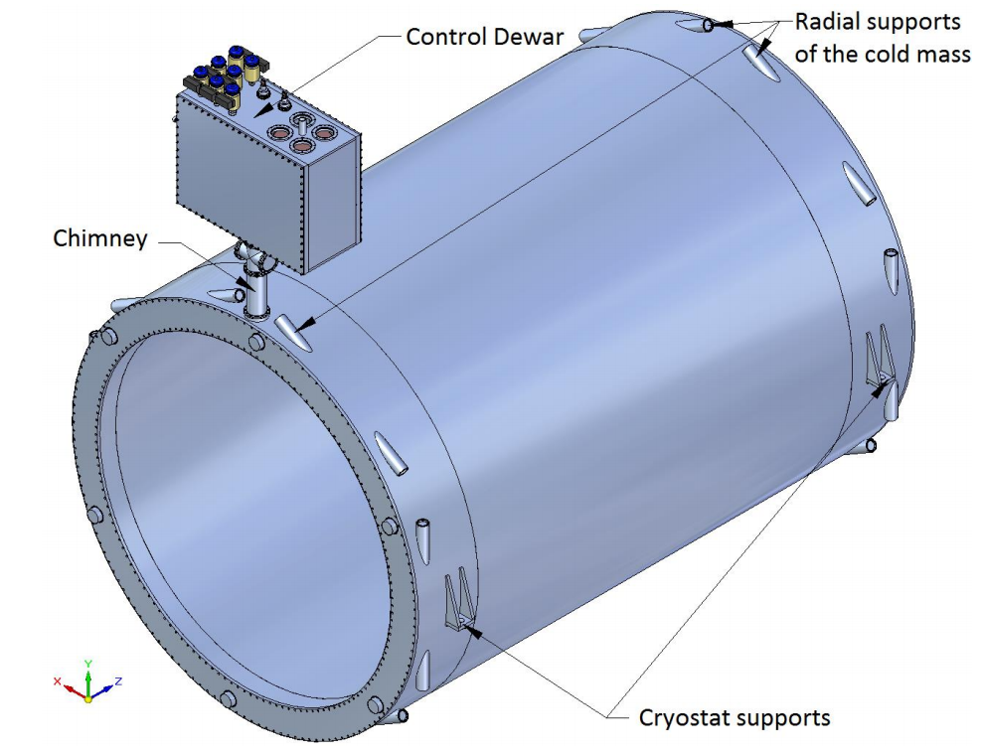
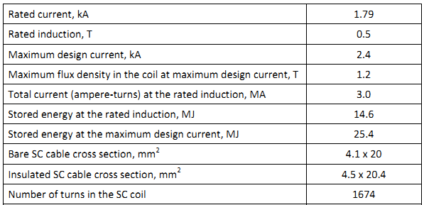
Geneal view of solenoid

Slide 3
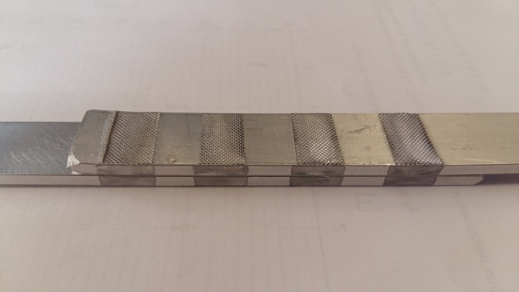
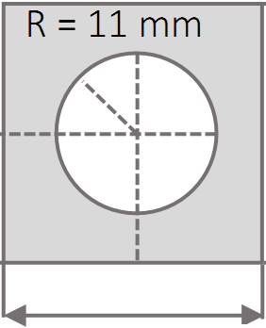
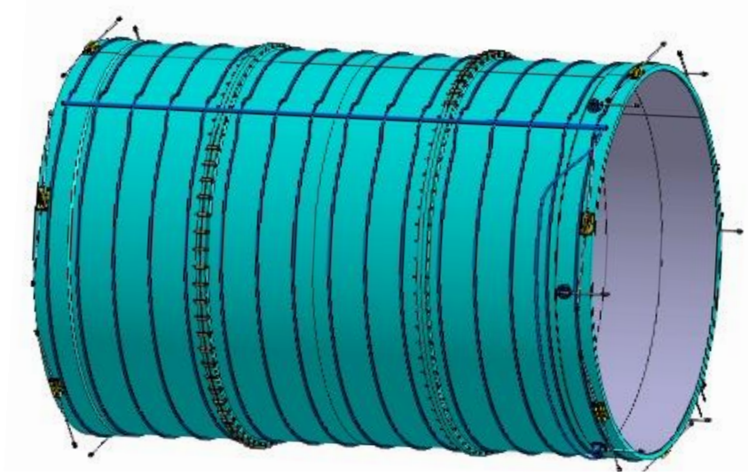
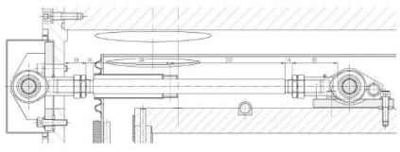
Structure of cold mass
Three modules of SC coil
Three modules of SC coil
Three modules of SC coil
Sample of cable joint
30 mm
Cooling pipe cross section
Axial rod
SC cable
Tie roads for suspension
Cooling pipes
Radial rod

Slide 4
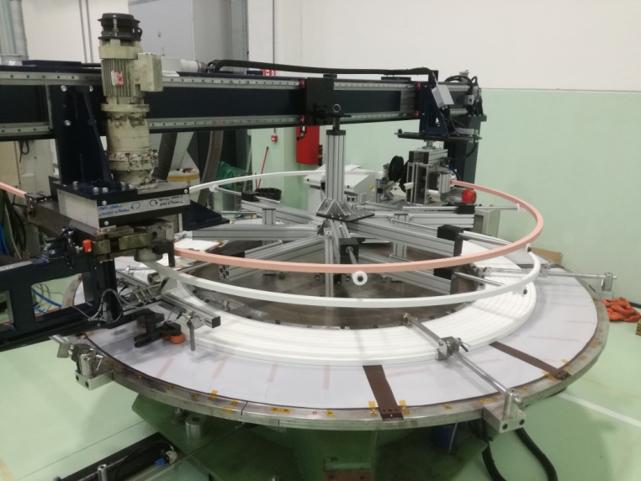
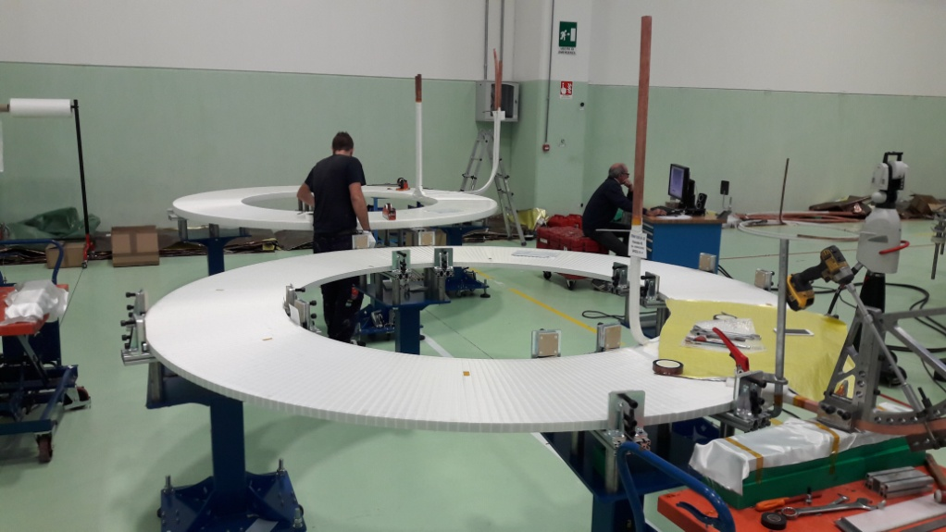
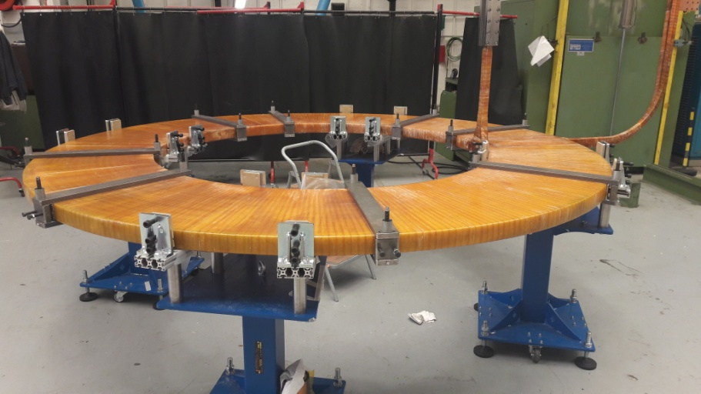
Production status
Trim coils
Current up to 4.4 kA
Voltage up to 35 V

Slide 5
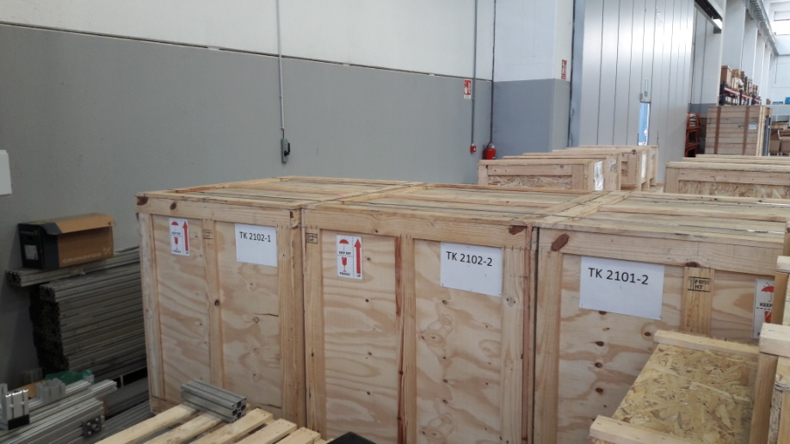
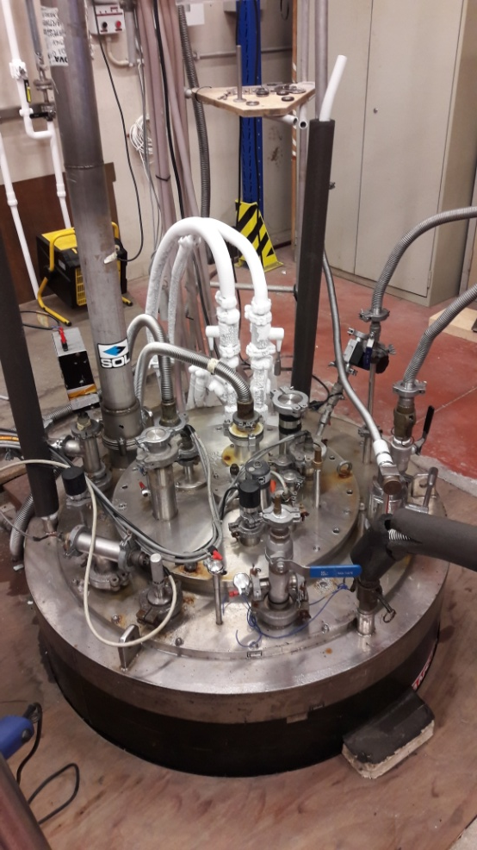
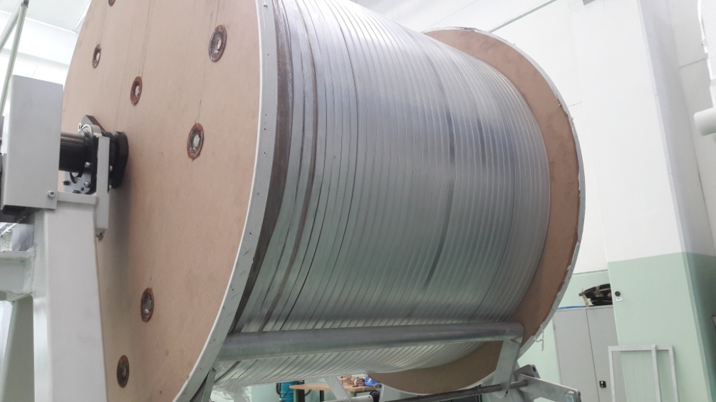
Production status
SC cable
28 km of cable in total
Facility which was used for testing the cable

Slide 6
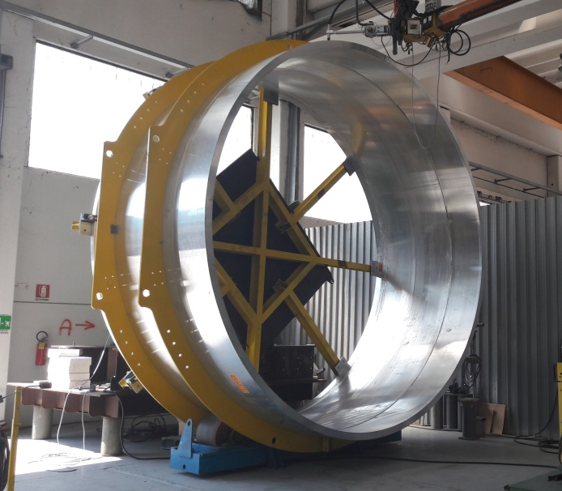
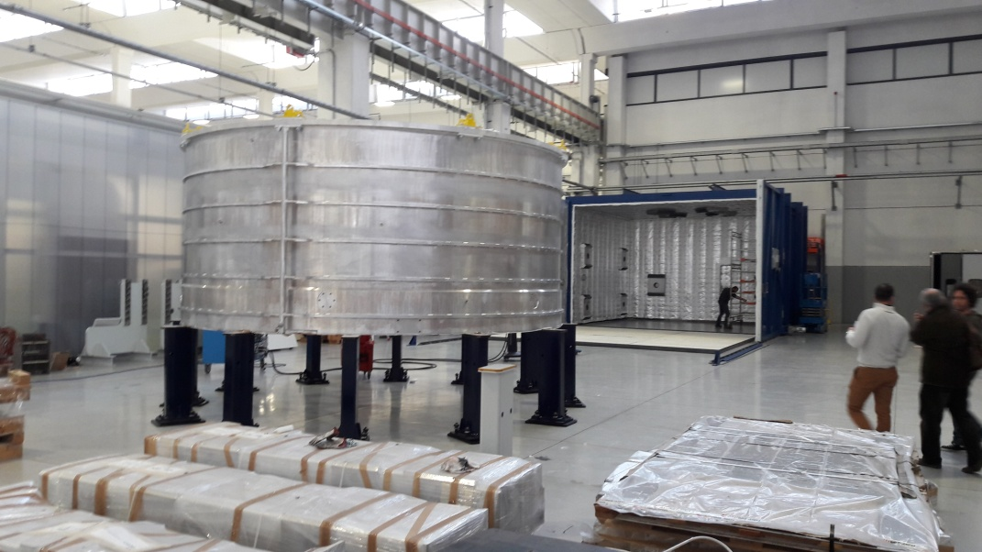
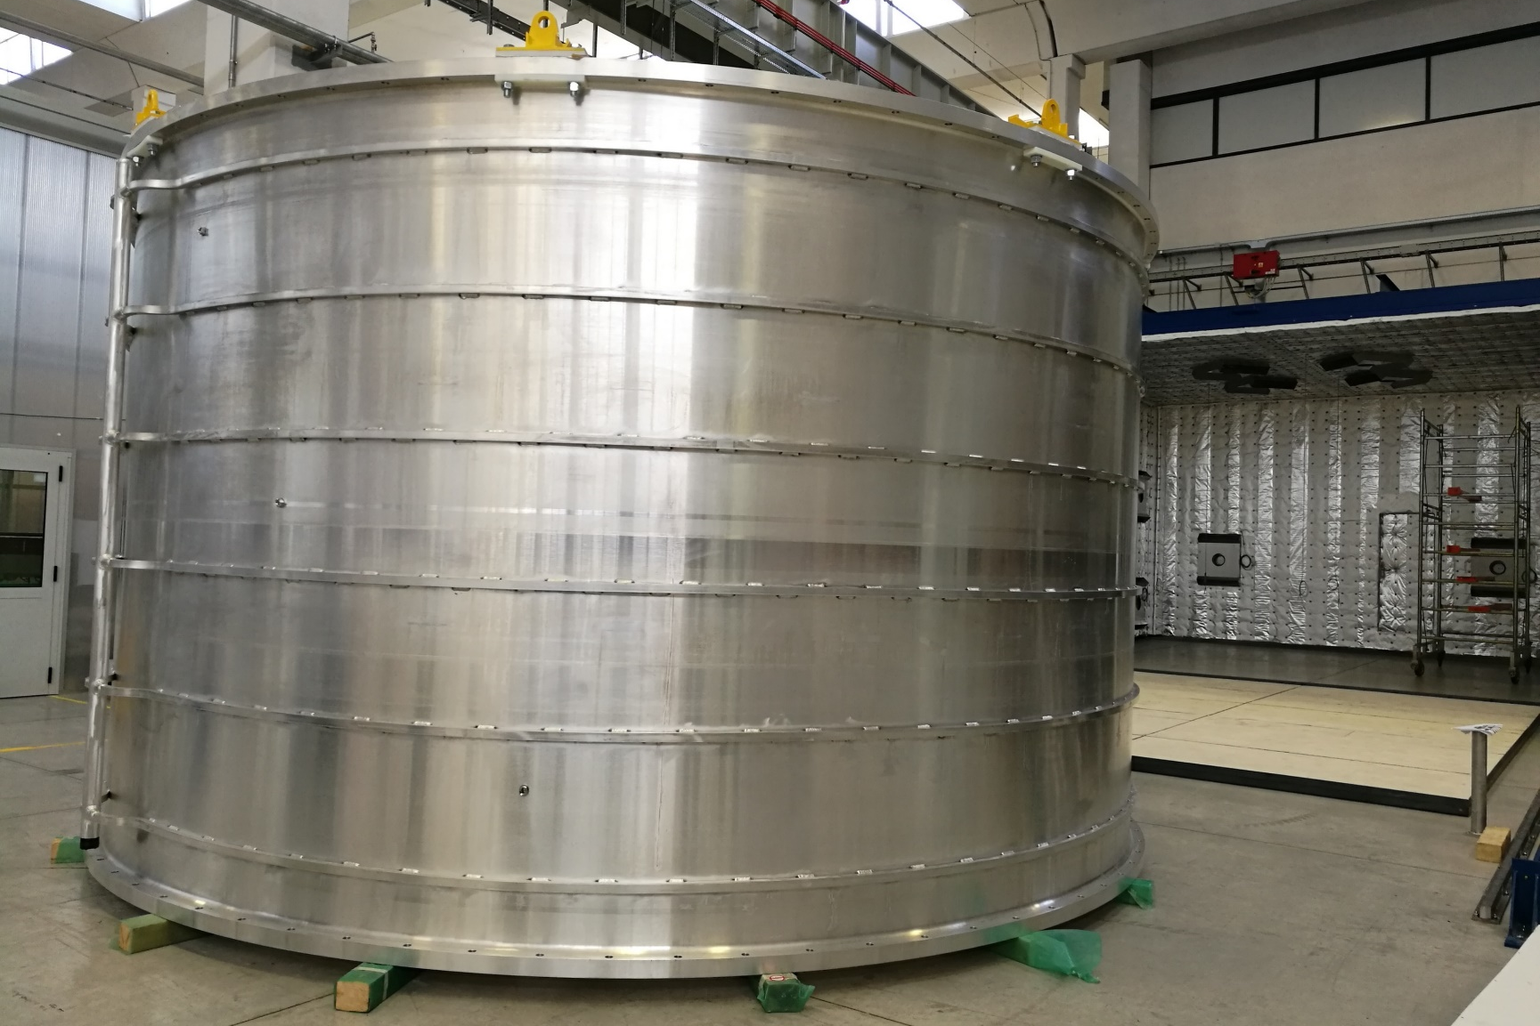
Production status
Aluminium support cilinder
All three modules are completed

Slide 7
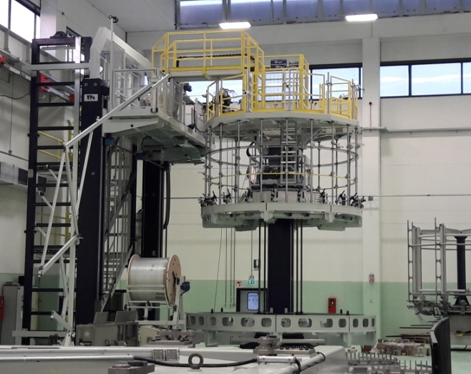
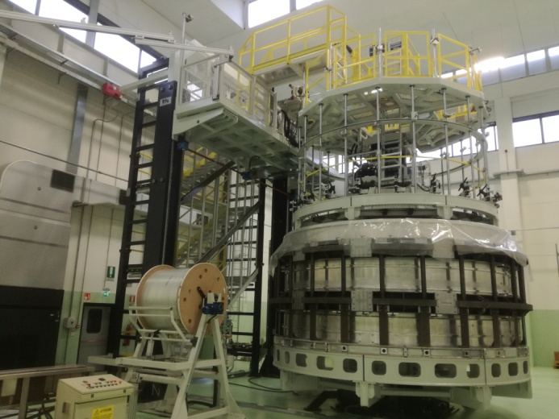
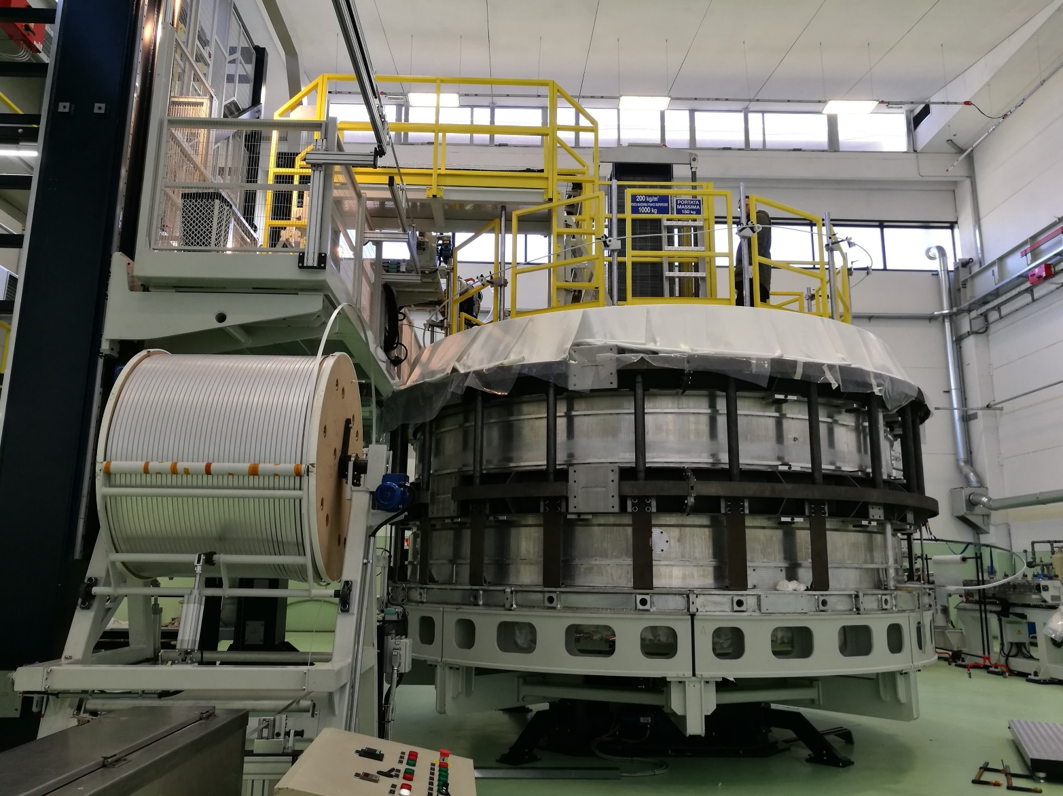
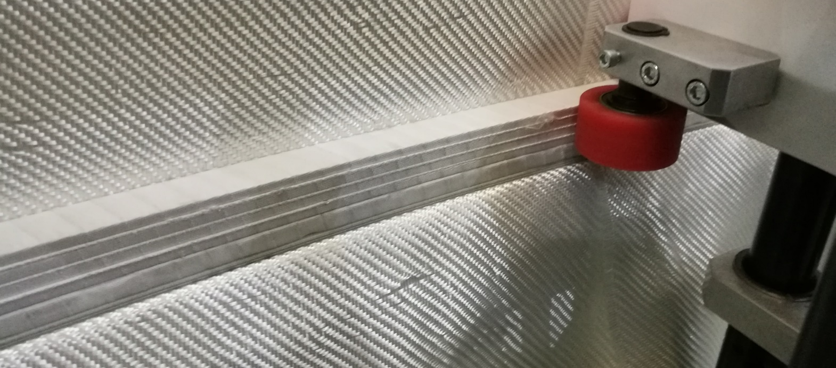
Production status
Winding of SC coil
Winding process
Cold mass production completion – end of 2018
Delivery of magnet to JINR – May 2019

Slide 8
Thank you for your attention!

