Slide 1
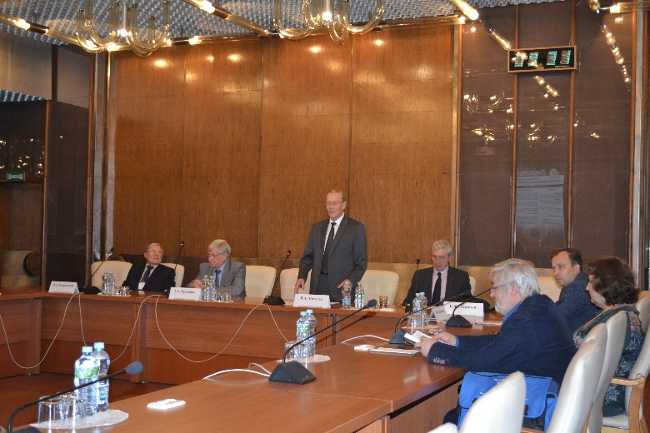
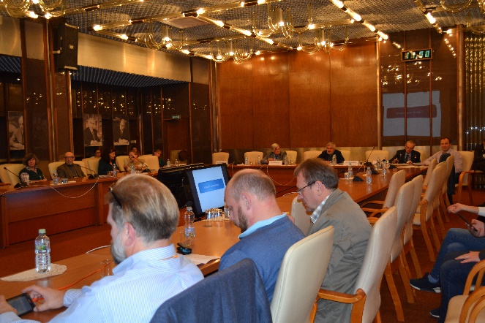
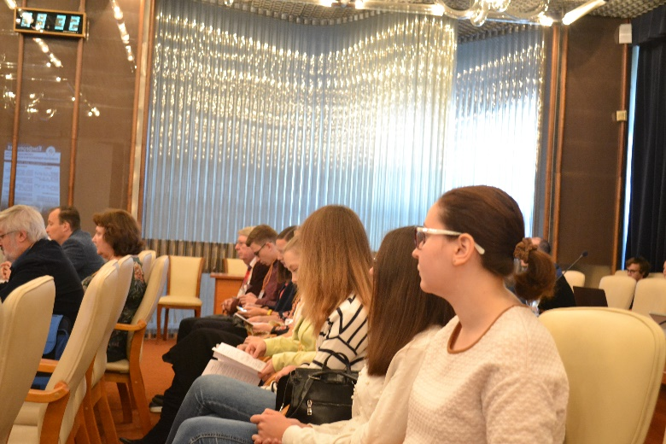

Slide 2
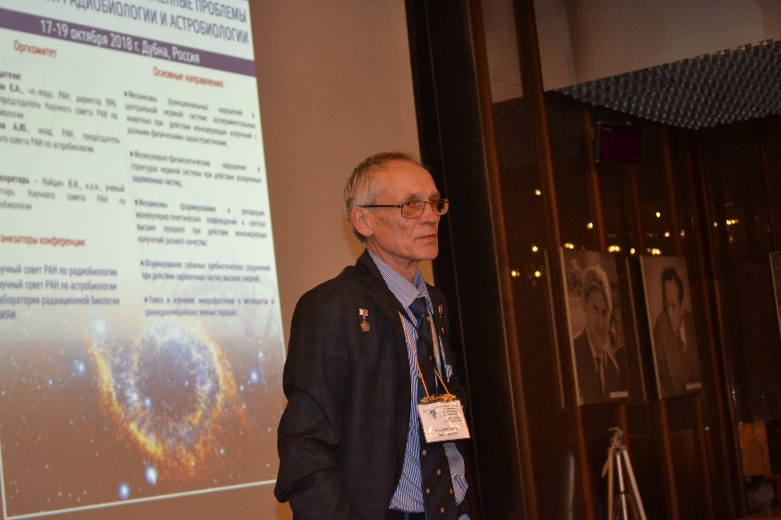
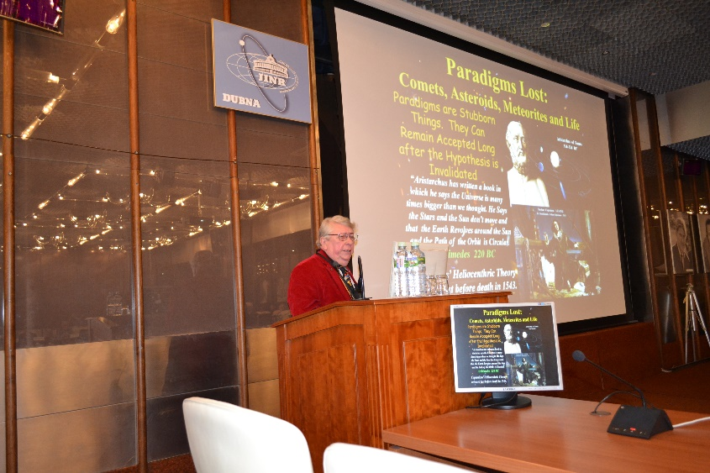
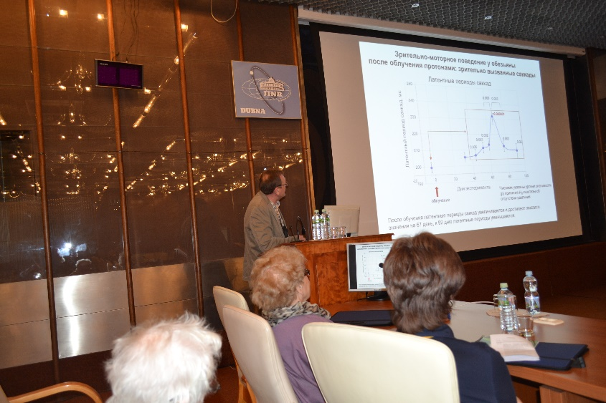
Areas of the scientific program
Research on the mechanisms of the functional responses of the central nervous system and cognitive activity to exposure to radiation and other extreme factors in model experiments on animals.
Research on molecular and physiological disorders in nervous system structures caused by accelerated charged particles.
Research on the mechanisms of the formation and repair of molecular and genetic damage induced by ionizing radiations with different physical characteristics.
Research on the formation of complex prebiotic compounds under radiation exposure.
Search for and studying microfossils in meteorites and early Precambrian terrestrial rocks.

Slide 3
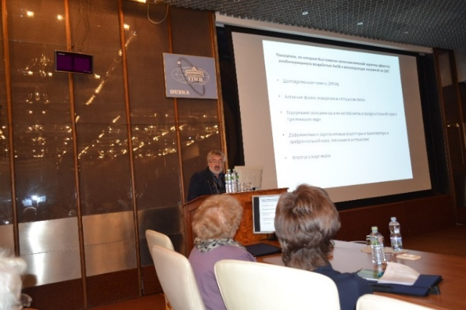
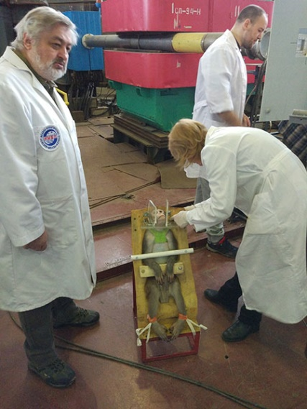
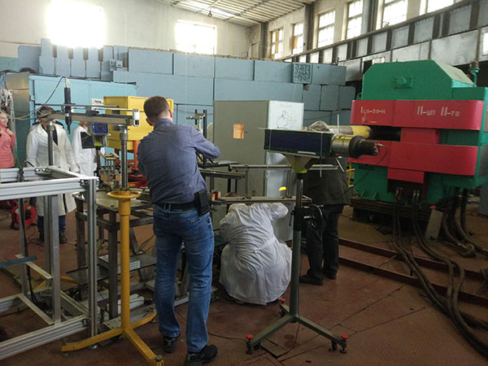
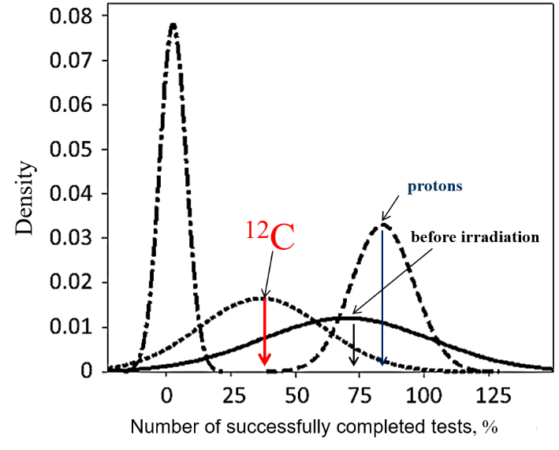
A.S. Stemberg (the Institute of Biomedical Problems RAS, Moscow) considered combined effects of ionizing radiation and weightlessness. In experiments, primates and small laboratory animals were exposed to different types of ionizing radiation (gamma rays and accelerated carbon and krypton ions) and simulated weightlessness (orthostatic weighing). It has been found that the combined exposures were not always synergetic; sometimes, they were antagonistic. It raises new questions and necessitates further research.

Slide 4
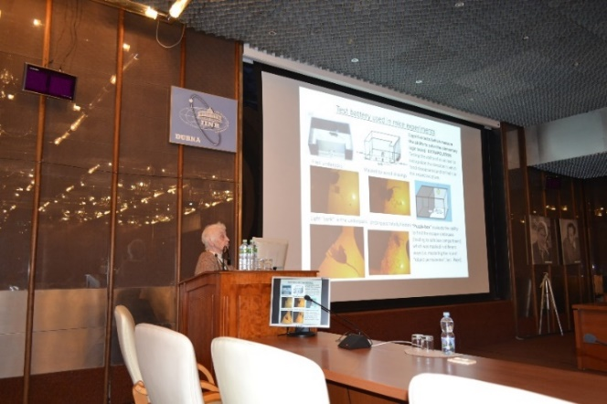
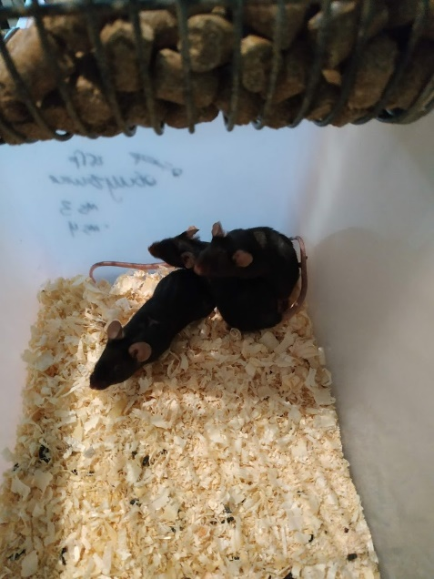
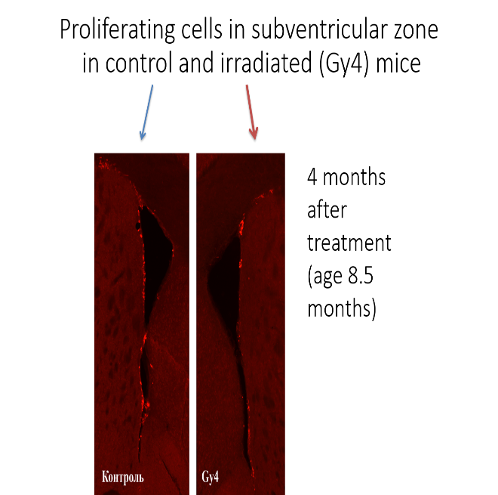
I.I. Poletaeva (the Biological Faculty, Moscow State University) spoke about proton irradiation of mice at the medical beam of the Phasotron (JINR's Laboratory of Nuclear Problems). This exposure caused an ambiguous effect on the animals' adaptive behavior. In a cognitive test of a search for the shelter entrance, the irradiated mice performed reliably worse than the control ones at the test stages where they had to dig chips in order to get to the comfortable section of the chamber. However, they passed reliably better than the control mice the test stages where they had to remove the plug blocking the way. The irradiated mice showed a decrease in neurogenesis in two proliferative parts of the frontal brain.
In discussions that followed the reports in this area, it was pointed out that further research has to be aimed at identifying the CNS critical structures whose damage can cause cognitive dysfunction.

Slide 5
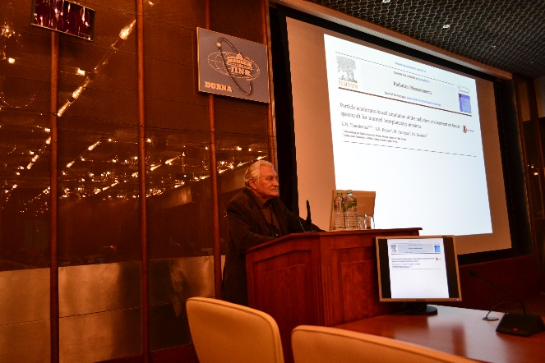
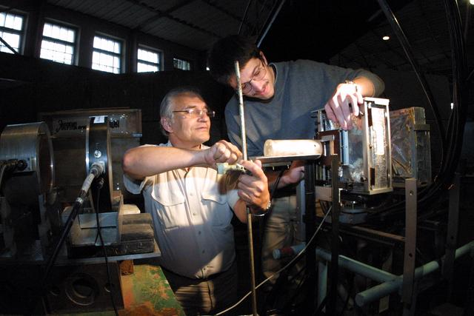
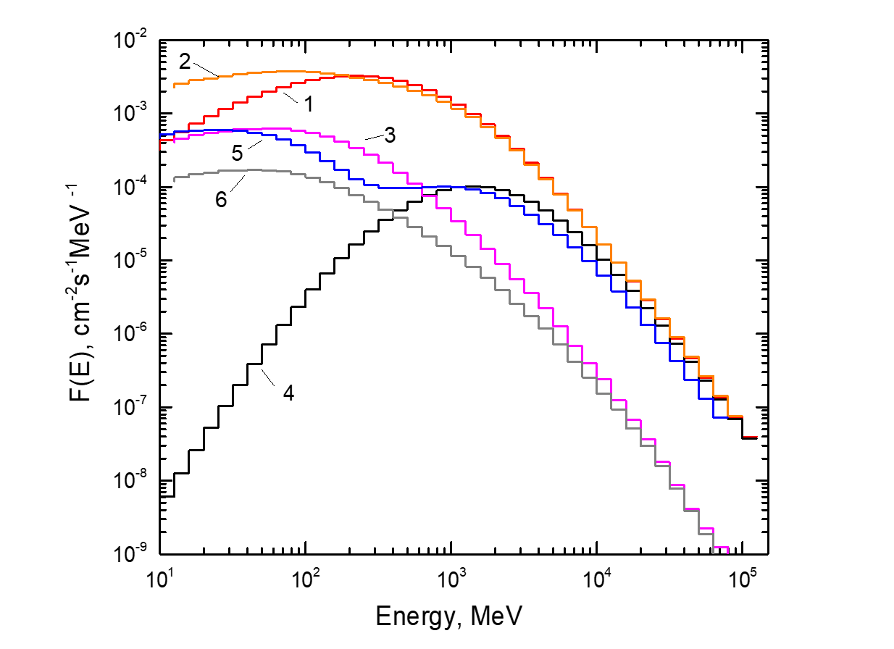
A number of talks were concerned with modeling the radiation fields that would be present inside spacecraft and evaluation of the corresponding risks. G.N. Timoshenko (LRB JINR) proposed a promising approach to the formation of mixed fields for biological experiments at a Nuclotron beam (the Laboratory of High Energy Physics, JINR).

Slide 6
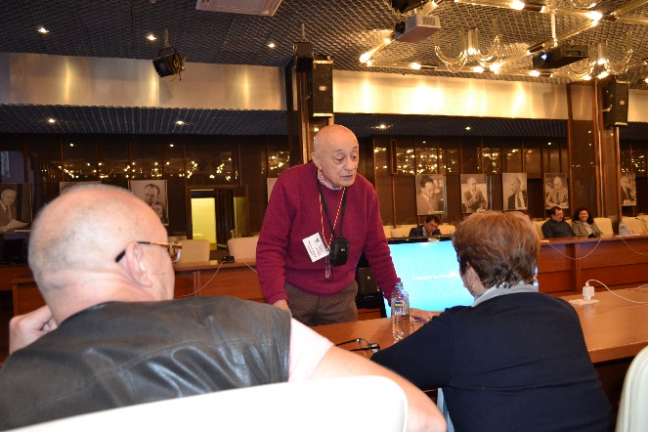
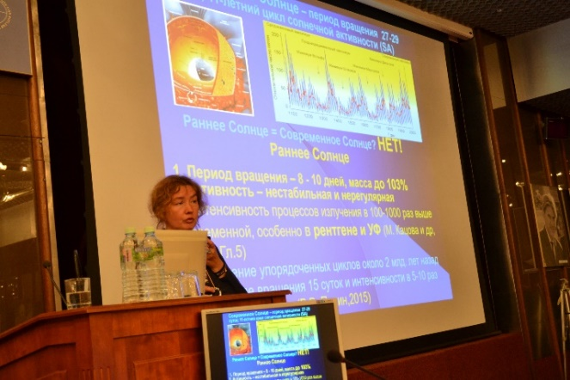
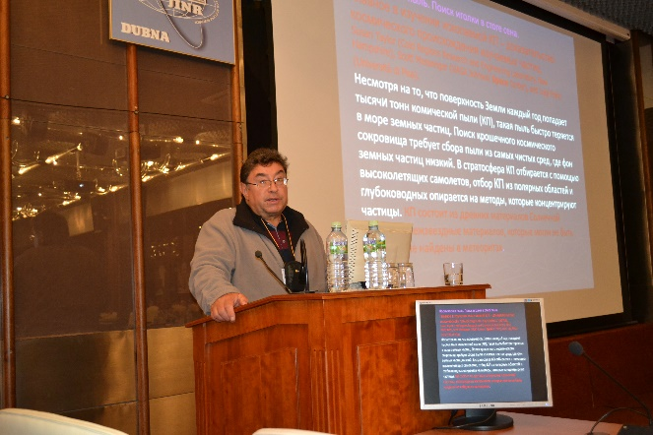
Astrobiological researches
Opening the session, Acad. RAS A.Yu. Rozanov (Borisyak Paleontological Institute RAS and the LRB JINR) said, "JINR is one of the few institutions in our country which have still kept the ability to be fully active in science." In his opinion, the research performed at the LRB JINR's Astrobiology Sector is an example of the emergence of such a paradigm, and it yields an ever increasing number of documented facts in favor of the panspermia theory.
M.V. Ragulskaya (the Institute of Terrestrial Magnetism, Ionosphere, and Radio Wave Propagation, Troitsk) in her talk entitled "Origin of life. IAU-2018, Vienna: impressions and questions" spoke about the main trends in astrobiology.
G.G. Managadze (Institute of Space Research RAS, Moscow) presented arguments in favor of the formation of the "correct" chirality of molecules during the meteorite impact exposure of the Earth surface.
V.A. Tselmovich (the Borok Geophysical Observatory, Yaroslavl Oblast) presented interesting results of space dust research and the evidence base confirming the extraterrestrial origin of different cataclysms on Earth (the Caroline Base phenomenon, Tungus meteorite, and Uchur space body). In all these locations, traces of pure nickel were found, which could have emerged only due to the fractioning of the matter of a low flying comet.

Slide 7
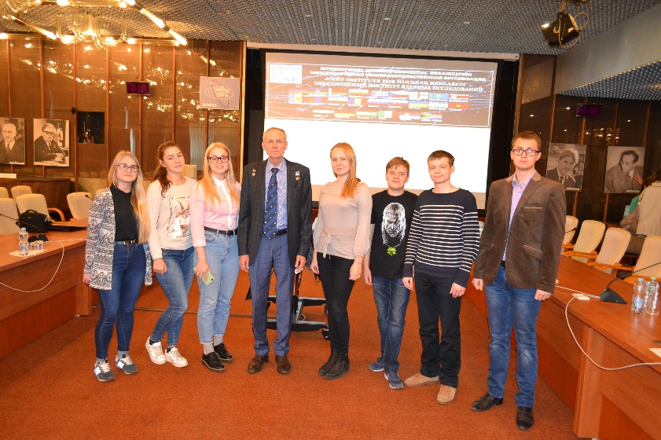
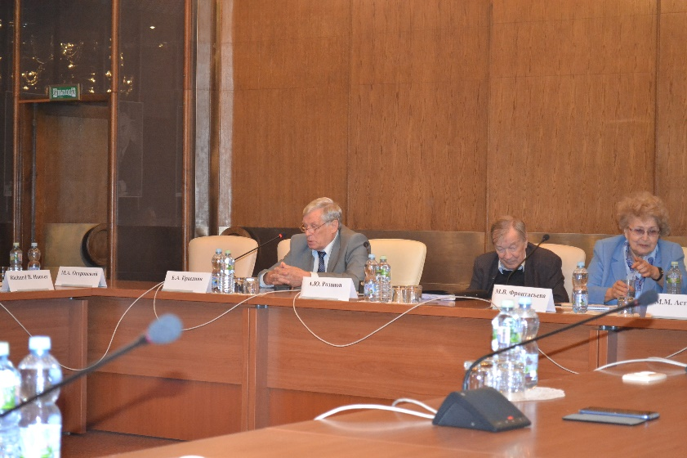
At the end of the conference on the general discussion S.V. Avdeev said: “The more I visit Dubna, the more I become convinced that not only Mars, but also the Moon is a deadly thing for manned flights. There is also a positive side - now we know much more than before, but this knowledge, already acquired and the one that is now being reported here, must sober up our rosy dreams. It requires a normal, reasonable conclusion from the work that is being carried out by experts who have gathered here and others who work with biological objects, and even more so with people.”
Concluding the conference, E.A. Krasavin, noted that although its thematic fields seemed to be different (radiobiology and astrobiology), they are complementary. They have their common beginnings in space radiation, which, on the one hand, is an adverse factor for the living systems; on the other, is a factor contributing to the formation of prebiotic structures.

Slide 8
Thank you for attention!

