Slide 1
The abnormal behavior of the resistive transition to the normal state of superconducting high-textured Nb-Ti tapes just below H_{c2}
The XXII International Scientific Conference of Young Scientists and Specialists (AYSS-2018)
Valentin Guryev, Sergey Shavkin, Vitaliy Kruglov
NRC “Kurchatov institute”
2018

Slide 2
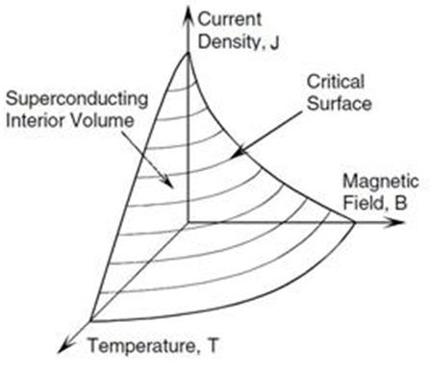
Introduction
Temperature phase transition
Field phase transition
Current phase transition
?
$$Q=\int_{t_{1}}^{t_{2}}{I^{2}Rdt}$$

Slide 3
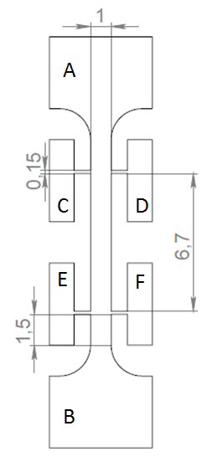
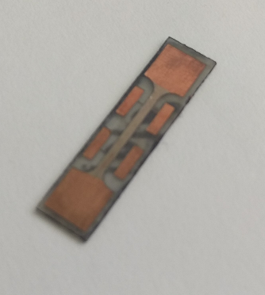
Object of study
Cold rolled single-phase β-Nb-Ti tape of Nb-50 mass% Ti alloy
The well-developed technology for manufacturing Nb-Ti superconductors can guarantee the homogeneity of the tape, which ensures the reproducibility of the results of experimental studies, allowing to study physical patterns, rather than individual features of specific samples.
A pure superconductor is in the place of the measuring bridge. There are no shunting layers of copper.

Slide 4
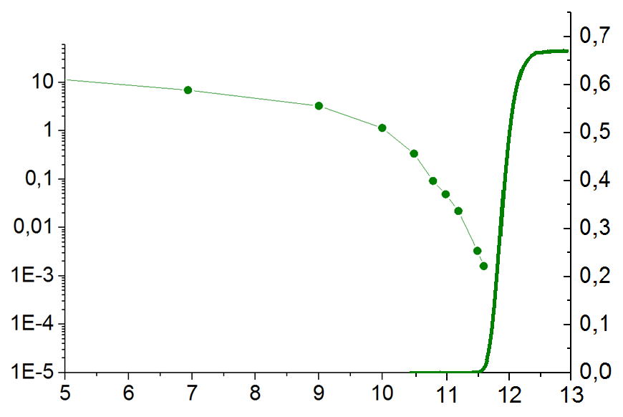
Critical current vs magnetic field
$$ρ_{N}$$
$$I_{c} (A)$$
$$ρ (μΩ∙m)$$
$$T=4.2 K$$
$$μ_{0}H (T)$$
$$H_{irr}$$

Slide 5
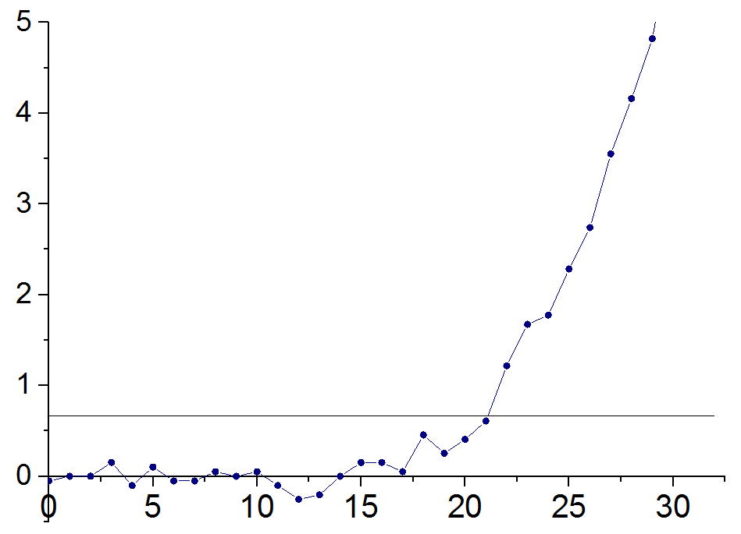
Current-Voltage Characteristic at high magnetic field
?
$$μ_{0}H=11.2 T$$
$$U (μV)$$
$$E=1 μV/cm$$
$$I_{c}$$
$$I (mA)$$

Slide 6
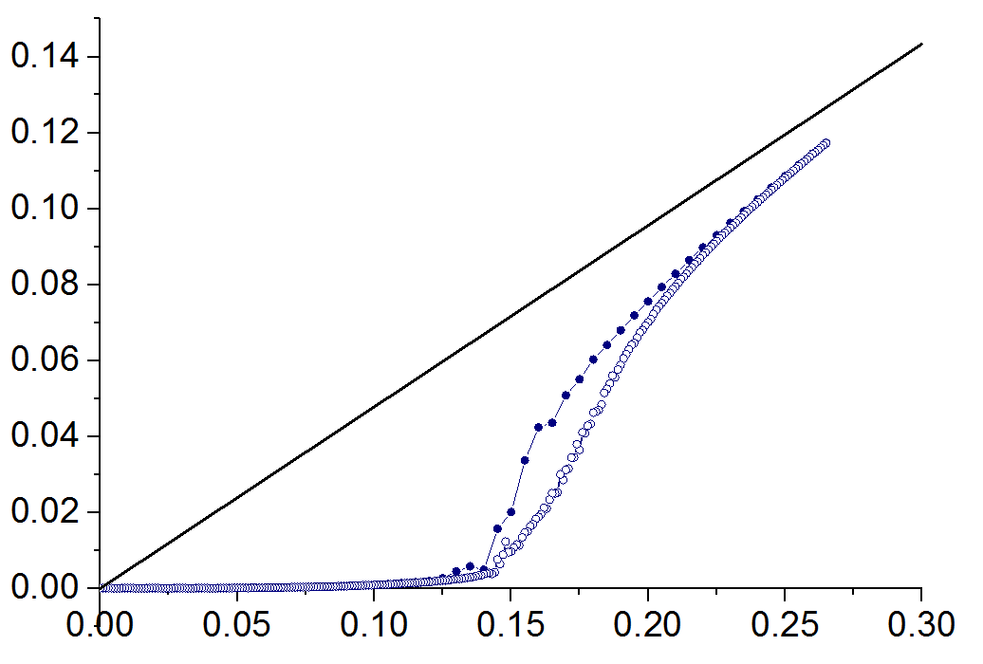
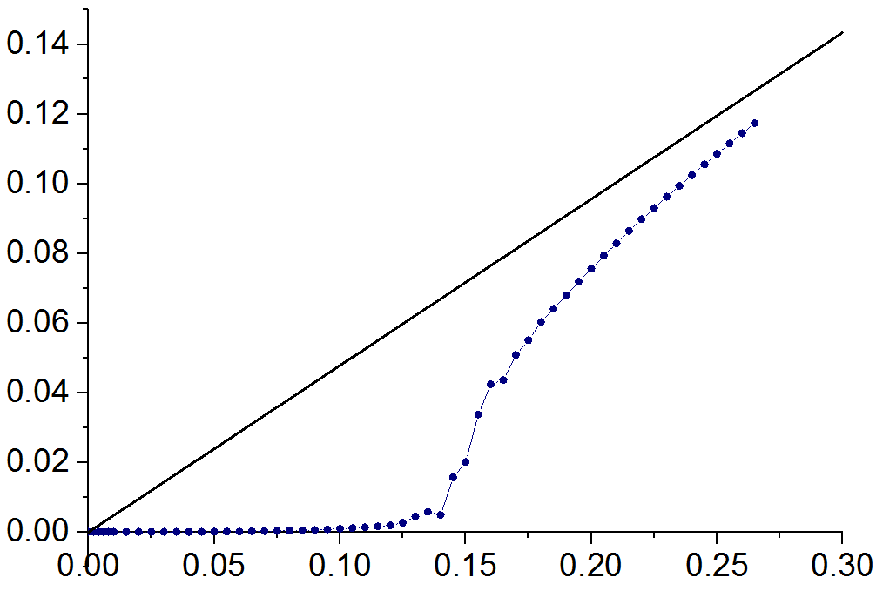
Hysteresis of the Current-Voltage Characteristics
R_{N}
$$U (V)$$
$$μ_{0}H=11. 2 T$$
$$I (A)$$

Slide 7
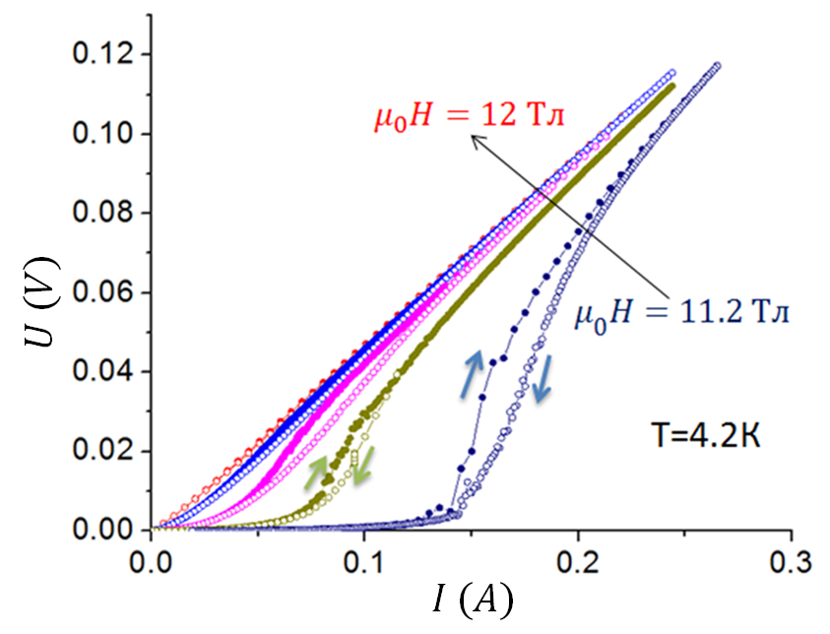
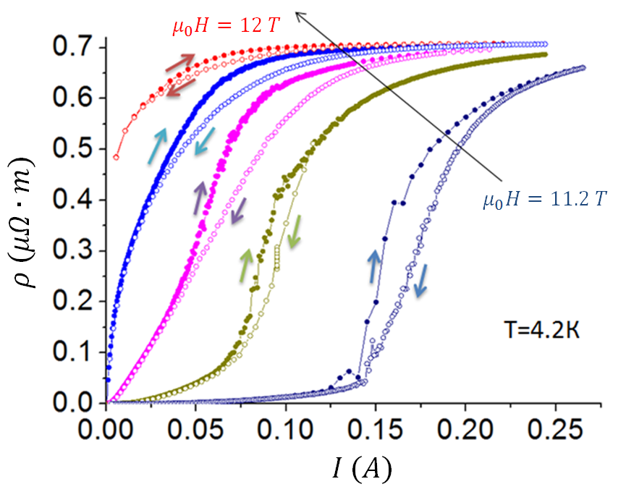
From CVC to Current-Resistivity Characteristics
step 0.2 T
step 0.2 T

Slide 8
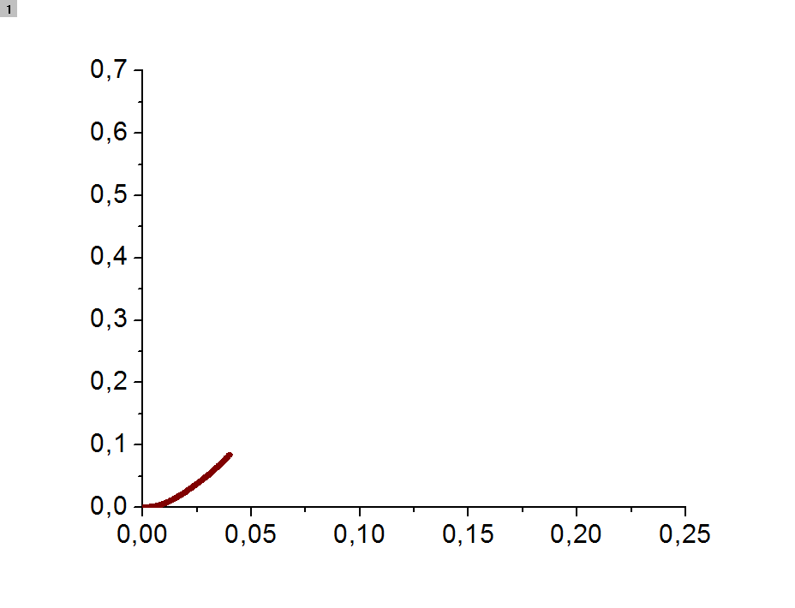
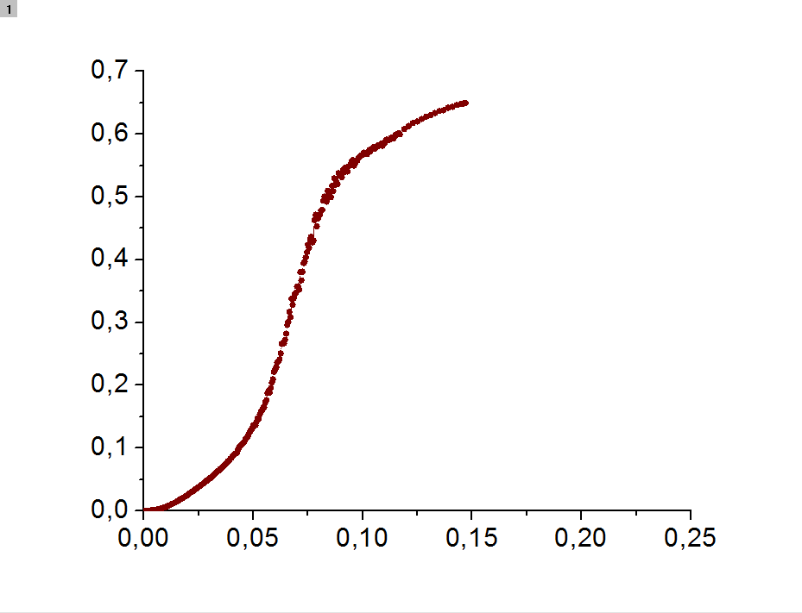
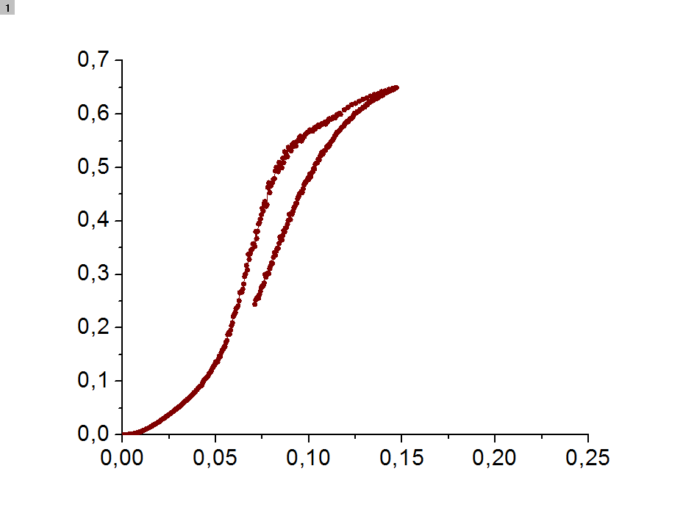
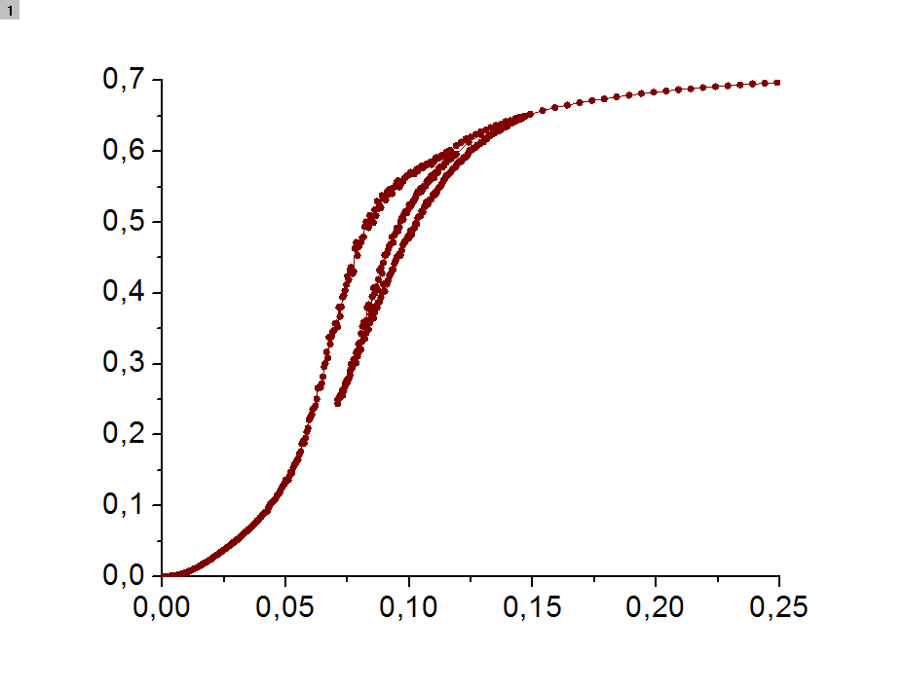
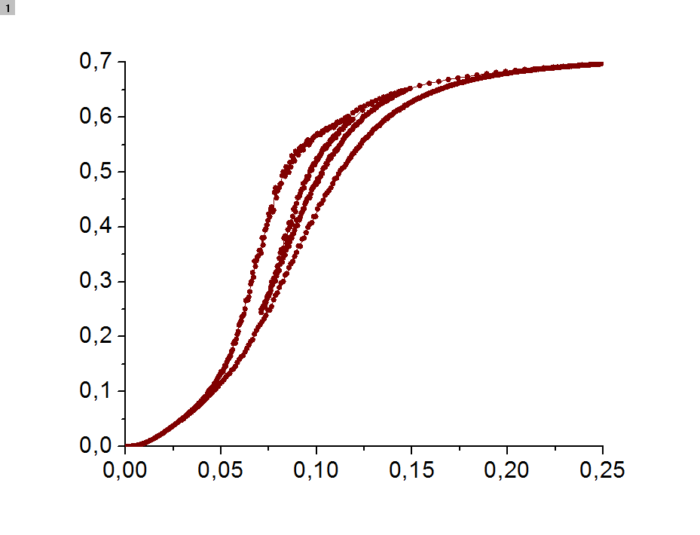
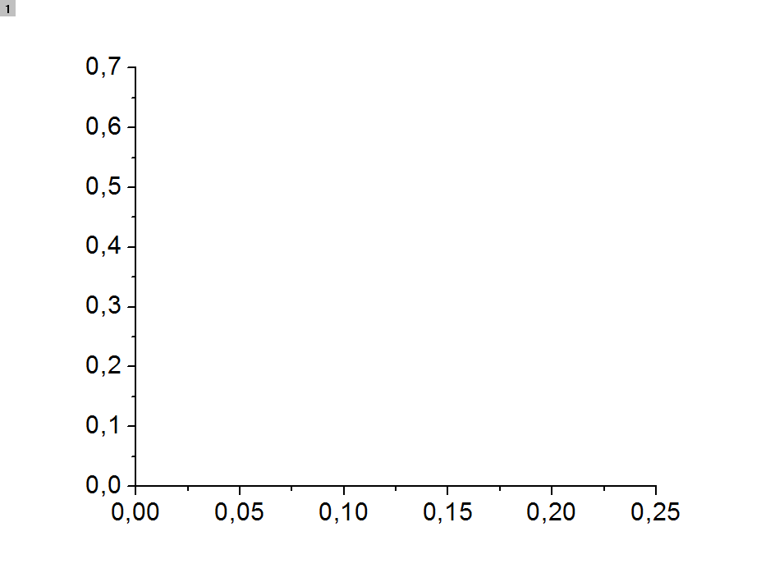
Common features of hysteresis of the Current-Resistivity Characteristics
4
2
$$ρ (μΩ∙m)$$
3
$$μ_{0}H=11.5 T$$
1
$$I (А)$$

Slide 9
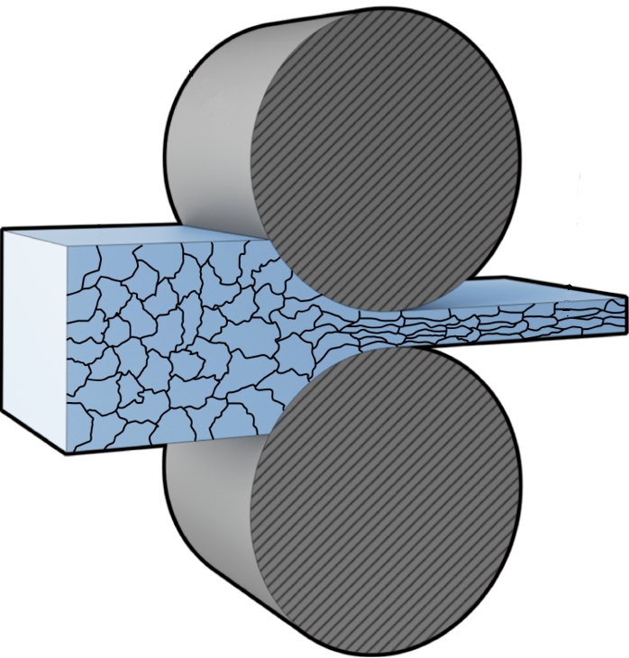
Interpretation
The same behavior was observed on granular superconductors*.
rolling direction
<d>=65 nm
<l>=3 μm
*-Turutanov O.G. ”Abnormal (non-thermal) hysteresis at current-voltage characteristics of granulated vanadium thin films in magnetic fields” // Bul.Zap.Nat.Uni. (2015) №3

Slide 10
Conclusions
1) The abnormal hysteresis of the current-voltage characteristics was detected in high magnetic fields (just below H_{c2}) on Nb-Ti tapes.
2) An interpretation of this hysteresis is proposed in the framework of the granular superconductor model. This model is an alternative to the widespread idea of a phase transition in the vortex matter.
3) This interpretation is in good agreement with the experimental data obtained in our group earlier

Slide 11
Thank you for attention!

Slide 12
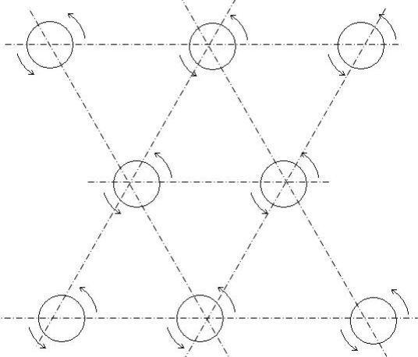
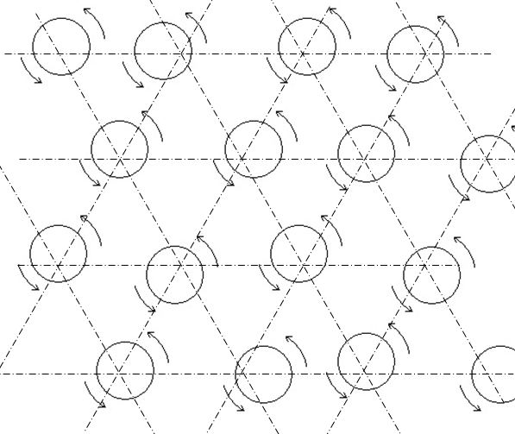
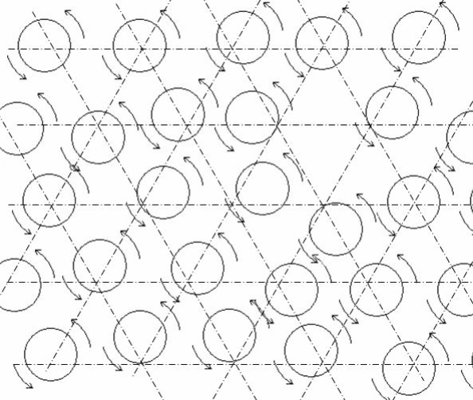
Thermal fluctuations
$$B<<μ_{0}H^{∗}$$
$$B≲μ_{0}H^{∗}$$
$$μ_{0}H^{∗}<B<μ_{0}H_{c2}$$
Giant Flux Creep
$$ρ_{j→0}≠0$$
?
$$ρ_{j→0}≠0$$
Phase transition in the vortex matter
$$ρ_{j→0}→0$$

