Slide 1
-C$ℏ$I NA Consortium
Fuqiang Wang (Huzhou University)
On behalf of the Chinese institutions

Slide 2
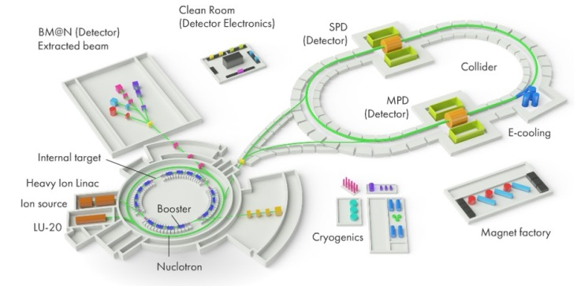
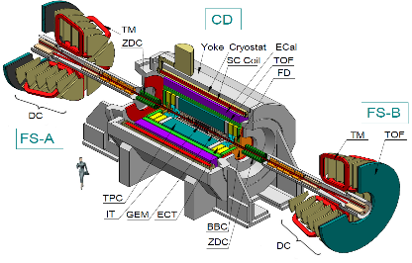
Why are we interested?
QCD emergent properties at high baryon density
New state of matter
Collectivity
Criticality
Chirality
Exotic particles
tetraquark, pentaquark
dibaryon
hypernuclei

Slide 3
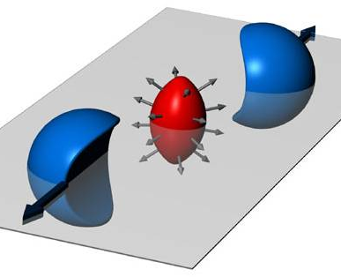
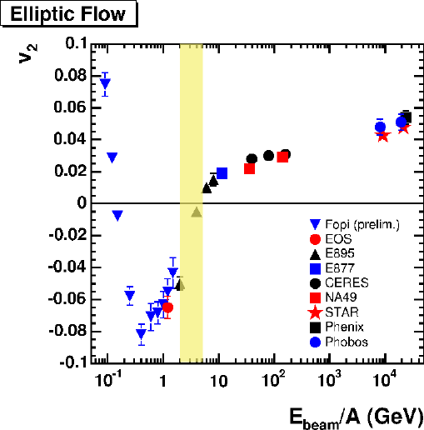
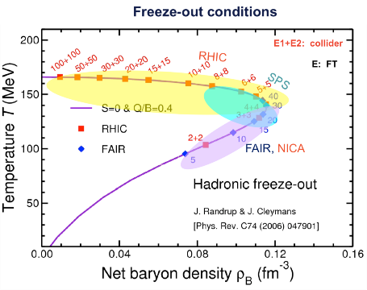
Collectivity
NICA energy region will be the softest
New state of matter:
Highest baryon density
Soft equation of state?
Hydrodynamic properties?

Slide 4
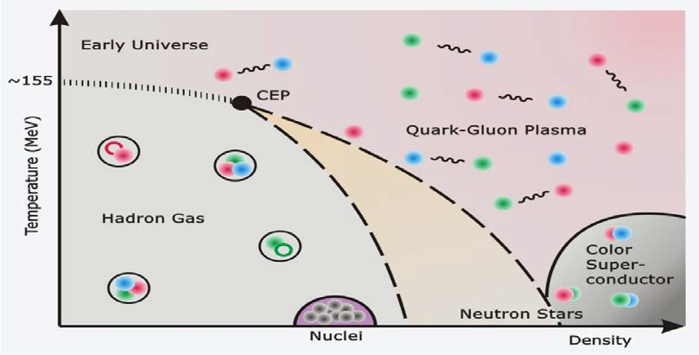
Criticality
NICA energy region will be critical
Near the critical point, several properties of the system diverge.
Large correlation length
Observables should show large fluctuations.

Slide 5
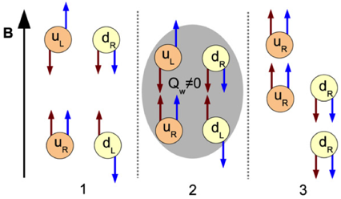
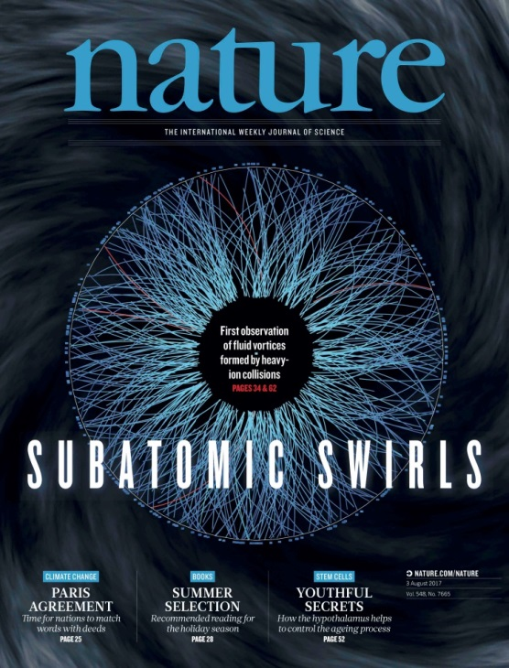
Chirality
NICA energy region will be the sweetest
Strong magnetic field
Quark degree of freedom, χ-symmetry
QCD vacuum fluctuations, Topological gluon field
Local P, CP violations

Slide 6
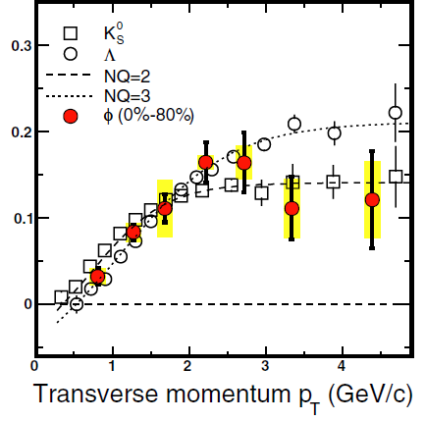
Exotic Particles
Examples: tetraquark, pentaquark, …
Traditionally, compare measurements to model calculations of mass, decay BR’s, etc.
We have a new tool in heavy ion collisions: the Number of Constituent Quark scaling of elliptic flow
? ? ?

Slide 7
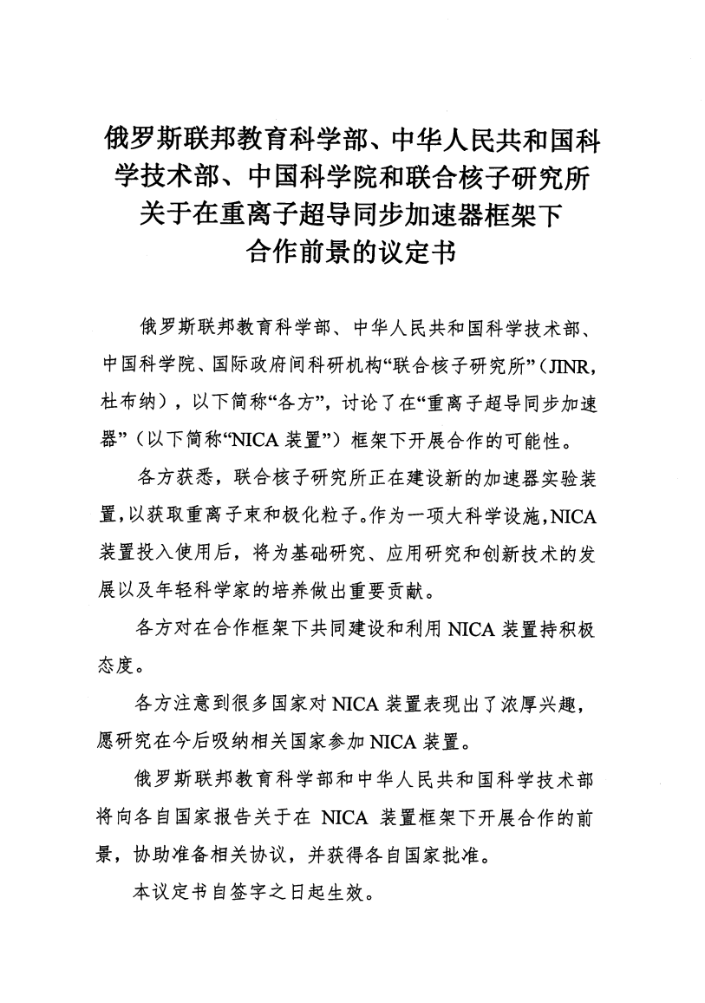
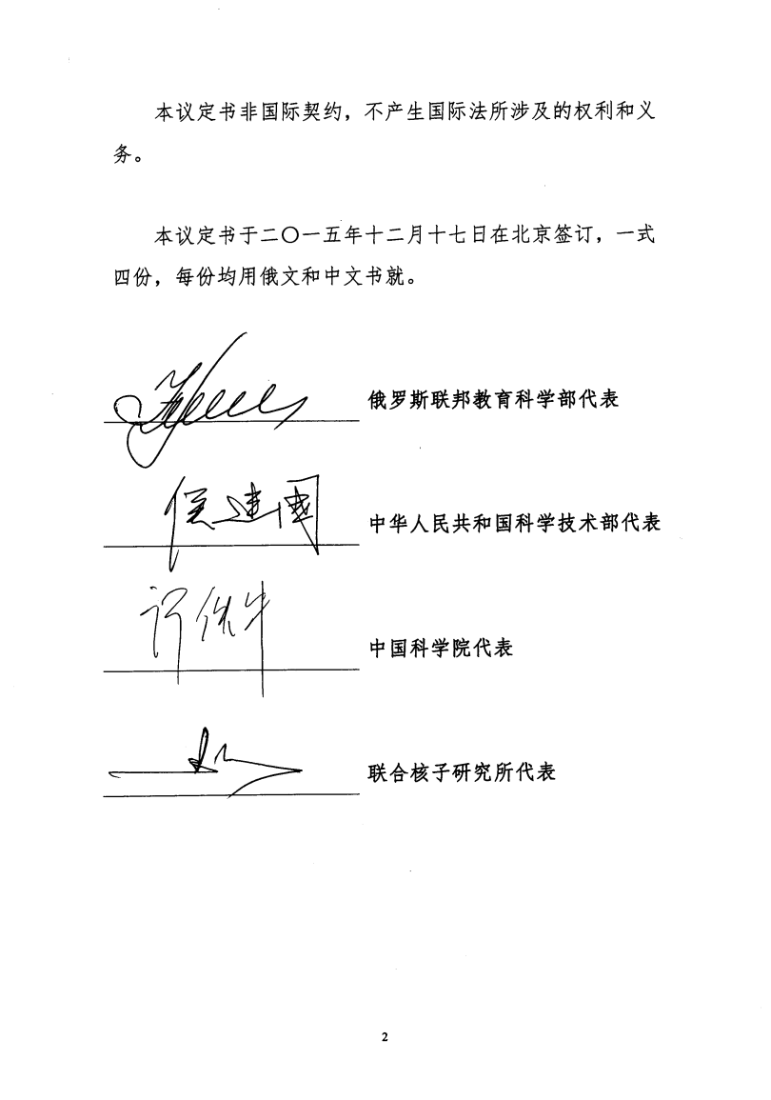
Russia-China Government Agreement on JINR/NICA Collaboration
Expert Panel (Russia & China) was formed
January 2018: Expert Panel meeting with Chinese MOST funding agency

Slide 8
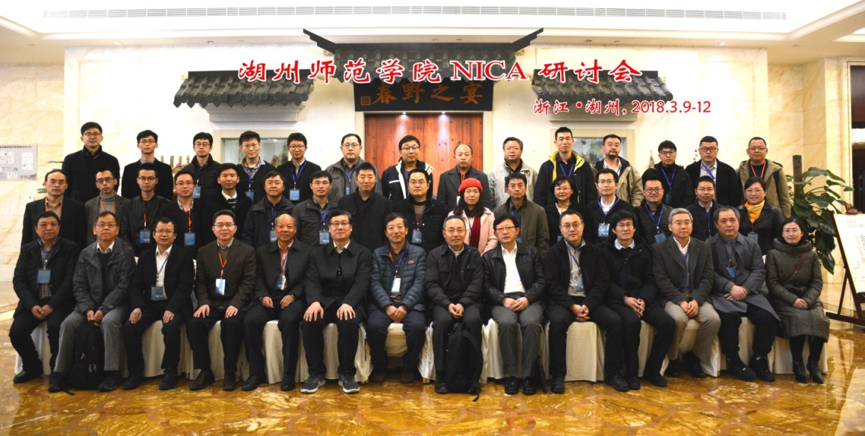
Huzhou NICA Workshop
Huzhou NICA workshop
March 10-11, 2018
13 institutions (so far): 中科院高能物理研究所、中科院近代物理研究所、中科院上海应用物理研究所、华中师范大学、复旦大学、湖州师范学院、北京大学、南华大学、山东大学、上海交通大学、三峡大学、清华大学、中国科学技术大学 CAS IHEP, CAS Inst Modern Phys, CAS Shanghai Inst Nucl & Applied Phys, Central China Normal Univ, Fudan Univ, Huzhou Univ, Peking Univ, South China Univ, Shandong Univ, Shanghai Jiaotong Univ, Three Gorge Univ, Tsinghua Univ, Univ Sci & Tech China
Total ~60 collaborators
Both experimental and theoretical efforts

Slide 9
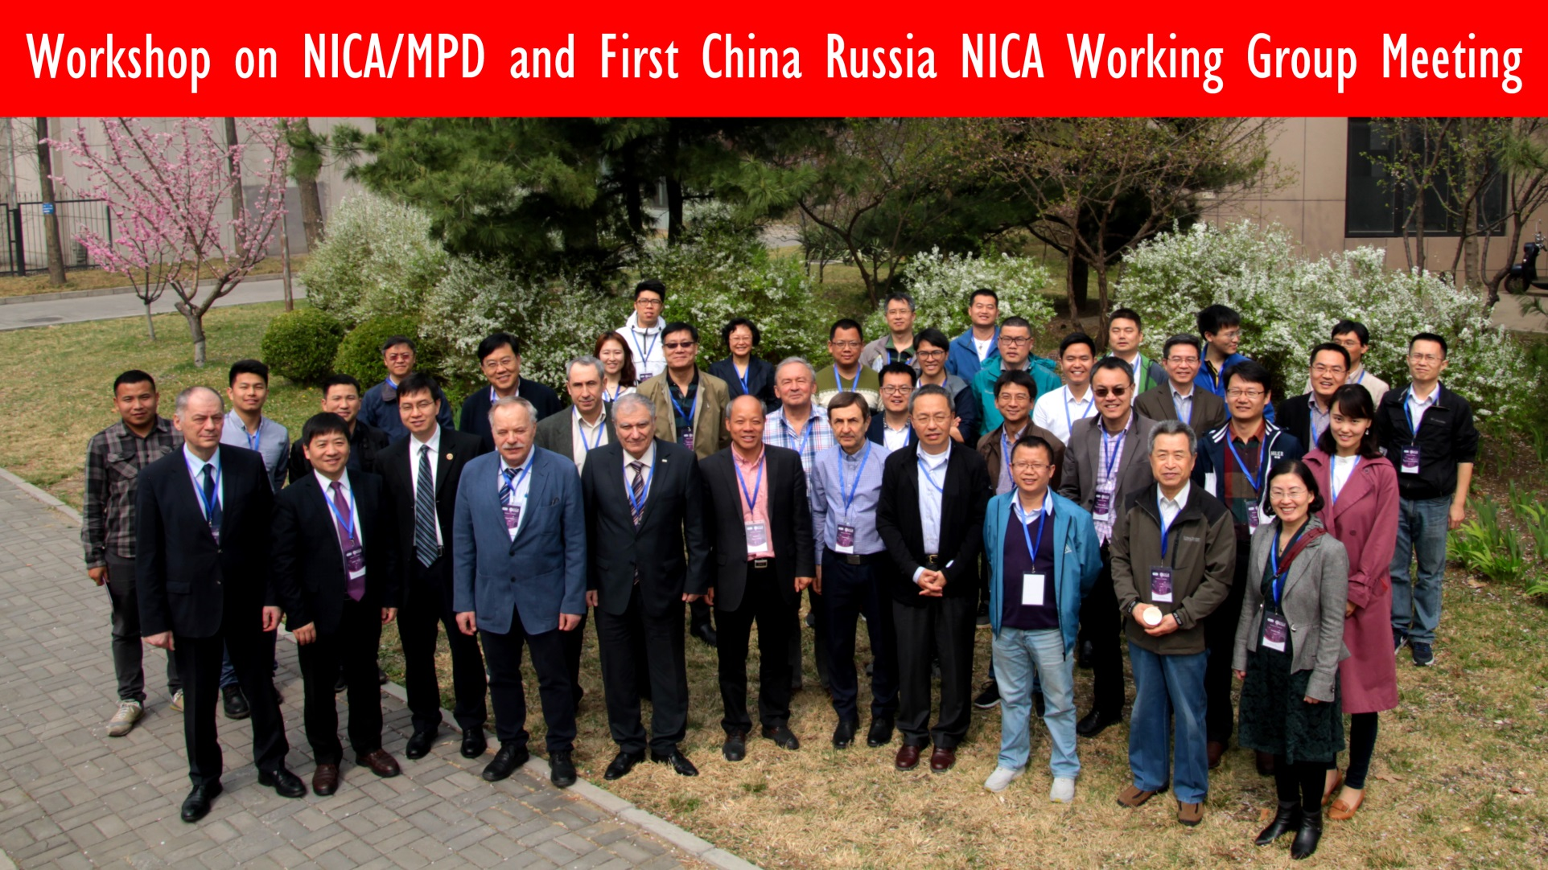
Tsinghua NICA Workshop
Tsinghua NICA workshop, April 2-3, 2018
Also had Expert Panel meeting @ Tsinghua University on April 3, 2018

Slide 10
NICA-China Consortium
Stage I (2019-2021)
ECAL
ITS R&D
TOF R&D
Fast Readout R&D
Computing
Stage II (2021-2025)
ITS production
TOF
April 3, 2018: Expert Panel meeting at Tsinghua University
Mid. June, 2018: Expert Panel meeting at JINR

Slide 11
-C$ℏ$I NA Consortium
Institutions who want to join NICA/MPD Collaboration now:
Tsinghua University (THU)
University of Science and Technology of China (USTC)
Huzhou University (HU)
Shandong University (SDU)
Central China Normal University (CCNU)
Shanghai Institute of Nuclear & Applied Physics (SINAP), Chinese Academy of Science
Southern China University (SCU)
Institute of High Energy Physics (IHEP), Chinese Academy of Science
Five more institutions who expressed interest and may join at later time

Slide 12
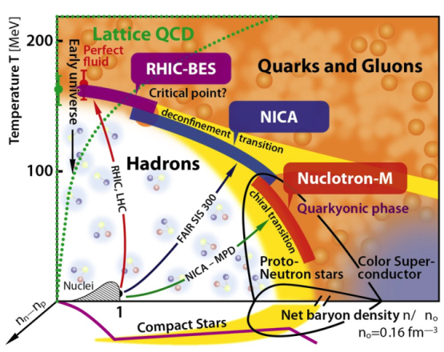
-C$ℏ$I NA Consortium
Rich physics at NICA
New state of matter
Collectivity, Criticality, Chirality
Exotic particles
multiquark, dibaryon, hypernuclei
NICA Consortium in China (exp. + theory)
Looking forward to the collaboration & physics…

